Slide 1

523
Our God, He Is Alive
Words and Music by: Aaron W. Dicus Copyright © 1966 by A. W. Dicus, Renewed 1994, Assigned to Ellis J. Crum 1973

Slide 2
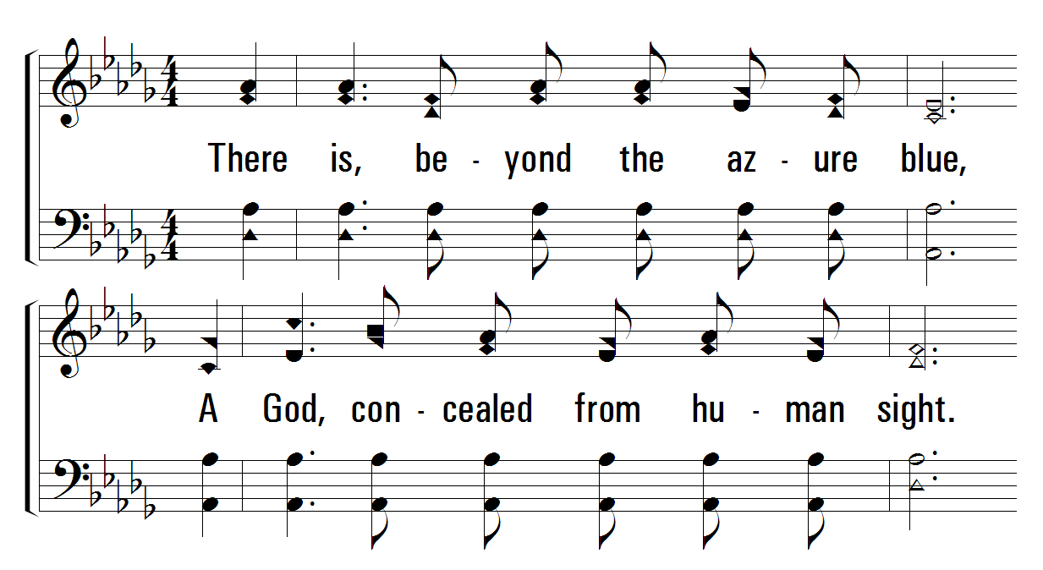
523
Our God, He Is Alive
1
C
2
C
3
C
4
C
© 2001 The Paperless Hymnal™

Slide 3
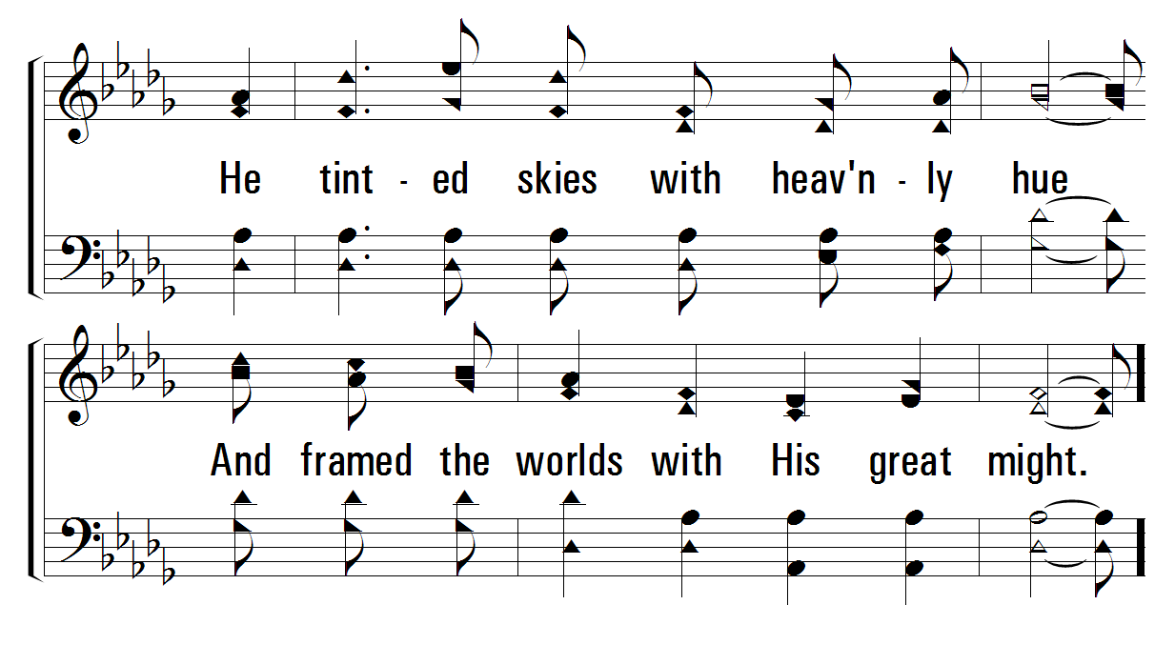
523
Our God, He Is Alive
1
C
2
C
3
C
4
C
© 2001 The Paperless Hymnal™

Slide 4
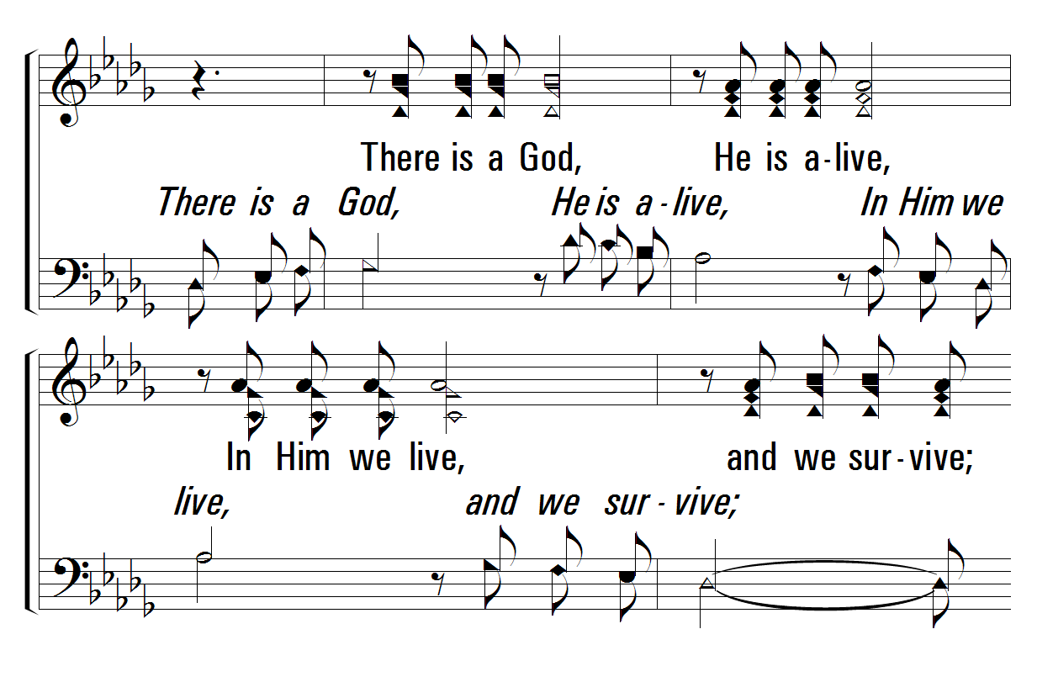
523
Our God, He Is Alive
1
C
2
C
3
C
4
C
© 2001 The Paperless Hymnal™

Slide 5
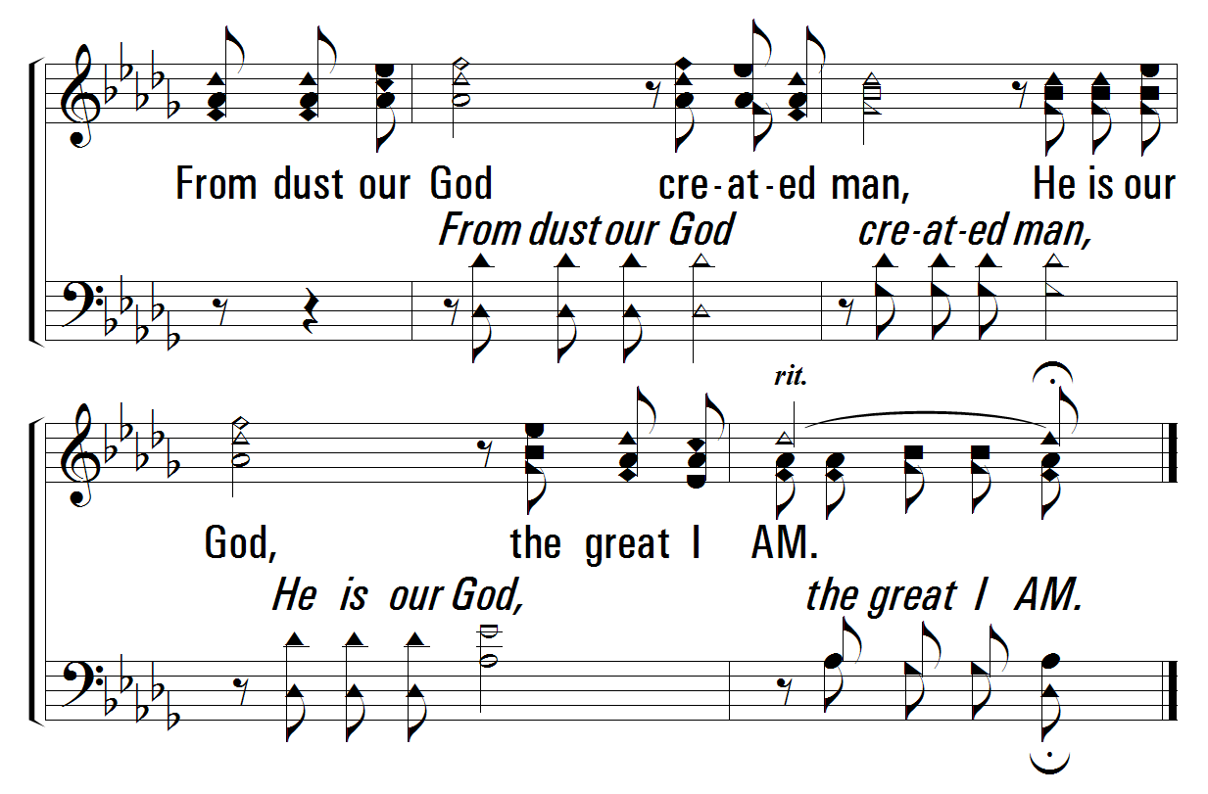
523
Our God, He Is Alive
1
C
2
C
3
C
4
C
© 2001 The Paperless Hymnal™

Slide 6
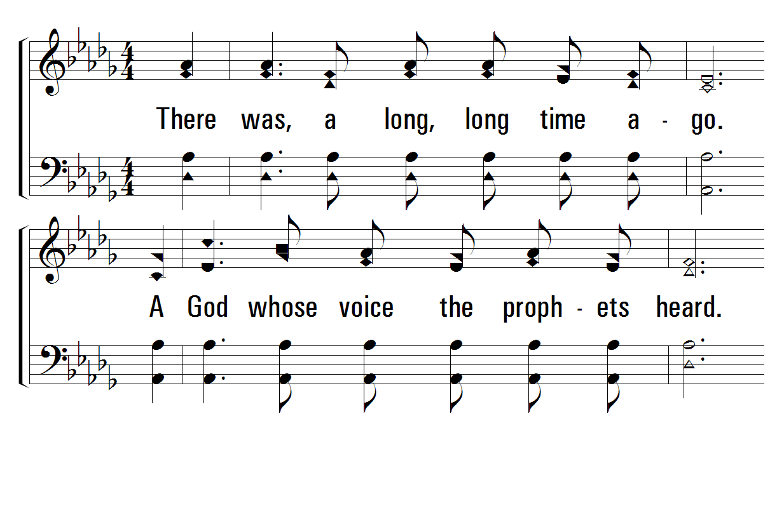
523
Our God, He Is Alive
1
C
2
C
3
C
4
C
© 2001 The Paperless Hymnal™

Slide 7
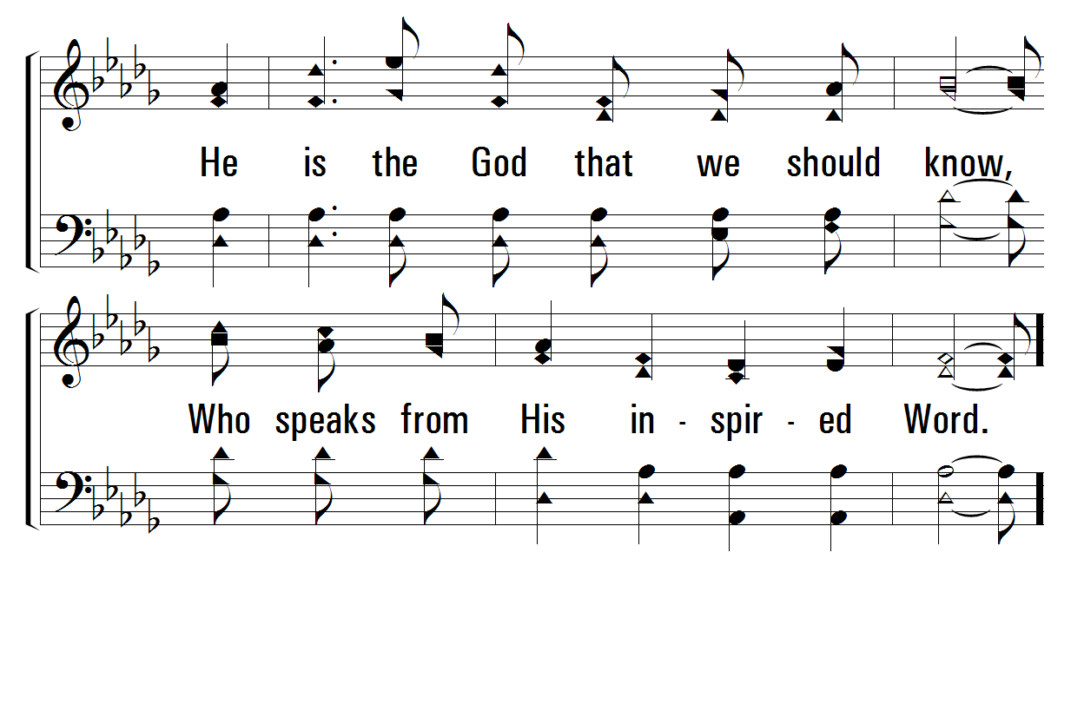
523
Our God, He Is Alive
1
C
2
C
3
C
4
C
© 2001 The Paperless Hymnal™

Slide 8
523
Our God, He Is Alive
1
C
2
C
3
C
4
C
© 2001 The Paperless Hymnal™

Slide 9
523
Our God, He Is Alive
1
C
2
C
3
C
4
C
© 2001 The Paperless Hymnal™

Slide 10
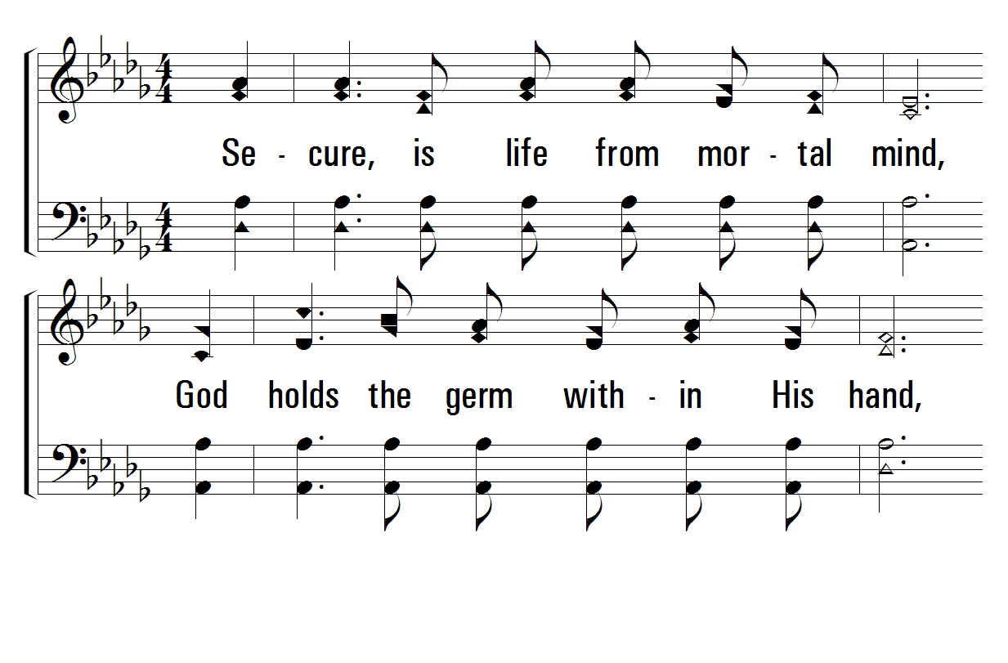
523
Our God, He Is Alive
1
C
2
C
3
C
4
C
© 2001 The Paperless Hymnal™

Slide 11
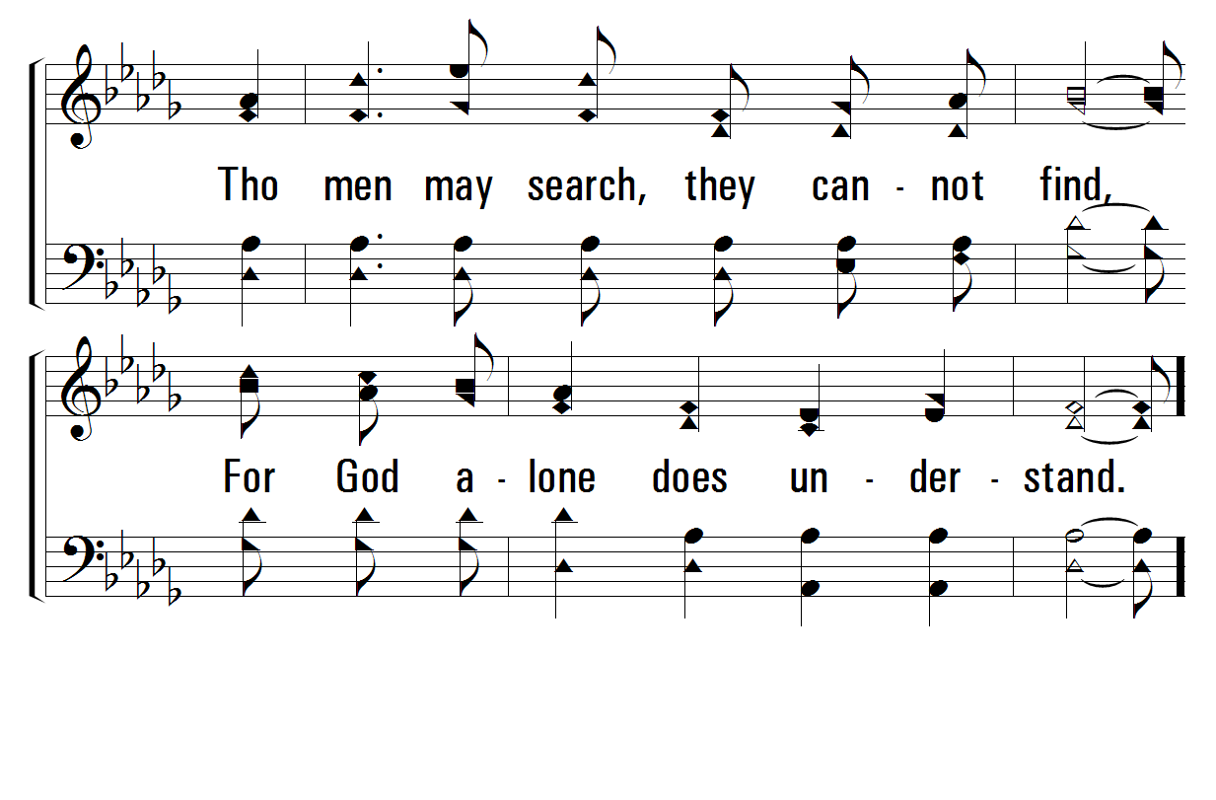
523
Our God, He Is Alive
1
C
2
C
3
C
4
C
© 2001 The Paperless Hymnal™

Slide 12
523
Our God, He Is Alive
1
C
2
C
3
C
4
C
© 2001 The Paperless Hymnal™

Slide 13
523
Our God, He Is Alive
1
C
2
C
3
C
4
C
© 2001 The Paperless Hymnal™

Slide 14
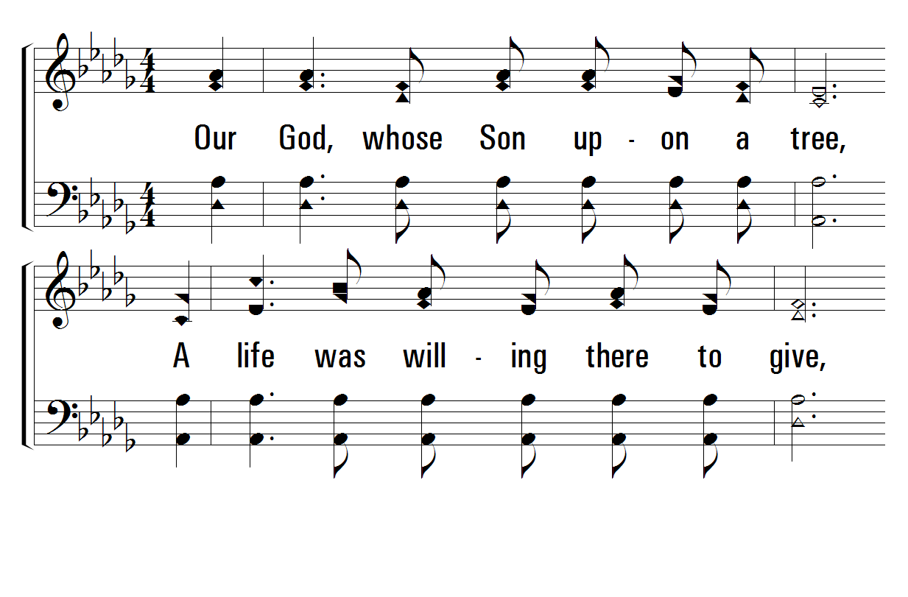
523
Our God, He Is Alive
1
C
2
C
3
C
4
C
© 2001 The Paperless Hymnal™

Slide 15
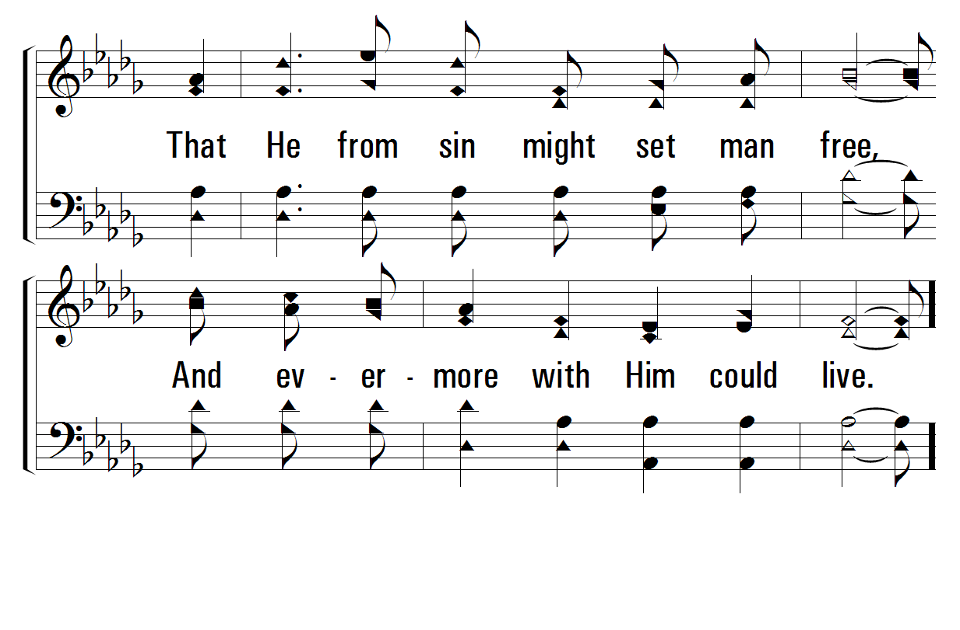
523
Our God, He Is Alive
1
C
2
C
3
C
4
C
© 2001 The Paperless Hymnal™

Slide 16
523
Our God, He Is Alive
1
C
2
C
3
C
4
C
© 2001 The Paperless Hymnal™

Slide 17
523
Our God, He Is Alive
1
C
2
C
3
C
4
C
© 2001 The Paperless Hymnal™

