Slide 1
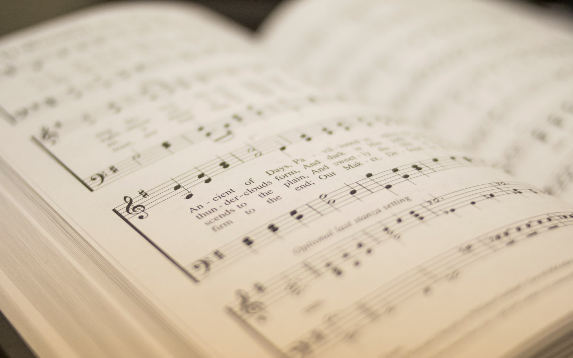


146
146
I WILL SING TO THE LORD (PSALM 146)
I WILL SING TO THE LORD (PSALM 146)
1
2
C
“CANTANDO...AL SEÑOR” COLOSENSES 3:16
“SINGING...TO THE LORD” COLOSSIANS 3:16
Words: Psalm 146, arr. Matthew L. Harber (2021) Music: PRINCES, Matthew L. Harber (2021), arr. MLH & S. E. Rouse
Words: Psalm 146, arr. Matthew L. Harber (2021) Music: PRINCES, Matthew L. Harber (2021), arr. MLH & S. E. Rouse

Slide 2
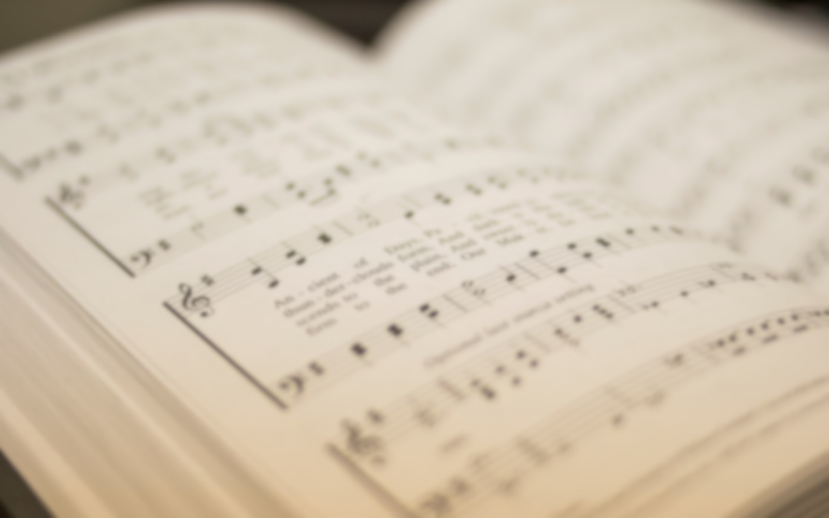
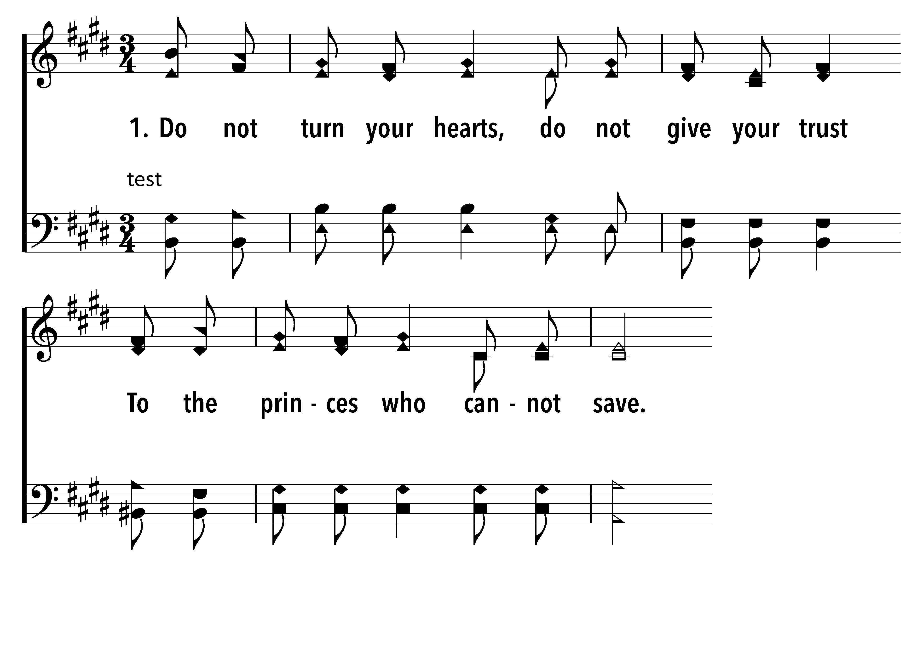


146
1
I WILL SING TO THE LORD (PSALM 146)
C
2
C
I WILL SING TO THE LORD (PSALM 146)
© 2021 Matthew L. Harber

Slide 3
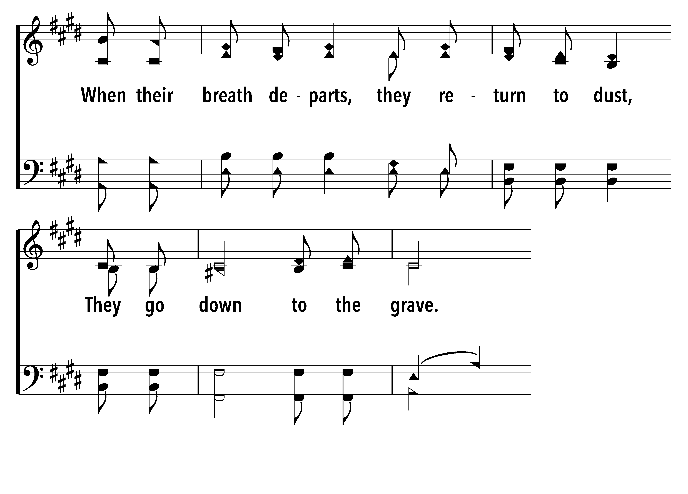
146
1
I WILL SING TO THE LORD (PSALM 146)
C
2
C
I WILL SING TO THE LORD (PSALM 146)
© 2021 Matthew L. Harber

Slide 4
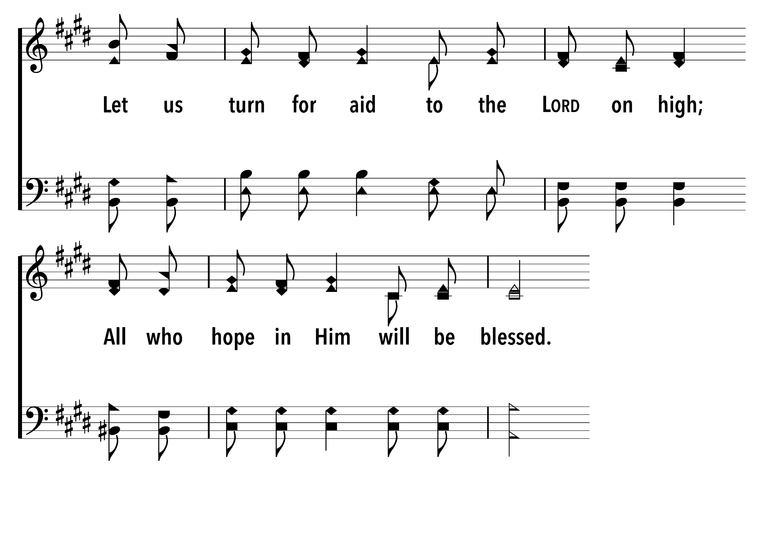
146
1
I WILL SING TO THE LORD (PSALM 146)
C
2
C
I WILL SING TO THE LORD (PSALM 146)
© 2021 Matthew L. Harber

Slide 5
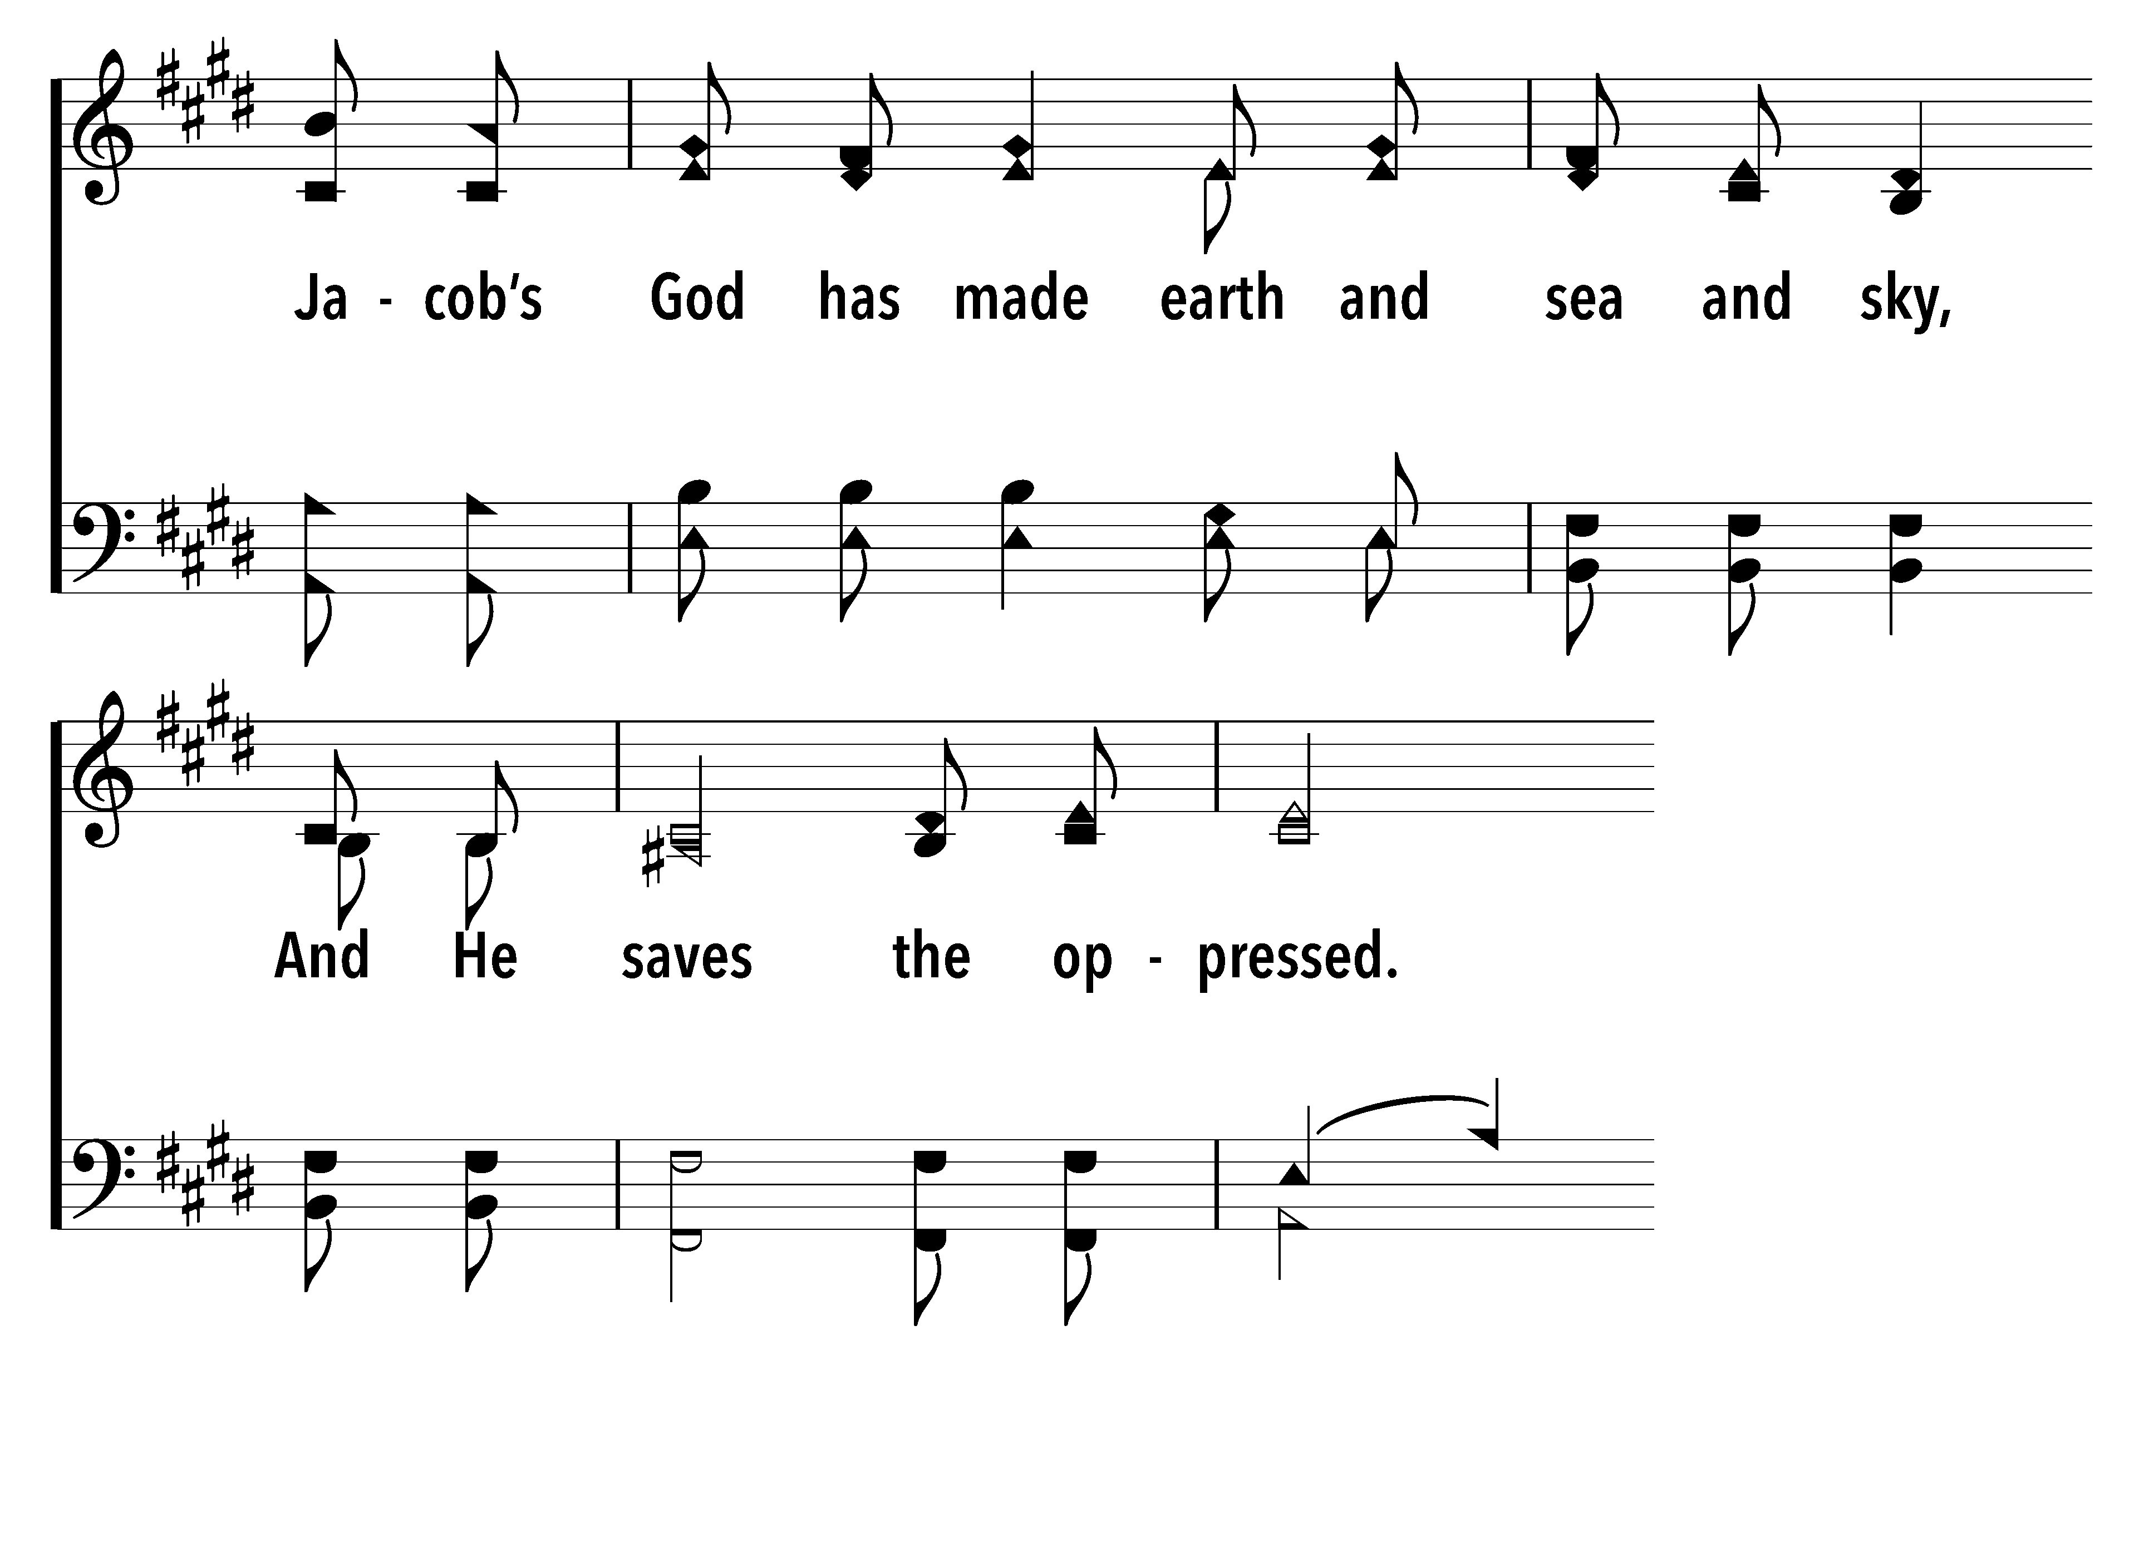
146
1
I WILL SING TO THE LORD (PSALM 146)
C
2
C
I WILL SING TO THE LORD (PSALM 146)
© 2021 Matthew L. Harber

Slide 6
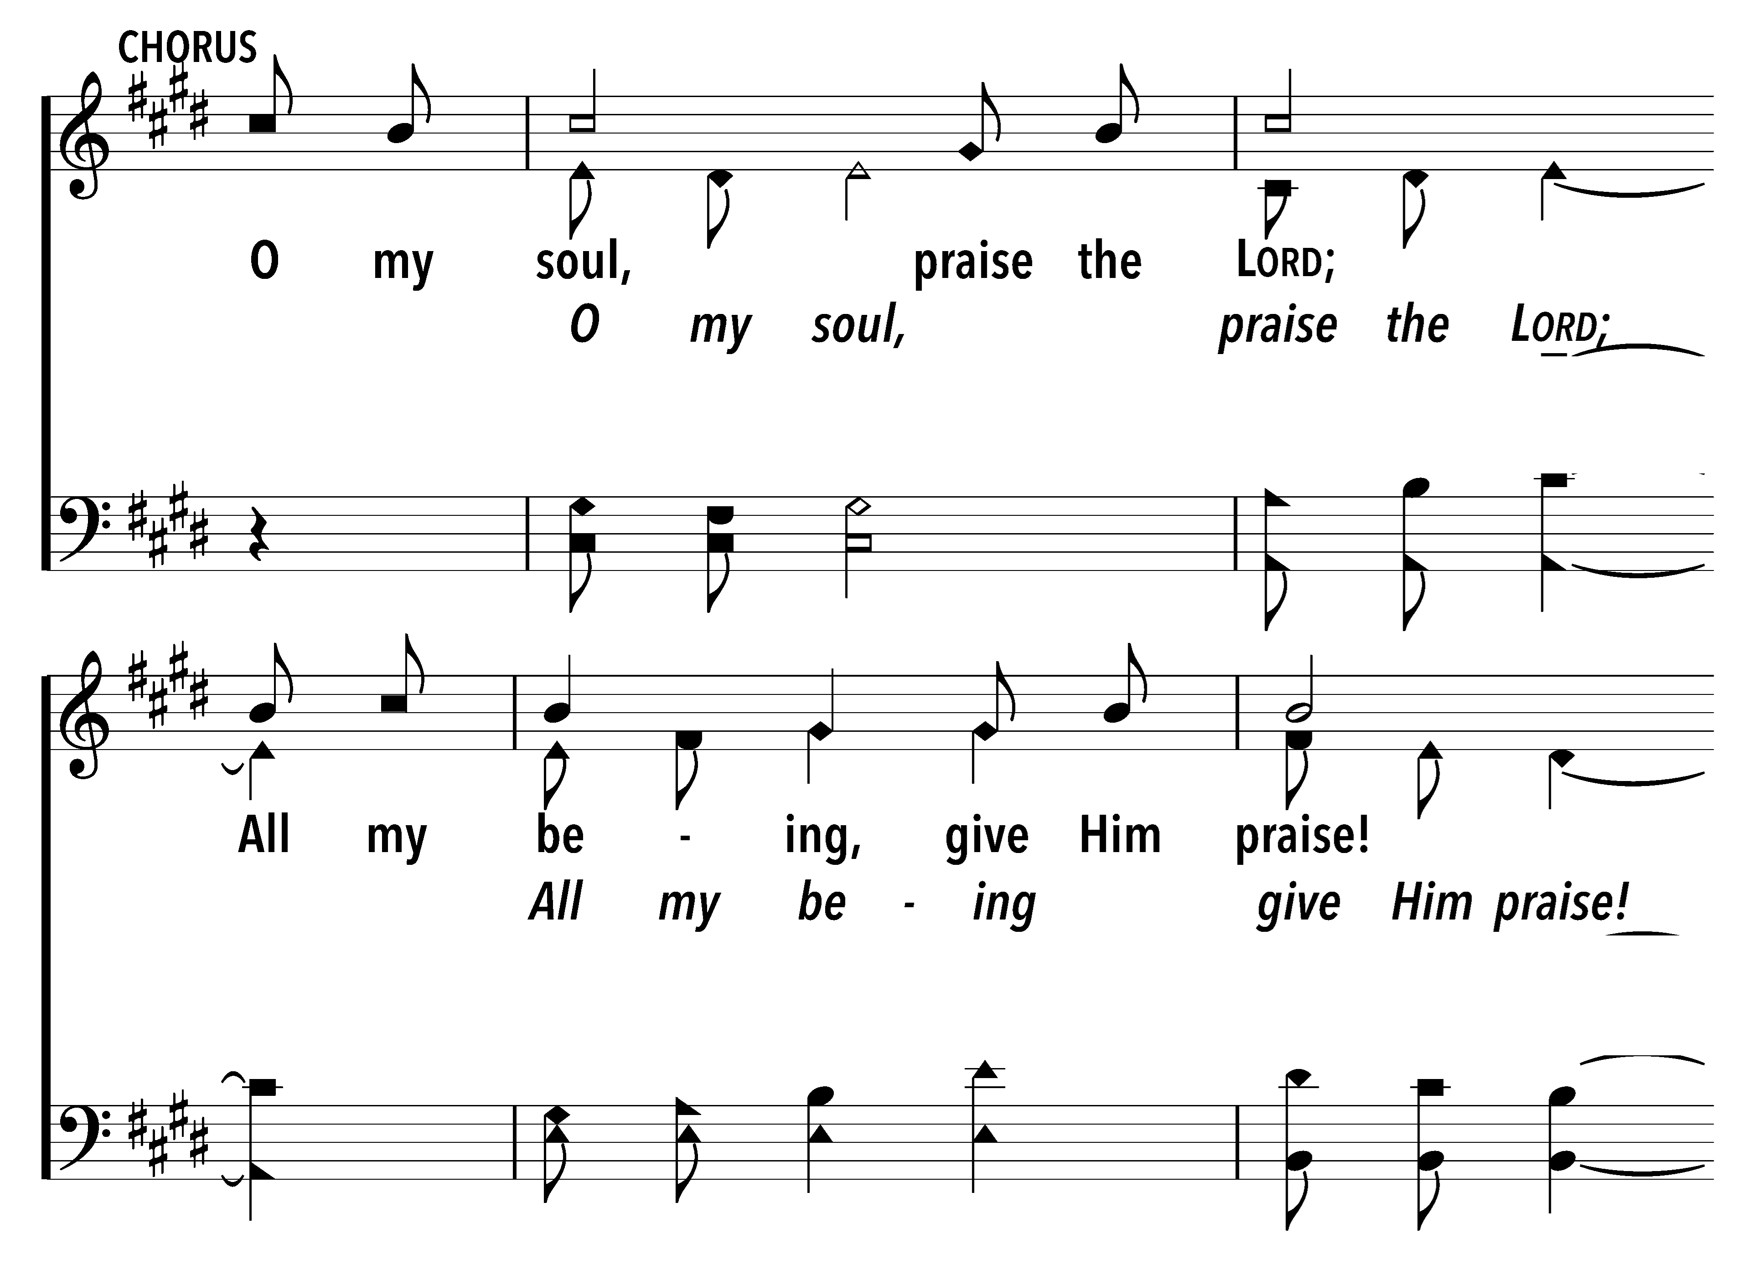
146
1
I WILL SING TO THE LORD (PSALM 146)
C
2
C
I WILL SING TO THE LORD (PSALM 146)
© 2021 Matthew L. Harber

Slide 7
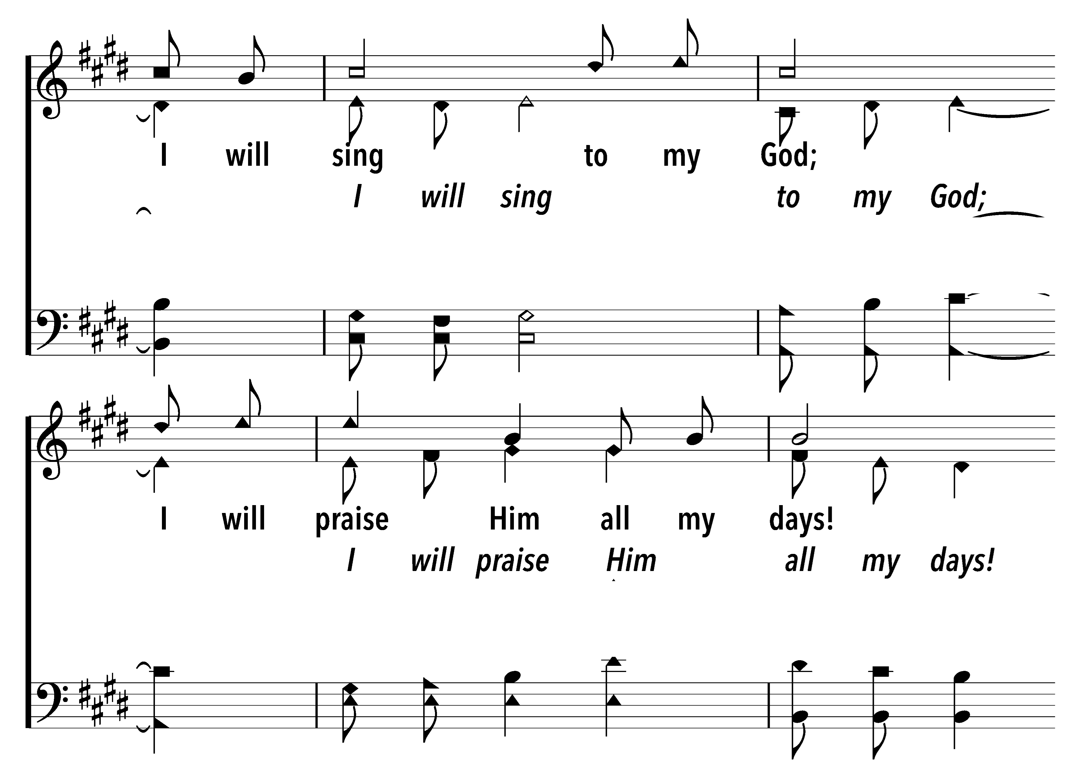
146
1
I WILL SING TO THE LORD (PSALM 146)
C
2
C
I WILL SING TO THE LORD (PSALM 146)
© 2021 Matthew L. Harber

Slide 8
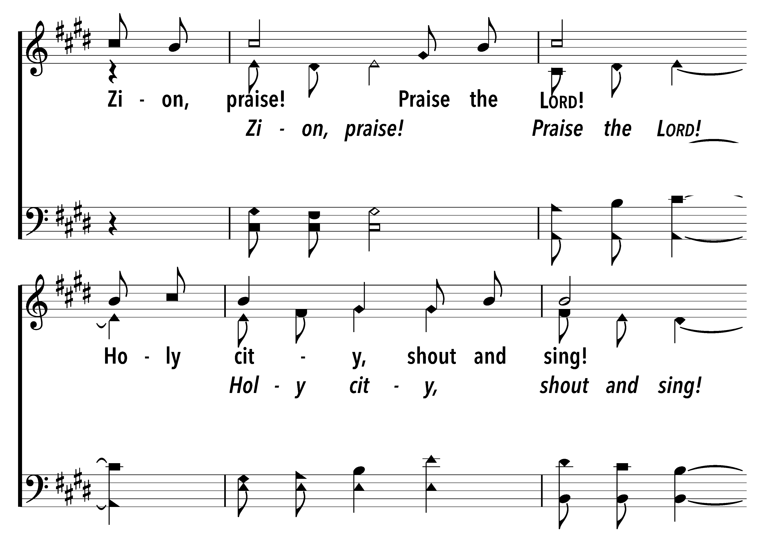
146
1
I WILL SING TO THE LORD (PSALM 146)
C
2
C
I WILL SING TO THE LORD (PSALM 146)
© 2021 Matthew L. Harber

Slide 9
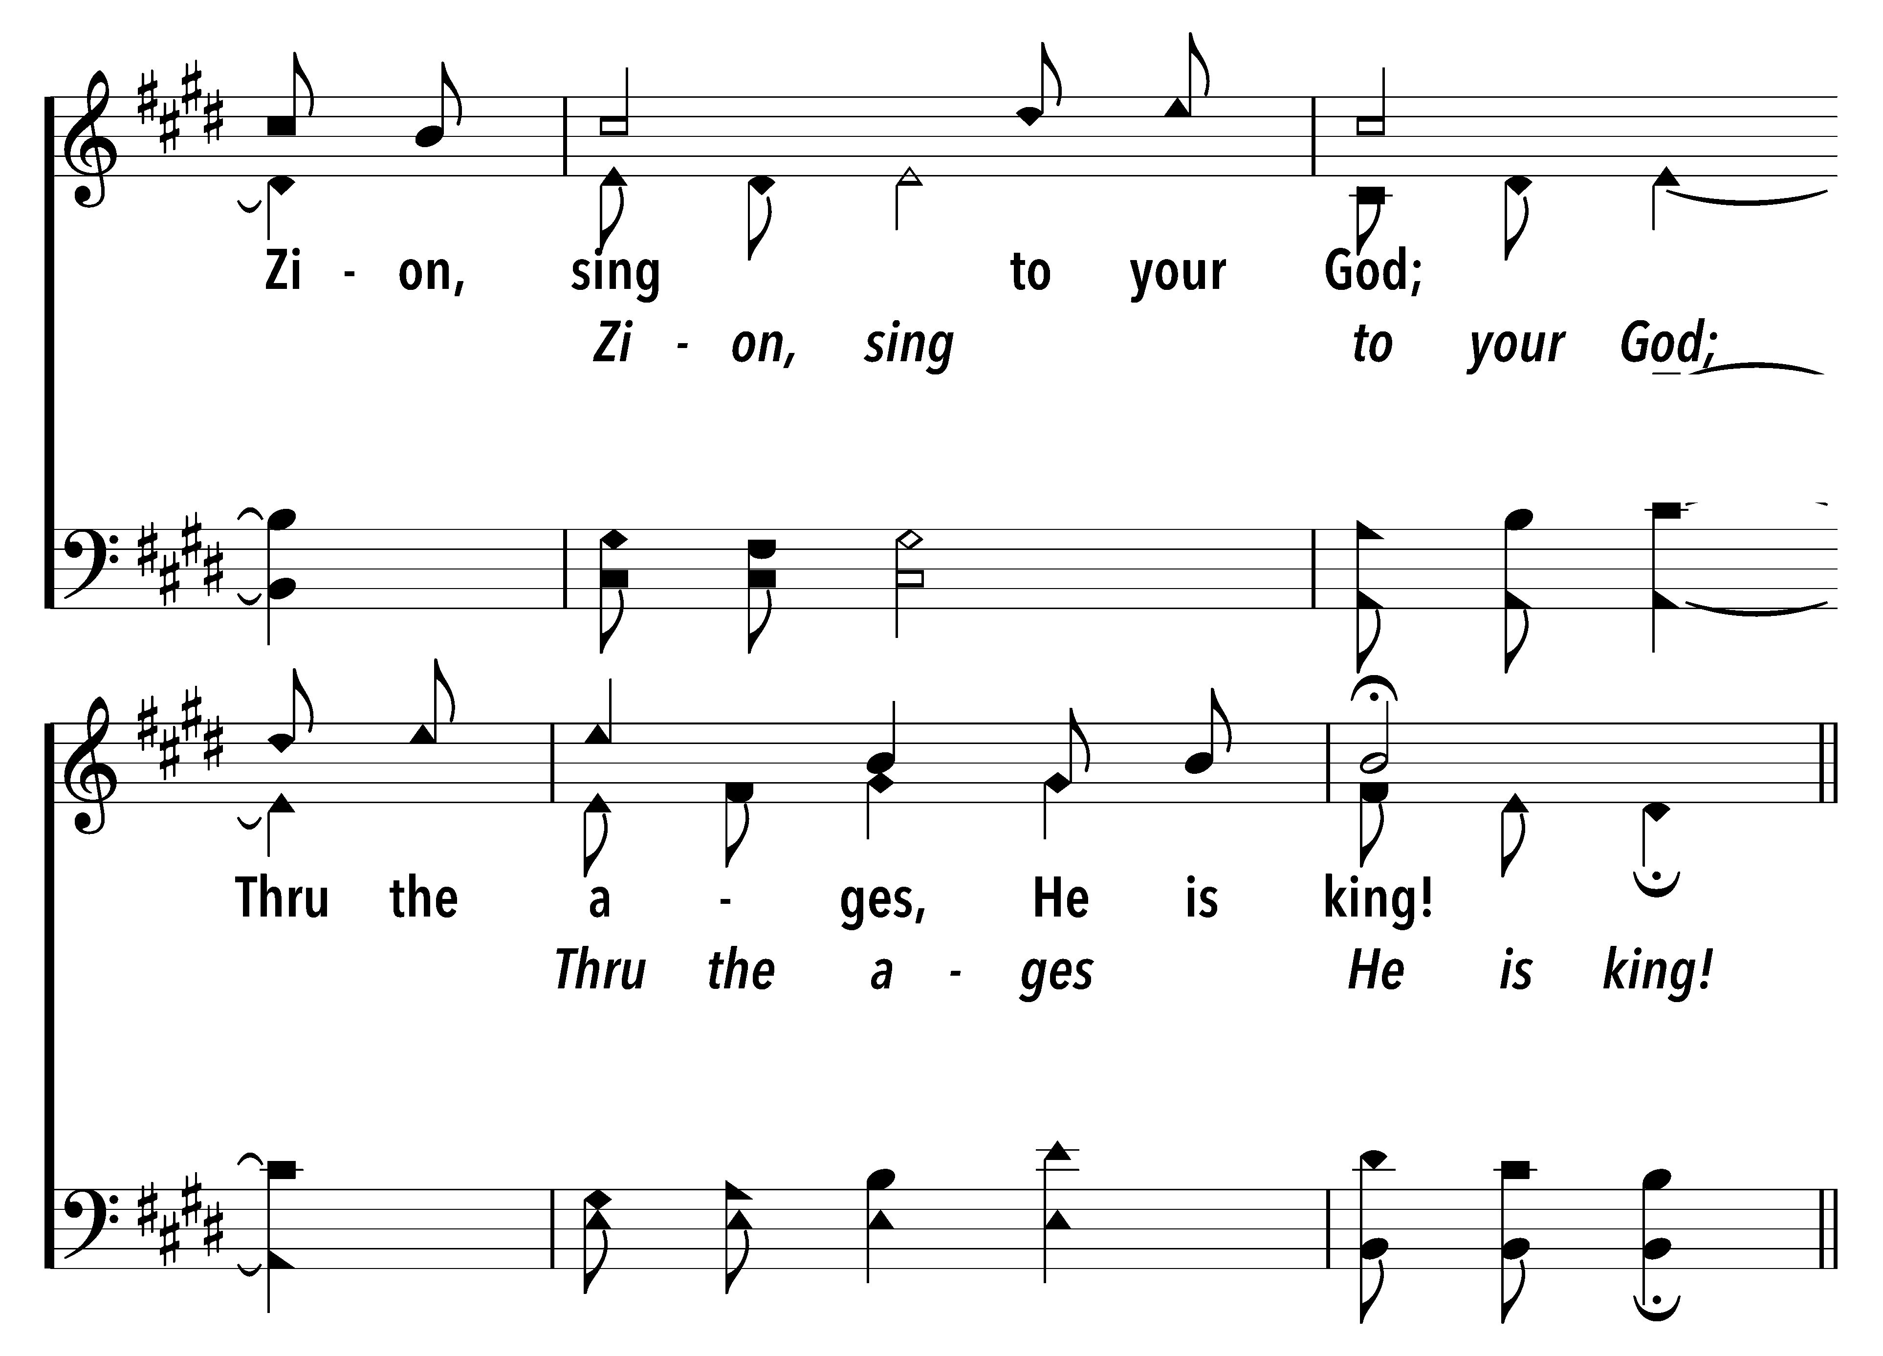
146
1
I WILL SING TO THE LORD (PSALM 146)
C
2
C
I WILL SING TO THE LORD (PSALM 146)
© 2021 Matthew L. Harber

Slide 10
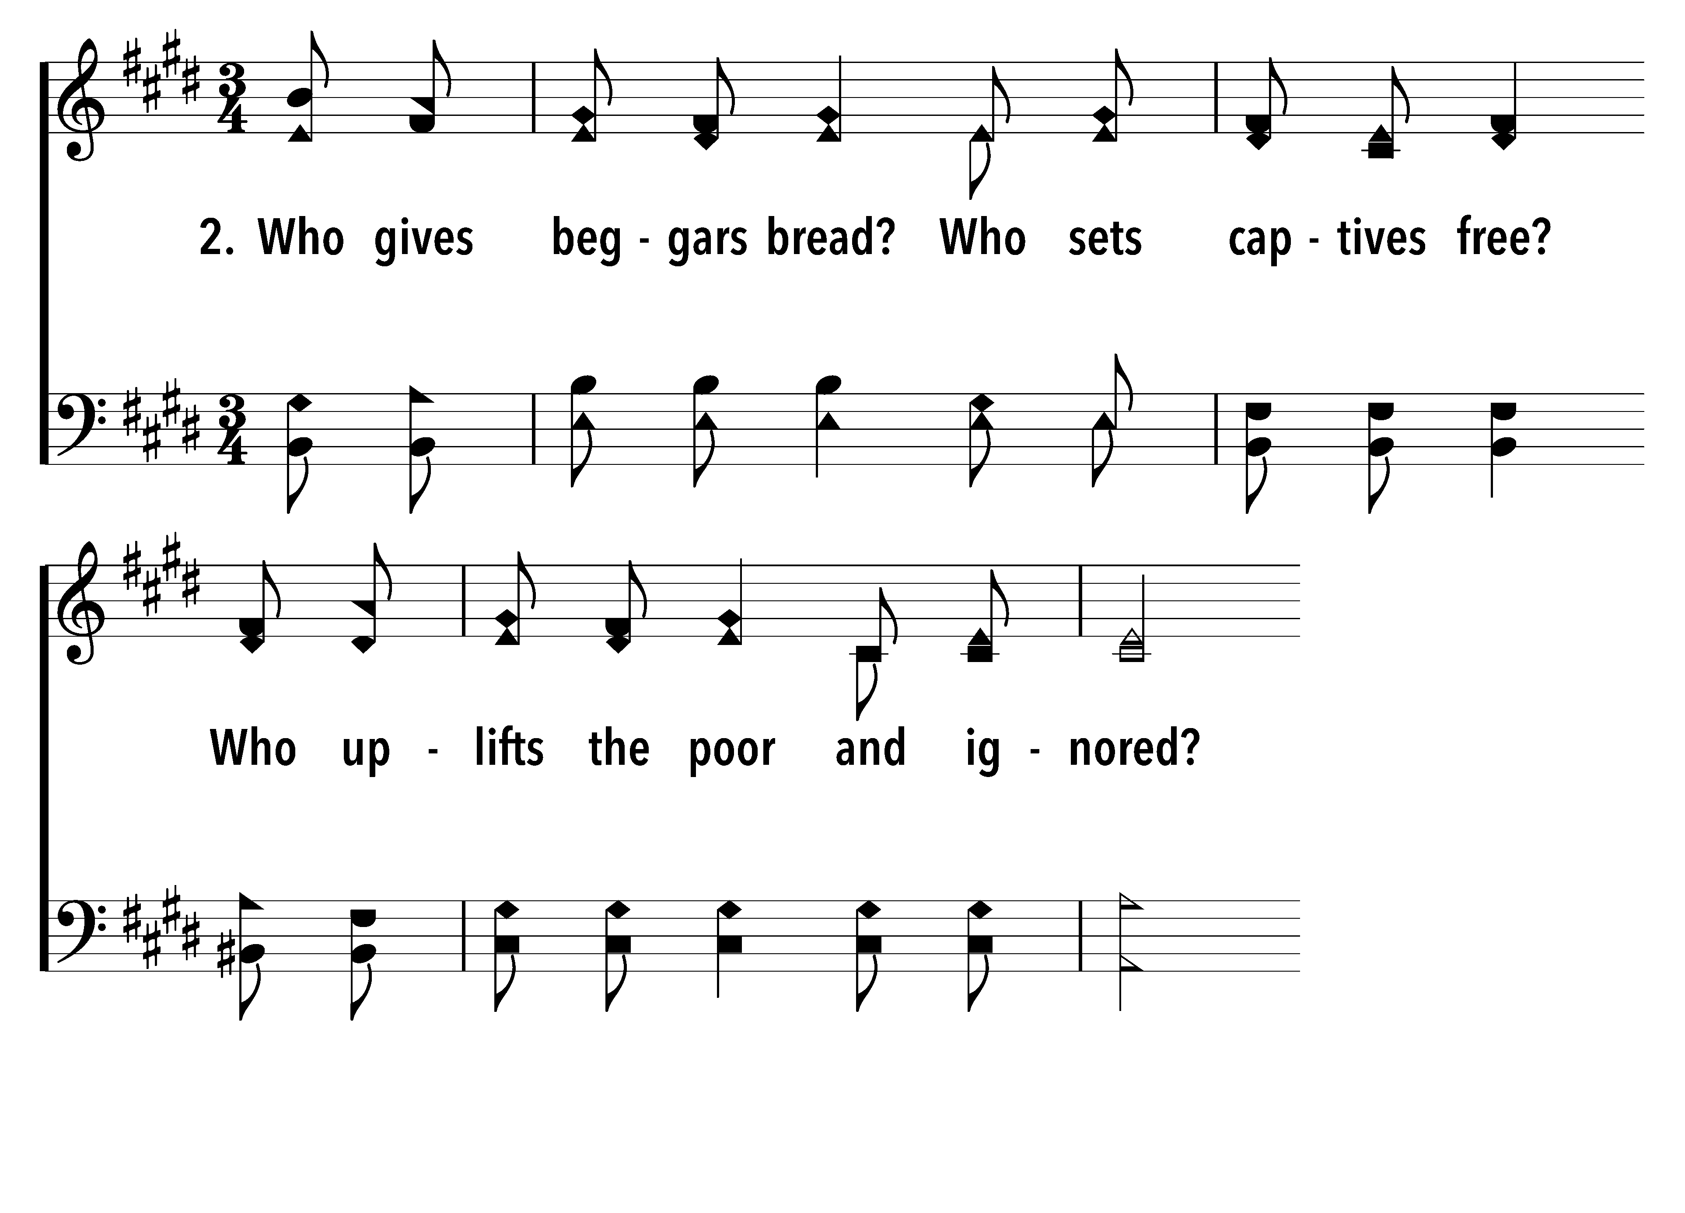
146
1
I WILL SING TO THE LORD (PSALM 146)
C
2
C
I WILL SING TO THE LORD (PSALM 146)
© 2021 Matthew L. Harber

Slide 11
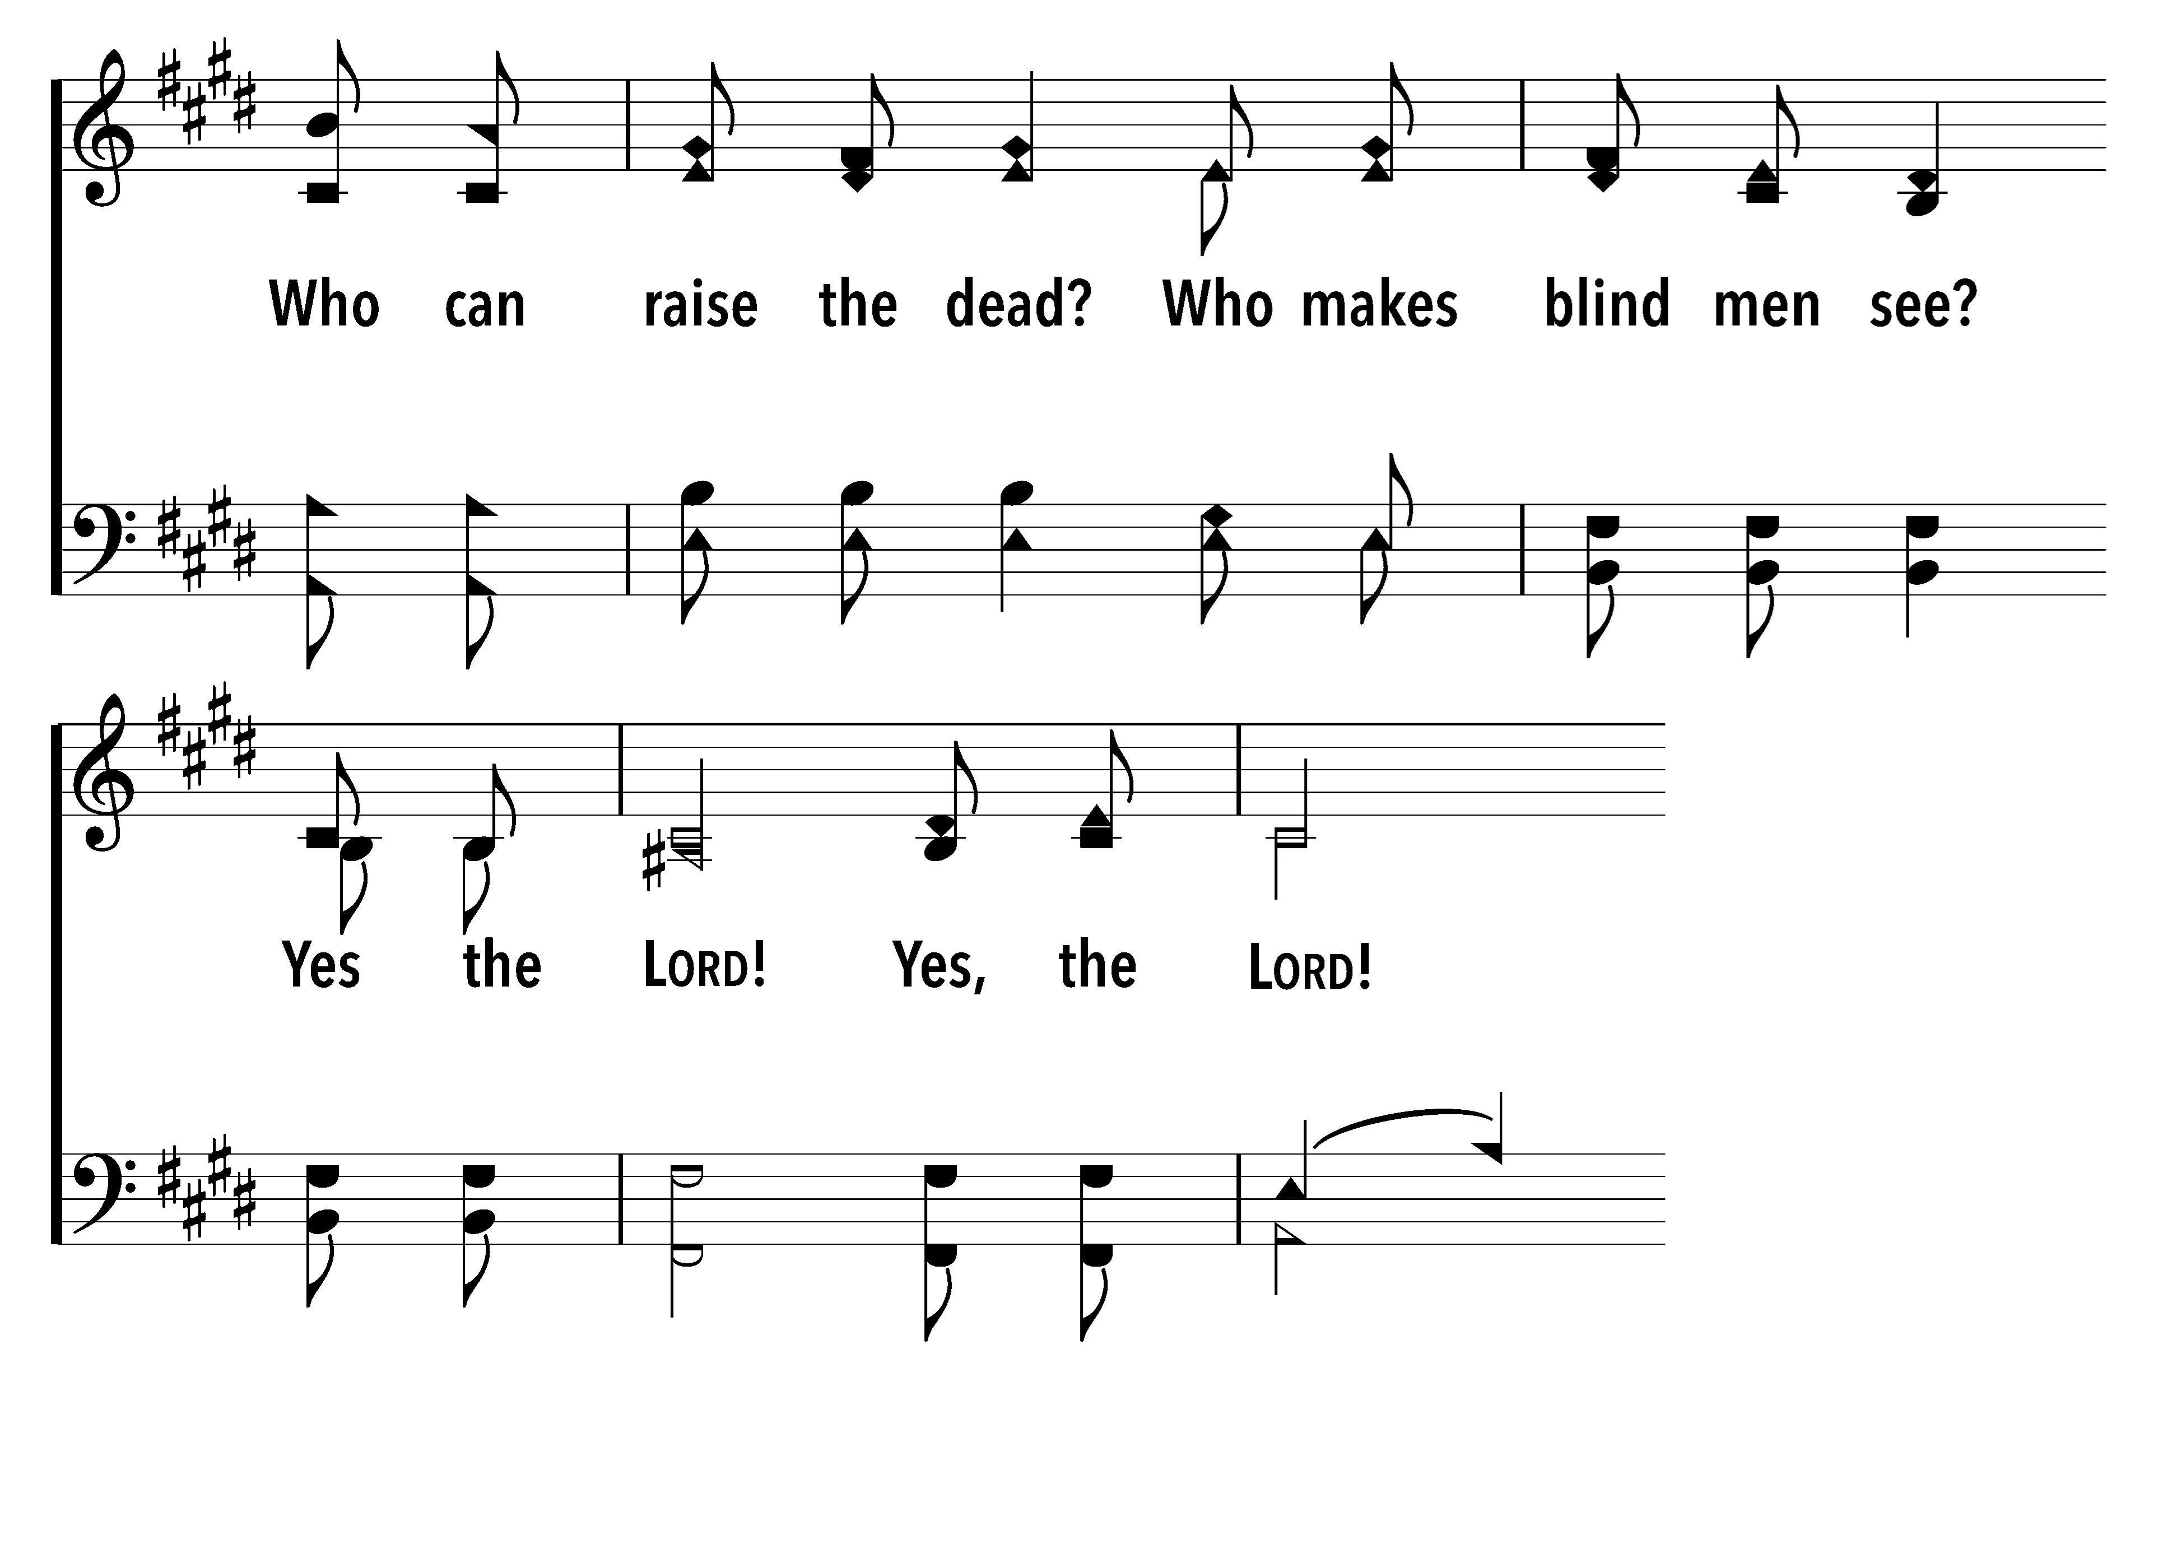
146
1
I WILL SING TO THE LORD (PSALM 146)
C
2
C
I WILL SING TO THE LORD (PSALM 146)
© 2021 Matthew L. Harber

Slide 12
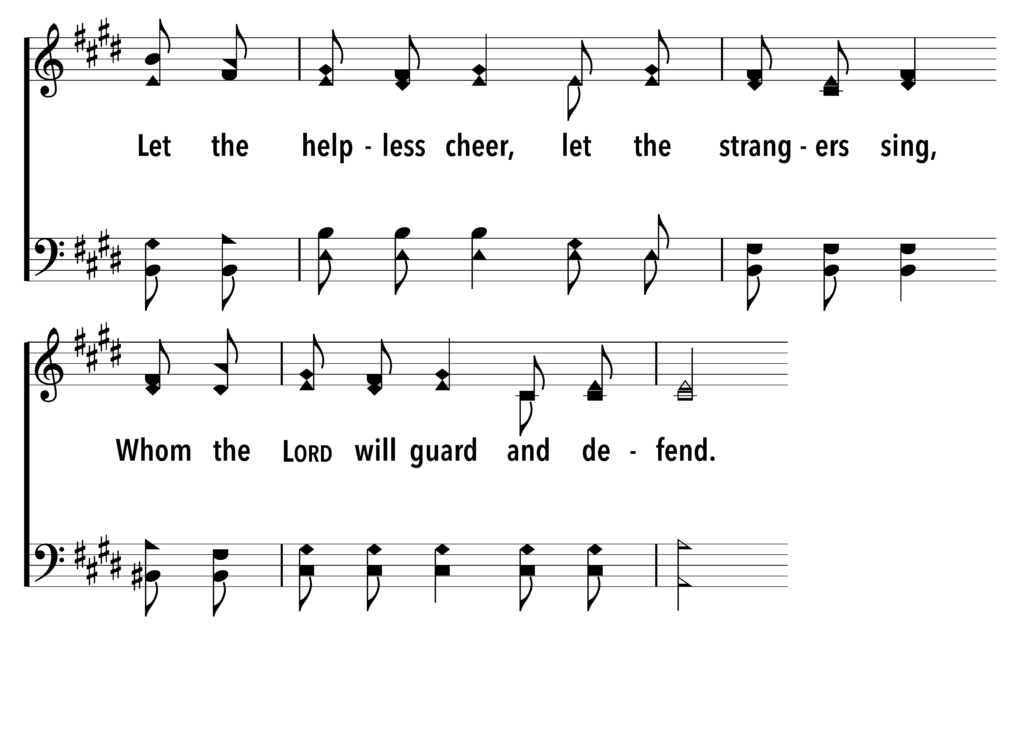
146
1
I WILL SING TO THE LORD (PSALM 146)
C
2
C
I WILL SING TO THE LORD (PSALM 146)
© 2021 Matthew L. Harber

Slide 13
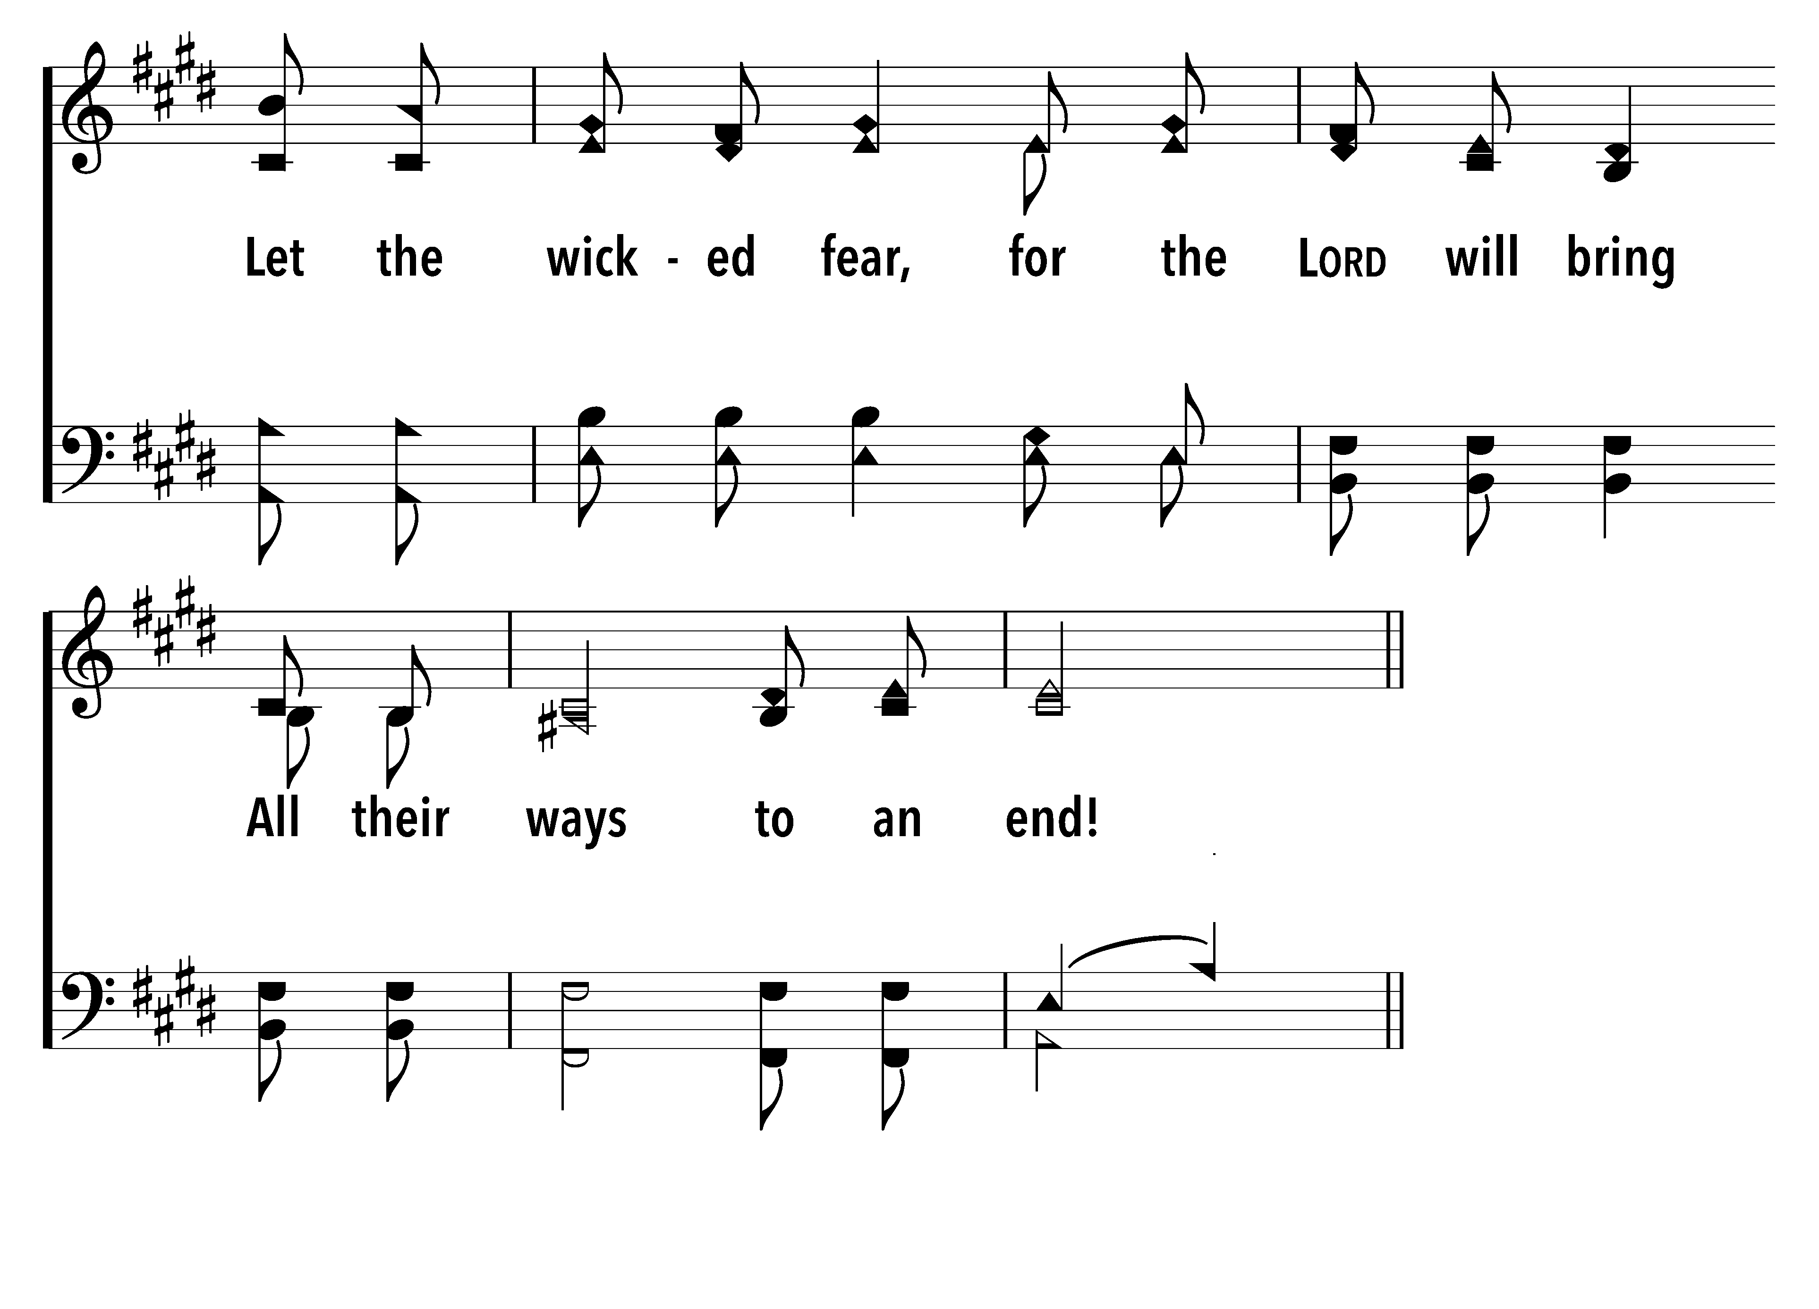
146
1
I WILL SING TO THE LORD (PSALM 146)
C
2
C
I WILL SING TO THE LORD (PSALM 146)
© 2021 Matthew L. Harber

Slide 14
146
1
I WILL SING TO THE LORD (PSALM 146)
C
2
C
I WILL SING TO THE LORD (PSALM 146)
© 2021 Matthew L. Harber

Slide 15
146
1
I WILL SING TO THE LORD (PSALM 146)
C
2
C
I WILL SING TO THE LORD (PSALM 146)
© 2021 Matthew L. Harber

Slide 16
146
1
I WILL SING TO THE LORD (PSALM 146)
C
2
C
I WILL SING TO THE LORD (PSALM 146)
© 2021 Matthew L. Harber

Slide 17
146
1
I WILL SING TO THE LORD (PSALM 146)
C
2
C
I WILL SING TO THE LORD (PSALM 146)
© 2021 Matthew L. Harber

Slide 18
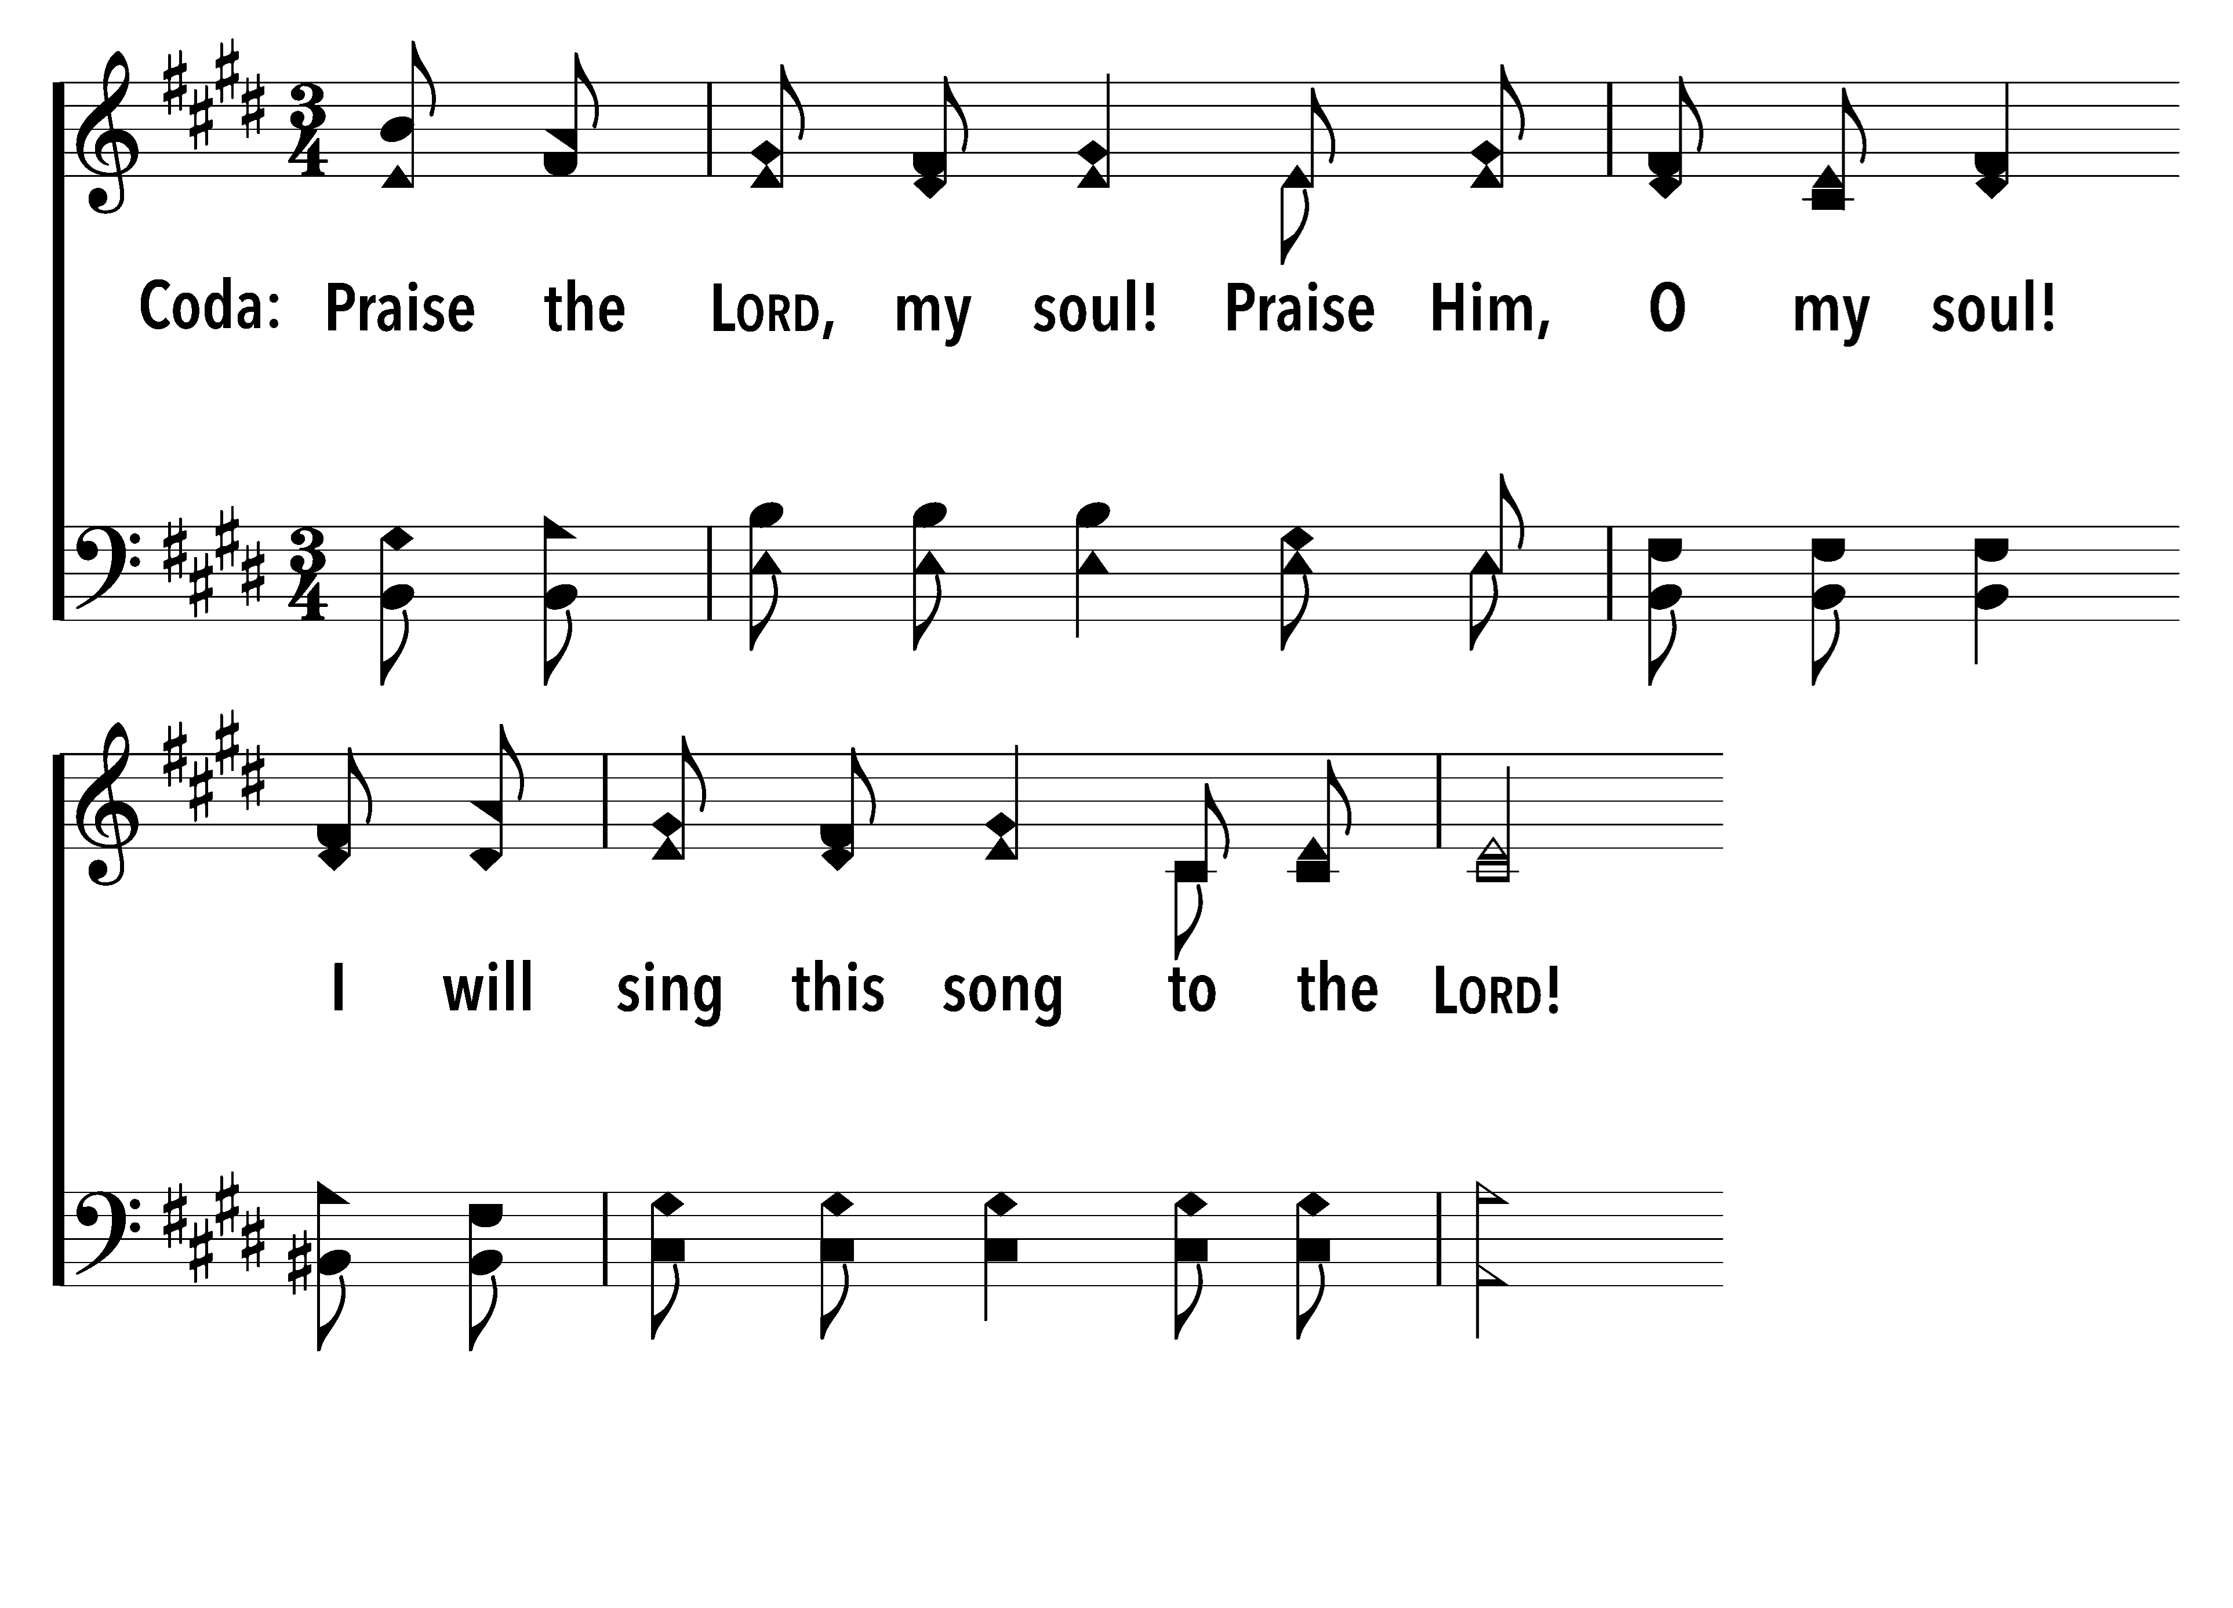
146
1
I WILL SING TO THE LORD (PSALM 146)
C
2
C
I WILL SING TO THE LORD (PSALM 146)
© 2021 Matthew L. Harber

Slide 19
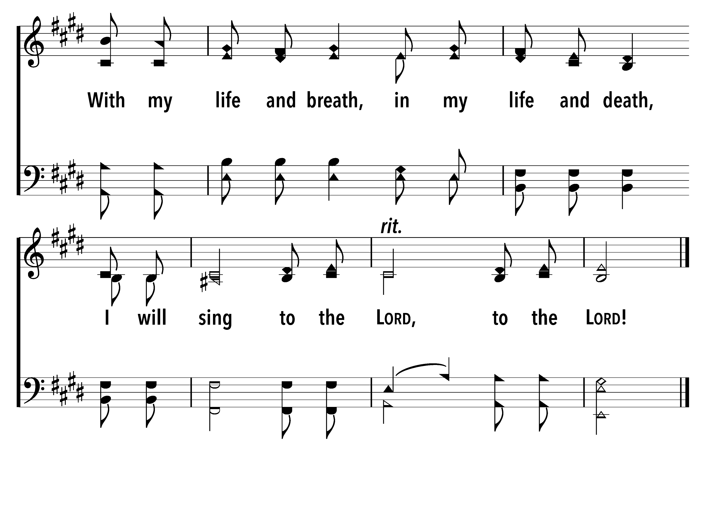
146
1
I WILL SING TO THE LORD (PSALM 146)
C
2
C
I WILL SING TO THE LORD (PSALM 146)
© 2021 Matthew L. Harber

