Slide 1
Alas! And Did My Savior Bleed
Words by: Isaac Watts, chorus by Ralph E. Hudson
Music by: Ralph E. Hudson

Slide 2
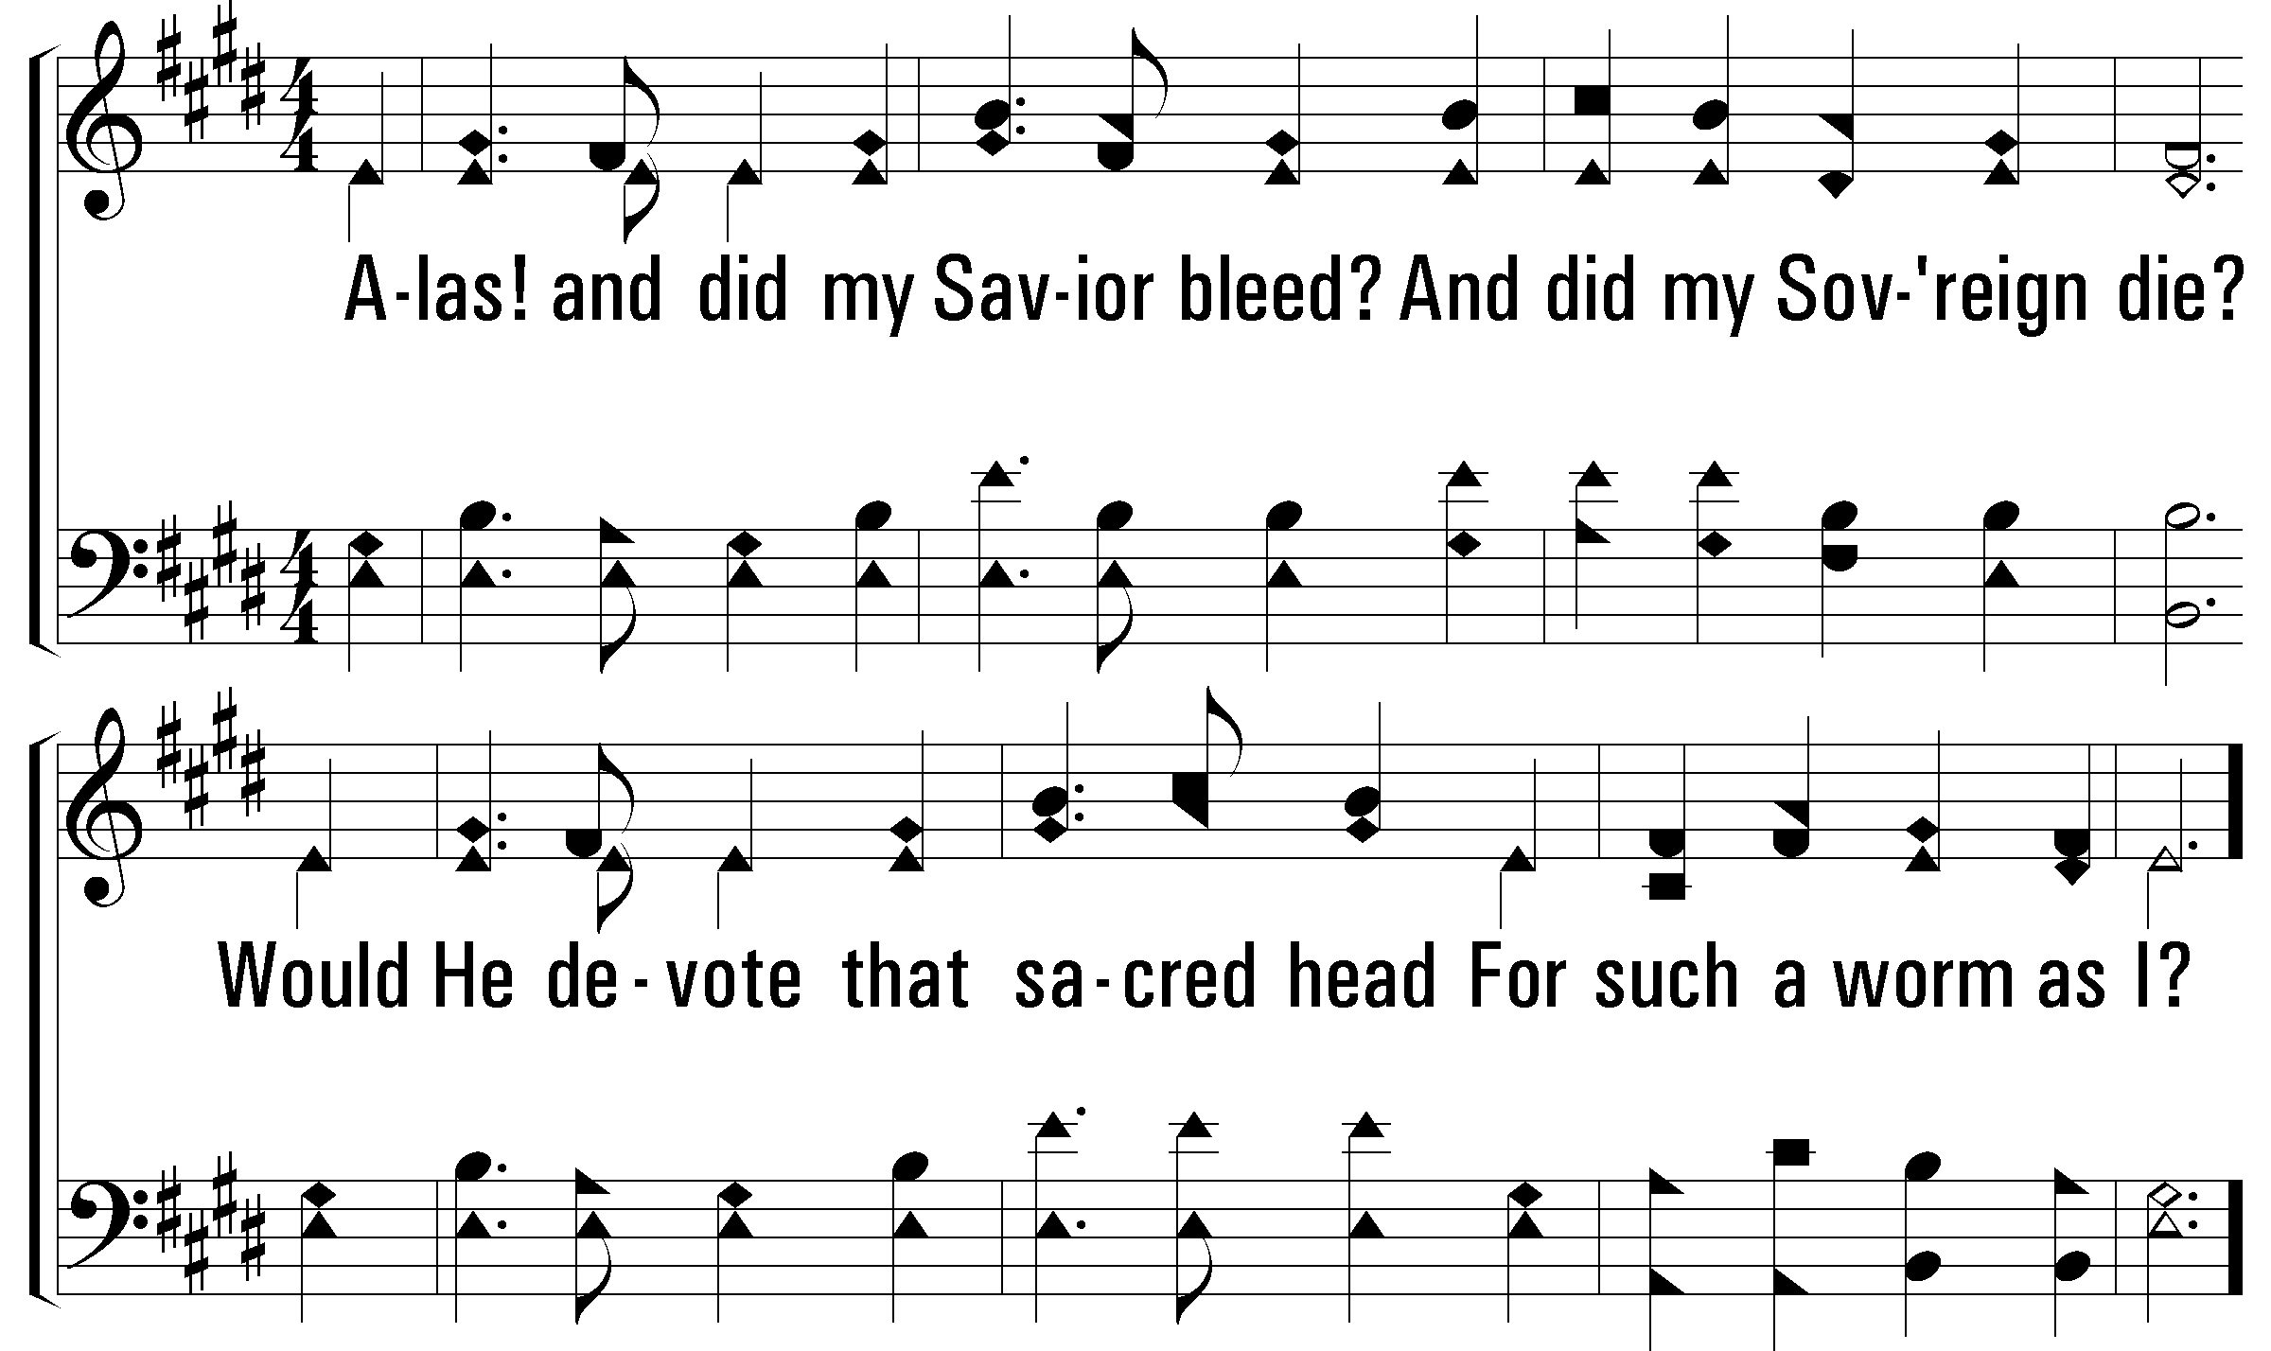
Notes:
2400x1800xpftl-012-001.png

Slide 3
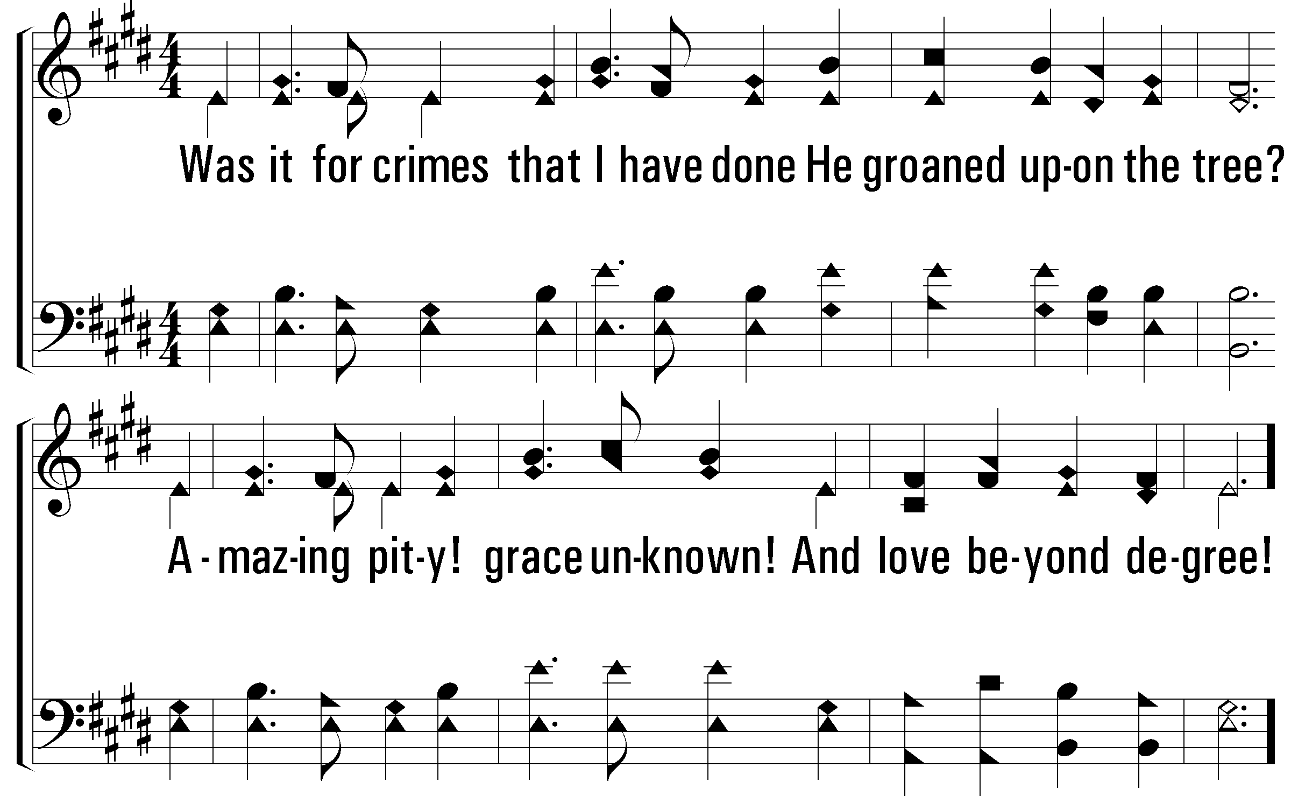
Notes:
2400x1800xpftl-012-002.png

Slide 4
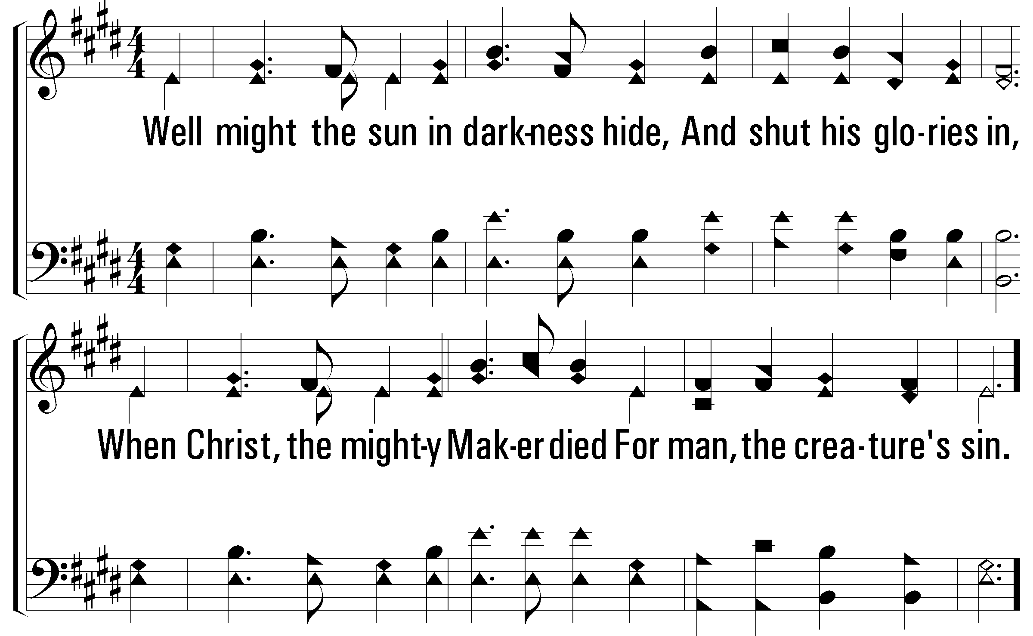
Notes:
2400x1800xpftl-012-003.png

Slide 5
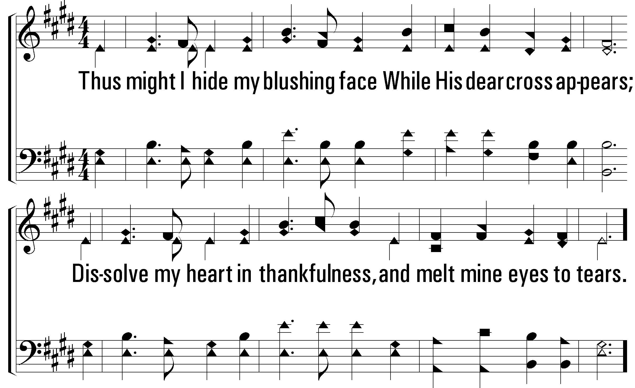
Notes:
2400x1800xpftl-012-004.png

Slide 6
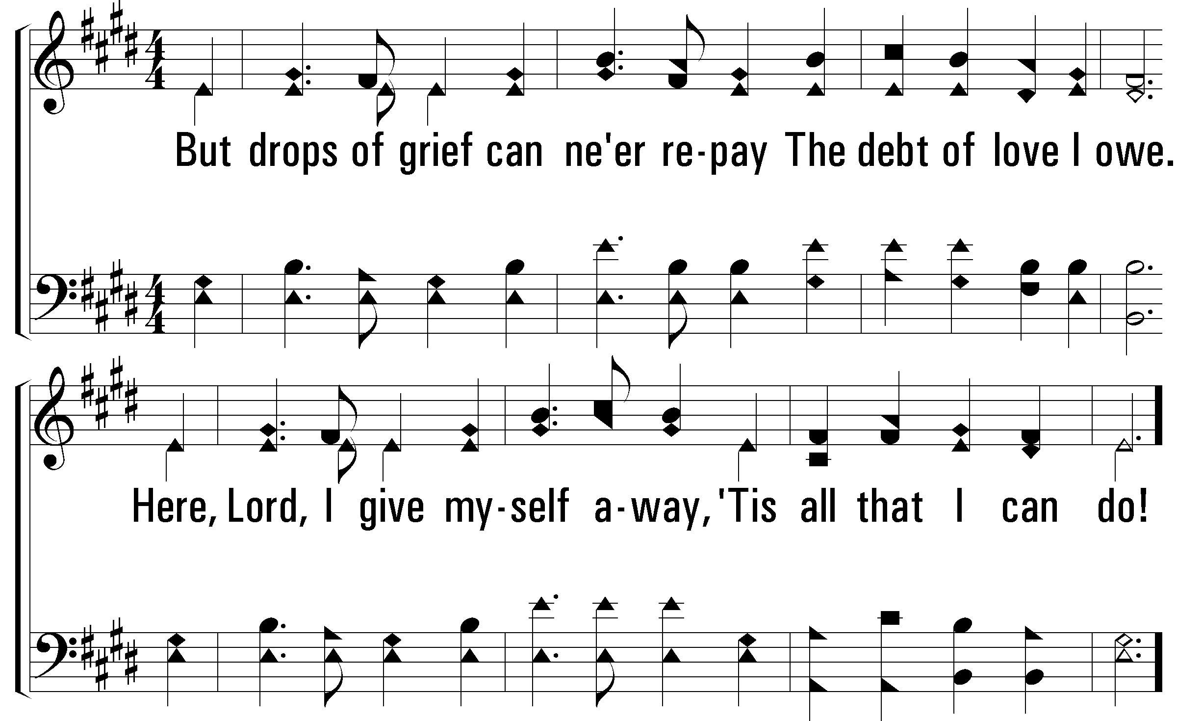
Notes:
2400x1800xpftl-012-005.png

Slide 7
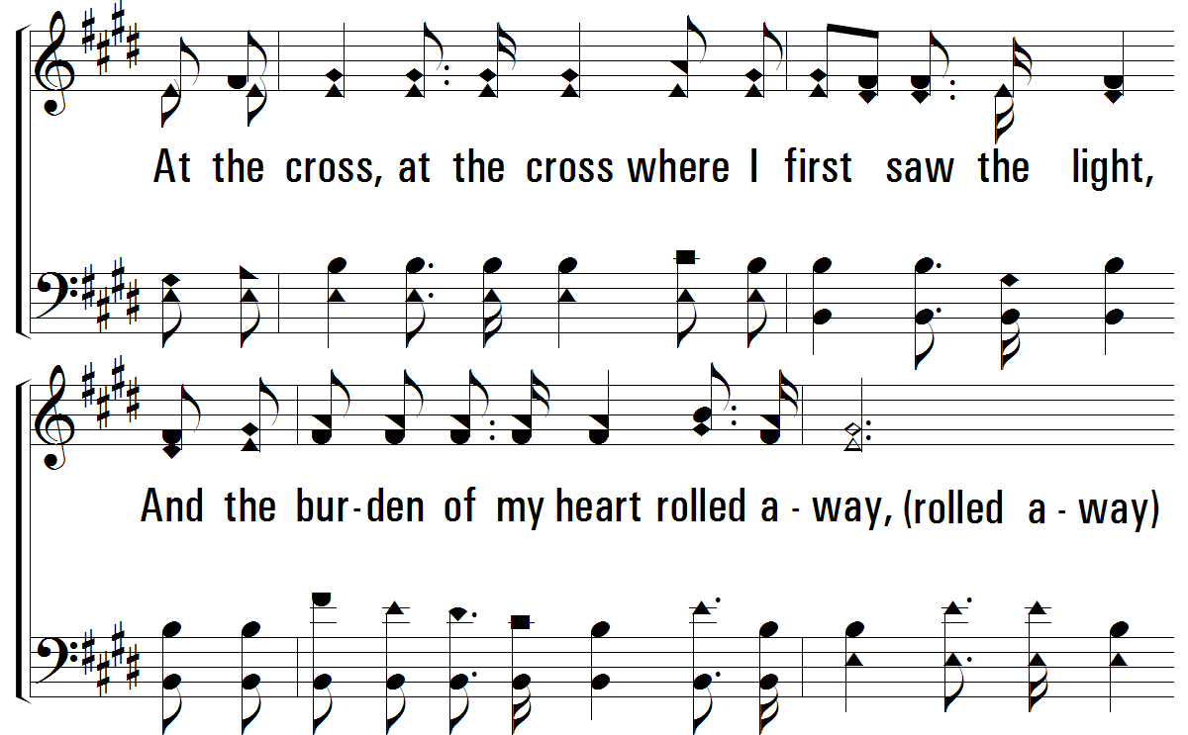
Notes:
2400x1800xpftl-012-006.png

Slide 8
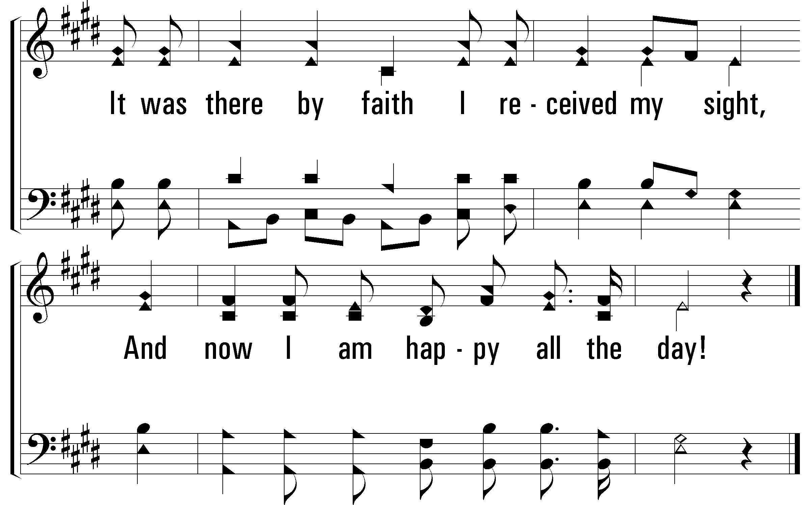
Notes:
2400x1800xpftl-012-007.png

