Slide 1
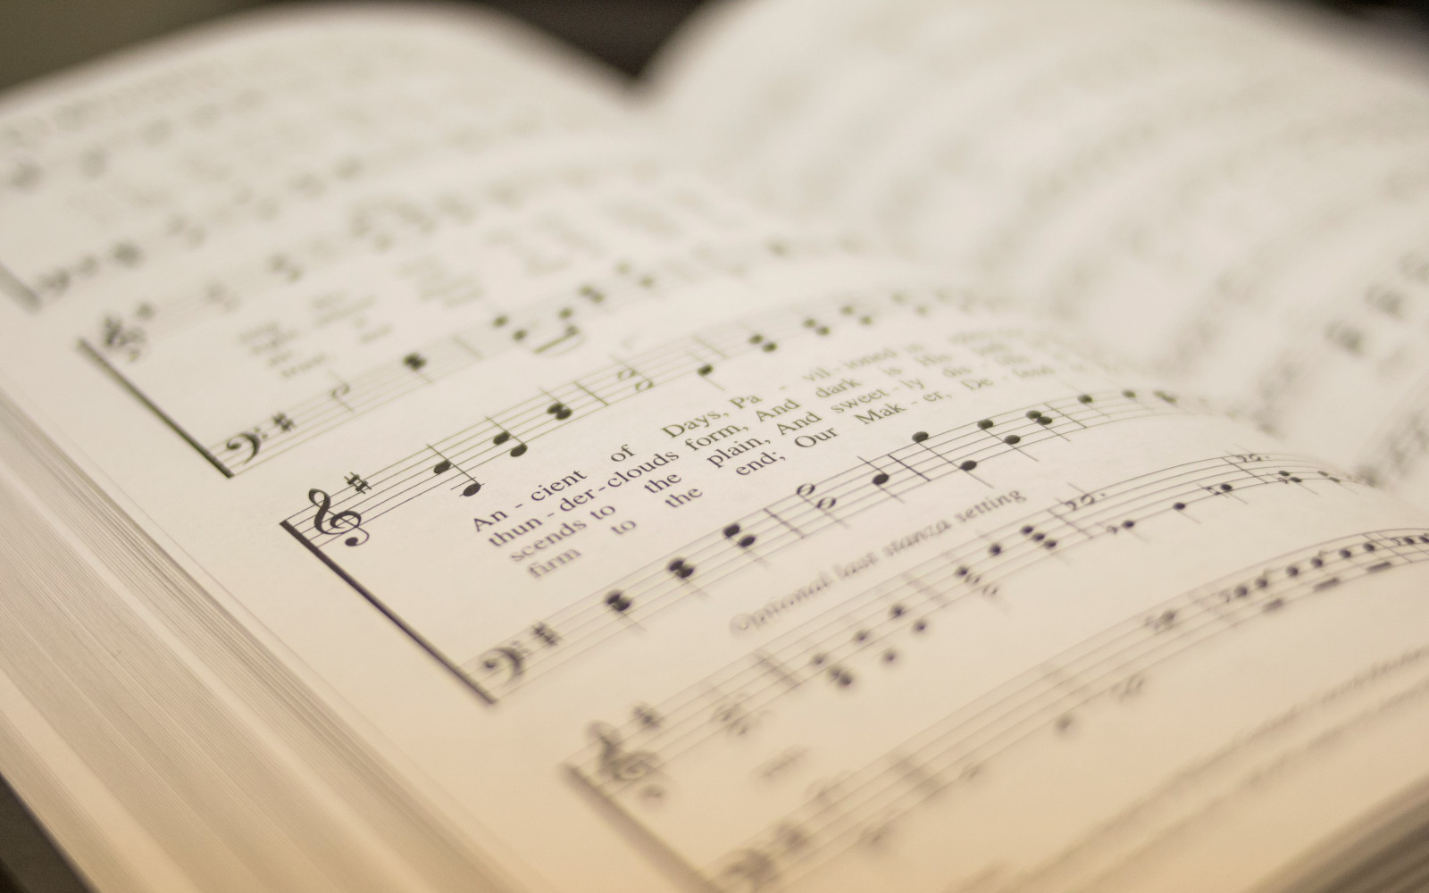

389
LET HIM HAVE HIS WAY WITH THEE
1
2
3
“SINGING...TO THE LORD” COLOSSIANS 3:16
Words & Music: Cyrus S. Nusbaum

Slide 2
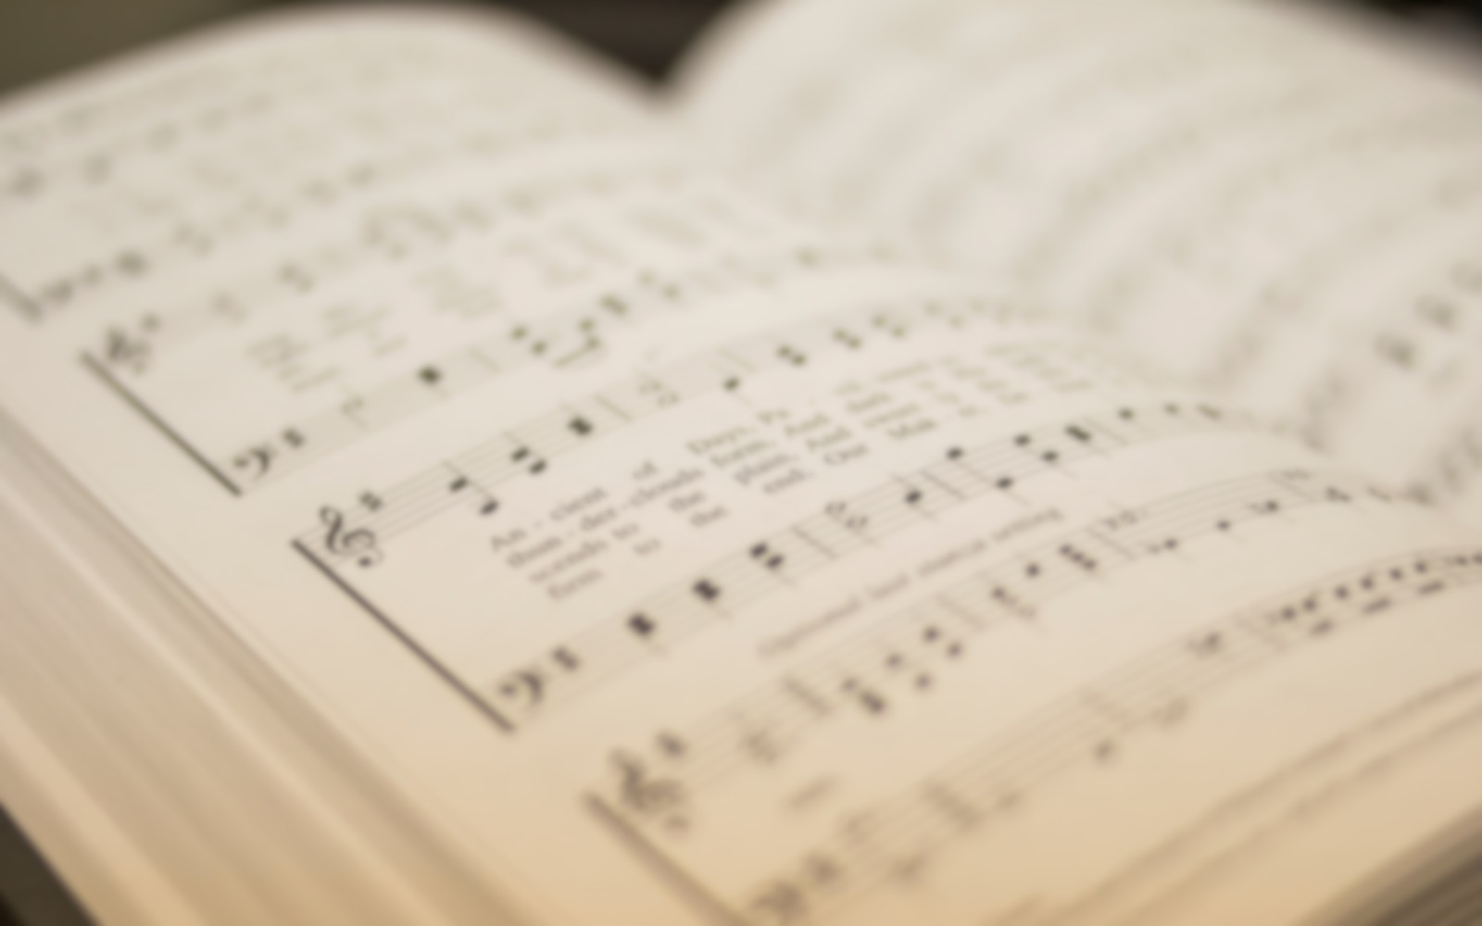
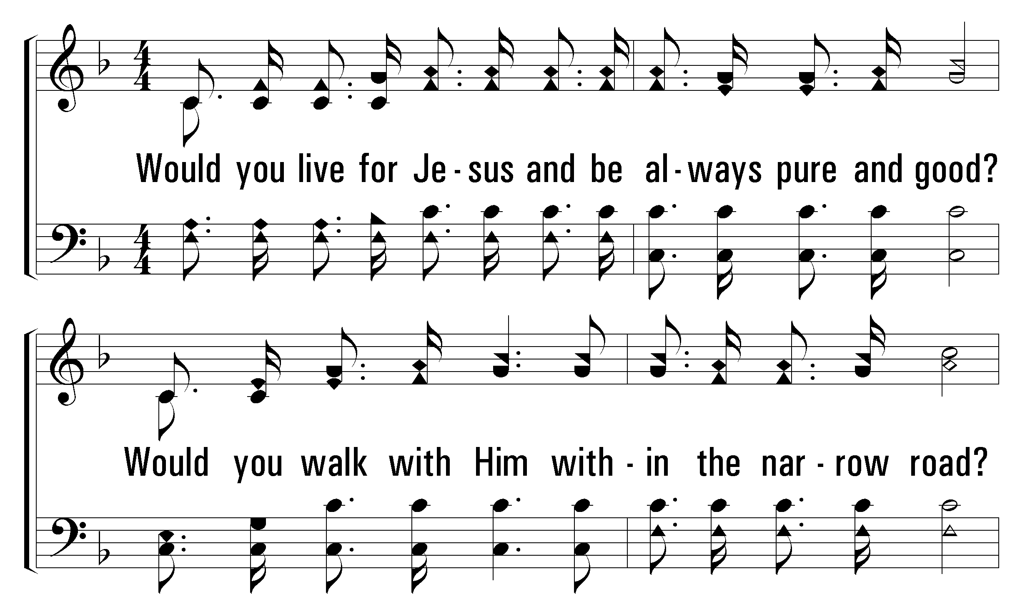


1
C
2
C
3
C
389
LET HIM HAVE HIS WAY WITH THEE
© 2008 The Paperless Hymnal®

Slide 3
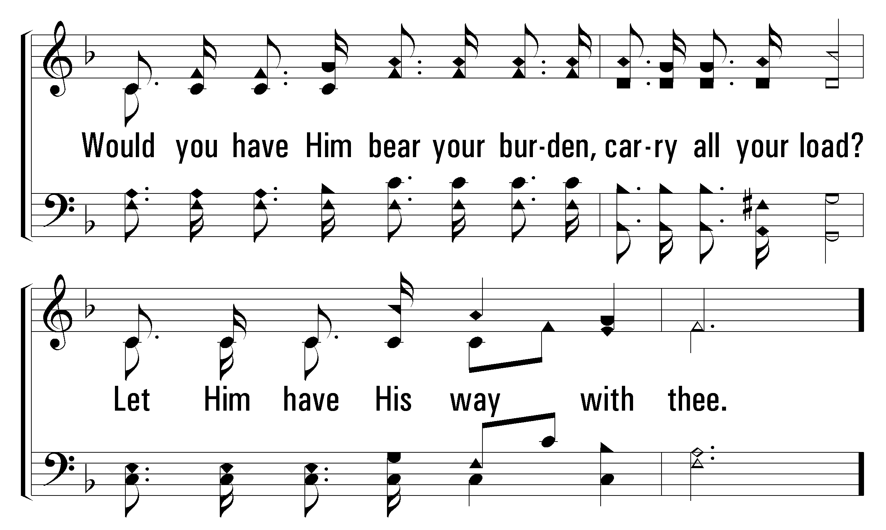
1
C
2
C
3
C
389
LET HIM HAVE HIS WAY WITH THEE
© 2008 The Paperless Hymnal®

Slide 4
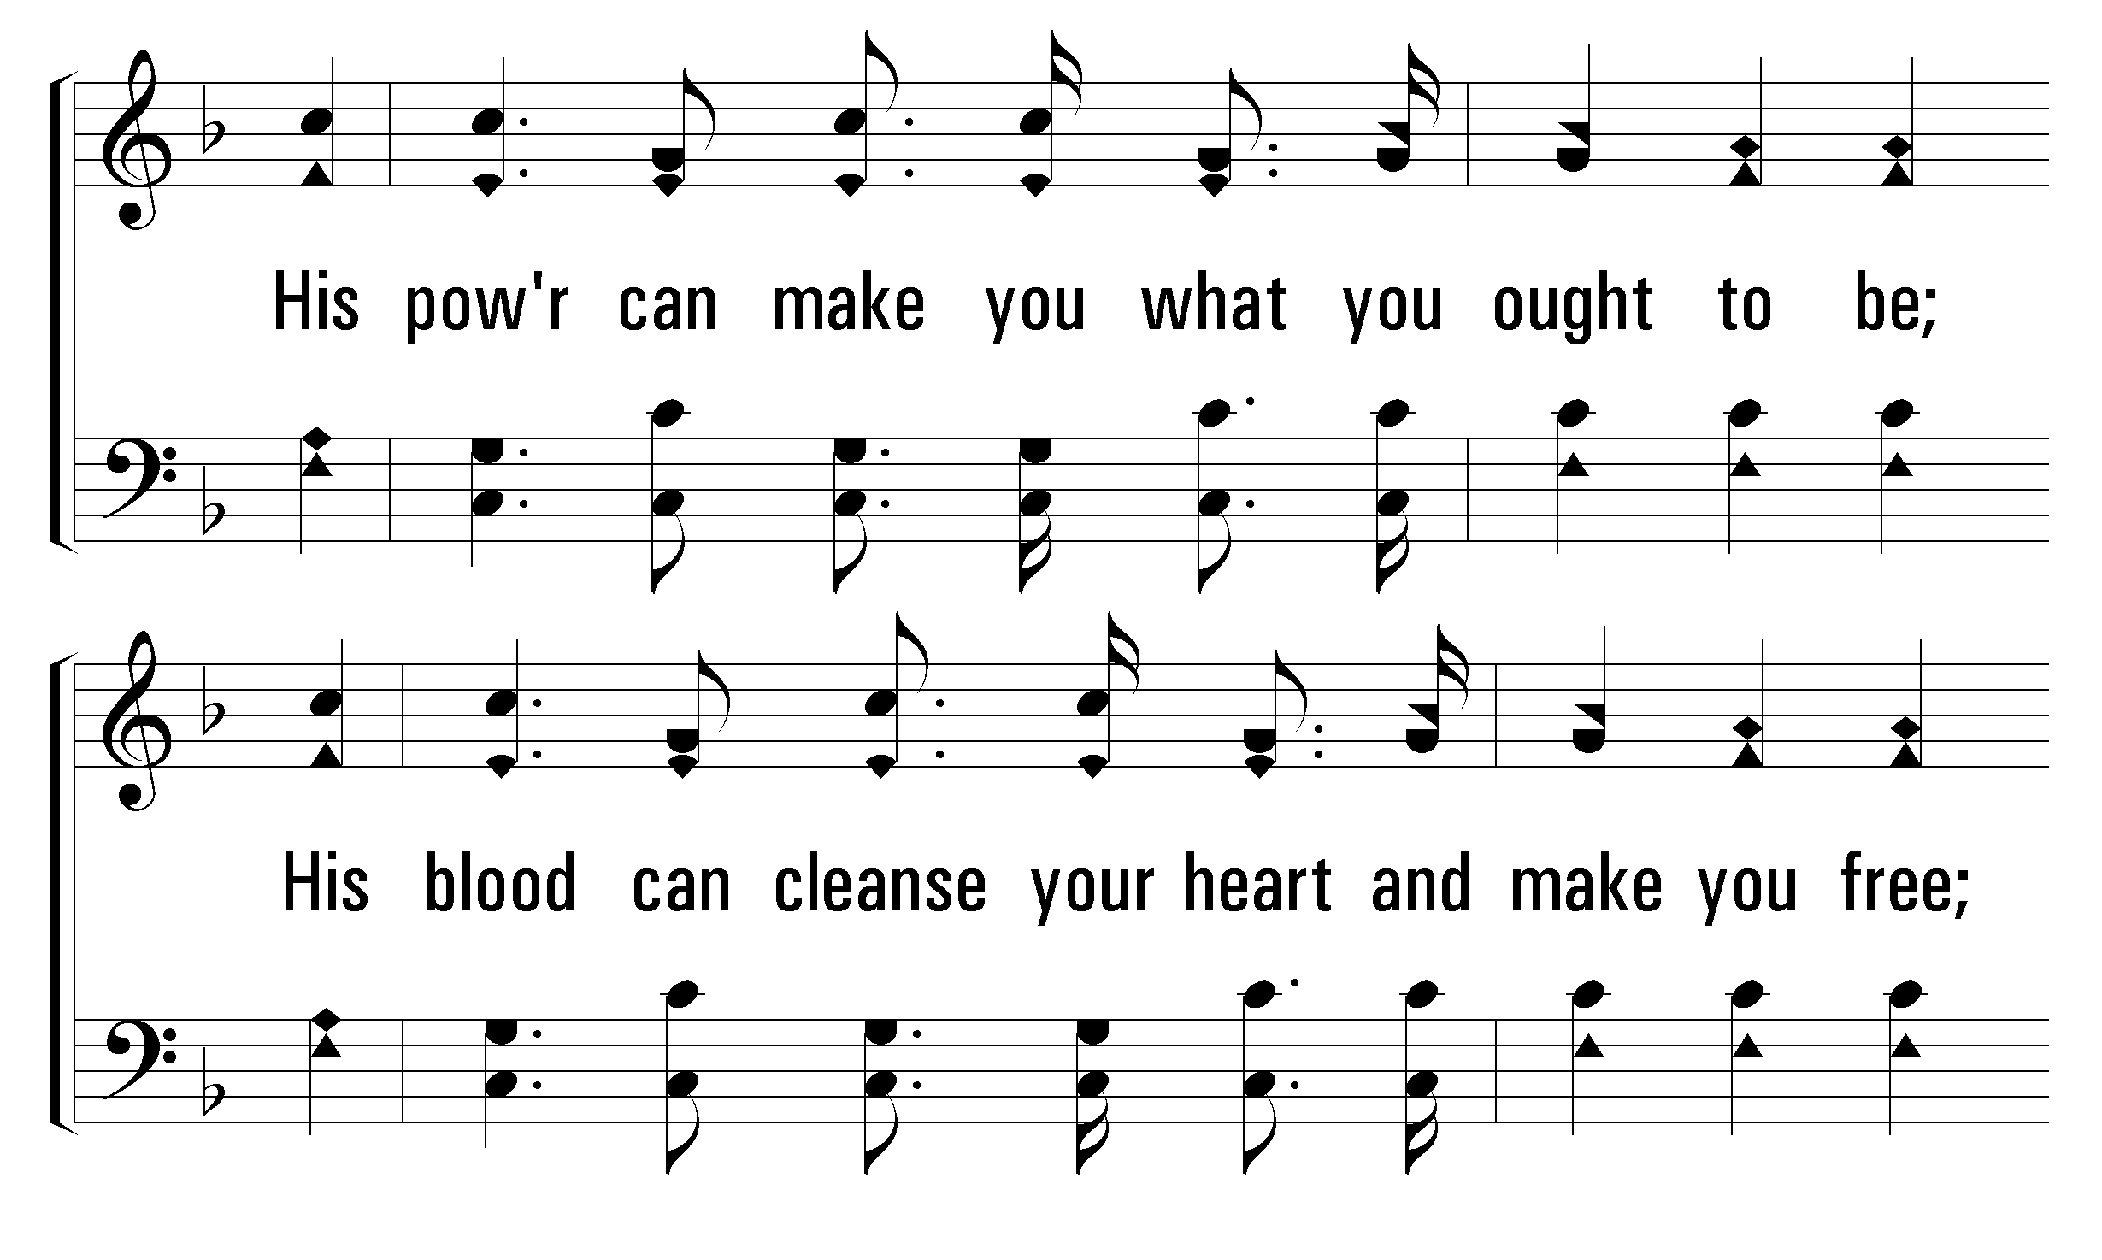
1
C
2
C
3
C
389
LET HIM HAVE HIS WAY WITH THEE
© 2008 The Paperless Hymnal®

Slide 5
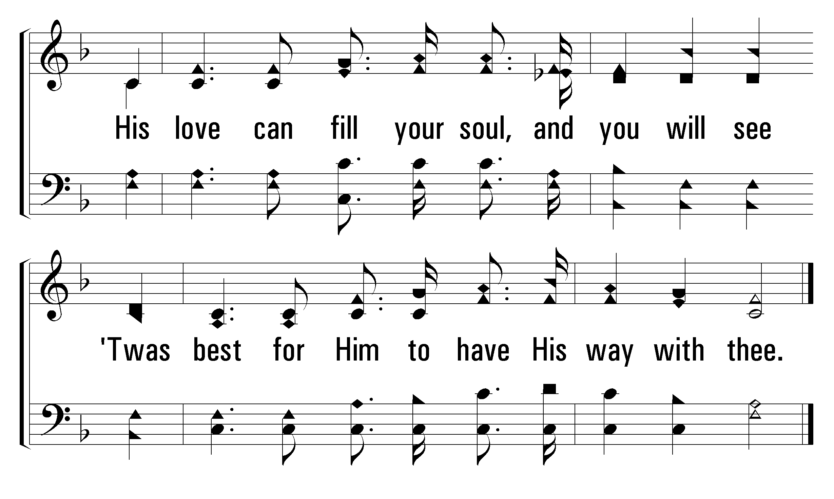
1
C
2
C
3
C
389
LET HIM HAVE HIS WAY WITH THEE
© 2008 The Paperless Hymnal®

Slide 6
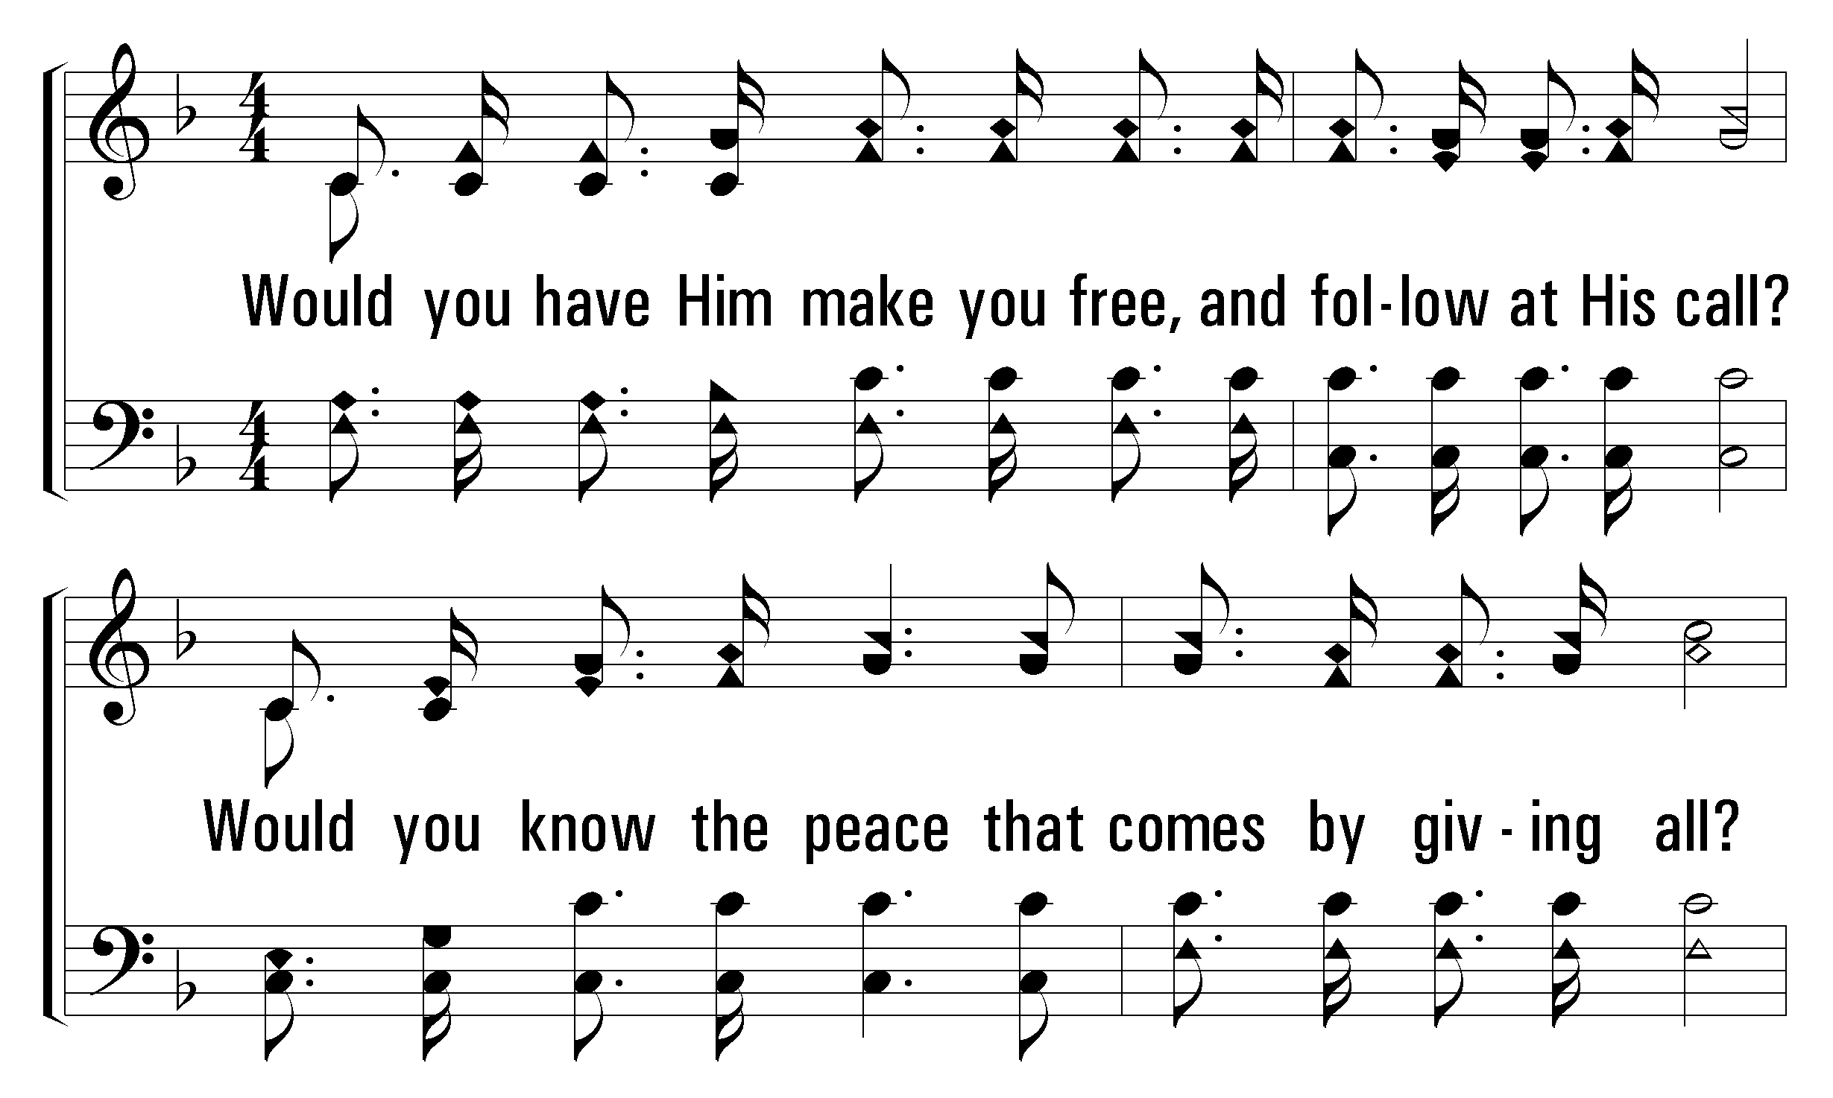
1
C
2
C
3
C
389
LET HIM HAVE HIS WAY WITH THEE
© 2008 The Paperless Hymnal®

Slide 7
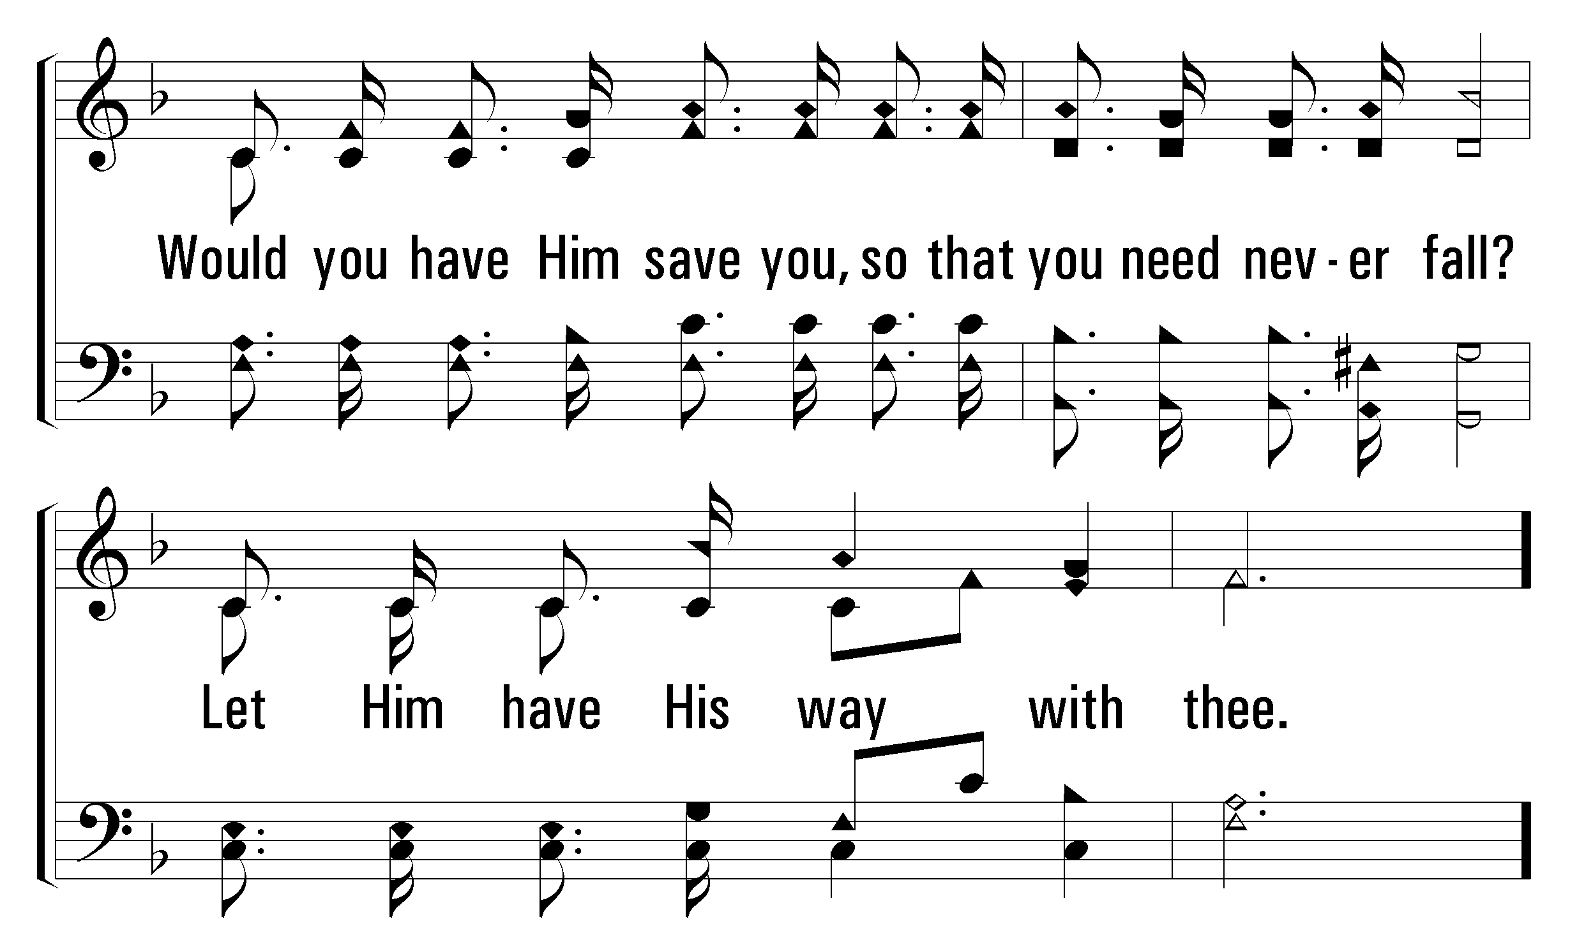
1
C
2
C
3
C
389
LET HIM HAVE HIS WAY WITH THEE
© 2008 The Paperless Hymnal®

Slide 8
1
C
2
C
3
C
389
LET HIM HAVE HIS WAY WITH THEE
© 2008 The Paperless Hymnal®

Slide 9
1
C
2
C
3
C
389
LET HIM HAVE HIS WAY WITH THEE
© 2008 The Paperless Hymnal®

Slide 10
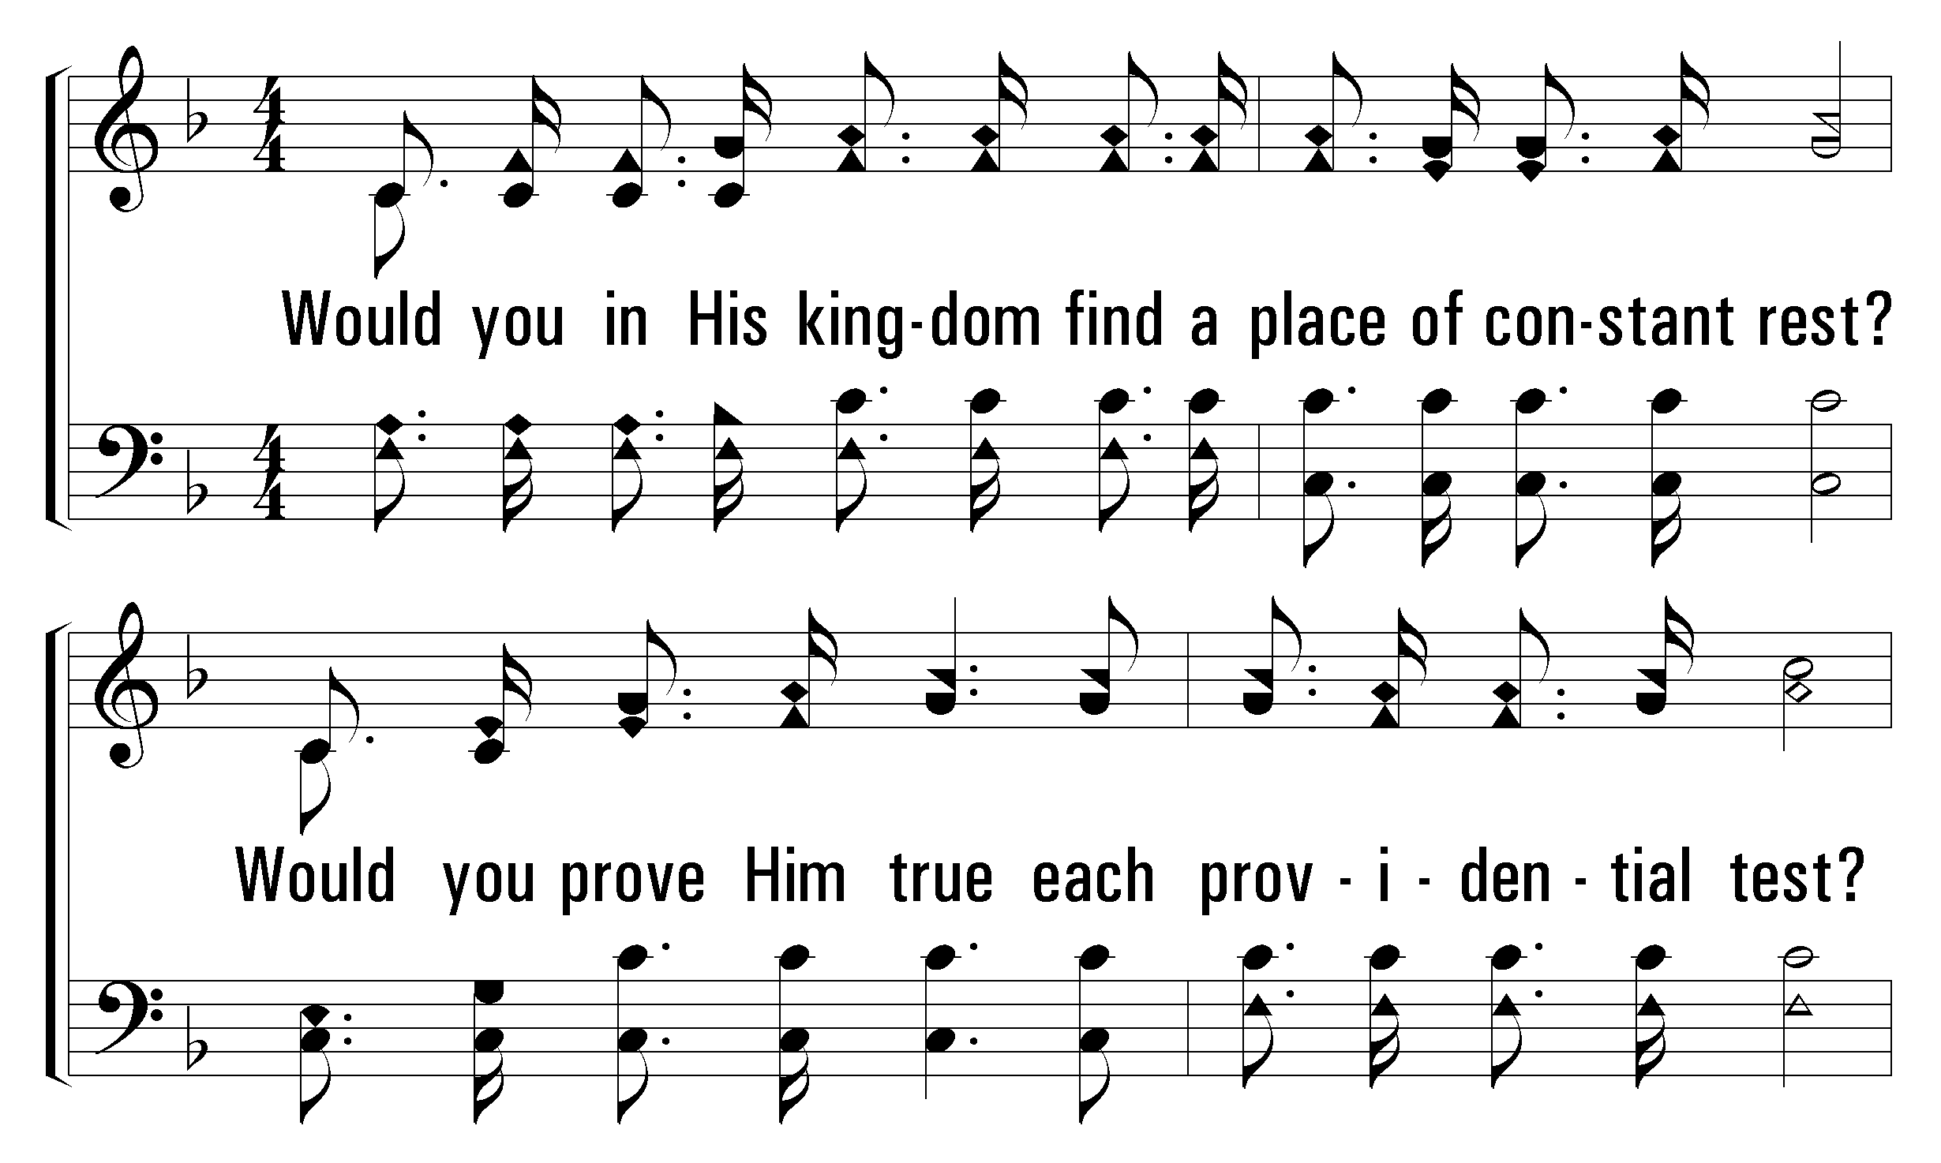
1
C
2
C
3
C
389
LET HIM HAVE HIS WAY WITH THEE
© 2008 The Paperless Hymnal®

Slide 11
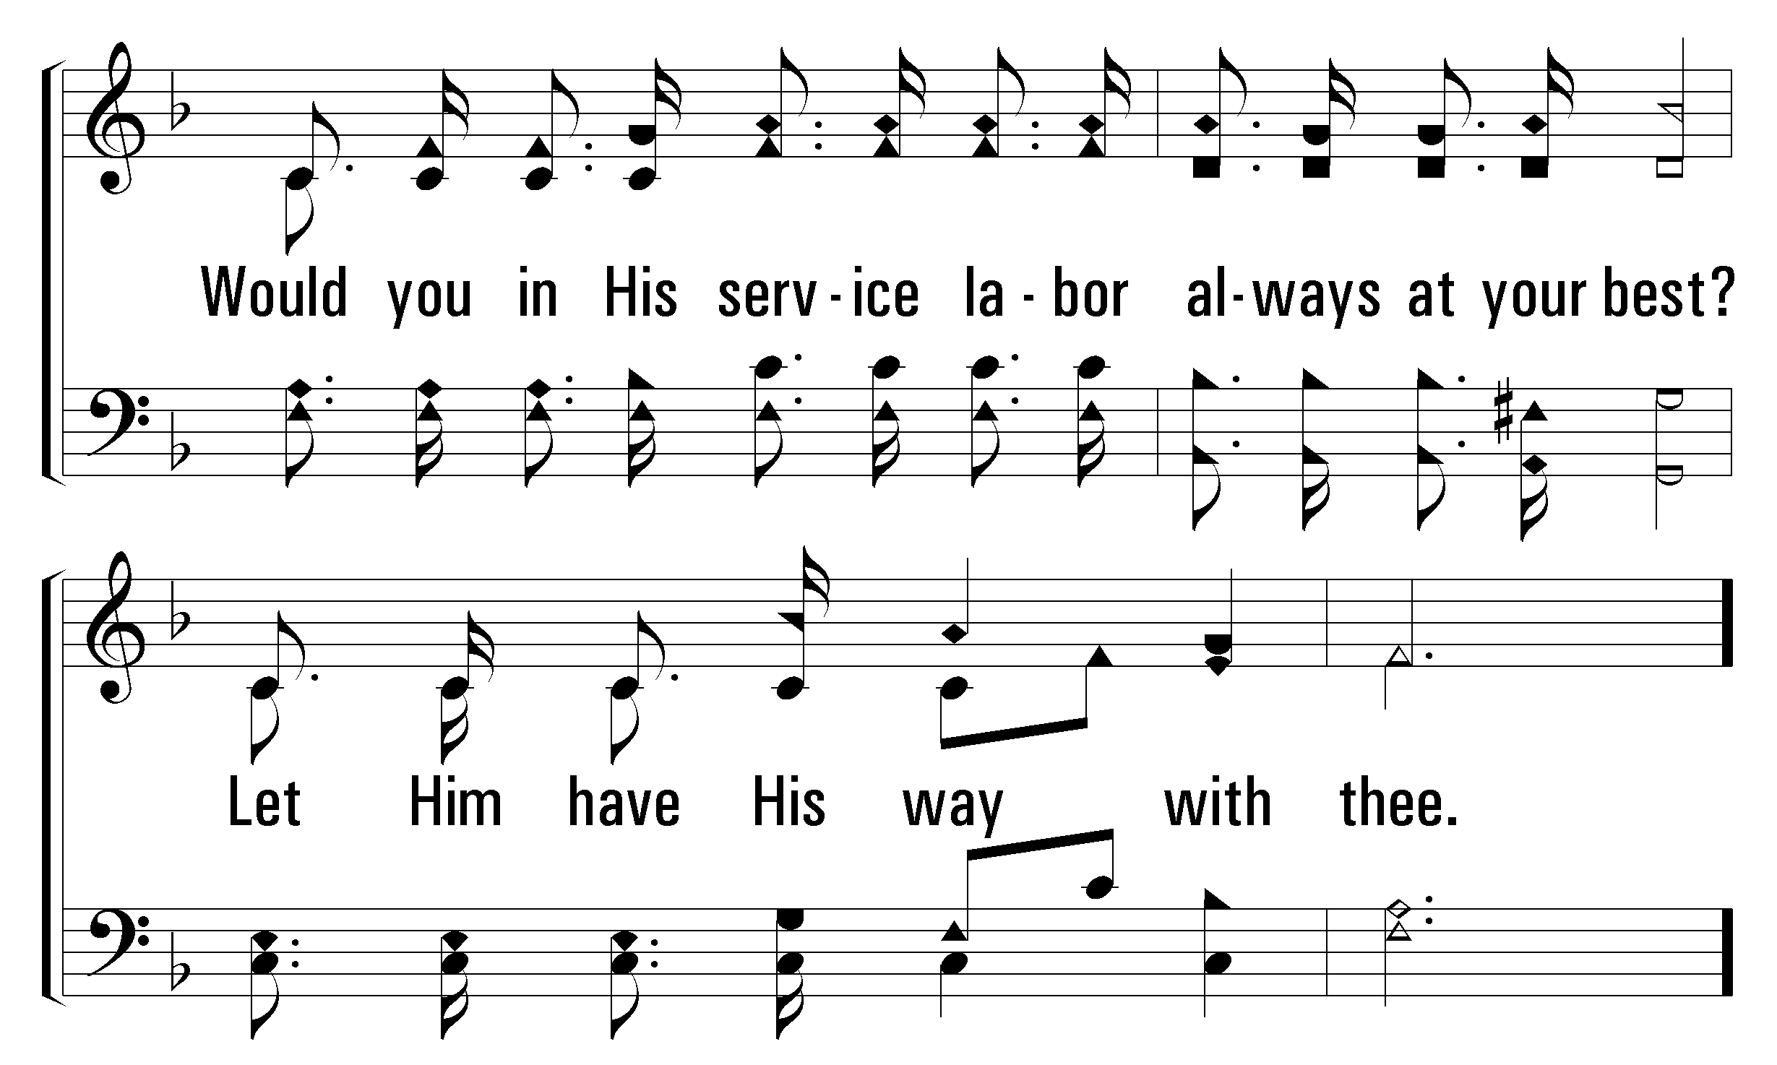
1
C
2
C
3
C
389
LET HIM HAVE HIS WAY WITH THEE
© 2008 The Paperless Hymnal®

Slide 12
1
C
2
C
3
C
389
LET HIM HAVE HIS WAY WITH THEE
© 2008 The Paperless Hymnal®

Slide 13
1
C
2
C
3
C
389
LET HIM HAVE HIS WAY WITH THEE
© 2008 The Paperless Hymnal®

