Slide 1
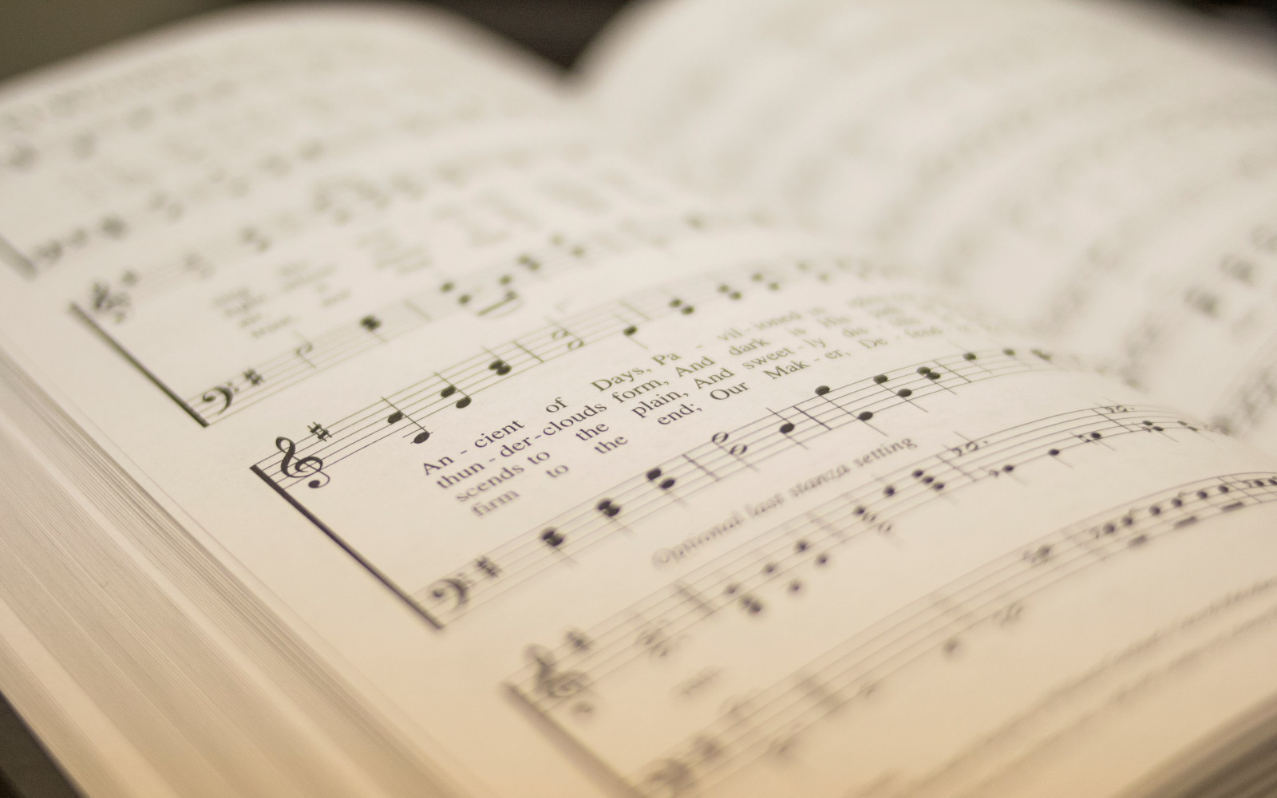

111
ALLELUIA!
1
2
3
4
“SINGING...TO THE LORD” COLOSSIANS 3:16
© 1972 Manna Music; arr. © 1986 Dane K. Shepard Tune: CALAIS • Jerry Sinclair (1972); arr. Dane K. Shepard (1987) st. 4 Lancaster and Mabry's Rejoice! And Sing to the Lord (1974) Hymn: Jerry Sinclair (1972); st. 3 Joseph M. Scriven (1855);

Slide 2
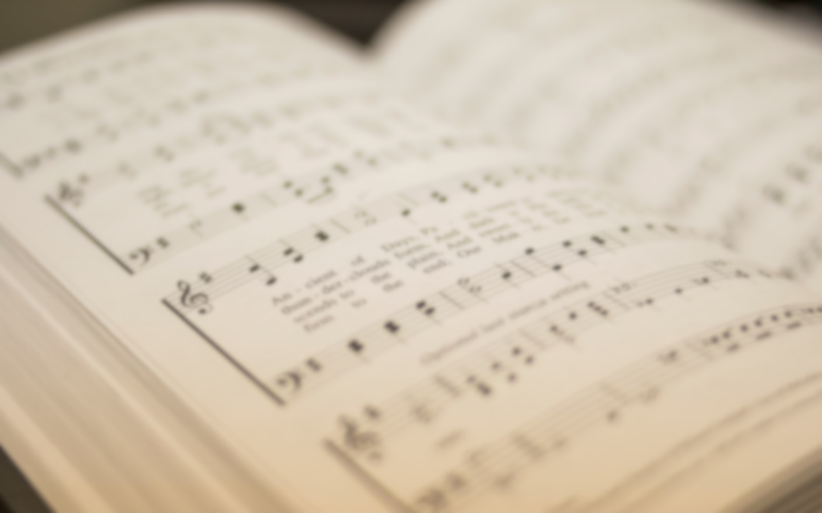
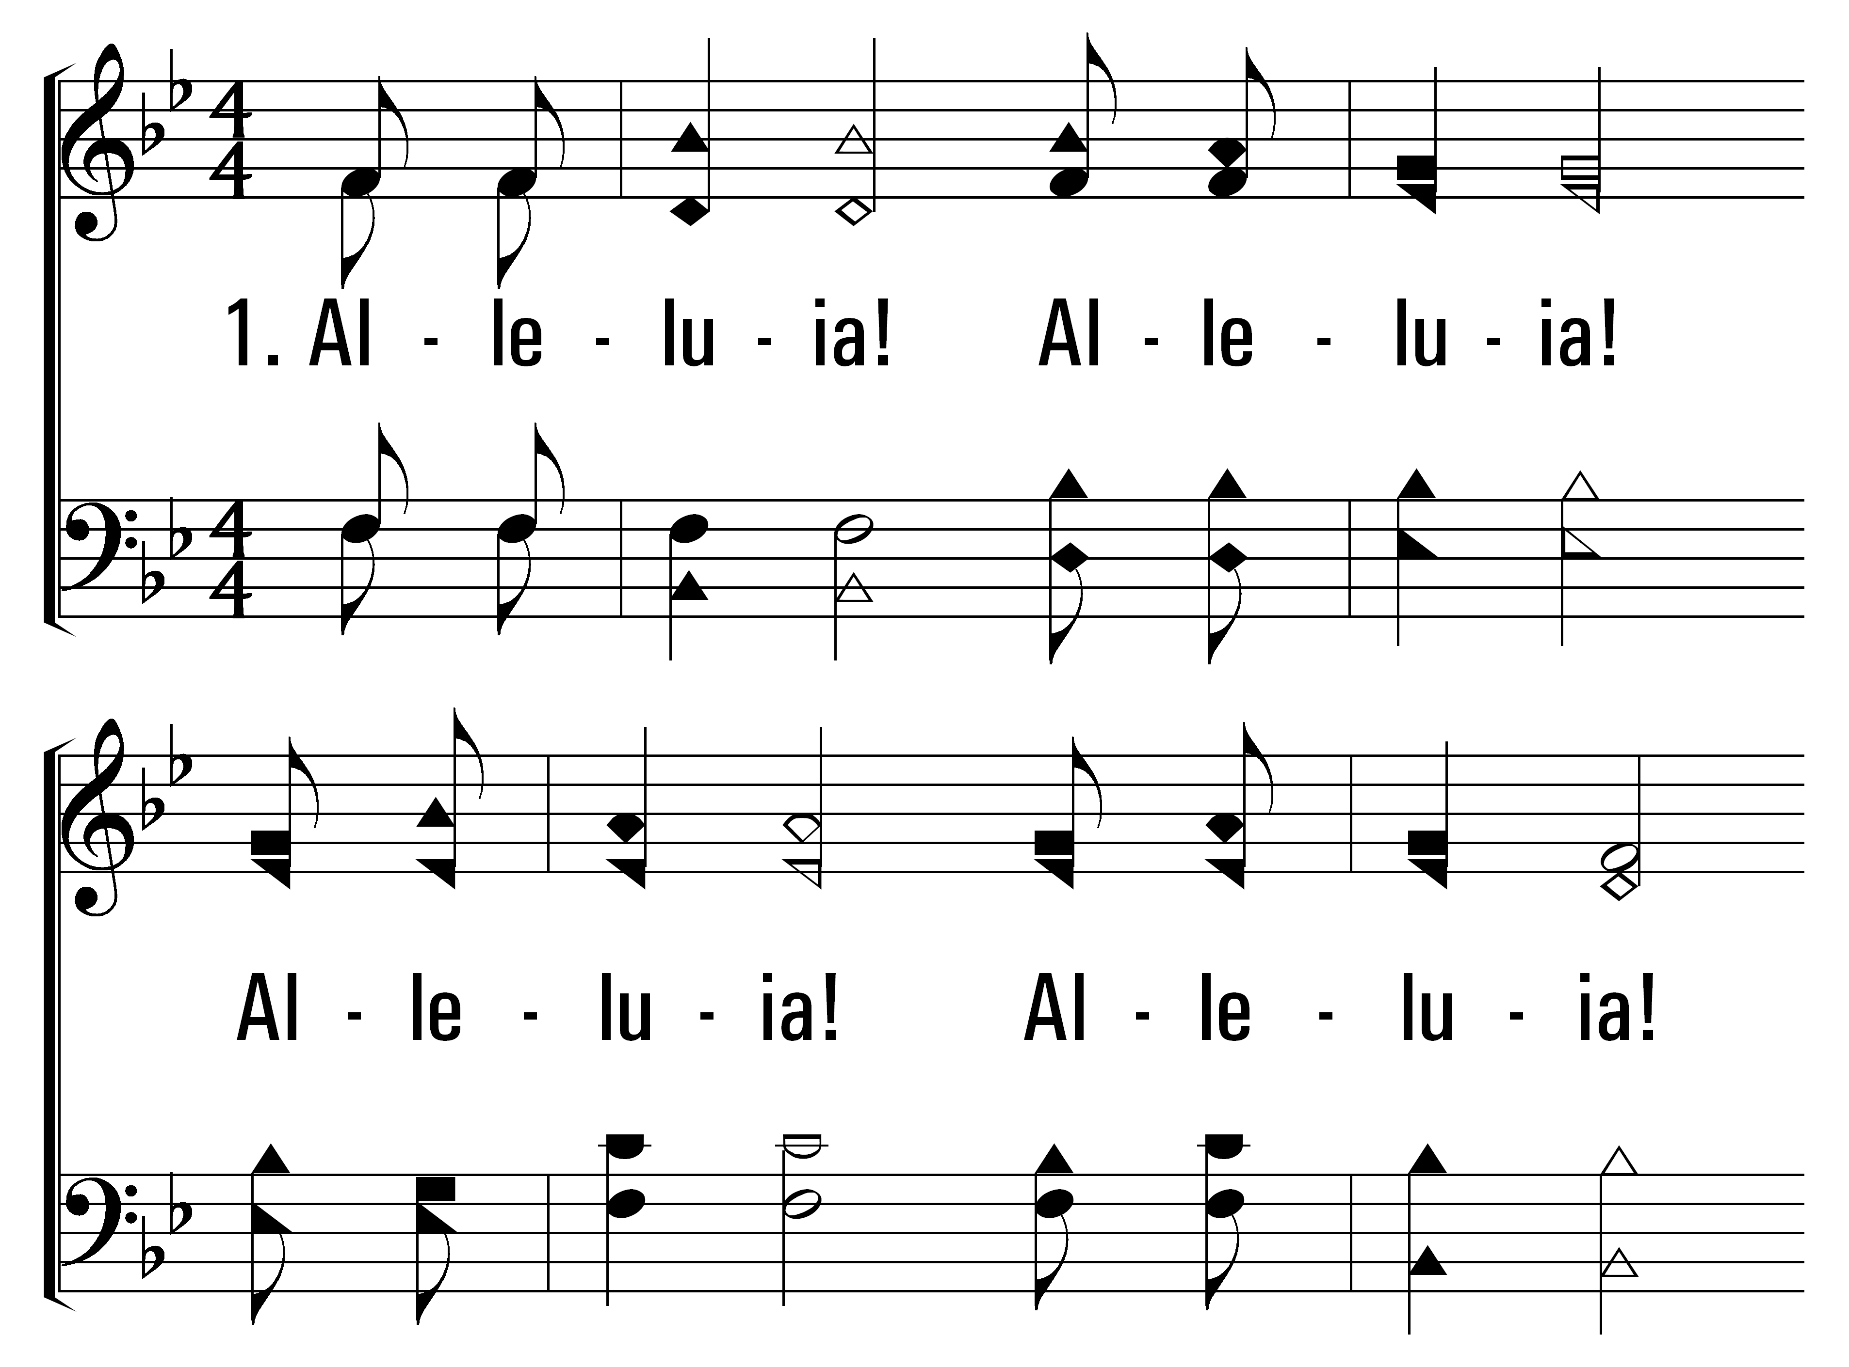


111
1
ALLELUIA!
2
3
4
© 2014 Sumphonia Productions, LLC

Slide 3
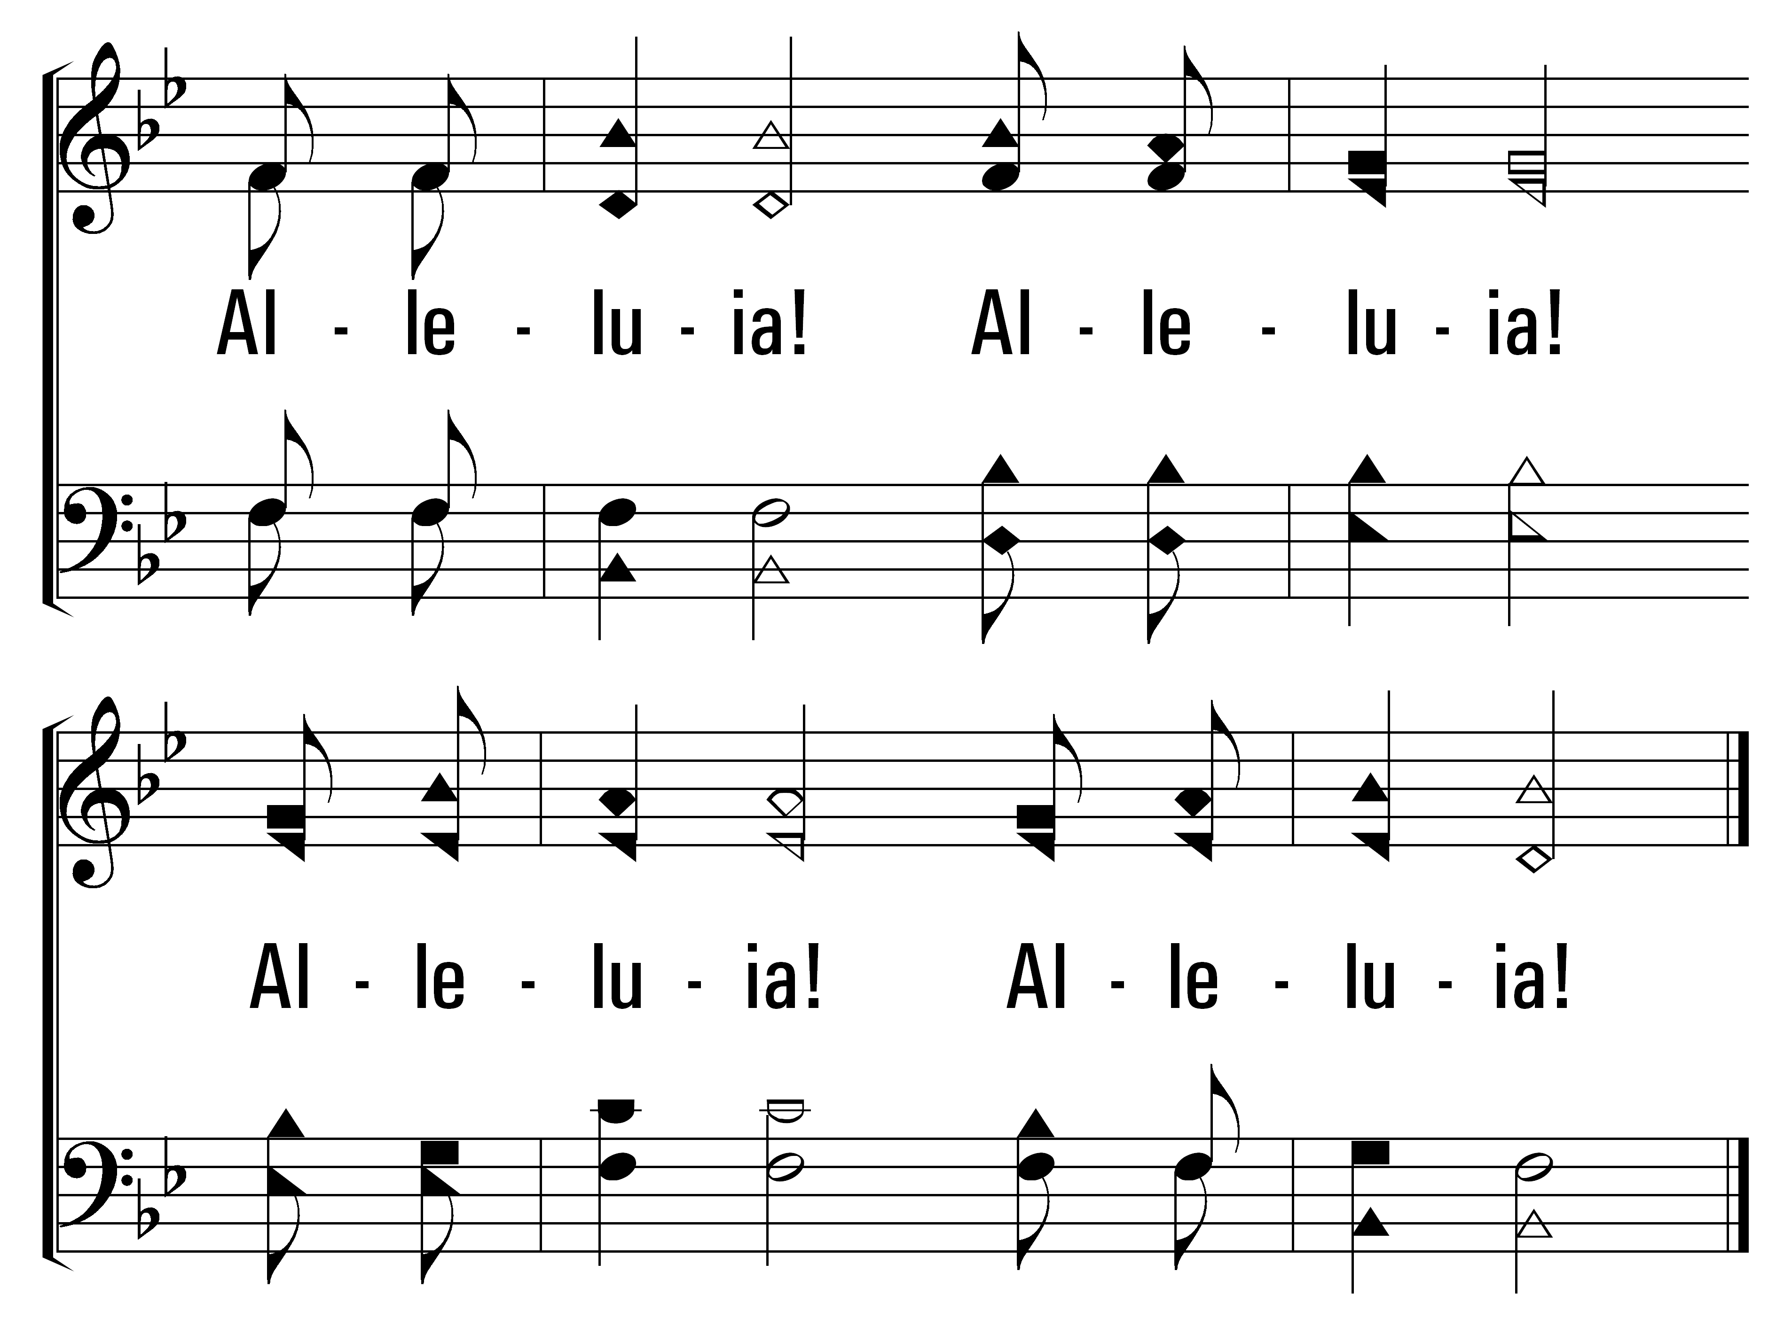
111
1
ALLELUIA!
2
3
4
© 2014 Sumphonia Productions, LLC

Slide 4
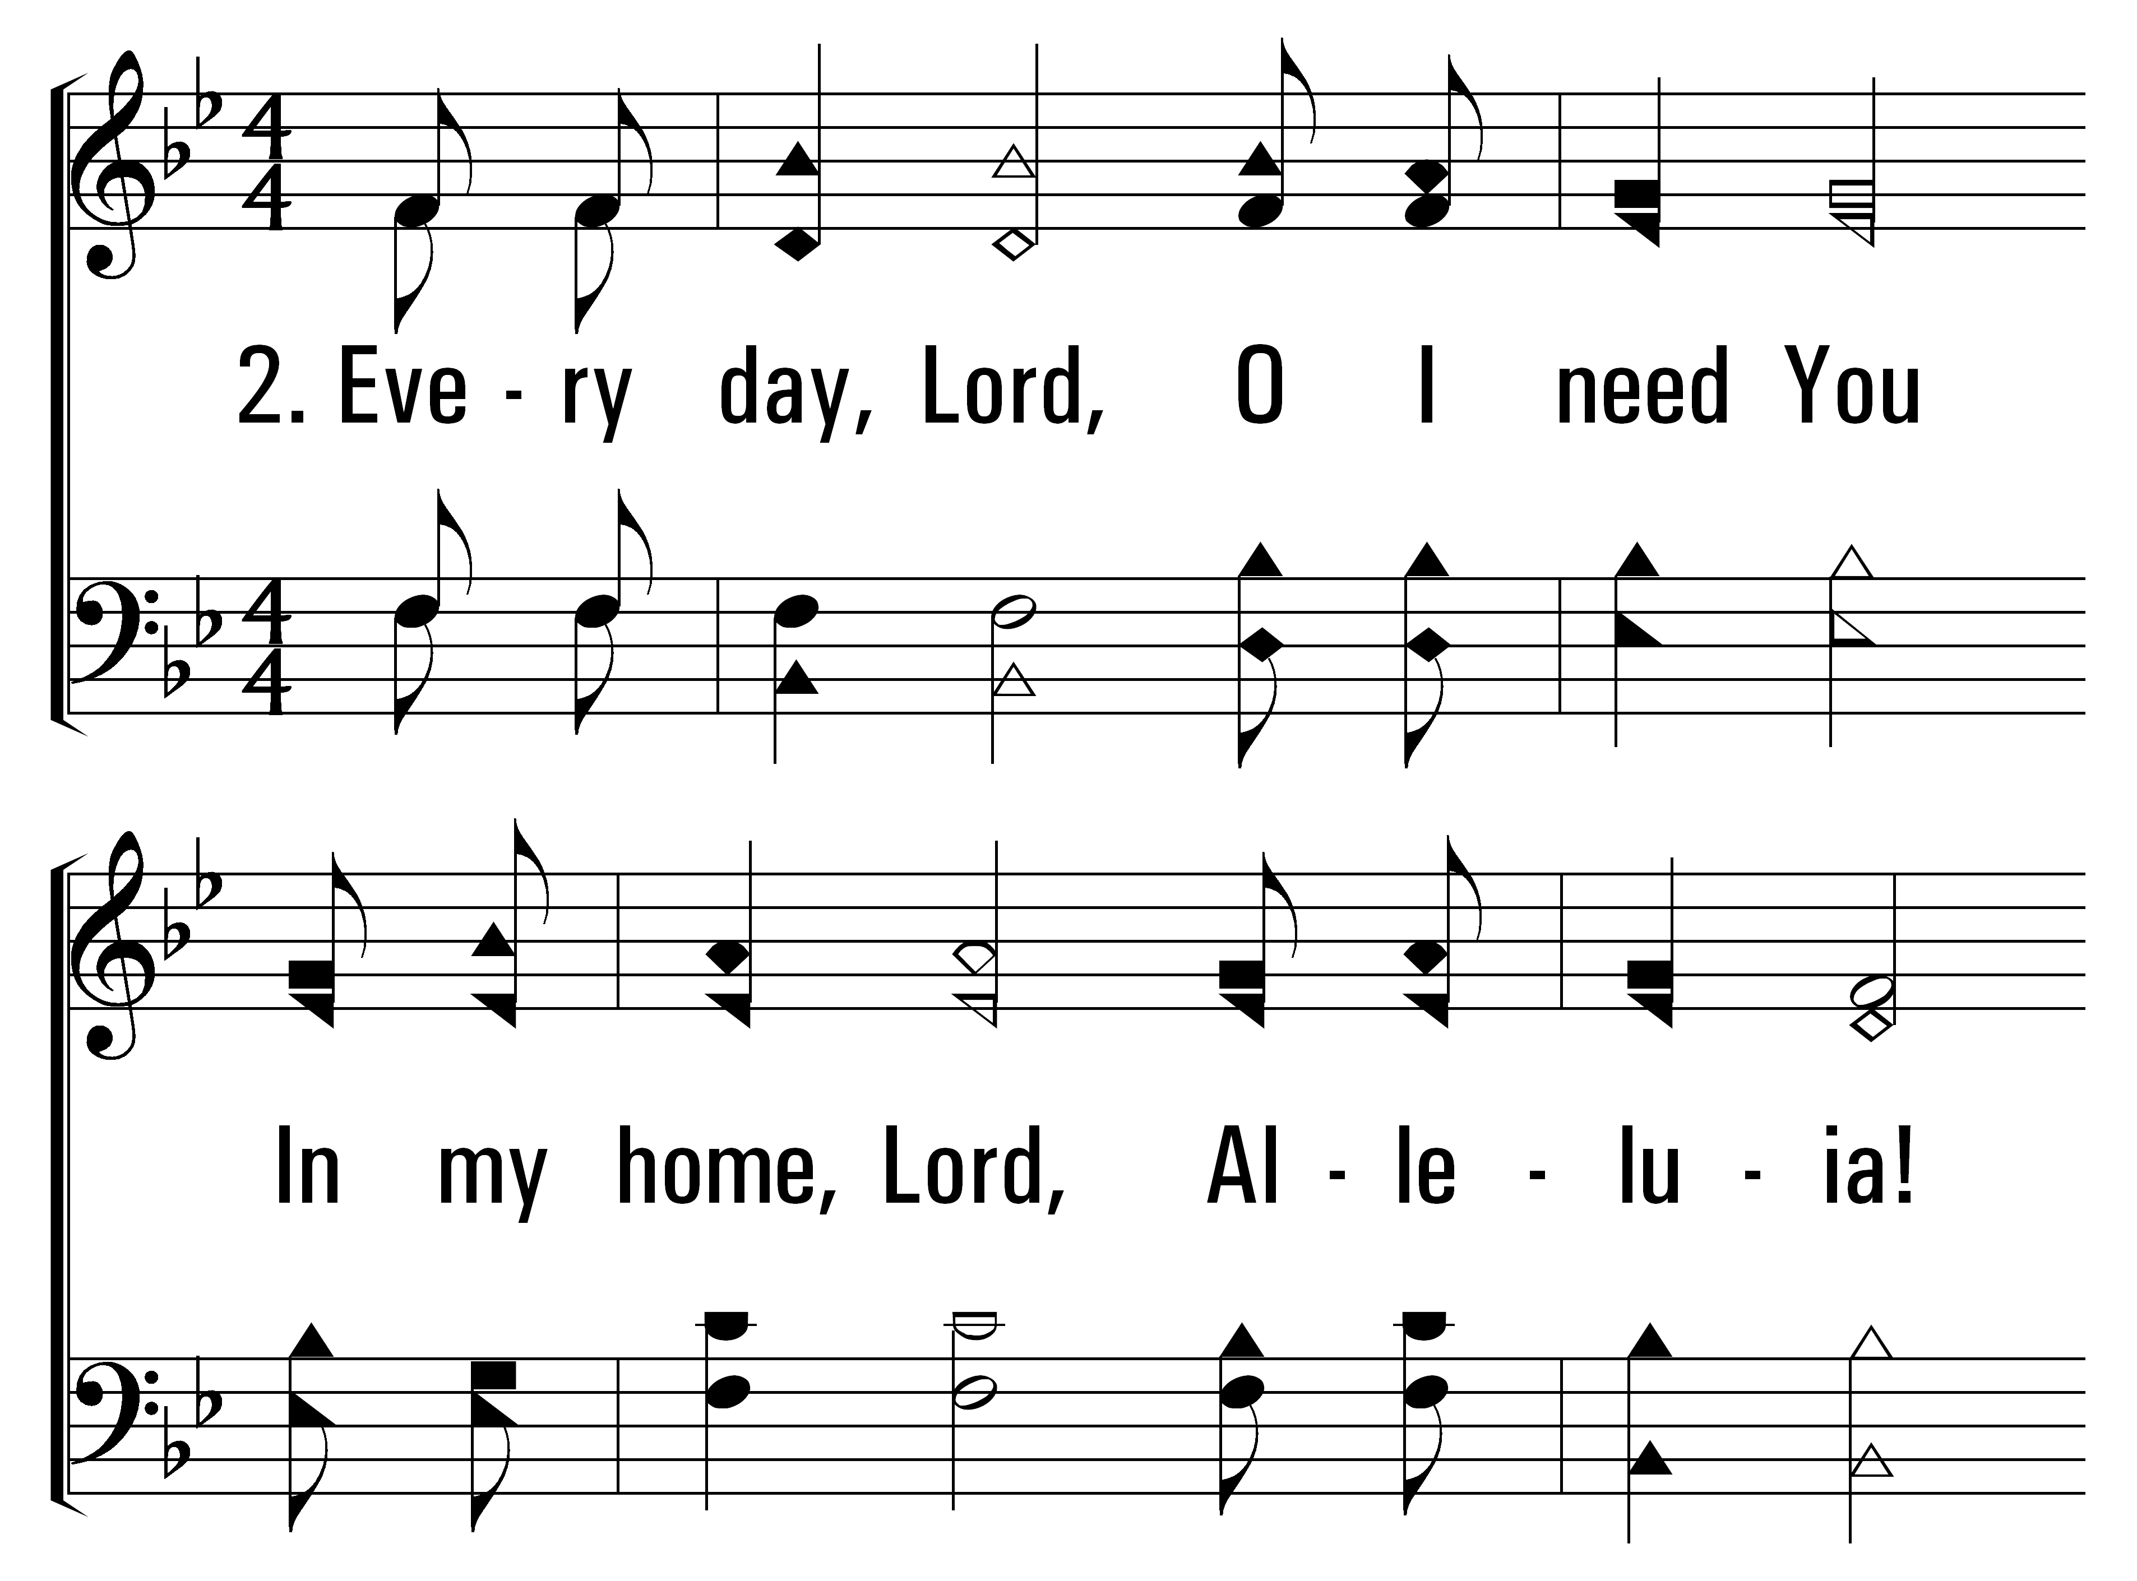
111
1
ALLELUIA!
2
3
4
© 2014 Sumphonia Productions, LLC

Slide 5
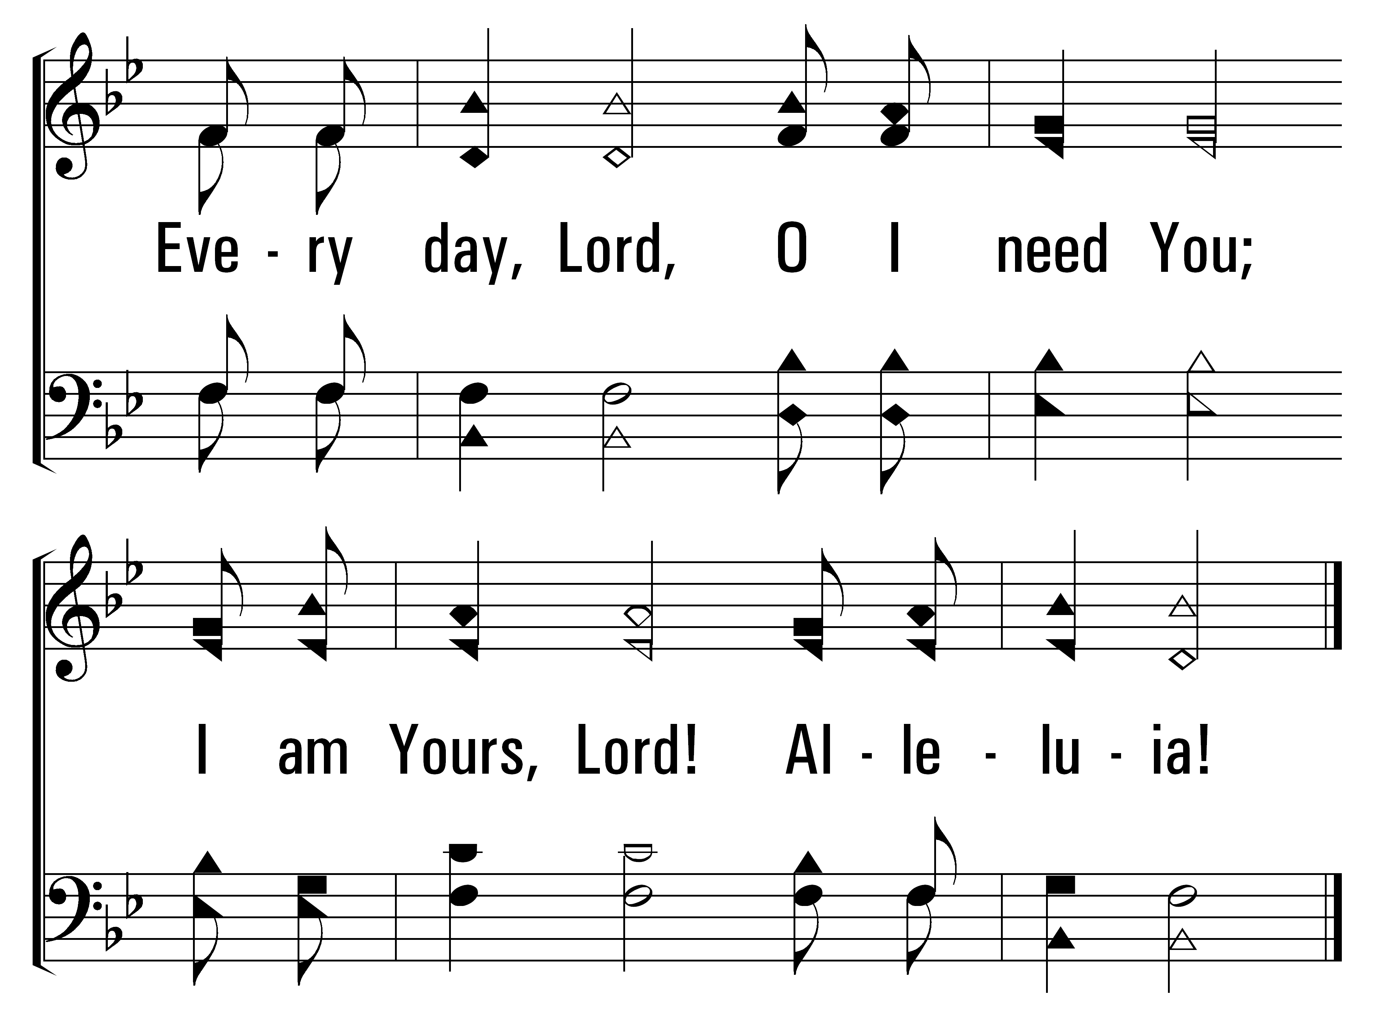
111
1
ALLELUIA!
2
3
4
© 2014 Sumphonia Productions, LLC

Slide 6
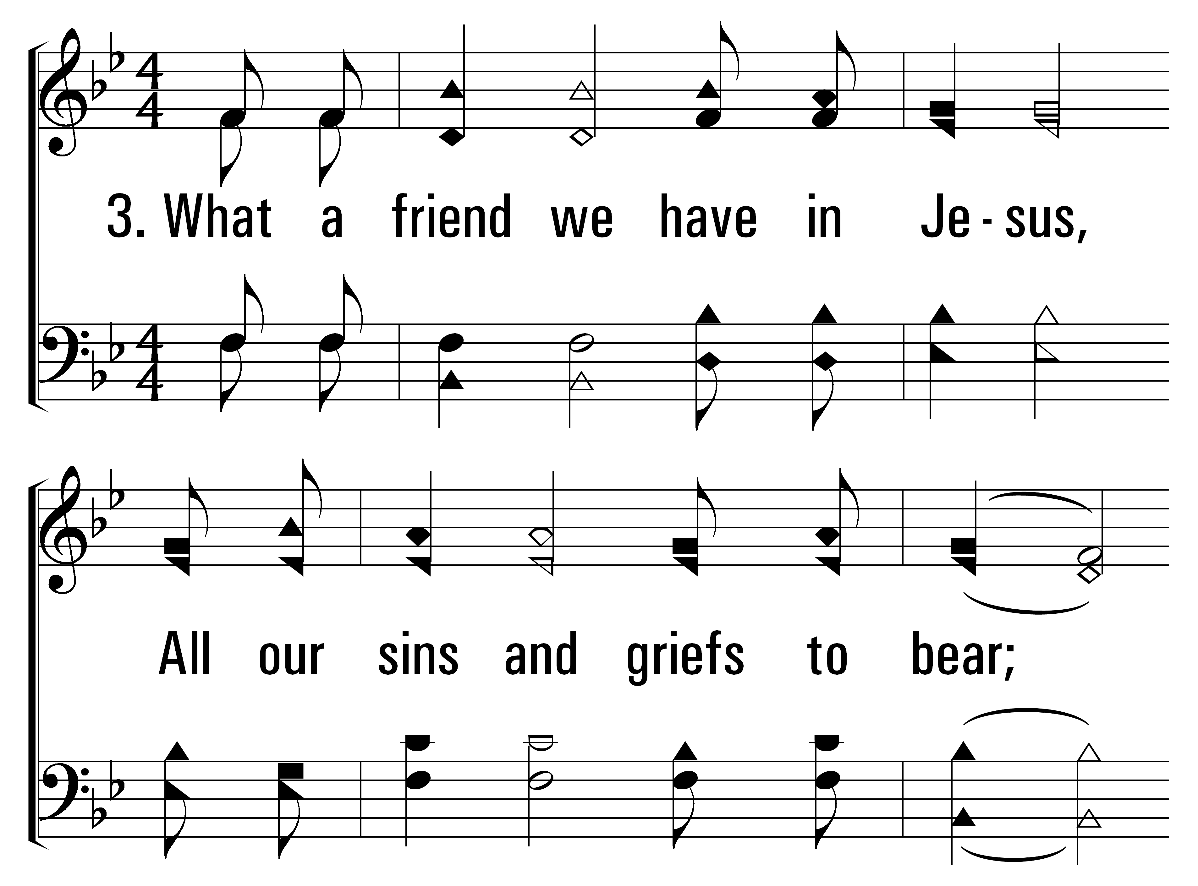
111
1
ALLELUIA!
2
3
4
© 2014 Sumphonia Productions, LLC

Slide 7
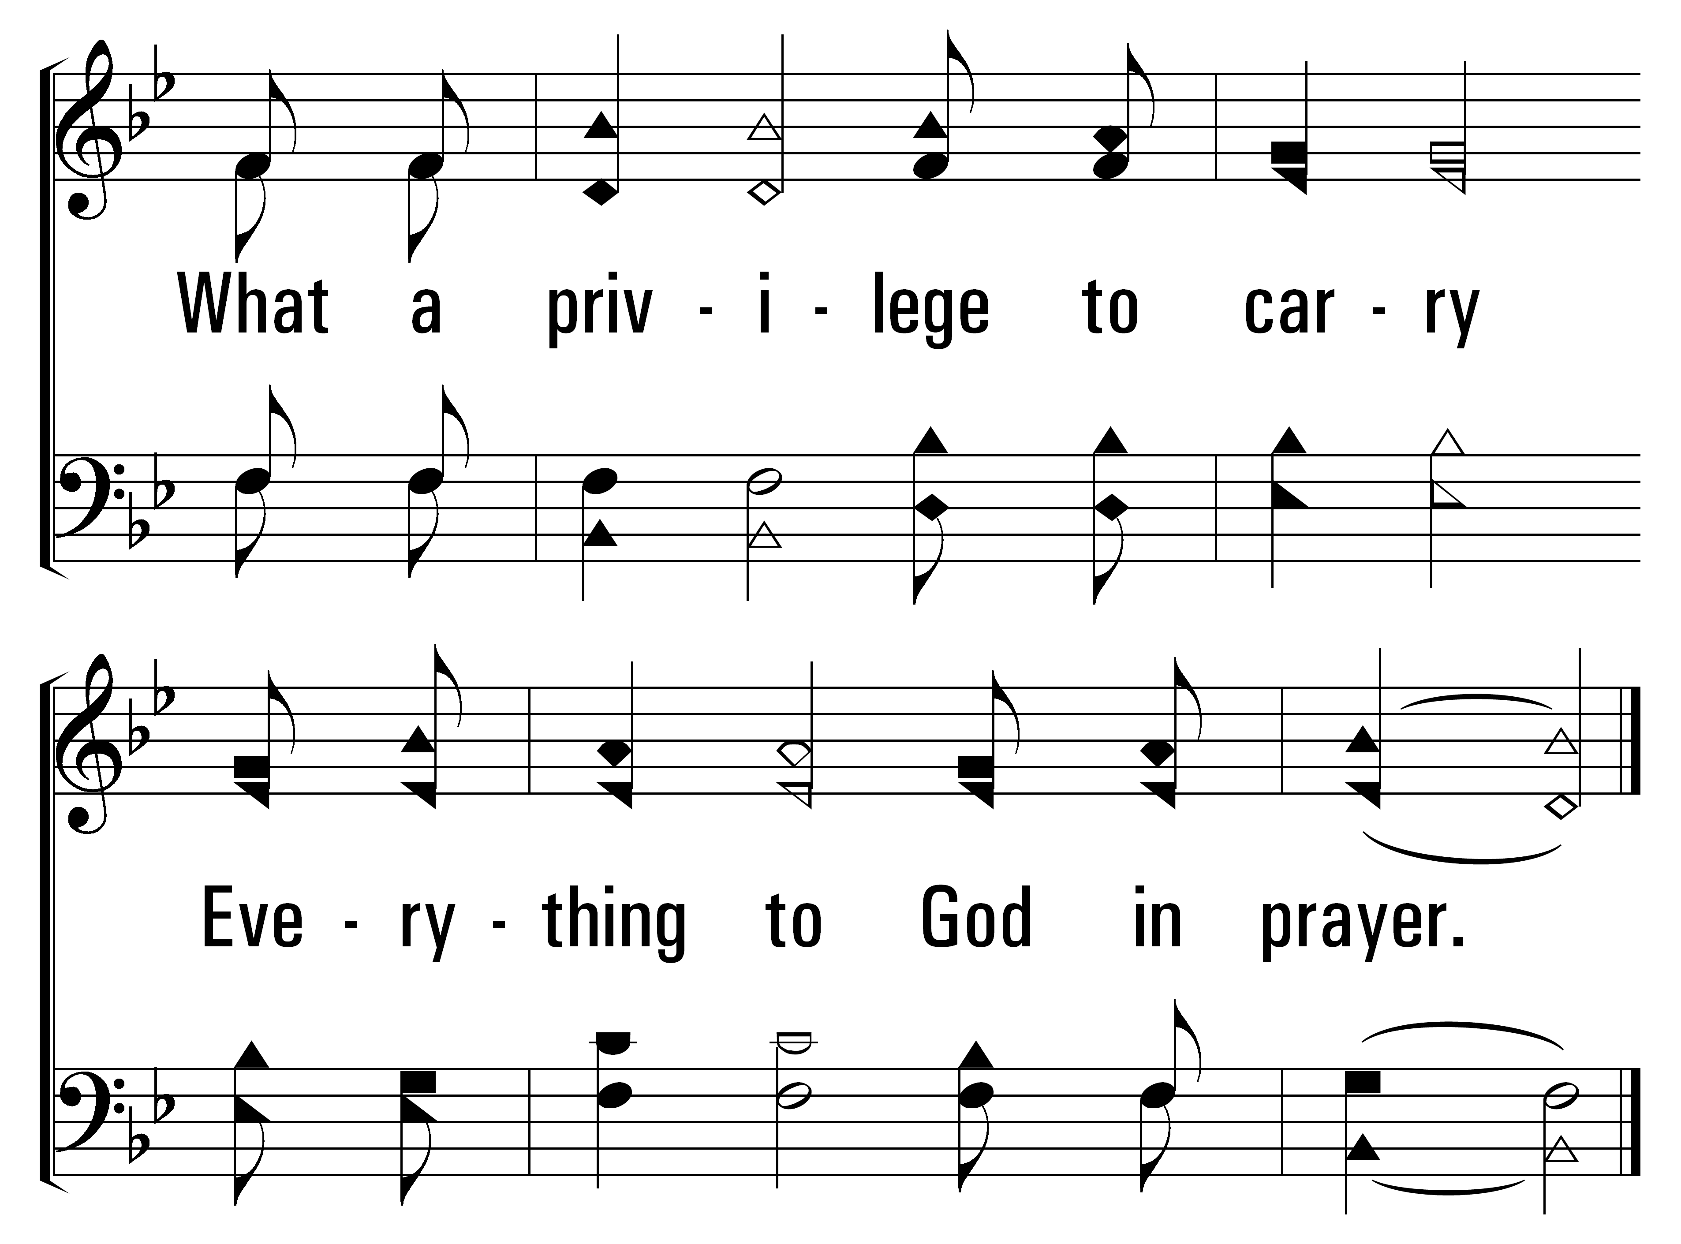
111
1
ALLELUIA!
2
3
4
© 2014 Sumphonia Productions, LLC

Slide 8
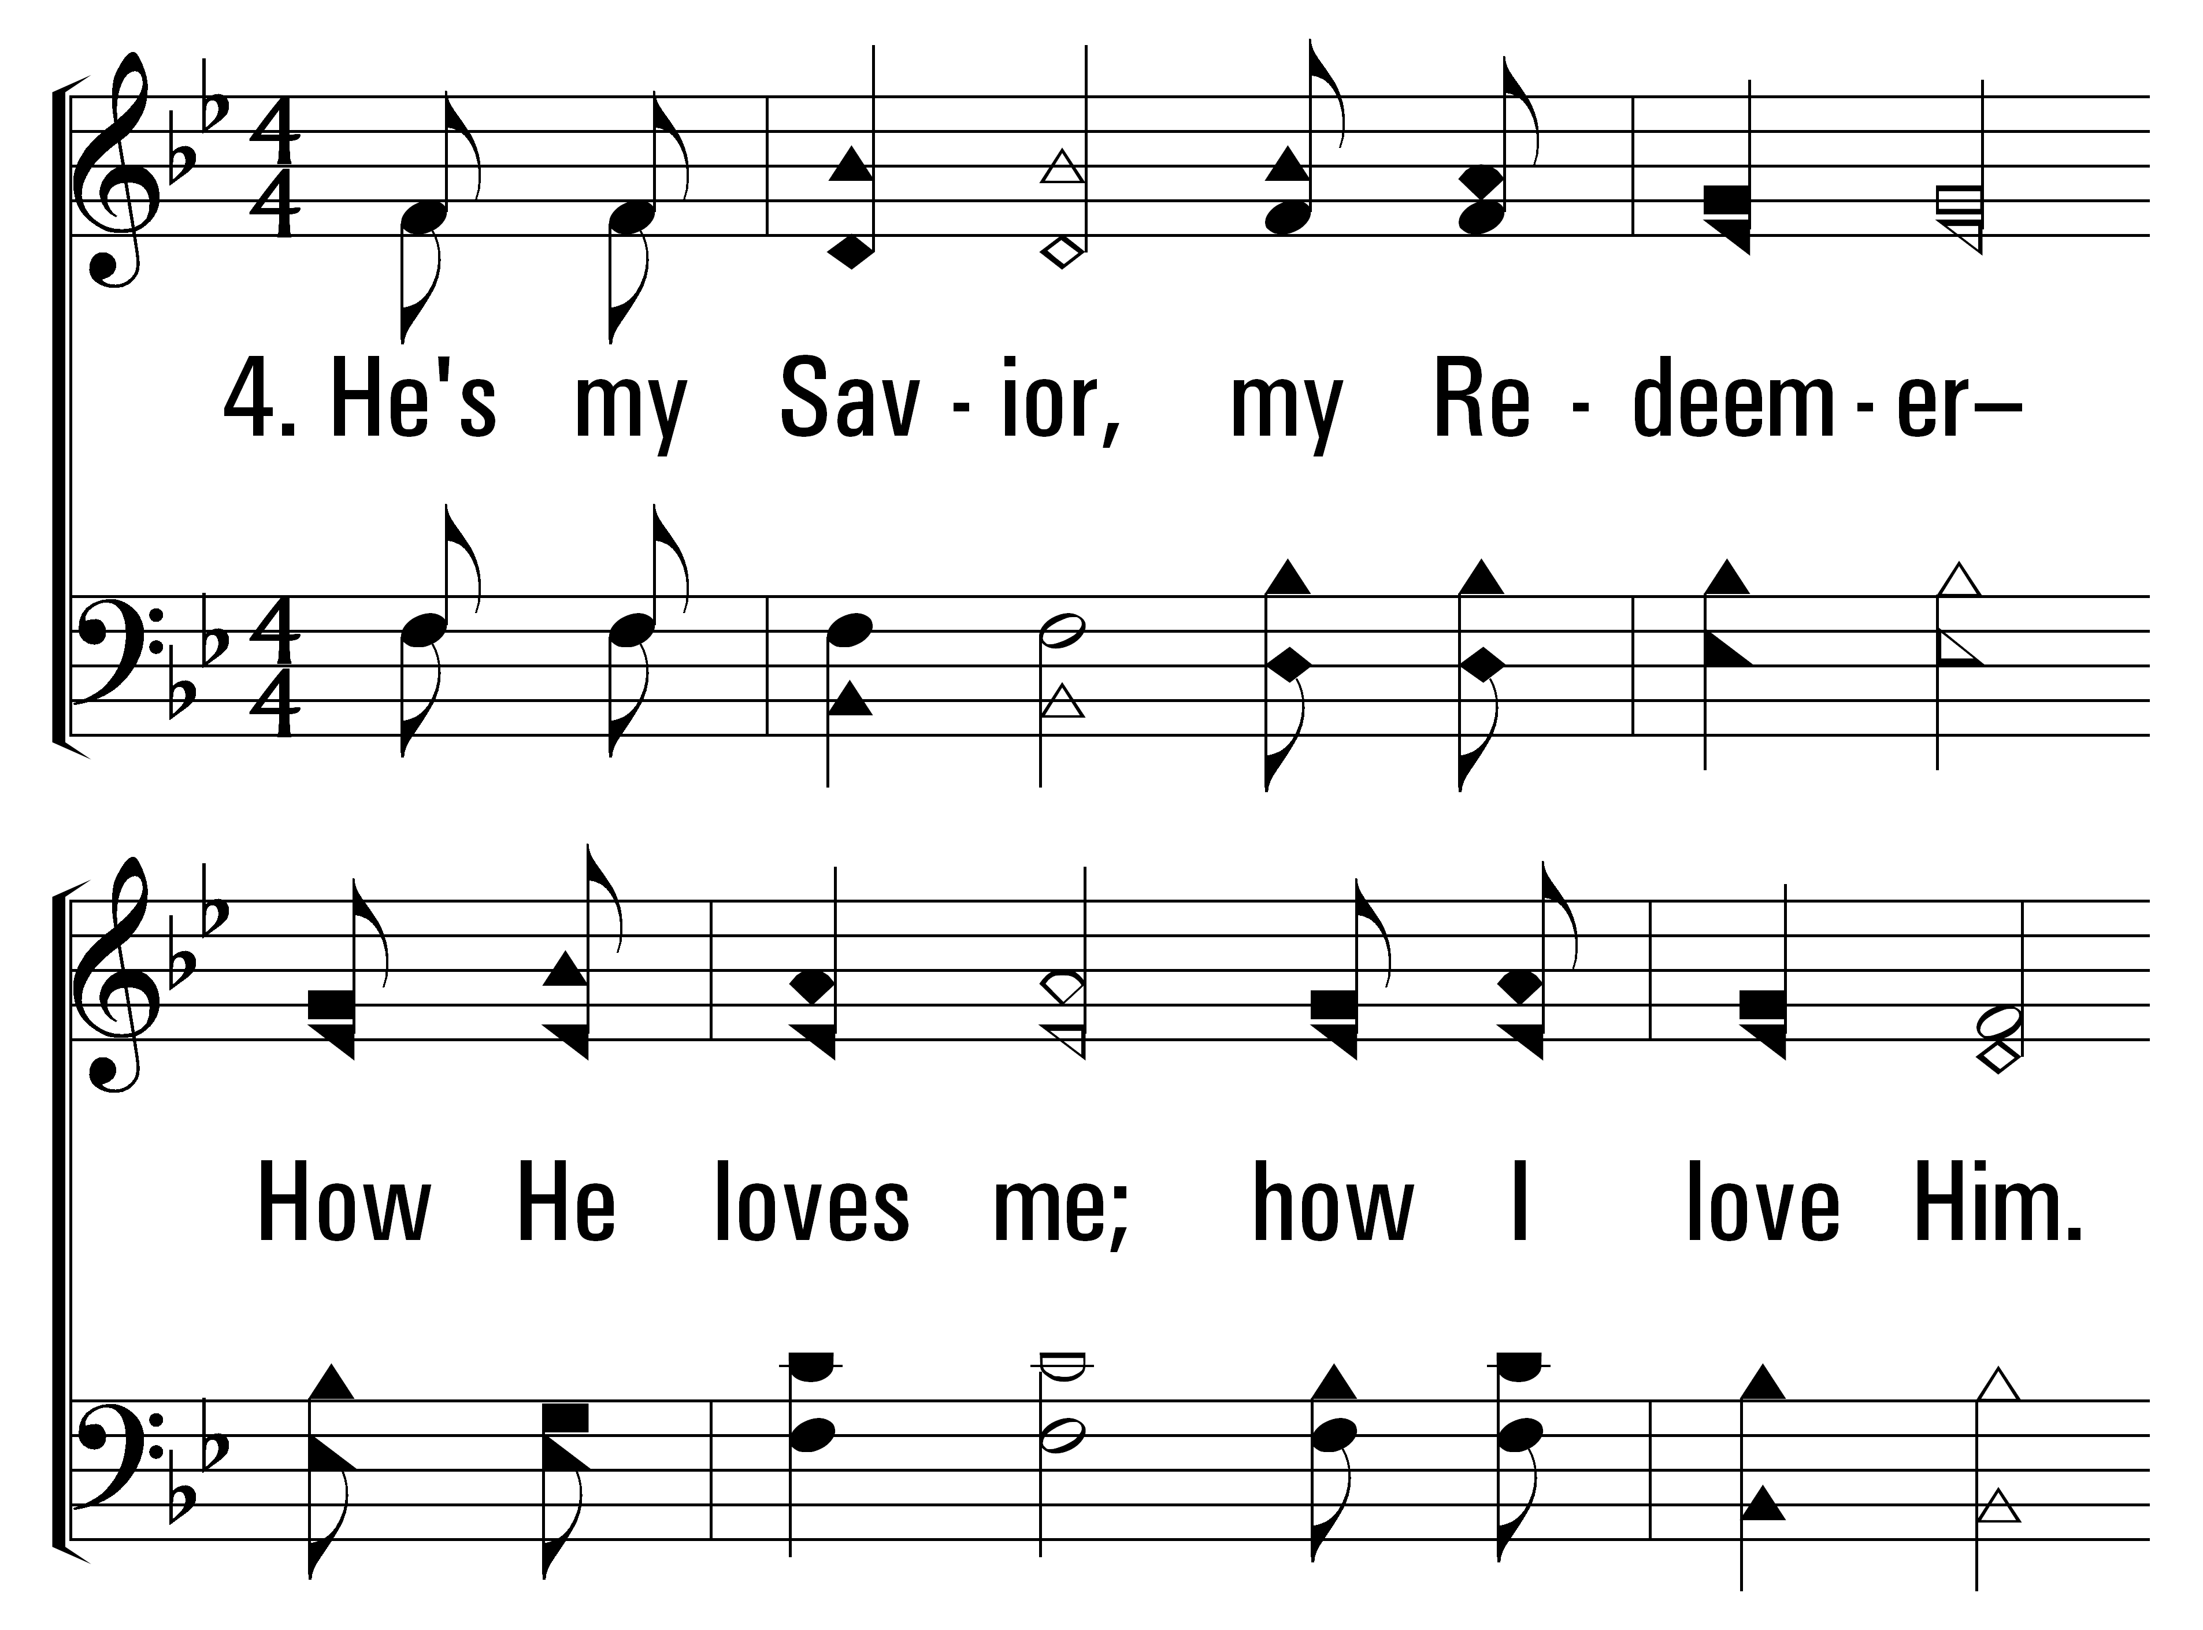
111
1
ALLELUIA!
2
3
4
© 2014 Sumphonia Productions, LLC

Slide 9
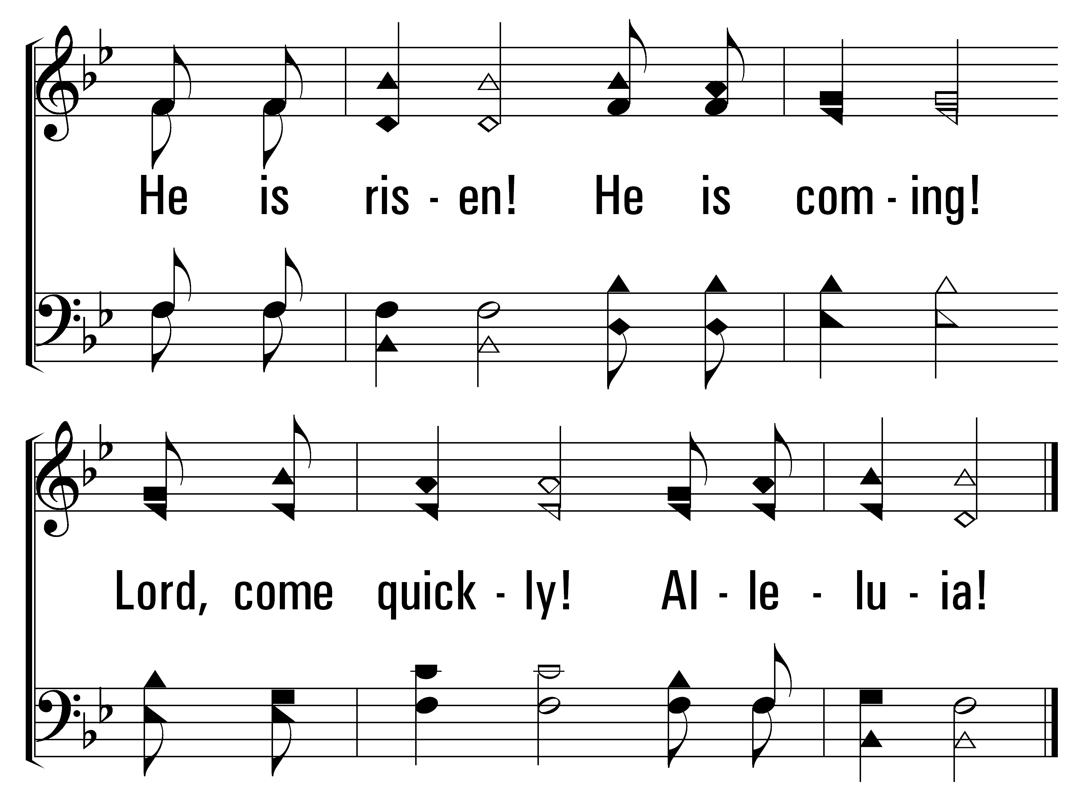
111
1
ALLELUIA!
2
3
4
© 2014 Sumphonia Productions, LLC

