Slide 1


Opening Song
O Thou Fount of Every Blessing
500
1
2
3
Words: Robert Robinson
Music: Wyeth’s Repository of Sacred Music

Slide 2

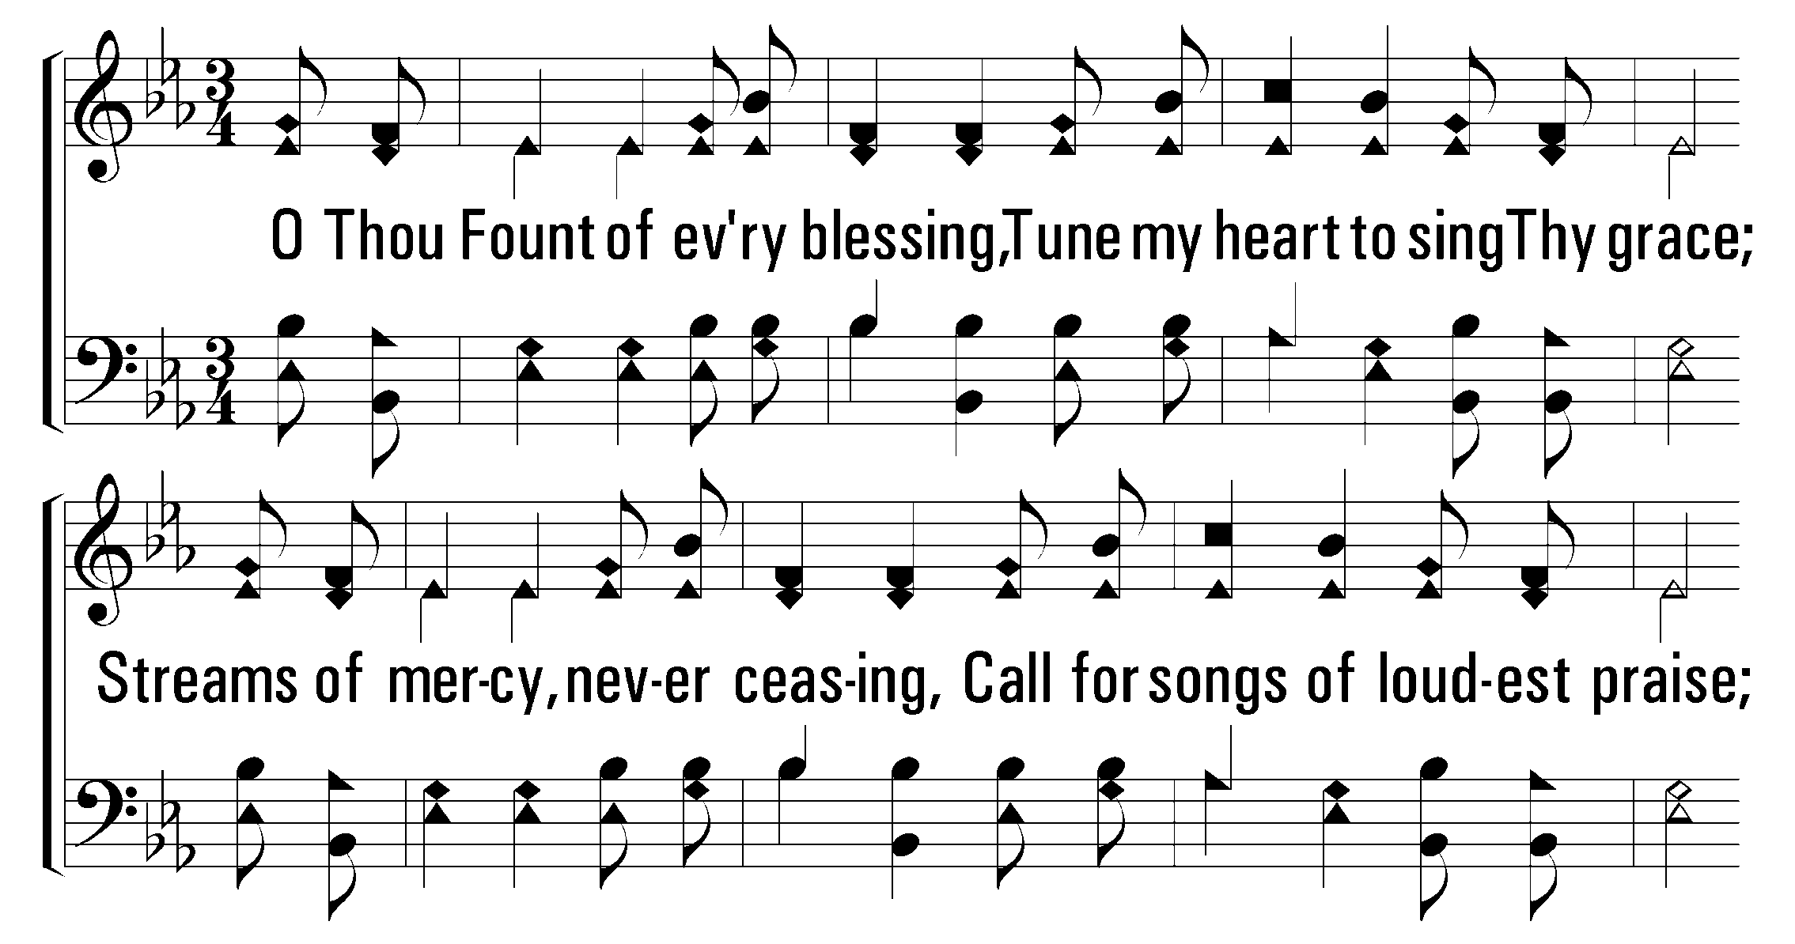

1
2
3
500
O Thou Fount of Every Blessing
© 2001 The Paperless Hymnal™

Slide 3
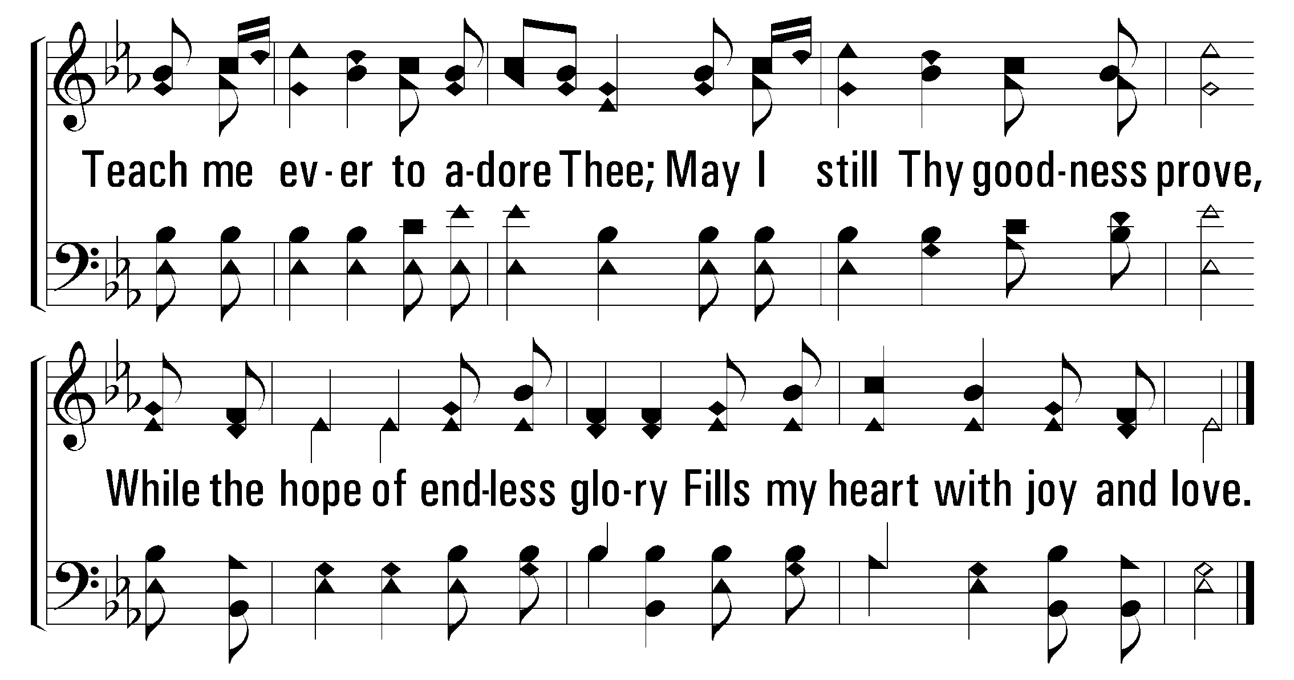
1
2
3
500
O Thou Fount of Every Blessing
© 2001 The Paperless Hymnal™

Slide 4
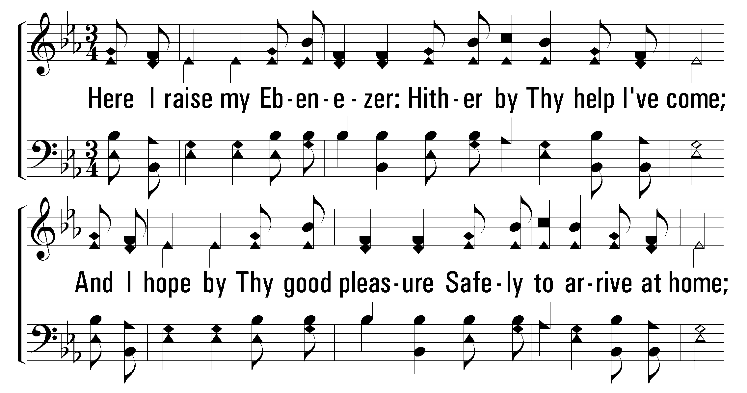
1
2
3
500
O Thou Fount of Every Blessing
© 2001 The Paperless Hymnal™

Slide 5
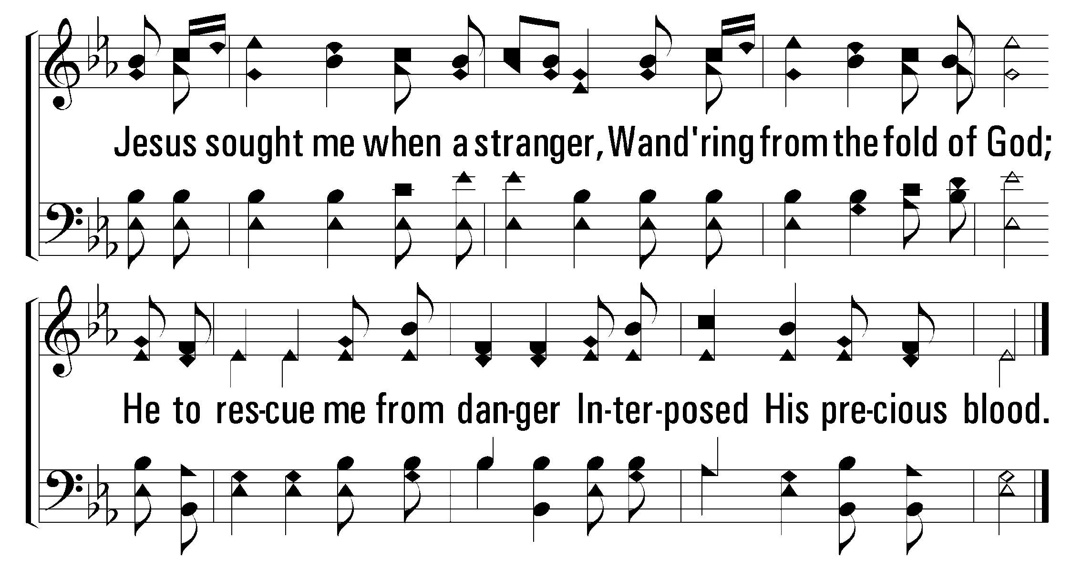
1
2
3
500
O Thou Fount of Every Blessing
© 2001 The Paperless Hymnal™

Slide 6
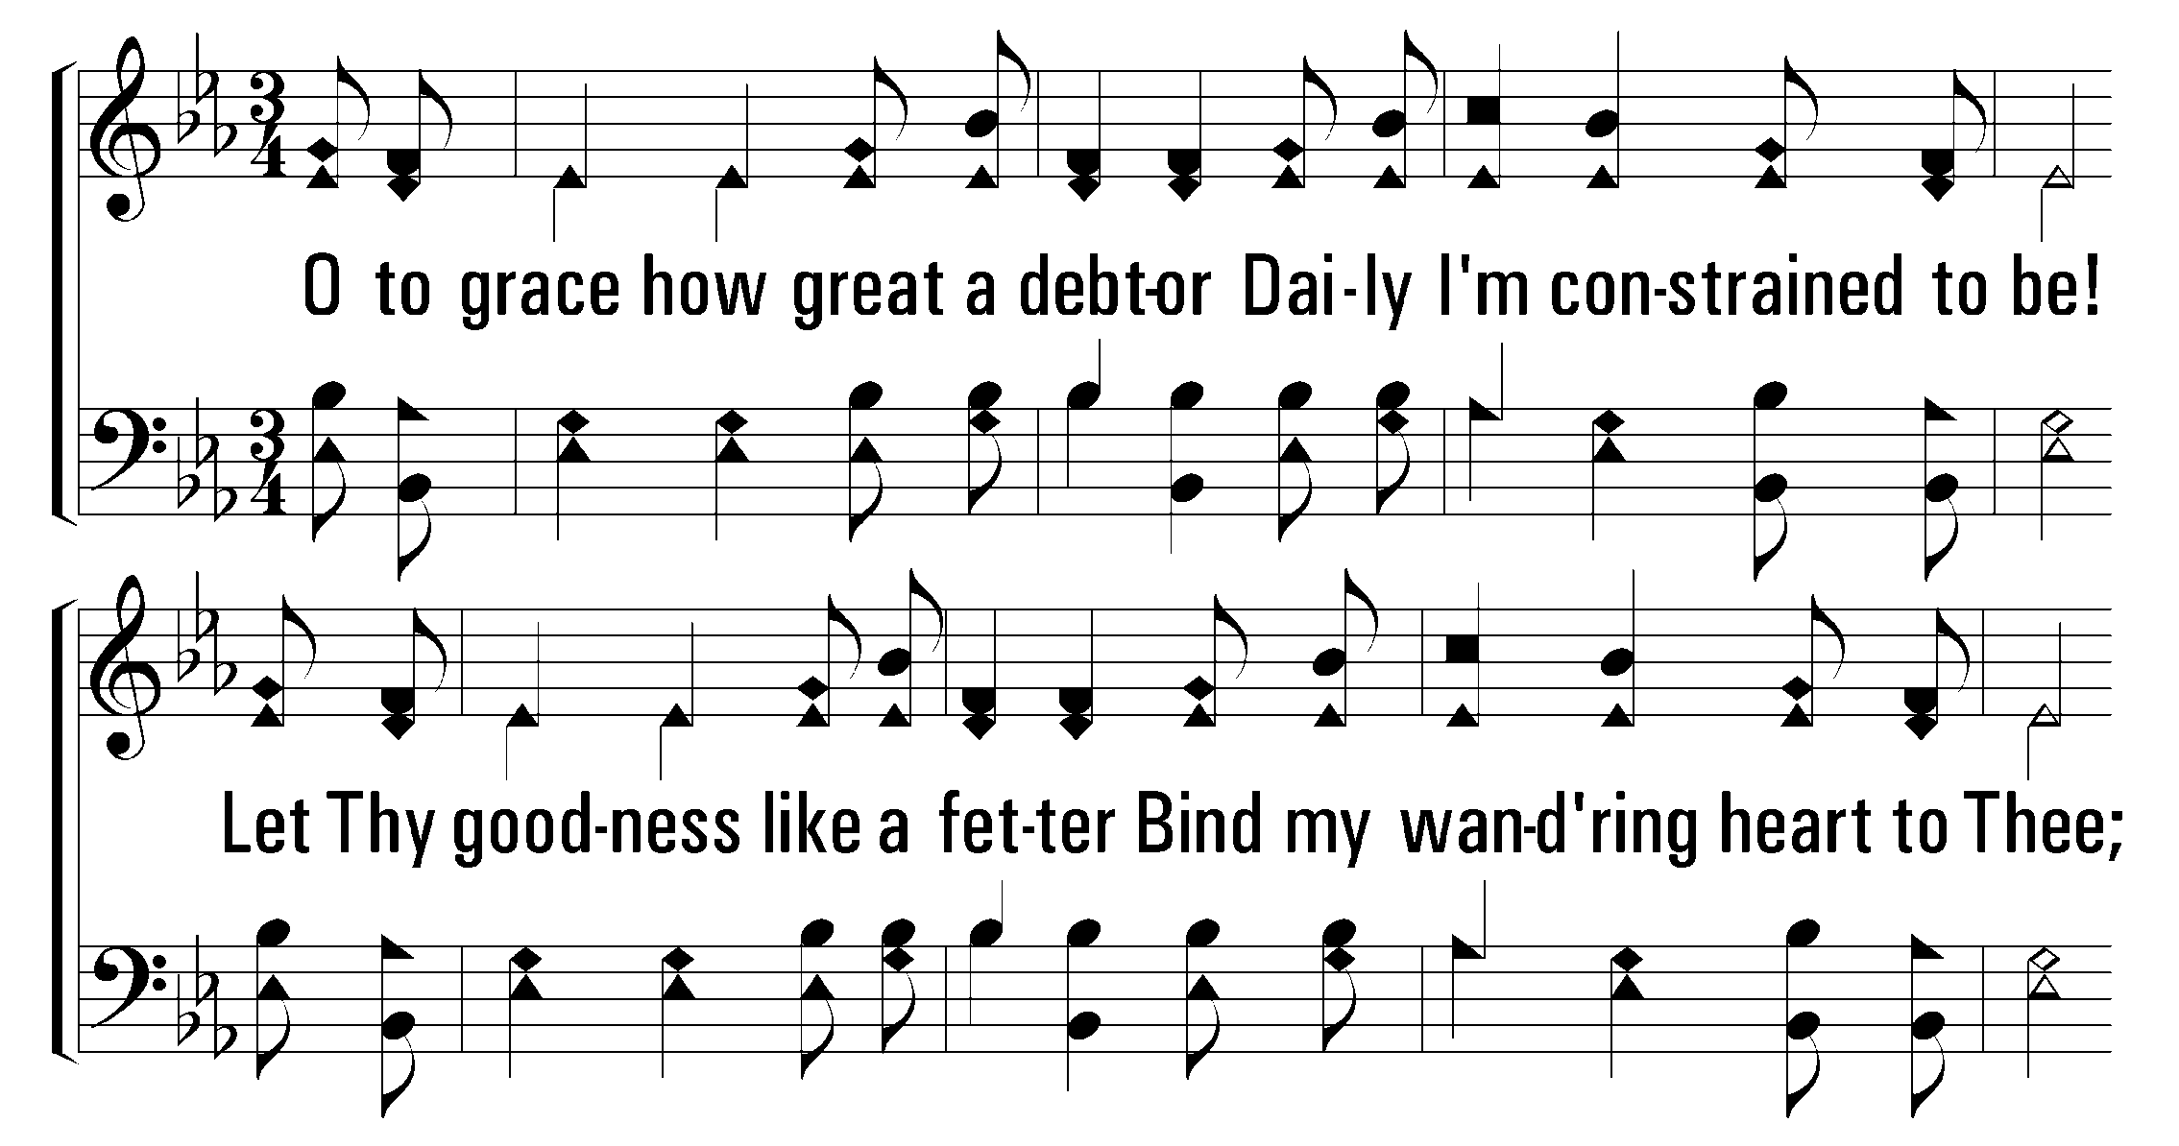
1
2
3
500
O Thou Fount of Every Blessing
© 2001 The Paperless Hymnal™

Slide 7
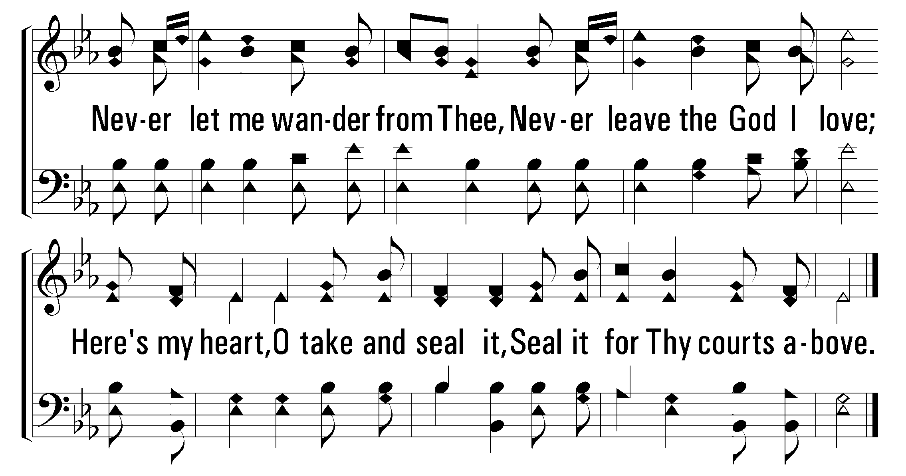
1
2
3
500
O Thou Fount of Every Blessing
© 2001 The Paperless Hymnal™

