Slide 1
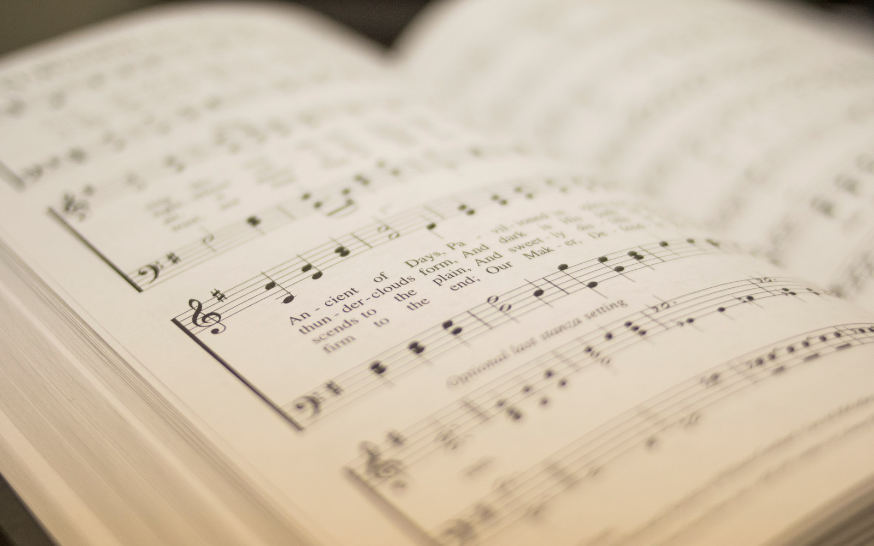

200
HALLELUJAH, PRAISE JEHOVAH
1
2
3
“SINGING...TO THE LORD” COLOSSIANS 3:16
Words and Music by: William J. Kirkpatrick

Slide 2
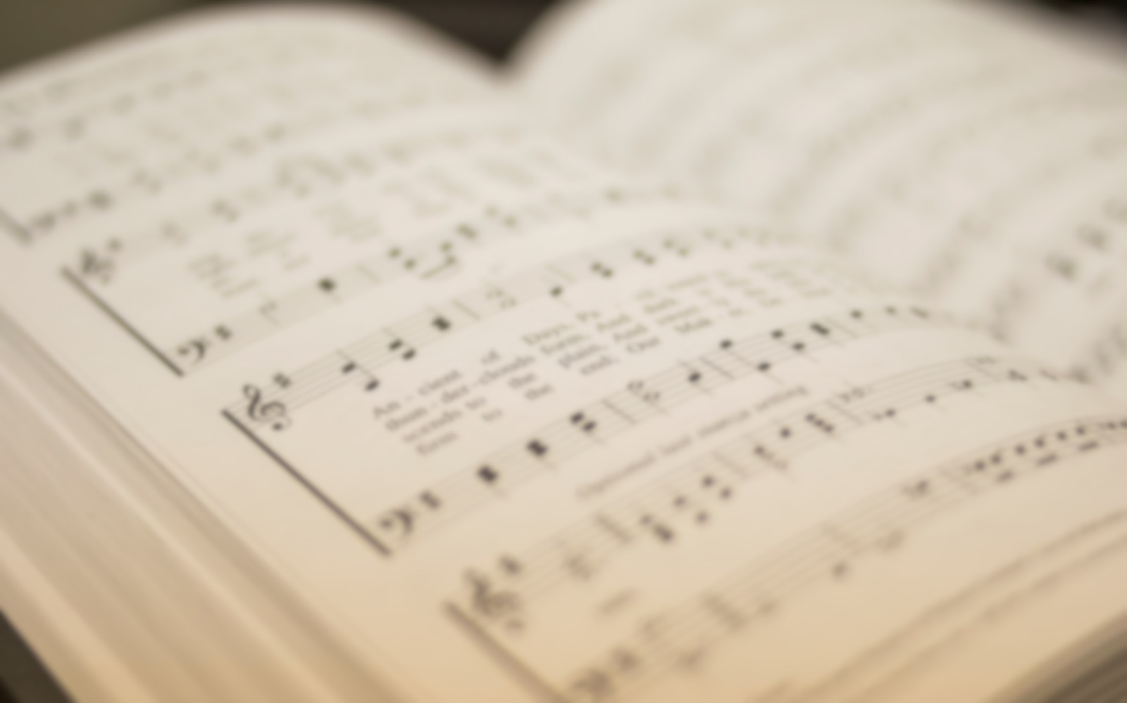
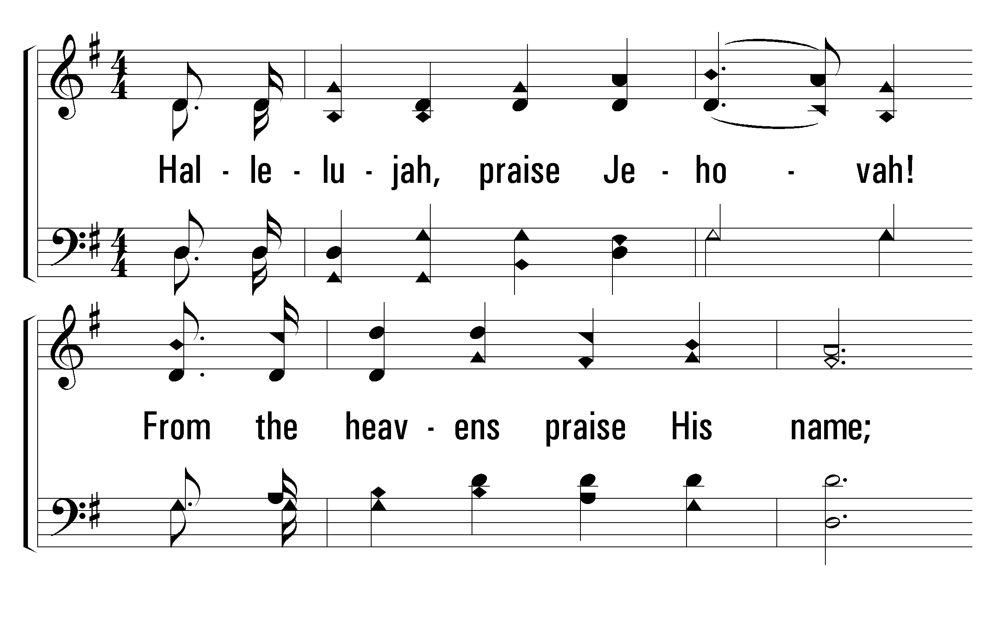


1
C
2
C
3
C
200
HALLELUJAH, PRAISE JEHOVAH
© 2001 The Paperless Hymnal™

Slide 3
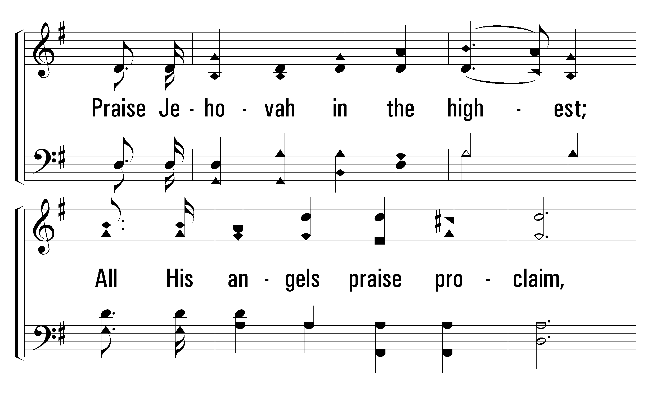
1
C
2
C
3
C
200
HALLELUJAH, PRAISE JEHOVAH
© 2001 The Paperless Hymnal™

Slide 4
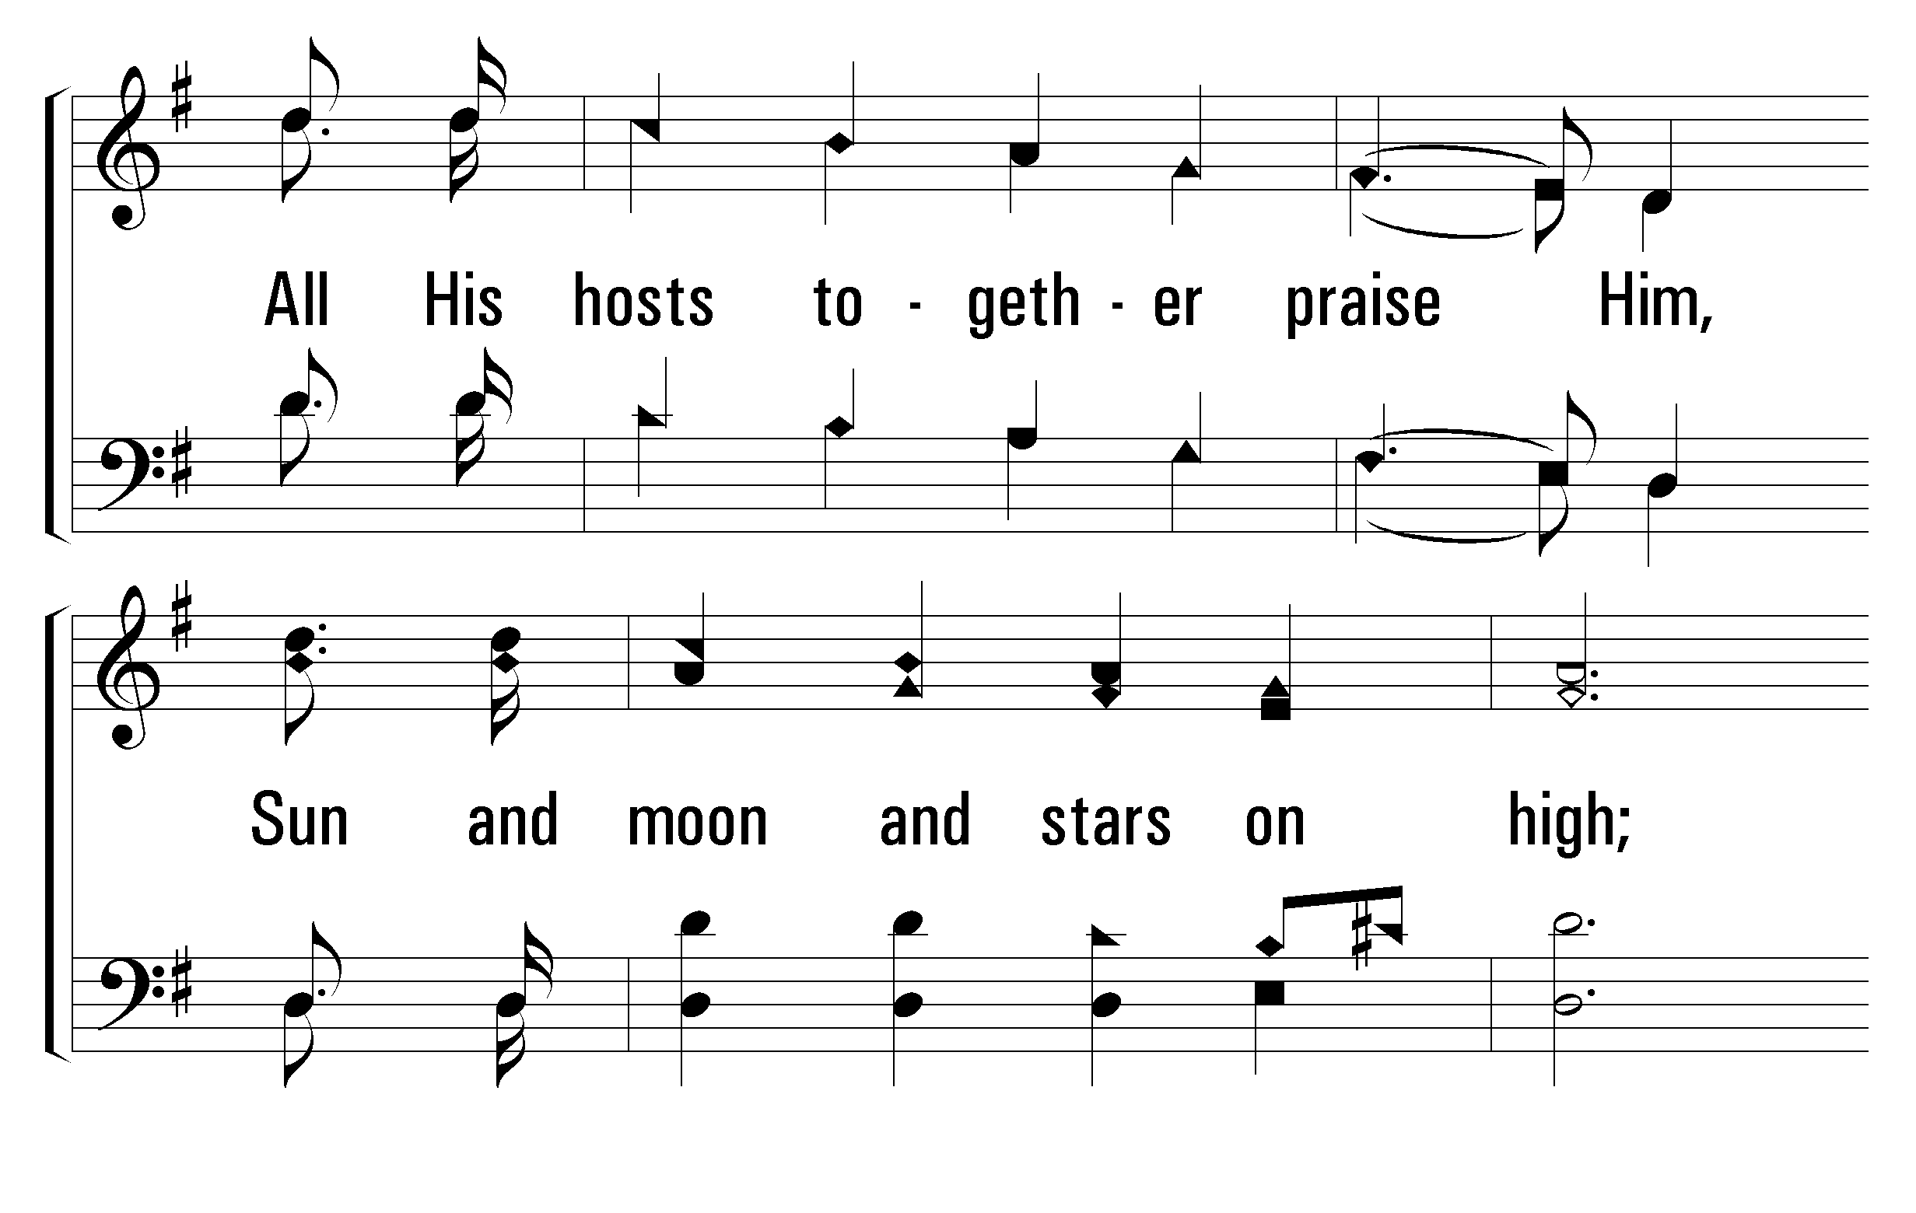
1
C
2
C
3
C
200
HALLELUJAH, PRAISE JEHOVAH
© 2001 The Paperless Hymnal™

Slide 5
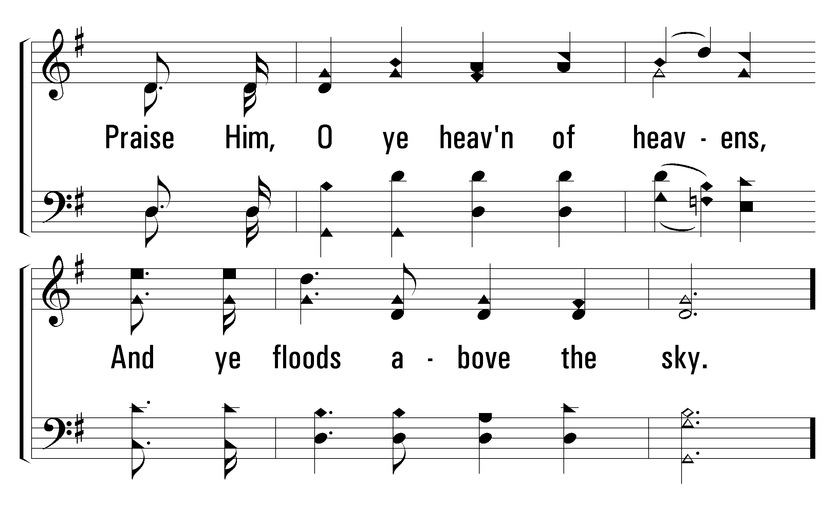
1
C
2
C
3
C
200
HALLELUJAH, PRAISE JEHOVAH
© 2001 The Paperless Hymnal™

Slide 6
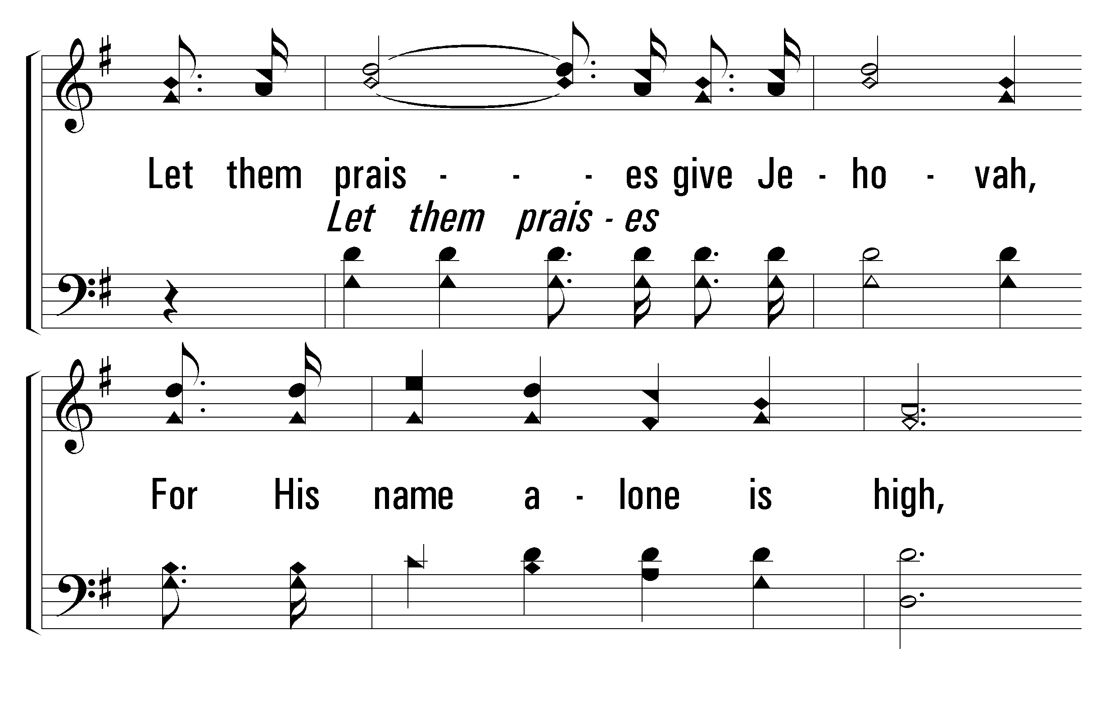
1
C
2
C
3
C
200
HALLELUJAH, PRAISE JEHOVAH
© 2001 The Paperless Hymnal™

Slide 7
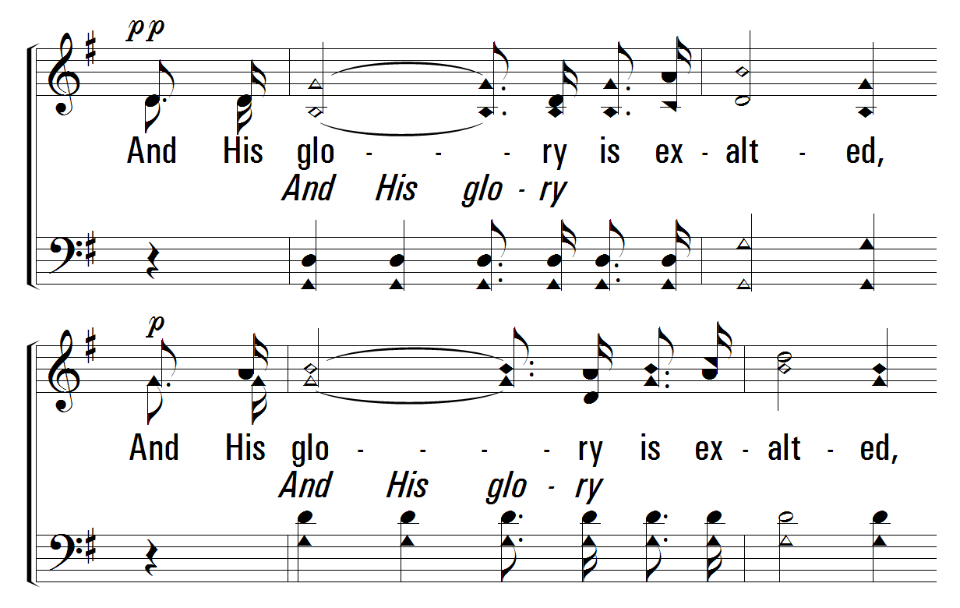
1
C
2
C
3
C
200
HALLELUJAH, PRAISE JEHOVAH
© 2001 The Paperless Hymnal™

Slide 8
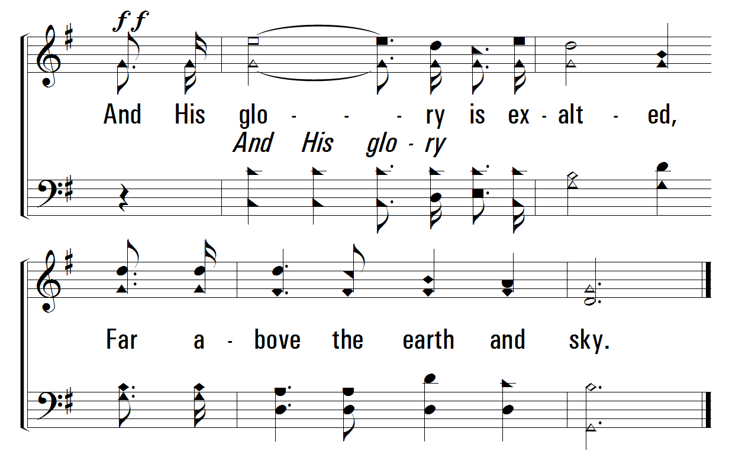
1
C
2
C
3
C
200
HALLELUJAH, PRAISE JEHOVAH
© 2001 The Paperless Hymnal™

Slide 9
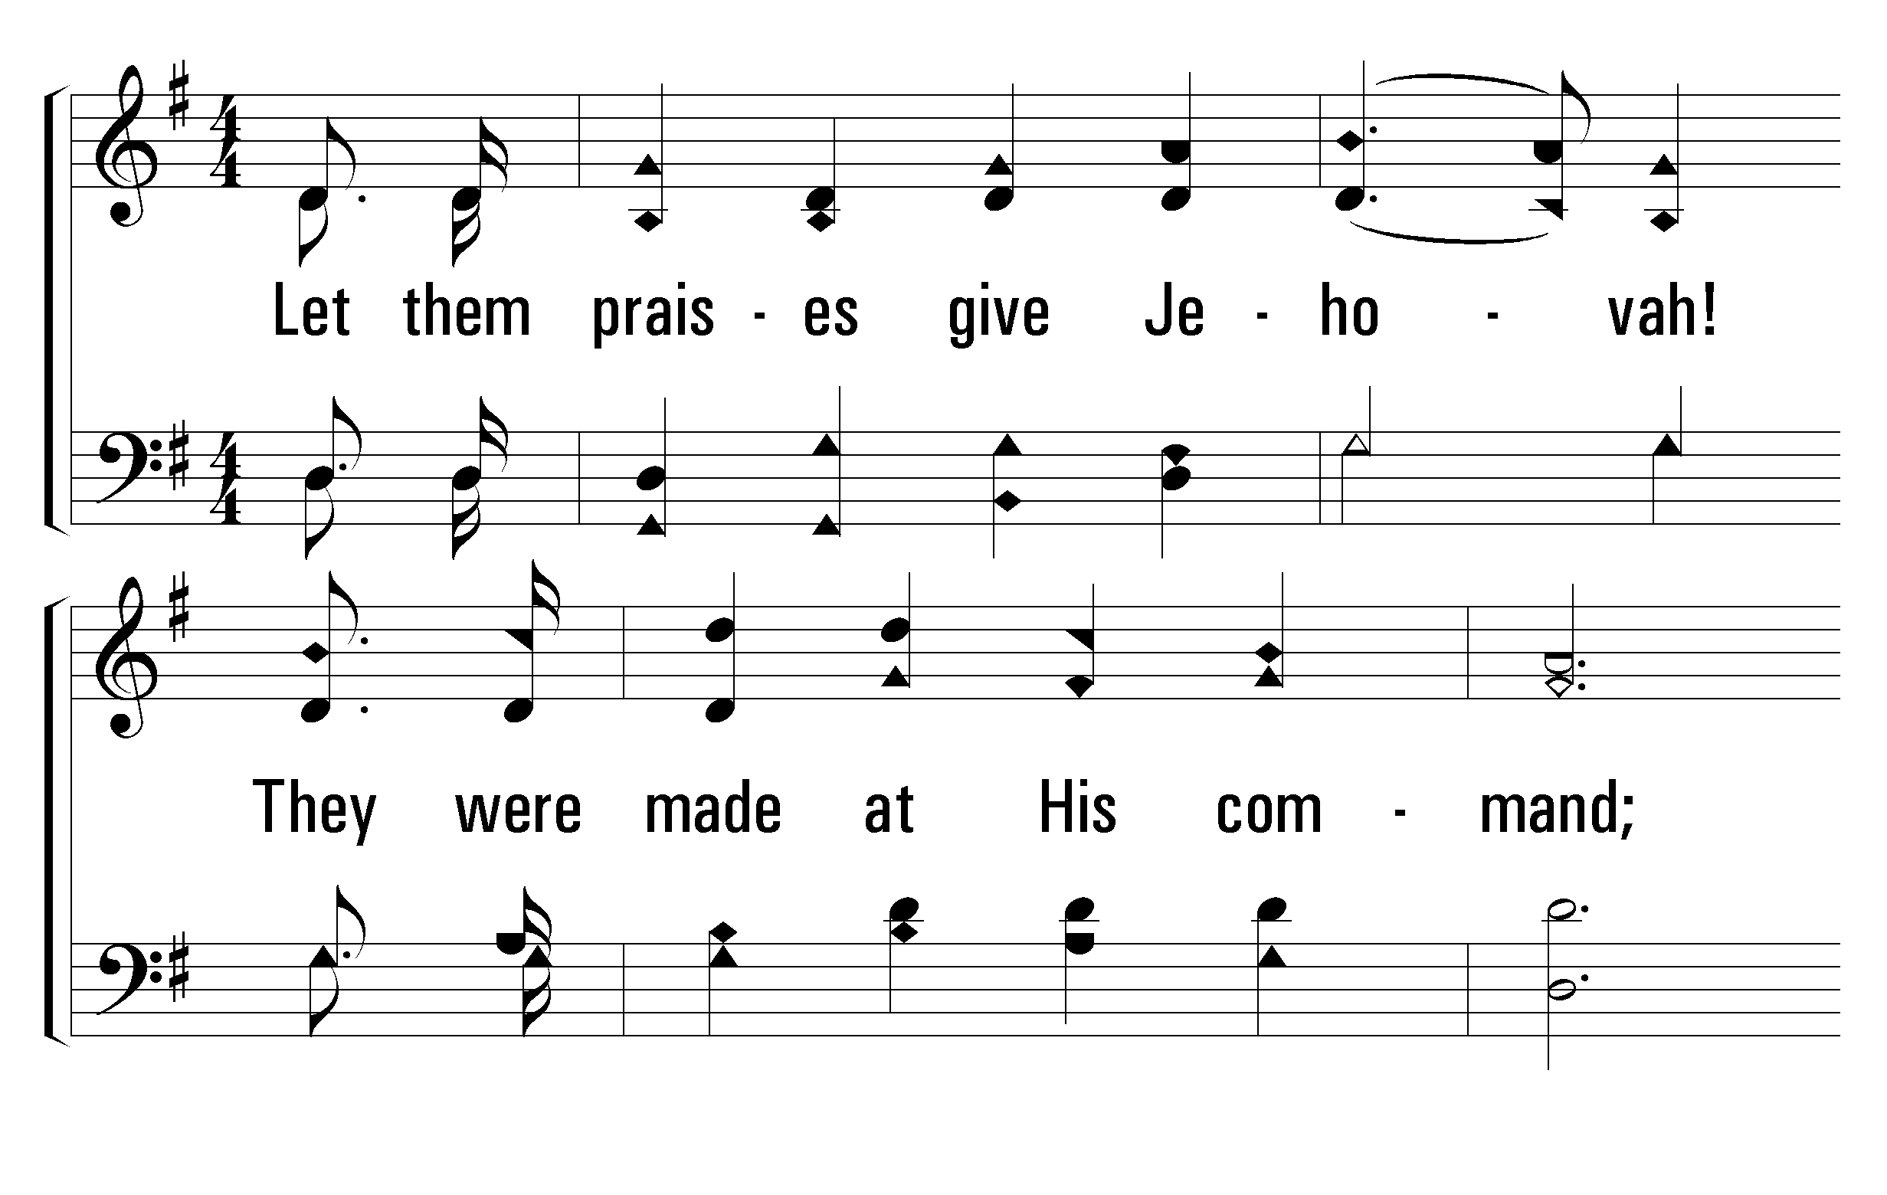
1
C
2
C
3
C
200
HALLELUJAH, PRAISE JEHOVAH
© 2001 The Paperless Hymnal™

Slide 10
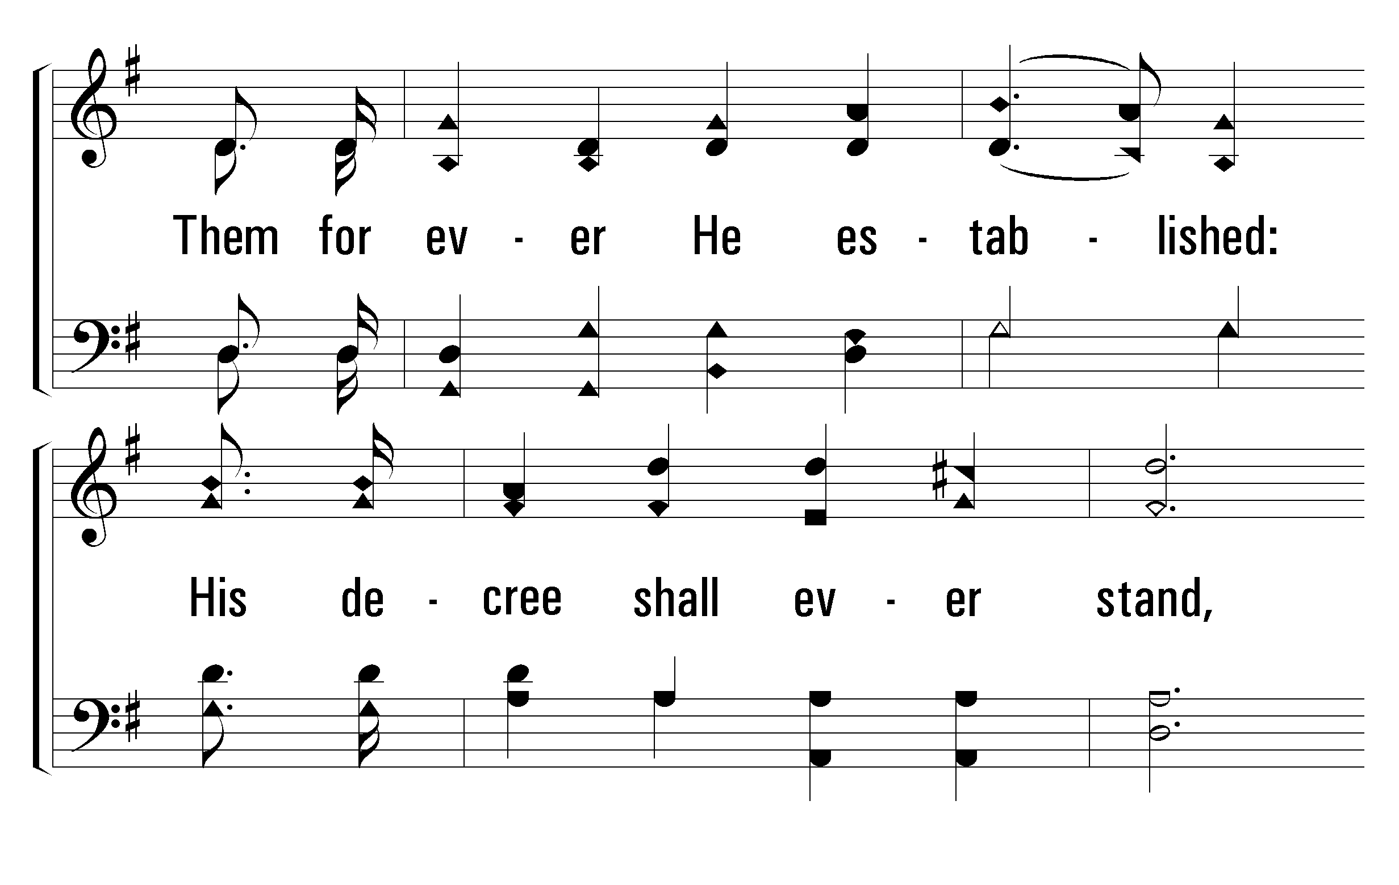
1
C
2
C
3
C
200
HALLELUJAH, PRAISE JEHOVAH
© 2001 The Paperless Hymnal™

Slide 11
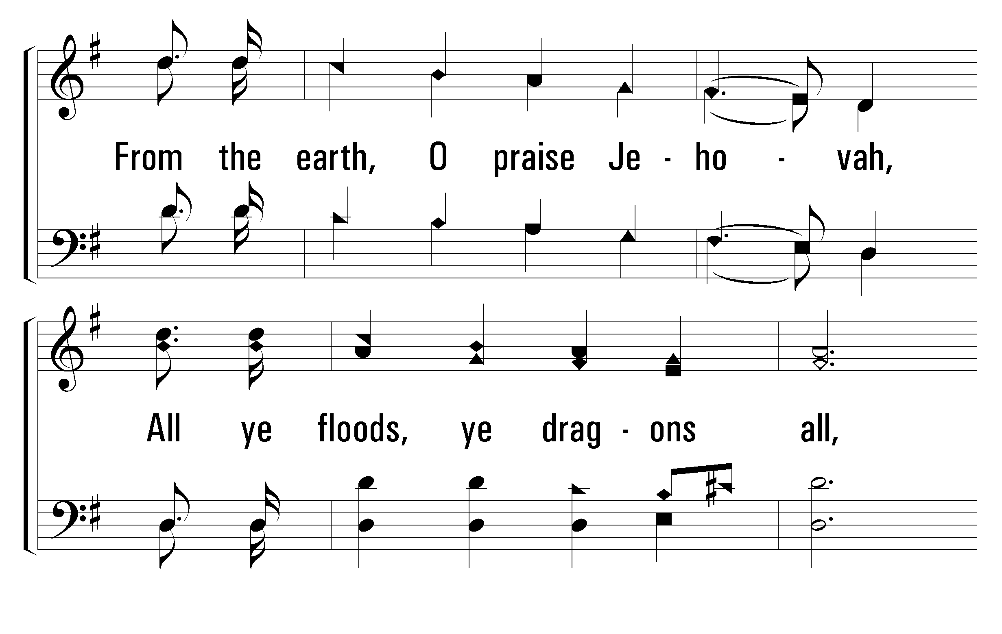
1
C
2
C
3
C
200
HALLELUJAH, PRAISE JEHOVAH
© 2001 The Paperless Hymnal™

Slide 12
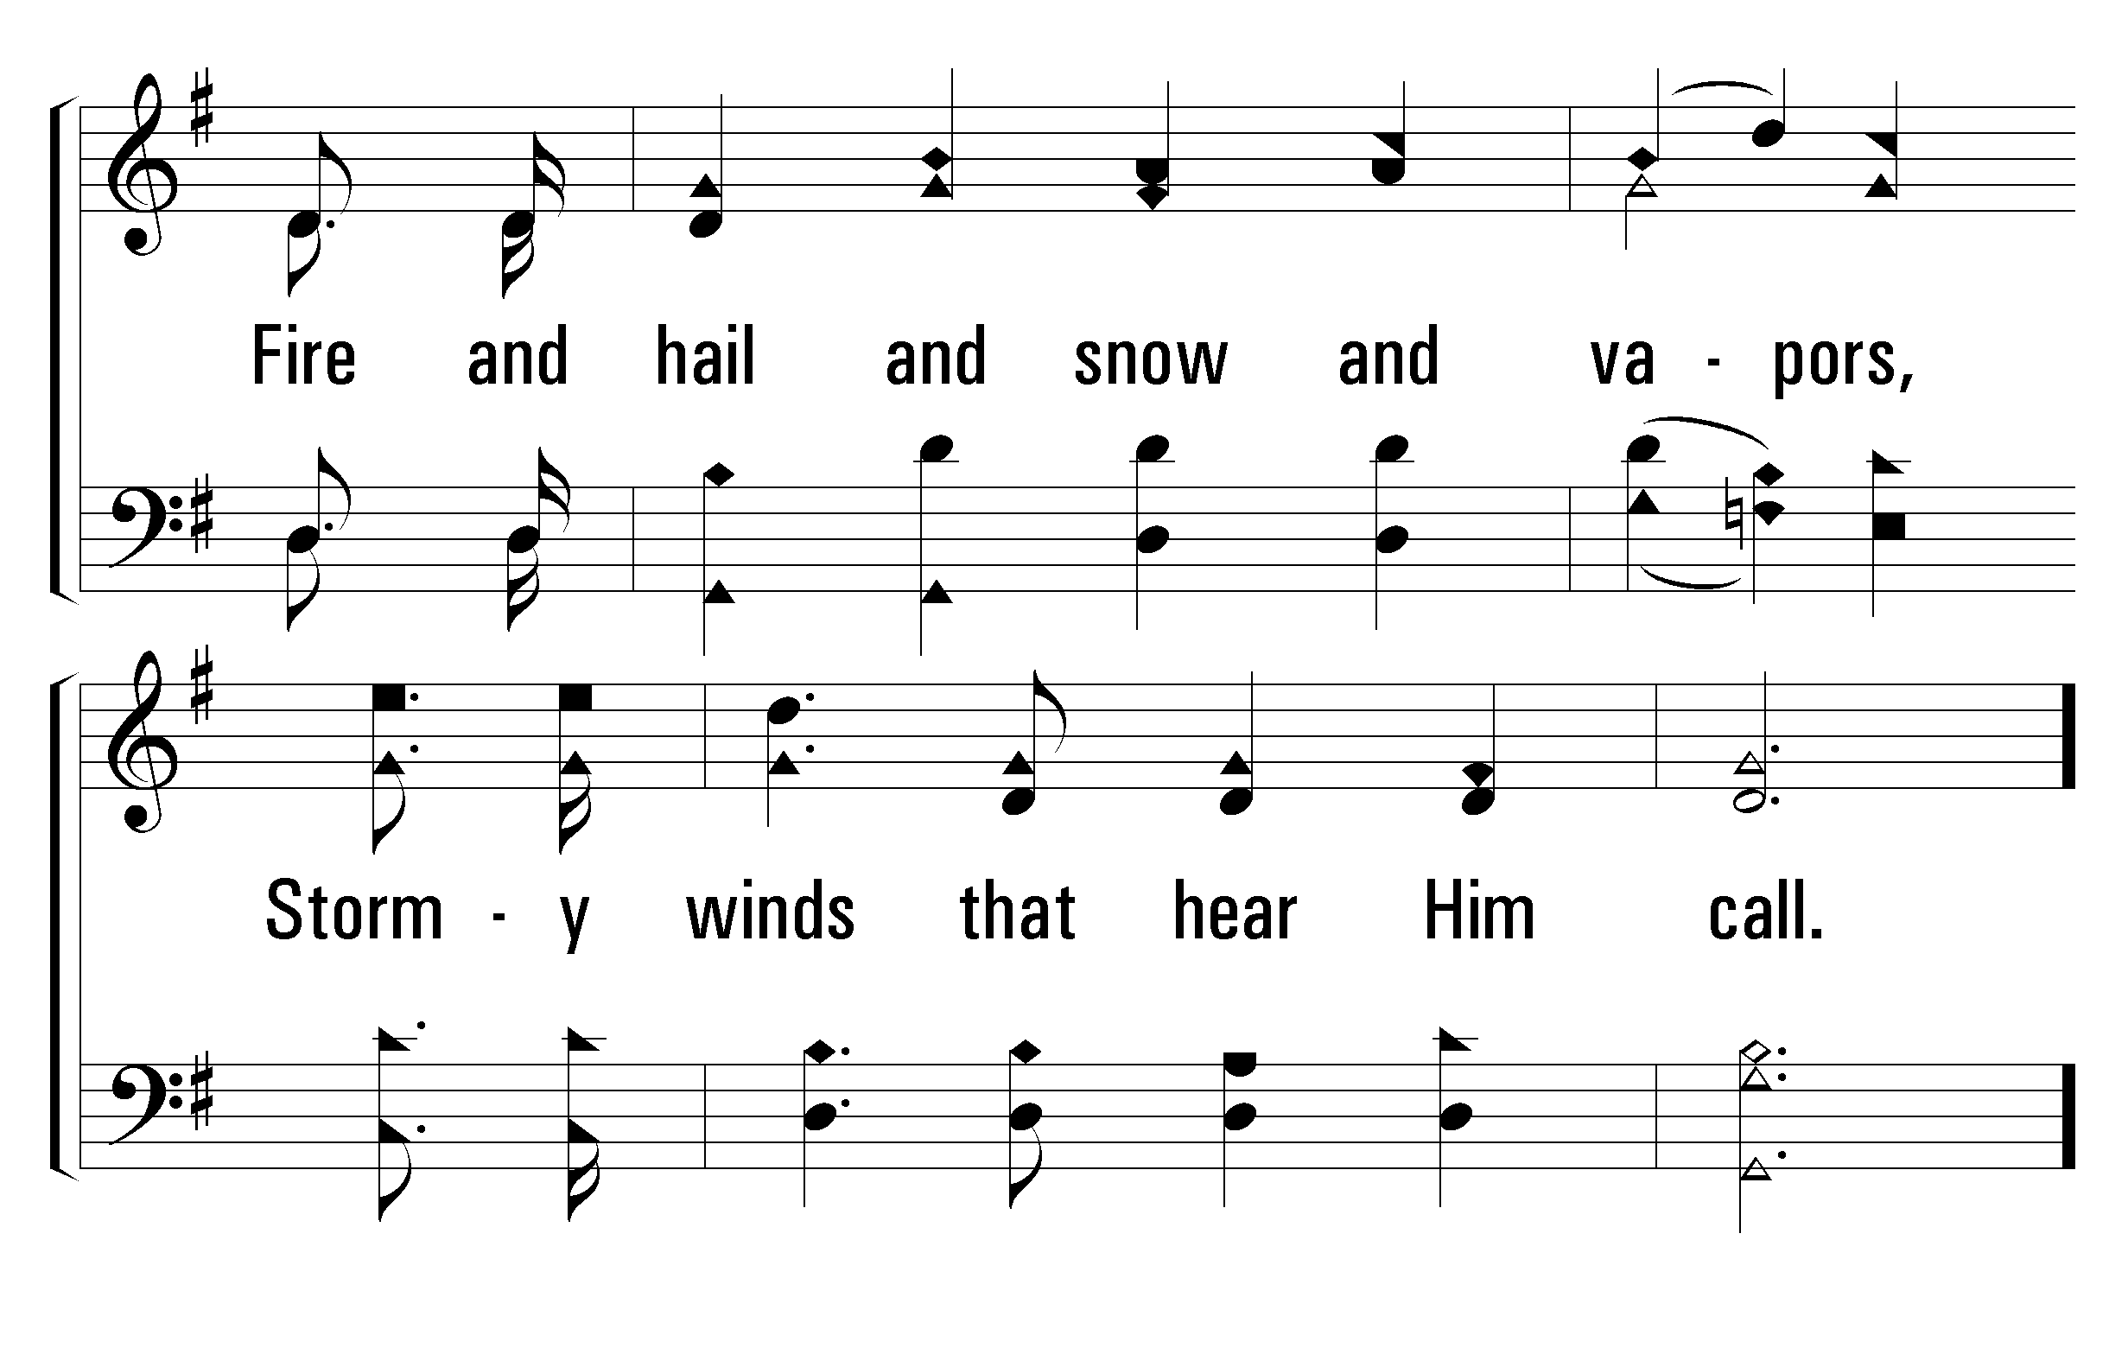
1
C
2
C
3
C
200
HALLELUJAH, PRAISE JEHOVAH
© 2001 The Paperless Hymnal™

Slide 13
1
C
2
C
3
C
200
HALLELUJAH, PRAISE JEHOVAH
© 2001 The Paperless Hymnal™

Slide 14
1
C
2
C
3
C
200
HALLELUJAH, PRAISE JEHOVAH
© 2001 The Paperless Hymnal™

Slide 15
1
C
2
C
3
C
200
HALLELUJAH, PRAISE JEHOVAH
© 2001 The Paperless Hymnal™

Slide 16
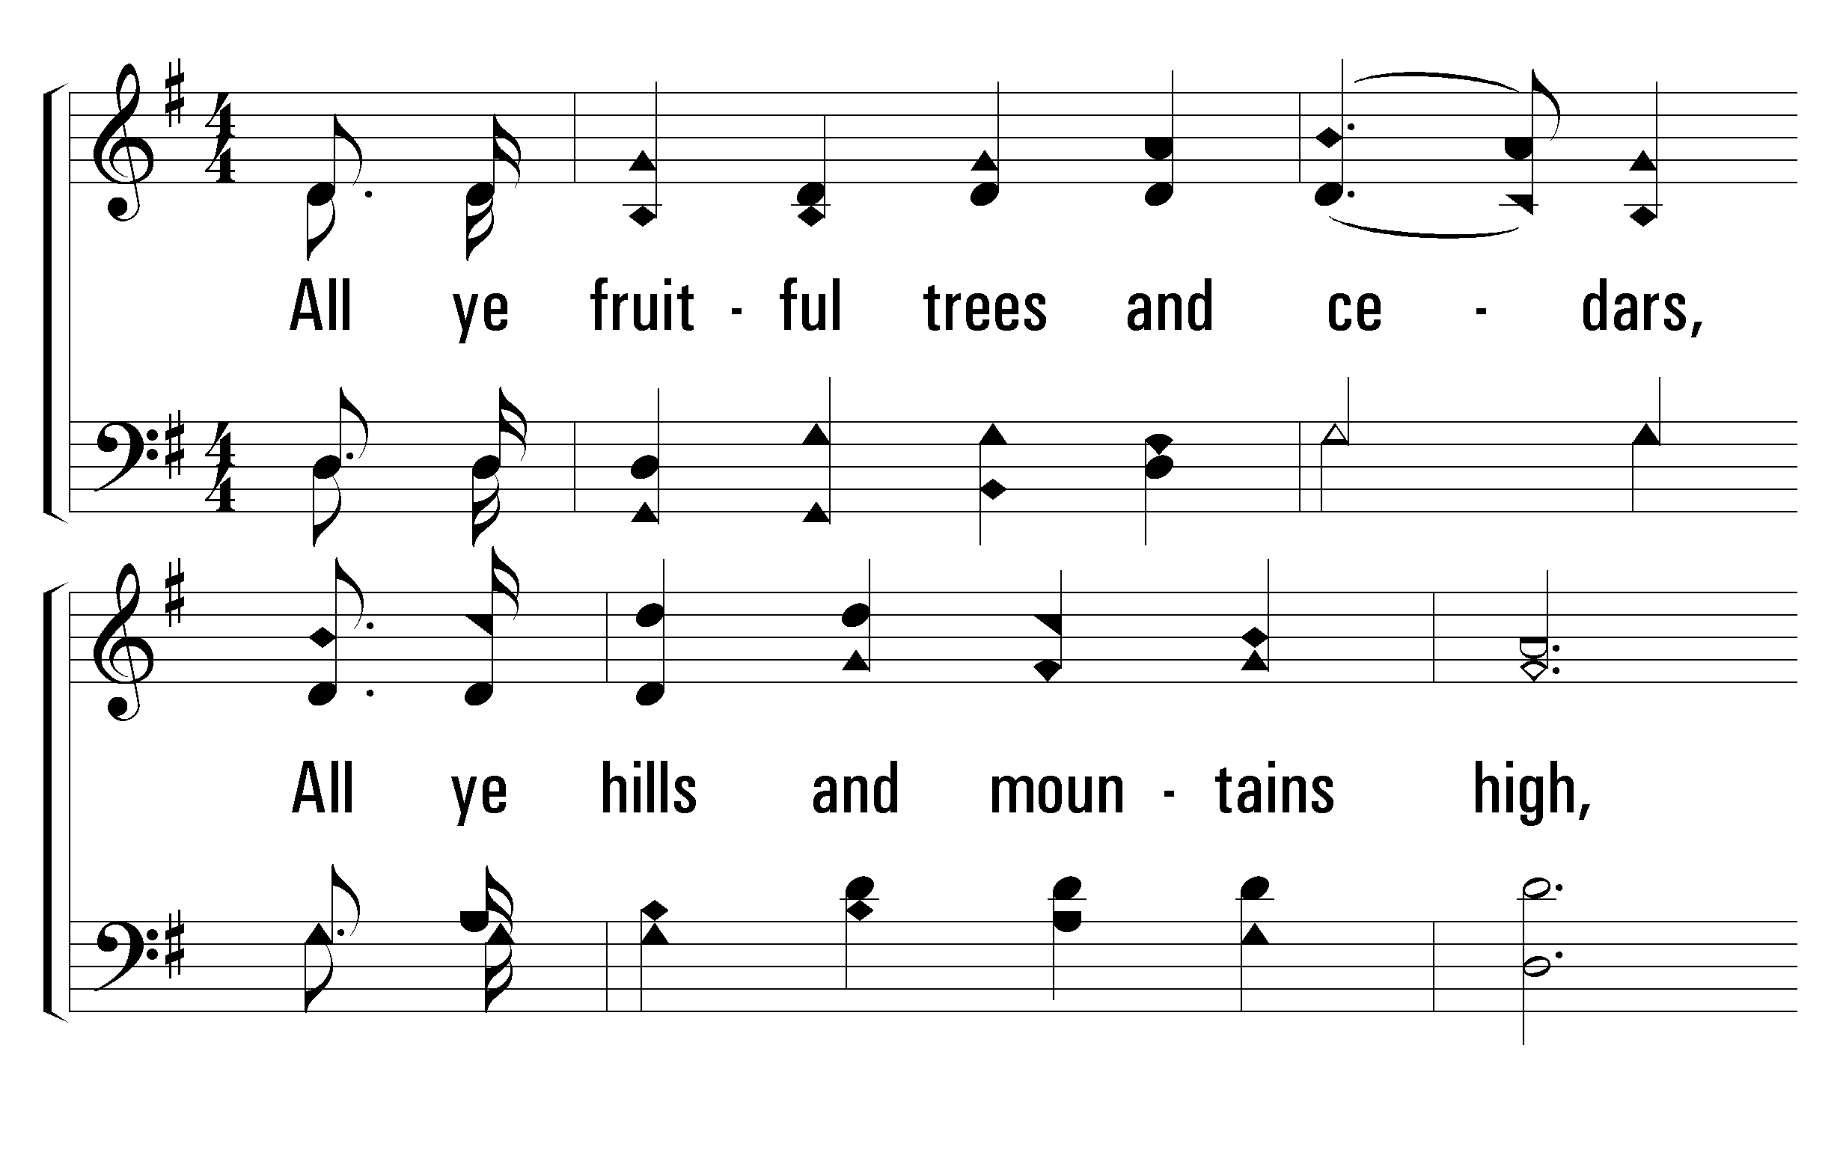
1
C
2
C
3
C
200
HALLELUJAH, PRAISE JEHOVAH
© 2001 The Paperless Hymnal™

Slide 17
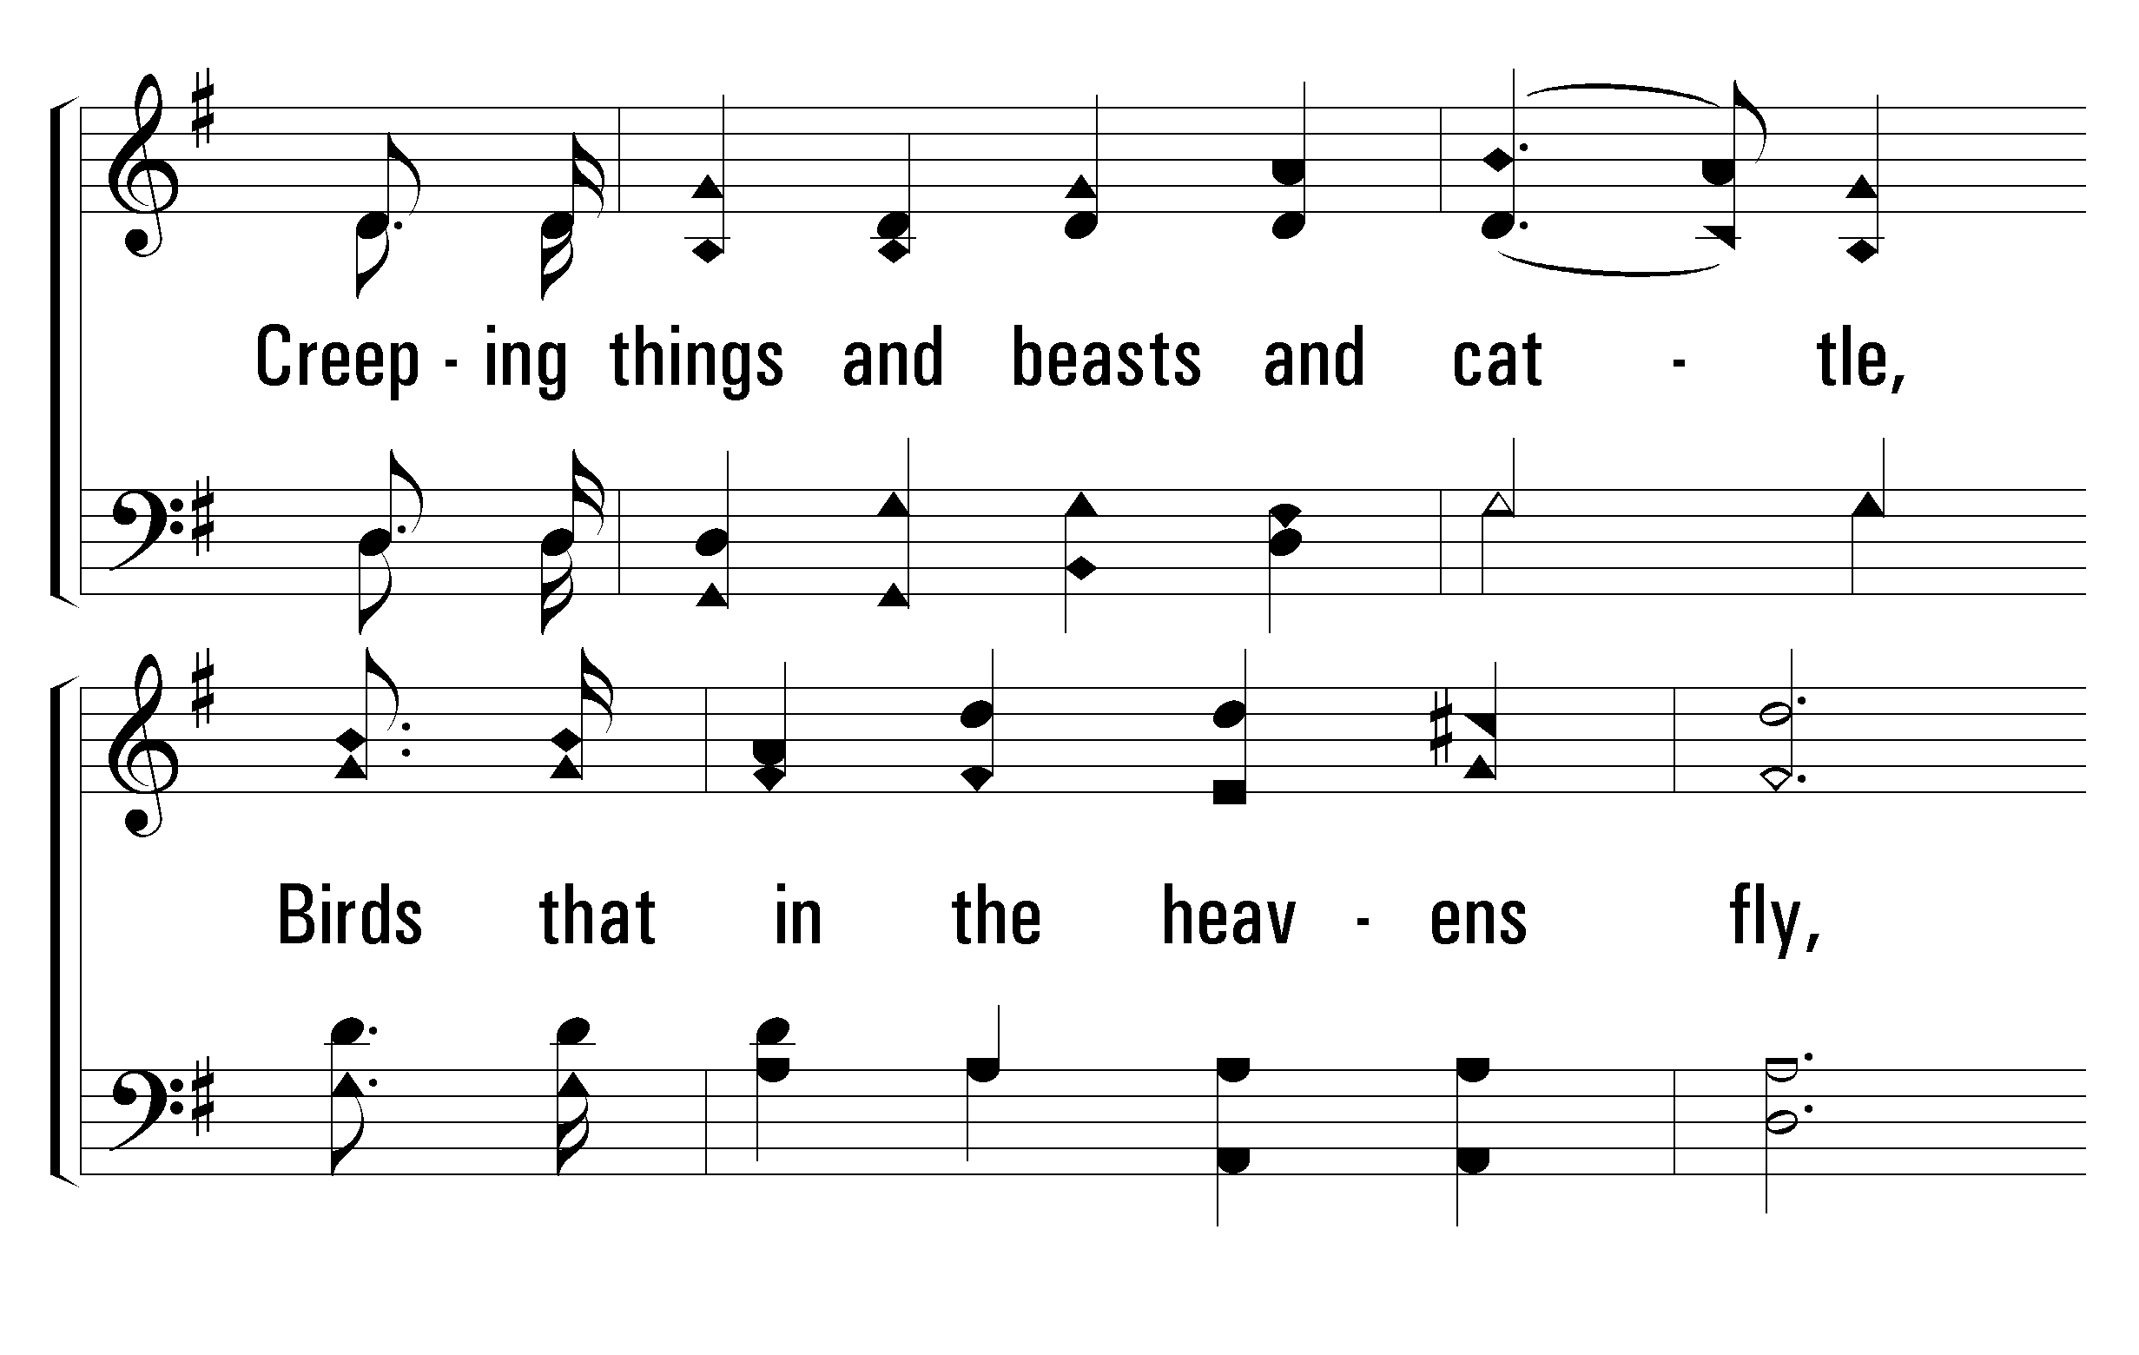
1
C
2
C
3
C
200
HALLELUJAH, PRAISE JEHOVAH
© 2001 The Paperless Hymnal™

Slide 18
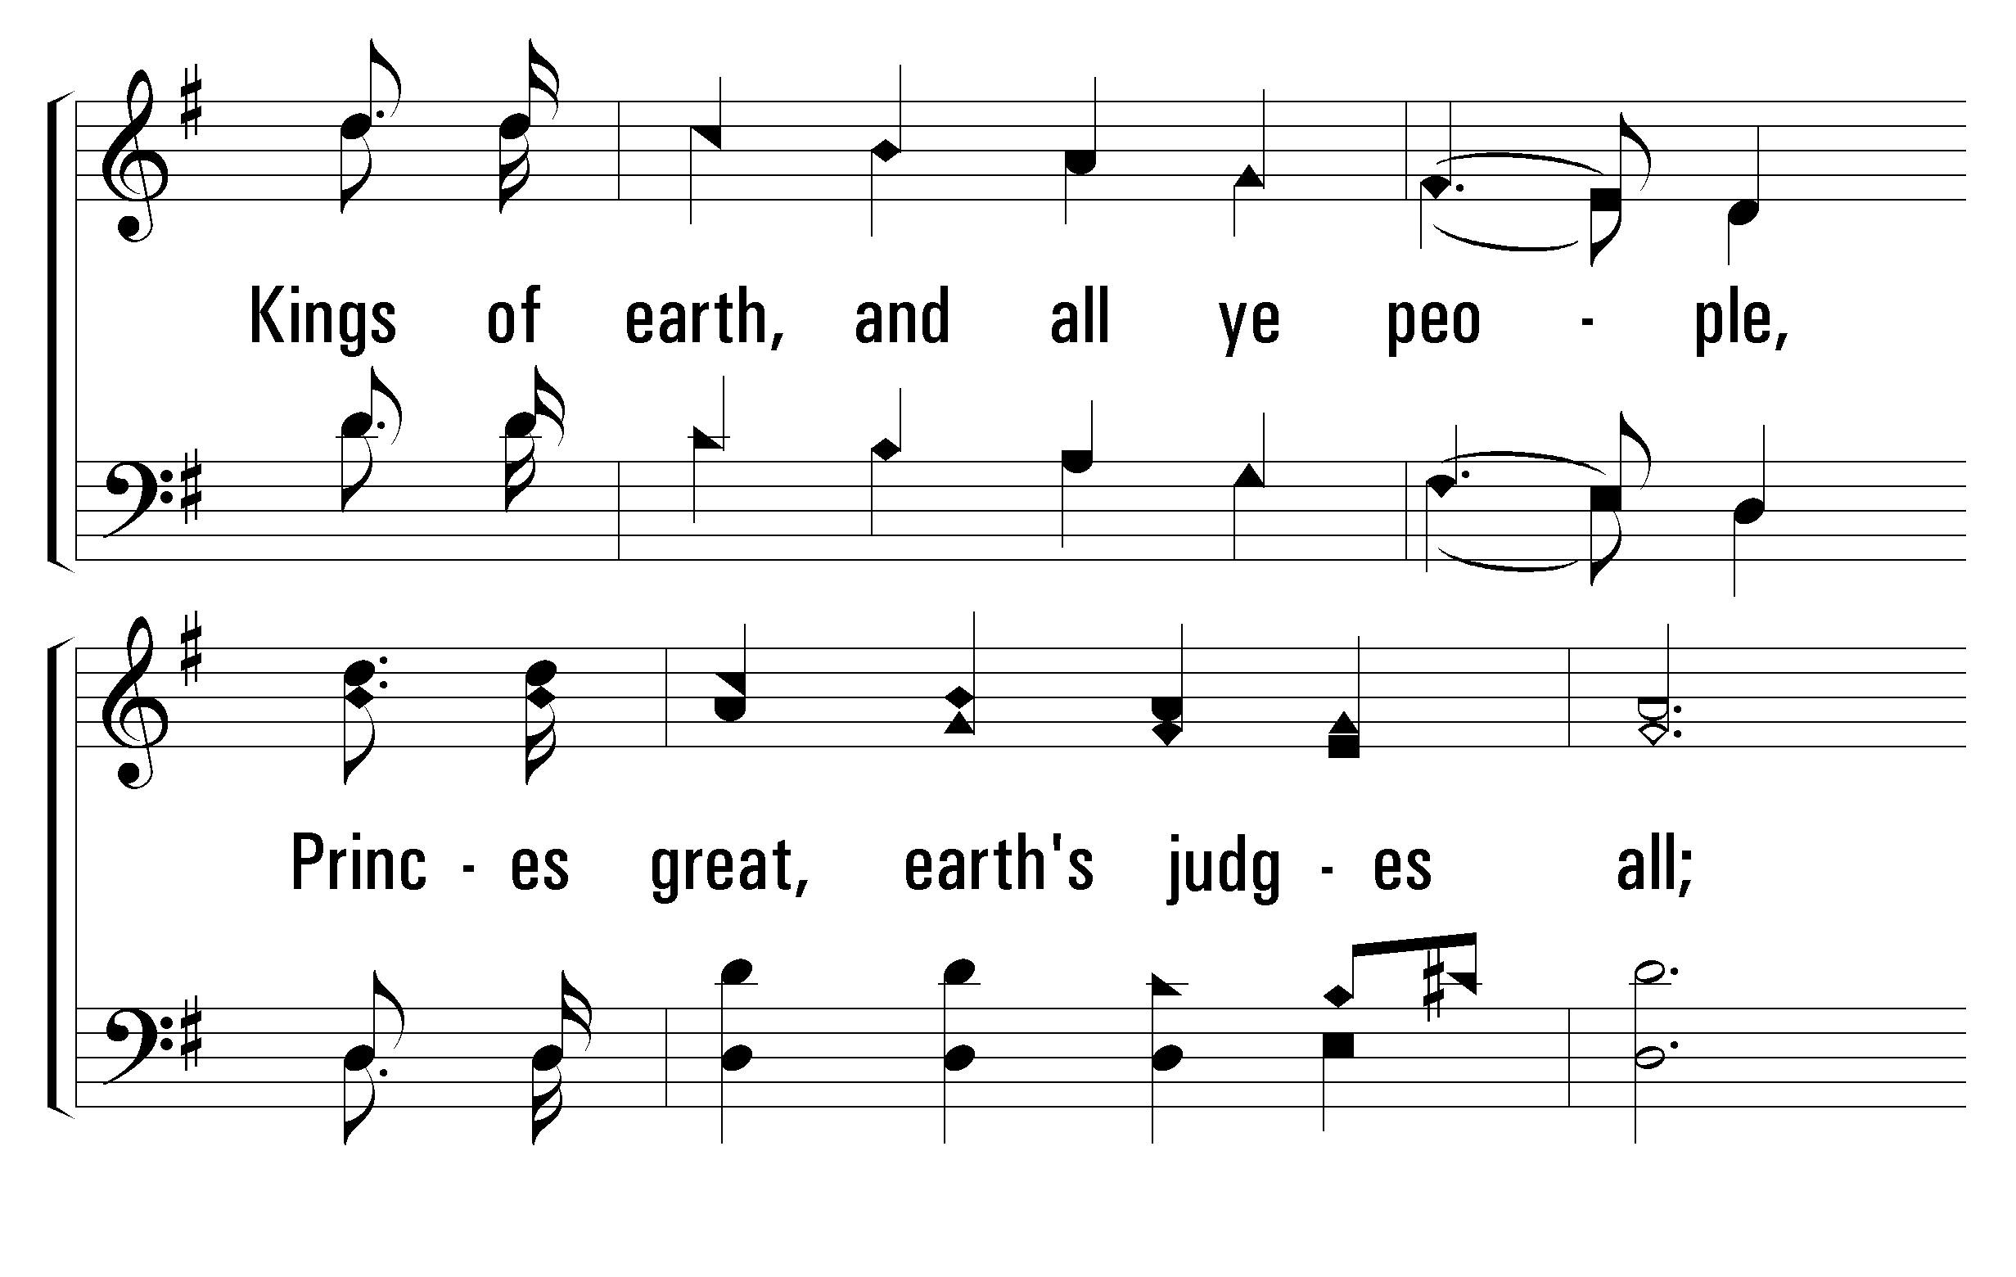
1
C
2
C
3
C
200
HALLELUJAH, PRAISE JEHOVAH
© 2001 The Paperless Hymnal™

Slide 19
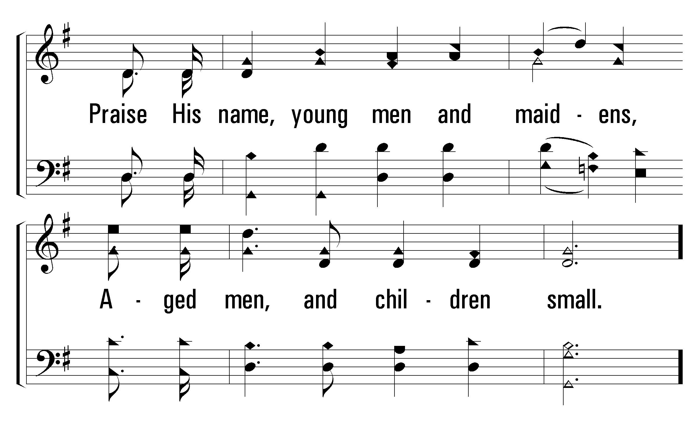
1
C
2
C
3
C
200
HALLELUJAH, PRAISE JEHOVAH
© 2001 The Paperless Hymnal™

Slide 20
1
C
2
C
3
C
200
HALLELUJAH, PRAISE JEHOVAH
© 2001 The Paperless Hymnal™

Slide 21
1
C
2
C
3
C
200
HALLELUJAH, PRAISE JEHOVAH
© 2001 The Paperless Hymnal™

Slide 22
1
C
2
C
3
C
200
HALLELUJAH, PRAISE JEHOVAH
© 2001 The Paperless Hymnal™

