Slide 1
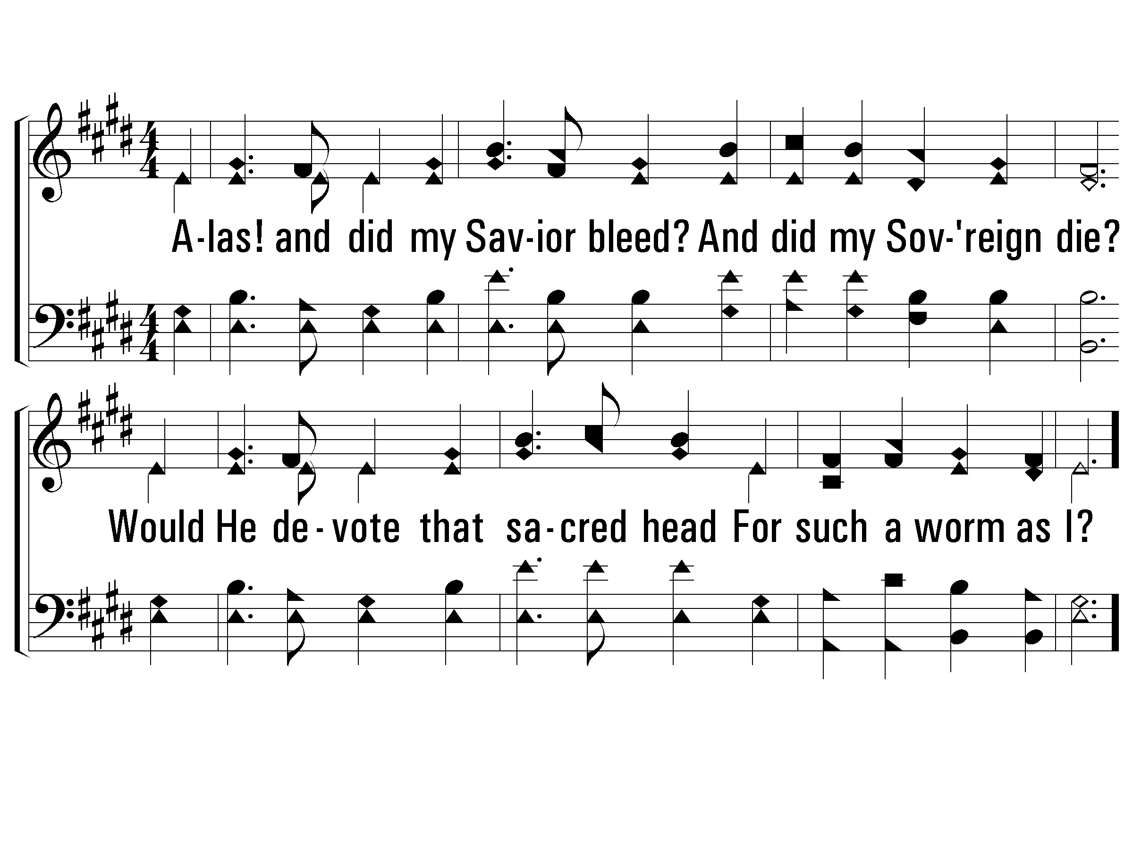
1 – Alas! And Did My Savior Bleed
12
1.
Alas! And did my Savior bleed?
And did my Sovereign die?
Would He devote that sacred head
For such a worm as I?
Words by: Isaac Watts, chorus by Ralph E. Hudson
Music by: Ralph E. Hudson
© 2001 The Paperless Hymnal™

Slide 2
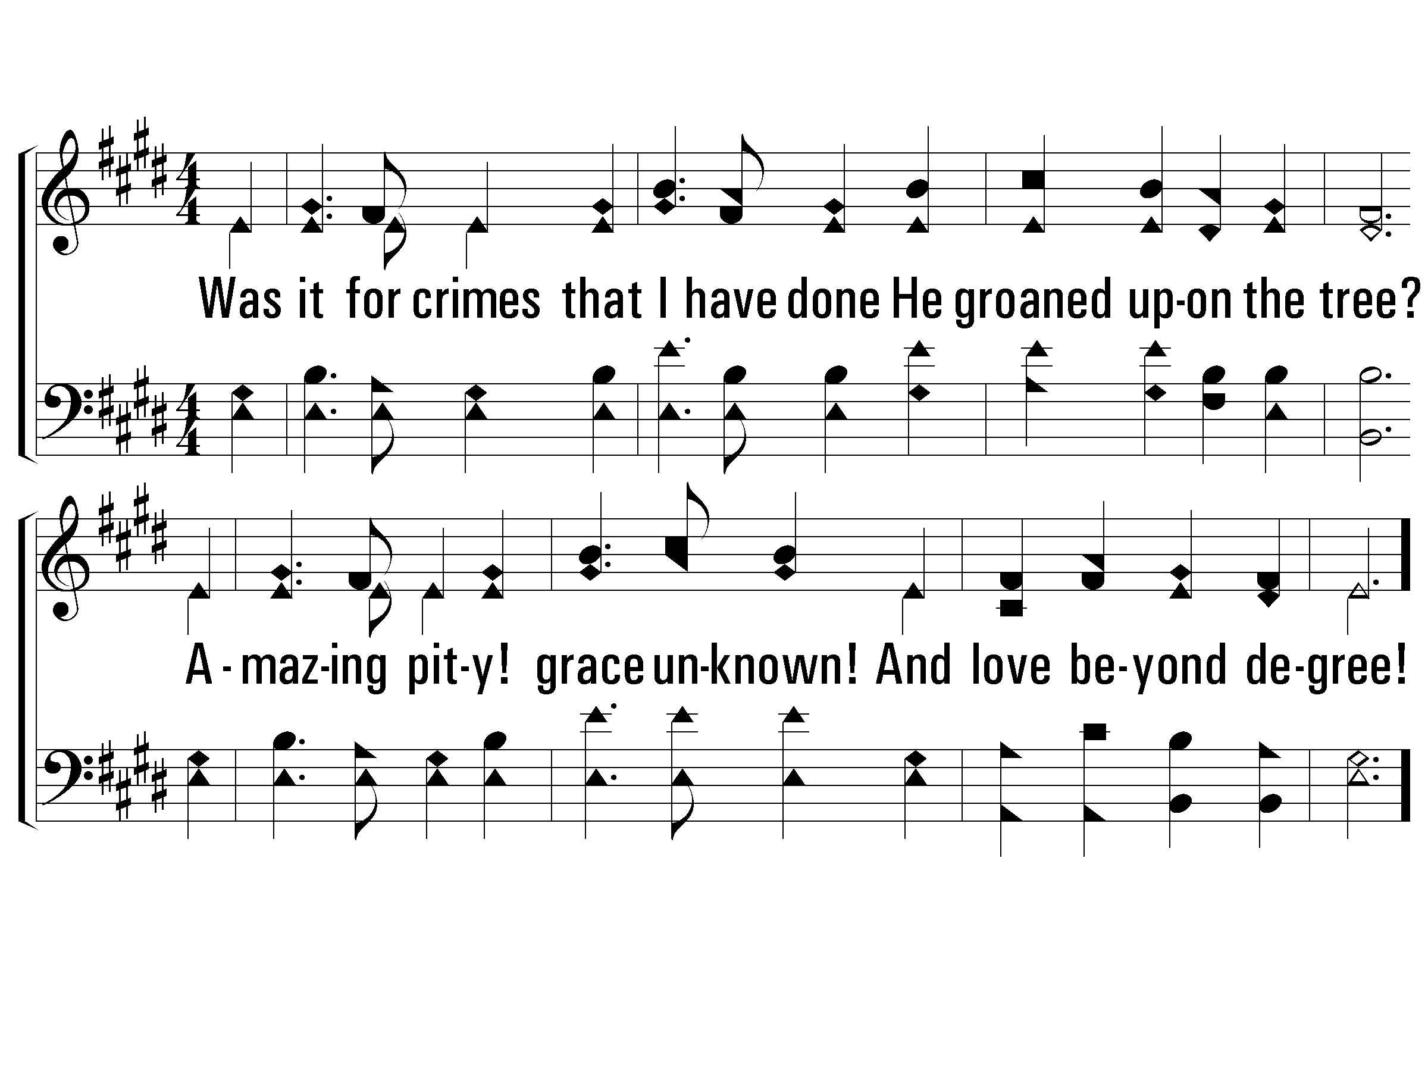
2 – Alas! And Did My Savior Bleed
12
2.
Was it for crimes that I have done
He groaned upon the tree?
Amazing pity! Grace unknown!
And love beyond degree!
Words by: Isaac Watts, chorus by Ralph E. Hudson
Music by: Ralph E. Hudson
© 2001 The Paperless Hymnal™

Slide 3
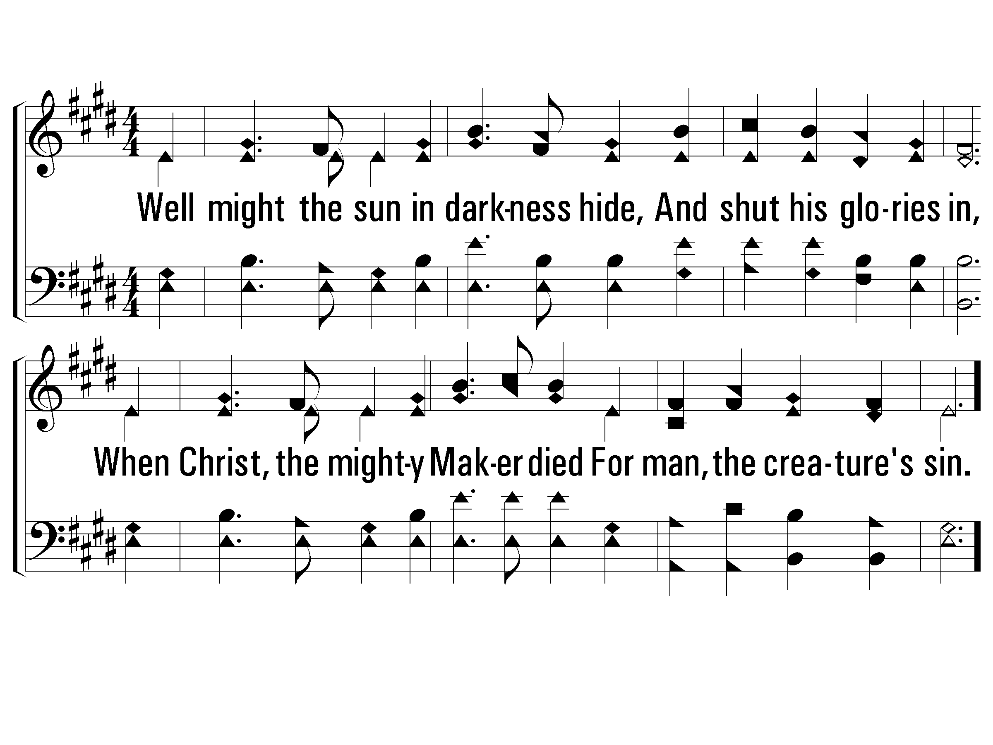
3 – Alas! And Did My Savior Bleed
12
3.
Well might the sun in darkness hide,
And shut his glories in,
When Christ, the mighty Maker died
For man, the creature's sin.
Words by: Isaac Watts, chorus by Ralph E. Hudson
Music by: Ralph E. Hudson
© 2001 The Paperless Hymnal™

Slide 4
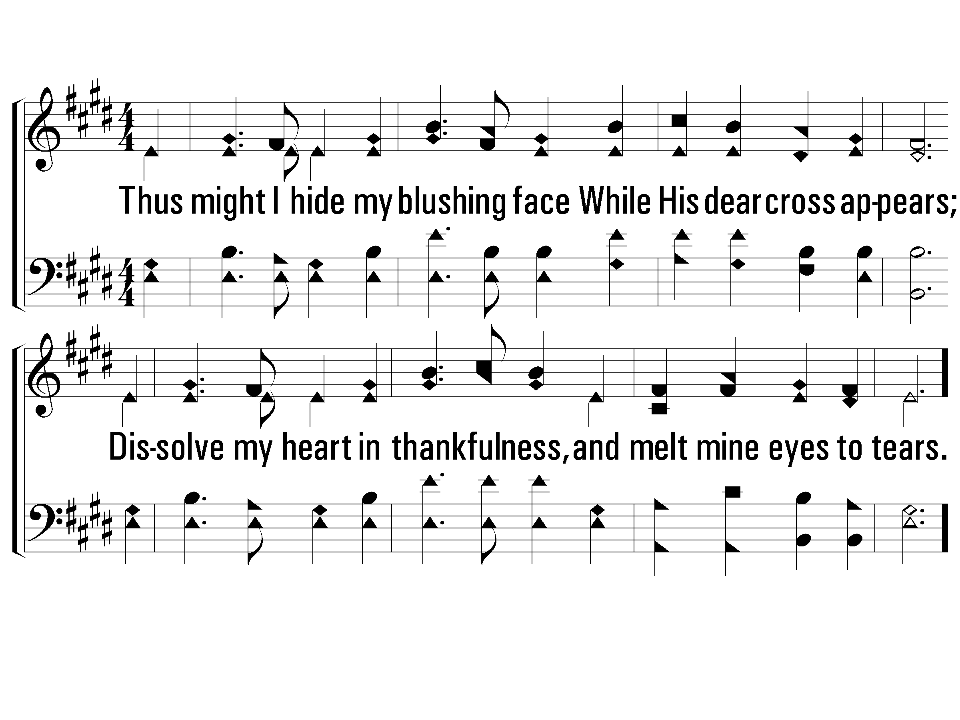
4 – Alas! And Did My Savior Bleed
12
4.
Thus might I hide my blushing face
While His dear cross appears;
Dissolve my heart in thankfulness,
an melt mine eyes to tears.
Words by: Isaac Watts, chorus by Ralph E. Hudson
Music by: Ralph E. Hudson
© 2001 The Paperless Hymnal™

Slide 5
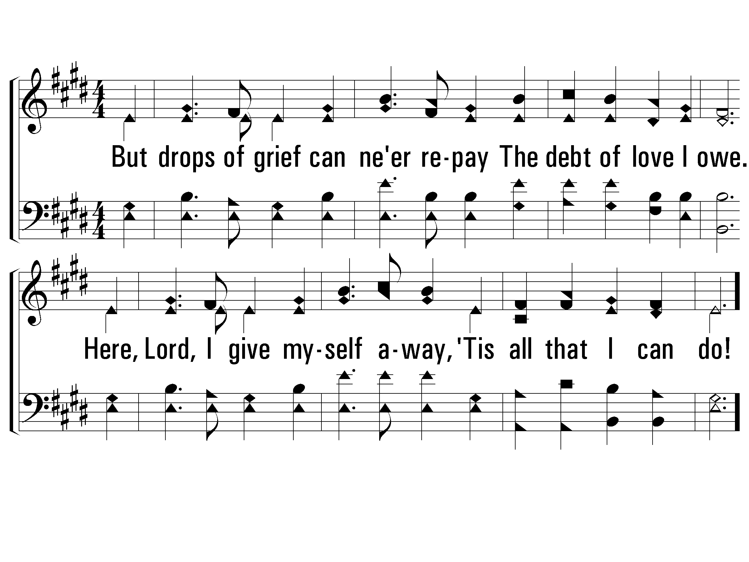
5 – Alas! And Did My Savior Bleed
12
5.
But drops of grief can ne'er repay
The debt of love I owe.
Here, Lord, I give myself away,
"Tis all that I can do!
Words by: Isaac Watts, chorus by Ralph E. Hudson
Music by: Ralph E. Hudson
© 2001 The Paperless Hymnal™

Slide 6
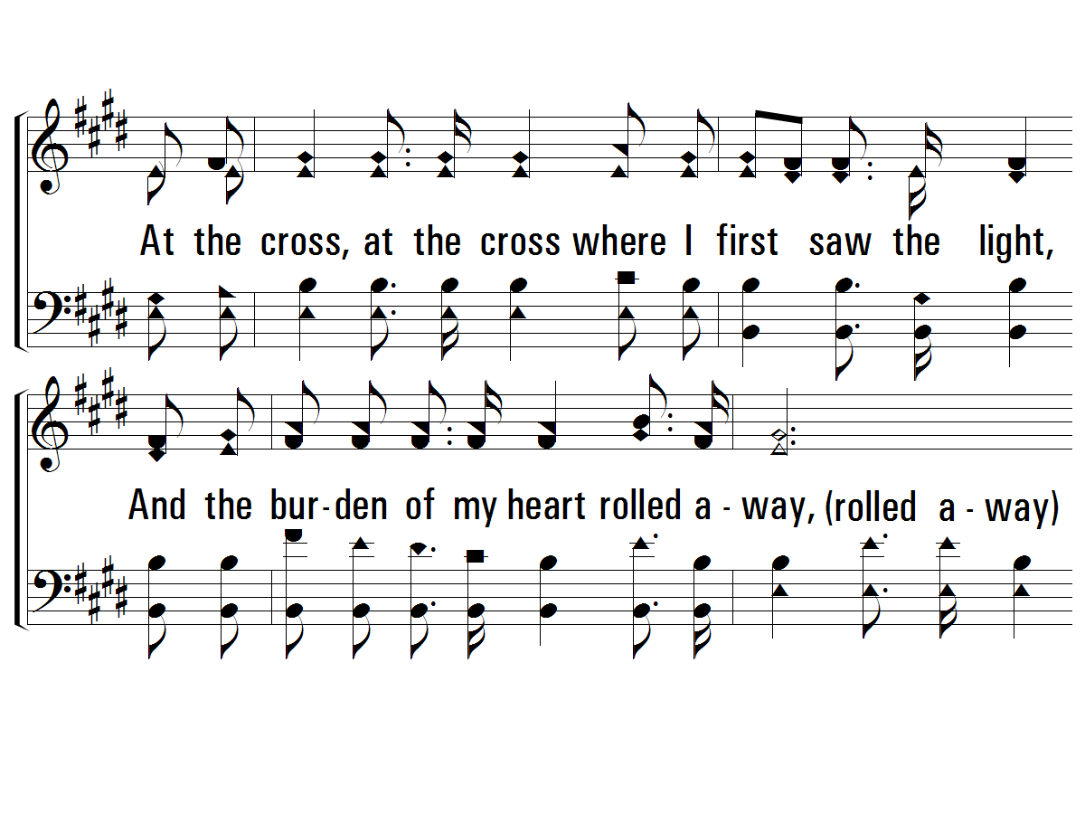
c – Alas! And Did My Savior Bleed
12
At the cross, at the cross where I first saw the light,
And the burden of my heart rolled away,
It was there by faith I received my sight,
And now I am happy all the day.
© 2001 The Paperless Hymnal™

Slide 7
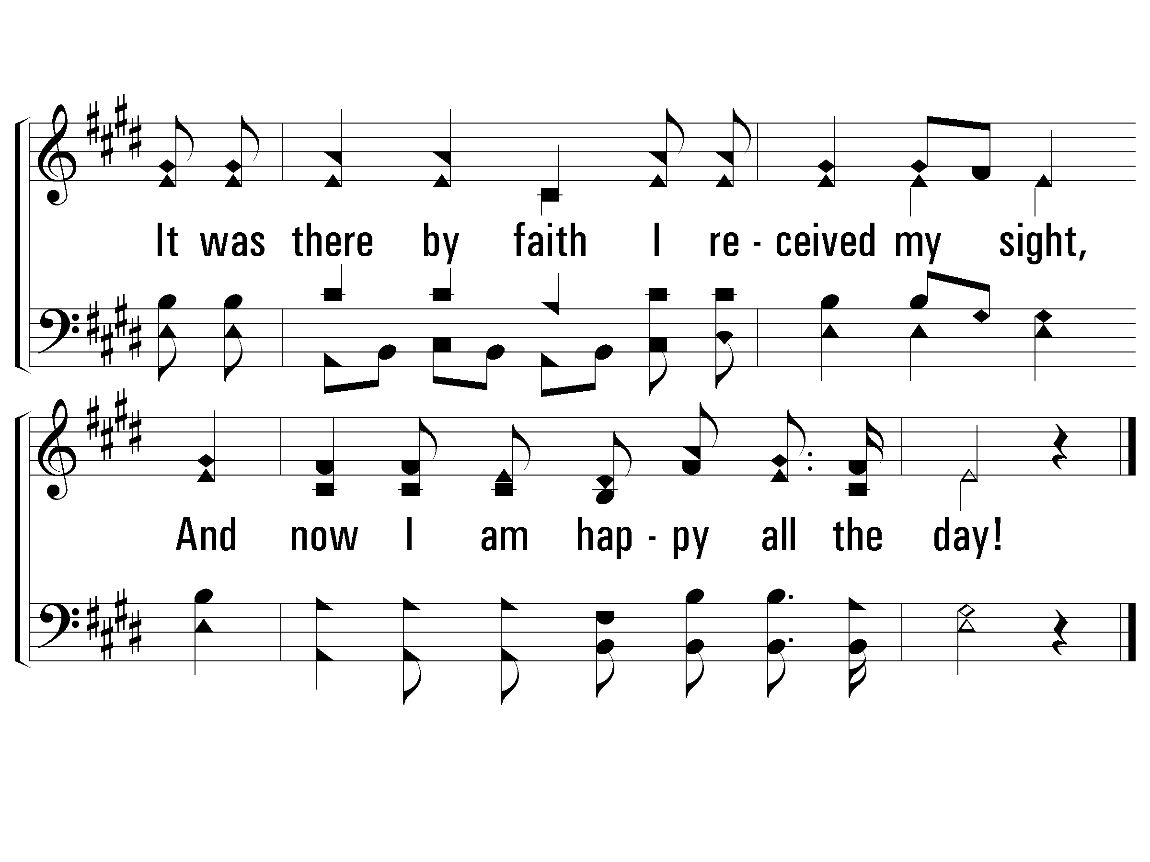
c – Alas! And Did My Savior Bleed
12
© 2001 The Paperless Hymnal™

