Slide 1
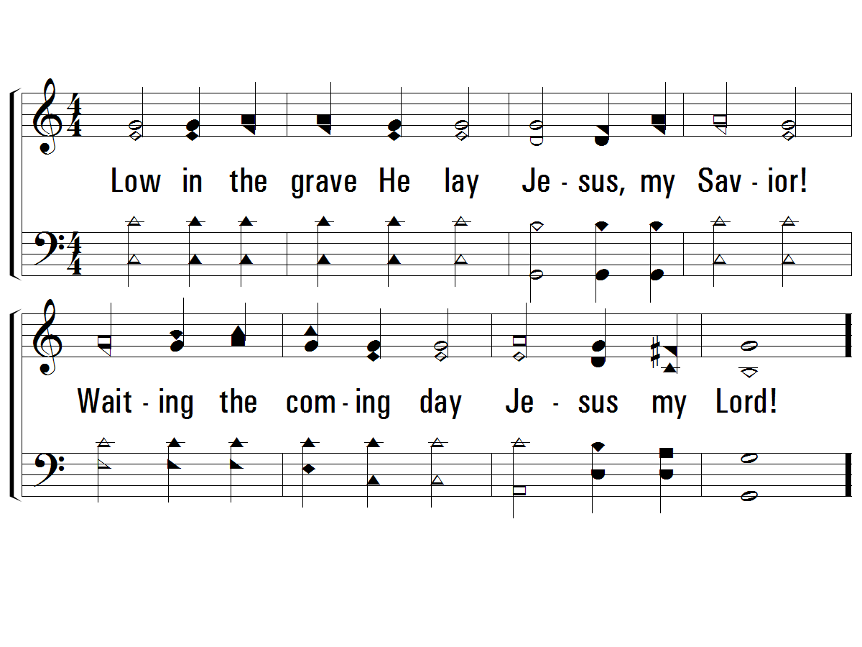
1 – Low in the Grave He Lay
408
 Slowly
1.
Low in the grave He lay
Jesus, my Savior!
Waiting the coming day
Jesus my Lord!
Words and Music by: Robert Lowry
© 2001 The Paperless Hymnal™

Slide 2
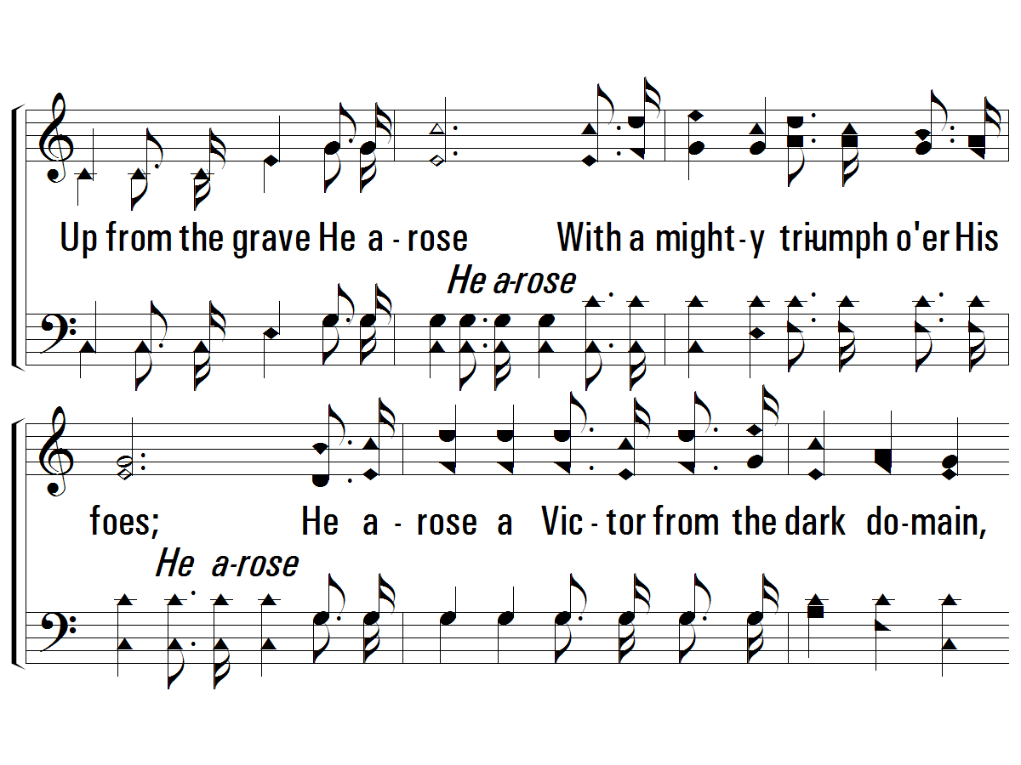
c – Low in the Grave He Lay
408
 Quickly
Up from the grave He arose
With a mighty triumph o'er His foes;
He arose a Victor from the dark domain,
And He lives forever with His saints to reign;
He arose! He arose!
Hallelujah! Christ arose!
© 2001 The Paperless Hymnal™

Slide 3
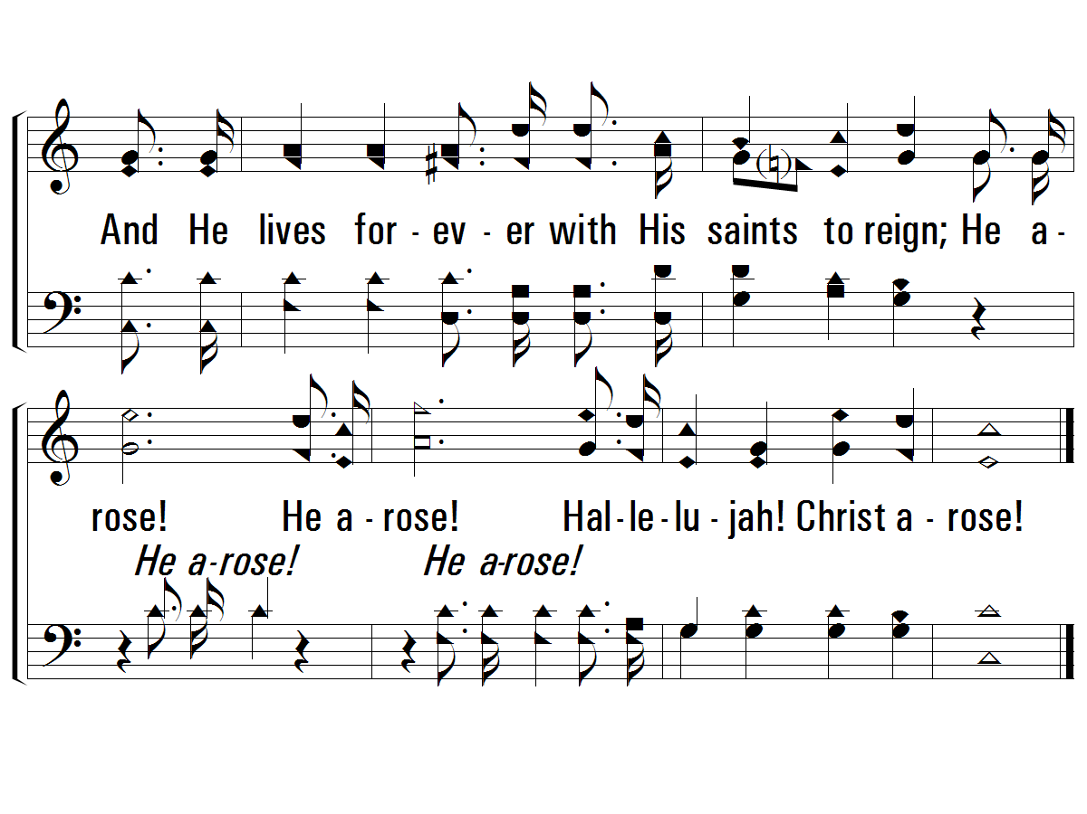
c – Low in the Grave He Lay
408
© 2001 The Paperless Hymnal™

Slide 4
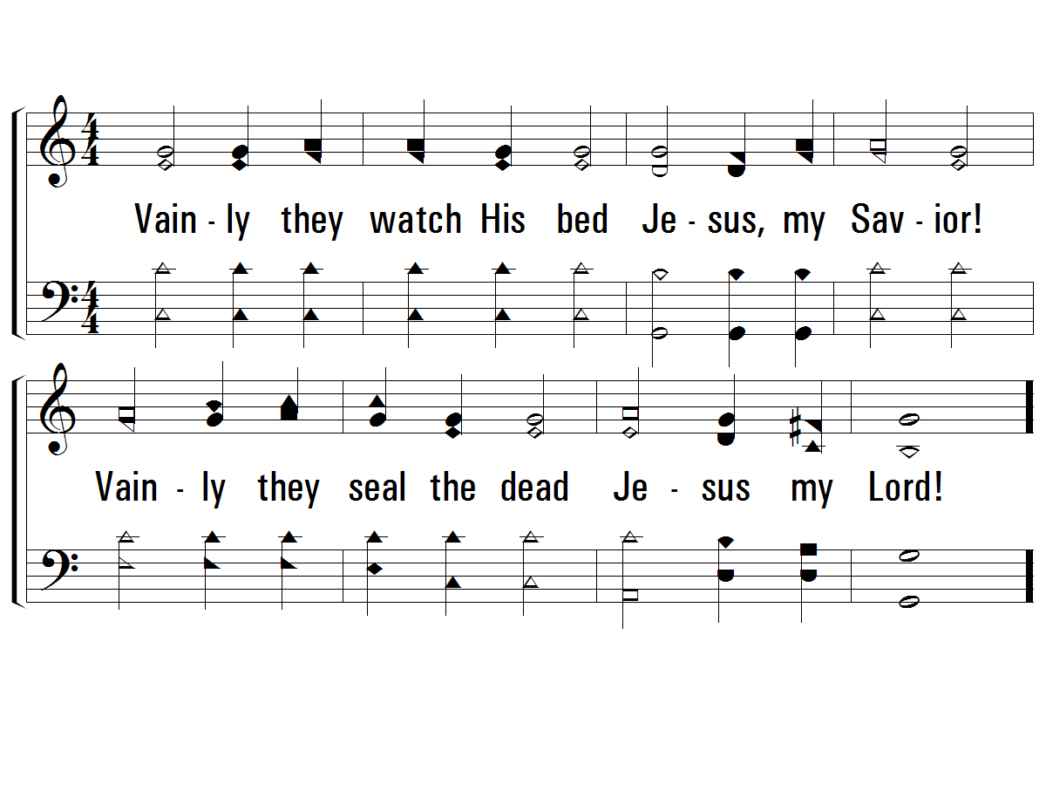
2 – Low in the Grave He Lay
408
 Slowly
2.
Vainly they watch His bed
Jesus, my Savior!
Vainly they seal the dead
Jesus my Lord!
Words and Music by: Robert Lowry
© 2001 The Paperless Hymnal™

Slide 5
c – Low in the Grave He Lay
408
 Quickly
Up from the grave He arose
With a mighty triumph o'er His foes;
He arose a Victor from the dark domain,
And He lives forever with His saints to reign;
He arose! He arose!
Hallelujah! Christ arose!
© 2001 The Paperless Hymnal™

Slide 6
c – Low in the Grave He Lay
408
© 2001 The Paperless Hymnal™

Slide 7
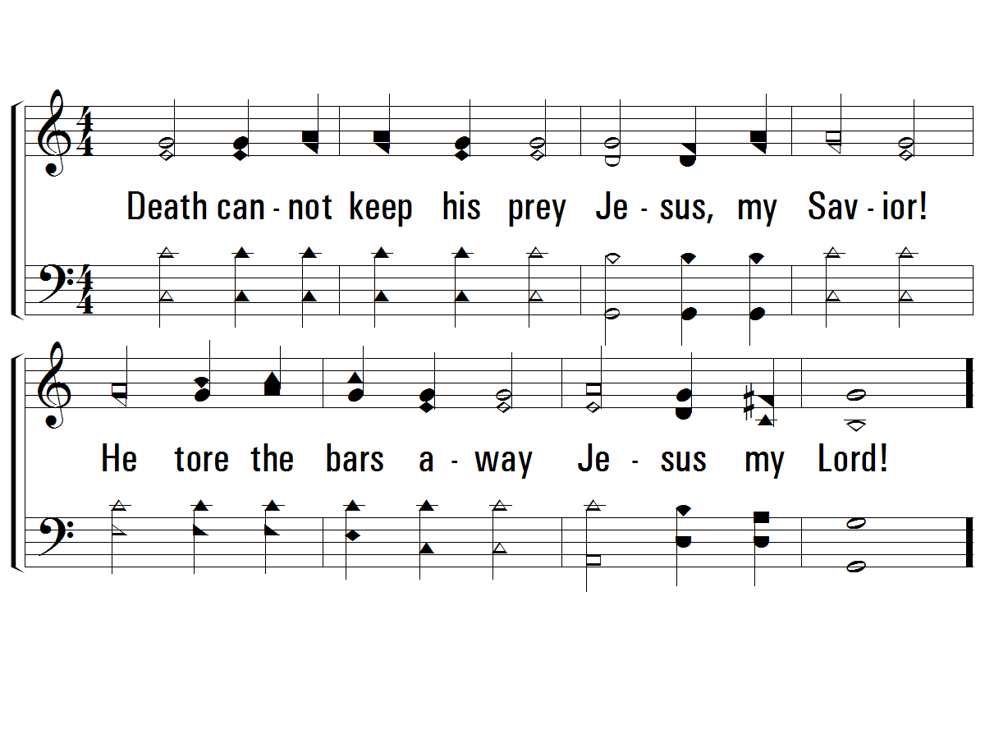
3 – Low in the Grave He Lay
408
 Slowly
3.
Death cannot keep his prey
Jesus, my Savior!
He tore the bars away
Jesus my Lord!
Words and Music by: Robert Lowry
© 2001 The Paperless Hymnal™

Slide 8
c – Low in the Grave He Lay
408
 Quickly
Up from the grave He arose
With a mighty triumph o'er His foes;
He arose a Victor from the dark domain,
And He lives forever with His saints to reign;
He arose! He arose!
Hallelujah! Christ arose!
© 2001 The Paperless Hymnal™

Slide 9
c – Low in the Grave He Lay
408
© 2001 The Paperless Hymnal™

