Slide 1
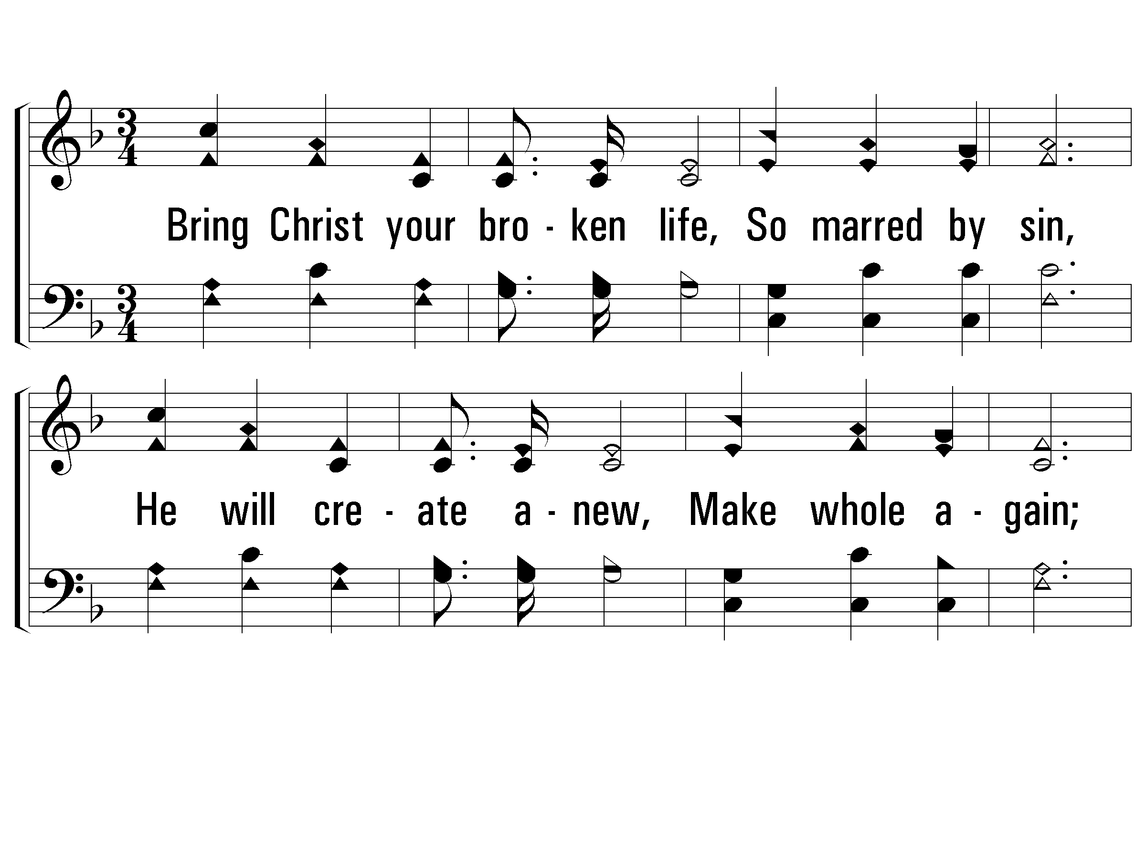
1 - Bring Christ Your Broken Life
67
1.
Bring Christ your broken life,
So marred by sin,
He will create anew,
Make whole again;
Your empty, wasted years
He will restore,
And your iniquities
Remember no more.
Words: Thomas O. Chisholm / Music: Lloyd O. Sanderson
Copyright © 1935, Renewed 1963 by L. O. Sanderson, Leon B. Sanderson, Owner.
All rights reserved. Used by permission.
© 2001 The Paperless Hymnal™

Slide 2
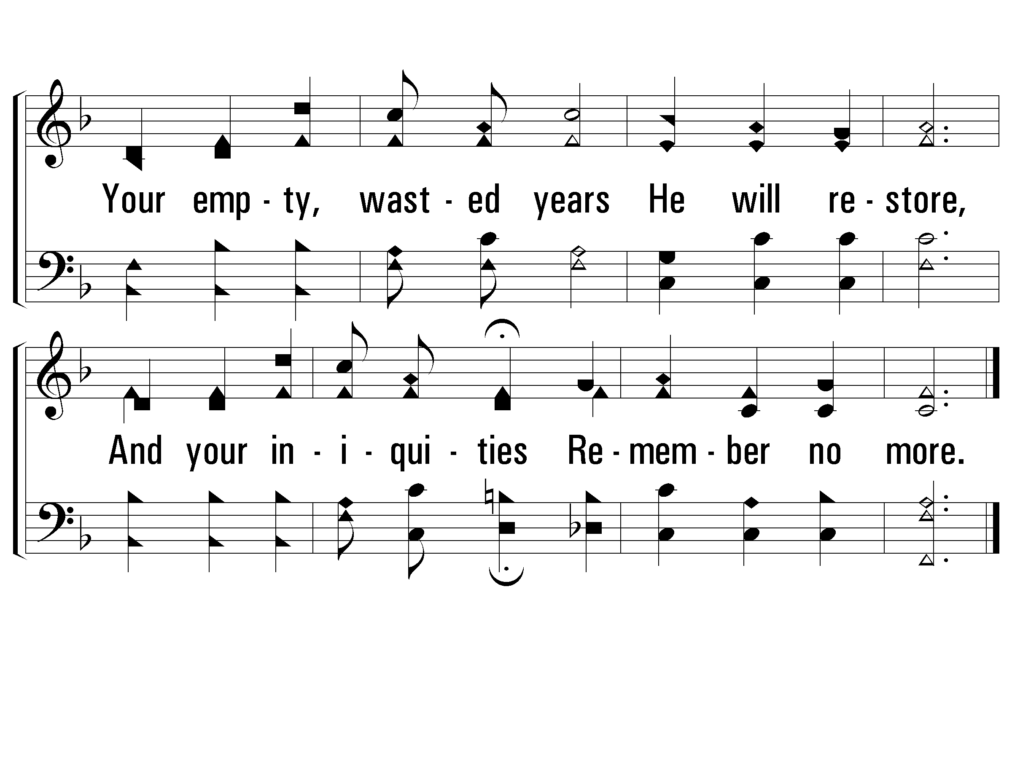
1 - Bring Christ Your Broken Life
67
© 2001 The Paperless Hymnal™

Slide 3
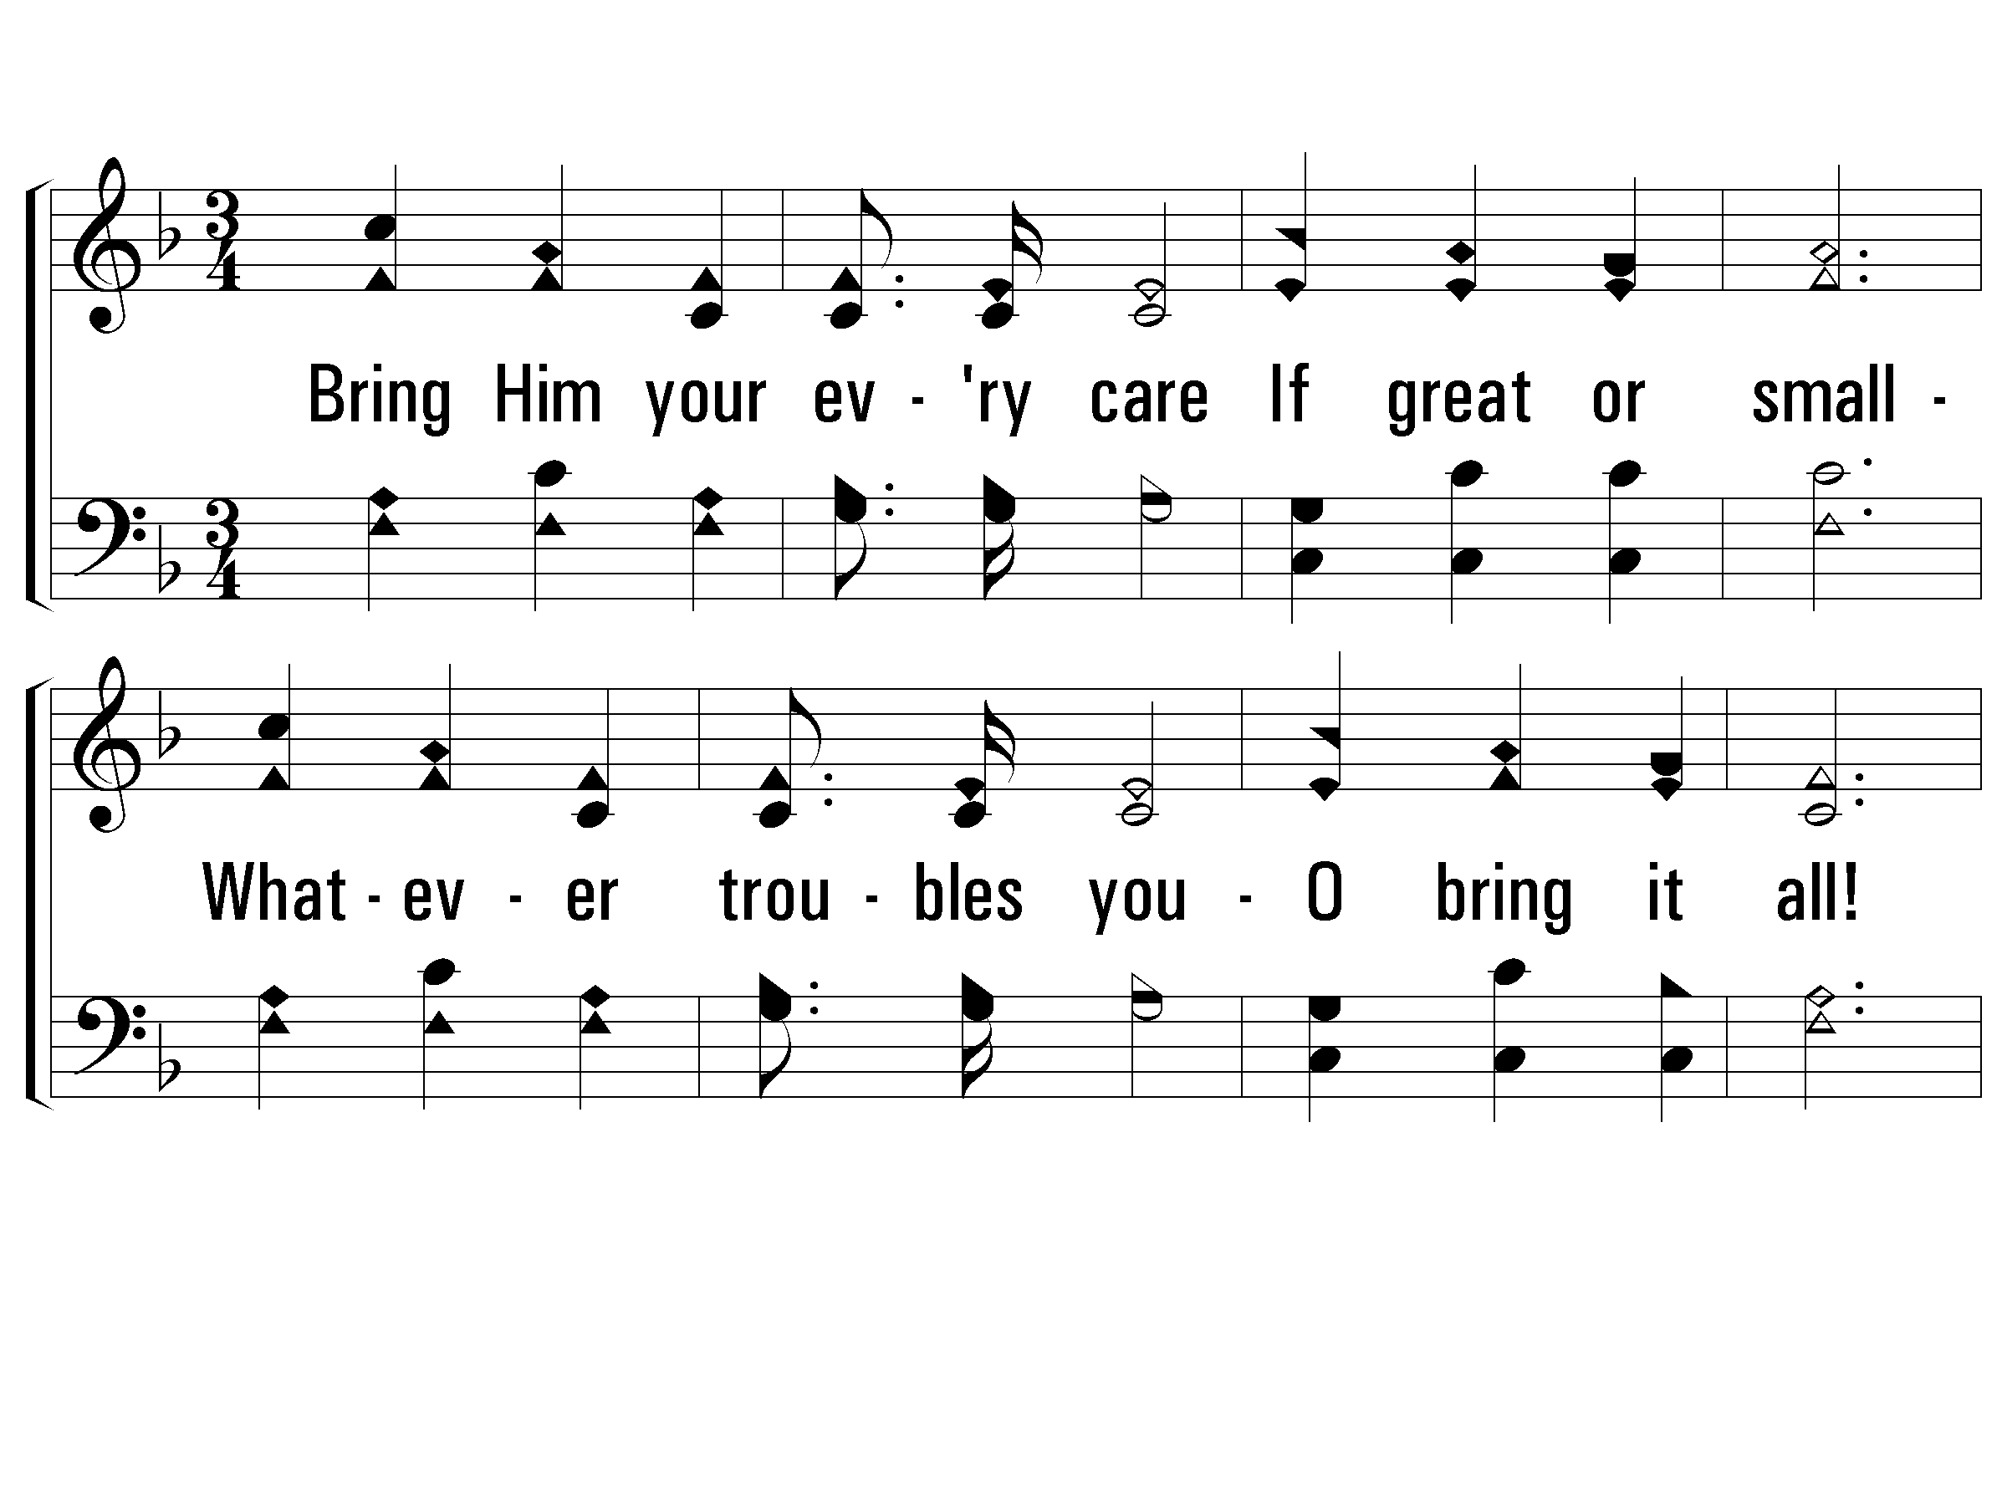
2 - Bring Christ Your Broken Life
67
2.
Bring Him your every care
If great or small -
Whatever troubles you -
O bring it all!
Bring Him the haunting fears,
The nameless dread,
Thy heart He will relieve,
And lift up thy head.
Words: Thomas O. Chisholm / Music: Lloyd O. Sanderson
Copyright © 1935, Renewed 1963 by L. O. Sanderson, Leon B. Sanderson, Owner.
All rights reserved. Used by permission.
© 2001 The Paperless Hymnal™

Slide 4
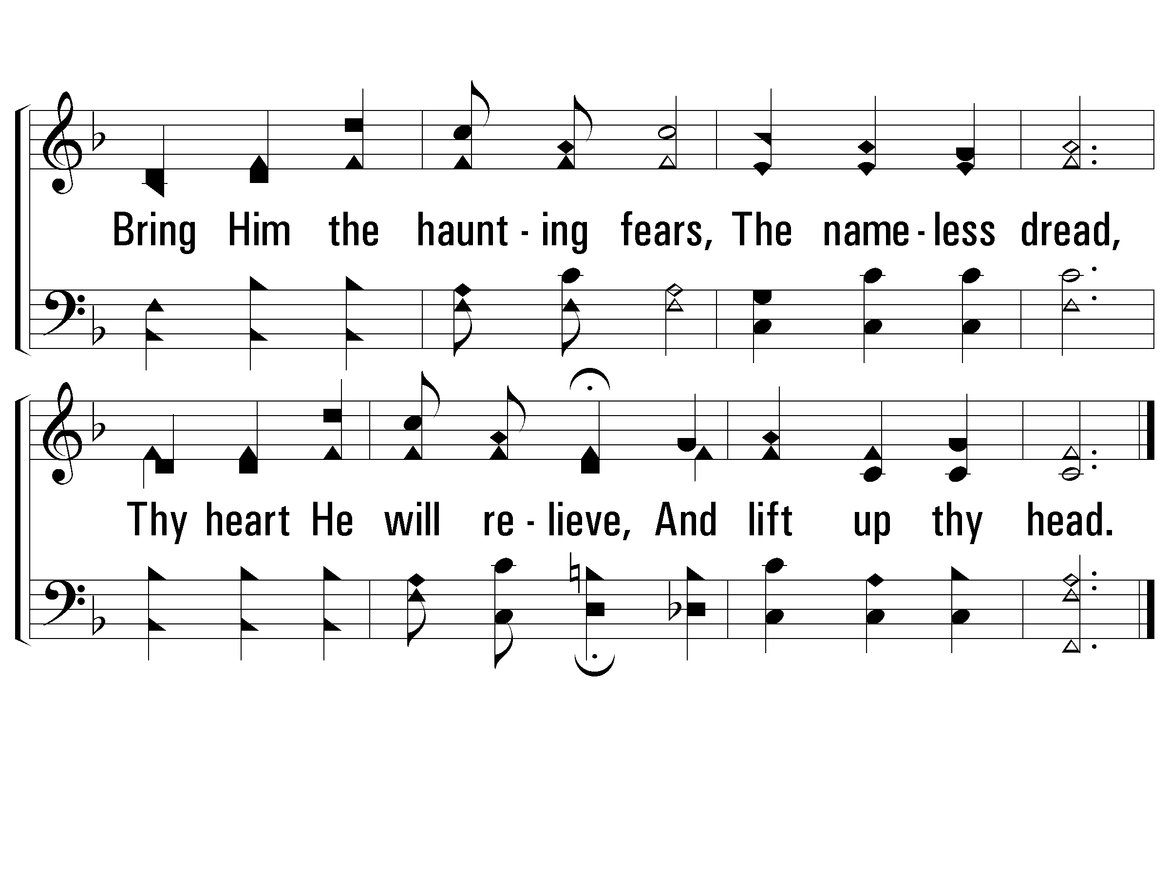
2 - Bring Christ Your Broken Life
67
© 2001 The Paperless Hymnal™

Slide 5
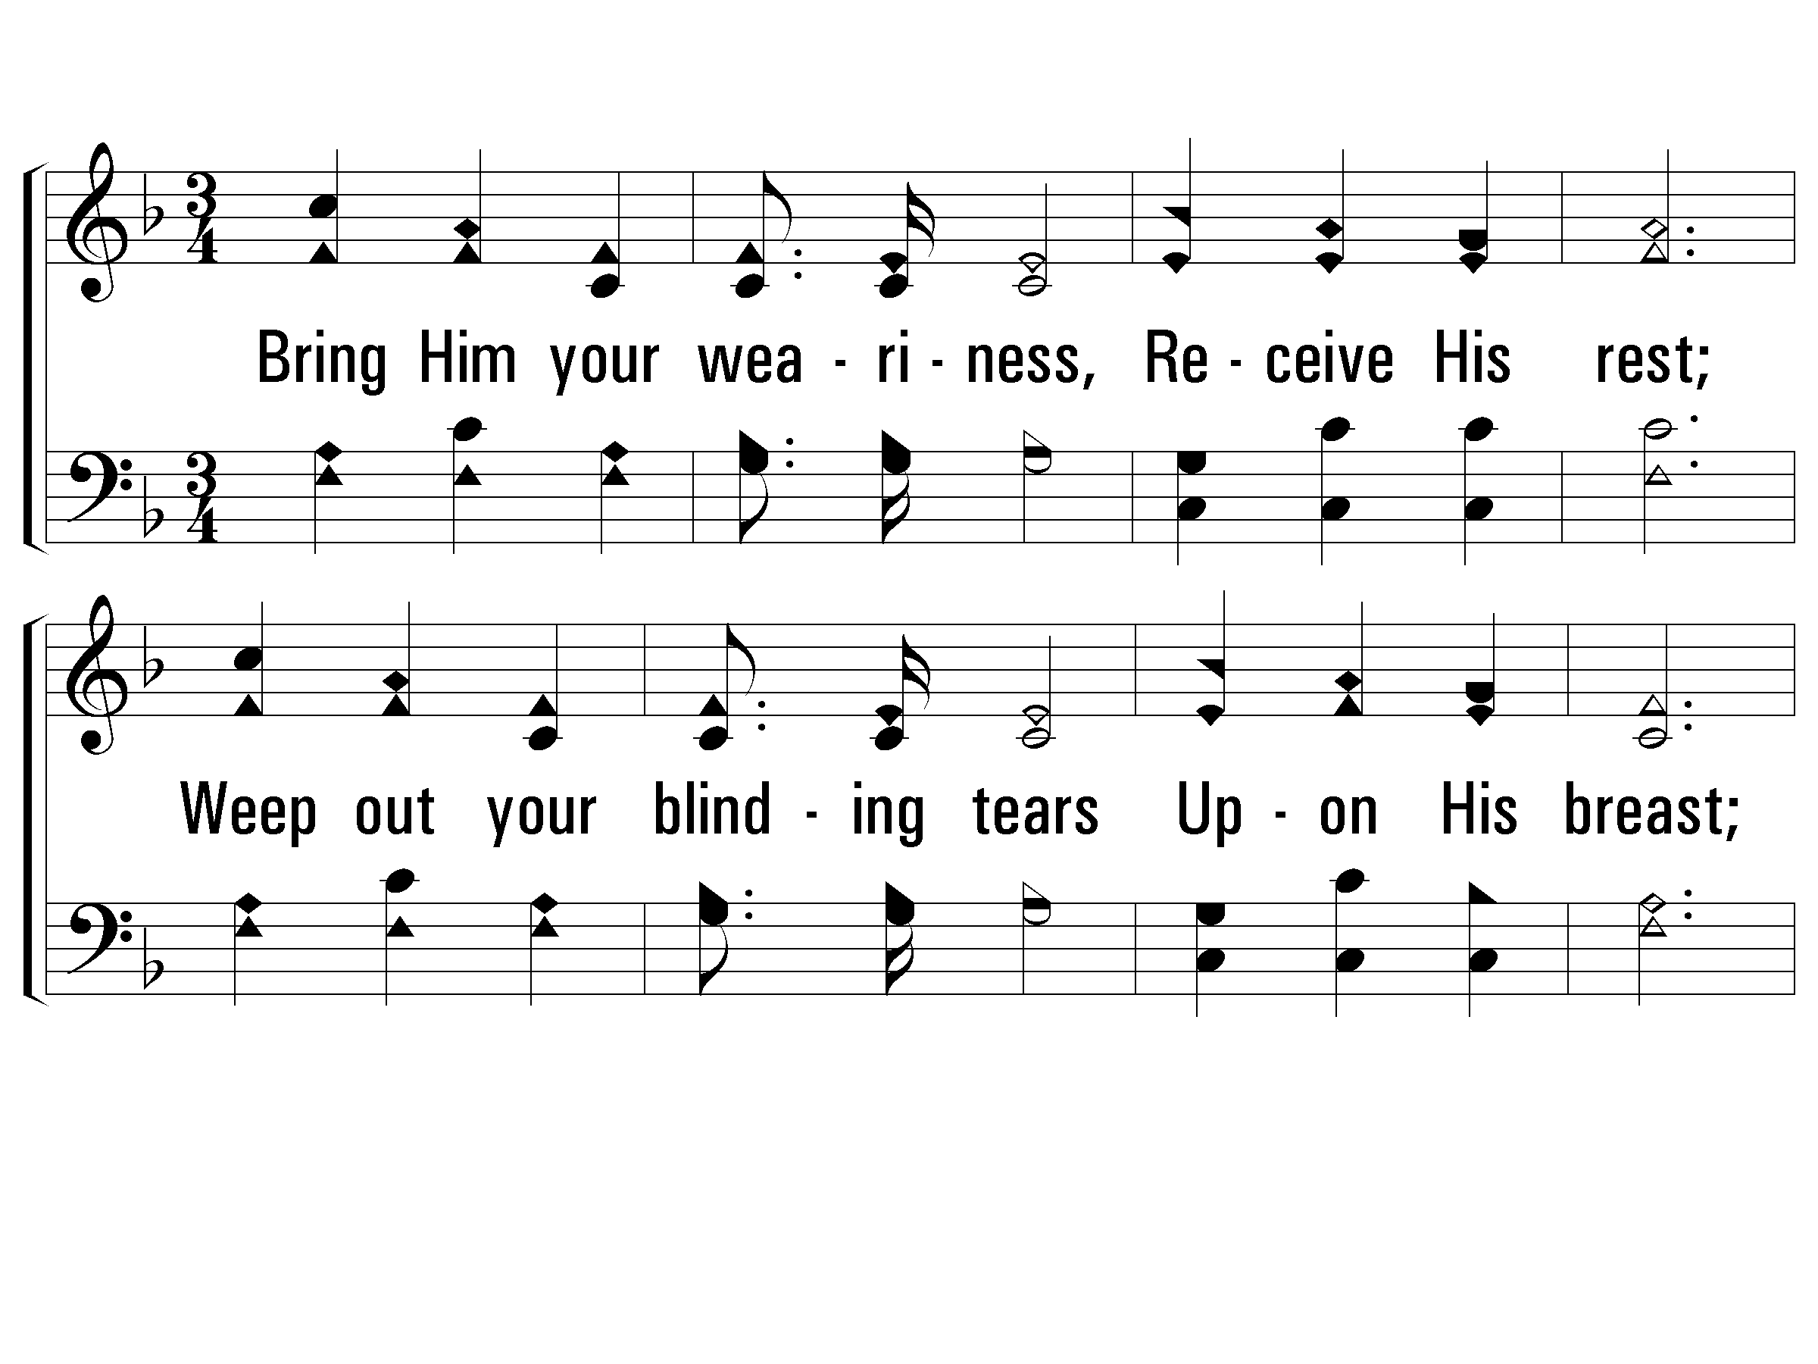
3 - Bring Christ Your Broken Life
67
3.
Bring Him your weariness,
Receive His rest;
Weep out your blinding tears
Upon His breast;
His love is wonderful,
His power is great,
"And none that trust in Him
Shall be desolate."
Words: Thomas O. Chisholm / Music: Lloyd O. Sanderson
Copyright © 1935, Renewed 1963 by L. O. Sanderson, Leon B. Sanderson, Owner.
All rights reserved. Used by permission.
© 2001 The Paperless Hymnal™

Slide 6
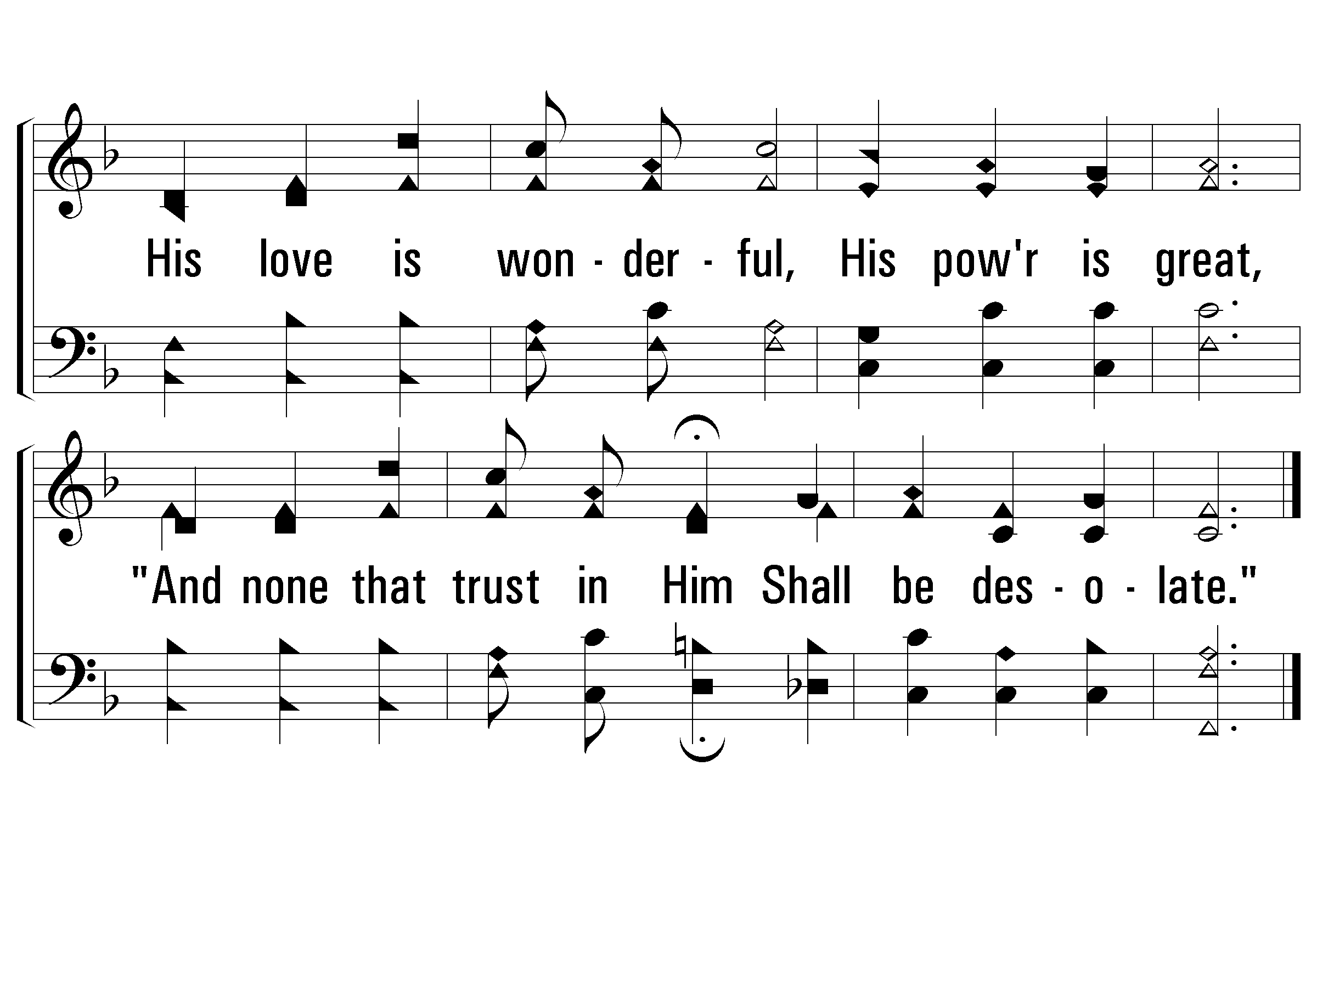
3 - Bring Christ Your Broken Life
67
© 2001 The Paperless Hymnal™

Slide 7
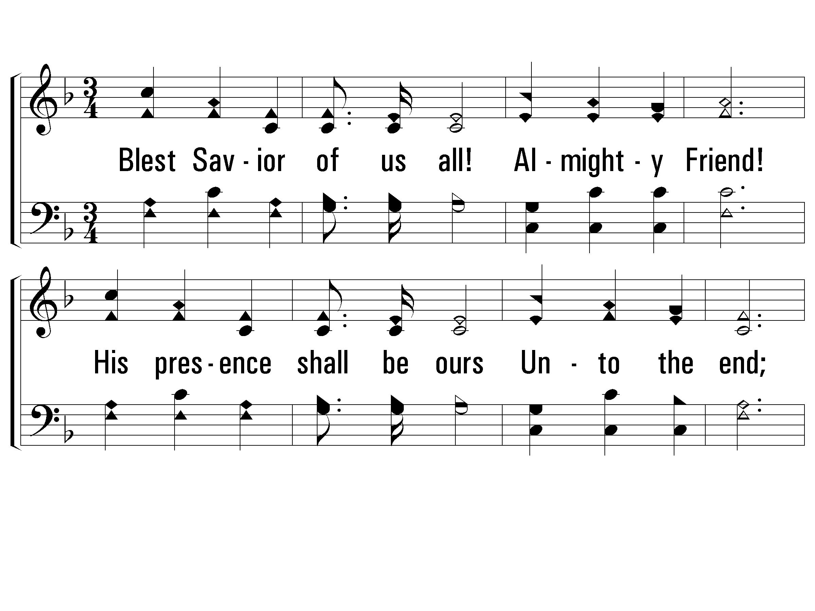
4 - Bring Christ Your Broken Life
67
4.
Blest Savior of us all!
Almighty Friend!
His presence shall be ours
Unto the end;
Without Him life would be
How dark, how drear!
But with Him morning breaks -
And heaven is near!
Words: Thomas O. Chisholm / Music: Lloyd O. Sanderson
Copyright © 1935, Renewed 1963 by L. O. Sanderson, Leon B. Sanderson, Owner.
All rights reserved. Used by permission.
© 2001 The Paperless Hymnal™

Slide 8
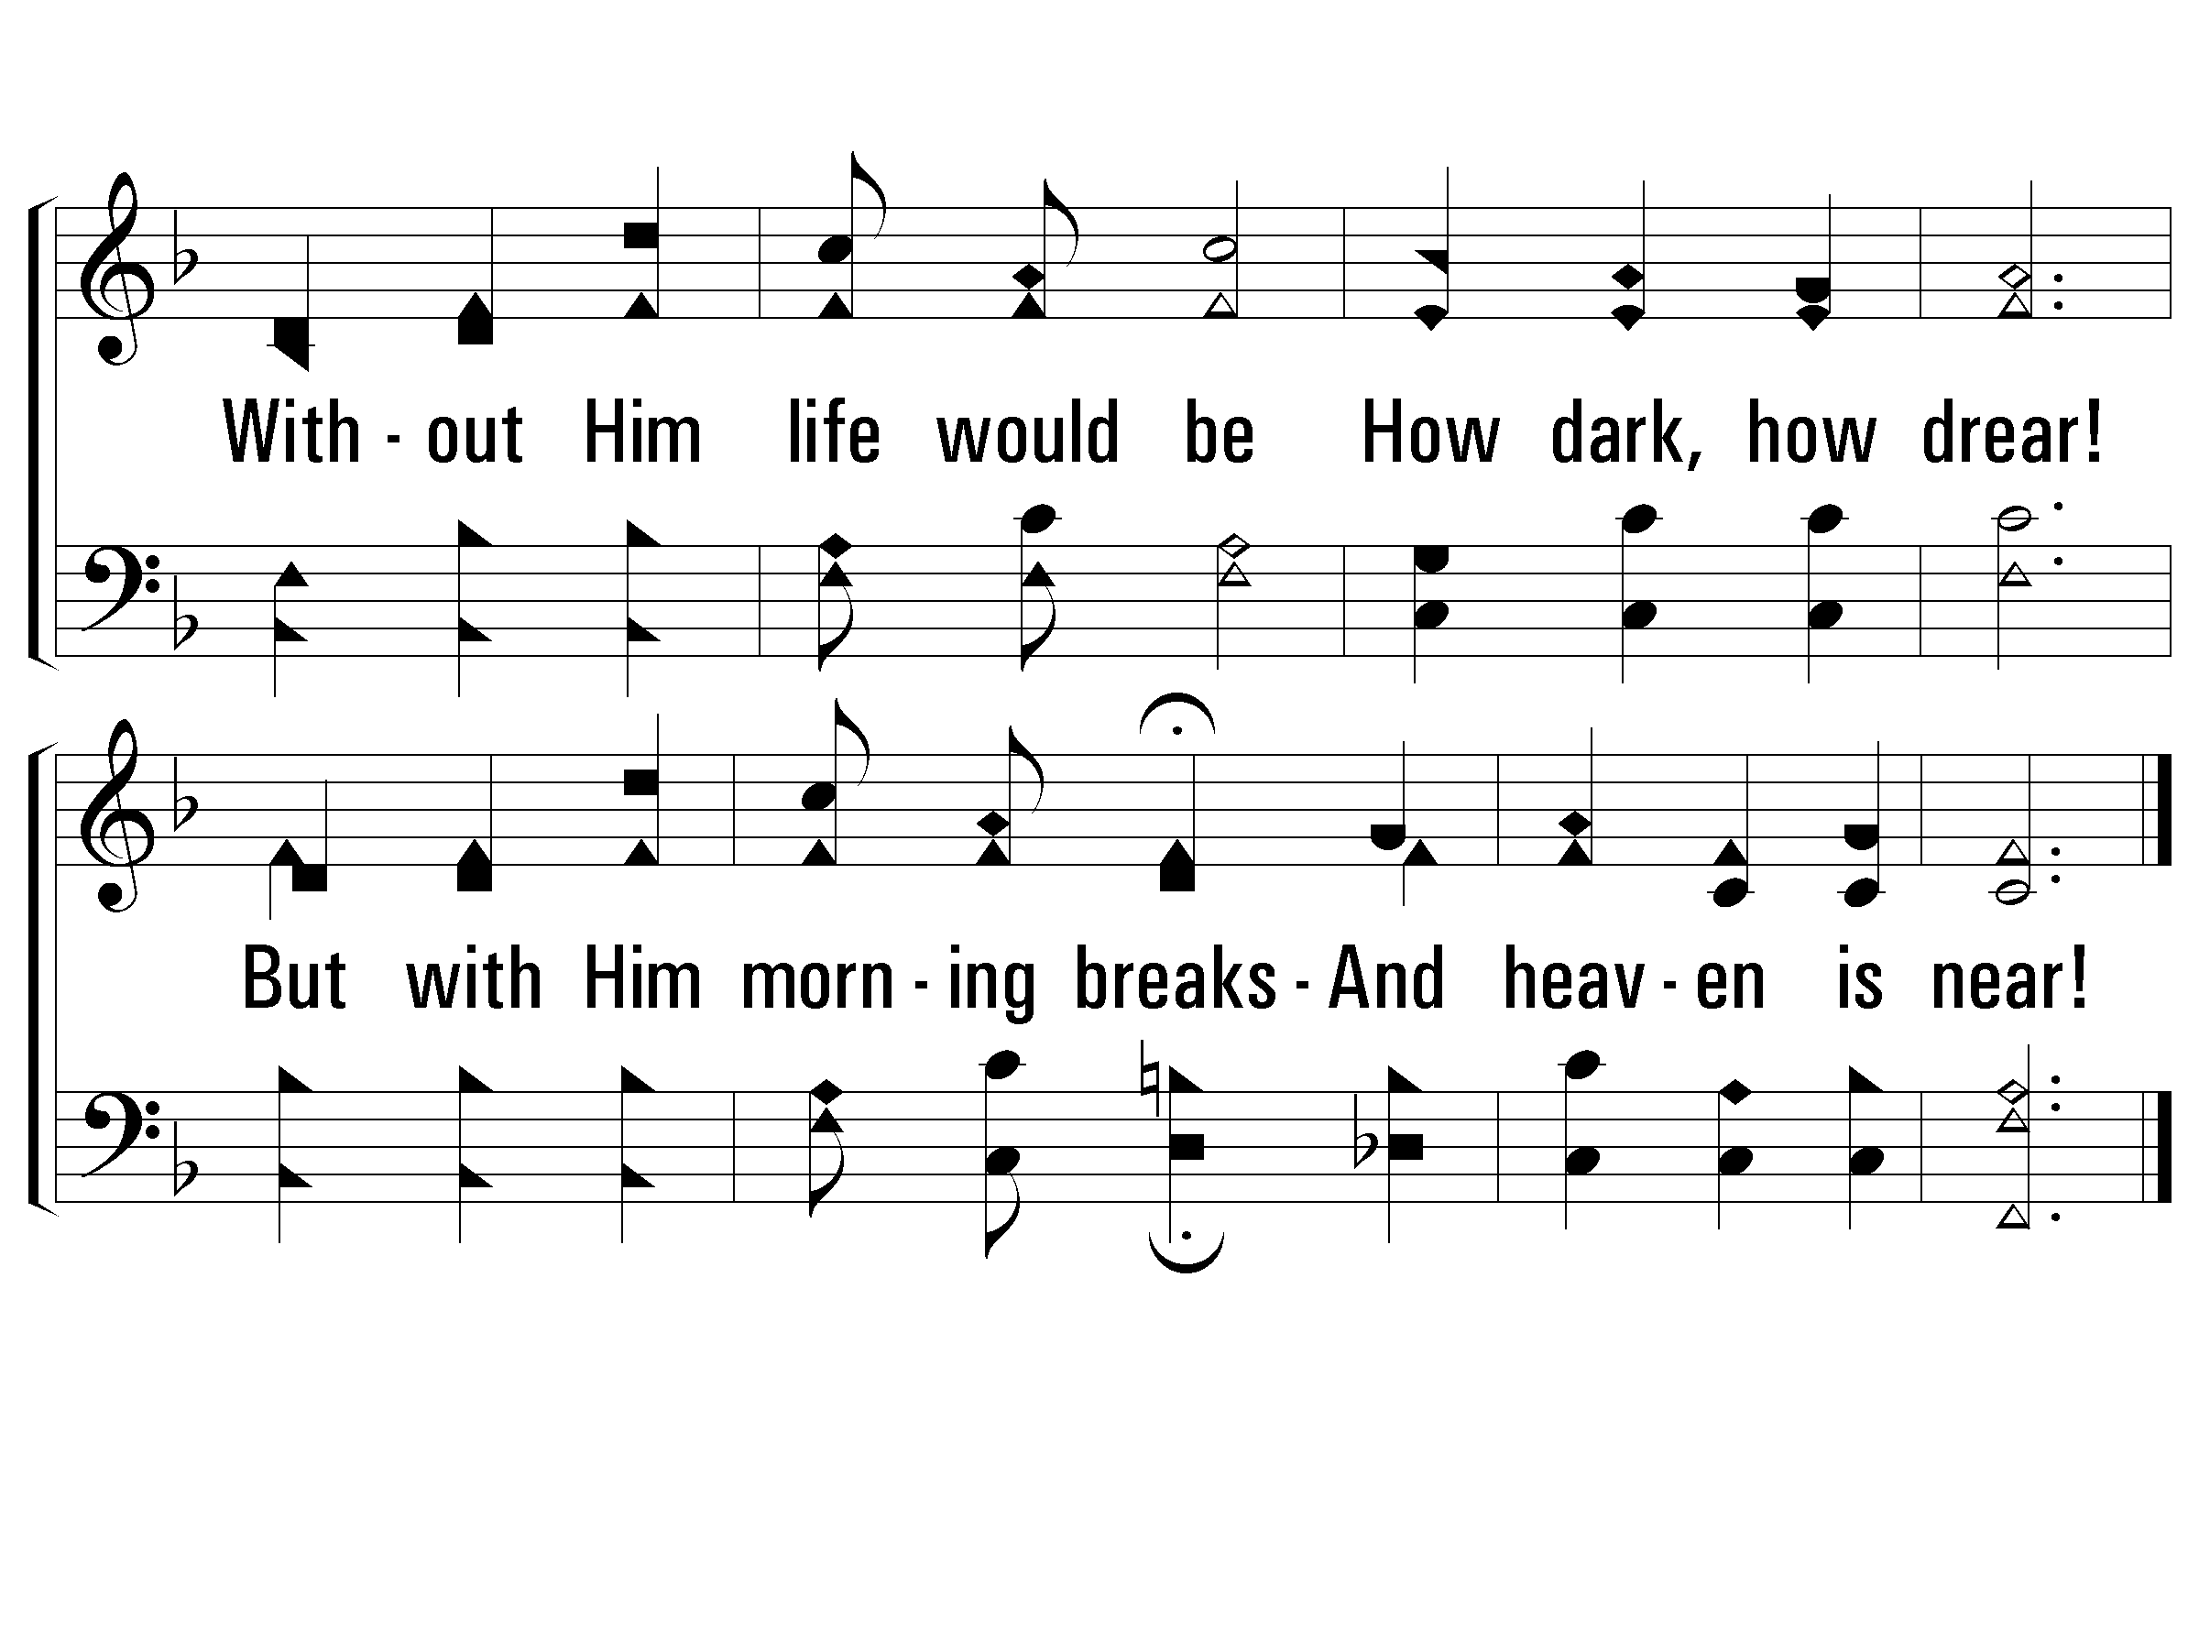
4 - Bring Christ Your Broken Life
67
© 2001 The Paperless Hymnal™

