Slide 1


Welcome
122
253
Prayer
851
Welcome
Dear Lord and Father of Mankind
How Shall the Young Secure Their Hearts?
Blue Skies and Rainbows
Please silence your phone
June 24, 2026
Wednesday • 10:30am

Slide 2
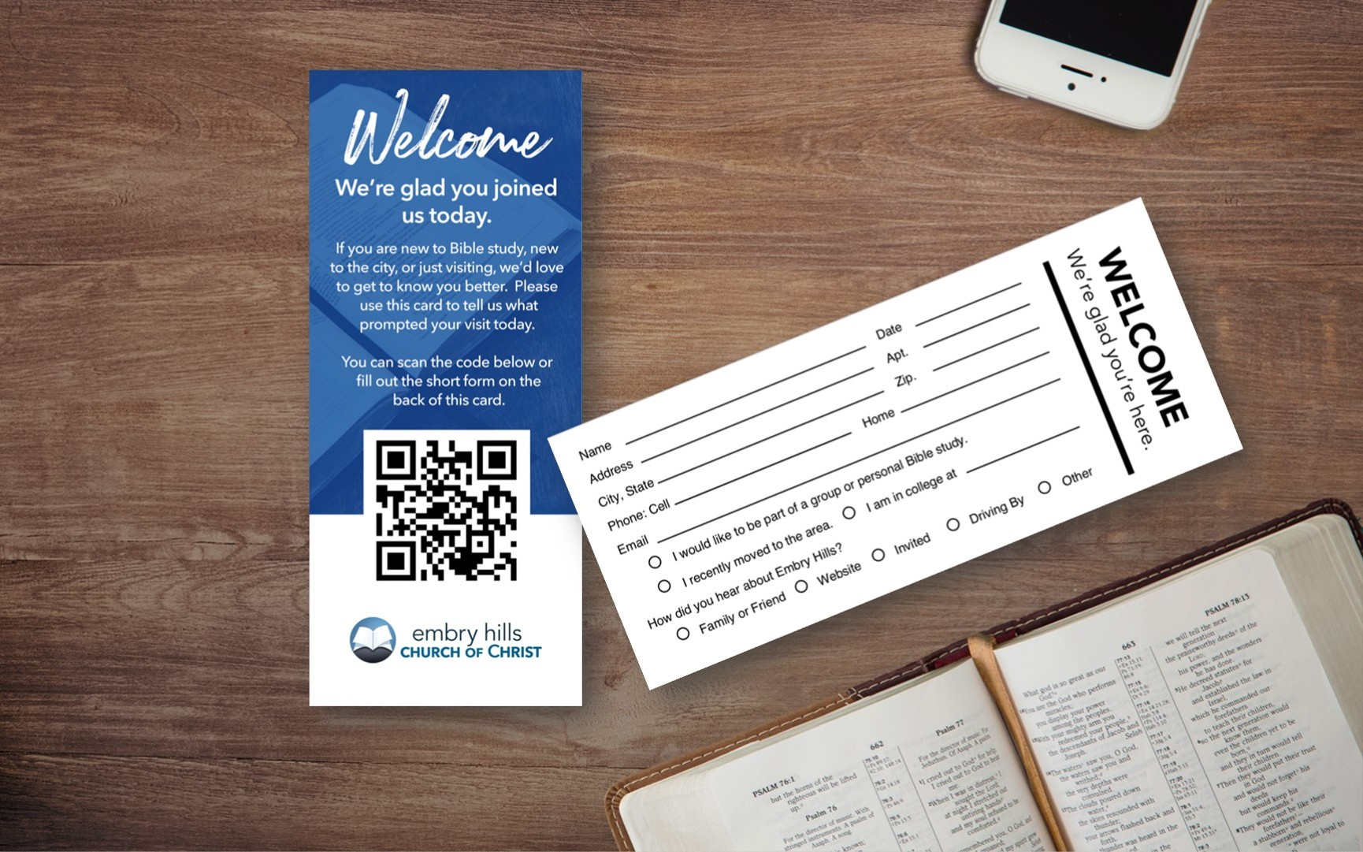
Welcome
122
253
Prayer
851

Slide 3
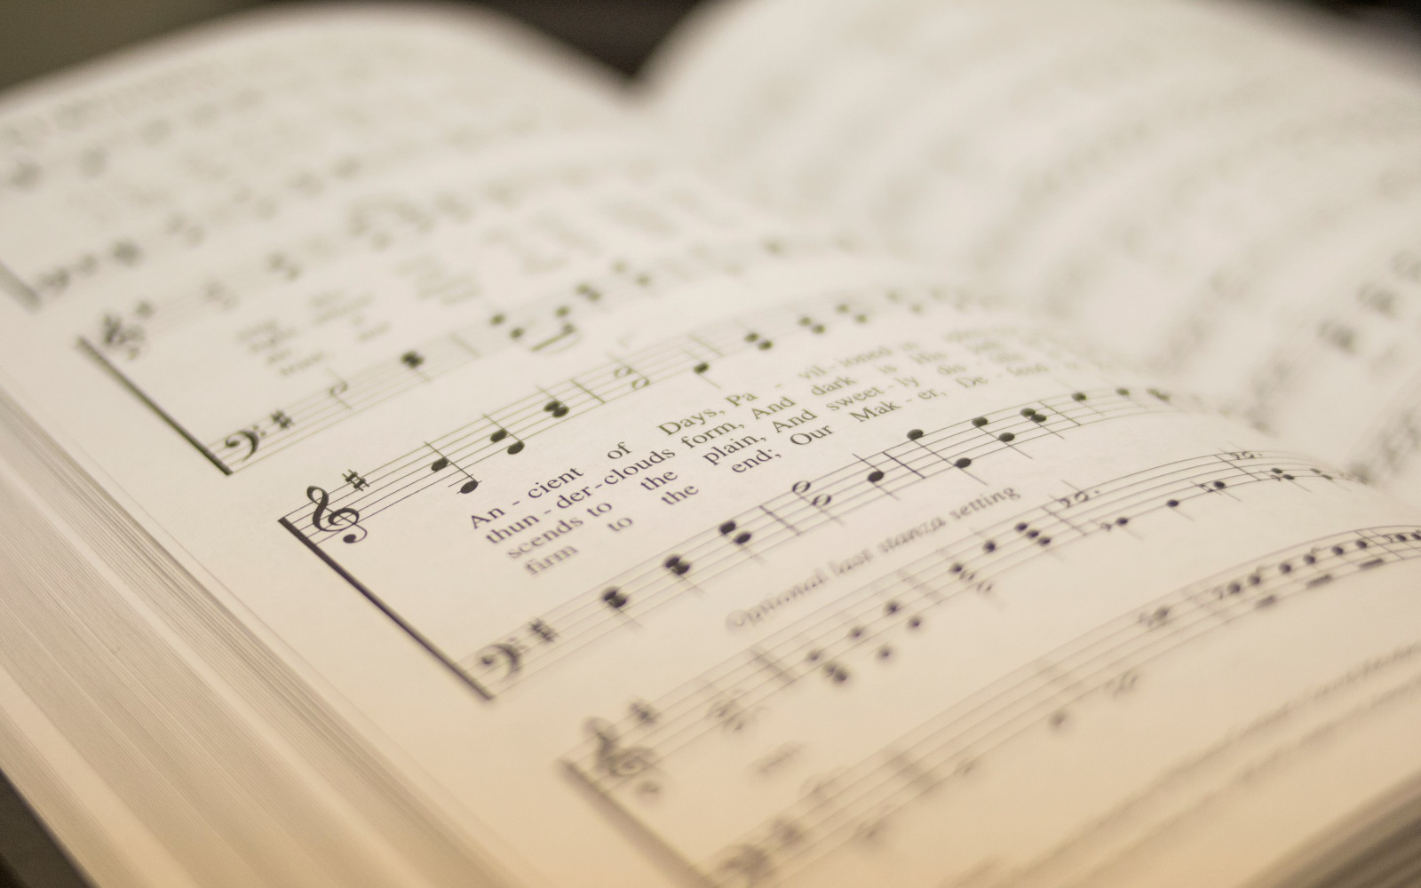
Welcome
122
253
Prayer
851
122
DEAR LORD AND FATHER OF MANKIND
1
2
3
4
“SINGING...TO THE LORD” COLOSSIANS 3:16
Words by: John G. Whittier Music by: Frederick C. Maker

Slide 4
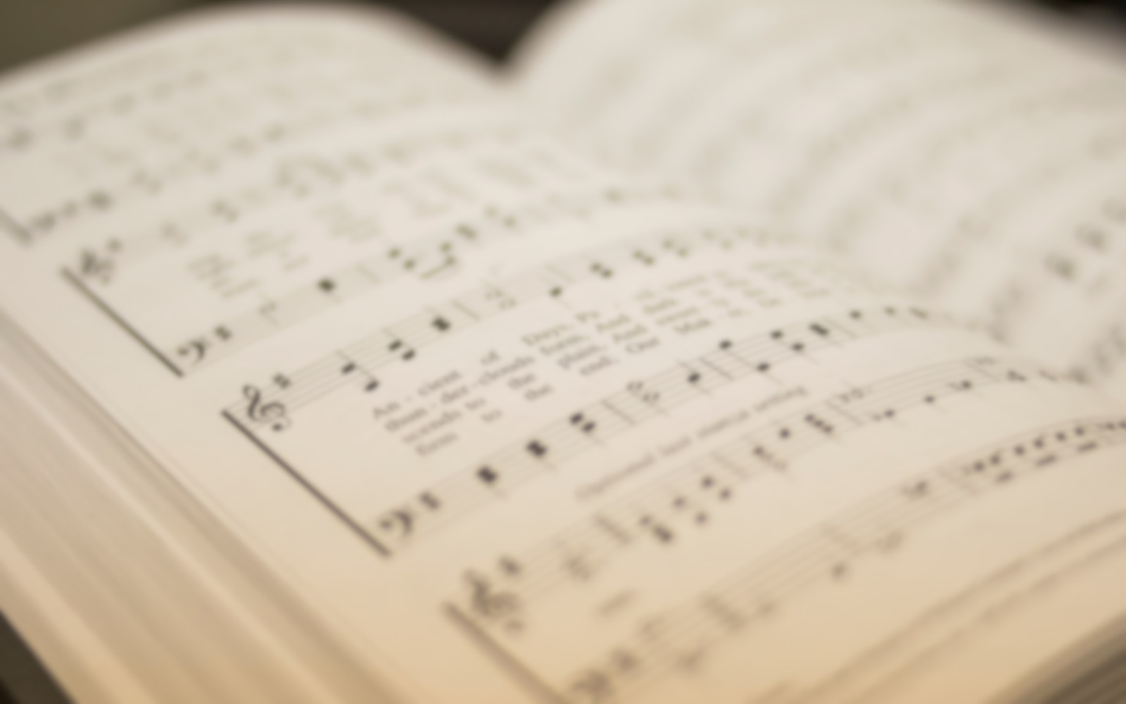
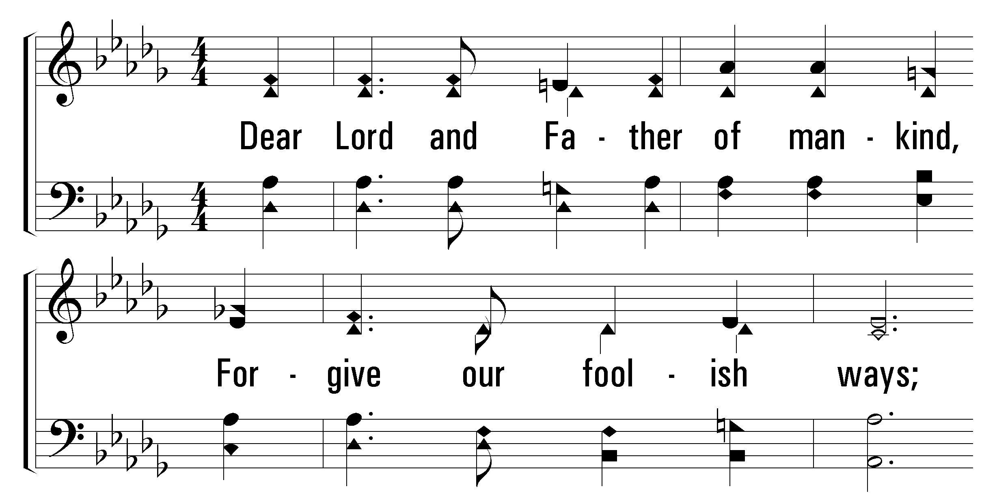


1
2
3
4
122
DEAR LORD AND FATHER OF MANKIND
© 2001 The Paperless Hymnal

Slide 5
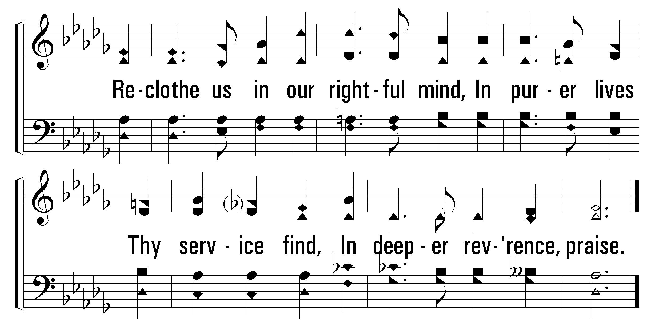
1
2
3
4
122
DEAR LORD AND FATHER OF MANKIND
© 2001 The Paperless Hymnal

Slide 6
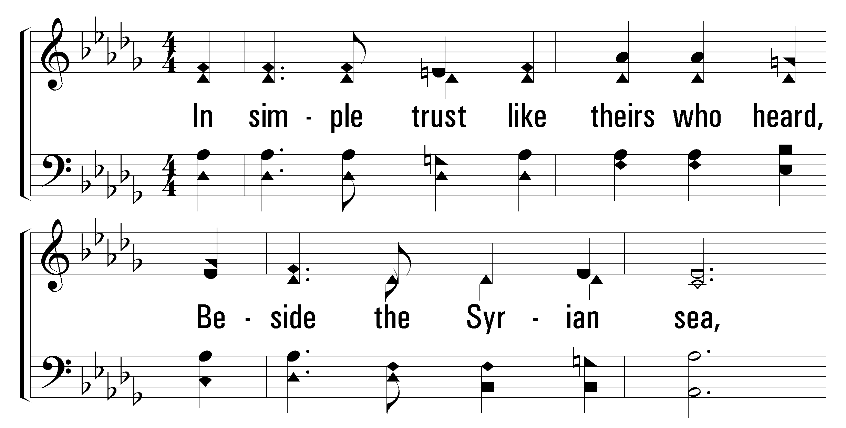
1
2
3
4
122
DEAR LORD AND FATHER OF MANKIND
© 2001 The Paperless Hymnal

Slide 7
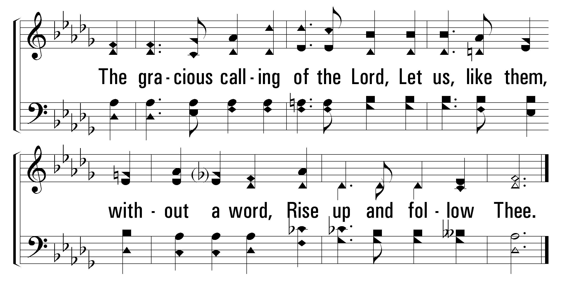
1
2
3
4
122
DEAR LORD AND FATHER OF MANKIND
© 2001 The Paperless Hymnal

Slide 8
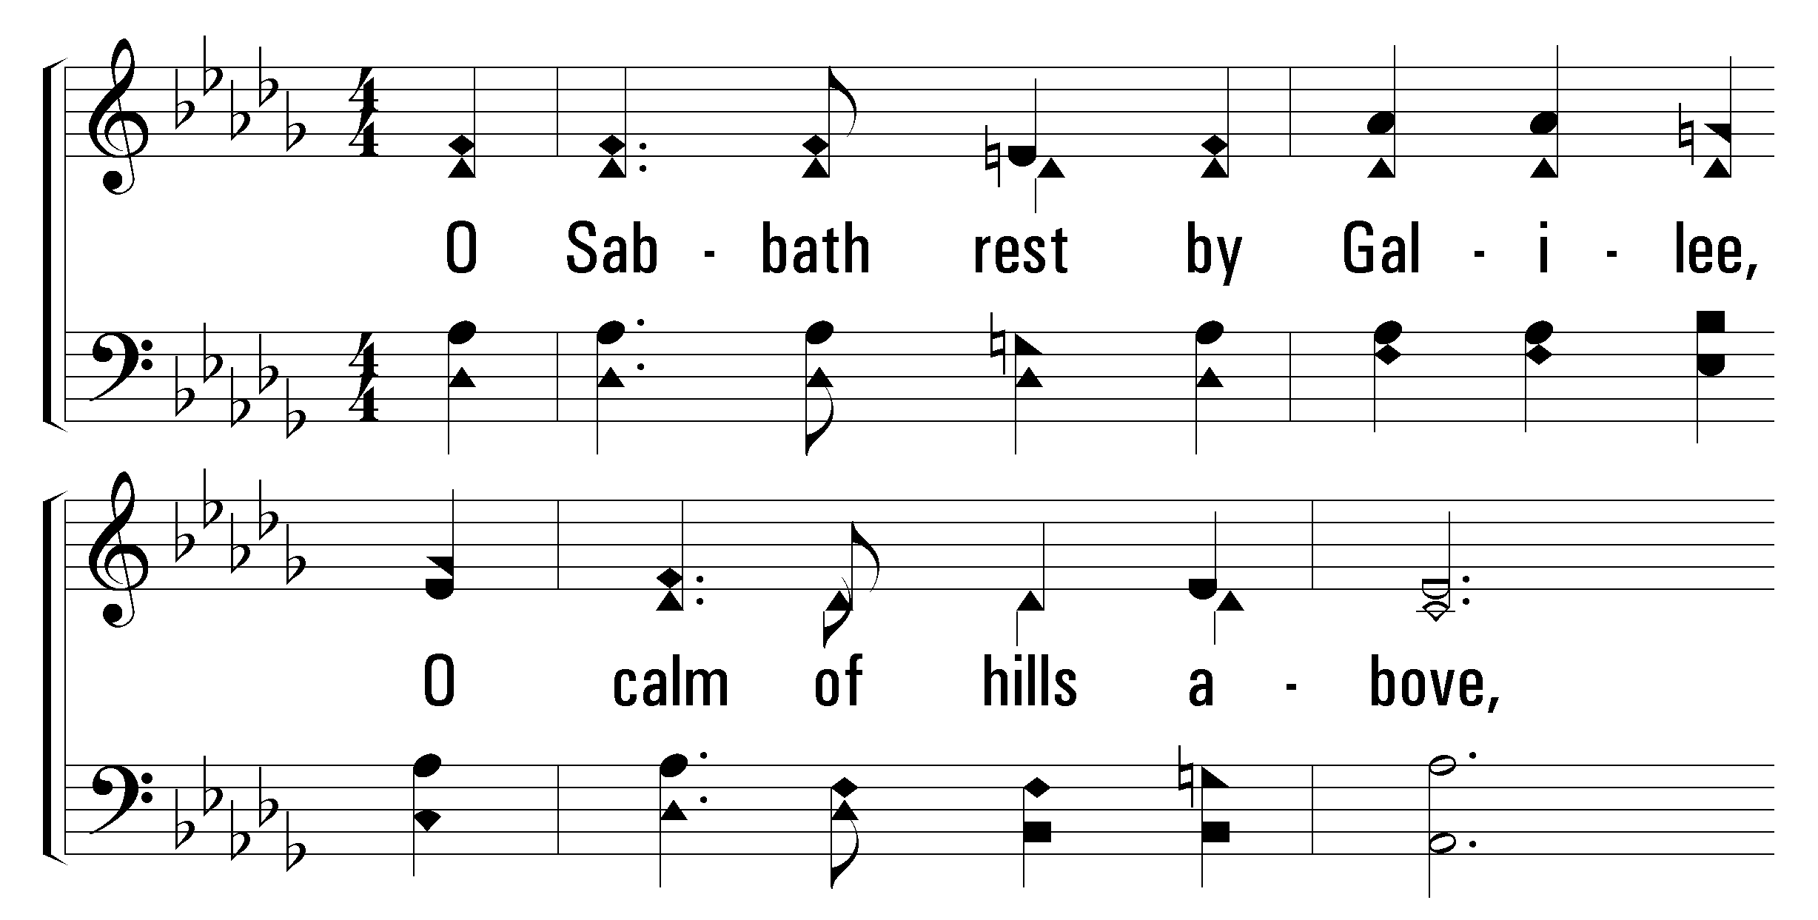
1
2
3
4
122
DEAR LORD AND FATHER OF MANKIND
© 2001 The Paperless Hymnal

Slide 9
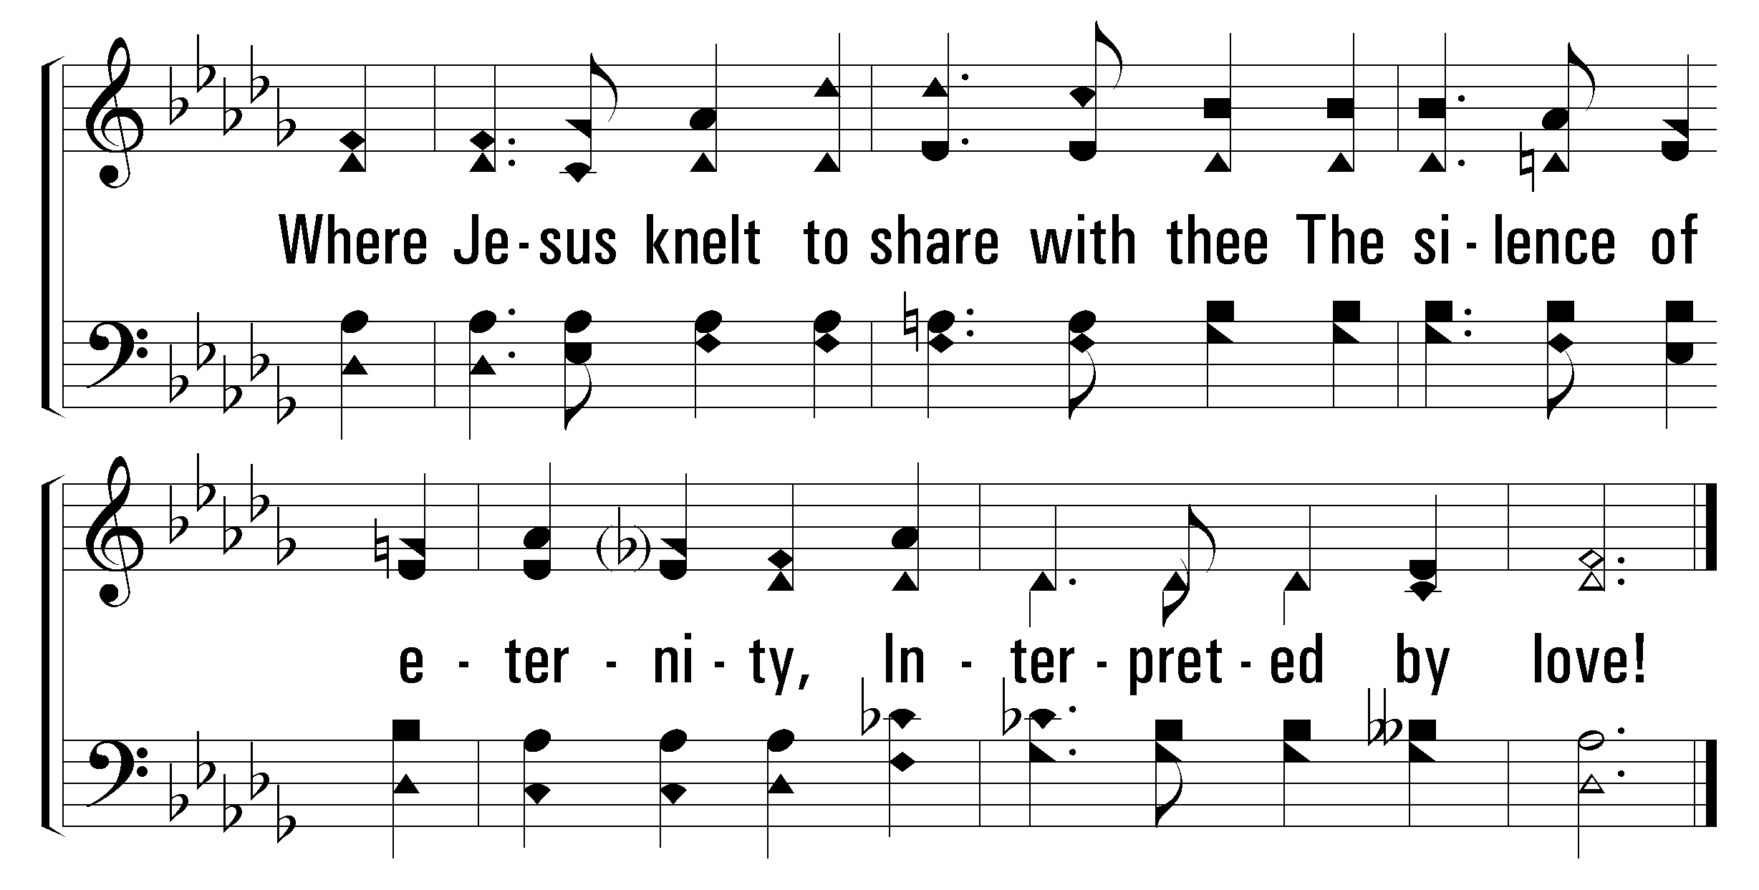
1
2
3
4
122
DEAR LORD AND FATHER OF MANKIND
© 2001 The Paperless Hymnal

Slide 10
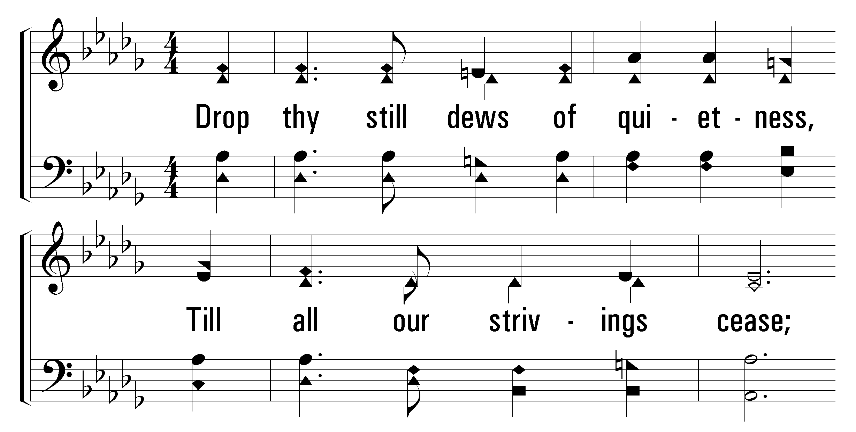
1
2
3
4
122
DEAR LORD AND FATHER OF MANKIND
© 2001 The Paperless Hymnal

Slide 11
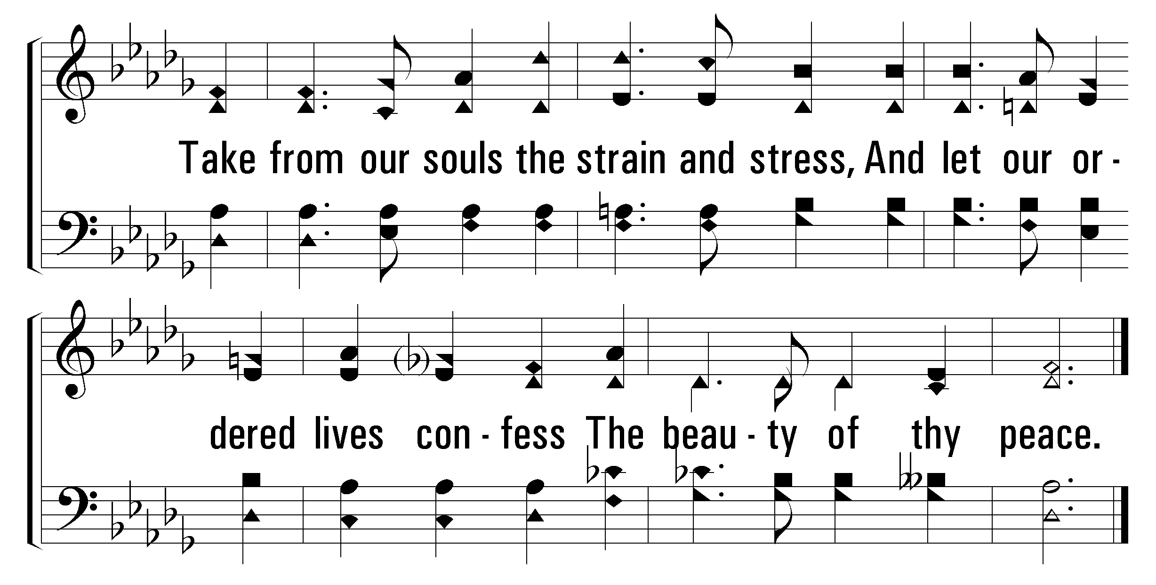
1
2
3
4
122
DEAR LORD AND FATHER OF MANKIND
© 2001 The Paperless Hymnal

Slide 12
Welcome
122
253
Prayer
851
253
HOW SHALL THE YOUNG SECURE THEIR HEARTS?
1
2
3
“SINGING...TO THE LORD” COLOSSIANS 3:16
Words by: Isaac Watts Music by: Hastings & Bradburys Psalmista

Slide 13
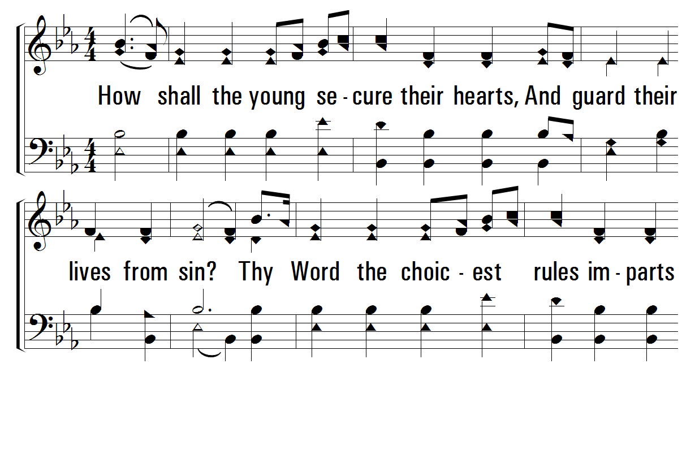
1
2
3
253
HOW SHALL THE YOUNG SECURE THEIR HEARTS?
© 2001 The Paperless Hymnal

Slide 14
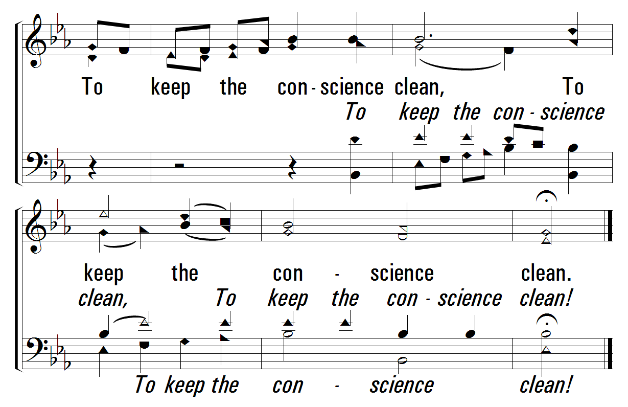
1
2
3
253
HOW SHALL THE YOUNG SECURE THEIR HEARTS?
© 2001 The Paperless Hymnal

Slide 15
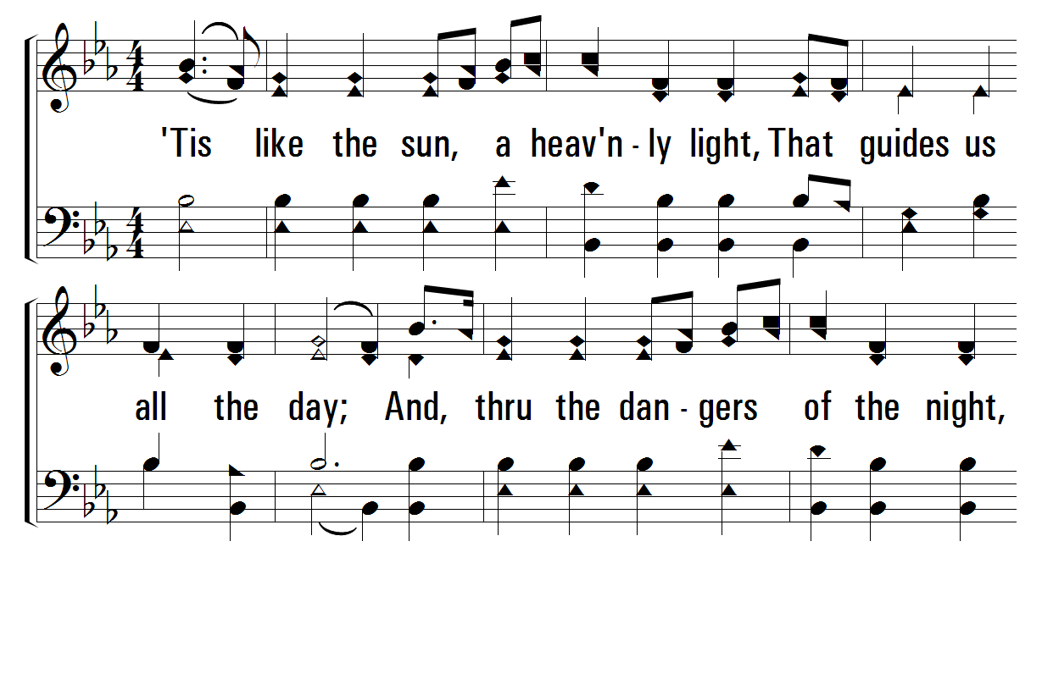
1
2
3
253
HOW SHALL THE YOUNG SECURE THEIR HEARTS?
© 2001 The Paperless Hymnal

Slide 16
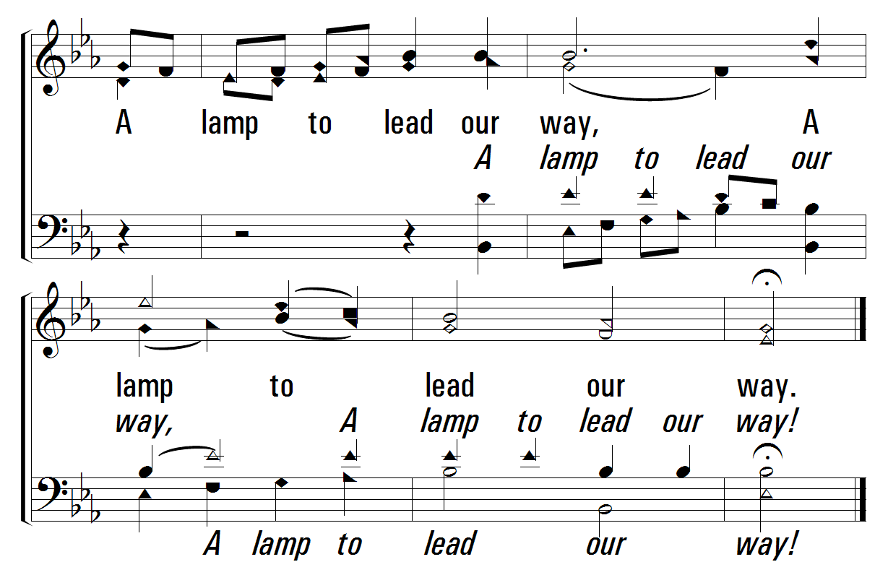
1
2
3
253
HOW SHALL THE YOUNG SECURE THEIR HEARTS?
© 2001 The Paperless Hymnal

Slide 17
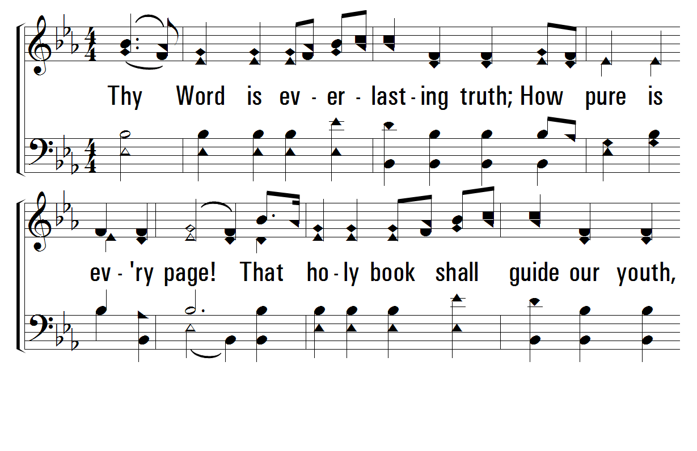
1
2
3
253
HOW SHALL THE YOUNG SECURE THEIR HEARTS?
© 2001 The Paperless Hymnal

Slide 18
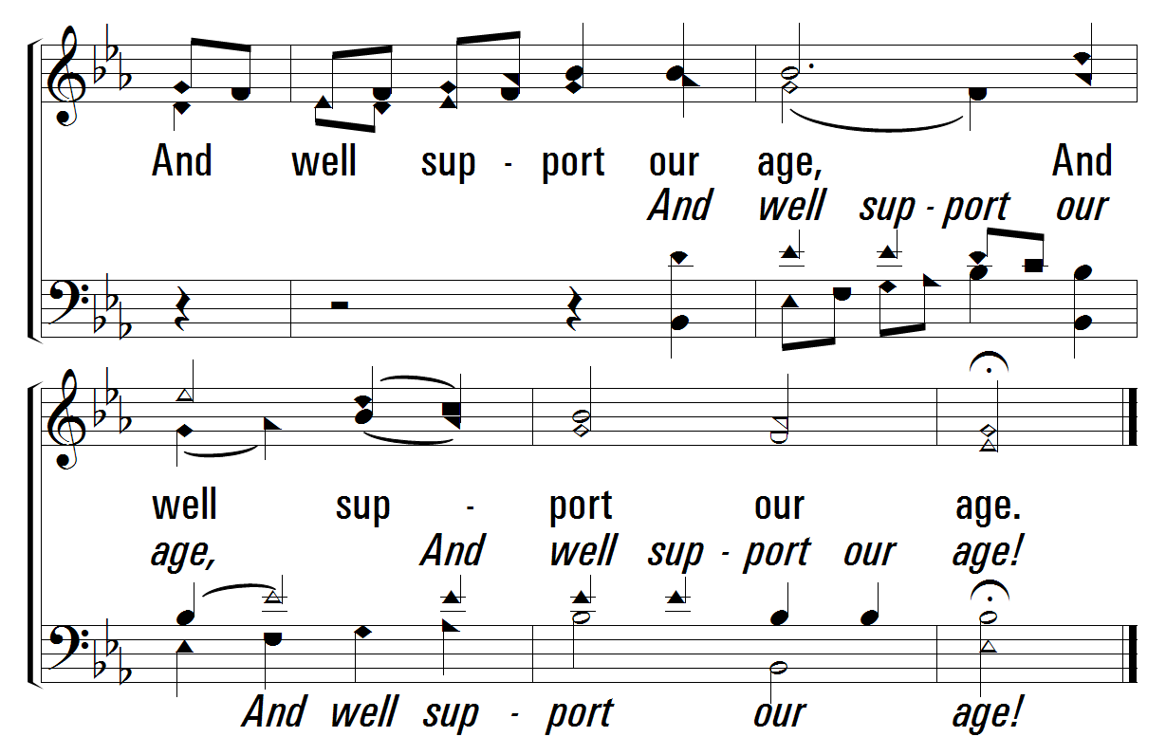
1
2
3
253
HOW SHALL THE YOUNG SECURE THEIR HEARTS?
© 2001 The Paperless Hymnal

Slide 19
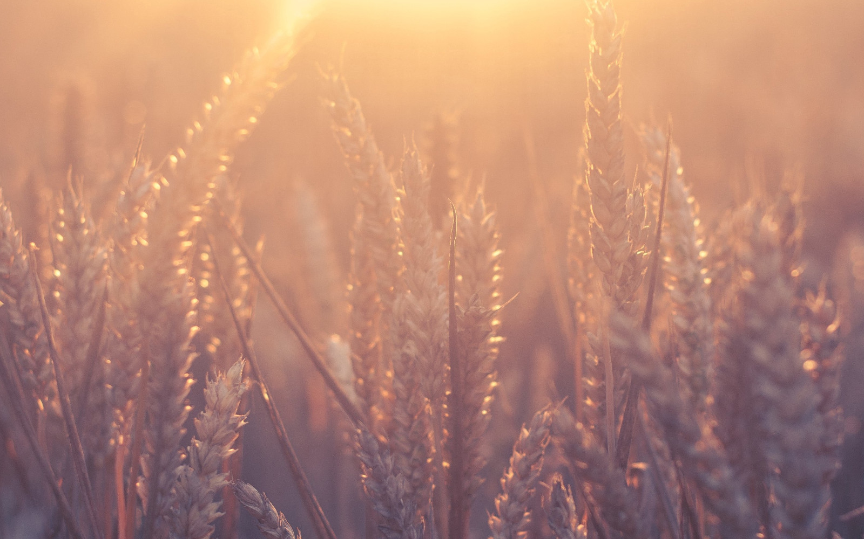
Welcome
122
253
Prayer
851
PRAYER
“DEVOTE YOURSELVES TO PRAYER”
COLOSSIANS 4:2

Slide 20
Welcome
122
253
Prayer
851
851
BLUE SKIES AND RAINBOWS
1
2
3
“SINGING...TO THE LORD” COLOSSIANS 3:16
Words and Music by: Gary Mabry Copyright © 1971 (Renewed) by Boston Music Company, a division of Music Sales Corp. International Copyright Secured, All rights Reserved. Reprinted by permission.

Slide 21
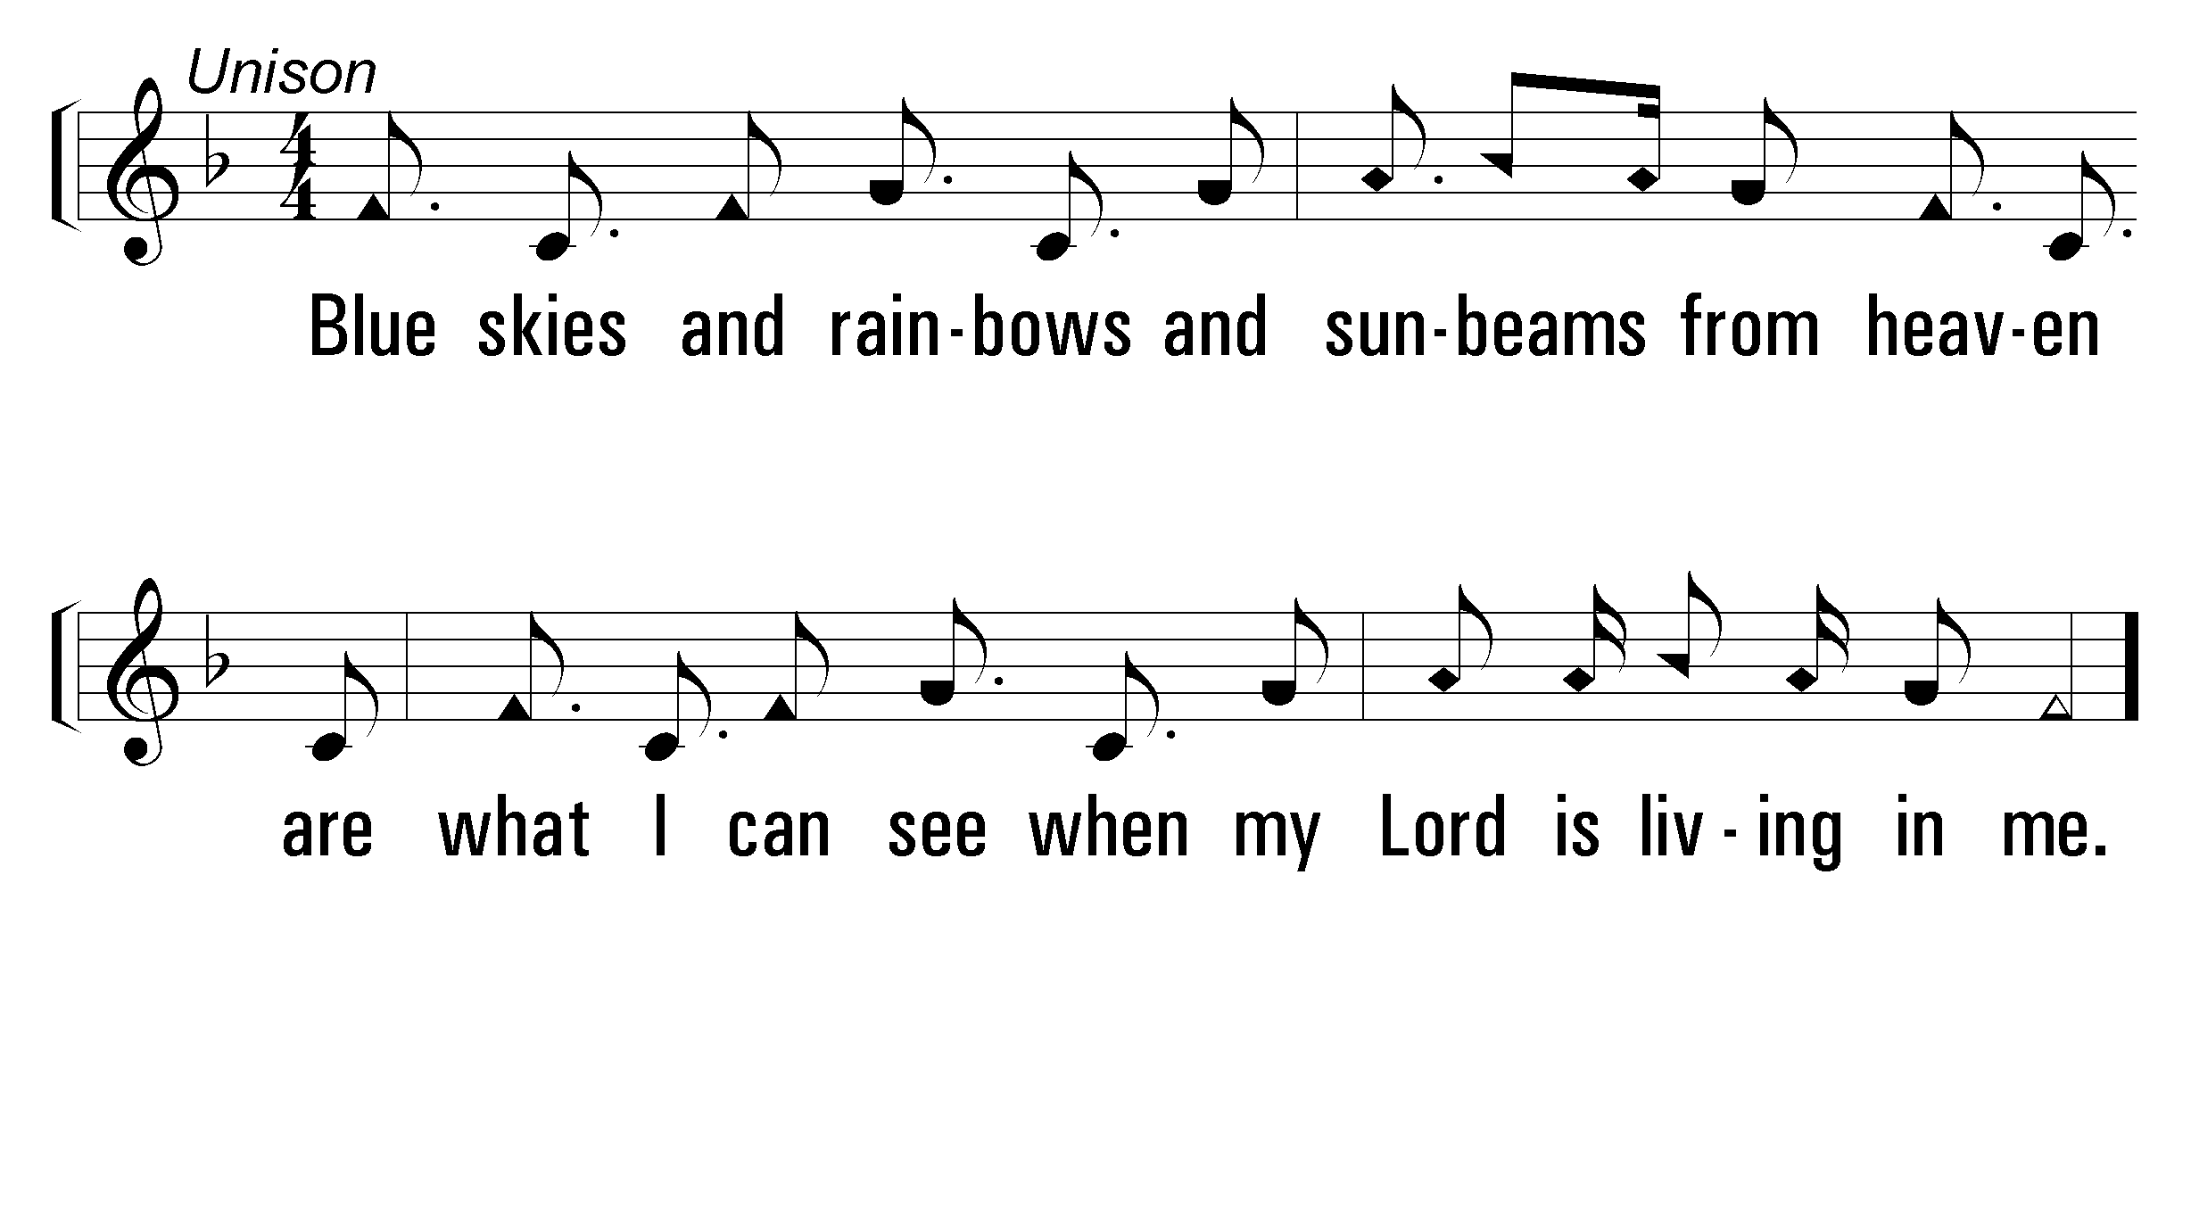
1
C
2
C
3
C
851
BLUE SKIES AND RAINBOWS
© 2007 The Paperless Hymnal®

Slide 22
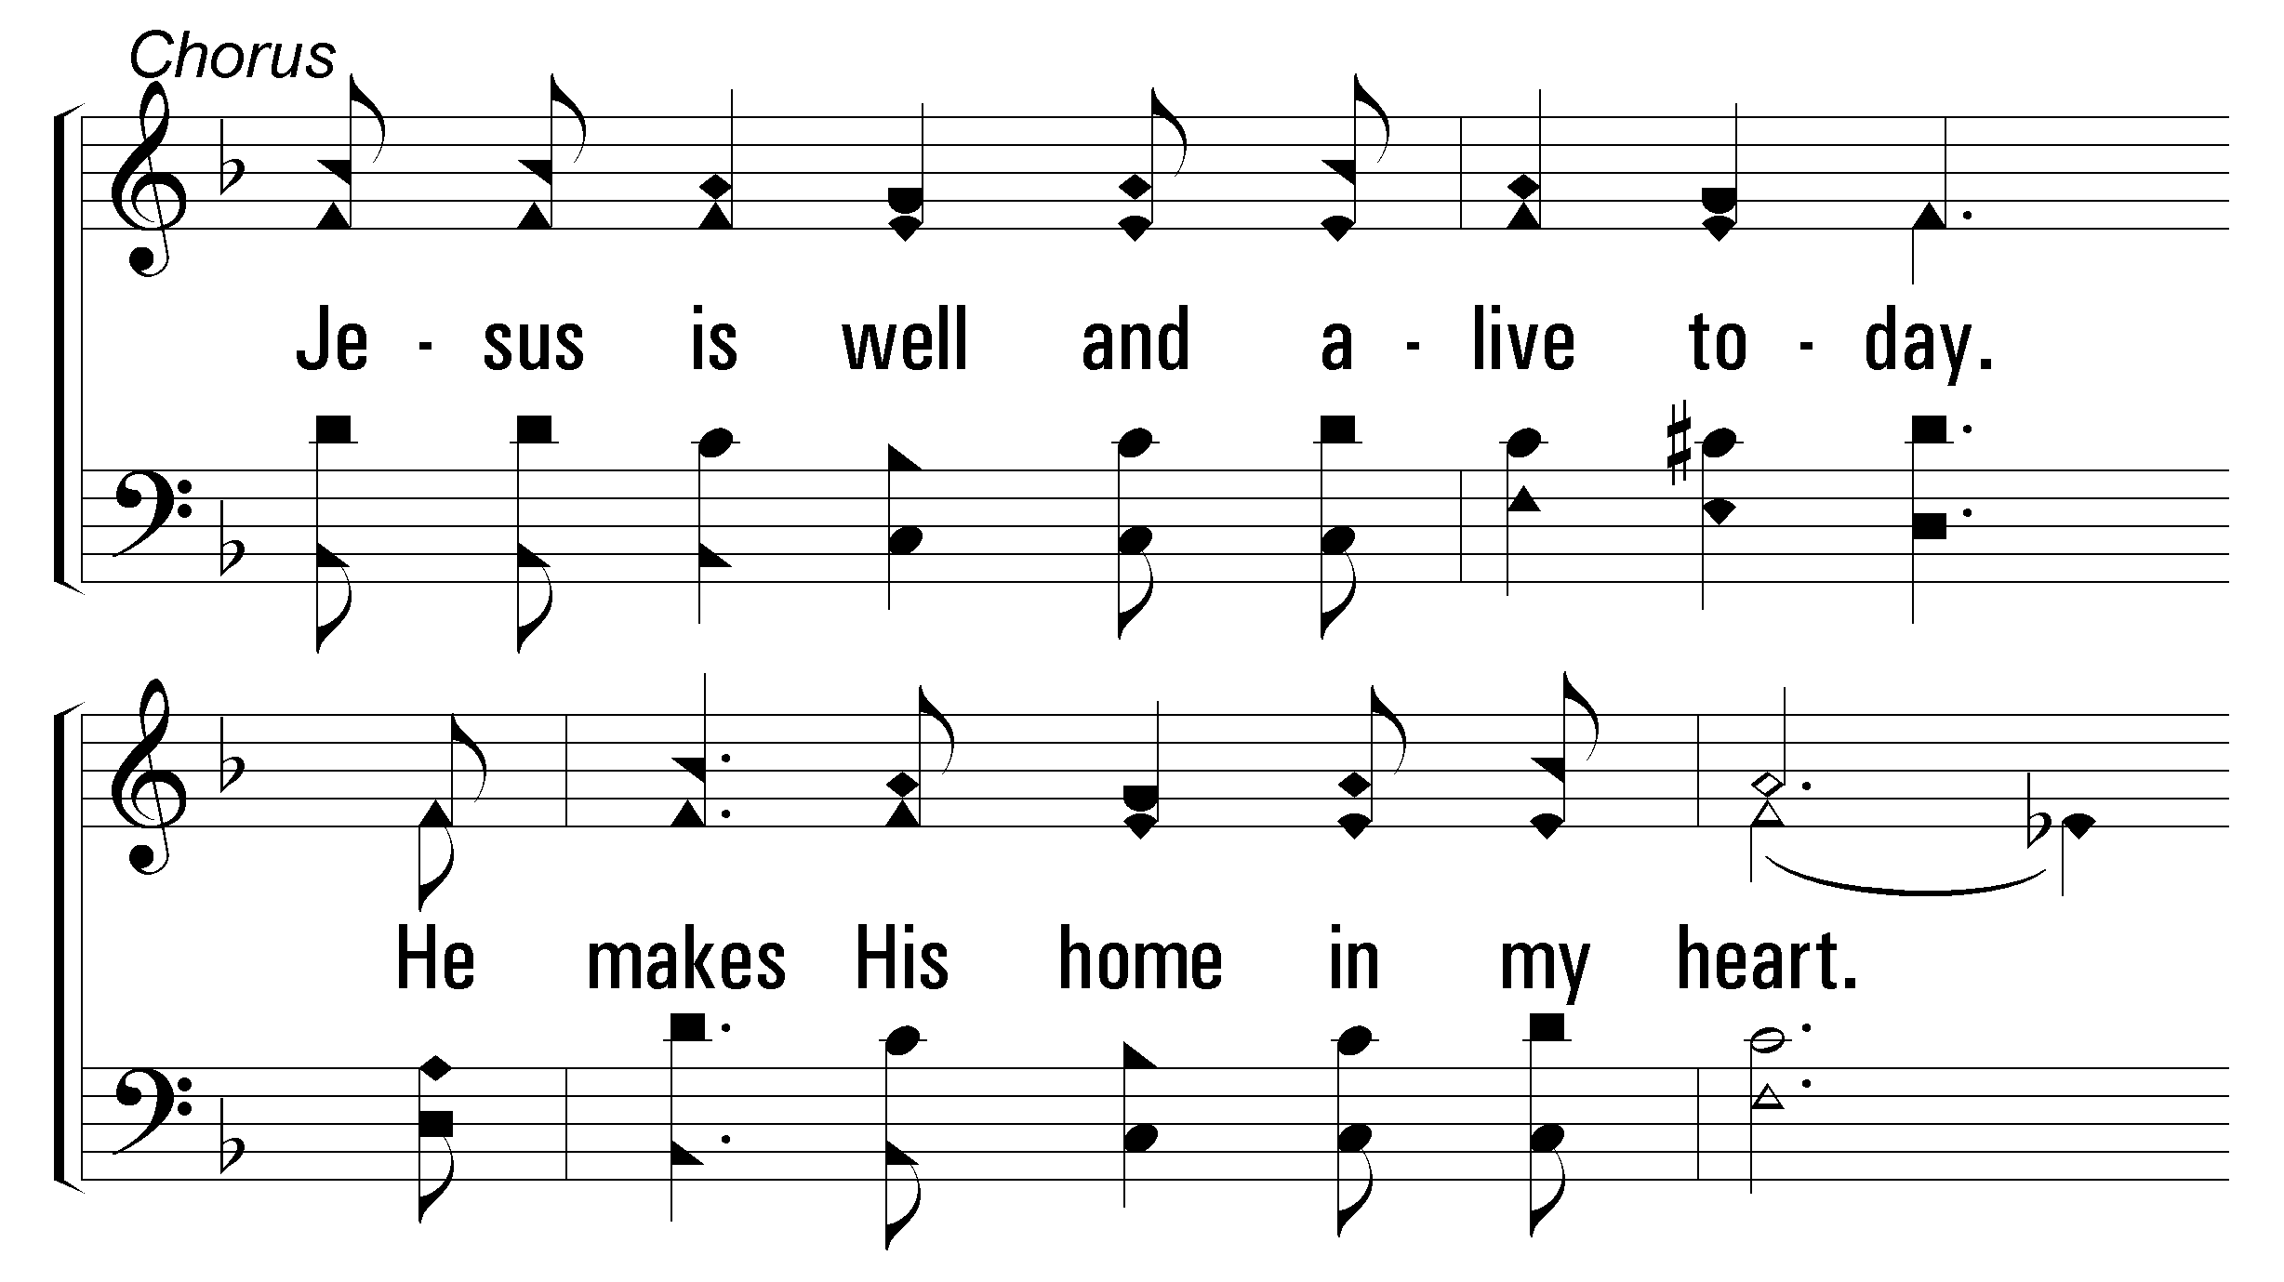
1
C
2
C
3
C
851
BLUE SKIES AND RAINBOWS
© 2007 The Paperless Hymnal®

Slide 23
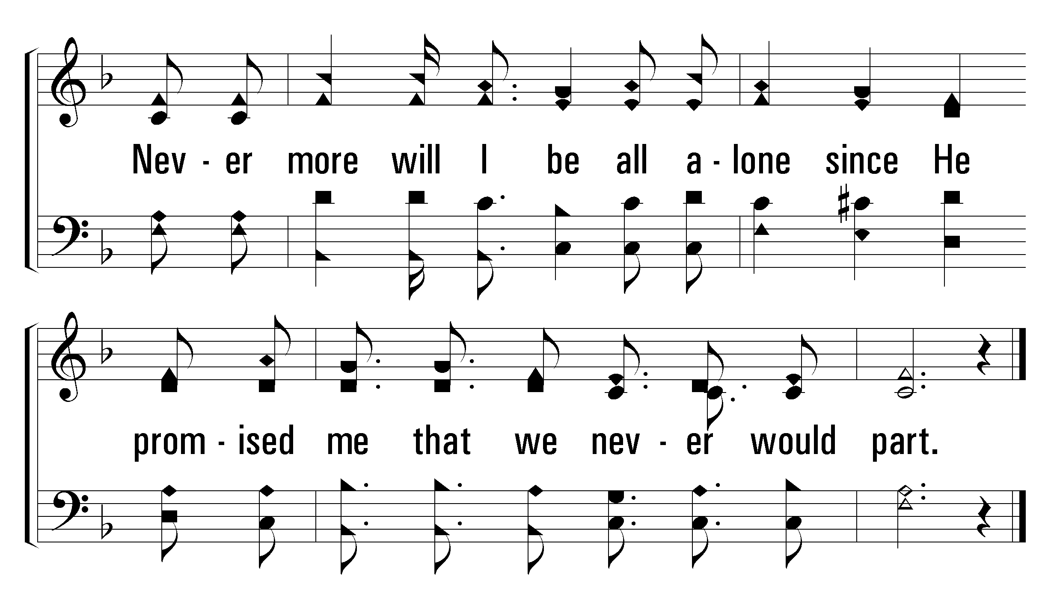
1
C
2
C
3
C
851
BLUE SKIES AND RAINBOWS
© 2007 The Paperless Hymnal®

Slide 24
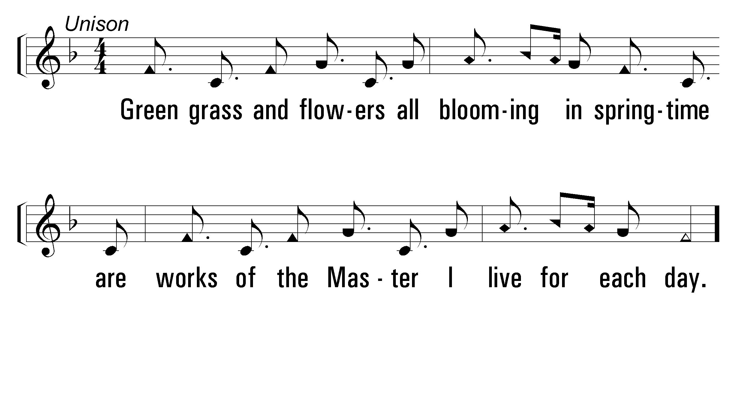
1
C
2
C
3
C
851
BLUE SKIES AND RAINBOWS
© 2007 The Paperless Hymnal®

Slide 25
1
C
2
C
3
C
851
BLUE SKIES AND RAINBOWS
© 2007 The Paperless Hymnal®

Slide 26
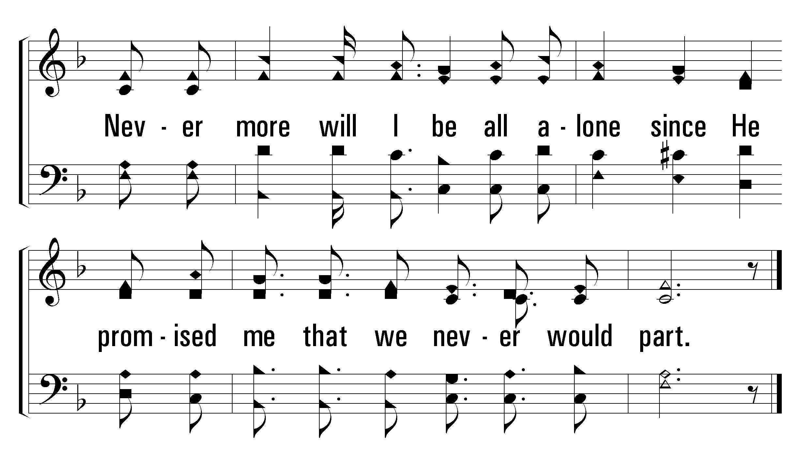
1
C
2
C
3
C
851
BLUE SKIES AND RAINBOWS
© 2007 The Paperless Hymnal®

Slide 27
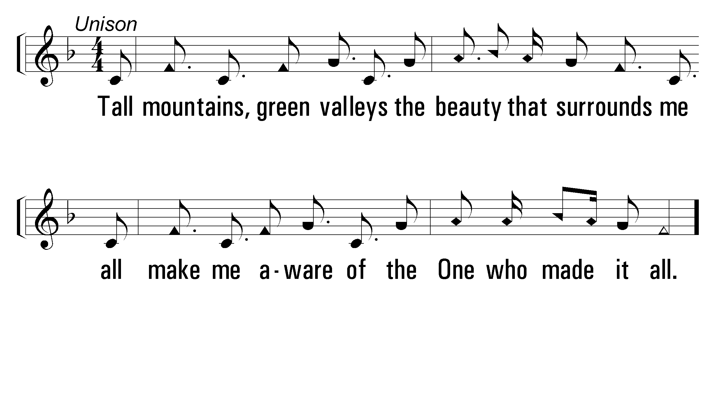
1
C
2
C
3
C
851
BLUE SKIES AND RAINBOWS
© 2007 The Paperless Hymnal®

Slide 28
1
C
2
C
3
C
851
BLUE SKIES AND RAINBOWS
© 2007 The Paperless Hymnal®

Slide 29
1
C
2
C
3
C
851
BLUE SKIES AND RAINBOWS
© 2007 The Paperless Hymnal®

