Slide 1
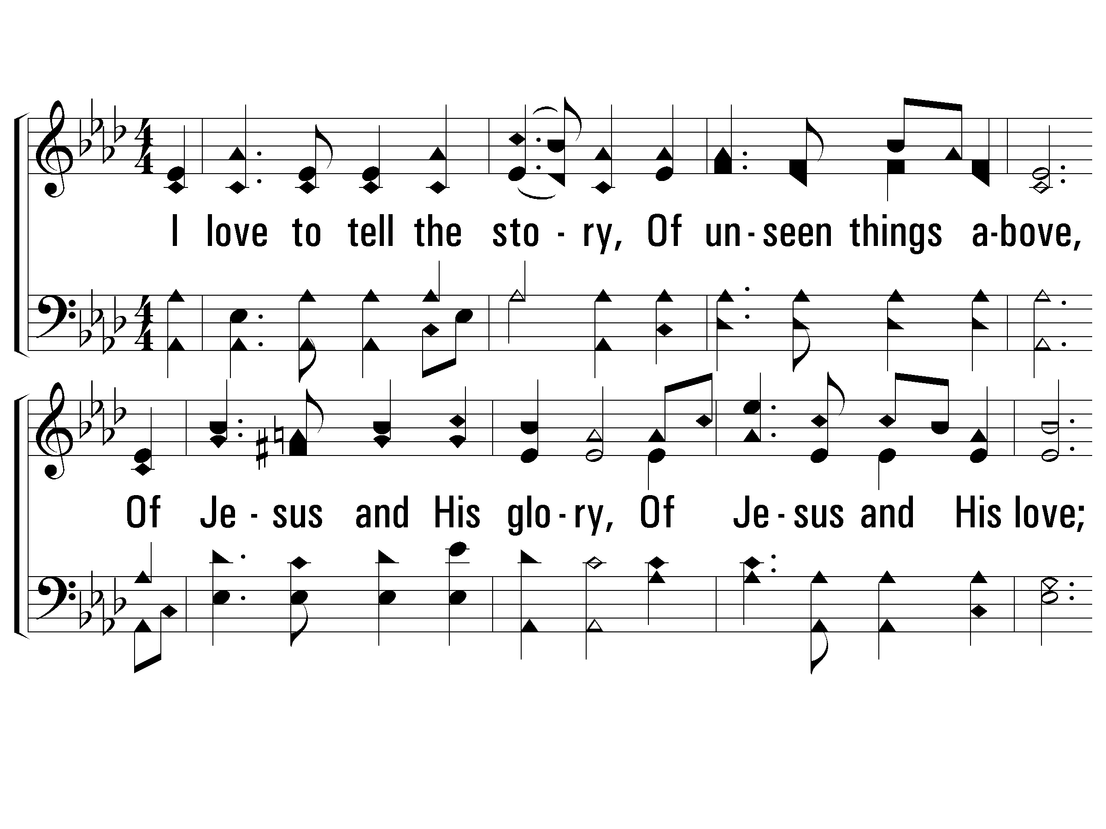
1 – I Love to Tell the Story
275
1.
I love to tell the story,
Of unseen things above,
Of Jesus and His glory,
Of Jesus and His love;
I love to tell the story
Because I know 'tis true;
It satisfies my longings
As nothing else can do.
Words: Catherine Hankey
Music: William G. Fischer
© 2001 The Paperless Hymnal™

Slide 2
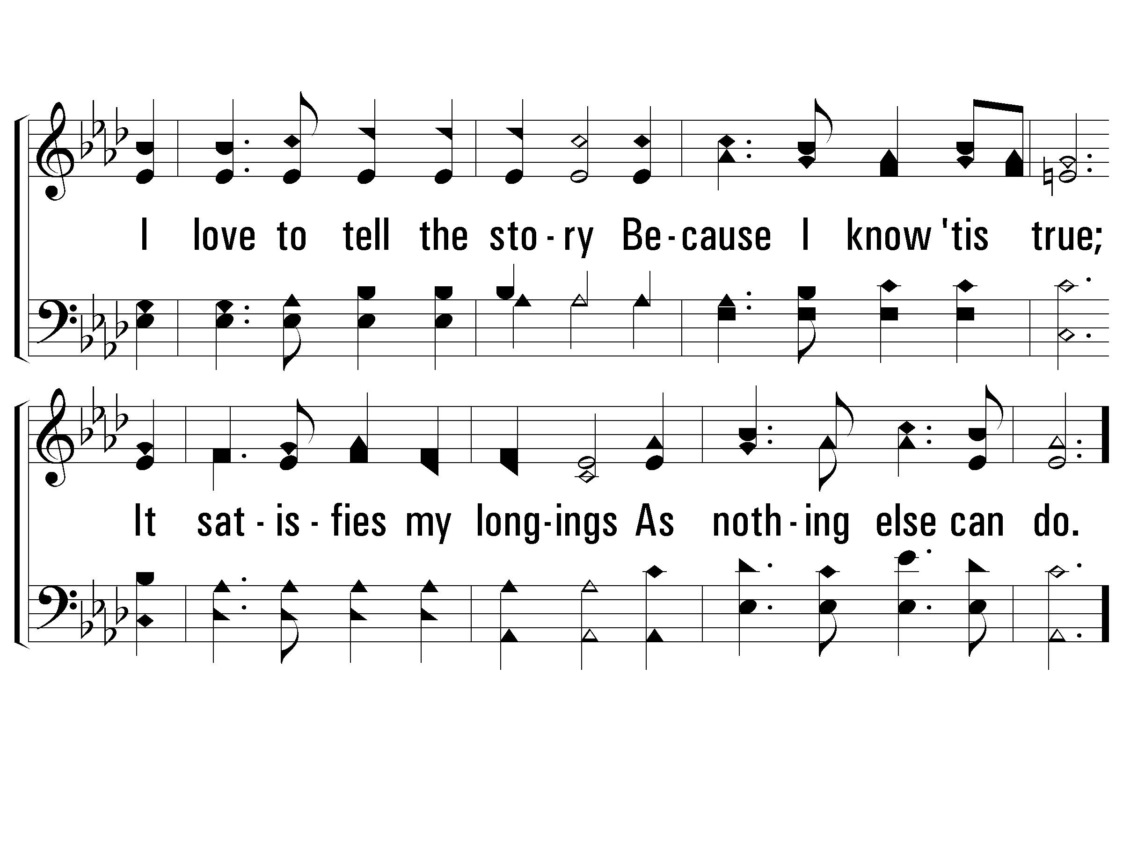
1 – I Love to Tell the Story
275
© 2001 The Paperless Hymnal™

Slide 3
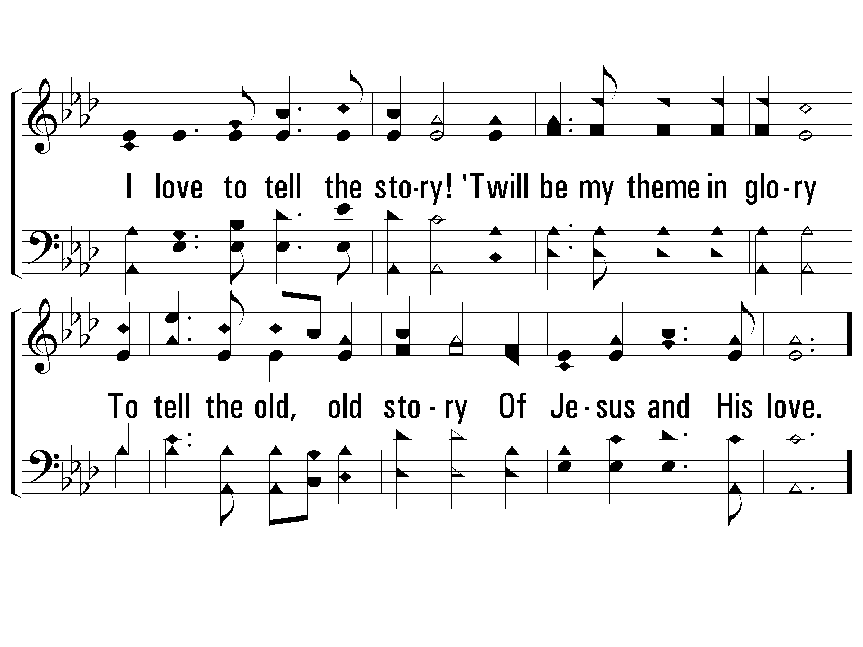
c – I Love to Tell the Story
275
I love to tell the story!
'Twill be my theme in glory
To tell the old, old story
Of Jesus and His love.
© 2001 The Paperless Hymnal™

Slide 4
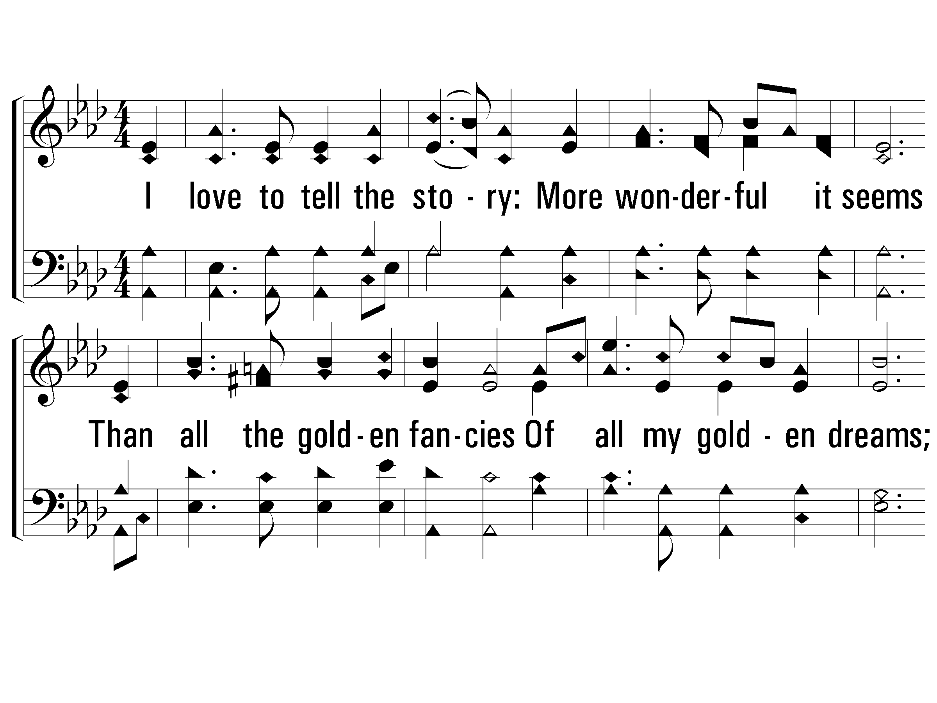
2 – I Love to Tell the Story
275
2.
I love to tell the story:
More wonderful it seems
Than all the golden fancies
Of all my golden dreams;
I love to tell the story:
It did so much for me;
And that is just the reason
I tell it now to thee.
Words: Catherine Hankey
Music: William G. Fischer
© 2001 The Paperless Hymnal™

Slide 5
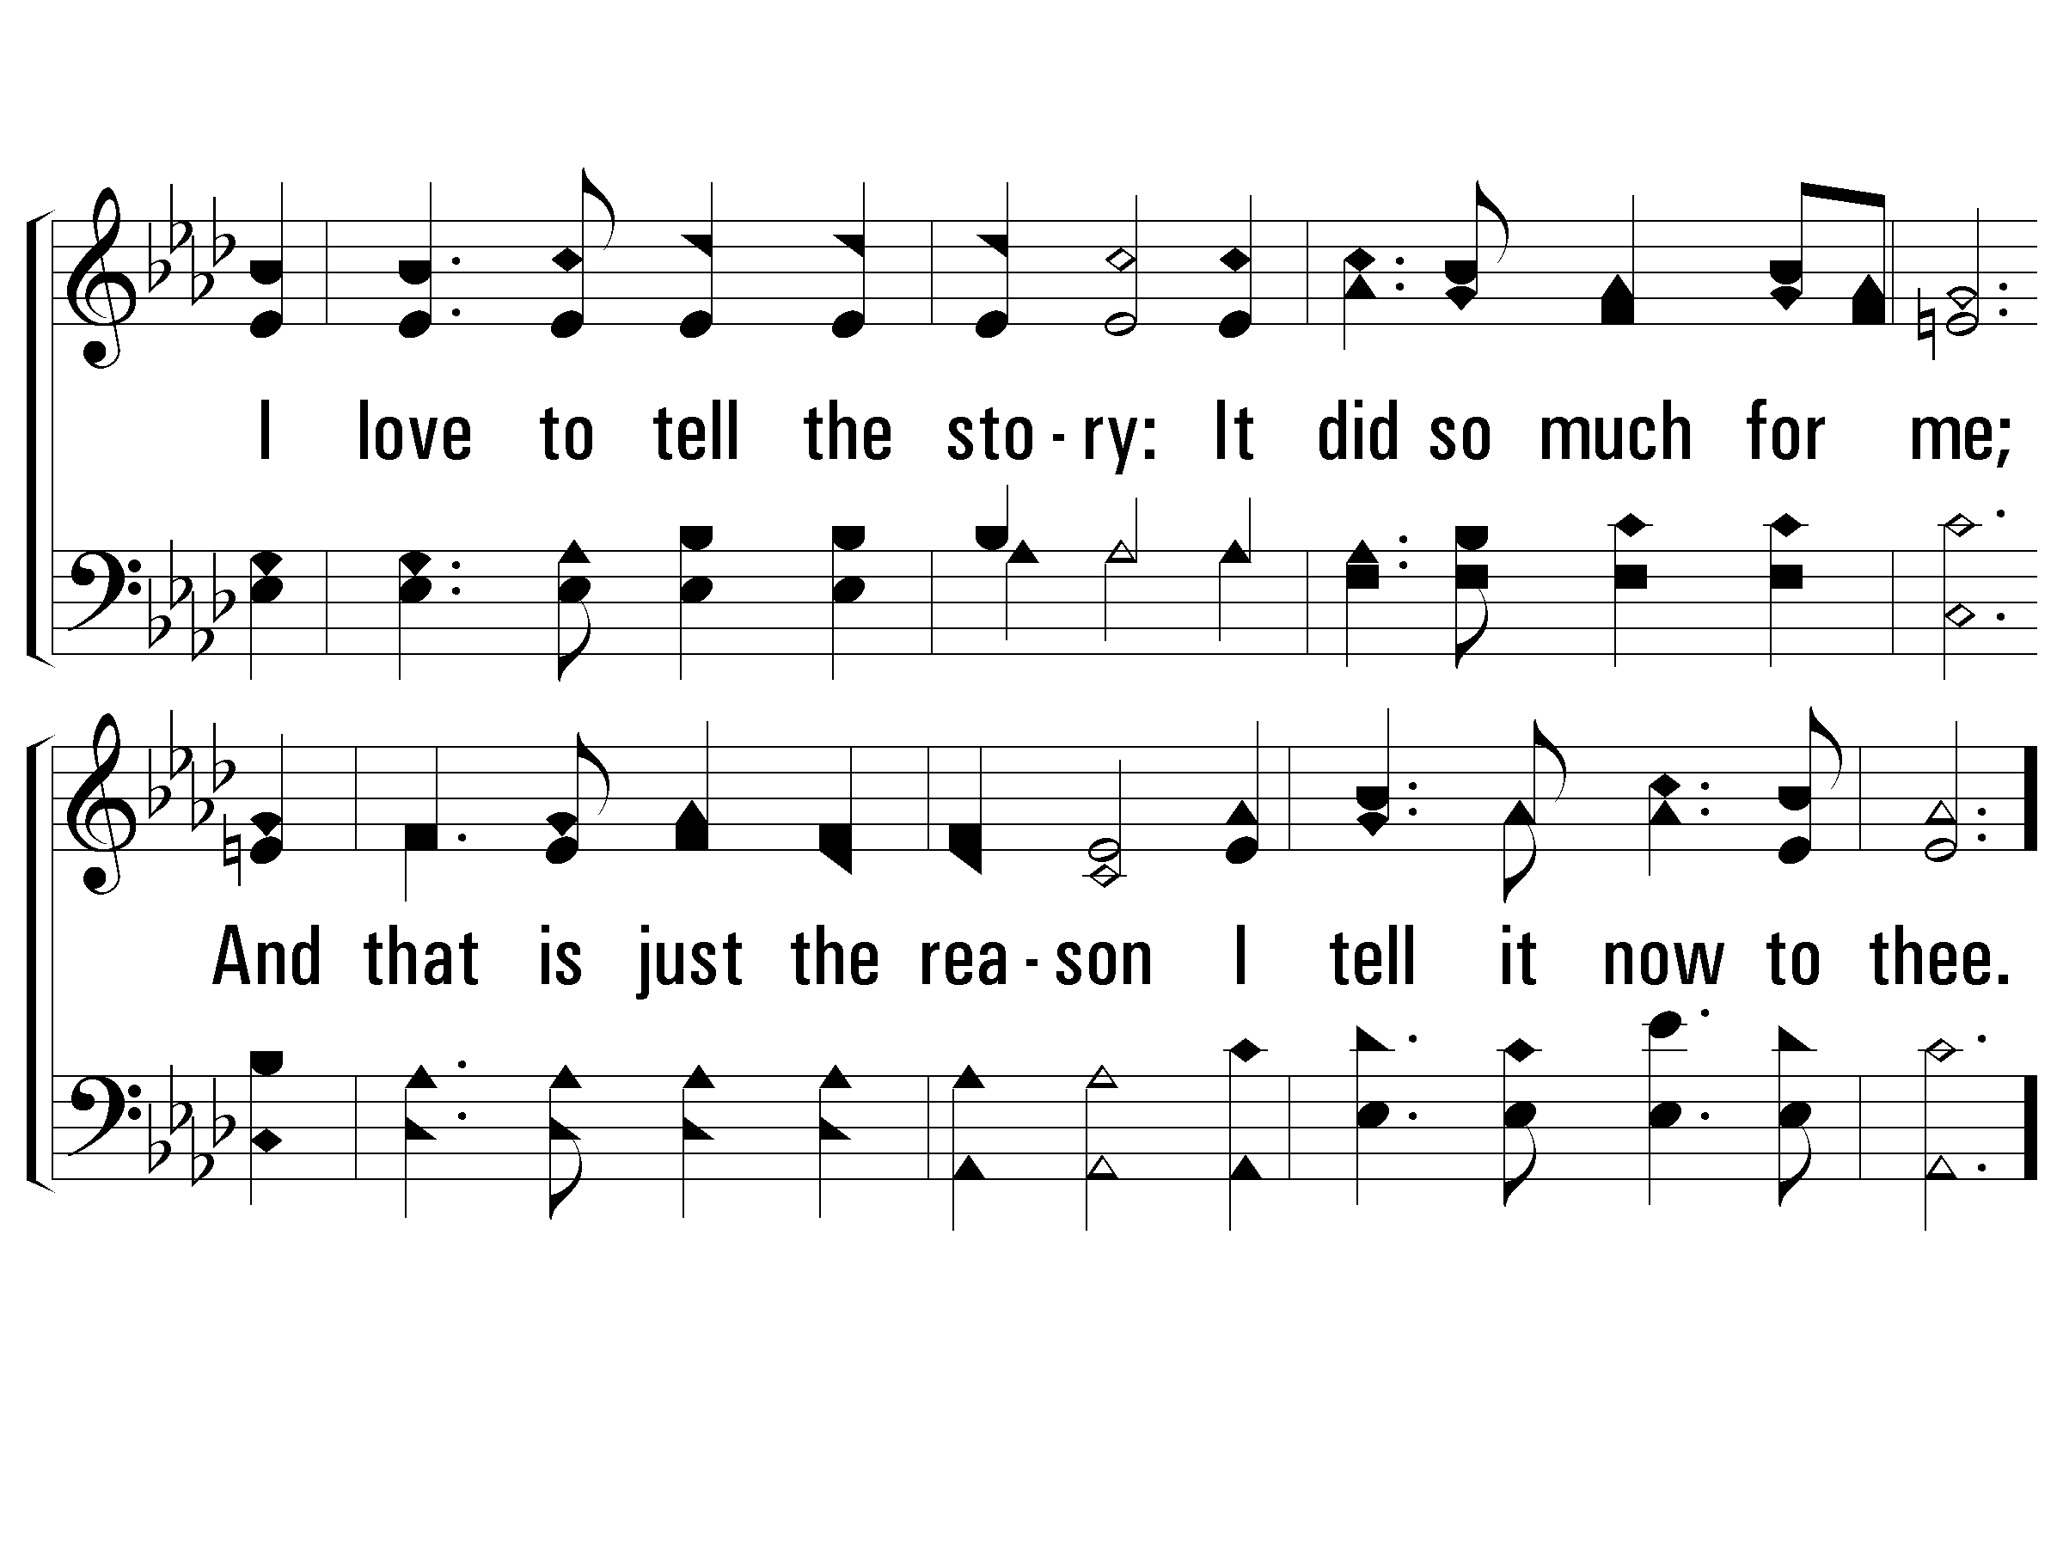
2 – I Love to Tell the Story
275
© 2001 The Paperless Hymnal™

Slide 6
c – I Love to Tell the Story
275
I love to tell the story!
'Twill be my theme in glory
To tell the old, old story
Of Jesus and His love.
© 2001 The Paperless Hymnal™

Slide 7
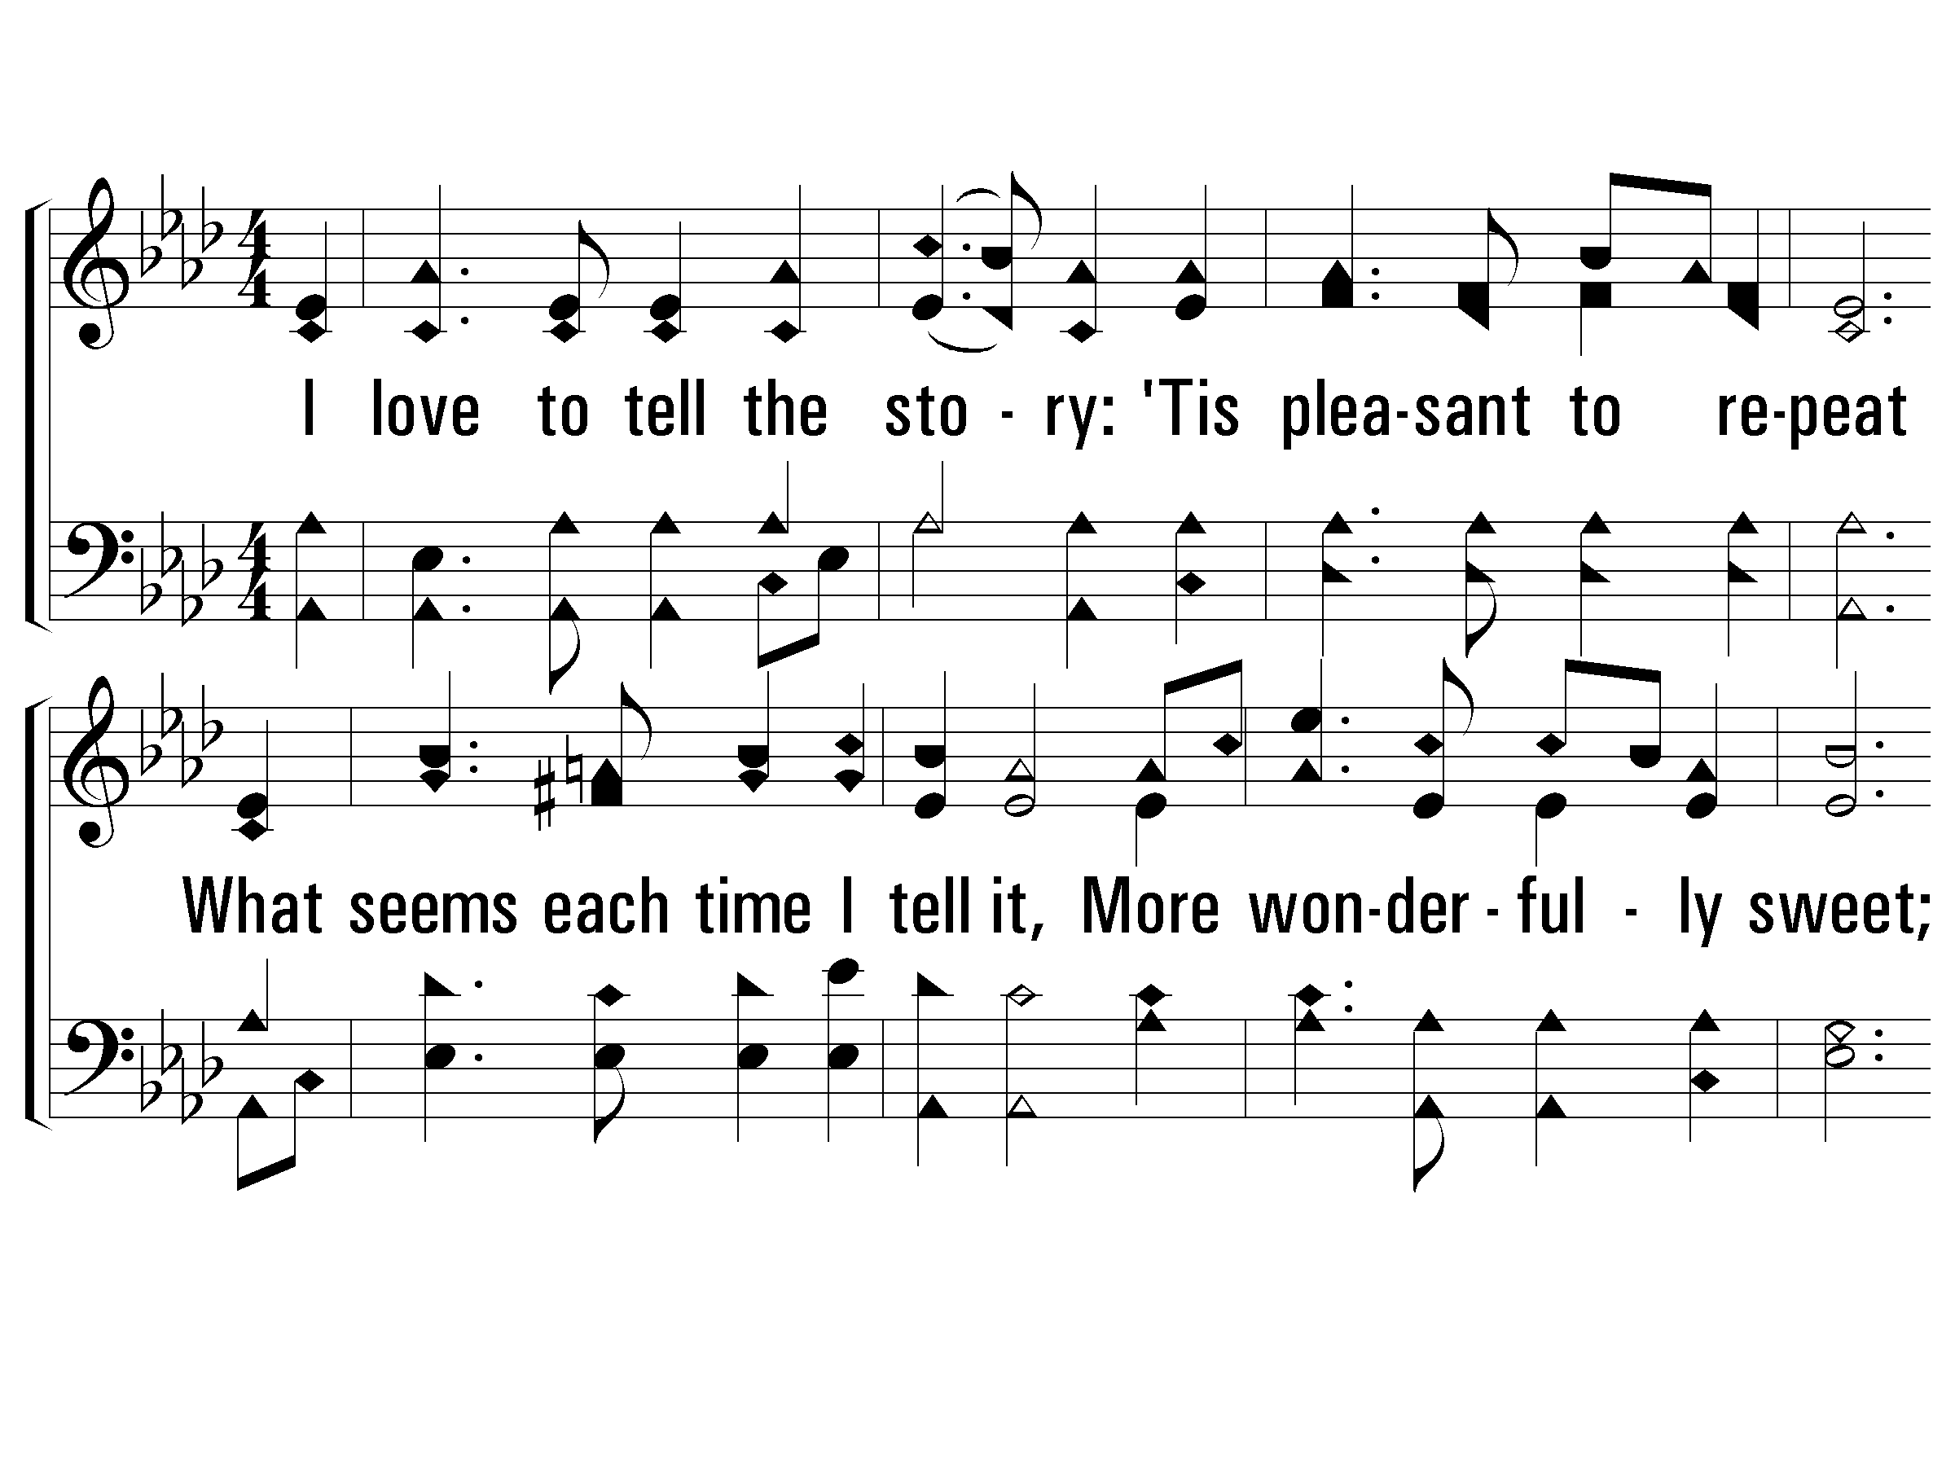
3 – I Love to Tell the Story
275
3.
I love to tell the story:
'Tis pleasant to repeat
What seems each time I tell it,
More wonderfully sweet;
I love to tell the story,
For some have never heard
The message of salvation
From God's own holy Word.
Words: Catherine Hankey
Music: William G. Fischer
© 2001 The Paperless Hymnal™

Slide 8
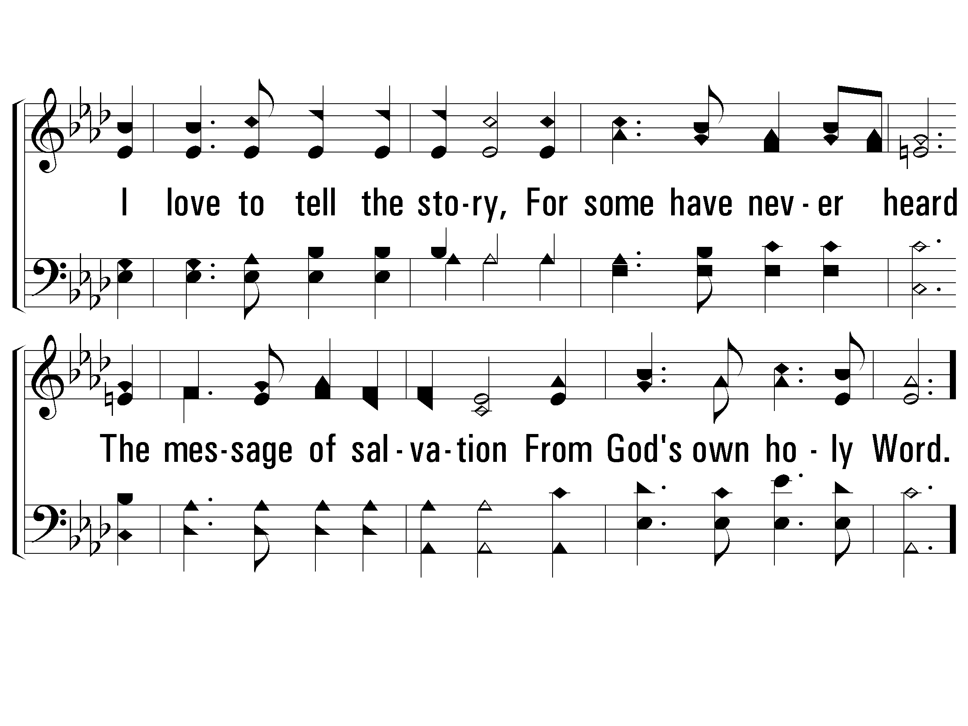
3 – I Love to Tell the Story
275
© 2001 The Paperless Hymnal™

Slide 9
c – I Love to Tell the Story
275
I love to tell the story!
'Twill be my theme in glory
To tell the old, old story
Of Jesus and His love.
© 2001 The Paperless Hymnal™

Slide 10
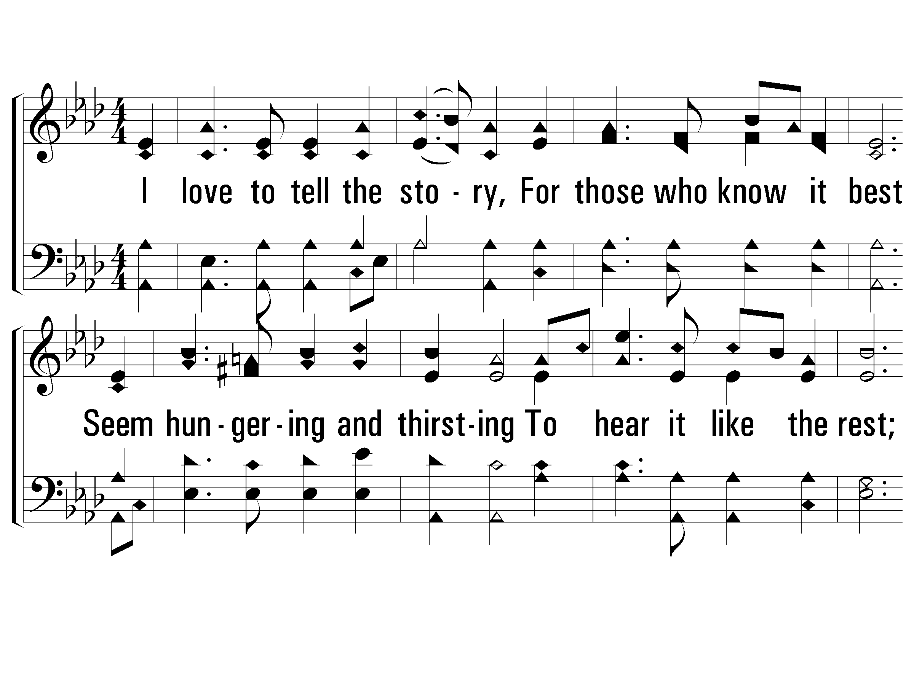
4 – I Love to Tell the Story
275
4.
I love to tell the story,
For those who know it best
Seem hungering and thirsting
To hear it like the rest;
And when, in scenes of glory,
I sing the new, new song,
'Twill be the old, old story
That I have loved so long.
Words: Catherine Hankey
Music: William G. Fischer
© 2001 The Paperless Hymnal™

Slide 11
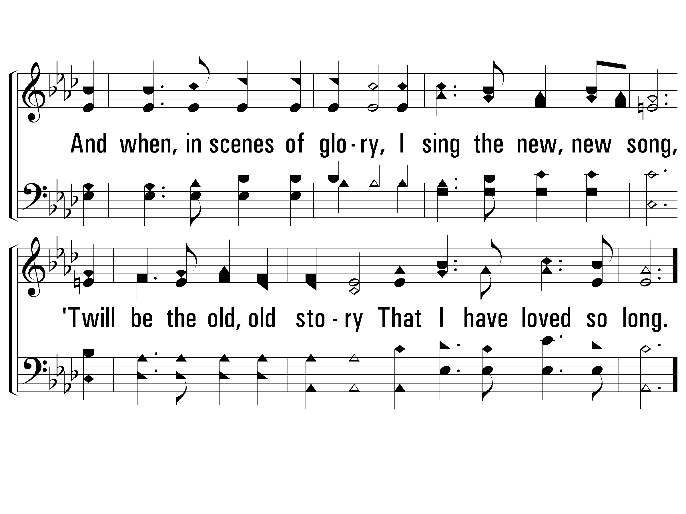
4 – I Love to Tell the Story
275
© 2001 The Paperless Hymnal™

Slide 12
c – I Love to Tell the Story
275
I love to tell the story!
'Twill be my theme in glory
To tell the old, old story
Of Jesus and His love.
© 2001 The Paperless Hymnal™

