Slide 1
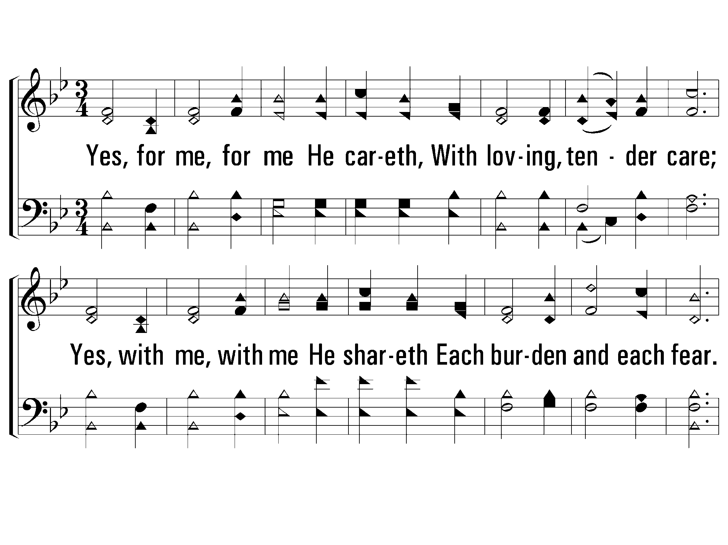
1 - Yes, for Me, for Me He Careth
787
1.
Yes, for me, for me He careth,
With loving, tender care;
Yes, with me, with me He shareth
Each burden and each fear.
Yes, over me, over me He watcheth,
Ceaseless watcheth night and day;
Yes, even me, even me He snatcheth
From perils of the way.
Words: Horatius Bomar / Music: Lloyd O. Sanderson
Copyright © 1935 by Leon B. Sanderson, All rights reserved. Used by permission.
© 2008 The Paperless Hymnal®

Slide 2
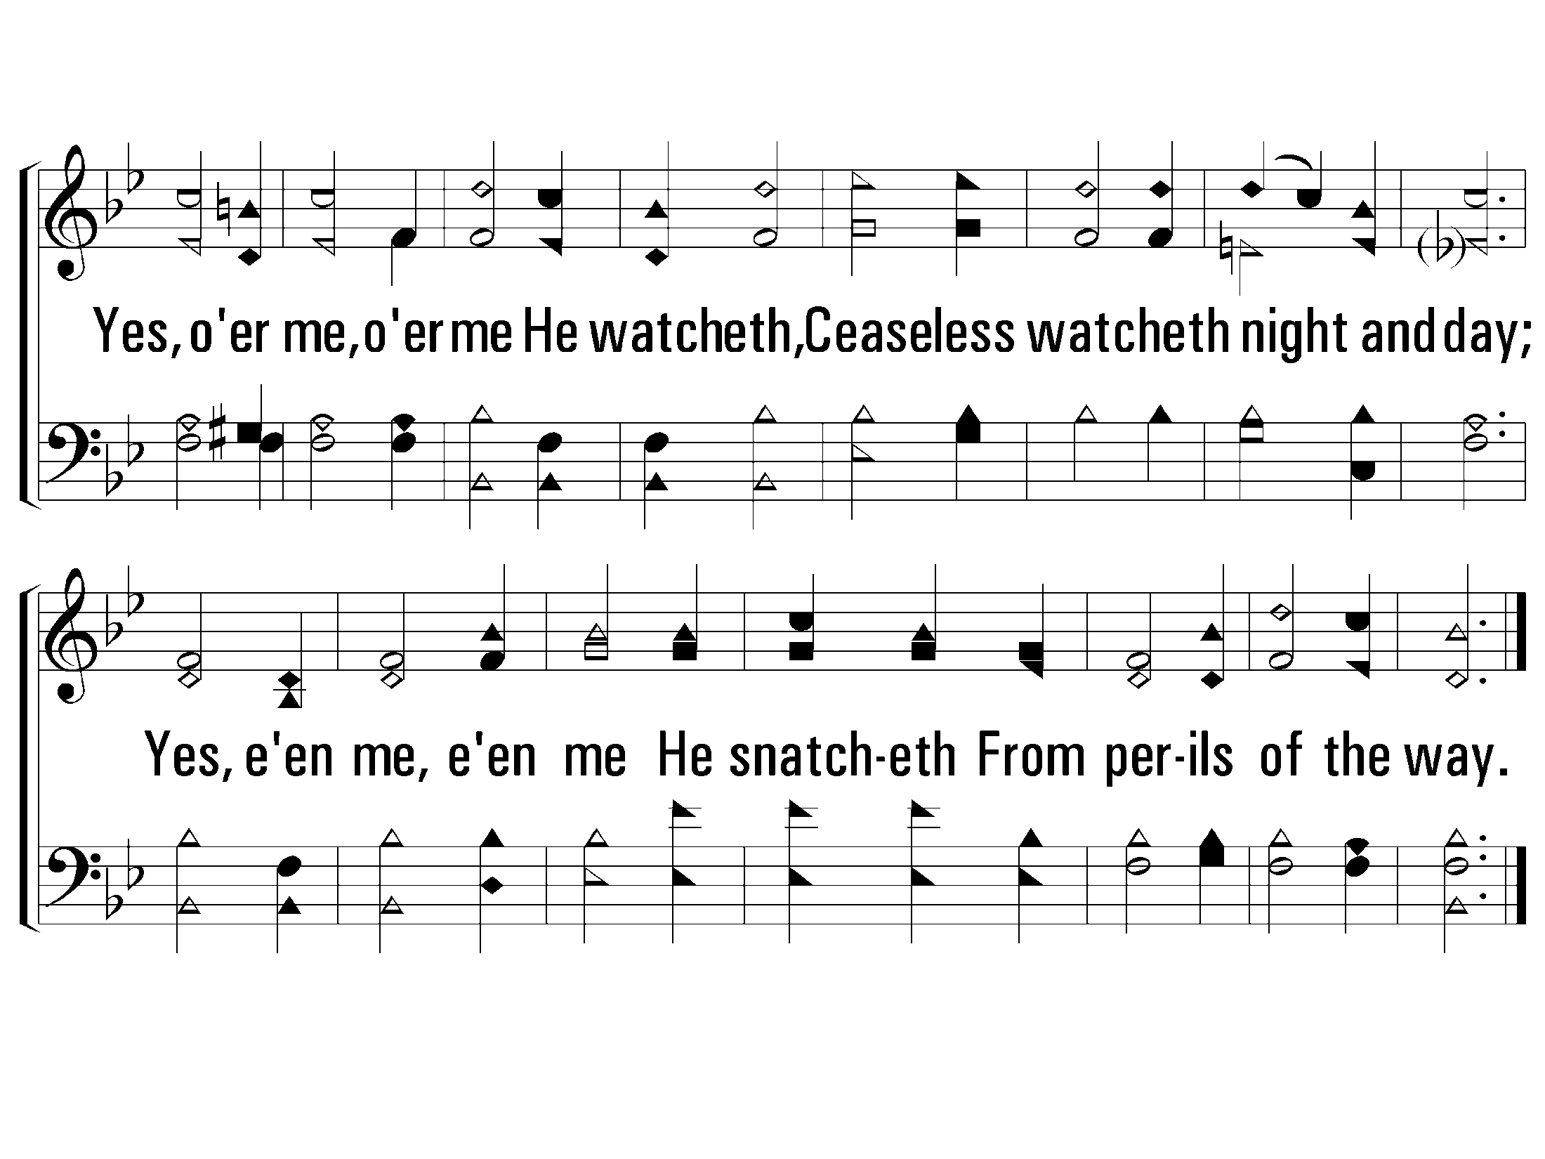
1 - Yes, for Me, for Me He Careth
787
© 2008 The Paperless Hymnal®

Slide 3
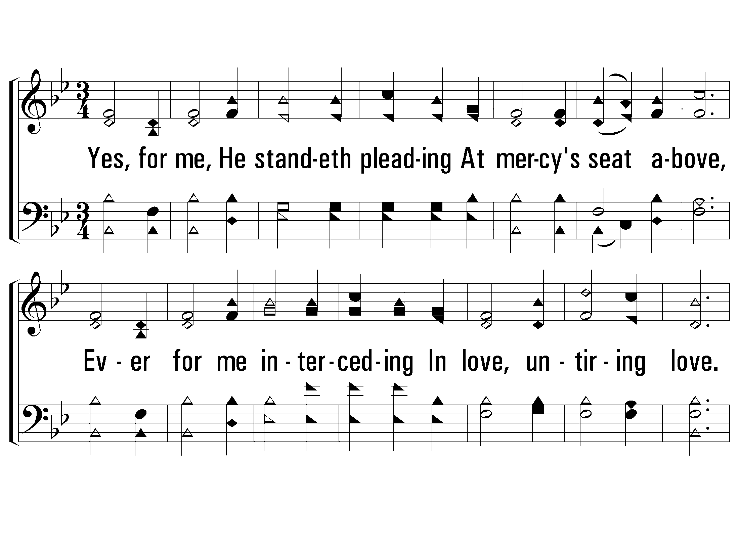
2 - Yes, for Me, for Me He Careth
787
2.
Yes, for me, He standeth pleading
At mercy's seat above,
Ever for me interceding
In love, untiring love.
Yes, in me abroad He sheddeth
Joys unearthly, love and light;
And to cover me He spreadeth
His loving wings of might.
Words: Horatius Bomar / Music: Lloyd O. Sanderson
Copyright © 1935 by Leon B. Sanderson, All rights reserved. Used by permission.
© 2008 The Paperless Hymnal®

Slide 4
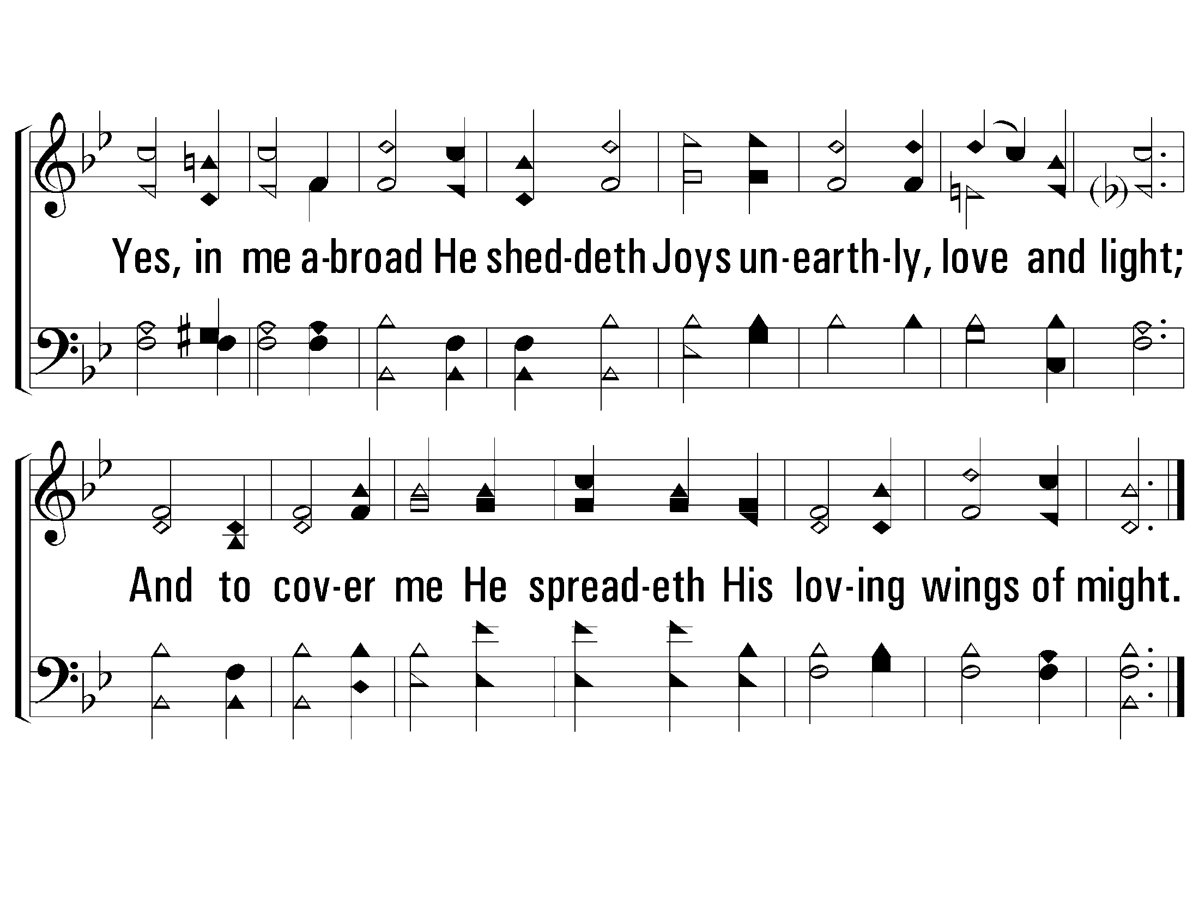
2 - Yes, for Me, for Me He Careth
787
© 2008 The Paperless Hymnal®

Slide 5
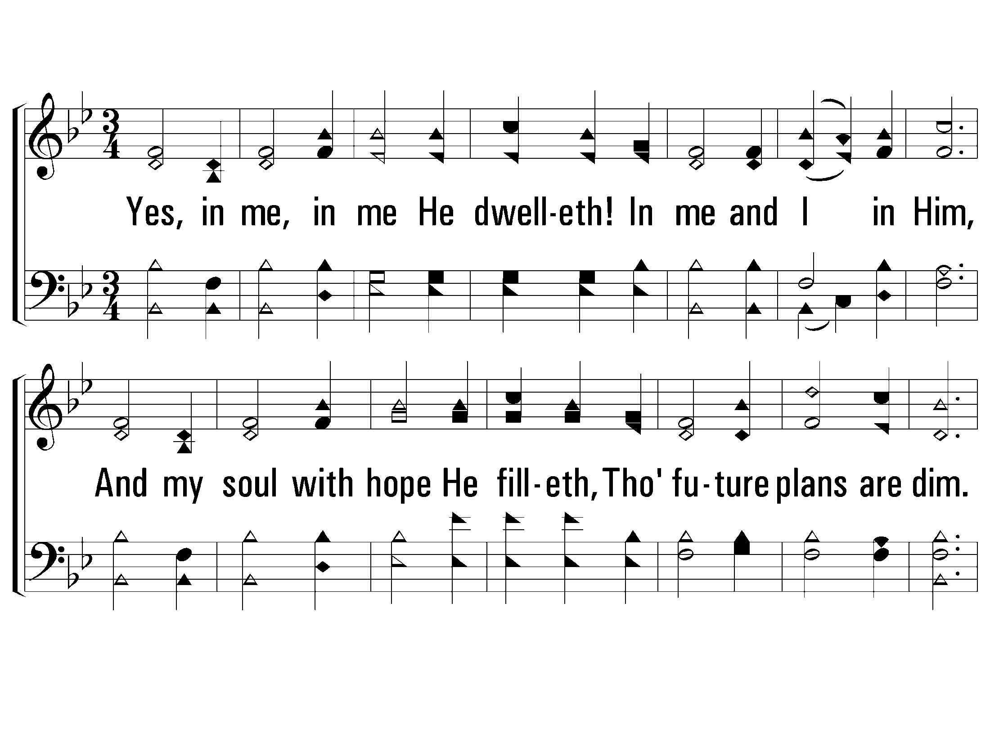
3 - Yes, for Me, for Me He Careth
787
3.
Yes, in me, in me He dwelleth!
In me and I in Him,
And my soul with hope He filleth,
Though future plans are dim.
Thus I wait for His returning,
Singing all the way to heaven;
Such the joyful song of morning,
Such tranquil song of even.
Words: Horatius Bomar / Music: Lloyd O. Sanderson
Copyright © 1935 by Leon B. Sanderson, All rights reserved. Used by permission.
© 2008 The Paperless Hymnal®

Slide 6
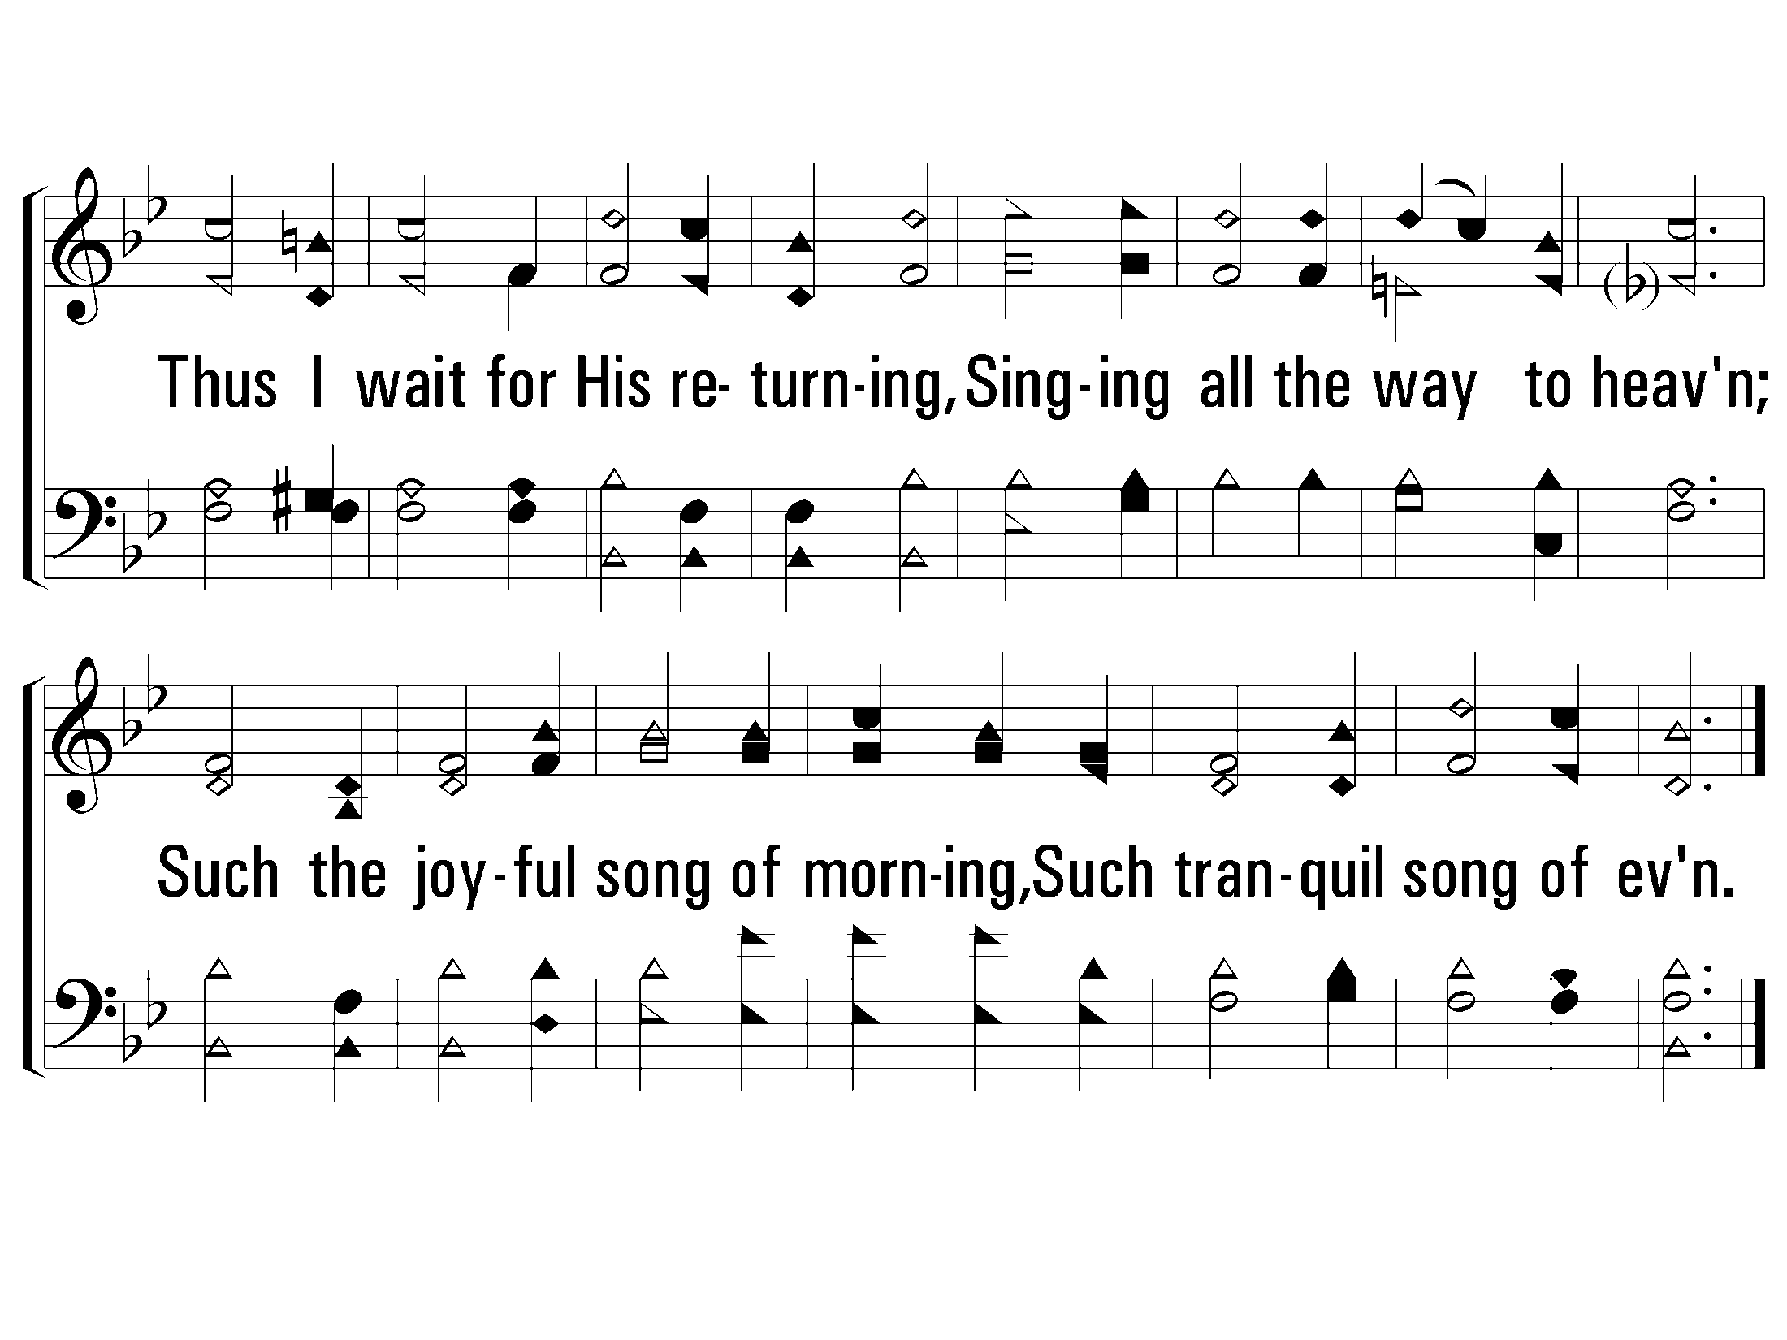
3 - Yes, for Me, for Me He Careth
787
© 2008 The Paperless Hymnal®

