Slide 1
APPLICATION OF MACHINE LEARNING IN PREDICTING THE PROBABILITY OF DEFAULT (PD) OF INDIVIDUAL CUSTOMERS AT CREDIT INSTITUTIONS

Slide 2
MEMBERS
01
BUI THI MAI LUONG (LEADER)
02
NGUYEN THI THUY DUONG
03
HO DUC DUY

Slide 3
TABLE OF CONTENTS
01.
Purpose
Dataset
02.
Insights
03.
Data preprocessing
04.
05.
Model results
06.
Conclusion

Slide 4
PURPOSE
01

Slide 5
PURPOSE
Building a good quality model in predicting the probability of default of individual customers.
Evaluating and analyzing the influence of factors affecting the probability of default of individual customers.

Slide 6
DATASET
02

Slide 7
DATASET
Application train
Main table
Info about loan and loan applicant at application time.
Bureau
Application data from previous loans that client got from other institutions and that were reported to Credit Bureau.
1716428 rows and 17 columns.
Previous application
Info about customers' previous loans at Home Credit.
1670214 rows and 37 columns.
Bureau balance
Monthly balance of credits in Credit Bureau
27299925 rows and 3 columns.
POS CASH balance
Monthly balance of client’s previous loan in Home Credit
10001358 rows and 8 columns.
Instalments payments
Past payment data for each installments of previous credits in Home Credit related to loan in our sample
Credit card balance
Monthly balance of client’s previous credit card loan in Home Credit
3840312 rows and 23 columns

Slide 8
DATASET
Application train/test
Main table
Info about loan and loan applicant at application time.
Bureau
Application data from previous loans that client got from other institutions and that were reported to Credit Bureau.
1716428 rows and 17 columns.
Previous application
Info about customers' previous loans at Home Credit.
1670214 rows and 37 columns.
Bureau balance
Monthly balance of credits in Credit Bureau
27299925 rows and 3 columns.
POS CASH balance
Monthly balance of client’s previous loan in Home Credit
10001358 rows and 8 columns.
Instalments payments
Past payment data for each installments of previous credits in Home Credit related to loan in our sample
Credit card balance
Monthly balance of client’s previous credit card loan in Home Credit
3840312 rows and 23 columns

Slide 9
The dataset has 307511 rows and 122 columns.
The dataset has 55/122 features containing missing values.
Application train/test
Main table
Info about loan and loan applicant at application time.
The dataset is divided into 5 main information:
Customer's personal information
Customer's debt information
Customer's debt-related information
Customer’s property information
Other information

Slide 10
DATASET
Application train/test
Main table
Info about loan and loan applicant at application time.
Bureau
Application data from previous loans that client got from other institutions and that were reported to Credit Bureau.
1716428 rows and 17 columns.
Previous application
Info about customers' previous loans at Home Credit.
1670214 rows and 37 columns.
Bureau balance
Monthly balance of credits in Credit Bureau
27299925 rows and 3 columns.
POS CASH balance
Monthly balance of client’s previous loan in Home Credit
10001358 rows and 8 columns.
Instalments payments
Past payment data for each installments of previous credits in Home Credit related to loan in our sample
Credit card balance
Monthly balance of client’s previous credit card loan in Home Credit
3840312 rows and 23 columns

Slide 11
INSIGHTS
03

Slide 12
PROBABILITY OF DEFAULT OF DATASET
The chart show the debt status of applicants

Slide 13
What is the age group of the applicants applying for the loan?
The age group was divided into 2 ranges: under 65 years old and over 65 years old.
Applicants over 65 years old account for a very small number of the total number of customers.
The chart shows the ratio of applicant’s age group

Slide 14
Age group of applicants in terms of loan is repaid or not
Younger people are more likely to default (higher default rate than older people).
The reason is that the group of young people don't have enough experience or knowledge to manage or identify risks in finance.
The number and probability of default by applicant’s age group

Slide 15
What is the source of income of Applicants applying for a loan?
The chart shows distribution of the applicant’s source of income
The chart shows the ratio of applicant’s source of income

Slide 16
What is the source of income of applicants applying for a loan?
The chart shows the number and probability of default by applicant’s source of income

Slide 17
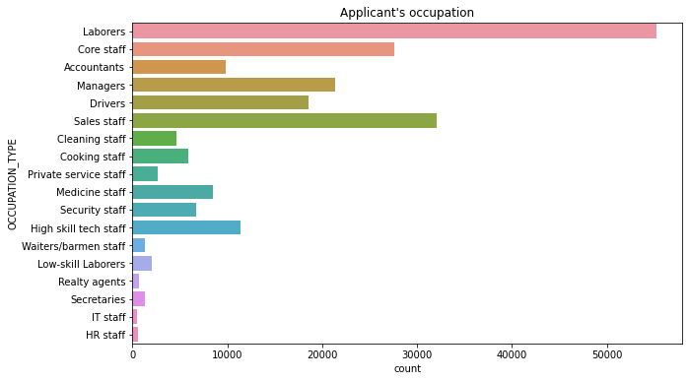
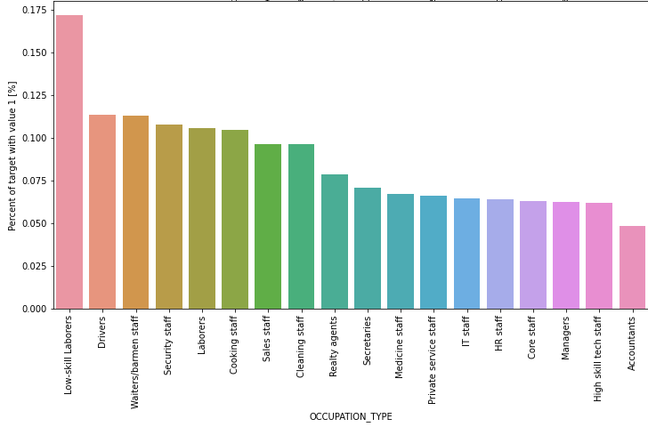
What is the occupation of a customer who applied for a loan ?
The chart shows distribution of the applicant’s occupation
The graph shows the ratio of applicant's occupation and target

Slide 18
What is the occupation of applicants applying for a loan ?
The applicants belonging to the high-skill group account for the largest proportion (171614 applicants - 54.81% of the total number of applicants), but the default rate of this group is the lowest of the three groups.
The number of applicants in the low-skill group is very low (only 8.9% of the total number of customers) but the default rate is the highest among customers..
The chart shows the number and probability of default of the applicant’s occupation
Notes:
Vẽ lại biểu đồ

Slide 19
How many children do the applicants have ?
Due to the relatively rare number of customers with 3 or more children, we grouped them into a group called "Above 3".
Most of applicants applying for loans are childless
The reason is that these are newlyweds, young or have many plans but the financial condition is not stable, so the need for loans is high.
The chart shows the number and probability of default of the applicant’s number of children

Slide 20


DATA PREPROCESSSING
04

Slide 21
STEPS FOR DATA PROCESSING
01
02
03
04
Editing
Eliminating
Handling
Correlation
Editing each table and combine into a complete dataset.
Eliminating the features with missing values above 75%.
Handling remaining the missing values.
Eliminating features based on correlation.

Slide 22
SCORING MODELS
05

Slide 23
SCORING MODELS
METHODS
Traditional Method
Machine Learning
Random Forest
LightGBM

Slide 24
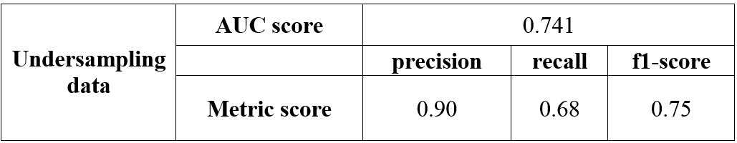
METHOD 1: TRADITIONAL METHOD
(Using WOE – IV)
Result of method 1 with Undersampling data:
In method 1 - the traditional method when classifying features by WOE - IV method and training with Logistic Regression model, the model results are not good.
Notes:
Chỉ lấy undersampling

Slide 25
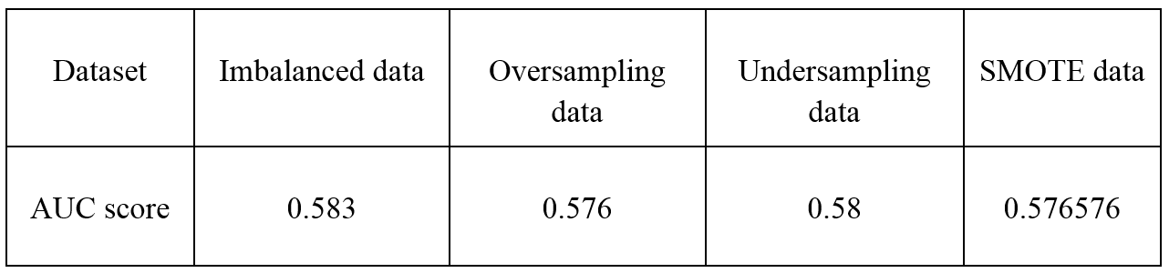
METHOD
Logistic Regression
Result of model Logistic Regression:
Our team's results when using all 4 different data sets (with skewed labels and not with skewed labels) are not good. Therefore, the Logistic Regression model with all 4 different data sets cannot be used.
Notes:
Không cần slide này.

Slide 26
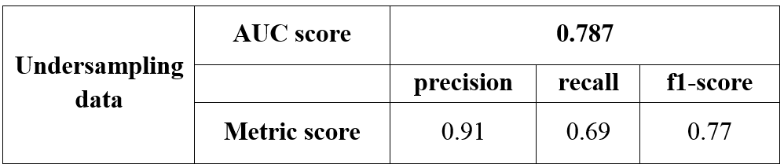
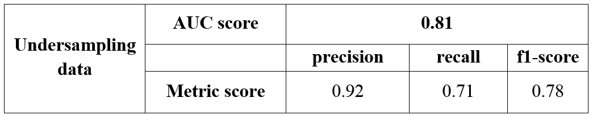
METHOD 2: MACHINE LEARNING
Result of Random Forest model
Result of LightGBM model
The best forecasting model for this dataset is LightGBM.
Notes:
Gộp slide Random Forest và LightGBM vào để so sánh với metric: AUC index, precision, recall, f1- score (lấy weighted avg).

Slide 27
CONCLUSION
06

Slide 28
CONCLUSION
Trực quan hóa để tìm ra những insight nổi bật của bộ dữ liệu như tình trạng nợ của khách hàng hoặc các loại khoản vay mà khách hàng thường đăng ký.
Xây dựng mô hình dự báo xác suất vỡ nợ của khách hàng cá nhân và mô hình đào tạo với hai phương pháp khác nhau. Mô hình Random Forest và mô hình LightGBM có thể đưa ra dự đoán tốt hơn thay vì thuật toán Logistic Regression, đặc biệt là với mô hình LightGBM tuning hyperparameter (siêu tham số).

Slide 29
CONCLUSION
Visualizing outstanding insights of the data set such as the customer's debt status or the types of loans that customers often apply for, ...
Building the models for forecasting probability of default of individual customers and training models with two different methods.
The Random Forest algorithm and the LightGBM algorithm can make better predictions instead of Logistic Regression algorithm, especially with the LightGBM model tuning hyperparameter.

Slide 30
Thanks for listening !
Please keep this slide for attribution

