Slide 1
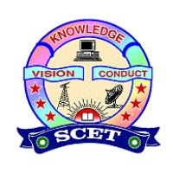
SWARNANDHRA COLLEGE OF ENGINEERING & TECHNOLOGY
(AUTONOMOUS) NARSPUR
COMPUTER SCIENCE AND ENGINEERING DEPARTMENT
BATCH-5
A.GREESHMA(22A21A0501)
CH.CHANDU(23A25A0502)
J. HARI(22A21A0557)

Slide 2
HALLUCINATION-RESISTANT , DOCUMENT-CENTRIC CONVERSATIONAL FRAMEWORK USING FUSION RETRIEVAL AUGMENTED GENERATION

Slide 3
ABSTRACT
FusionRAG-DocChat is a document-centric conversational framework that reduces hallucinations in Large Language Models. It uses Fusion Retrieval-Augmented Generation to retrieve relevant document information before generating responses. This approach improves the accuracy and reliability of document-based question answering.

Slide 4
INTRODUCTION
Large Language Models are widely used in conversational AI applications.
A major limitation of these models is hallucination, especially in document-based question answering.
To ensure trustworthy AI systems, document-centric conversational approaches are required.

Slide 5
Example: If information Is NOT Present in the Document / Database Scenario : Assume your system has only these documents:Company annual report (22-23) Internal policy documentsFinancial summary till 2023
Without Fusion RAG (Normal LLM)
User question:“What was the company’s profit in 2024?”LLM response (problem):“The company made a profit of ₹120 crores in 2024.”
This is hallucination
With Fusion RAG
User question:“What was the company’s profit in 2024?”System response:“The requested information is not available in the provided documents. The documents contain data only up to 2023.”

Slide 6
LITERATURE SURVEY
AUTHOR & YEAR | METHOD USED | KEY FINDINGS | LIMITATIONS
Early Systems (Pre-2015) | Rule-Based Chatbots | Simple and predictable conversational behavior | Not scalable, lacks intelligence
Brown et al. (2020) | LLM-Based Conversational Systems | Human-like and flexible responses | Hallucination, unreliable outputs
Lewis et al. (2020) | Basic Retrieval-Augmented Generation | Improved context awareness using documents | Single retriever, limited accuracy
Ram et al. (2022) | Document-Centric Question Answering | More reliable and factual answers | Performance depends on retrieval quality
Proposed Work | Fusion RAG–Based DocChat | Higher accuracy with reduced hallucination | System evaluation in progress

Slide 7
EXISTING SYSTEM
Existing conversational systems mainly rely on Large Language Models or basic chatbots.
These systems often generate responses without strict grounding to document content.
As a result, they suffer from hallucination and reduced reliability in document-based applications.

Slide 8
PROPOSED SYSTEM
Document-centric conversational chatbot
Uses Fusion RAG for document retrieval
Generates responses grounded in documents
Reduces hallucination and improves accuracy

Slide 9
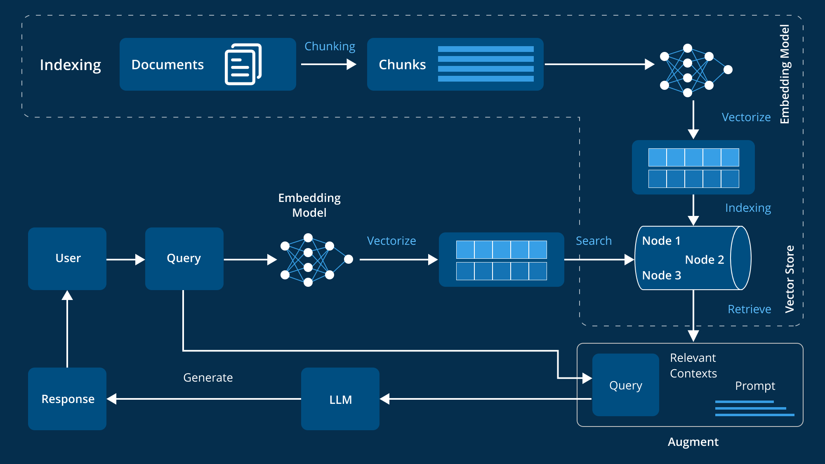
SYSTEM ARCHITECTURE

Slide 10
CONCLUSION
This project proposes a document-centric conversational framework to address hallucination in AI systems. Fusion Retrieval-Augmented Generation is used to ground responses strictly in document content. Review-1 focused on conceptual understanding, with implementation planned for the next phase.

Slide 11


