Slide 1
Growth Curve Analysis App – Background Material
This Shiny app was made to help analyze laboratory growth curve data for research on Borrelia burgdorferi. It takes a single CSV input file which must contain columns with:
“sample” information (i.e. the name of the strain or clonal isolate being grown)
“condition” information (e.g. induced vs. uninduced, low vs. high inoculum, starving vs. replete, etc.)
daily cell concentration measurements by column (numerically labeled 0, 1, 2, etc.)
In the example data provided, I measure B. burgdorferi growth with and without IPTG-induction of our inducible CRISPRi system for operon silencing and selective in trans gene complementation (Murphy et al., 2022 bioRxiv). Specifically, I’ve designed a series of three sgRNAs (NT1, NT2, and T2) that target different sites in the BB0346 open reading frame, which encodes a homolog of the soluble lipoprotein chaperone LolA. Since differentially expressed surface lipoproteins facilitate each individual stage of this bacterium’s pathogenic lifecycle (from tick vector colonization to dissemination and persistence in mammalian hosts), we’re interested in utilizing the CRISPRi system for a full cell-based structure-function analysis of BB0346. To accomplish this, the native protein must be sufficiently silenced for complementation with CRISPRi-resistant (PAM*) alleles. With numerous other essential functions in eubacteria, depletion of LolA/BB0346 should cause a severe growth defect in addition to limiting virulence-associated lipoprotein secretion.
The application uses ggplot2 (rather than the interactive plotly) in order to produce journal publication-quality images. It must tidy a standard data acquisition format, statistically analyze the data replicates, provide customizability for the plot output (especially to obtain the right dimensions for fitting into a figure), and allow for clear visualization of each sample point/line.

Slide 2
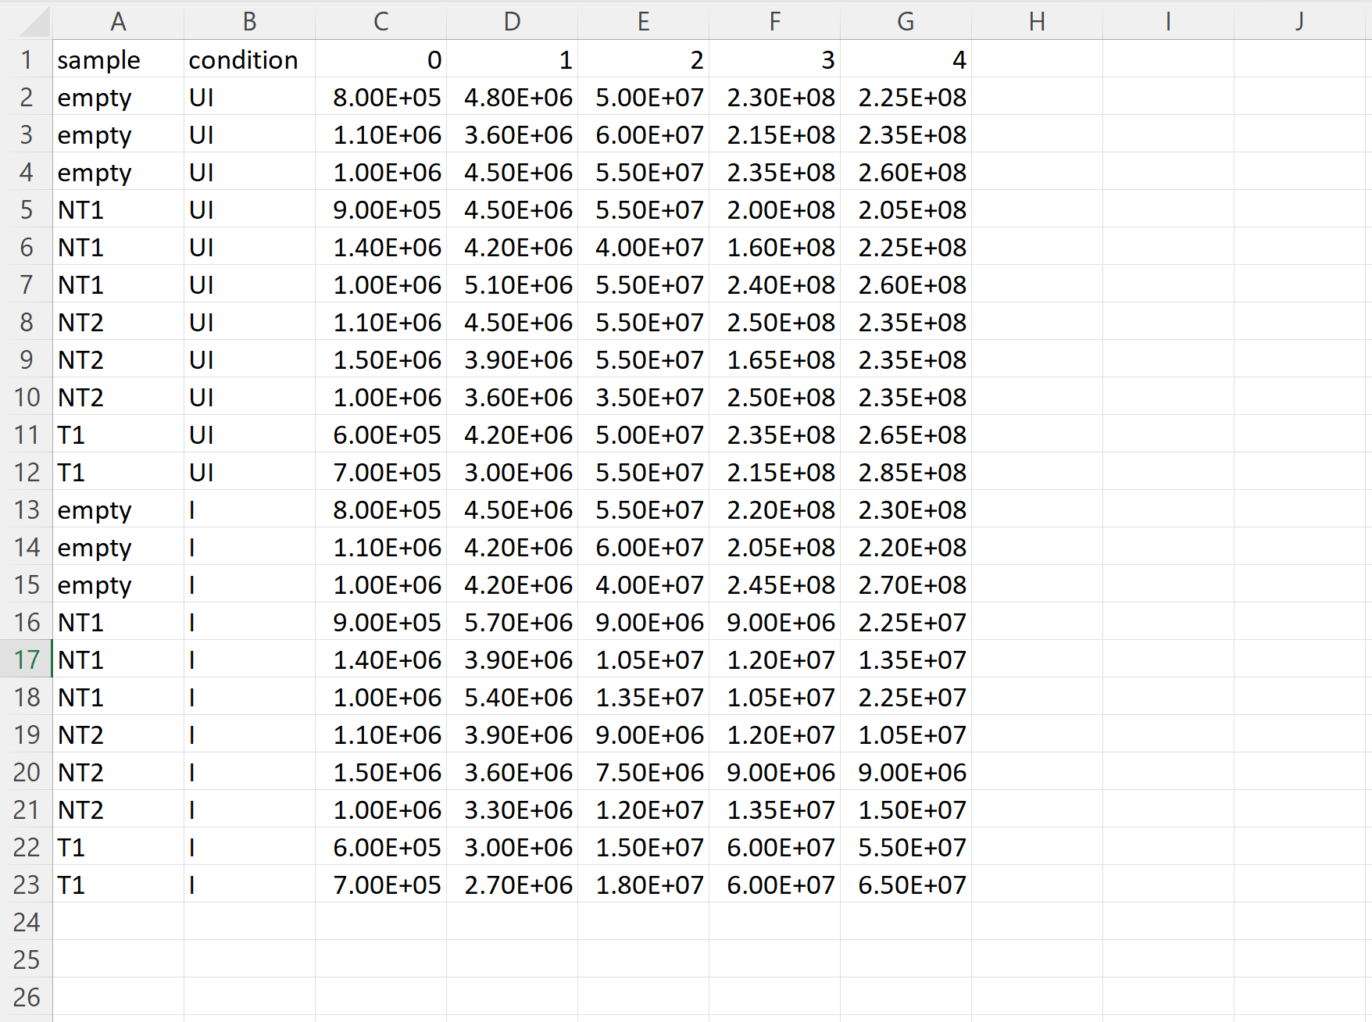
Growth Curve Analysis App – Data Input Example
CSV files only.
“sample”, “condition”, and numeric day values.
DO NOT LEAVE OBSERVATIONS BLANK for sample or condition columns. Blank measurements are permitted but may disrupt statistical analysis.
No limit to the number of days (4 shown in example) nor the number of samples/conditions.
Requires 2+ replicates for each sample/condition to provide statistical analysis (biological triplicates are ideal).

Slide 3
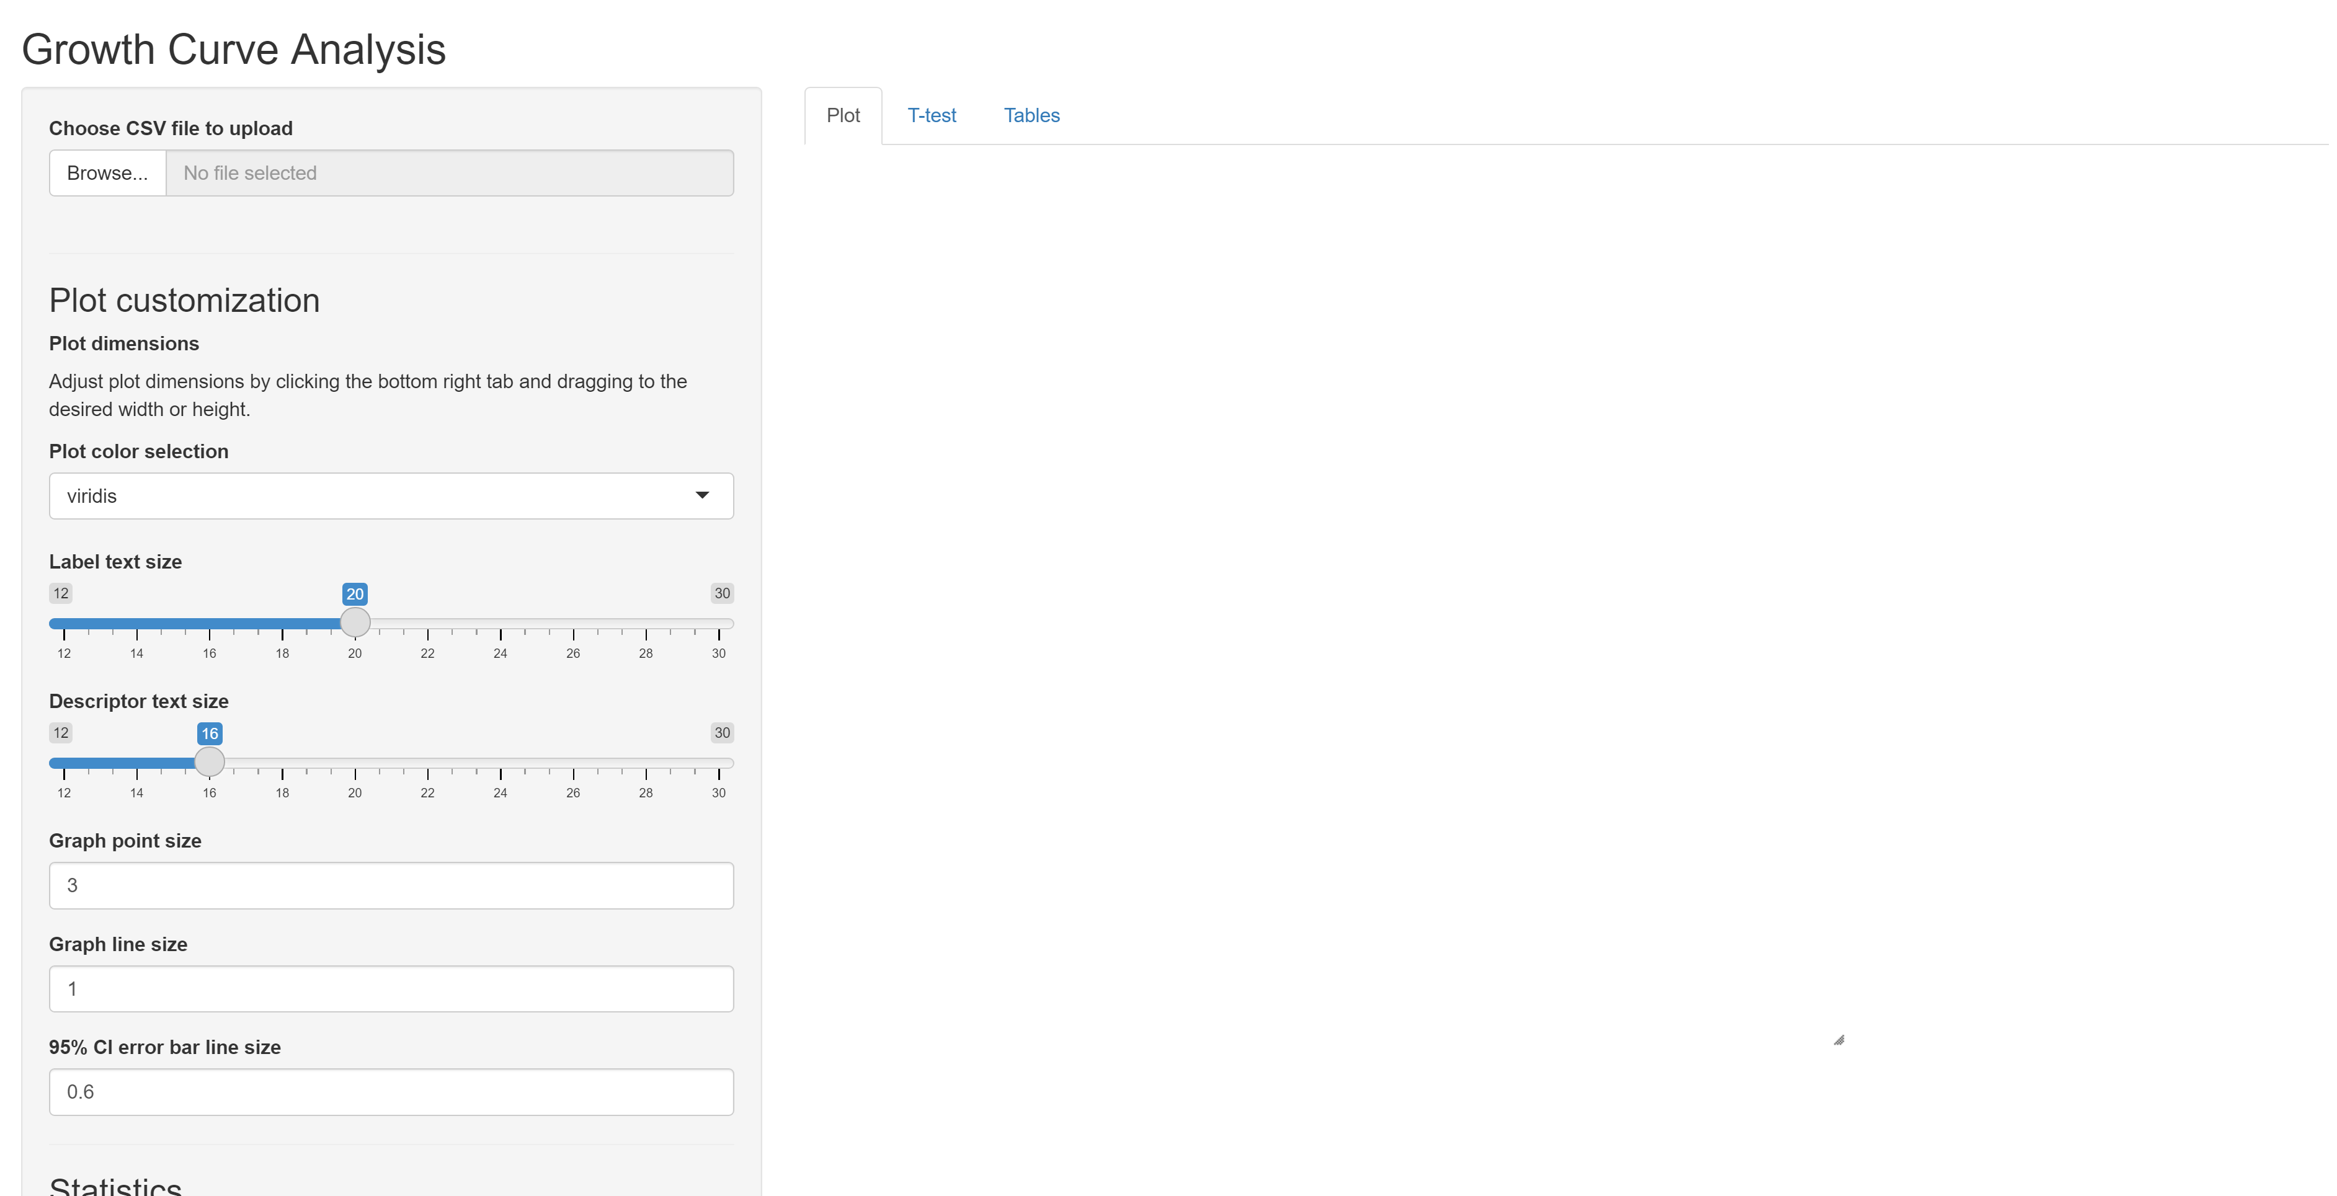
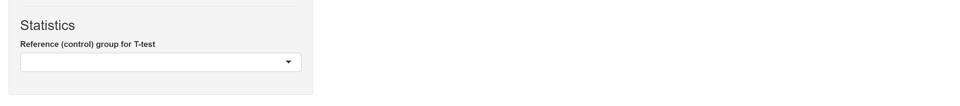
Growth Curve Analysis App – Layout
4. Separated results tabs
1. CSV file upload button
2. Plot customization pane
3. Data control selection pane

Slide 4
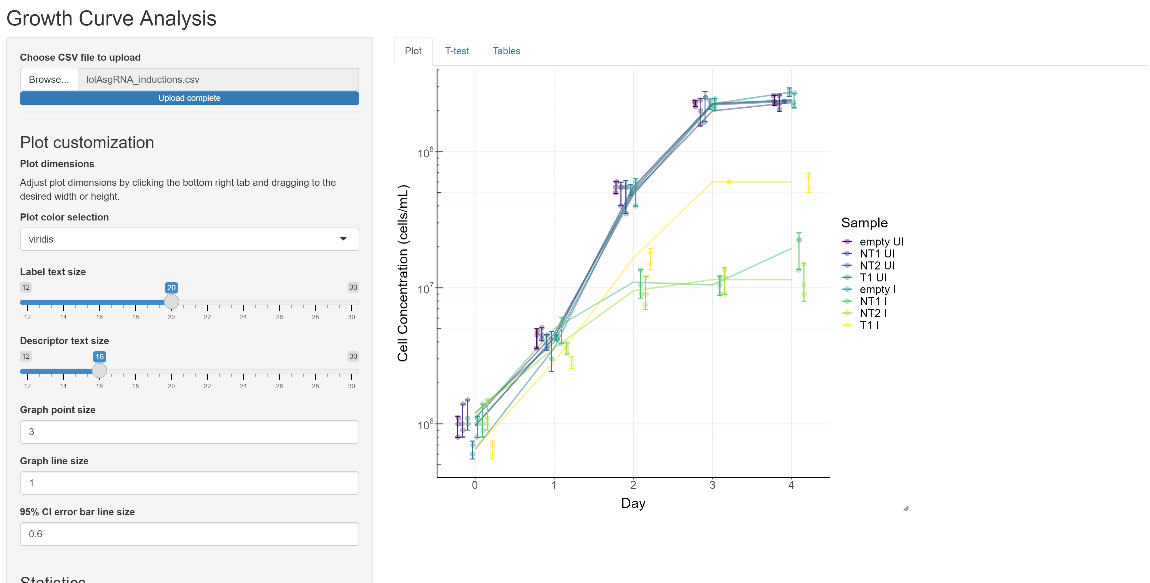
Growth Curve Analysis App – Plot Results
Customize to your desire!
*Since it is not feasible to start this line chart at 0, it will never have a lie factor equal to 1 (i.e. the effect of the graphic will always be greater than the effect of the data). Normalization of the data would eliminate the story it tells to others in my field (I inoculate my cultures at a starting concentration of 10^6 cells/mL, and the cells stop growing when I use CRISPRi to knock down a gene of interest with different sgRNAs, preventing them from reaching the carrying capacity of approximately 2x10^8 cells/mL), so I believe this is the best way to represent the data without added distortion.

Slide 5
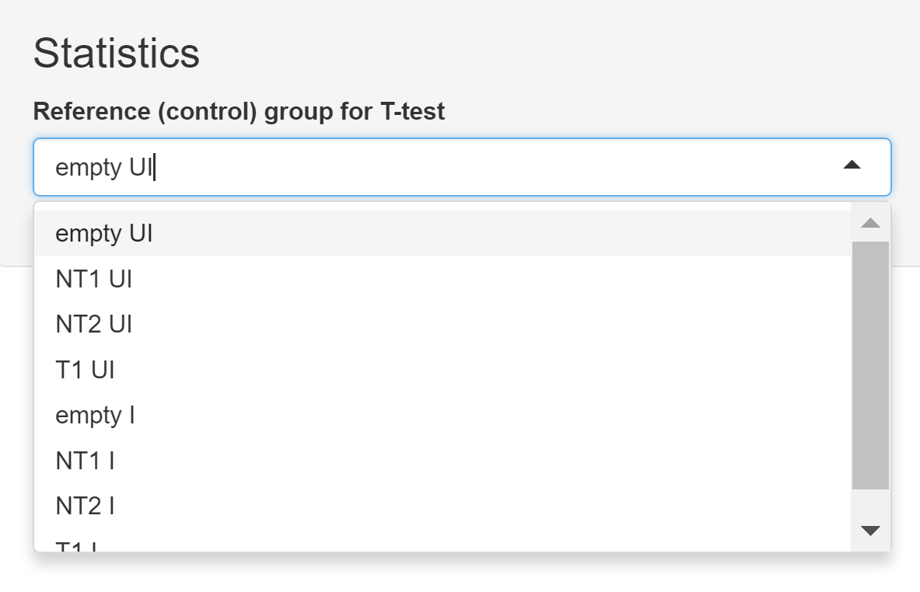
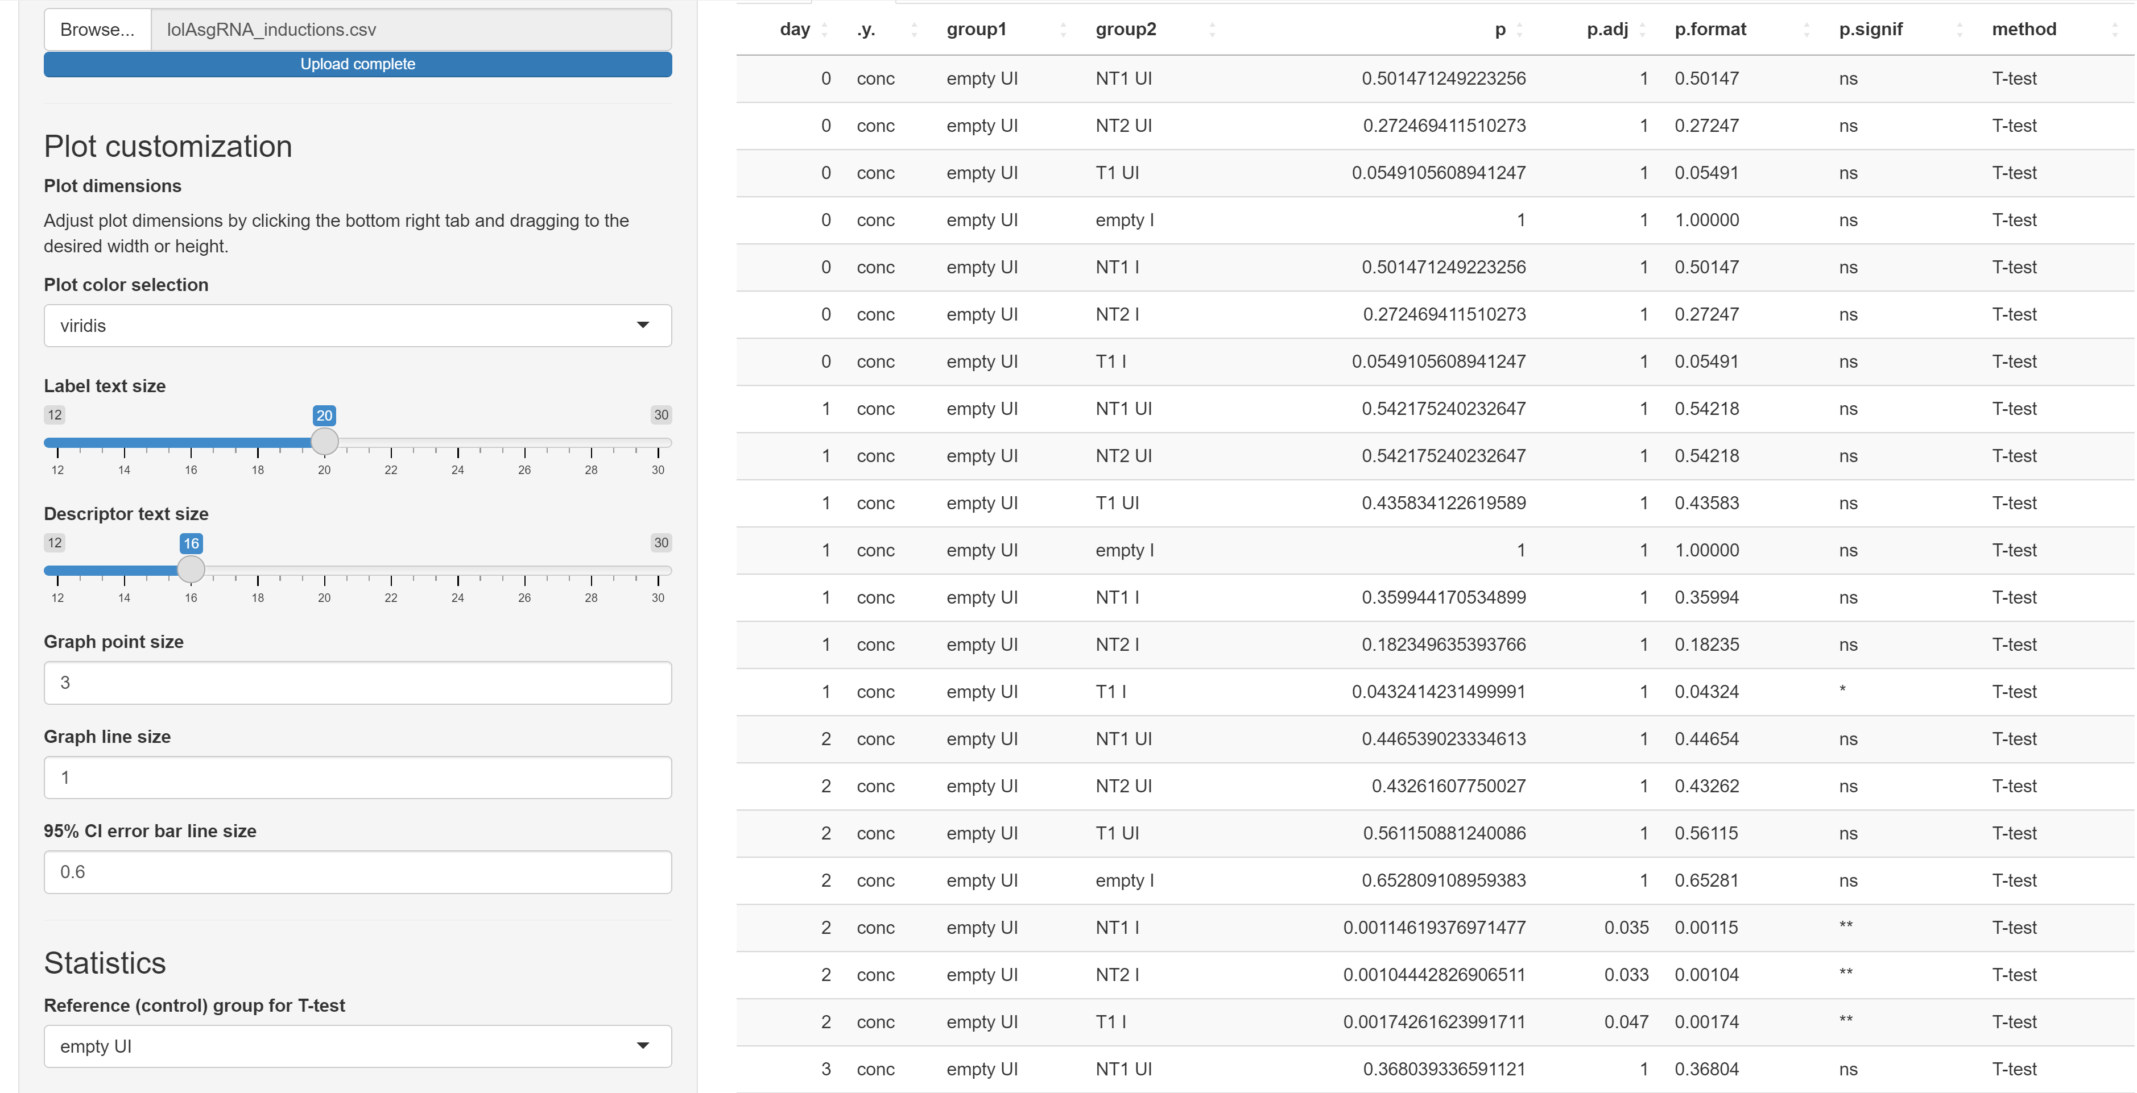
Growth Curve Analysis App – T-test Results
P-value significance of deviation from selected control
Factorized data default to first sample/condition (i.e. interaction) from input CSV file
Compared sample/conditions

Slide 6
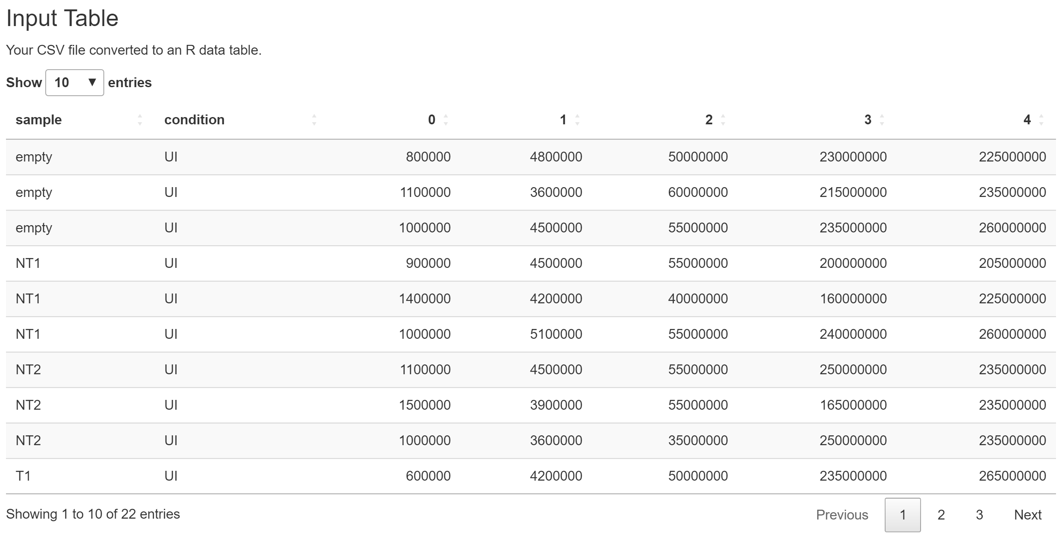
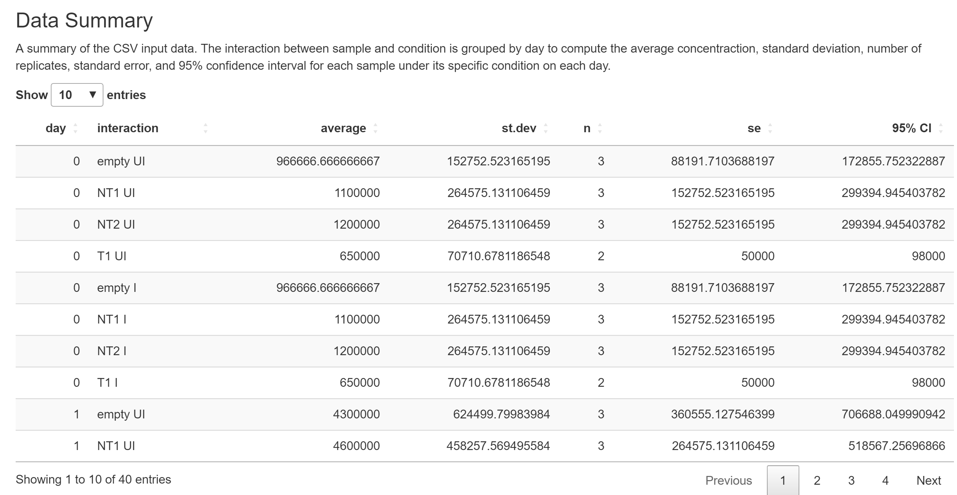
Growth Curve Analysis App – Tables Results
Output data table of input CSV to confirm full/successful file upload
dplyr summarized data with valuable analyses including the 95% confidence intervals for error bars generated in the plot

