Slide 1
New Integration Platform V0.1 – 2011-01-13
Nguyễn Bá Thành
Software Manager, Game Platform & Integration

Slide 2
Agendas
System’s Objectives
System Design
Service Server Architecture
Scalability & Availability
Service Deployment, Management & Interaction
Multiple-protocols & Standard Service APIs

Slide 3
Objectives
High scalability and availability
Handle interactions between VNG services/platforms
Standard APIs
Multiple-protocols supported (HTTP/HTTPS, TCP/IP socket, SOAP, etc)
Effective service dependency management and deployment
Easy to extend and maintain

Slide 4
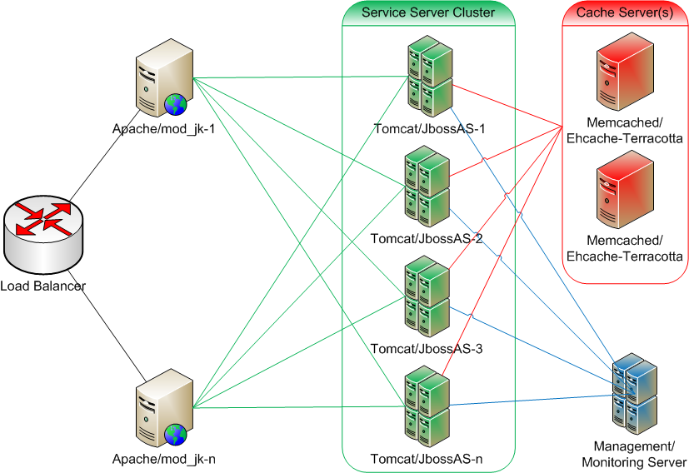
System Design
Notes:
1 to n Apache servers with mod_jk
1 to n Service servers (Java Application Server: Tomcat or JBossAS)
1 to n Cache servers (Memcached or Ehcache-Terracotta)

Slide 5
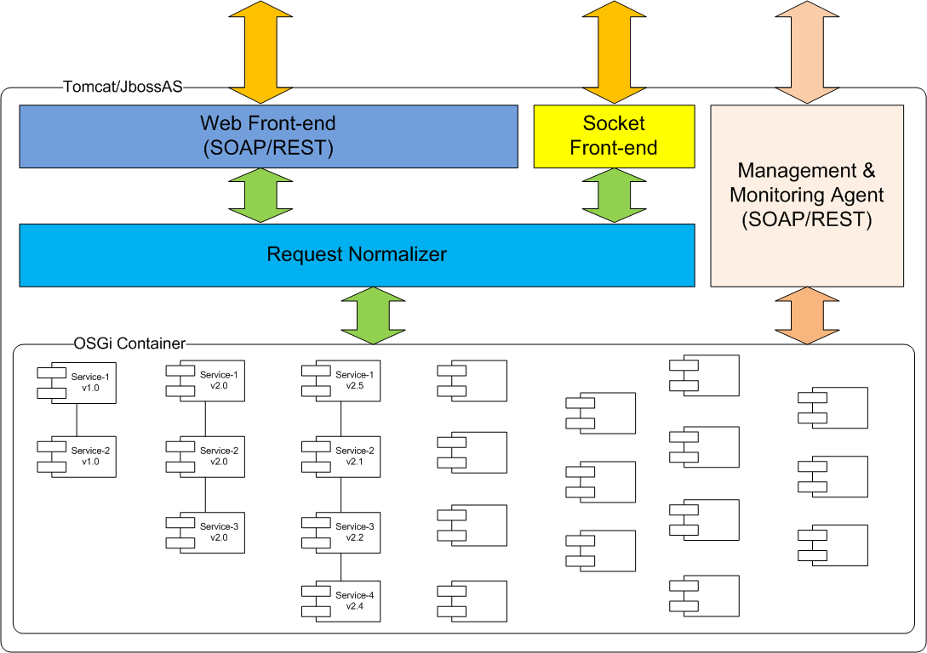
Service Server

Slide 6
Scalability & Availability
Horizontal scale:
1 to N service servers
1 to N web servers
1 to N cache servers
Each service server has a complete copy of all services
Web, Service and Cache servers are on independent layers
Notes:
Note: no auto scale yet

Slide 7
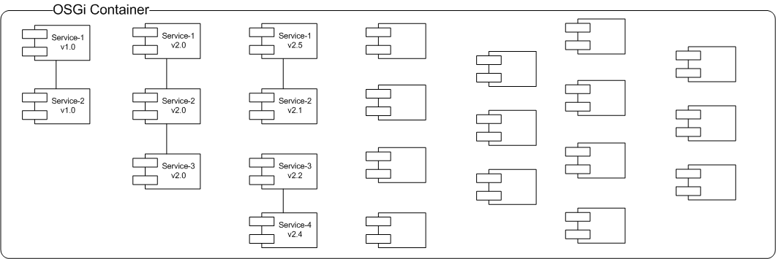
Service Deployment, Management & Interaction - Overview
Notes:
Each service is an OSGi bundle
Each service server has a complete copy of all services
MM Server is the remote management & monitoring tool

Slide 8
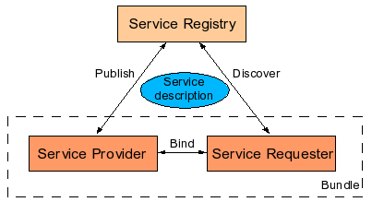
Service Deployment, Management & Interaction - Service Platform

Slide 9
Service Deployment, Management & Interaction - Service Description (provider example)
Bundle-Name: Provider
Bundle-Description: A service provider sample
Bundle-Vendor: VNG GPI
Bundle-Version: 1.0.0
Bundle-Activator: vng.example1.Activator
Export-Package: vng.example1.service
Import-Package: org.osgi.framework

Slide 10
Service Deployment, Management & Interaction - Service Description (client example)
Bundle-Name: Client
Bundle-Description: A service client sample
Bundle-Vendor: VNG GPI
Bundle-Version: 1.0.0
Bundle-Activator: vng.example2.Activator
Import-Package: org.osgi.framework, vng.example1.service

Slide 11
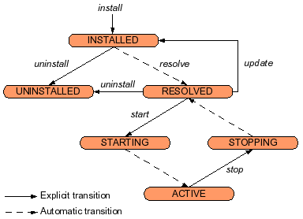
Service Deployment, Management & Interaction - Deployment

Slide 12
Multiple-protocols & Standard Service APIs
Front-end protocols:
Web: http/https, SOAP, REST
Socket
Request normalizer:
Be the bridge between front-end and service container

Slide 13
Q & A

