Slide 1
New Integration Platform V0.3 – 2011-01-27
Nguyễn Bá Thành
Software Manager, Game Platform & Integration

Slide 2
Agendas
System’s Objectives
System Design
Scalability & Availability
Service Server Architecture
Service Deployment, Management & Interaction
Multiple-protocols & Standard Service APIs

Slide 3
Objectives
High scalability and availability
Handle interactions between VNG services/platforms
Standard APIs
Multiple-protocols supported (HTTP/HTTPS, TCP/IP socket, SOAP, etc)
Effective service dependency management and deployment
Extensibility & Maintainability

Slide 4
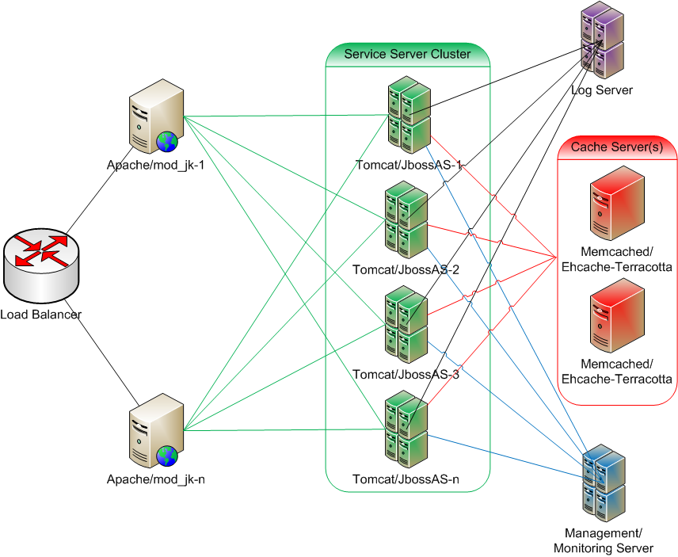
System Design
Notes:
1 to n Apache servers with mod_jk
1 to n Service servers (Java Application Server: Tomcat or JBossAS)
1 to n Cache servers (Memcached or Ehcache-Terracotta)

Slide 5
Scalability & Availability
Horizontal scale:
1 to N service servers
1 to N web servers
1 to N cache servers
Each service server has a complete copy of all services
Web, Service and Cache servers are on independent layers
Notes:
Note: no auto scale yet

Slide 6
Scalability & Availability – Fronting “Tomcat” With “Apache”
Best practice
Scalability / Load-balancing / Failover
Security
Notes:
Best practice:
http://people.apache.org/~mturk/docs/article/ftwai.html
Scalability:
Free Tomcat from the load of static content
Security:
A firewall between Apache (public zone) and Tomcat (private zone)

Slide 7
Scalability & Availability - Add New Service Server
Boot up new Service Server
Update Apache’s httpd.conf
Reload Apache’s configuration file
(repeat 2 & 3 on each Apache server)
Downtime: ~0
Notes:
Note: no auto scale yet

Slide 8
Scalability & Availability - Deploy New Service
Deploy new service (or new version of existing service) on MM Server
The service is populated to service servers and becomes available
Downtime: 0
Notes:
Note: no auto scale yet

Slide 9
Scalability & Availability - Replace A Service
Stop-Redeploy the service on MM Server
The service is populated to service servers
The service is Stopped-Redeployed on service servers
Global Downtime: 0
Local Downtime: a few seconds
Notes:
Note: no auto scale yet

Slide 10
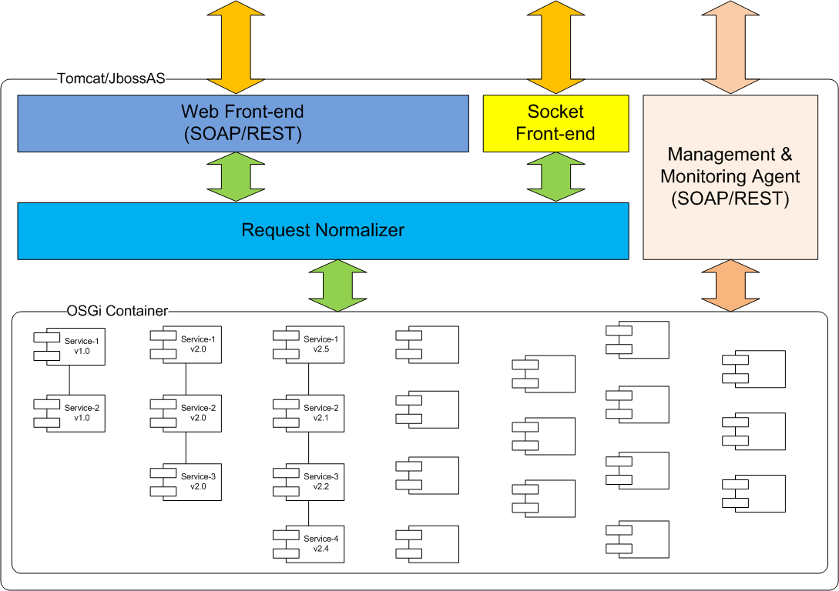
Service Server

Slide 11
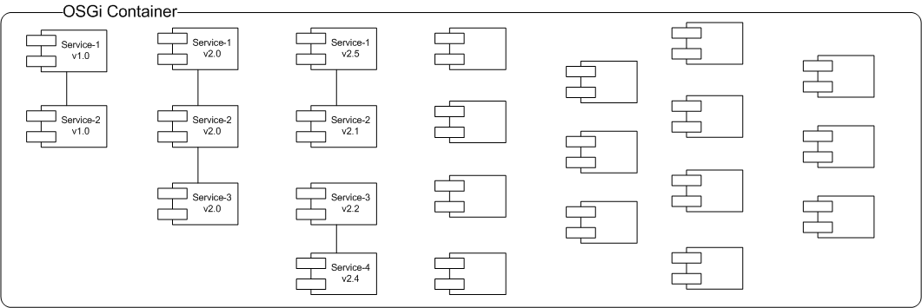
Service Deployment, Management & Interaction - Overview
Notes:
Each service is an OSGi bundle
Each service server has a complete copy of all services
MM Server is the remote management & monitoring tool

Slide 12
Service Deployment, Management & Interaction - Interaction
In-process communication between services:
Direct API calls
Local queue / pooling
Notes:
Each service is an OSGi bundle
Each service server has a complete copy of all services
MM Server is the remote management & monitoring tool

Slide 13
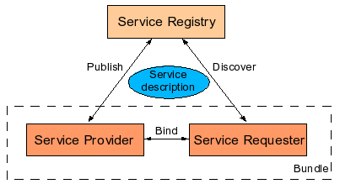
Service Deployment, Management & Interaction - Service Platform

Slide 14
Service Deployment, Management & Interaction - Service Description (provider example)
Bundle-Name: Provider
Bundle-Description: A service provider sample
Bundle-Vendor: VNG GPI
Bundle-Version: 1.0.0
Bundle-Activator: vng.example1.Activator
Export-Package: vng.example1.service
Import-Package: org.osgi.framework

Slide 15
Service Deployment, Management & Interaction - Service Description (client example)
Bundle-Name: Client
Bundle-Description: A service client sample
Bundle-Vendor: VNG GPI
Bundle-Version: 1.0.0
Bundle-Activator: vng.example2.Activator
Import-Package: org.osgi.framework, vng.example1.service
Export-Package: vng.example2.service

Slide 16
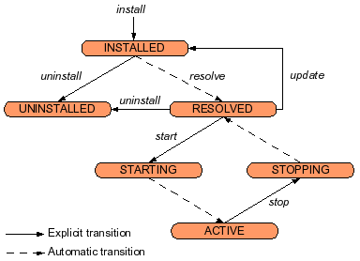
Service Deployment, Management & Interaction - Deployment

Slide 17
Service Deployment, Management & Interaction – MMServer
Services are managed from MM Server:
Deploy new service / New version of existing service
Stop-Redeploy existing service
Stop/Remove existing service
View status/stats of services on Service Server(s)

Slide 18
Multiple-protocols & Standard Service APIs
Front-end protocols:
Web: http/https, SOAP, REST
Socket
Request normalizer:
Be the bridge between front-end and service container

Slide 19
Q & A

