Slide 1
New Integration Platform V0.4 – 2011-02-28
Nguyễn Bá Thành
Software Manager, Game Platform & Integration

Slide 2
Agendas
Objectives of the System
Brief Technology Choice Discussion
System Design
Q&A

Slide 3
Objectives
Current system:
Mainly PHP
New requirements/features are hitting PHP’s not-so-strong points
New system:
“Upgraded” version of the current system
Notes:
The system is not web site or web application!
Socket, Scheduling, etc

Slide 4
Objectives (cont)
High scalability & availability
Standard APIs
Multiple-protocols supported (HTTP/HTTPS, Socket, SOAP, REST, etc)
Extensibility & Maintainability

Slide 5
Brief Technology Choice Discussion
APIs & Web Services, not web site/web application!
No need for Http Session, hence no session replication!
Technology such as .NET or Java would be more appropriate
Java has been chosen :-)

Slide 6
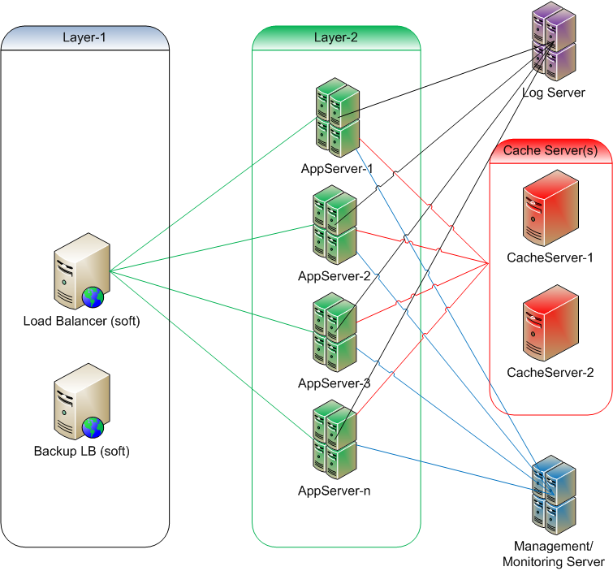
System Design – Compact Model
Notes:
Layer 1: load balancer
HA Proxy
Apache + mod_jk
Apache + mod_proxy + mod_load_balancer
Layer 2: application server(s)
Any javax.servlet container
Apache Tomcat
Jetty
Jboss Application Server
Notes:
No failover at LB!

Slide 7
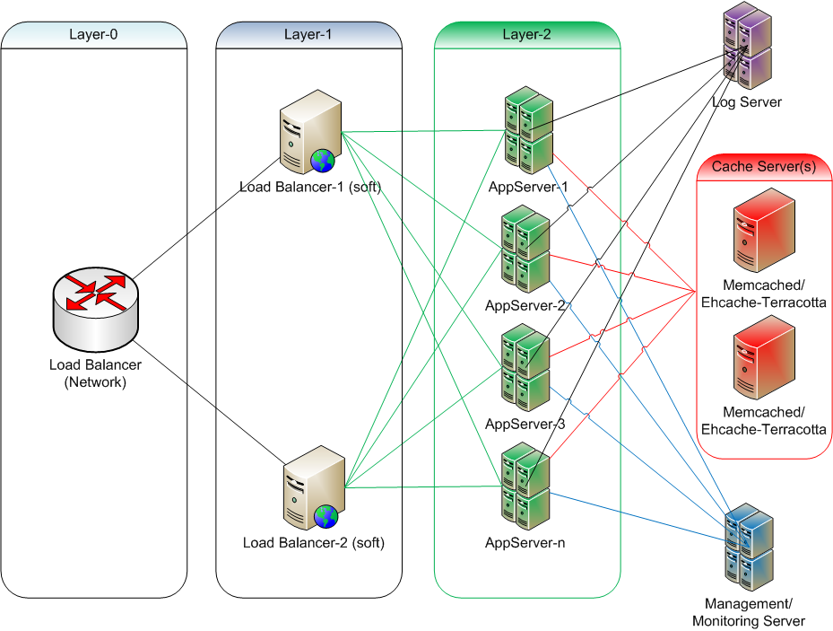
System Design – Extended Model
Notes:
Layer 0: network load balancer
Layer 1: load balancer
HA Proxy
Apache + mod_jk
Apache + mod_proxy + mod_load_balancer
Layer 2: application server(s)
Any javax.servlet container
Apache Tomcat
Jetty
Jboss Application Server
Notes:
The network LB is the bottle neck/single point of failure

Slide 8
System Design (cont)
Layer 0: network load balancer
Layer 1: load balancer
From 1 to n servers
Layer 2: application server(s)
From 1 to n servers
Misc:
1-n cache servers

Slide 9
System Design – Layer 1
Load balancer
HA Proxy
Apache + mod_jk
Apache + mod_proxy + mod_load_balancer
HA Proxy is the 1st choice as other options support only HTTP/HTTPS
Apache + mod_jk plus HA Proxy is the 2nd choice
Note: we can switch options easily!

Slide 10
System Design – Layer 2
Application server(s)/Service container
Any javax.servlet container
Apache Tomcat
Jetty
Jboss Application Server
etc
Apache Tomcat is the 1st choice
Jetty is the 2nd choice
Note: we can switch options easily

Slide 11
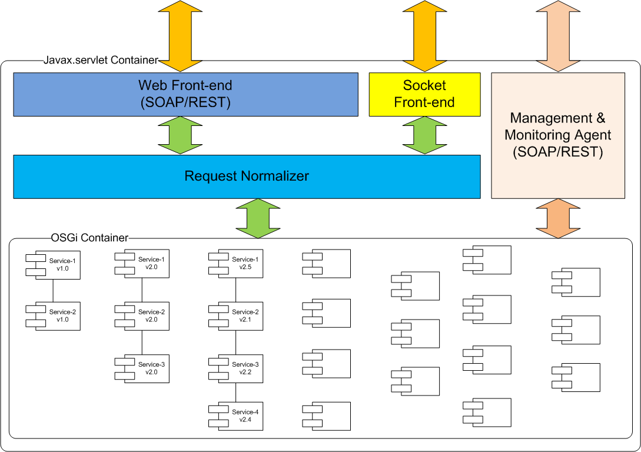
System Design – Application Server

Slide 12
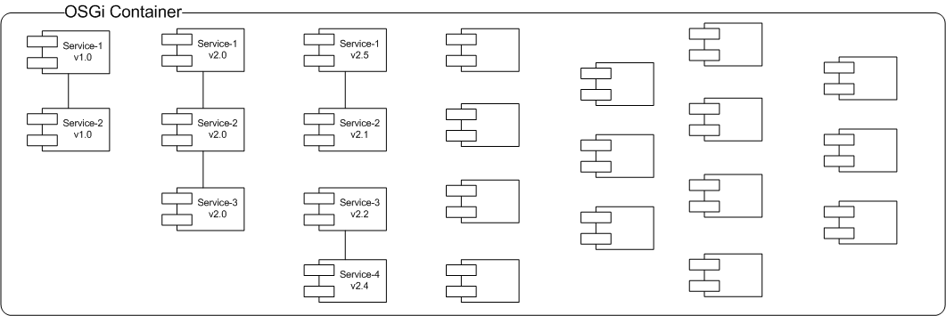
System Design – Application Server (cont)
Notes:
Each service is an OSGi bundle
Each service server has a complete copy of all services
MM Server is the remote management & monitoring tool

Slide 13
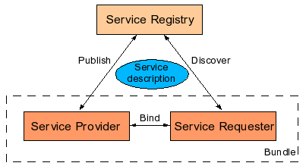
System Design – Application Server (cont)

Slide 14
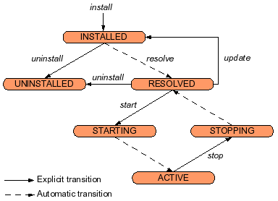
System Design – Application Server (cont)

Slide 15
Q & A

