Slide 1
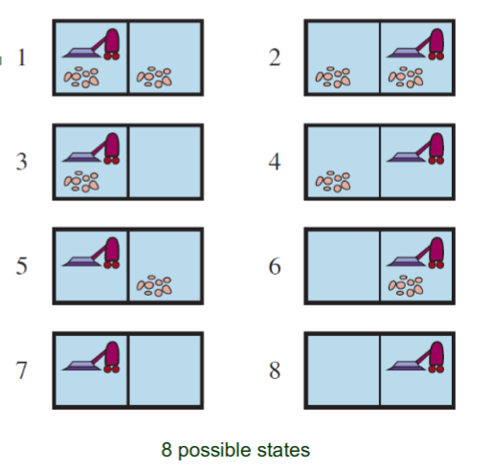
Right
Left
Suck, Left
Suck
Suck, Right
Right
Left

