Slide 1
Attrition Analysis Investigation
DDSAnalytics – Your source for better analytics

Slide 2
Investigation
DDSAnalytics was contacted to investigate employee performance
Find factors that lead to attrition.
The top three factors that contribute to turnover.
The business is also interested in learning about any job role specific trends that may exist.
A CSV was provided for investigation purposes

Slide 3
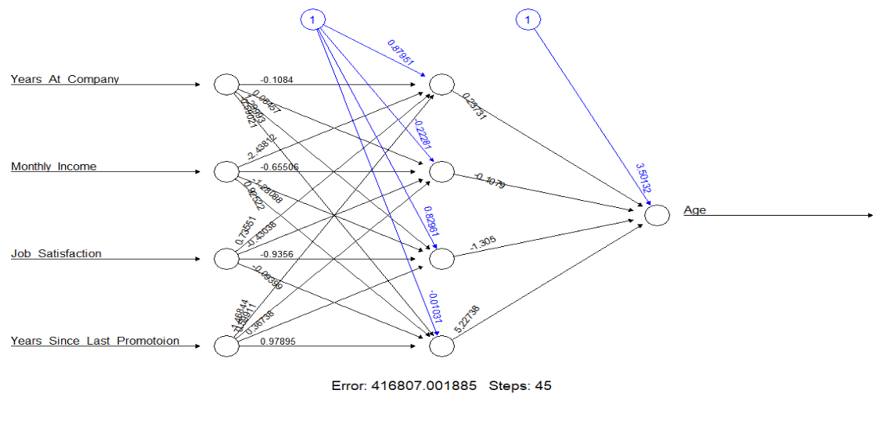
NN Accuracy Test
Neural networks(NN)
Set layers of highly interconnected processing elements (neurons)
Series of transformations on the data to generate its own understanding of the data, also called features.
Test concluded: .9998 percent accuracy
Data: Test ensured data used was at highest accuracy for modelling results

Slide 4
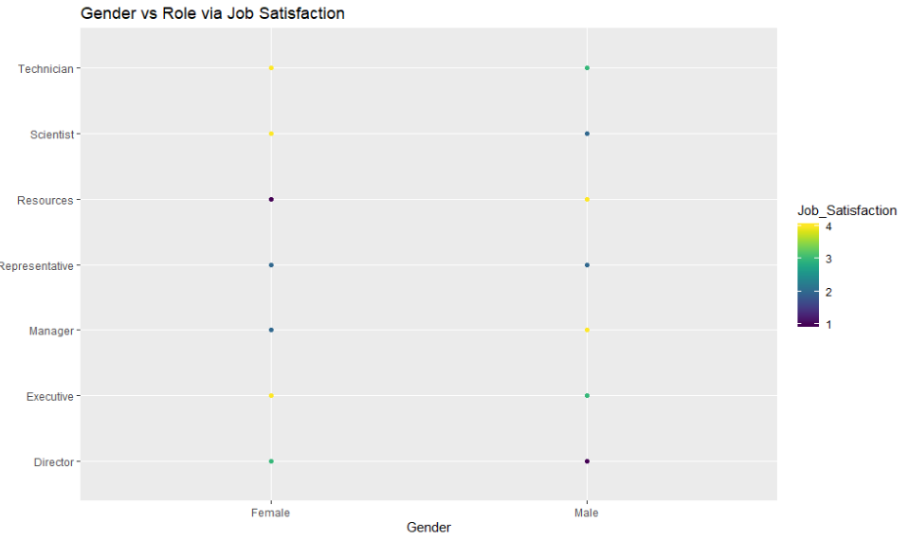
Gender and Role vs Job Satisfaction
Gender vs Job Satisfaction
Women are least happy being in Human Resources
Men are least happy with being a Director
Women prefer Executive, Technician, and Scientist roles
Men prefer Manager or Human Resources roles

Slide 5
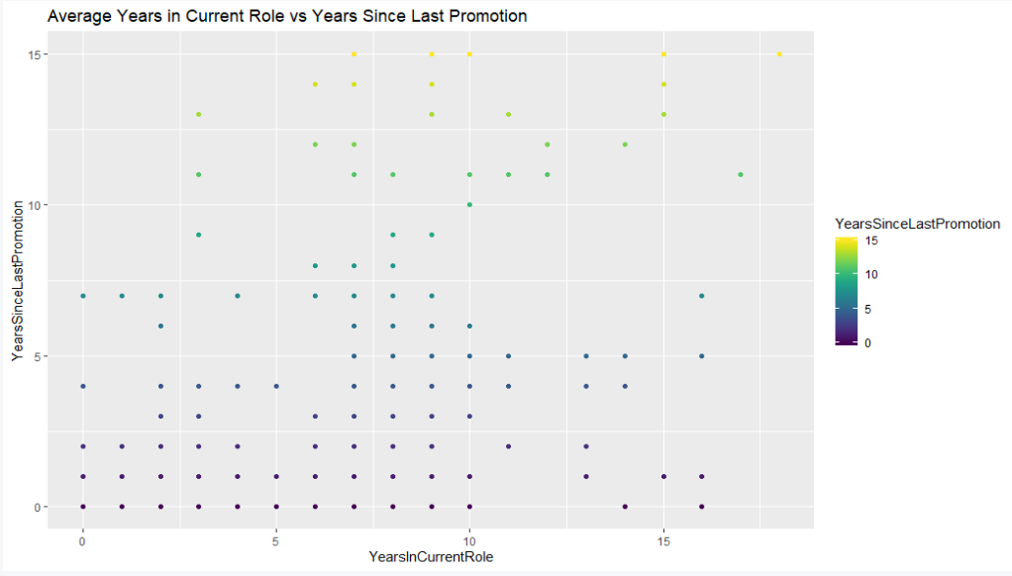
Average Years in Current Role vs Years Since Last Promotion
Years in Current Role vs Years Since Last Promotion
Promotions are not very frequent after the first 5 years of employment
7-10 years of service had the highest amount of employees without promotions
Promotions are more frequent around the 15 year range

Slide 6
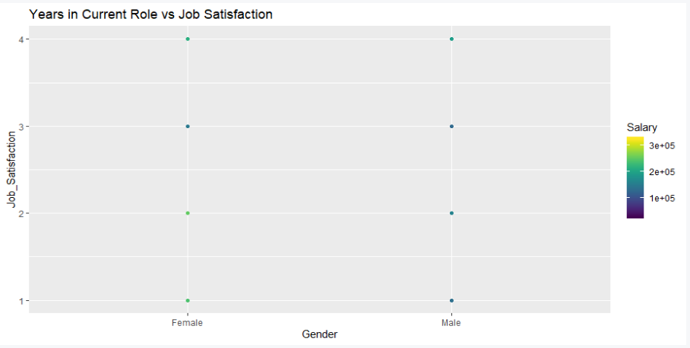
Average Gender vs Job Satisfaction and Salary
Gender vs Job Satisfaction via Salary
Both genders have a medium satisfaction in regards to salary
Females are slightly higher on job satisfaction vs pay

Slide 7
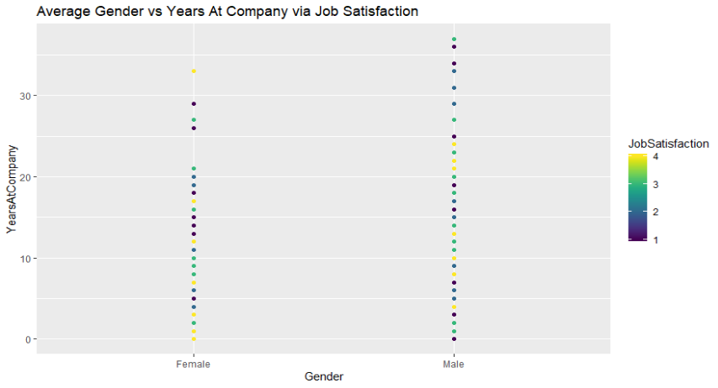
Gender vs Years At Company via Job Satisfaction
Gender vs Job Satisfaction via Job Satisfaction
Females and Males are about the same for job satisfaction.
Females are less like to still be employed after 30 years of service. Some leave before the 30 year mark.
Makes are consistent with employment but are less satisfied after the 30 year mark.

Slide 8
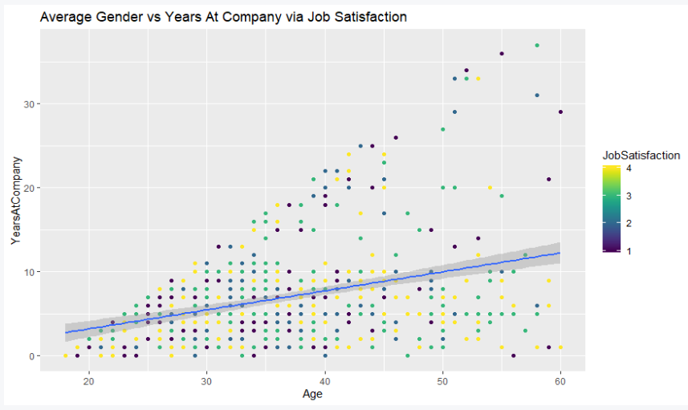
Age vs Years At Company and Job Satisfaction
Average Gender vs Years At Company via Job Satisfaction
Overall Job Satisfaction is mainly scored between a 3 and 4.
This highest density is within the 10 year range as employees become older.
It may appear that employees tend to disappear after the 10 year mark.
After 20 years of service, job satisfaction drops significantly.

Slide 9
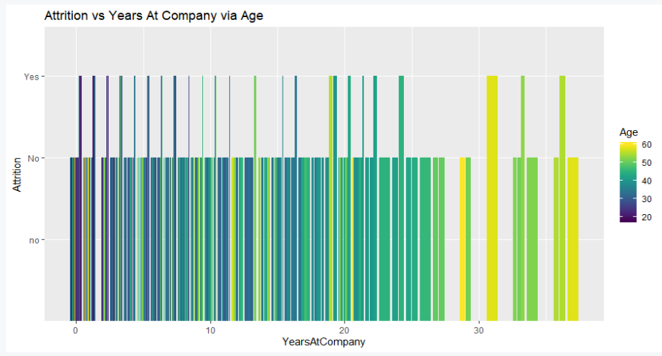
Attrition vs Years At Company
Attrition vs Years At Company
Attrition is consistent the first 25 years of service
There is more attrition after the 30 year employment mark

Slide 10
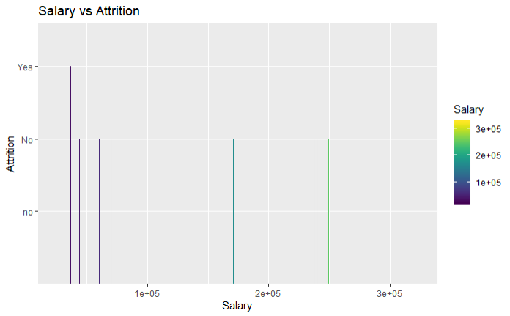
Salary vs Attrition
Salary vs Attrition
Employees with the lowest salaries tend to leave the most
Salaries do not appear to be a reason why employees may be leaving overall

Slide 11
Summary
Overall employees are staying with the company for many years
Salaries do not seem to be a factor for attrition
Possible Further Investigations
Investigate why females are leaving the company around the 30 year mark
Investigate why males and females are less happy in certain positions
Investigate promotion frequency for employees

Slide 12
Conclusion
Q & A
Meeting Close

