Slide 1
How to Panic in a Coding Interview
Benjamin Toll
benjamintoll.com
benjam72@yahoo.com

Slide 2
Topics
Interview Prep
In the Interview
Presentation Format
Presentation Goals
Time Complexity
Space Complexity
Examples of Common Runtimes
Algorithms
- Strings and Arrays
- Linked Lists
- Stacks and Queues
- Trees
- Bit Manipulation
References

Slide 3
Interview Prep
Practice in a language in which you’re not fluent (preferably one that doesn’t natively support all data structures).
Read at least one book and use several websites.
Study other people’s solutions.
Practice all the time in blocks of time.
Write the algorithms down using pencil and paper and only then type it into the computer.
Want to at least get to the point where you think “ah, I’ve seen this one before”.

Slide 4
In the Interview
Remember, the interview is a conversation. You want to know as much about them as they do about you.
Don’t assume anything. Ask questions if you’re unsure about what has been asked.
Demonstrate your knowledge:
  If using a hash, talk about its how accessor functions are O(1) except in the case where there are collisions, which depends on the distribution of the hash function.
  If using an array, talk about how insertions are constant time except when it occurs during a power of two, at which point the language could do table doubling. However, this cost is amortized since most insertions won’t trigger the table doubling.
Draw it out!
If stumped, try to at least do a brute-force solution.
Meanwhile, think of a better runtime complexity and space complexity.
Check for edge cases and trouble spots, such as off-by-one errors.
Take a deep breath!

Slide 5
Presentation Format
Question
Interviewer imposes constraints
Your analysis (talking out loud)

Slide 6
Presentation Goals
We’re looking at the algorithms to get a feel for their complexity, both time and space.
We’re not looking at Big O from an academic point of view, we just want to get more familiar and comfortable with talking about runtime complexity.
As such, we’re not going to be analyzing the algorithms in detail, instead looking at the big picture.
We’re not interested in doing a code review and analyzing every line of code.
I chose examples that are interesting to me and/or have been asked in interviews.

Slide 7
Time Complexity
Also known as asymptotic runtime or Big O
Gives us a language with which to measure the efficiency of an algorithm
Common runtimes:
  O(1) - constant
  O(lg n) - logarithmic
  O(n) - linear
  O(n lg n) - linearithmic
  O(n²) - quadratic
  O(2^{n}) – exponential
  O(n!) - factorial
Asymptotic notations
  Big O – upper bound on the runtime (i.e., “it’s at least as fast as O(n), O(n lg n), O(n²), etc.”)
  Big Theta Θ – tight bound on the runtime, means both Big O and Big Omega
  Big Omega Ω – lower bound on the runtime (i.e., “it’s at least as slow as O(n), O(lg n)...O(1)”)
When programmers speak of Big O, they usually mean Big Theta
For each runtime, there are best, worst and expected cases
Only concerned with the higher-order terms, everything else is dropped

Slide 8
Space Complexity
The amount of memory required by an algorithm
Parallel concept to time complexity:
  An array of size `n` requires O(n) space
  A matrix (2d array) of size `n` x `n` requires O(n²) space

Slide 9
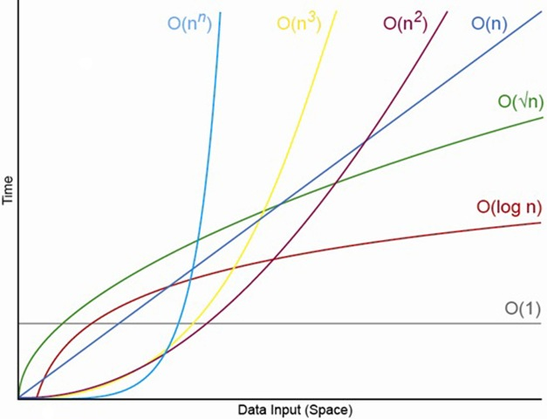
Common Runtimes

Slide 10
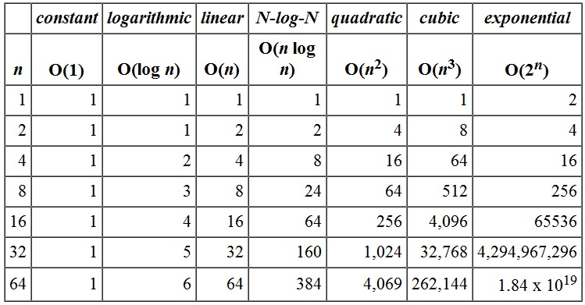
Runtime Comparisons

Slide 11
Examples of Common Runtimes

Slide 12
void rot3(char* s) {
int k = 0;
while (*(s + k)) {
char c = *(s + k);
if (c >= 'a' && c <= 'z')
*(s + k) = ((c + 3 - 'a') % 26) + 'a';
k++;
}
}
void main(int argc, char** argv) {
if (argc == 1) {
printf("Usage: %s <string>\n", argv[0]);
exit(1);
}
char *s = argv[1];
rot3(s);
printf("%s\n", s);
}
./rot3 "pq!rst uvwxyz_abc"
O(n)

Slide 13
size_t len(char* s) {
size_t k = 0;
while (*(s++)) k++;
return k;
}
void rot3(char* s) {
for (int i = 0; i < len(s); i++) {
char c = s[i];
if (c >= 'a' && c <= 'z')
s[i] = ((c + 3 - 'a') % 26) + 'a';
}
}
void main(int argc, char **argv) {
char s[] = "pq!rst uvwxyz_abc";
rot3(s);
int k = 0;
while (*(s + k)) {
printf("%c", *(s + k++));
}
}
O(n)

Slide 14
void main(int argc, char **argv) {
for (int i = 25; i > -1; --i)
printf("%c\n", 'a' + i);
}
O(1)

Slide 15
void main(int argc, char **argv) {
if (argc < 2) {
printf("Usage: %s <n>\n", argv[0]);
exit(1);
}
int n = atoi(argv[1]);
int matrix[n][n];
int k = 0;
for (int i = 0; i < n; i++)
for (int j = 0; j < n; j++)
matrix[i][j] = k++;
}
O(n²)

Slide 16
#include <stdio.h>
void main(int argc, char **argv) {
char *s = argv[1];
char *t = argv[2];
while (*s)
printf("%c\n", *s++);
while (*t)
printf("%c\n", *t++);
}
O(a+b)

Slide 17
int binary_search(int nodes[], int p, int r, int k) {
if (p > r)
return -1;
int q = p + r >> 1;
if (nodes[q] == k)
return q;
if (nodes[q] > k)
binary_search(nodes, p, q - 1, k);
else
binary_search(nodes, q + 1, r, k);
}
O(lg n)

Slide 18
Strings and Arrays

Slide 19
Q. Determine if a string contains only unique characters
Interviewer:
  No constraints

Slide 20
Analysis
What data structures could be used?
If the constraints are open-ended, ask if you can do an operation to simplify the problem (like sorting).
Whenever you can sort something, do it! The tradeoff is that the order of growth may increase, but it can greatly simplify the problem.
For example, the solution may then be able to be done in constant space instead of using another data structure.

Slide 21
int main(int argc, char **argv) {
char s[] = "yellowjacket";
int len = strlen(s);
if (len > 26) return 0;
// sort string
for (int i = 0; i < len; i++)
if (s[i] == s[i + 1]) return 0;
return 1;
}
O(n lg n)

Slide 22
Q. Determine if a string contains only unique characters (continued)
Interviewer:
  Do it in constant space

Slide 23
Analysis
Can it be done in only one pass?
What about a bit vector?
Weeeeeeeeeeeeeeeeeeeeee

Slide 24
int main(int argc, char **argv) {
char* s = "yellowjacket";
int v = 0, k = 0;
while (s[k]) {
int shift = 1 << s[k++] - 'a';
if ((v & shift) > 0) return 0;
v |= shift;
}
return 1;
}
O(n)

Slide 25
Q. Remove duplicate characters in a string
Interviewer:
  No constraints

Slide 26
Analysis
I know I can use another data structure, but...
Can it be done using the same string?

Slide 27
void main(int argc, char **argv) {
char s[] = "wrhelodldl";
size_t l = sizeof(s) / sizeof(char);
// mergesort
int k = 0;
for (int i = 0; i < l; ++i)
if (s[i] != s[i + 1])
s[k++] = s[i];
s[k] = '\0';
printf("%s\n", s);
}
O(n lg n)

Slide 28
void main(int argc, char **argv) {
char s[] = "hwwrhelodldl";
int v = 0, k = 0;
printf("%s\n", s);
for (int i = 0; i < strlen(s); ++i) {
int shifted = 1 << s[i] - 'a';
if ((v & shifted) == 0) {
v |= shifted;
s[k++] = s[i];
}
}
s[k] = '\0';
printf("%s\n", s);
}
O(n)

Slide 29
Sometimes, the solution requires special domain knowledge.
This is another reason to always be practicing.

Slide 30
Q. Find missing integer in a sorted array
Interviewer:
  Integers are ordered in an arithmetic series
  Do not use any extra data structures

Slide 31
Analysis
The key to solving this is in the hint that the array is an arithmetic sequence, i.e., the difference between the numbers is constant.
Developers with a math background will know that Gauss developed an elegant (and simple) method to find the aggregate of an arithmetic progression of 1s:
    (n² + n) / 2
    n(n + 1) / 2
    n = max

Slide 32
void main(int argc, char **argv) {
int n = 100, k = 0;
int nums[n];
for (int i = 0; i < n; ++i)
nums[i] = i + 1;
// "Randomly" reset one of the elements to 0.
nums[53] = 0;
for (int i = 0; i < n; ++i)
k += nums[i];
int gauss = (n * (n + 1)) / 2;
printf("%d\n", gauss - k);
}

Slide 33
Q. Find unique integer in an unsorted array
Interviewer:
  All other integers in the array have a duplicate
  Do not use any extra data structures

Slide 34
Analysis
It would be simple to solve this using an array or hash, but this must be solved in constant space.
What about a bitwise operation?
XORing a number by itself is zero.

Slide 35
void main(int argc, char **argv) {
int nums[] = { 3, 5, 7, 6, 8, 9, 7, 42, 6, 8, 5, 9, 3 };
int k = 0;
for (int i = 0; i < sizeof(nums) / sizeof(int); ++i)
k ^= nums[i];
printf("%d\n", k);
}

Slide 36
Linked Lists

Slide 37
Q. Create a linked list
Singly? Doubly? Ask!
Should there be a reference to the tail?
What about the API?

Slide 38
struct node {
struct node *next;
int val;
};
void add(struct node **head, int v) {
struct node *n;
if (!(n = malloc(sizeof(struct node)))) {
fprintf(stderr, "Could not allocate memory for new node!");
exit(1);
}
if (*head == NULL) {
n->val = v;
n->next = NULL;
*head = n;
} else {
struct node *c = *head;
while (c->next) {
c = c->next;
}
n->val = v;
n->next = NULL;
c->next = n;
}
}
void list(struct node **head) {
struct node *n = *head;
while (n) {
printf("%d\n", n->val);
n = n->next;
}
}
struct node* find(struct node **head, int v) {
if (*head == NULL) return NULL;
if ((*head)->val == v) return *head;
struct node *n = (*head)->next;
while (n) {
if (n->val == v) return n;
n = n->next;
}
return NULL;
}

Slide 39
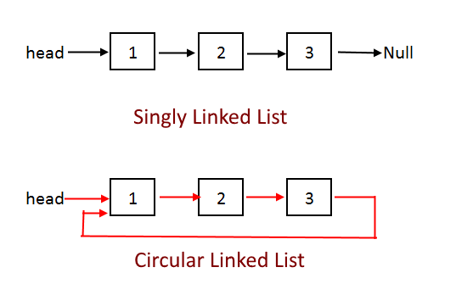
Q. Determine if a linked list is circular

Slide 40
#include "../linked_list.c"
int is_circular(struct node **node) {
struct node *tortoise = *node;
struct node *hare = *node;
int i = 0;
while (i++ < 2 && hare->next)
hare = hare->next;
while (tortoise->next && hare->next) {
tortoise = tortoise->next;
hare = hare->next;
if (tortoise == hare) return 1;
if (hare->next) hare = hare->next;
}
return 0;
}
void main(int argc, char **argv) {
struct node *HEAD = NULL;
for (int i = 1; i < 10; ++i)
add(&HEAD, i * 2);
list(&HEAD);
struct node *tail = find(&HEAD, 18);
tail->next = HEAD;
printf("%d\n", is_circular(&HEAD));
}

Slide 41
Q. Delete a node in a linked list given only the node itself
You are not given a reference to HEAD
The linked list is not doubly-linked

Slide 42
#include "../linked_list.c"
void main(int argc, char **argv) {
struct node *HEAD = NULL;
for (int i = 1; i < 10; ++i)
add(&HEAD, i * 2);
struct node *to_delete = find(&HEAD, 10);
if (to_delete->next) {
to_delete->val = to_delete->next->val;
to_delete->next = to_delete->next->next;
} else {
fprintf(stderr, "Can't delete tail!");
exit(1);
}
}

Slide 43
Q. Return the kth to last node

Slide 44
#include "../linked_list.c"
int kth_to_last(struct node **node, int k) {
struct node *tortoise = *node;
struct node *hare = (*node)->next;
int j = 1;
while (j++ < k && hare->next)
hare = hare->next;
if (j - 1 != k) {
fprintf(stderr, "Error: list length is less than k");
exit(1);
}
while (hare->next) {
tortoise = tortoise->next;
hare = hare->next;
}
return (*tortoise).val; // Same as `tortoise->val`.
}
void main(int argc, char **argv) {
struct node *HEAD = NULL;
for (int i = 1; i < 10; ++i)
add(&HEAD, i * 2);
list(&HEAD);
printf("\n%d\n", kth_to_last(&HEAD, 3));
}

Slide 45
Stacks and Queues

Slide 46
Q. Create a stack
Implement
- pop
- push
- size

Slide 47
#define MAX_N 100
struct stack {
int data[MAX_N];
int sp; // stack pointer
};
struct stack* create_stack() {
struct stack *s;
if (!(s = malloc(sizeof(struct stack)))) {
fprintf(stderr, "Error: Could not initialize stack");
exit(1);
}
return s;
}
int pop(struct stack *s) {
if (s->sp > 0)
return s->data[--s->sp];
else
fprintf(stderr, "Error: Stack empty");
}
void push(struct stack *s, int v) {
if (s->sp < MAX_N)
s->data[s->sp++] = v;
else
fprintf(stderr, "Error: Stack full");
}
int size(struct stack *s) {
return s->sp;
}

Slide 48
Q. Create a queue from two stacks
Interviewer:
  Implement
    enqueue
    dequeue
    is_empty

Slide 49
#include "../stack.c"
struct queue {
struct stack *s1;
struct stack *s2;
};
void enqueue(struct queue *q, int v) {
if (size(q->s2) > 0)
while (size(q->s2))
push(q->s1, pop(q->s2));
push(q->s1, v);
}
int dequeue(struct queue *q) {
if (size(q->s1))
while (size(q->s1))
push(q->s2, pop(q->s1));
return pop(q->s2);
}
int is_empty(struct queue *q) {
return (size(q->s1) + size(q->s2)) > 0;
}
void main(int argc, char **argv) {
struct queue *q;
if (!(q = malloc(sizeof(struct queue)))) {
fprintf(stderr, "Error: Could not initialize queue");
exit(1);
}
q->s1 = create_stack();
q->s2 = create_stack();
enqueue(q, 5);
enqueue(q, 7);
enqueue(q, 9);
enqueue(q, 11);
printf("%d\n", dequeue(q));
enqueue(q, 3);
printf("size s1 -> %d\n", size(q->s1));
printf("size s2 -> %d\n", size(q->s2));
}

Slide 50
Q. Determine if parentheses are balanced
Interviewer:
  No constraints

Slide 51
#include "../stack.c"
void main(int argc, char **argv) {
char *t = "He(ll(o) W)o()r(ld)";
struct stack *s = create_stack();
while (*t) {
if (*t == '(') push(s, *t);
if (*t == ')')
if (size(s) == 0) push(s, *t);
else pop(s);
*t++;
}
printf("%d\n",
size(s) == 0 ? 1 : 0);
}

Slide 52
Trees

Slide 53
Q. Determine if binary tree is a binary search tree
Interviewer:
  Remember that a node in a binary tree has 0, 1 or 2 children
  Placement of a child node is not constrained by value

Slide 54
Analysis
What are the non-variants of a binary search tree?
What type of tree traversal is needed?
Should the traversal be recursive or iterative?

Slide 55
struct tree {
struct tree_node *root;
size_t count;
};
void main(int argc, char **argv) {
struct tree *t;
if ((t = malloc(sizeof(struct tree))) == NULL) {
fprintf(stderr, "Could not allocate memory for new tree!");
exit(1);
}
make_tree(t);
int collector[t->count];
int k = 0;
traverse(t->root, &k, collector);
for (int i = 1; i < t->count; ++i)
if (collector[i] < collector[i - 1]) {
printf("0\n");
return;
}
printf("1\n");
}

Slide 56
void traverse(struct tree_node *n, int *k, int nodes[]) {
if (n == NULL) return;
traverse(n->left, k, nodes);
nodes[*k] = n->val;
*k = *k + 1;
traverse(n->right, k, nodes);
}

Slide 57
Q. Serialize a binary search tree
Interviewer:
  Do it iteratively

Slide 58
__ 100 __
/ \
50 150
/ \ / \
25 75 125 175
/ \
15 30

Slide 59
Bit Manipulation

Slide 60
Q. Determine if n is a power of two

Slide 61
Analysis
What does it mean for a number to be a power of two?
Is there a pattern?
Could we look at each bit in turn?

Slide 62
int is_power_of_two(int v) {
if (v == 1) return 1;
do {
if (v & 1 != 0) return 0;
} while ((v >>= 1) > 1);
return 1;
}
void main(int argc, char **argv) {
printf("%d\n",
is_power_of_two(atoi(argv[1])));
}

Slide 63
Q. Determine if n is a power of two (continued)
Since a power of two will only have one 1 bit, is there a bitwise operation that can determine yes/no/true/false with `n` and another operand?

Slide 64
void main(int argc, char **argv) {
int v = atoi(argv[1]);
printf("%d\n",
(v & (v - 1)) == 0);
}

Slide 65
Q. Create a bitmask from bits j to k, inclusive
j = 8, k = 4
- Mask will be 0000 0000 1111 0000

Slide 66
Analysis
What does a bitmask do?

Slide 67
void main(int argc, char **argv) {
if (argc < 4) {
printf("Usage: %s <value> <high bit> <low bit>\n", argv[0]);
exit(1);
}
// Create mask between bits j and k, inclusive.
int v = atoi(argv[1]);
int j = atoi(argv[2]);
int k = atoi(argv[3]);
int left = ~0 << j;
int right = (1 << k) - 1;
int mask = ~(left | right);
int res = mask & v;
printf(" mask -> %d\n", mask);
printf("result -> %d\n", res);
}

Slide 68
Q. Tic-tac-toe

Slide 69
Analysis
How would you store the state?
Consider: what is the total number of combined moves?
Can you optimize the storage space?
What about a bit vector?

Slide 70
1 << 0 = 1
1 << 1 = 2
1 << 2 = 4
= 7 bits
1 << 3 = 8
1 << 4 = 16
1 << 5 = 32
= 56 bits
1 << 6 = 64
1 << 7 = 128
1 << 8 = 256
= 448 bits
( Note that all the left shifts compute to powers of two. )
+---------+
|0 | 1 | 2|
|----------|
|3 | 4 | 5|
|----------|
|6 | 7 | 8|
+---------+

Slide 71
void play(short player, int *state) {
char buf[2];
printf("Your play [%c]: ", player % 2 ? 'X' : 'O');
fgets(buf, 3, stdin);
int move = atoi(buf);
if (player % 2) {
if ((*state & (1 << move)) == 0)
*state |= 1 << move;
} else {
short o = *state >> 16;
if ((o & (1 << move)) == 0) {
o |= 1 << move;
*state |= o << 16;
}
}
}
int winners[] = {
// Across.
7, // 1, 2, 4
56, // 8, 16, 32
448, // 64, 128, 256
// Down.
73, // 1, 8, 64
146, // 2, 16, 128
292, // 4, 32, 256
// Diagonal.
273, // 1, 16, 256
84 // 4, 16, 64
};

Slide 72
short is_winner(int *winners, int *state) {
short k = 0;
char winner = '\0';
short x = *state;
short o = *state >> 16;
while (*(winners + k)) {
int w = *(winners + k);
if ((w & x) == w) {
winner = 'X';
break;
}
if ((w & o) == w) {
winner = 'O';
break;
}
k++;
}
...
return 0;
}

Slide 73
References
btoll/howto-panic-in-a-coding-interview
K&R
Project Euler
LeetCode
Cracking the Coding Interview

Slide 74
FIN
Benjamin Toll
benjamintoll.com
benjam72@yahoo.com

