Slide 1
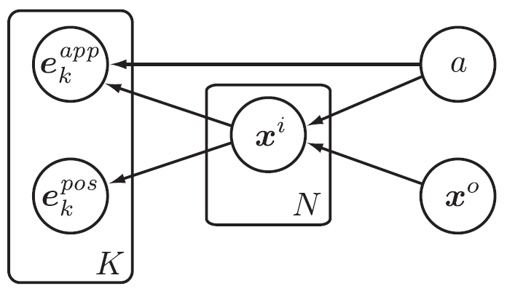
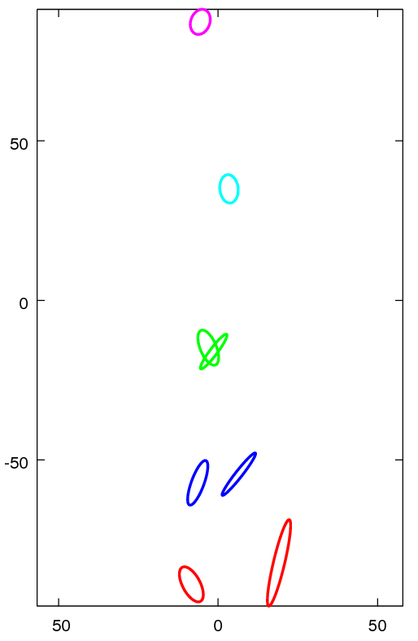
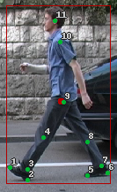
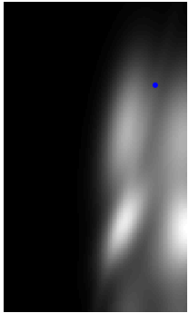
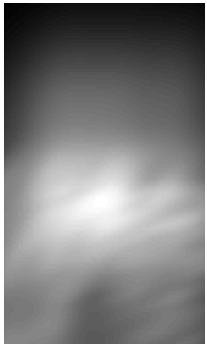
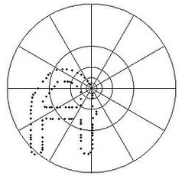
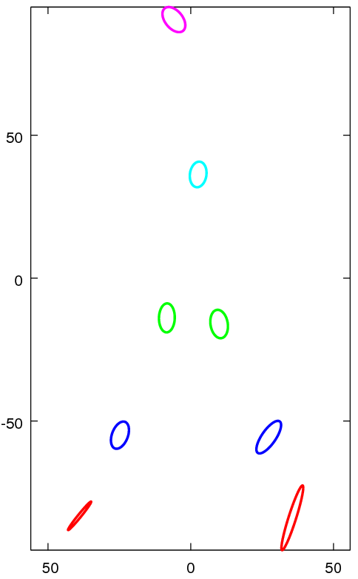







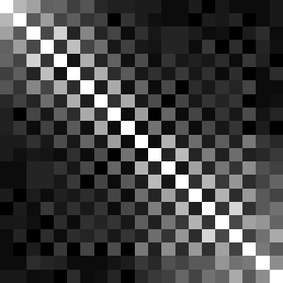
Part-based Human Detection
Brandon Tolsch and Joseph Richardson
Overview
Part-Based Model
Detection
We first attempted to implement “People-Tracking-by-Detection and People-Detection-by-Tracking” [A], but quickly found that to be too ambitions for our time constraints. Instead, we opted to implement the first half of their paper, which deals entirely with detection.
While we were able to implement the paper in its basic state, we ran into many problems early on in the pipeline, especially with keypoint detection and feature descriptors, which ultimately resulted in poor results. In addition to discussing the theory of the paper and our implementation of it, we also discuss the reasons for our failures, as well as plans to improve our results.
We first attempted to implement “People-Tracking-by-Detection and People-Detection-by-Tracking” [A], but quickly found that to be too ambitious for our time constraints. Instead, we opted to implement the first half of their paper, which deals entirely with detection.
While we were able to implement the paper in its basic state, we ran into many problems early on in the pipeline, especially with keypoint detection and feature descriptors, which ultimately resulted in poor results. In addition to discussing the theory of the paper and our implementation of it, we also discuss the reasons for our failures, as well as plans to improve our results.
This is a latent variable model where the goal is to infer the position of the limbs given features observed in the image. The features are e, limb positions are x^{i}, the center of mass is x⁰, and a is the phase of the walking cycle. Given the shape of this model, [B] gives an efficient way to maximize the resulting likelihood function.
To perform detection within a window, we first find interest points in the window and compute their feature descriptors. We find the codebook word closest to each feature and maximize p(L | a, E) using the method from [B].
[A]
Training
p(x^{i}) given x⁰
We were fortunate to have a well-labeled training set (from [A]) giving the L={x^{i}} set for each person in a series of images, where x^{i} is the position of the ith part of the person.
In training, we fit several gaussian distributions:
Shape Contexts
p(x^{i} | x⁰, a=1, 2, ...)
Shape Contexts [B] are a form of feature descriptor that relies on the relative positions of keypoints rather than on nearby brightness values. This I done by taking a histogram of the log-radial coordinates of all other points relative the current point.
[C]
p(x^{i}) given one keypoint
p(xi) given all keypoints
p(x^{i}) given x⁰ and keypoints
Vary x^{i}
We also use clustering on shape contexts, and state that p(c_{j} | e^{k}_{app}) is proportional to the L2 norm of (c_{j} – e^{k}_{app}). This gives us a c_{j} for each e, which lets us fit p(x^{i} | a, c_{j}, e^{k}_{pos}). The final likelihood can be computed from:
Vary x⁰
Shape Contexts are generally robust to noise, outliers, and deformations [B]. We repeated some tests from [B], with success, and added our own sanity checks as well. Shown above are some points and their corresponding descriptors; shown right is a similarity matrix between points in the “disc” image.
p(L | a, E) ≈ ∏ p(x | x , a) [ β + ∑ p(x | a, e ) ]
i i 0 k i k
p(x | a, e ) = ∑ p(x | a, c , e ) p(c | e )
pos app
i k i j k j k
Future Work
REFERENCES NOT YET USED:
Mention that reference D says to do away with Shape Contexts
Mention that reference E describes how to perform the probability maximization efficiently with dynamic programming techniques
Mention that reference F describes Harris-Laplace interest point detectors”
References
A) Andriluka, Roth, and Schiele, “People-Tracking-by-Detection and People-Detection-by-Tracking”, https://www.d2.mpi-inf.mpg.de/andriluka_cvpr08
B) Belongie, Malik, and Puzicha, “Shape Context: A new descriptor for shape matching and object recognition”, http://citeseerx.ist.psu.edu/viewdoc/download?doi=10.1.1.27.8567&rep=rep1&type=pdf
C) https://en.wikipedia.org/wiki/Shape_context#/media/File:Shapecontext.jpg
D) Leibe, Seemann, and Schiele, “Pedestrian Detection in Crowded Scenes”, http://luthuli.cs.uiuc.edu/~daf/courses/AppCV/Papers-2/leibe-crowdedscenes-cvpr05.pdf
E) Felzenszwalb and Huttenlocher, “Pictorial Structurs for Object Recognition”, http://citeseerx.ist.psu.edu/viewdoc/download?doi=10.1.1.66.5153&rep=rep1&type=pdf
F) Mikolajczyk and Schmid, “Scale & Affine Invariant Interest Point Detectors”, http://www.robots.ox.ac.uk/~vgg/research/affine/det_eval_files/mikolajczyk_ijcv2004.pdf

