Slide 1

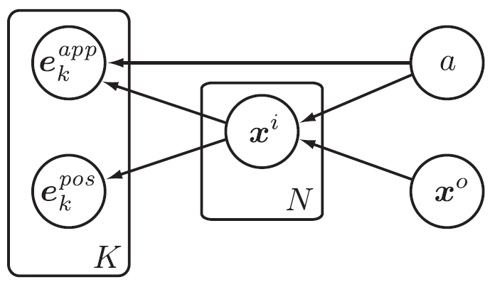
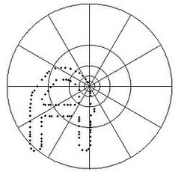

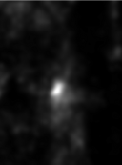

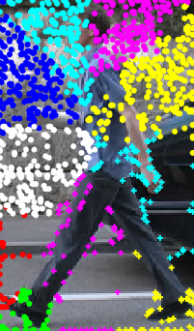
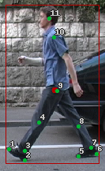
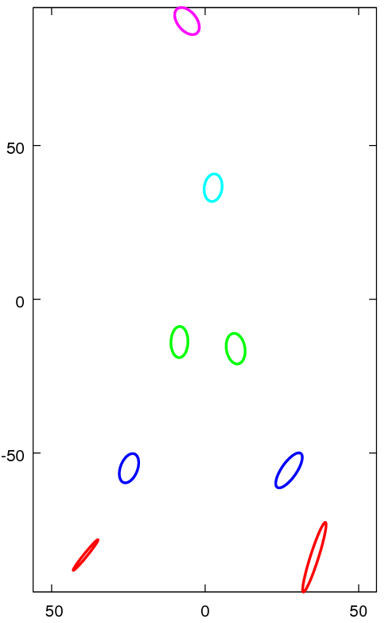
Part-based Human Detection
Brandon Tolsch and Joseph Richardson
Goal: To detect humans and the location of their limbs using a parts-based model which can be extended for tracking
Uses articulation state to make limb positions independent
Implement unusual feature detector (this is our problem…)
Find the positions and articulation state to maximize likelihood:
Failed at actually detecting humans and limbs… but learned from it!
Train distributions of joints relative to the body center and relative to keypoints of different types.
We hoped for results like this...
… and we get results like this.
(this example is for p(x^{i} | a, e_{k}))

