Slide 1
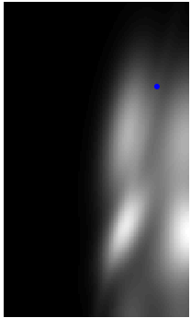

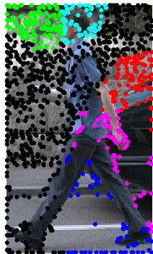
Part-based Human Detection
Brandon Tolsch and Joseph Richardson
p(xi) given
x0, a
p(xi) given
one keypoint,
a
p(xi) given
all keypoints,
a
p(xi) given
x0, a, and
keypoints

