Slide 1
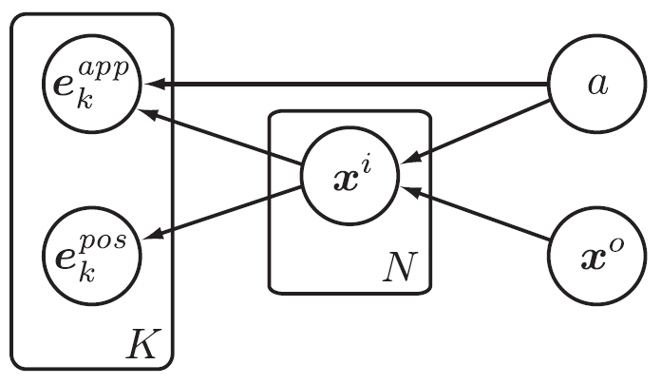
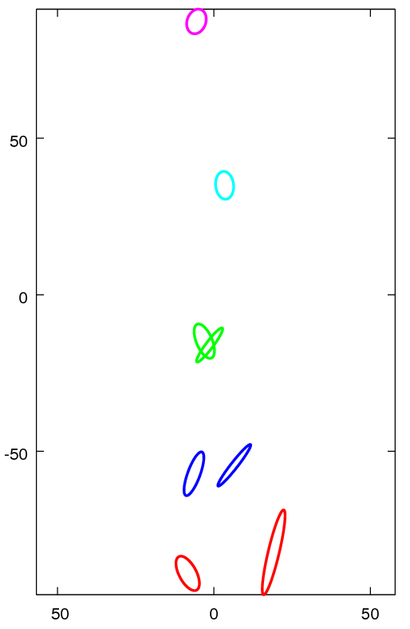
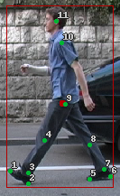
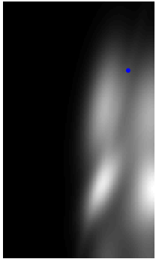

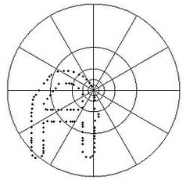

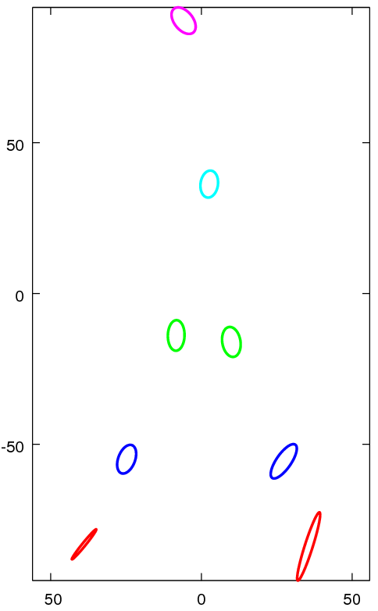






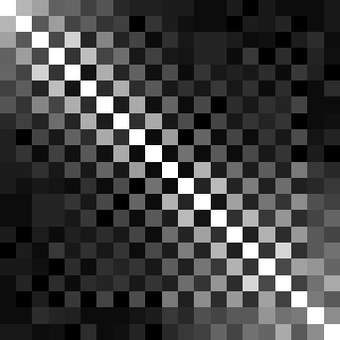
Part-based Human Detection
Brandon Tolsch and Joseph Richardson
Overview
Part-Based Model
Detection
We first attempted to implement “People-Tracking-by-Detection and People-Detection-by-Tracking” [A], but quickly found that to be too ambitions for our time constraints. Instead, we opted to implement the first half of their paper, which deals entirely with detection.
While we were able to implement the paper in its basic state, we ran into many problems early on in the pipeline, especially with keypoint detection and feature descriptors, which ultimately resulted in poor results. In addition to discussing the theory of the paper and our implementation of it, we also discuss the reasons for our failures, as well as plans to improve our results.
We first attempted to implement “People-Tracking-by-Detection and People-Detection-by-Tracking” [A], but quickly found that to be too ambitions for our time constraints. Instead, we opted to implement the first half of their paper, which deals entirely with detection.
While we were able to implement the paper in its basic state, we ran into many problems early on in the pipeline, especially with keypoint detection and feature descriptors, which ultimately resulted in poor results. In addition to discussing the theory of the paper and our implementation of it, we also discuss the reasons for our failures, as well as plans to improve our results.
EXPLANATION HERE
EXPLANATION HERE
[A]
Training
We were fortunate to have a well-labeld training set (from [A]) giving the L={xi} set for each person in a seriese of images, where xi is the position of the ith part of the person.
In training, we fit several gaussian distributions:
p(xi) given x0
Shape Contexts
We also use clustering on shape contexts, and state that p(cj | ek_app) is proportional to the L2 norm of (cj - ek_app).
Shape Contexts [B] are a form of feature descriptor that relies on the relative positions of keypoints rather than on nearby brightness values. This I done by taking a histogram of the log-radial coordinates of all other points relative the current point.
[C]
p(xi) given one keypoint
p(xi) given all keypoints
p(xi) given x0 and keypoints
Vary xi
Vary x0
Shape Contexts are generally robust to noise, outliers, and deformations [B]. We repeated some tests from [B], with success, and added our own sanity checks as well. Shown above are some points and their corresponding descriptors; shown right is a similarity matrix between points in the “disc” image.
p(L | a, E) ≈ ∏ p(x | x , a) [ β + ∑ p(x | a, e ) ]
Future Work
i i 0 k i k
p(x | a, e ) = ∑ p(x | a, c , e ) p(c | e )
pos app
i k i j k j k
REFERENCES NOT YET USED:
Mention that reference D says to do away with Shape Contexts
Mention that reference E describes how to perform the probability maximization efficiently with dynamic programming techniques
Mention that reference F describes Harris-Laplace interest point detectors”
References
A) Andriluka, Roth, and Schiele, “People-Tracking-by-Detection and People-Detection-by-Tracking”, https://www.d2.mpi-inf.mpg.de/andriluka_cvpr08
B) Belongie, Malik, and Puzicha, “Shape Context: A new descriptor for shape matching and object recognition”, http://citeseerx.ist.psu.edu/viewdoc/download?doi=10.1.1.27.8567&rep=rep1&type=pdf
C) https://en.wikipedia.org/wiki/Shape_context#/media/File:Shapecontext.jpg
D) Leibe, Seemann, and Schiele, “Pedestrian Detection in Crowded Scenes”, http://luthuli.cs.uiuc.edu/~daf/courses/AppCV/Papers-2/leibe-crowdedscenes-cvpr05.pdf
E) Felzenszwalb and Huttenlocher, “Pictorial Structurs for Object Recognition”, http://citeseerx.ist.psu.edu/viewdoc/download?doi=10.1.1.66.5153&rep=rep1&type=pdf
F) Mikolajczyk and Schmid, “Scale & Affine Invariant Interest Point Detectors”, http://www.robots.ox.ac.uk/~vgg/research/affine/det_eval_files/mikolajczyk_ijcv2004.pdf

