Slide 1
eyeLock
you CAN have your cake and eat it too
(security and convenience)

Slide 2
Where we are now…
B2B application dominates
Employee Authorization
B of A
Mandarin Oriental (time and attendance)
Port of Santos
Cornell’s nuclear irradiator
Shifting to B2C
Myris - USB plug and play for personal use
Bank Audi sal - Branches/ATM

Slide 3
Where we are going…
In addition to current applications and personal mobile embedment…
Casinos
Security is their number one priority
Employee authorization
Law Enforcement
No more ID/insurance checks
Payment + Loyalty Programs + CRM
No more credit cards, stamp cards, point cards (your whole wallet!)
Even PayPal and M-Pesa wants to move towards physical transactions

Slide 4
Where we are going…
Medical Records
Entire medical history stored in database and accessible through an eye scan
Elimination of paperwork, human error (memory faults)
Insurance Companies
Cars (ignition only under authorized access), theft, leveled access and tracking
Online/home banking
Elimination of RSA Tokens
New forms of identification
Ongoing project in South Africa and Nigeria on developing biometric-based card (new national identity card)

Slide 5
Things eyeLock can make obsolete…
In addition to presentation:
Passports (Personal Identification)
Credit Cards
Loyalty Cards
RSA Tokens
Medical Records
Business Cards
Chipped/smart cards
PAPER WORK
eyeLock can be applied to ANY verticals that requires identification, access, housekeeping paperwork

Slide 6
We can sit here all day and brainstorm applications…

Slide 7
We can sit here all day and brainstorm applications…
The opportunity…

Slide 8
We can sit here all day and brainstorm applications…
The opportunity…
Software Development Kit (SDK)

Slide 9
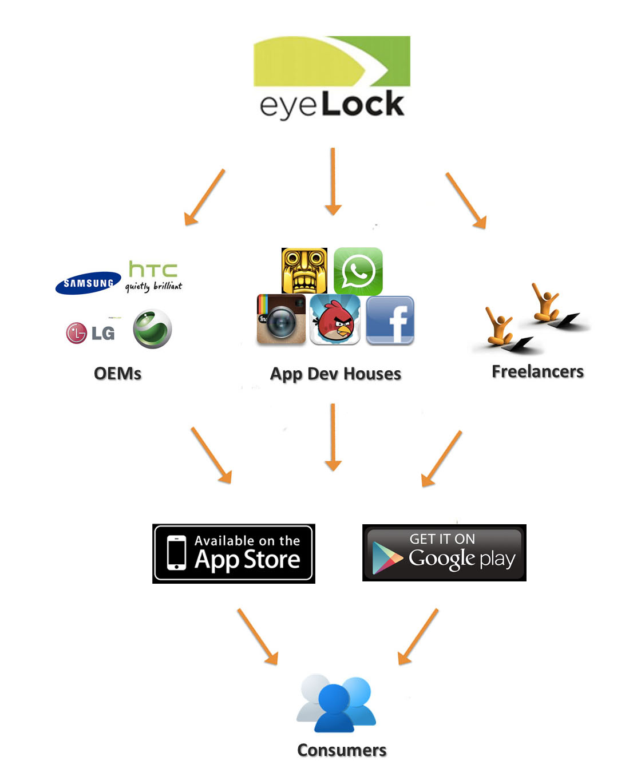

Slide 10
Value of a Software Development Kit
Why?
Scalability
Creativity
Excellent ROI for mass adoption (out source creativity and software development)
Ex. iPhone ecosystem in 2007
Since 2008’s iPhone Software Development Kit (SDK), mobile apps exploded

Slide 11
Convenience and Security is nice… but the REAL value…

Slide 12
in the data eyeLock can potentially collect
Value to businesses, government
Insights to help make better decisions
Big data we collect would include:
- consumer behaviour, spending patterns and habits (MasterCard’s 300MM+ revenue in 2013) http://uk.reuters.com/article/2014/06/11/us-mastercard-data-idUKKBN0EM1CI20140611
- online browsing data
- health records (all personal information) etc…

Slide 13
Big Data
Cross disciplinary analytics and insights
Triggers cutting edge research in big data analytics
Ex. Know the medication spending habits of diabetics, convicted felons’ gambling intentions etc.
Additional revenue streams
Sell data and insights to businesses and governments
Use data insights to consult businesses and governments
Subsequently, we become the leader in consumer trends, providing real-time insights quicker than government statistics

Slide 14
Things to look out for…
Strategic
Focusing on Myris and its’ personal mobile embedment technology because of the fear of competition in the business and government market space
Two largest mobile manufacturers Apple (acquired AuthenTec in 2012) and Samsung (applied for patent in South Korea relating to the user interface of iris authentication in smartphones) has their own in-house biometrics team
Google’s new contact lens that analyses blood through tears
Apple hiring employees from Sano Intelligence, creator of non-invasive sticker that is able to assess blood chemistry and transmit data to receiving devices (DNA more accurate than iris)
Australian Criminal Intelligence Agency introducing biometrics identification system, 2017 (with Morpho)
“A long way to go” until we can fit Myris’ technology (size and weight) into a smartphone (factor of 5) – EVP Mobile, Samsung
Innovation from payment platforms – VISA, MaterCard, Amex, PayPal, M-Pesa, Square, Amazon
Public opinion
Privacy Concerns
Notes:
http://www.macrumors.com/2014/01/21/apple-iris-scanning/
http://www.biometricupdate.com/201407/visa-europe-considers-biometric-authentication-for-payment
http://www.biometricupdate.com/201407/samsung-galaxy-note-5-may-feature-iris-scanning-technology
http://www.crimtrac.gov.au/

Slide 15
Other things…
Technical
Visible Wavelength (VW) or Near Infrared Imaging (NIR)?
Requires decent lighting? Affected by alcohol consumption? Eye surgeries (cataracts)?
Financial
Lack of past financial statements

Slide 16
Questions
Near Field Communication & Bluetooth LE to eyeLock, how are they complementary technologies?
Does eyeLock use visible wavelength technology, or near infrared imaging?
eyeLock also reduces cost when replacing access cards? How?
What are the details in regards to the development of the Software Development Kit? What is in phase 2 and phase 3?
Financials
Equity in return for 20MM?
Missing past financial statements since inception in 2006

