Slide 1

CREDIT RISK ASSESSMENT
Tirumala Prasad Bade

Slide 2




Business Problem:
Objective: Automate the Loan Approval process.
Traditional loan approval processes are slow, costly, and prone to inconsistencies. Manual reviews with paperwork result in delayed decisions, frustrating both applicants as well as lenders. Human judgments can lead to unfair outcomes. To stay competitive and manage risk efficiently in a fast-paced world, institutions must modernize their processes.
By developing an accurate machine learning model that can predict whether a loan application can be accepted or rejected based on the provided features thus enhancing efficiency and reducing human bias in making those decisions.
FELICIANO SCHOOL OF BUSINESS | GROUP-4

Slide 3

Data Exploration:
Dataset: https://www.kaggle.com/datasets/laotse/credit-risk-dataset
Target Variable: “loan_status” - Loan Application Accepted (1) or Rejected (0).
Number of Rows: 32581 (Represent each customer)
Number of columns: 12 (Customer Attributes)
FELICIANO SCHOOL OF BUSINESS | GROUP-4

Slide 4


Data Dictionary:
person_age: Age of the Loan applicant. It’s a numerical variable.
person_income: Annual Income of the Loan applicant.
person_home_ownership: Type of ownership of applicant - "Rent," "Own," "Mortgage," and “Other”.
person_emp_length: Number of years the applicant has been employed.
loan_intent: Categorical feature that indicates the purpose or intent for which the loan is sought.
loan_grade: Credit Rating or Risk associated with the loan assigned by the lender such as "A," "B," "C," etc.
loan_amnt: Total Amount of the Loan applied for by the applicant.
loan_int_rate: Annual Interest Rate charged on the Loan Amount.
loan_status: Outcome of the loan application whether it is Accepted (1) or Rejected (0).
loan_percent_income: Percentage of the applicant's income that the loan amount represents.
cb_person_default_on_file: Applicant’s history of defaults, represented as "Y" for yes and "N" for no.
cb_preson_cred_hist_length: Number of years the applicant has had a credit history.
FELICIANO SCHOOL OF BUSINESS | GROUP-4

Slide 5

Model Comparison:
Model | F1 | Recall | Precision | Accuracy | ROC AUC
Logit Model | 0.27 | 0.16 | 0.73 | 0.80 | 0.76
kNN Model | 0.69 | 0.58 | 0.85 | 0.88 | 0.88
Decision Tree | 0.71 | 0.67 | 0.76 | 0.88 | 0.83
Random Forest Model | 0.74 | 0.61 | 0.96 | 0.91 | 0.90
Boosted Tree Model | 0.71 | 0.63 | 0.81 | 0.89 | 0.90
Naive Bayes | 0.48 | 0.36 | 0.74 | 0.83 | 0.82
ANN Classification | 0.59 | 0.48 | 0.76 | 0.85 | 0.86
Deep Learning | 0.62 | 0.54 | 0.74 | 0.86 | 0.87
FELICIANO SCHOOL OF BUSINESS | GROUP-4

Slide 6
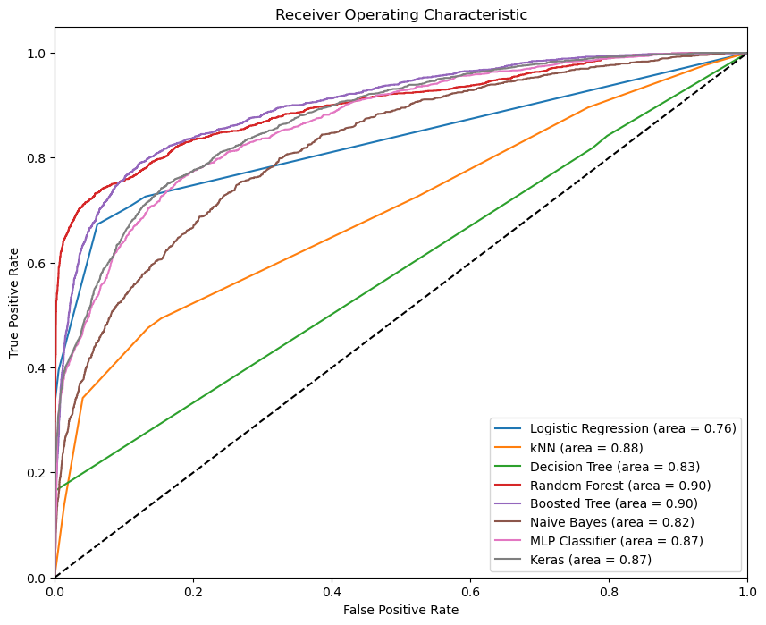
Receiver Operating Characteristic (ROC) Curves:
Random Forest Model has the highest ROC AUC
FELICIANO SCHOOL OF BUSINESS | GROUP-4

Slide 7
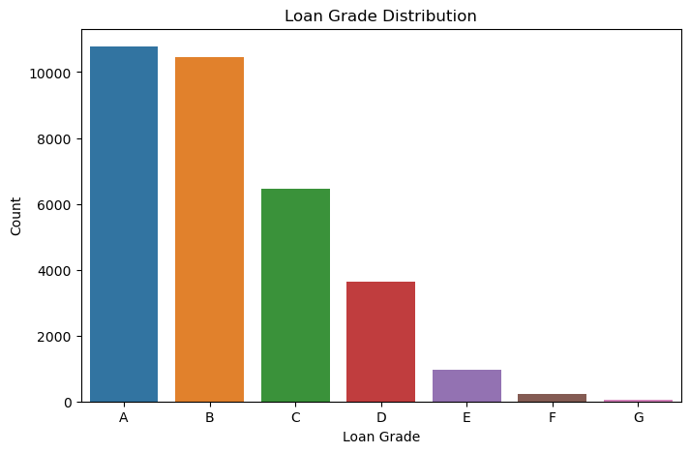
Data Visualisations & Insights:
FELICIANO SCHOOL OF BUSINESS | GROUP-4

Slide 8
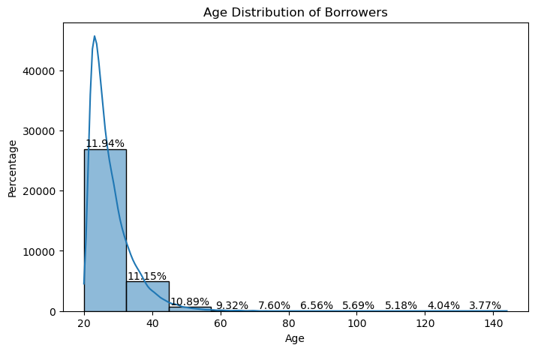
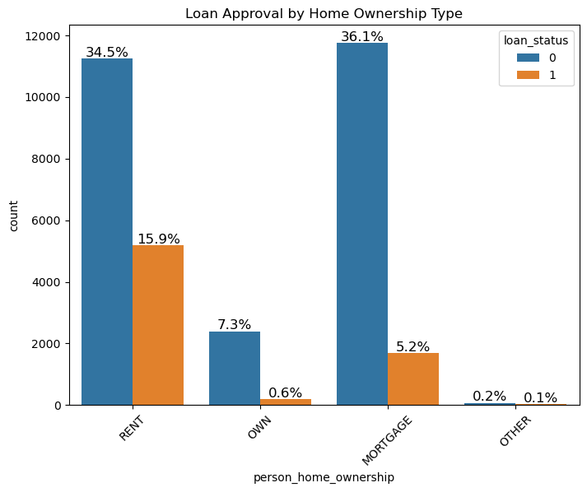
Data Visualisations & Insights:
FELICIANO SCHOOL OF BUSINESS | GROUP-4

Slide 9




Next Steps & Recommendations:
Model Integration: The Credit Risk assessment model needs to be integrated into the Loan Application process which should be a seamless and an automated process.
Staff Training: Train the lending team about how to use the model’s output and interpret the results in their decision making.
Feedback Loop: Periodical improvements and adjustments are to be made to the model by making use of both the qualitative and quantitative feedback.
Risk Diversification and Risk Mitigation: Predictions from the model can be used to make informed decisions about diversifying the lending portfolio such as adjusting the lending criteria or introduce new loan schemes, charging higher interest rates, etc.
FELICIANO SCHOOL OF BUSINESS | GROUP-4

Slide 10



Next Steps & Recommendations:
Transparency & Communication: Borrowers should be ensured transparent communication in explaining the factors which have influenced in the decision-making process and giving necessary information to improve their credit worthiness.
Adaptation to Market Trends: Market conditions and Economic trends are ever changing and unpredictable and one needs to adapt to such trends which can influence the credit risk.
Customer Feedback: Customer Feedback to be collected with respect to Loan application process, user friendliness and responsiveness of the staff, etc.
Thus, effective implementation, monitoring and continuous improvements are necessary to manage a profitable loan portfolio while ensuring transparency and fairness.
FELICIANO SCHOOL OF BUSINESS | GROUP-4

Slide 11

GROUP– 4:
- TIRUMALA PRASAD BADE

