Slide 1
Overview – ASPICE
1
Internal | RBEI/ESQ | 08/03/2016
© Robert Bosch Engineering and Business Solutions Private Limited 2016. All rights reserved, also regarding any disposal, exploitation, reproduction, editing, distribution, as well as in the event of applications for industrial property rights.

Slide 2
What is Automotive SPICE?
An initiative to develop a common framework for the assessment of suppliers in the Automotive Industry.
Based on ISO 15504, [SPICE (Software Process Improvement and Capability dEtermination)]
Members of HIS (“Hersteller Initiative Software” - Car manufacturer Initiative Software), i.e., Audi, BMW, Daimler, Porsche, and Volkswagen together with other OEMs such as Ford, Volvo and FIAT assess their software suppliers on the basis of ASPICE
2
Internal | RBEI/ESQ | 08/03/2016
© Robert Bosch Engineering and Business Solutions Private Limited 2016. All rights reserved, also regarding any disposal, exploitation, reproduction, editing, distribution, as well as in the event of applications for industrial property rights.

Slide 3
3
Internal | RBEI/ESQ | 08/03/2016
© Robert Bosch Engineering and Business Solutions Private Limited 2016. All rights reserved, also regarding any disposal, exploitation, reproduction, editing, distribution, as well as in the event of applications for industrial property rights.

Slide 4
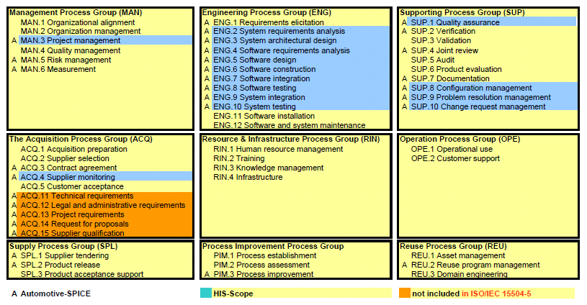
Overview - ASPICE
4
Internal | RBEI/ESQ | 08/03/2016
© Robert Bosch Engineering and Business Solutions Private Limited 2016. All rights reserved, also regarding any disposal, exploitation, reproduction, editing, distribution, as well as in the event of applications for industrial property rights.

Slide 5
Overview - ASPICE
Level 0 Organization- Immature
The organization does not demonstrate effective implementation of its processes that are fundamental to support the organization’s business.
Level 1 Organization - Basic
The organization demonstrates achievement of the purpose of the processes that are fundamental to support the organization’s business.
Level 2 Organization – Managed
The organization demonstrates management of the processes that are fundamental to support the organization’s business.
5
Internal | RBEI/ESQ | 08/03/2016
© Robert Bosch Engineering and Business Solutions Private Limited 2016. All rights reserved, also regarding any disposal, exploitation, reproduction, editing, distribution, as well as in the event of applications for industrial property rights.

Slide 6
Overview - ASPICE
Level 3 Organization – Established
The organization demonstrates effective definition and deployment of the processes that are fundamental to support the organization’s business.
Level 4 Organization – Predictable
The organization demonstrates a quantitative understanding of relevant processes that are fundamental to support the organization’s business goals, in order to establish consistent and predictable performance.
Level 5 Organization – Innovating
The organization demonstrates the ability to change and adapt the performance of the processes that are fundamental to support the organization’s business goals in a systematically planned and predictable manner.
6
Internal | RBEI/ESQ | 08/03/2016
© Robert Bosch Engineering and Business Solutions Private Limited 2016. All rights reserved, also regarding any disposal, exploitation, reproduction, editing, distribution, as well as in the event of applications for industrial property rights.

Slide 7
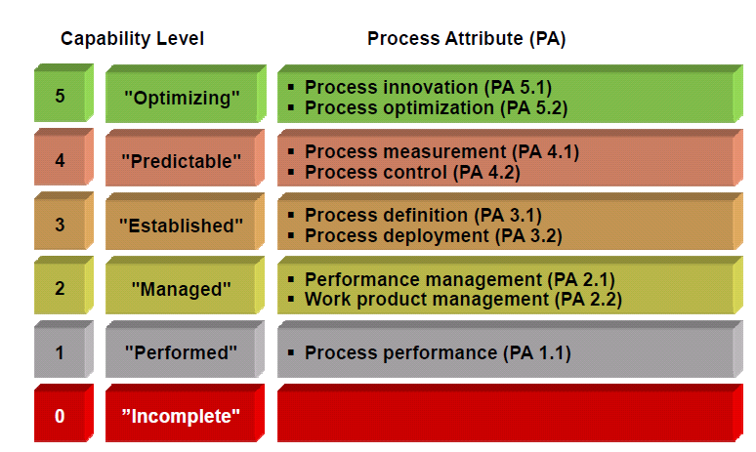
Overview - ASPICE
7
Internal | RBEI/ESQ | 08/03/2016
© Robert Bosch Engineering and Business Solutions Private Limited 2016. All rights reserved, also regarding any disposal, exploitation, reproduction, editing, distribution, as well as in the event of applications for industrial property rights.

Slide 8
Generic Practices
Overview - ASPICE
ENG.4 SW Requirements Analysis @ CC-DA
Level 1: Performed process | PA 1.1 Process performance attribute. | GP 1.1.1 Achieve the process outcomes
Level 2: Managed process | PA 2.1 Performance management attribute | GP 2.1.1 Identify the objectives
 |  | GP 2.1.2 Plan and monitor the performance
 |  | GP 2.1.3 Adjust the performance of the process
 |  | GP 2.1.4 Define responsibilities and authorities for performing the process
 |  | GP 2.1.5 Identify and make available resources to perform the process according to plan
 |  | GP 2.1.6 Manage the interfaces between involved parties
 | PA 2.2 Work product management attribute | GP 2.2.1 Define the requirements for the work products
 |  | GP 2.2.2 Define the requirements for documentation and control of the work products.
 |  | GP 2.2.3 Identify, document and control the work products.
 |  | GP 2.2.4 Review and adjust work products to meet the defined requirements.
8
Internal | RBEI/ESQ | 08/03/2016
© Robert Bosch Engineering and Business Solutions Private Limited 2016. All rights reserved, also regarding any disposal, exploitation, reproduction, editing, distribution, as well as in the event of applications for industrial property rights.

Slide 9
Overview - ASPICE
Level 3: Established process | PA 3.1 Process definition attribute | GP 3.1.1 Define the standard process that will support the deployment of the defined process.
 |  | GP 3.1.2 Determine the sequence and interaction between processes so that they work as an integrated system of processes
 |  | GP 3.1.3 Identify the roles and competencies for performing the standard process
 |  | GP 3.1.4 Identify the required infrastructure and work environment for performing the standard process
 |  | GP 3.1.5 Determine suitable methods to monitor the effectiveness and suitability of the standard process.
 | PA 3.2 Process deployment attribute | GP 3.2.1 Deploy a defined process that satisfies the context specific requirements of the use of the standard process.
 |  | GP 3.2.2 Assign and communicate roles, responsibilities and authorities for performing the defined process.
 |  | GP 3.2.3 Ensure necessary competencies for performing the defined process.
 |  | GP 3.2.4 Provide resources and information to support the performance of the defined process.
 |  | GP 3.2.5 Provide adequate process infrastructure to support the performance of the defined process.
 |  | GP 3.2.6 Collect and analyse data about performance of the process to demonstrate its suitability and effectiveness.
9
Internal | RBEI/ESQ | 08/03/2016
© Robert Bosch Engineering and Business Solutions Private Limited 2016. All rights reserved, also regarding any disposal, exploitation, reproduction, editing, distribution, as well as in the event of applications for industrial property rights.

Slide 10
10
Internal | RBEI/ESQ | 08/03/2016
© Robert Bosch Engineering and Business Solutions Private Limited 2016. All rights reserved, also regarding any disposal, exploitation, reproduction, editing, distribution, as well as in the event of applications for industrial property rights.

Slide 11
11
Internal | RBEI/ESQ | 08/03/2016
© Robert Bosch Engineering and Business Solutions Private Limited 2016. All rights reserved, also regarding any disposal, exploitation, reproduction, editing, distribution, as well as in the event of applications for industrial property rights.

Slide 12
Activity
ENG.4 SW Requirements Analysis @ CC-DA
Count number of “a”
The QA team's job is to see that standards, processes, and policies
(or other governing/guiding "writ") are in place and carried out;
to recommend and implement improvements to them, and to ensure that the people that need to know about them know about them. QA "audits" or "reviews" are intended to determine the efficiency of these "writs."
12
Internal | RBEI/ESQ | 08/03/2016
© Robert Bosch Engineering and Business Solutions Private Limited 2016. All rights reserved, also regarding any disposal, exploitation, reproduction, editing, distribution, as well as in the event of applications for industrial property rights.
Notes:
6, 4, 3, 5, 1

Slide 13
ENG.4 SW Requirements Analysis
13
Internal | RBEI/ESQ | 08/03/2016
© Robert Bosch Engineering and Business Solutions Private Limited 2016. All rights reserved, also regarding any disposal, exploitation, reproduction, editing, distribution, as well as in the event of applications for industrial property rights.

Slide 14
ENG.4 SW Requirements Analysis
14
Internal | RBEI/ESQ | 08/03/2016
© Robert Bosch Engineering and Business Solutions Private Limited 2016. All rights reserved, also regarding any disposal, exploitation, reproduction, editing, distribution, as well as in the event of applications for industrial property rights.

Slide 15
ENG.4 SW Requirements Analysis
15
Internal | RBEI/ESQ | 08/03/2016
© Robert Bosch Engineering and Business Solutions Private Limited 2016. All rights reserved, also regarding any disposal, exploitation, reproduction, editing, distribution, as well as in the event of applications for industrial property rights.

Slide 16
ENG.4 SW Requirements Analysis
‘DFS table’ for platform parameters
DOORS module „ PP5_VW_MQB_Parameter”
for customer specific parameters
DOORS module : SYS/SW Element
DOORS module including baseline, status updated
16
Internal | RBEI/ESQ | 08/03/2016
© Robert Bosch Engineering and Business Solutions Private Limited 2016. All rights reserved, also regarding any disposal, exploitation, reproduction, editing, distribution, as well as in the event of applications for industrial property rights.

Slide 17
ENG.4 SW Requirements Analysis
RAR: Requirements Analysis Report
DOORS module including baseline, status updated
DOORS module: Verification Criteria attribute
17
Internal | RBEI/ESQ | 08/03/2016
© Robert Bosch Engineering and Business Solutions Private Limited 2016. All rights reserved, also regarding any disposal, exploitation, reproduction, editing, distribution, as well as in the event of applications for industrial property rights.

Slide 18
ENG.4 SW Requirements Analysis
RAR: Requirements Analysis Report
Estimate the needed µC resources
The operating environment is defined as the system that the software works in
(e.g. hardware, operating system, etc.).
18
Internal | RBEI/ESQ | 08/03/2016
© Robert Bosch Engineering and Business Solutions Private Limited 2016. All rights reserved, also regarding any disposal, exploitation, reproduction, editing, distribution, as well as in the event of applications for industrial property rights.

Slide 19
ENG.4 SW Requirements Analysis
DOORS module including baseline, status updated
RAR: Requirements Analysis Report
DOORS module: Verification Criteria attribute
19
Internal | RBEI/ESQ | 08/03/2016
© Robert Bosch Engineering and Business Solutions Private Limited 2016. All rights reserved, also regarding any disposal, exploitation, reproduction, editing, distribution, as well as in the event of applications for industrial property rights.

Slide 20
ENG.4 SW Requirements Analysis
20
Internal | RBEI/ESQ | 08/03/2016
© Robert Bosch Engineering and Business Solutions Private Limited 2016. All rights reserved, also regarding any disposal, exploitation, reproduction, editing, distribution, as well as in the event of applications for industrial property rights.

Slide 21
ENG.4 SW Requirements Analysis
21
Internal | RBEI/ESQ | 08/03/2016
© Robert Bosch Engineering and Business Solutions Private Limited 2016. All rights reserved, also regarding any disposal, exploitation, reproduction, editing, distribution, as well as in the event of applications for industrial property rights.

Slide 22
ENG.4 SW Requirements Analysis
The requirements have attribute "Arcitecture/Design" Where reference to architecture at activity level is given.
The requirements are imported from DOORS in 01_Requirements folder.
High level design: The elements of SW architectural design are linked to requirements at feature level, and
Detailed design: Inside the activity diagram at sub-feature level.
22
Internal | RBEI/ESQ | 08/03/2016
© Robert Bosch Engineering and Business Solutions Private Limited 2016. All rights reserved, also regarding any disposal, exploitation, reproduction, editing, distribution, as well as in the event of applications for industrial property rights.

Slide 23
ENG.4 SW Requirements Analysis
23
Internal | RBEI/ESQ | 08/03/2016
© Robert Bosch Engineering and Business Solutions Private Limited 2016. All rights reserved, also regarding any disposal, exploitation, reproduction, editing, distribution, as well as in the event of applications for industrial property rights.

Slide 24
References
Link for process Landscape:
http://abt-prolib.de.bosch.com:8080/pkit/main.do;jsessionid=3BA8A482410EFFB600CEF16D3307FE6E
24
Internal | RBEI/ESQ | 08/03/2016
© Robert Bosch Engineering and Business Solutions Private Limited 2016. All rights reserved, also regarding any disposal, exploitation, reproduction, editing, distribution, as well as in the event of applications for industrial property rights.

Slide 25
Any questions left ??
25
Internal | RBEI/ESQ | 08/03/2016
© Robert Bosch Engineering and Business Solutions Private Limited 2016. All rights reserved, also regarding any disposal, exploitation, reproduction, editing, distribution, as well as in the event of applications for industrial property rights.

