Slide 1
Intro to Algorithmically Curated Feeds
Bao T. Truong · 22.10.2026

Slide 2
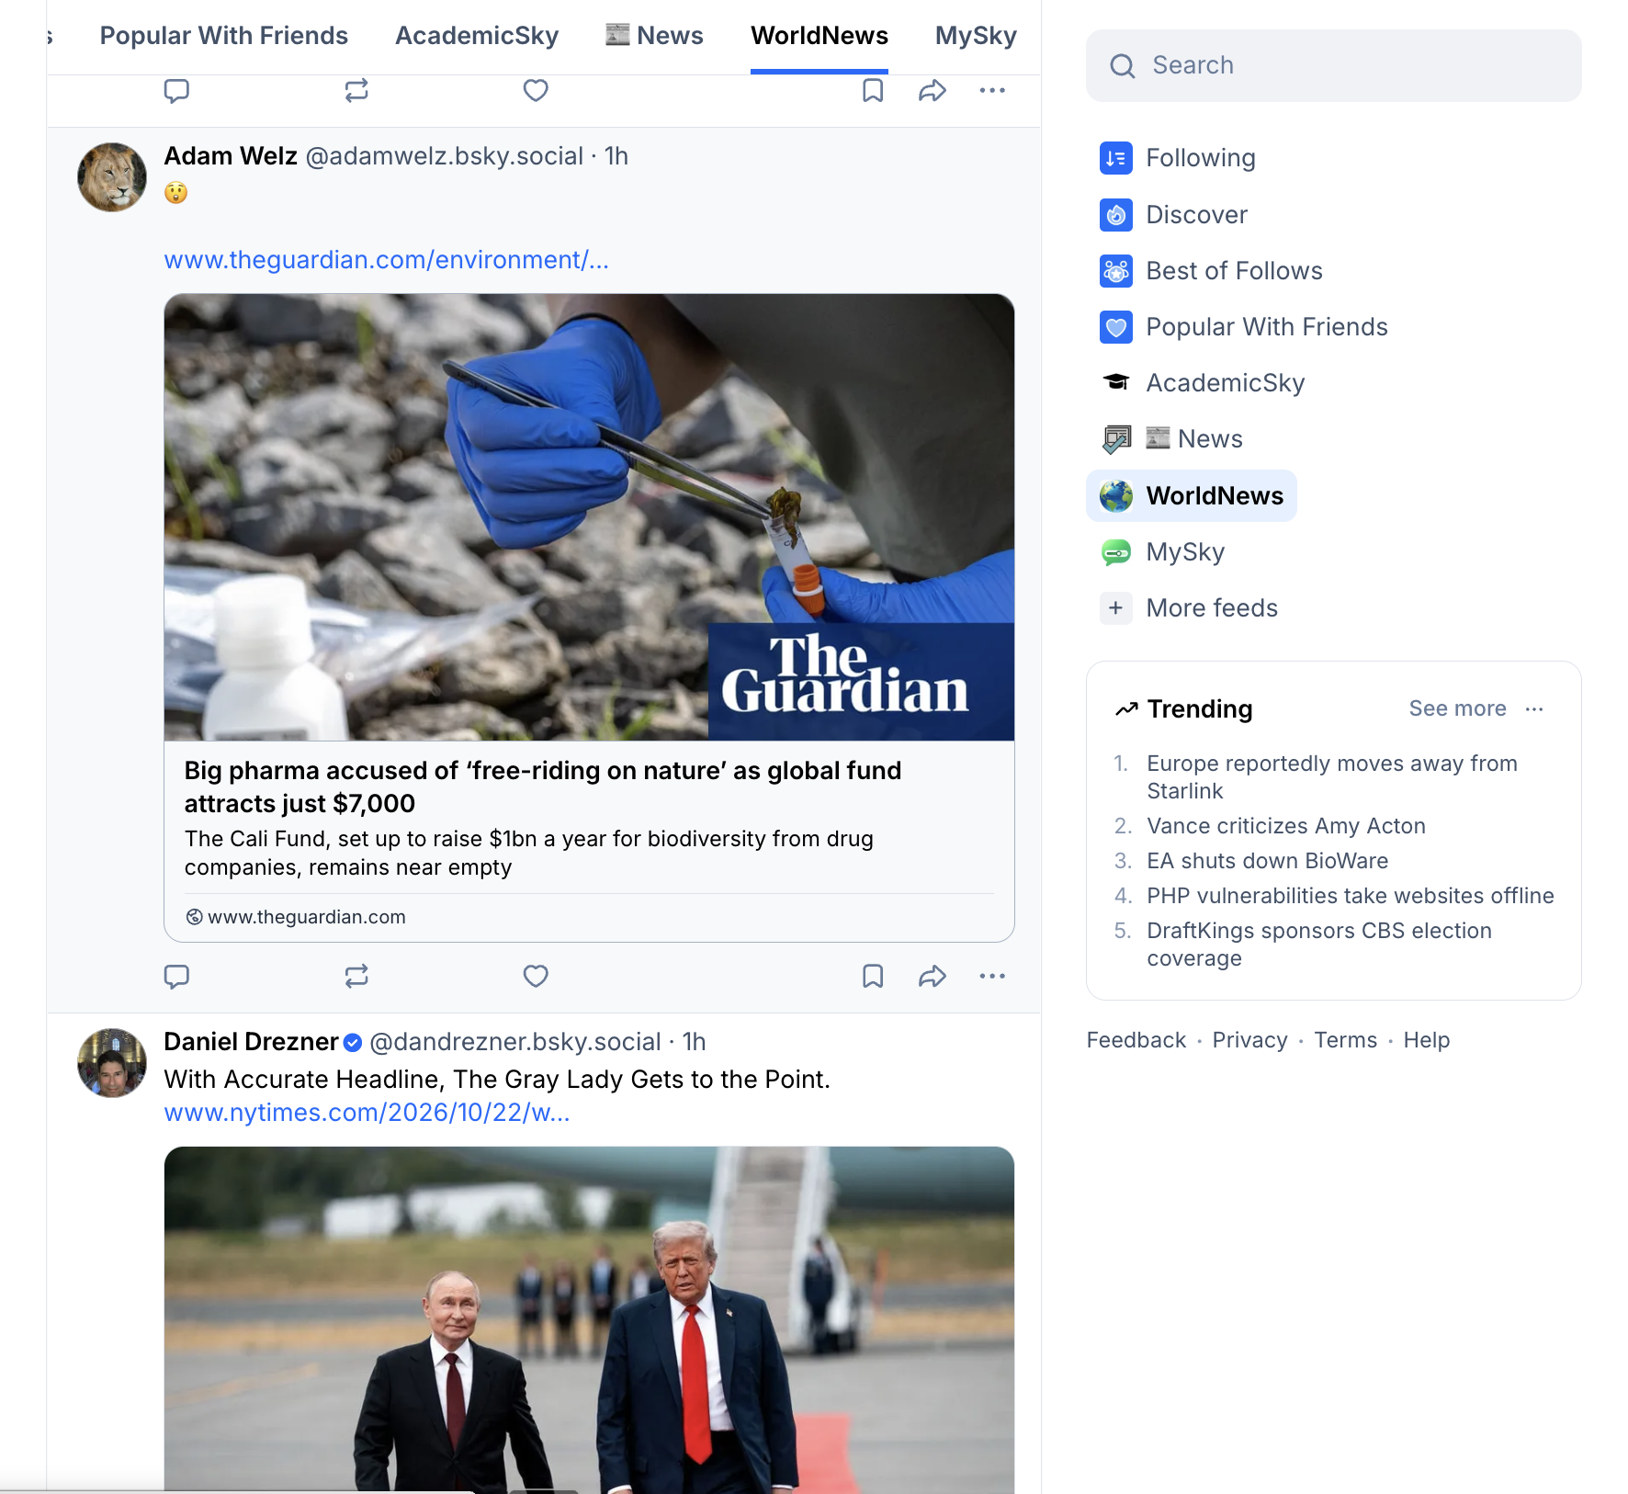
Curation is how sites decide which posts goes in the feed and in what order they’re displayed
An example of a feed on Bluesky

Slide 3
Objectives
Explain the basic stages of an algorithmically curated feed
Apply simple filtering and scoring rules to select and order posts
Understand how practical constraints and design choices influence what users see.
Start thinking about a modification to the pipeline and formulate a testable hypothesis about its consequences.
Notes:
Identify trade-offs and potential unintended consequences of algorithmic decisions.

Slide 4
Why do we need curation?
Helps users find relevant items when there are too many choices
Reduce information overload and support decision-making
Inspired by social navigation — sharing knowledge to guide others
  Ants leave trails → guide others to food
  Humans rely on others’ experiences (e.g., trying food, critics)

Slide 5

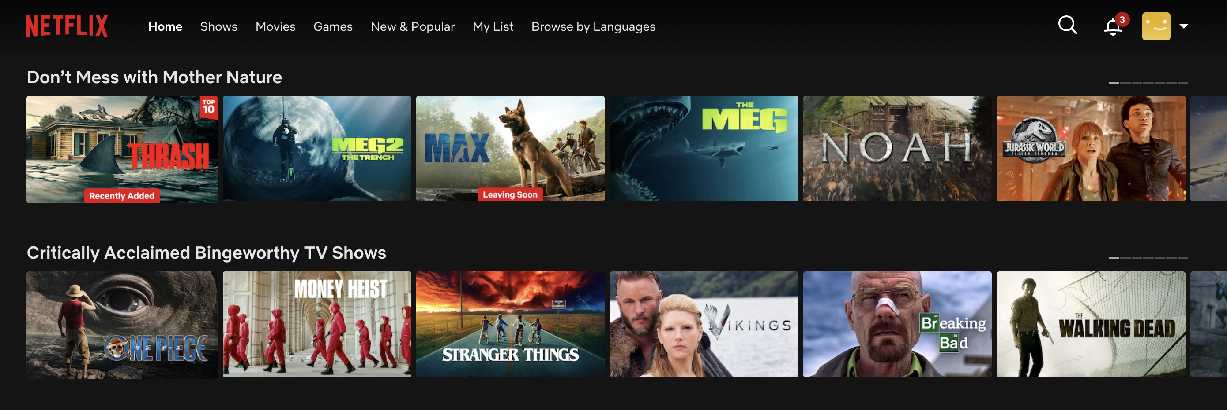
Curation is built on recommender systems
Recommender systems became widespread in the mid–late 1990s
Now ubiquitous in digital platforms

Slide 6
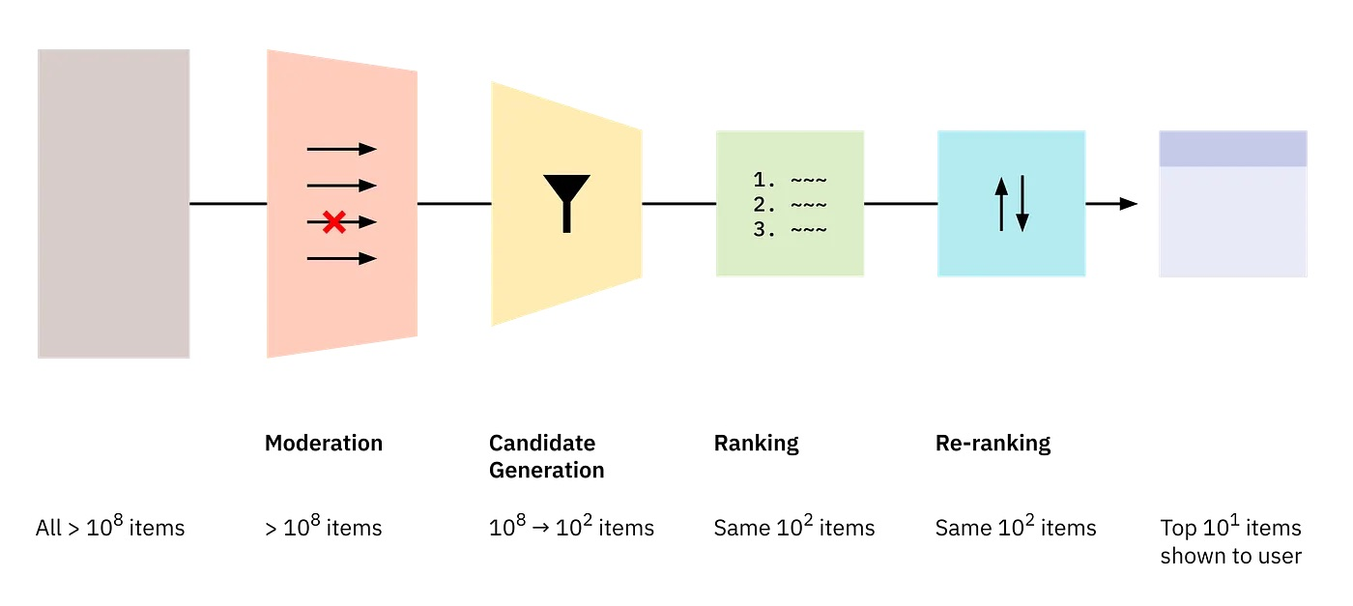
A typical algorithmic curation pipeline includes Retrieval + Ranking
Retrieval
Surface desirable candidates
How Platform Recommenders Work

Slide 7
Algorithmic curation
Recommender systems are part of algorithmic curation. However, the goals and means of algorithmic curation are broader.
It aims to select and organize content for display
To do this the means are:
Filtering
Moderation
Ranking

Slide 8
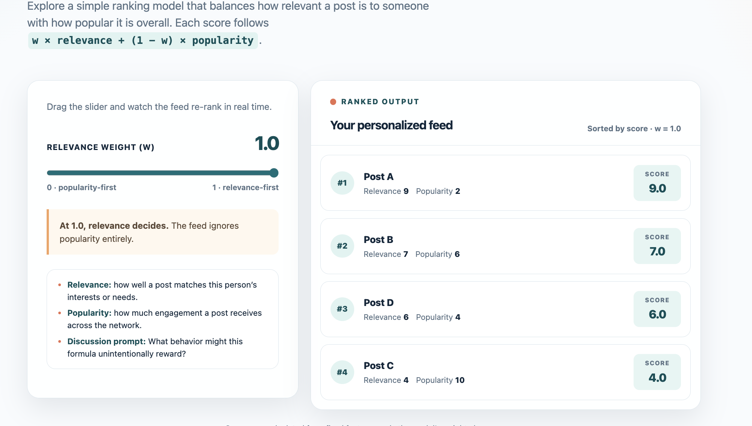
Explore a ranking example
Explore a ranking example
Click on the link to explore interactively

Slide 9
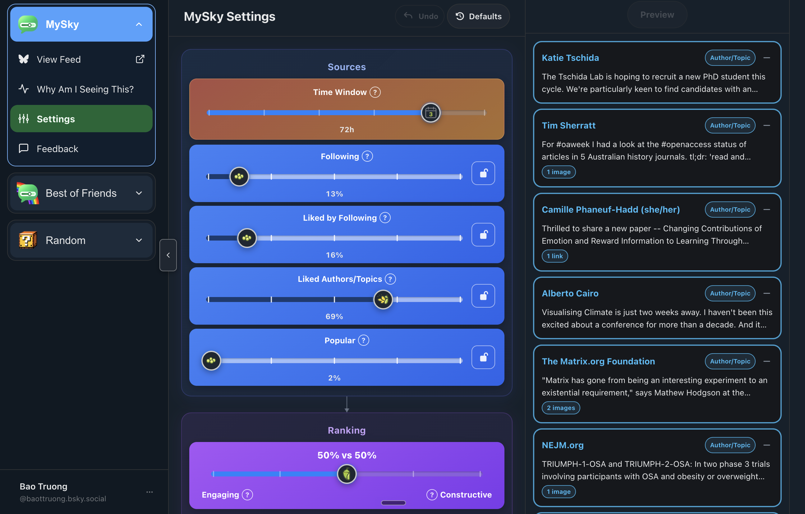
Explore a customized feed
Click on the link to explore interactively

Slide 10
Homework : Redesign a Social Media Feed
Objective: Explore how algorithmic design choices can shape users' experiences on social media. This exercise is meant to get you started on brainstorming ideas for an experiment. Focus on making your proposed modification concrete and explaining its potential consequences.
Visit Prosocial Design and explore its proposed interventions. Choose one intervention that interests you, then complete the following tasks:
Briefly describe the intervention, the problem it addresses, and its proposed solution.
Propose your own modification to a social media feed, inspired by the intervention or your own ideas. Identify which stage of the curation pipeline you would modify (retrieval, scoring, ranking, or presentation) and explain how.
Reflect. Discuss one potential benefit and one possible drawback of your modification. Propose one research question that could be investigated experimentally.
Submission: A short written response (300–400 words) as prompt to discuss in class.

Slide 11
Homework, optional
Read the primers from Prosocial Design
Read Understanding Social Media Recommendation Algorithms (Narayanan, 2023)

