Slide 1
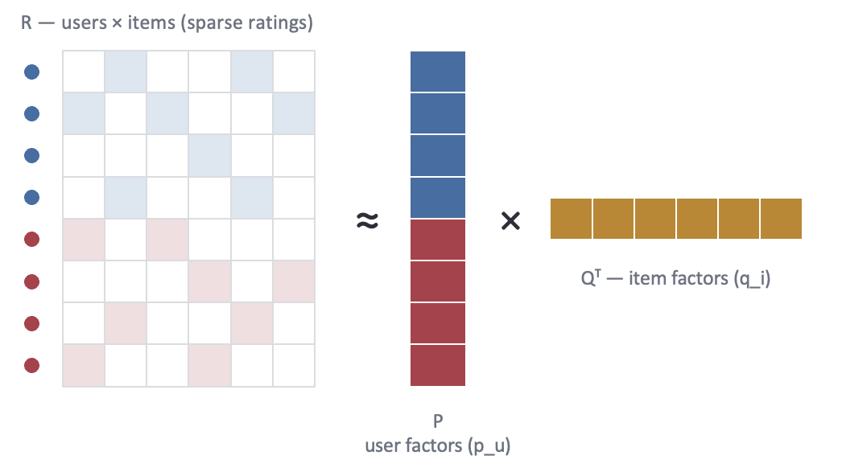
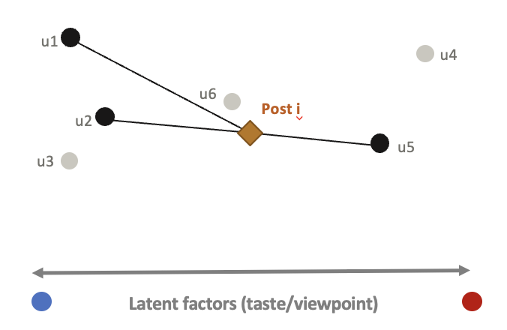
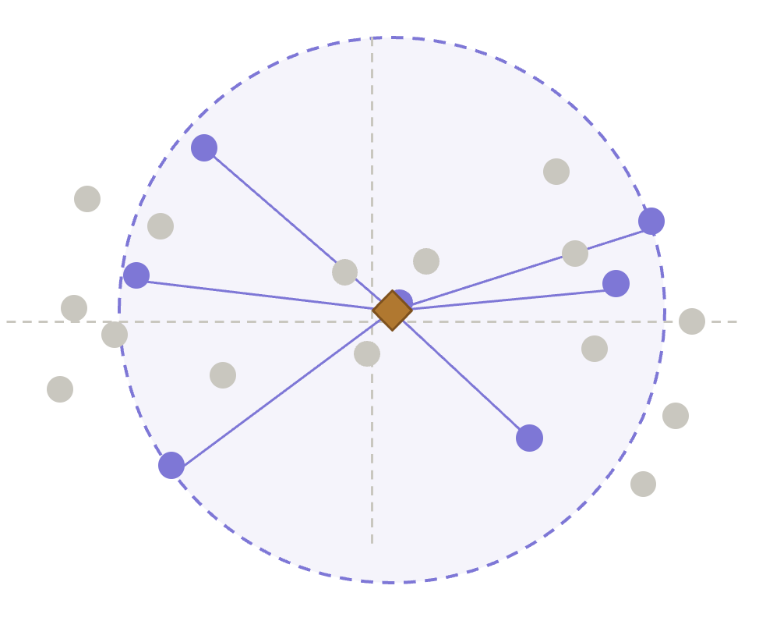
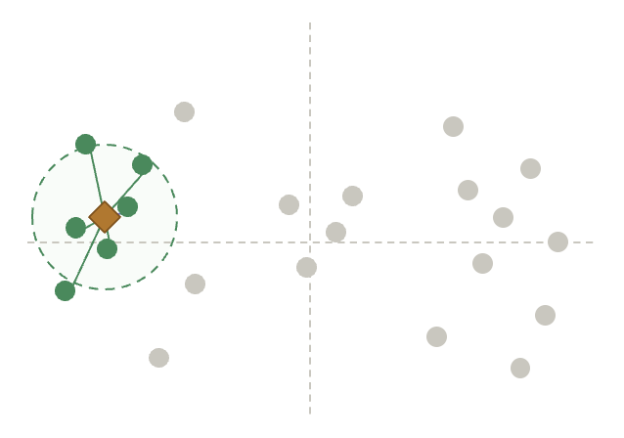
a. Multi-source retrieval
b. Ranking
NEW POSTS INGESTED
Interaction snapshots
(likes · reposts)
Content
(texts · URLs)
Users & posts representation
Topic Model
Infer post topic based on content
Harmfulness Response (HaR) Model
Predicts ratio of toxic responses based on content
NETWORK SNAPSHOT
R ≈ P Q^{T}
Diverse approval
Engagement
Follower graph
Structural communities
Relevance retrieval
Posts likely to appeal to user u based on their history of approvals
Bridging retrieval
Posts approved by people who historically approve of different things
Post topic
HaR score
Structural bridging
Supplement to sparse data
Top-k bridging candidates
C_{bridge} (u)
Top-k relevant candidates
C_{rel} (u)
Union · deduplication · topic diversification
C(u) = C_{rel} (u) ∪ C_{bridge} (u)
Candidate set
Final For-you Feed
personalized feed
for user u
Ranker
· promote recency · bridging
· demote potential harmful posts
Notes:
Bridging Ranker — For-You Pipeline. The pipeline builds a user's feed in two phases: multi-source retrieval, which gathers a broad pool of candidate posts, and ranking, which orders that pool into the final feed.
a. Multi-source retrieval. Signals are drawn from two ingestion streams that run on independent schedules. A dedicated network snapshot provides the follower graph through a periodic crawl, while the new-posts stream provides interaction snapshots (likes, reposts) and post content (texts, URLs); keeping them separate lets the graph refresh on its own cadence rather than once per post. Each stream is converted into features: the follower graph into a structural embedding z^c_u for every user, the interaction snapshots into a latent collaborative-filtering representation of user preference, and the content into a topic model and a harm (HaR) model. Two retrievers then query this pool in parallel. The bridging retriever looks for posts that win approval across otherwise-separate audiences, scoring them from the structural embedding together with an engagement signal derived from the latent representation. The relevance retriever looks for posts that match the user's own tastes, scoring them from the latent representation alone. Their two top-K lists are merged, de-duplicated, and spread across topics using the topic model so that no single subject dominates the candidate set.
b. Ranking. The diversified candidate set is ordered by a single multi-objective score that rewards recent posts, penalises harmful ones using the HaR score routed directly from the harm model, and rewards bridging strength carried over from retrieval. The top of this ranking is returned as the final Top-K feed shown to the user.

Slide 2
NEW POSTS STREAM
Interaction snapshots
(likes · reposts)
Content
(texts · URLs)
Users & posts representation
Harmfulness Response (HaR) Model
Predicts ratio of toxic responses based on content
NETWORK SNAPSHOT
R ≈ P Q^{T}
Diverse approval
Engagement
Follower graph
Topic Model
Infer post topic based on content
Structural communities
Relevance retrieval
Posts likely to appeal to user u based on their history of approvals
Bridging retrieval
Posts approved by people who historically approve of different things
Structural bridging
Supplement to sparse data
(low-confidence users)
Post topic
HaR score
Top-k bridging candidates
C_{bridge} (u)
Top-k relevant candidates
C_{rel} (u)
Union · deduplication · topic diversification
C(u) = C_{rel} (u) ∪ C_{bridge} (u)
Candidate set
Final For-you Feed
personalized feed
for user u
Ranker
· promote recency · bridging
· demote potential harmful posts
Notes:
Notes:
-

Slide 3
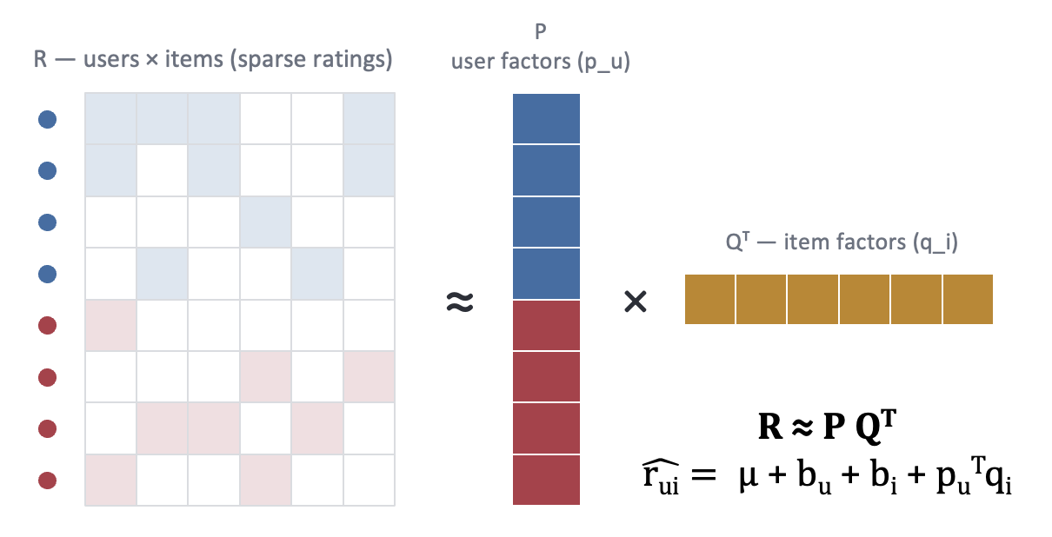
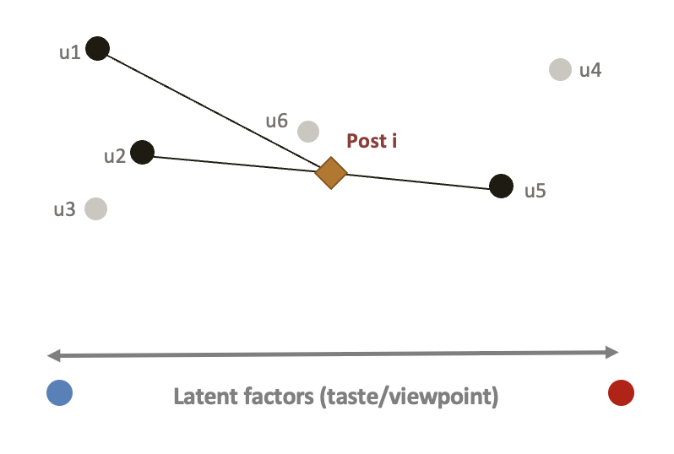
Follower graph
a. retrieval
NETWORK SNAPSHOT
Structural bridging
· define independent polarization axes
· address cold start & sparse data
Structural communities
Bridging retrieval
Posts approved by users with historically different engagement patterns
Users & posts representation
Top-k
bridging candidates
C_{bridge} (u)
Ranked by p_{u}^{T}q_{i}
Interaction snapshots
(likes · reposts)
Relevance retrieval
Posts likely to appeal to a user based on their past engagement
Union · deduplication · topic diversification
C(u) = C_{rel} (u) ∪ C_{bridge} (u)
Top-k
relevant candidates
C_{rel} (u)
NEW POSTS STREAM
Ranked by b_{i}
Candidate set
Topic Model
Infer post topic based on content
Post topic
Content
(texts · URLs)
b.
Ranker
· promote recency · bridging
· demote potential harmful posts
Final For-you Feed
personalized feed
for user u
Harmfulness Response (HaR) Model
Predicts ratio of toxic responses based on content
HaR score

Slide 4
Follower graph
a. retrieval
NETWORK SNAPSHOT
Structural bridging
· define independent polarization axes
· address cold start & sparse data
Structural communities
Bridging retrieval
Posts approved by users with historically different engagement patterns
Users & posts representation
Top-k
bridging candidates
C_{bridge} (u)
Ranked by p_{u}^{T}q_{i}
Interaction snapshots
(likes · reposts)
Relevance retrieval
Posts likely to appeal to a user based on their past engagement
Union · deduplication · topic diversification
C(u) = C_{rel} (u) ∪ C_{bridge} (u)
Top-k
relevant candidates
C_{rel} (u)
NEW POSTS STREAM
Ranked by b_{i}
Candidate set
Topic Model
Infer post topic based on content
Post topic
Content
(texts · URLs)
b
Ranker
· promote recency · bridging
· demote potential harmful posts
Final For-you Feed
personalized feed
for user u
Harmfulness Response (HaR) Model
Predicts ratio of toxic responses based on content
HaR score

Slide 5
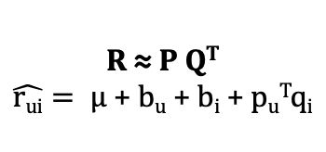
The Shared Starting Point
Both systems fit the same kind of model to a ratings matrix
P
user factors (p_u)
predicted rating / helpfulness:
R — users × items (sparse ratings)
score(u, i) = μ + bu + bi + (pu · qi)
Qᵀ — item factors (q_i)
Legend — used the same way on every slide
≈
×
Group A — one cluster of users / tastes
R ≈ P Q^{T}
$\hat{rui}= μ$ + b_{u} + b_{i} + p_{u}^{T}q_{i}
Group B — a different cluster of users
Item or note vector being ranked
Term the ranking decision is based on
Term the model fits, but ranking ignores
Shown here at rank 1 — a single latent factor per user / item, e.g. “which side of an issue do you lean toward.”
Both systems fit user vectors, item vectors, and bias terms to explain past ratings. What differs is which piece of this equation each one uses to decide what to show — that's the whole story on the next two slides.
2

Slide 6
i1
i2
i3
i4
i5
i6
u1
5
4
5
1
2
3
u2
4
5
4
2
3
2
u1
u4
u3
5
5
2
1
2
3
u6
Post i
u2
u4
1
2
3
5
2
4
u3
u5
u5
2
1
5
4
3
3
u6
3
3
2
3
5
3
Latent factors (taste/viewpoint)
Factional item
Diverse approval
one camp approves
both camps approve

