Slide 1

Squared Circle Daily
Brendan Treynor
CIS265 2VB1
Professor Anderson
April 20, 2021

Slide 2
Final Project Outline – aka “Part One”
Purpose?
Entertain individuals that have a love for fantasy, wrestling, and sports entertainment.
Goals?
Provide a fun and interactive website.
Pique interest in fantasy wrestling/sports entertainment.
Target Audience?
Children – High Priority
Male demographic ages 6 - 59
Opportunity?
Provides opportunity to catch up on favorite characters.
Win faux prizes
Be featured in events
Autographs and meet-and-greets
Media?
YouTube videos (Cartoon Network, WWE2k14 simulation)
Podcast audio (provided by wrestlingaudio.com)
Sprites, favicon, font color changes
Cartoon wrestling/miscellaneous character pictures.
Bright colors with easy-to-read interface

Slide 3
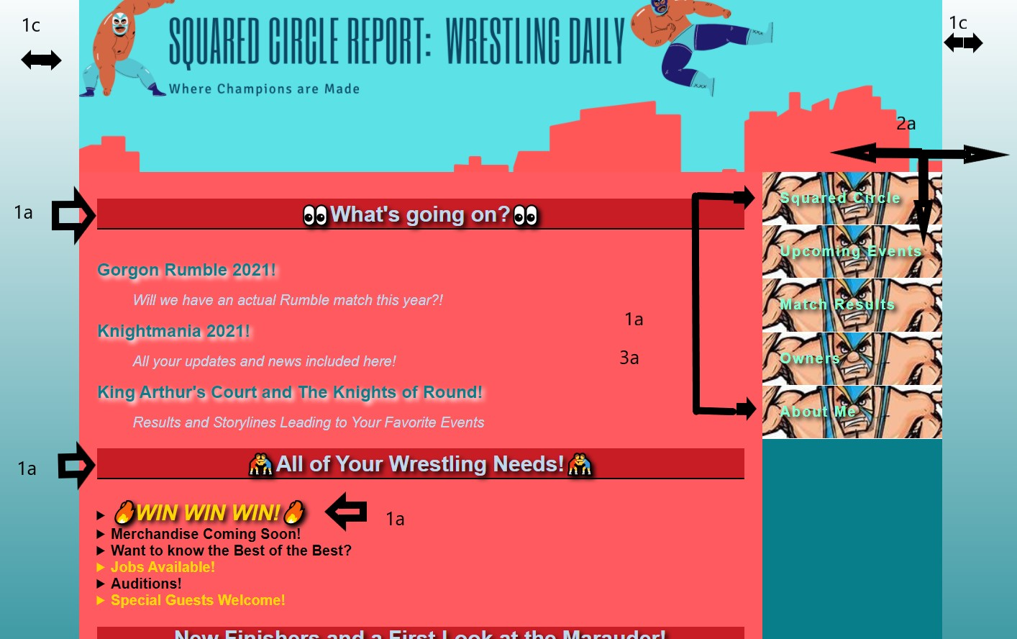
“Part Two”
Chapter 4
Text Shadow on H2 tags, win class, DD tags and navigation text
Image as Hyperlink with gallery on bottom of page
Linear-gradient throughout
Chapter 6
2 column layout throughout
Image gallery on bottom of page – hover shows captions
Chapter 7
Sprite – on navigation bar throughout
Page displayed properly on phone/tablet

Slide 4
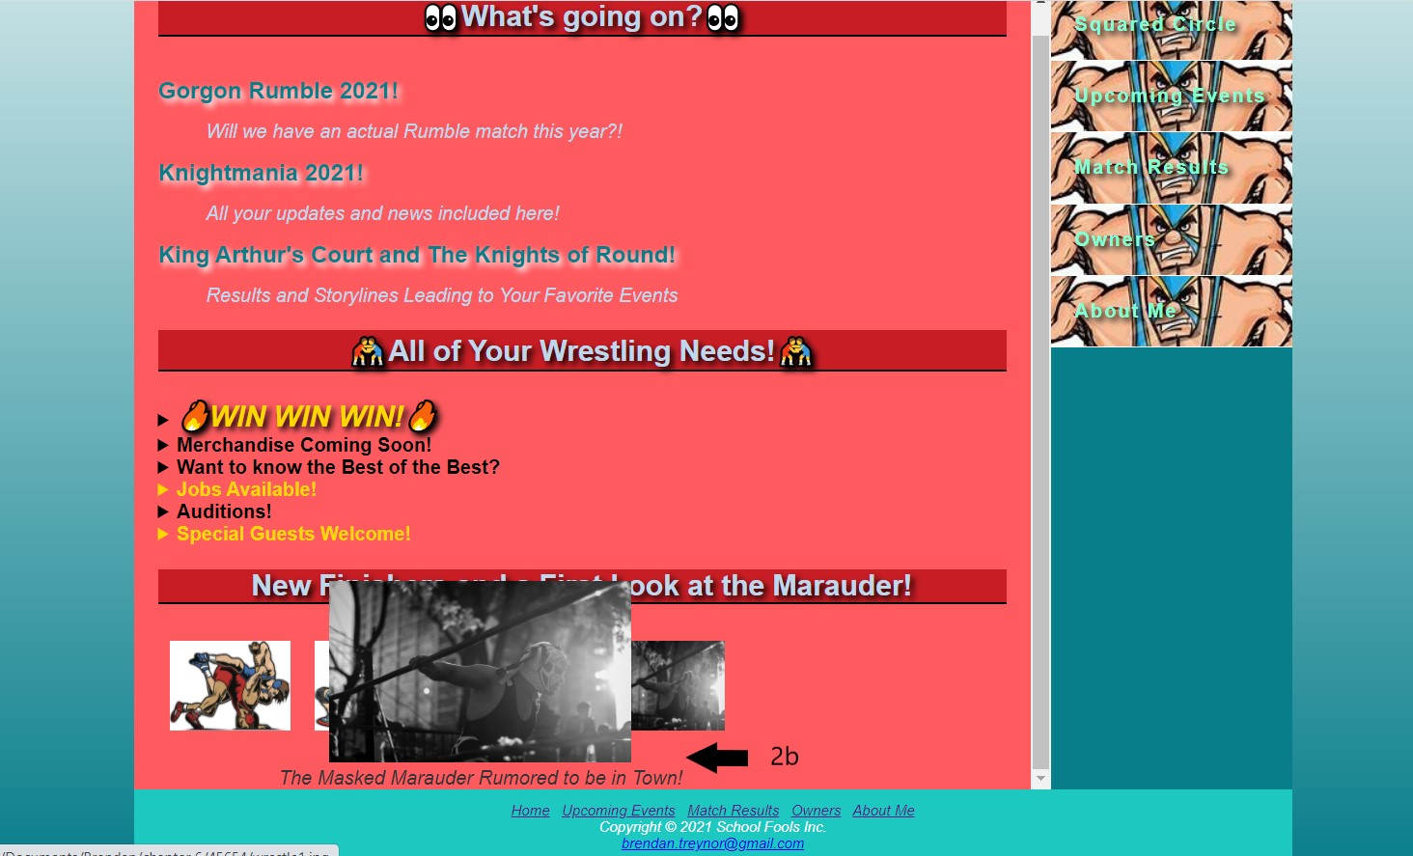
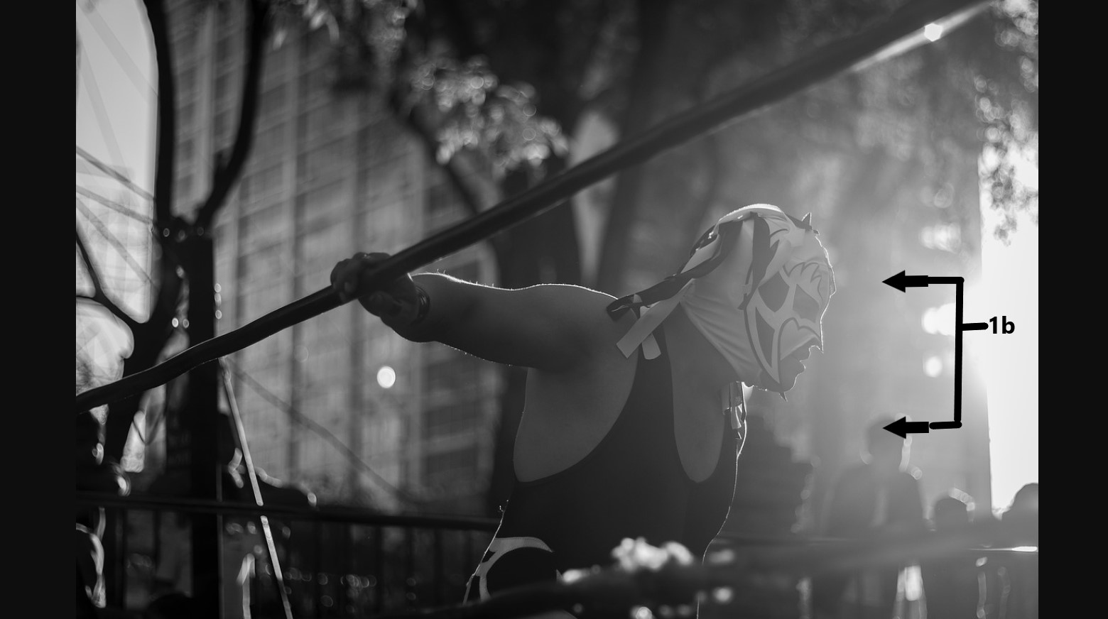
Part Two Cnt’d
Chapter 4
Text Shadow on H2 tags, win class, DD tags and navigation text
Image as Hyperlink with gallery on bottom of page – when clicked hyperlink displays image larger
Linear-gradient throughout
Chapter 6
2 column layout throughout
Image gallery on bottom of page – hover shows captions

Slide 5
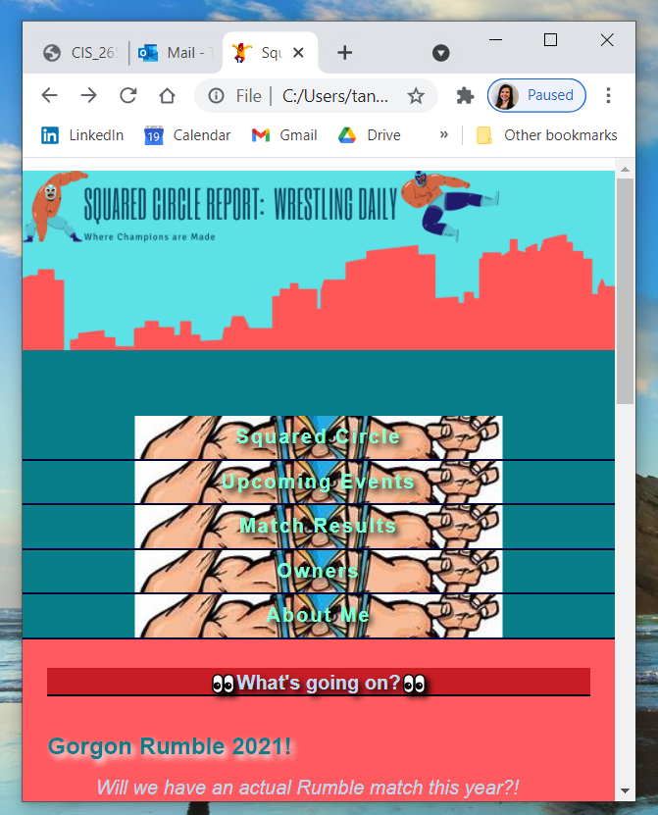
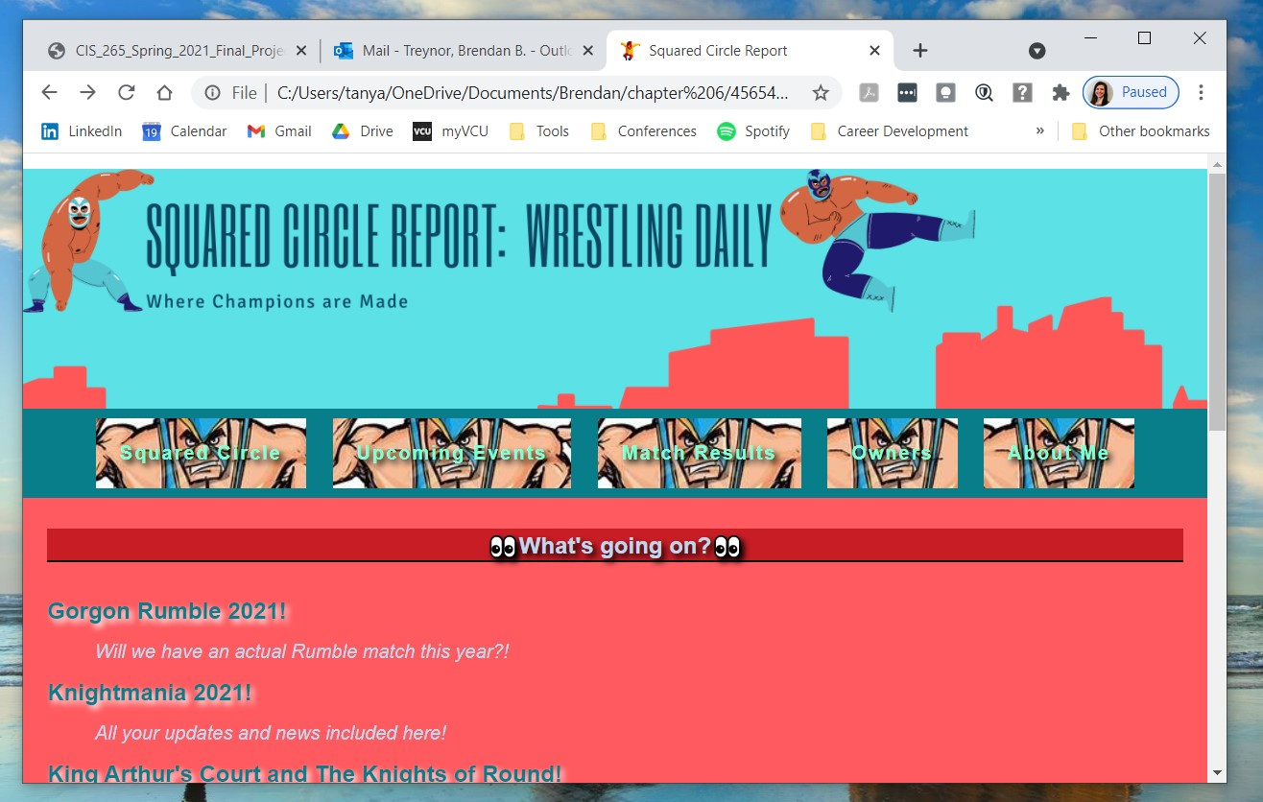
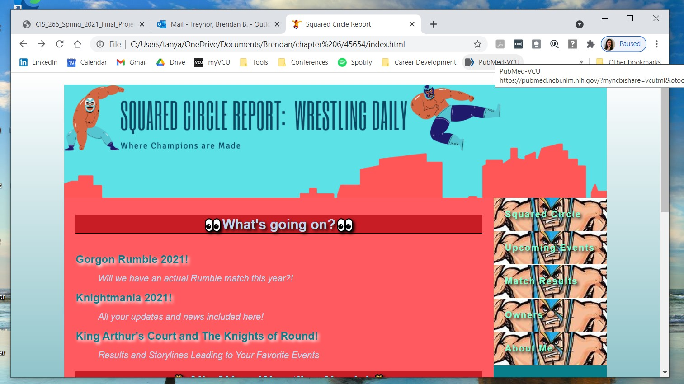
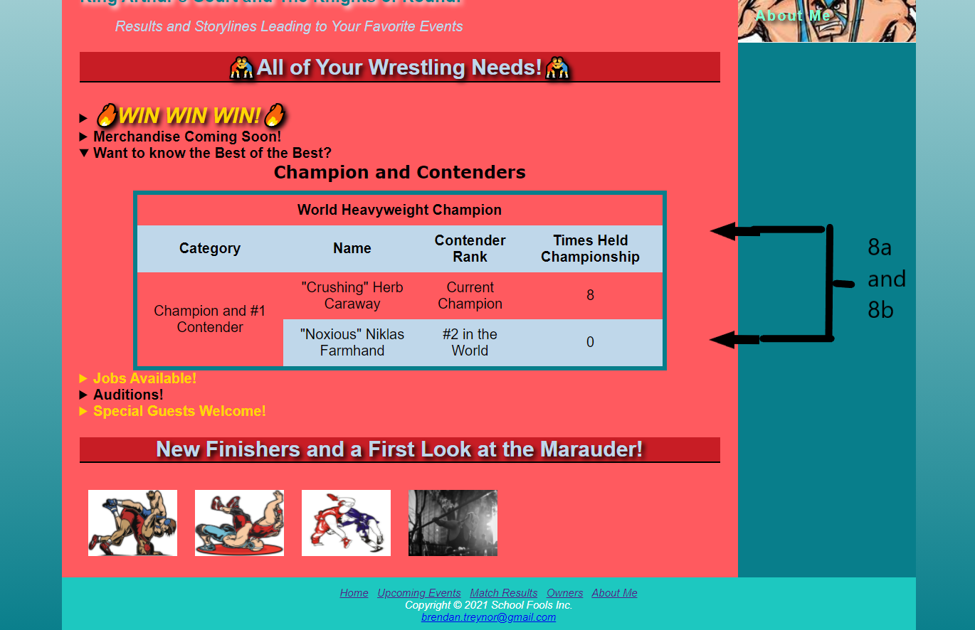
Part Two Cnt’d
Chapter 7
Sprite – on navigation bar throughout
Page displayed properly on phone/tablet – page configures to size
Chapter 8
Table with a cell that spans multiple columns or rows
CSS to configure table
3b
4a and 4b

Slide 6
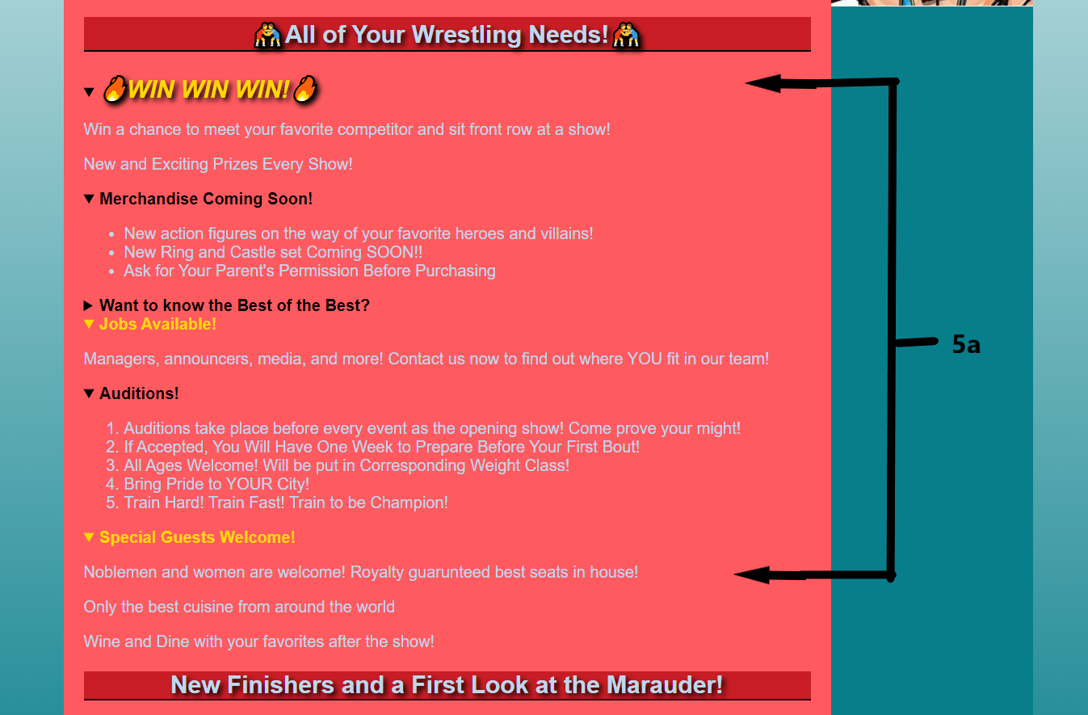
Part Two Continued
Chapter 11
Configure a Details and Summary element
All the above as specified included on at least one of your pages is confirmed for the “index.html”. “You do not have to include all of the above elements on all four of the pages in your website.”

Slide 7
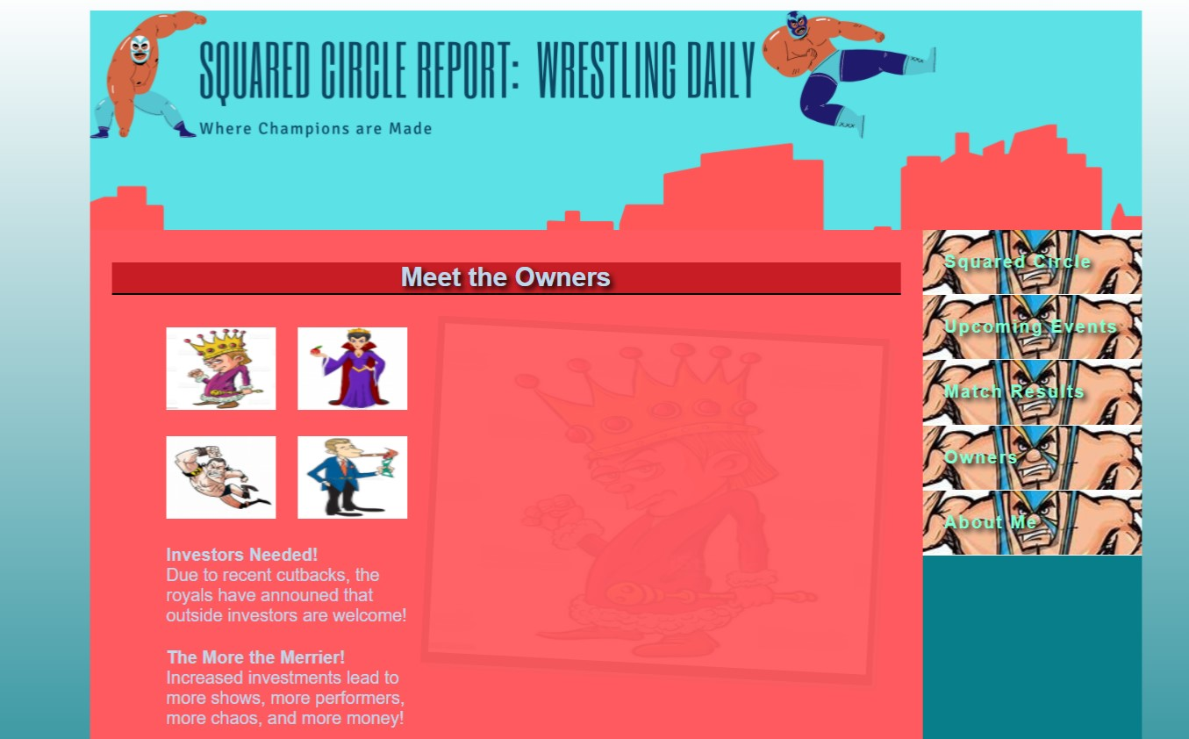
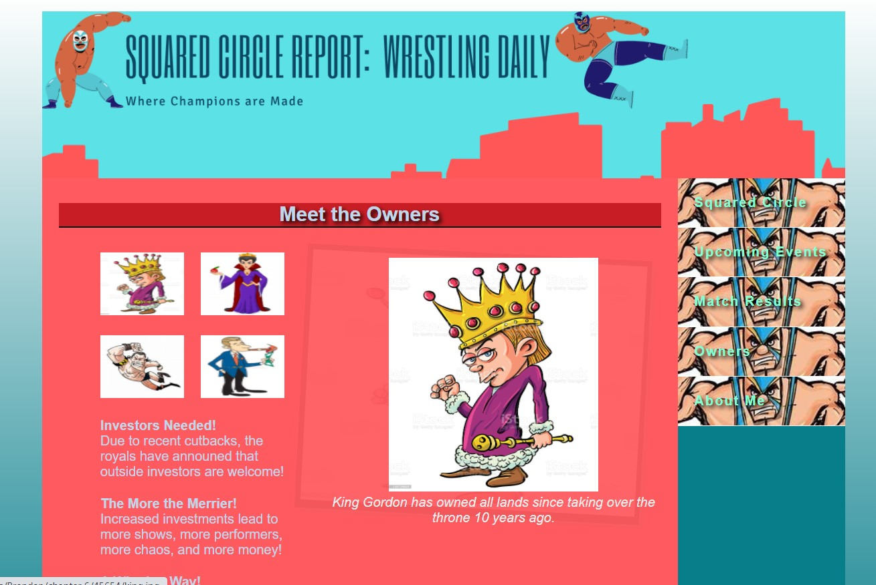
Image Gallery Extras
This Image Gallery is more interactive. When mouse hovers over each picture they fade into focus. Original King Picture remains faded in background.

Slide 8
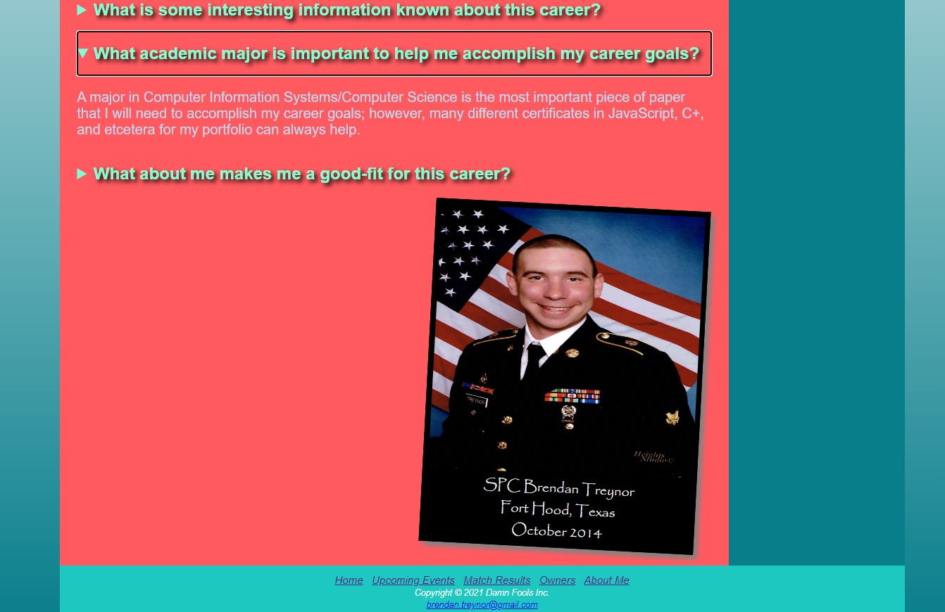
Miscellaneous
Details and summary tags configured with CSS.
Picture rotated, with figure caption and box shadow

Slide 9
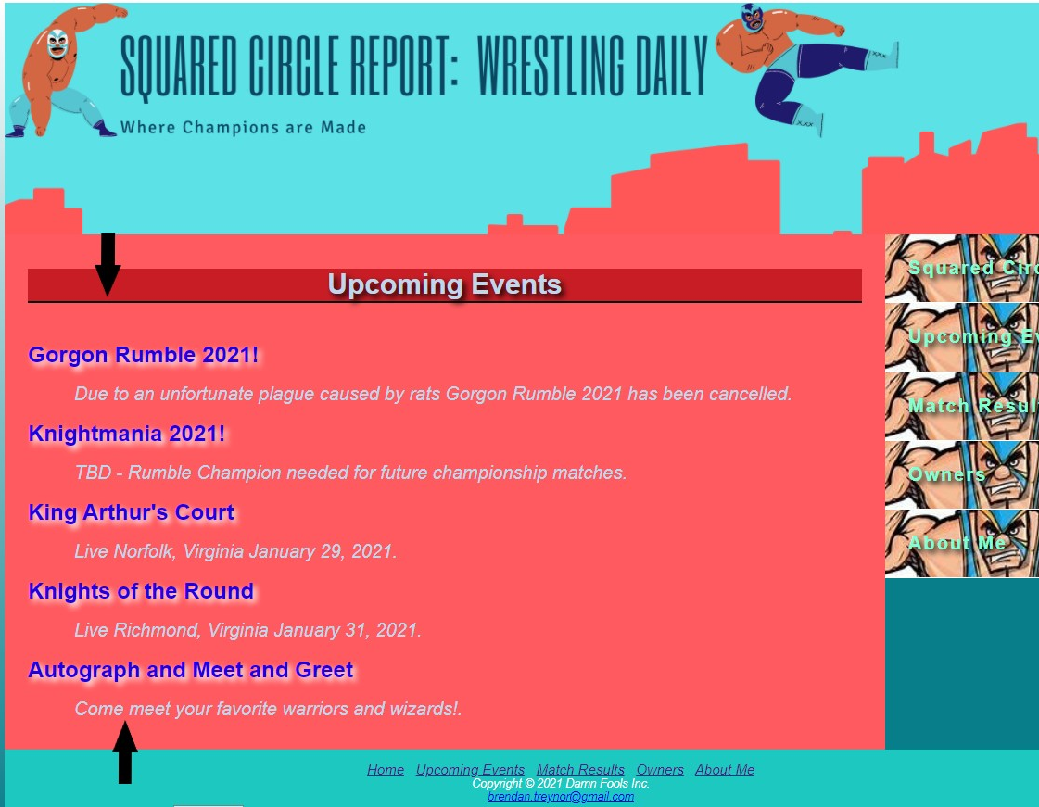
Miscellaneous Continued
DT Tags configure text to change colors on their own

Slide 10

Thank You!
Thank you for your time!
I really enjoyed this project. The ability to create something and see it work on screen has been something that I thoroughly enjoyed doing!

