Slide 1
Task1: Why mixed reality?
Mixed reality is the wrong choice for this use case. The use case identifies a few key functions the proposed system must perform: 1. Record water samples 2. Allow interaction with the water sample in a lab environment.
Regarding point 1, it is assumed that the recordings will be done by IoT devices (as per Task 6); in this situation an augmented or virtual reality application makes no sense as the task is fully automated and there is no human involvement. However, it is possible that recordings may need to be done manually, if this is the case a worker will need to find a location to place the device and make a measurement. Again, this does not require a mixed reality solution as the researcher is simply identifying a location to take the measurement, without existing measurements there is no meaningful data that can be displayed to the user to assist them with this task. There is a third option for data collection here which will be addressed at the end.
Regarding point 2, the water sample is in a lab environment. Data has already been recorded by the IoT device mentioned in case 1 thus everything has already been recorded and is in a digital format. There is no reason provide researchers with mixed reality in this case as there is no additional understanding that a physical representation of the data could offer, i.e. there is no reason to display what the data looks like in any medium other than text.
In order to see where the data comes from it is acceptable to simply display a map on a computer screen as a bird’s eye view of Auckland and its bodies of water is entirely 2D and thus fits on a 2D display.
In order to physically examine any physical samples a researcher would need to use a machine and could not use augmented reality to accomplish this task.
Mixed reality makes most sense when a user needs to interact with a digitized representation of a complex system in a way that would not be practical with the physical system itself. Creating a 3D digital representation of a system allows a user to explore interactions between components that would have been hidden or impossible to replicate in a physical system.
In this situation there is no underlying complexity that cannot be represented in a 2D format, we aren’t interested in what Auckland’s waterways look like – we are interested in pollution and there is no virtual representation that we can create that makes more sense than 2D graphs, maps, or regular text.
Despite MR being the wrong choice for this project, the task does ask to list the benefits of an MR solution and not whether MR makes sense in this use case.
So… Benefit 1: Make maps that can be viewed on the ground in a larger format than they could be on a screen.
Benefit 2: Make graphs that can be physically projected against a wall in a larger format than they could be on a screen.
Benefit 3: Explore data collection sites (assuming you have existing images you can interact with)
Benefit 4: Use robots to collect data and interact with surroundings (this is literally the only meaningful case that can be accomplished using MR that could not be better represented on a conventional monitor). If using robots to collect data, then the robots will likely not be autonomous and thus will require a pilot. Interacting with an environment is easier when the environment is in 3D.

Slide 2
Task1: Why mixed reality?
Based on the choices I have made previously I will be designing this MR application as if it was for a robot gathering water samples. Creating an interactive map or graphing data just doesn’t make sense here.

Slide 3
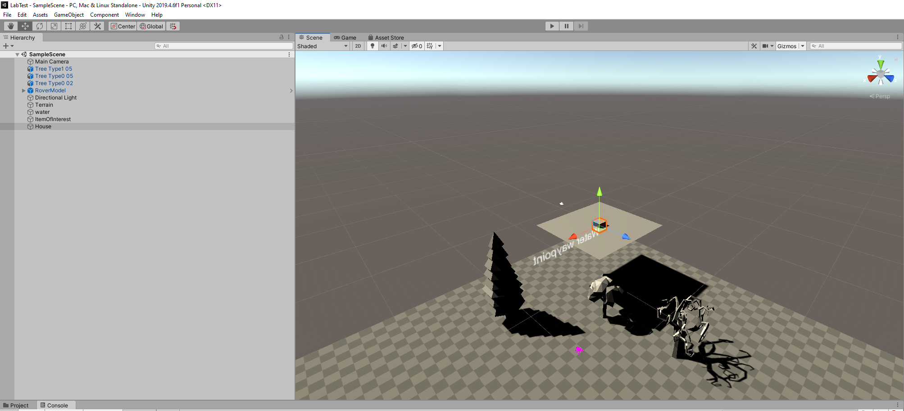
Task2/4: Unity project https://github.com/btri623/labtest
Using github because it is better for both of us - I hope I am not marked down for using version control here.

Slide 4
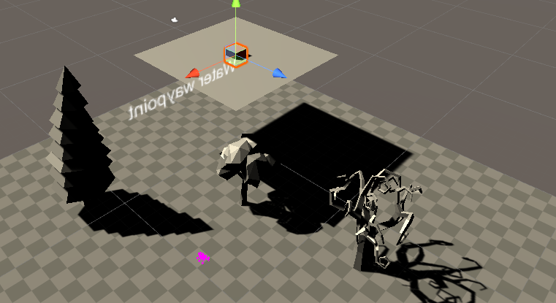
Task2/4: Unity project https://github.com/btri623/labtest
I have a cube which is representative of a house object
I have trees I imported from Asset Store I placed multiple of these to indicate a forest is growing.
I have the mars rover which is substituting for the robot that will be collecting samples
I created a 2D plane which is representative of water
I created text which is a way point so users can see locations of interest

Slide 5

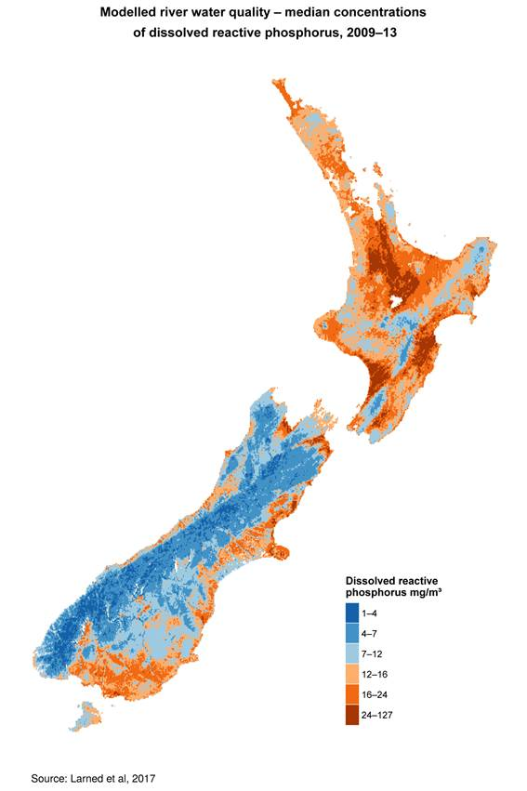
Task3/4: A 2D app used in conjunction with MR.
This is where a graphical representation of water pollution levels makes sense. A 2D map can be used to show pollution throughout New Zealand as per the attached image.
Clicking on a pollutant will display the heatmap for that given substance.
Pollution levels:
x dissolved reactive phosphorous o e coli o lead

Slide 6
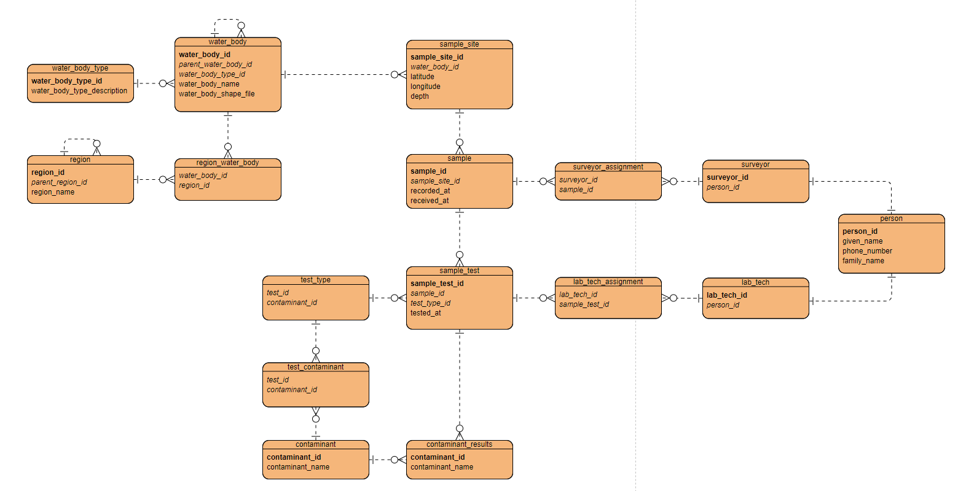
I reviewed the Information modelling notes in Canvas and respect the use of PascalCase, however in most databases tables and columns are represented with_underscores_and_no_caps so I decided to use this convention here as I feel that is best practice.
Bold represents PK
Italics represents FK
Task5: Information Model

Slide 7
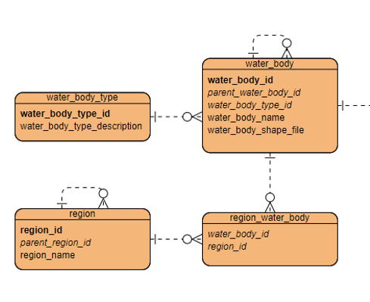
Task5: Information Model
I have self-referenced both water_body and region here. A region can be part of a greater region, e.g. Manukau is part of Auckland. And the same is true for bodies of water.
A body of water can be associated with multiple different regions if it is sufficiently large and vice versa (a region can contain multiple bodies of water), I have included a region_water_body table as a precise mapping here to remove the many-to-many relationship.
water_body_type could be replaced with an enum and a string representation in the database, there is no reason to reference another table here. However it is useful for clarity of the information model, each body of water has a specific classification however a classification can be given to many different bodies of water.

Slide 8
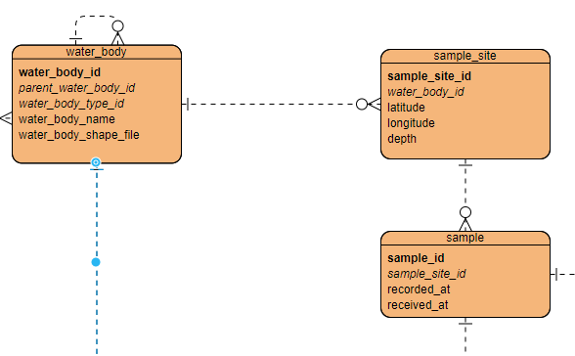
Task5: Information Model
A body of water will have zero or more sample sites. (cannot be illustrated in my ERD diagramming tool unfortunately as I am showing one-to-many instead of zero-to-many).
A sample_site will have precise x/y/z coordinates.
A sample_site will have one or more samples associated with it.
This quote from the assignment can be simplified “The location of a sample may be identified by either a previously defined sample site or a simple grid reference such as latitude and longitude. An example of a previously defined sample site would be Mission Bay/1. This would have been recorded in the database previously along with it's grid reference.”
The implementation of this detail involves creating a new sample_site when there is a new sample being taken instead of changing the datatype from a sample_site_id i.e. MissionBay/1 to co-ords, instead we will always use the sample_site_id.
recorded_at and received_at aare both datetime objects

Slide 9
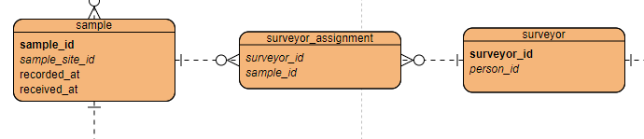
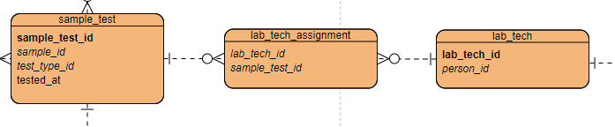
Task5: Information Model
A sample may be collected by one or more surveyors and a surveyor may collect one or more samples.
A sample may be tested by one or more labtechs and a labtech may test one or more samples.

Slide 10
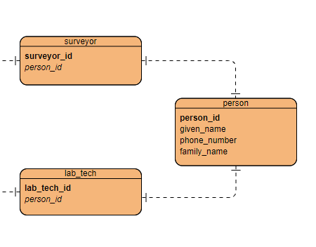
Task5: Information Model
This relationship should be “Is one of” however this cannot be represented in my ERD diagramming tool. As it stands it is a perfectly logical assertion that a person is BOTH a surveyor and a labtech instead of being EITHER a labtech or a surveyor.

Slide 11
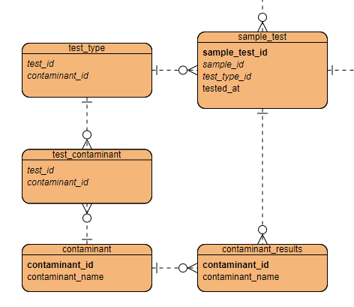
Task5: Information Model
A sample_test is associated with a particular test type, the test types need to be replicable each time. A test can find more than one contaminant however it is generally expected that it would be a one to one reltationship between the two. We should not code a one to one relationship though as this locks us in to that particular structure in the future.
A sample test can have one or more contaminants depending on the test that was run.

Slide 12
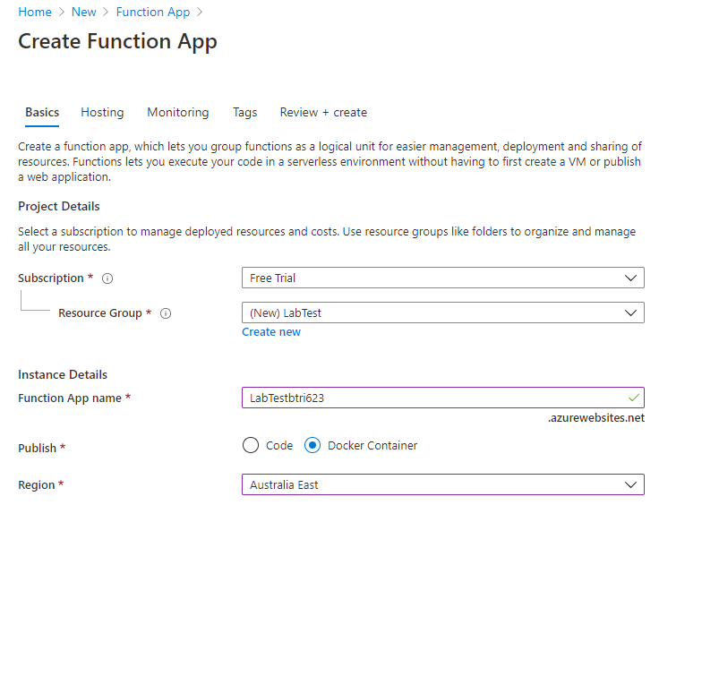
Task2: Azure functions
I actually changed my mind re: docker when I realised I needed to set up a registry etc, so went for a regular web app running on a windows machine. Not an ideal situation but we’re getting graded on whether we can create a function and not whether it will cost a fortune to run in a prod environment… Also I changed the region to Australia SE to handle latency issues though these will be trivial.

Slide 13
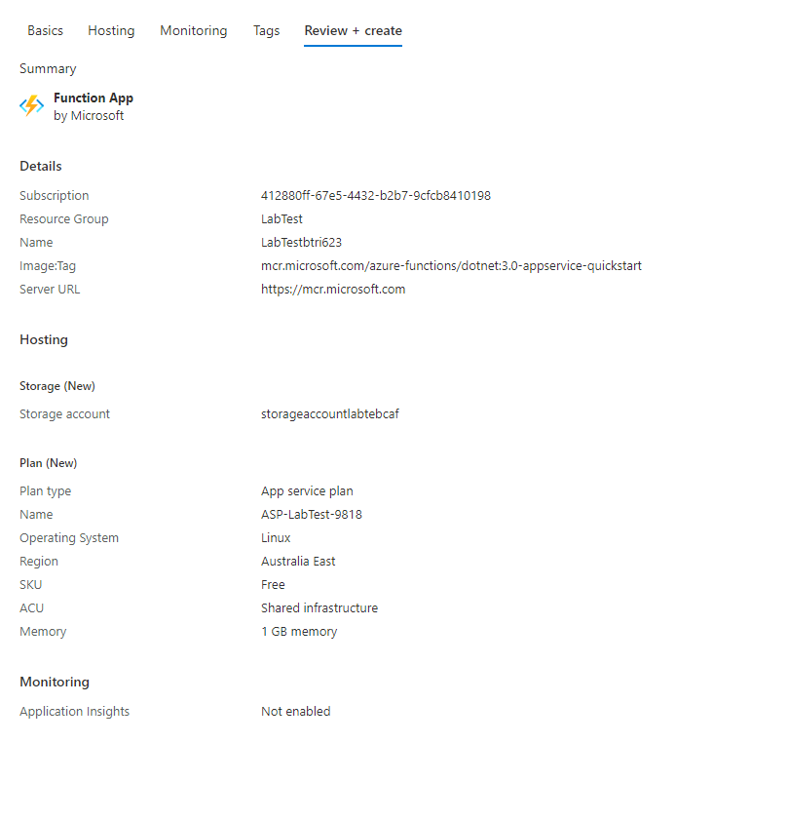
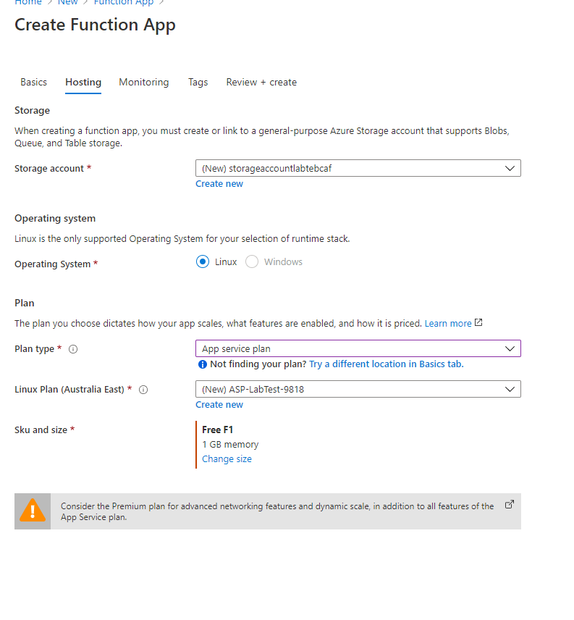
Task2: Azure functions

Slide 14
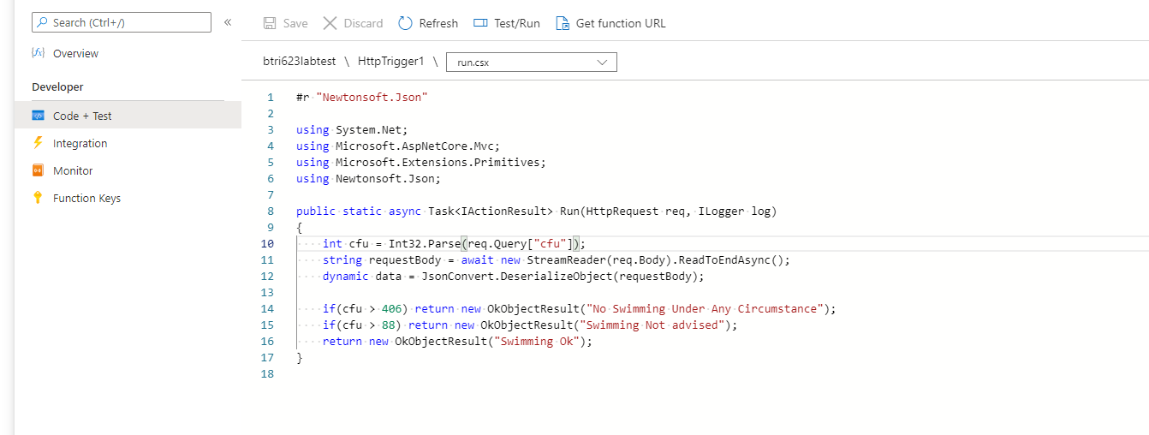
Task2: Azure functions
Code being used in the function. A bit hacky and not best practice with the multiple return statements here. A controller method should only have the one return and should be creating the message separately. Also anything that cannot be parsed as an integer will throw an error which will not be handled gracefully, but I am assuming that the calling application is aware of this and will be responsible for ensuring integers are provided. This is arguably a feature as it explicitly disallows non parsable values
/s
I will keep the function running for the foreseeable future so you can test:
https://btri623labtest.azurewebsites.net/api/HttpTrigger1?code=pRQD5oVQRKnYVTvEkP1mHgG3AAm3Nji5FVGjwBXD/ndMmJzgxL/6Yw==&cfu=88

Slide 15
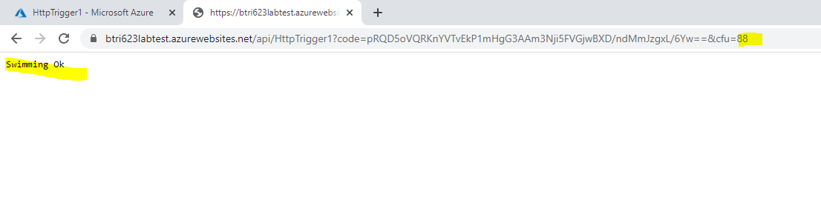
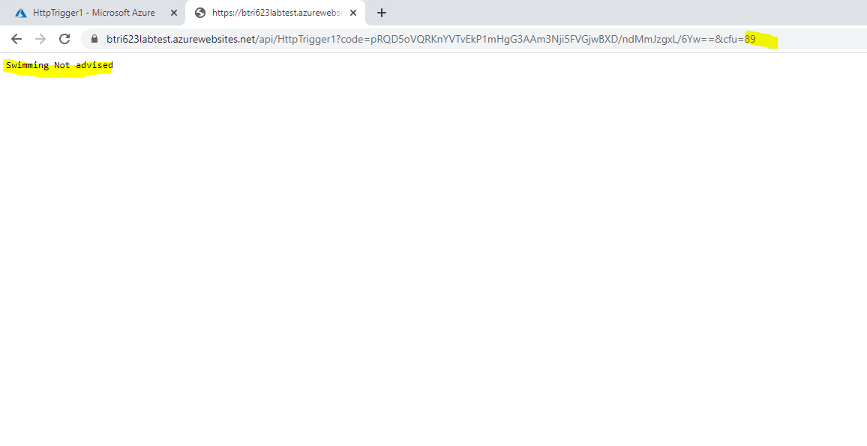
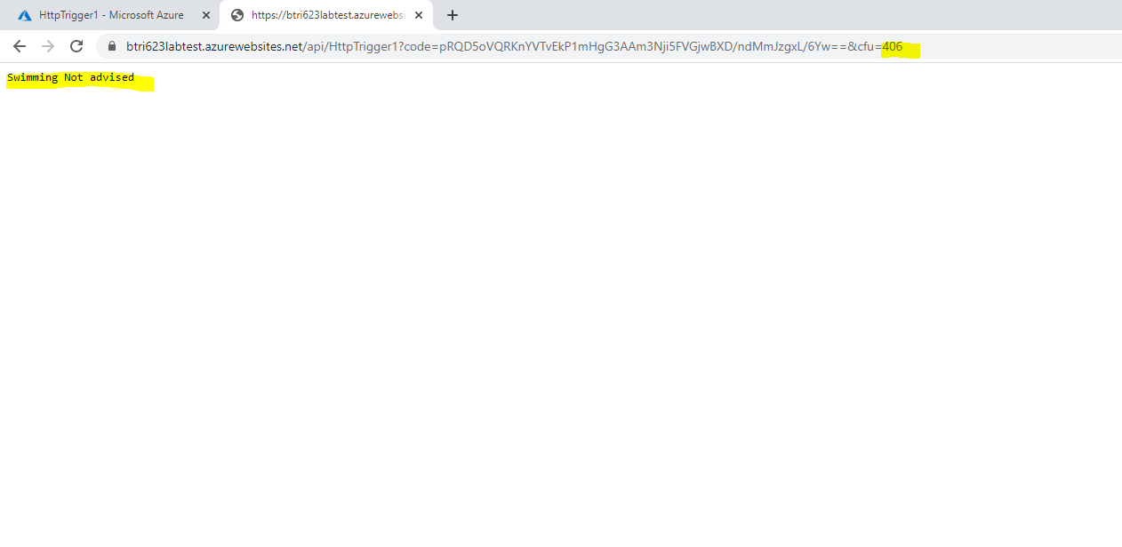
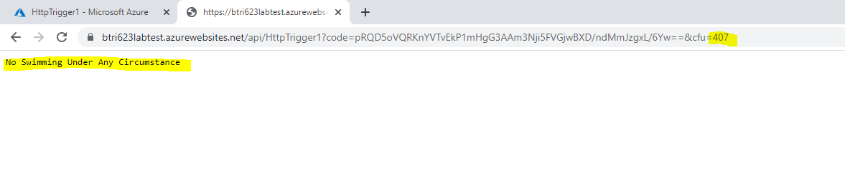
Task2: Azure functions
Tests:
Function_SwimmingOk_WhenCfuIs88
Function_ ShouldReturnSwimmingNotAdvised _WhenCfuIs89
Function_ShouldReturnSwimmingNotAdvised_WhenCfuIs406
Function_ShouldReturnNoSwimmingUnderAnyCircumstances_WhenCfuIs407

