Slide 1
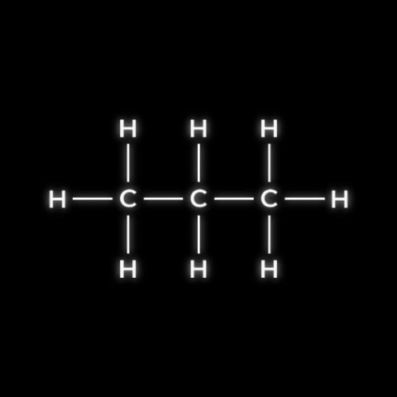

CARD 01 - PROPANE
Molecular Formula: C3H8
MOLECULAR FORMULA
LEWIS STRUCTURE
C3H8
CONDENSED STRUCTURAL FORMULA
BOND-LINE FORMULA
CH3CH2CH3
- VERIFICATION STRIP -
Atom Count Verified
Valence Checked
Bond Order Checked
Same Connectivity

Slide 2

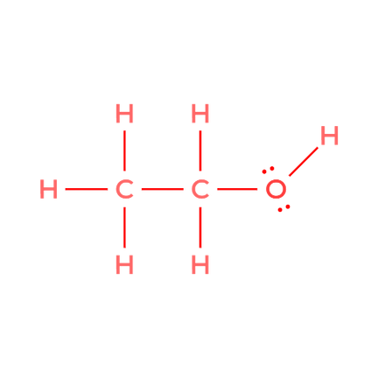

CARD 02 - ETHANOL
Molecular Formula: C2H60
MOLECULAR FORMULA
LEWIS STRUCTURE
C2H6O
CONDENSED STRUCTURAL FORMULA
BOND-LINE FORMULA
CH3CH2OH
- VERIFICATION STRIP -
Atom Count Verified
Valence Checked
Bond Order Checked
Same Connectivity

Slide 3
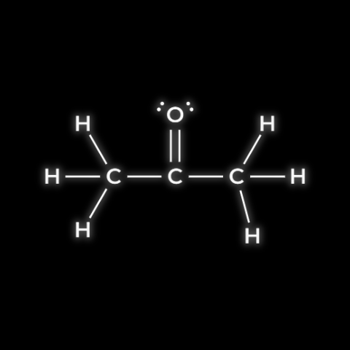
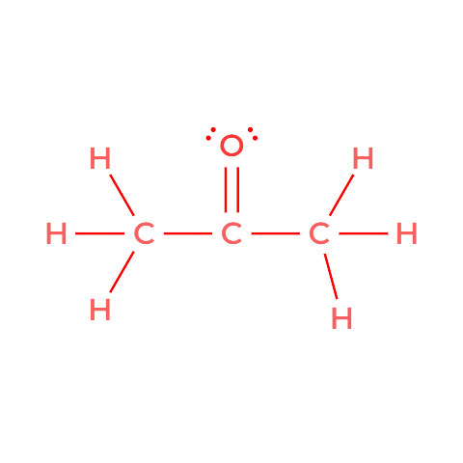

CARD 03 - ACETONE (propan-2-one)
Molecular Formula: C3H60
MOLECULAR FORMULA
LEWIS STRUCTURE
C3H6O
CONDENSED STRUCTURAL FORMULA
BOND-LINE FORMULA
CH3COCH3
- VERIFICATION STRIP -
Atom Count Verified
Valence Checked
Bond Order Checked
Same Connectivity

Slide 4

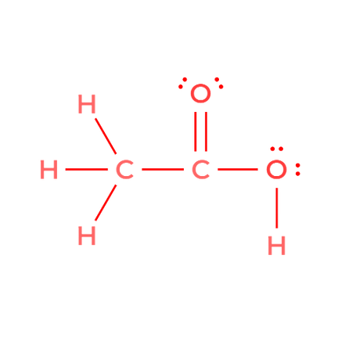


CARD 04 - ACETIC ACID (ethanoic acid)
Molecular Formula: C2H402
MOLECULAR FORMULA
LEWIS STRUCTURE
C2H402
CONDENSED STRUCTURAL FORMULA
BOND-LINE FORMULA
CH3COOH
- VERIFICATION STRIP -
Atom Count Verified
Valence Checked
Bond Order Checked
Same Connectivity

Slide 5

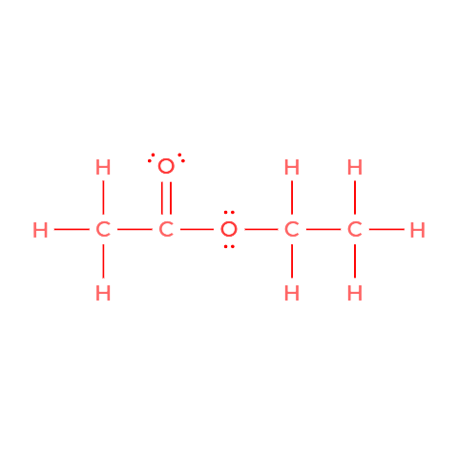

CARD 05 - ETHYL ACETATE (ethyl ethanoate)
Molecular Formula: C4H802
MOLECULAR FORMULA
LEWIS STRUCTURE
C4H8O2
CONDENSED STRUCTURAL FORMULA
BOND-LINE FORMULA
CH3COOCH2CH3
- VERIFICATION STRIP -
Atom Count Verified
Valence Checked
Bond Order Checked
Same Connectivity

Slide 6


CARD 06 - CYCLOHEXANE
Molecular Formula: C6H12
MOLECULAR FORMULA
LEWIS STRUCTURE
C6H12
CONDENSED STRUCTURAL FORMULA
BOND-LINE FORMULA
cyclo-(CH2)6
- VERIFICATION STRIP -
Atom Count Verified
Valence Checked
Bond Order Checked
Same Connectivity

Slide 7
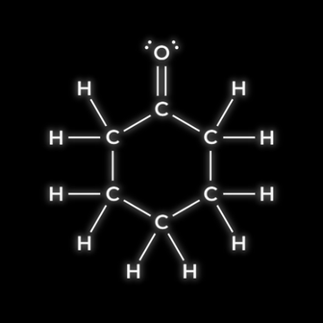
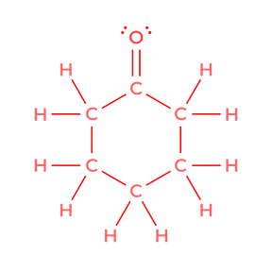

CARD 07 - CYCLOHEXANONE
Molecular Formula: C6H10O
MOLECULAR FORMULA
LEWIS STRUCTURE
C6H10O
CONDENSED STRUCTURAL FORMULA
BOND-LINE FORMULA
(CH2)5C=O
- VERIFICATION STRIP -
Atom Count Verified
Valence Checked
Bond Order Checked
Same Connectivity

Slide 8
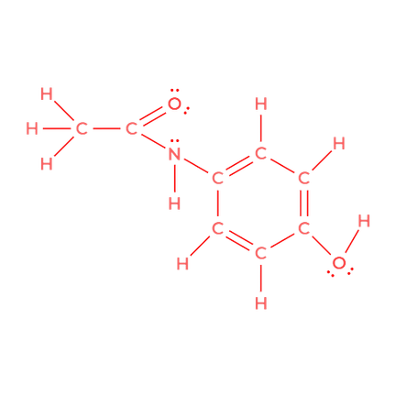
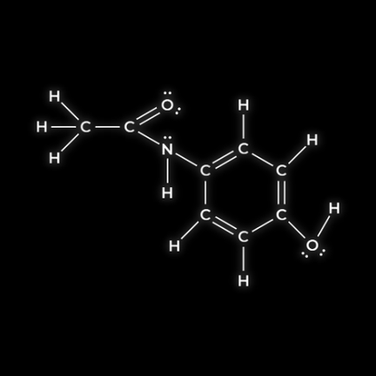
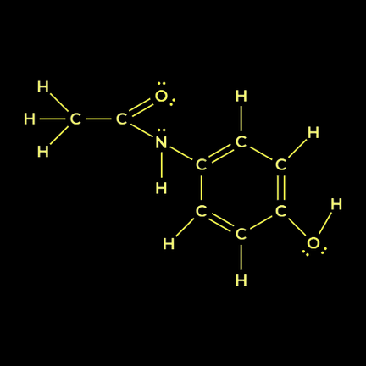

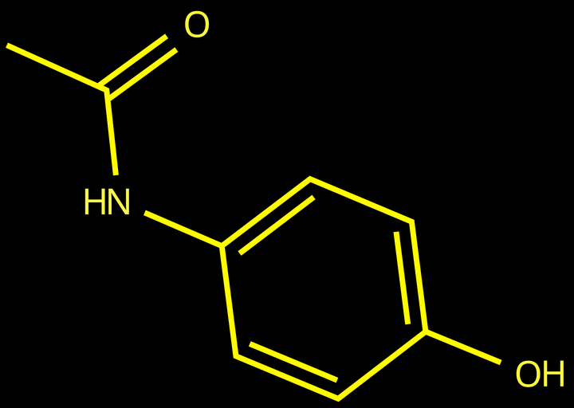
CARD 08 - ACETAMINOPHEN (paracetamol)
Molecular Formula: C8H9N02
MOLECULAR FORMULA
LEWIS STRUCTURE
C8H9NO2
CONDENSED STRUCTURAL FORMULA
BOND-LINE FORMULA
CH3CONH
(1,4-C6H4)OH
- VERIFICATION STRIP -
Atom Count Verified
Valence Checked
Bond Order Checked
Same Connectivity

Slide 9

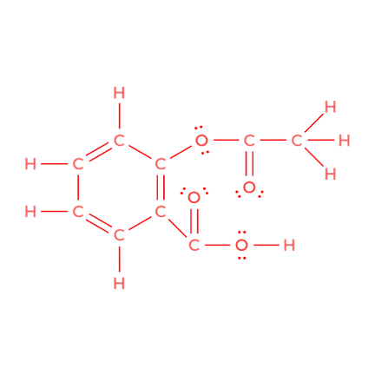

CARD 09 - ASPIRIN (acetylsalicylic acid)
Molecular Formula: C9H804
MOLECULAR FORMULA
LEWIS STRUCTURE
C9H8O4
CONDENSED STRUCTURAL FORMULA
BOND-LINE FORMULA
CH3COO
(1,2-C6H4)COOH
- VERIFICATION STRIP -
Atom Count Verified
Valence Checked
Bond Order Checked
Same Connectivity

Slide 10
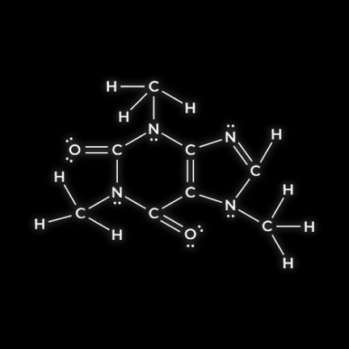
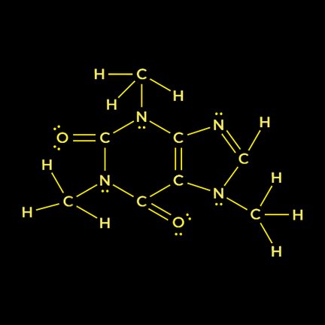
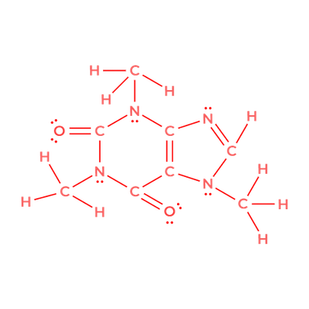


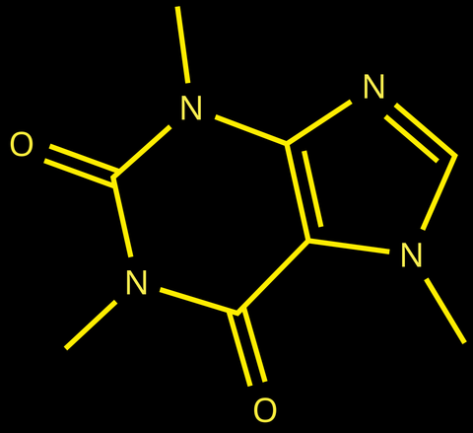
CARD 10 - CAFFEINE
Molecular Formula: C8H10N4O2
MOLECULAR FORMULA
LEWIS STRUCTURE
C8H10N4O2
CONDENSED STRUCTURAL FORMULA
BOND-LINE FORMULA
CH3N1¹CH=NC2=C1¹C(=O)
N(CH3)C(=O)N2CH3
- VERIFICATION STRIP -
Atom Count Verified
Valence Checked
Bond Order Checked
Same Connectivity

