Slide 1
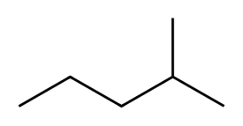
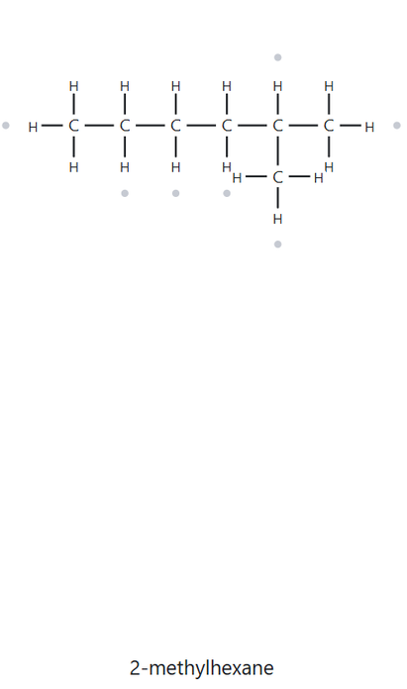


CARD A01 — STRUCTURE → NAME
Level: FOUNDATION Molecular Formula (counted): C6H14
1. NUMBERED PARENT
2. NAMING TRAIL
Parent: longest chain=5 C→ pentane. Two 5-C paths exist (through the right-hand CH₃ or through the upward branch), but each carries one methyl group, so they lead to the same name.
Numbering: left → right gives 4; right → left gives 2. First point of difference: 2 < 4, so number from the right.
Substituents: methyl on C2 → 2-methyl
2
1
4
5
3
3. MY NAME
4. THE ALKANE CHECK
2-methylpentane
✓ MATCH
- VERIFICATION STRIP -
Longest Chain Ring
Lowest Locants
Alphabetical Order
Punctuation
Formula Counted

Slide 2
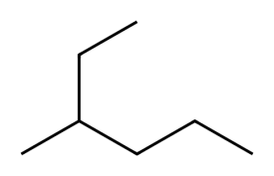
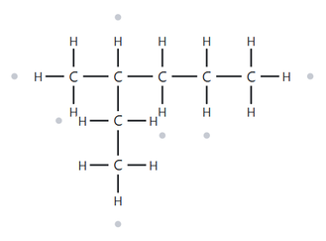
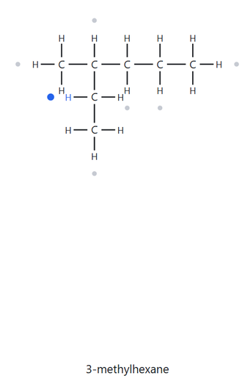
CARD A02 — STRUCTURE → NAME
Level: FOUNDATION Molecular Formula (counted): C7H16
1. NUMBERED PARENT
2. NAMING TRAIL
1
Parent: longest chain = 6 C → hexane (open chain). Only one 6-C path exists, running from the top line end down through the branched carbon and along to the bottom-right end. The path through the bottom-left line end is only 5 C, so that line is a branch.
Numbering: top end → bottom-right end gives 3; bottom-right end → top end gives 4. First point of difference: 3 < 4, so number from the top end.
Substituents: methyl on C3 → 3-methyl
2
3
5
4
6
3. MY NAME
4. THE ALKANE CHECK
3-methylhexane
✓ MATCH
- VERIFICATION STRIP -
Longest Chain Ring
Lowest Locants
Alphabetical Order
Punctuation
Formula Counted

Slide 3
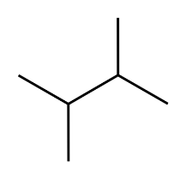
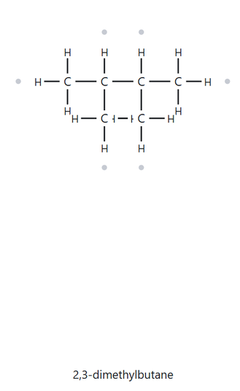
CARD A03 — STRUCTURE → NAME
Level: FOUNDATION Molecular Formula (counted): C6H14
1. NUMBERED PARENT
2. NAMING TRAIL
4
Parent: longest chain = 4 C → butane. Several 4-C paths exist, but each carries two methyl groups, so they lead to the same name.
Numbering: left → right gives 2,3; right → left gives 2,3. There is no point of difference, so the direction doesn’t change the name and either one is fine.
Substituents: methyl on C2 and C3 → 2,3-dimethyl
3
1
2
3. MY NAME
4. THE ALKANE CHECK
2,3-dimethylbutane
✓ MATCH
- VERIFICATION STRIP -
Longest Chain Ring
Lowest Locants
Alphabetical Order
Punctuation
Formula Counted

Slide 4
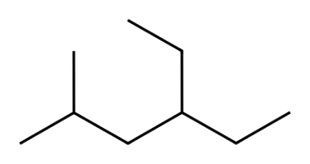
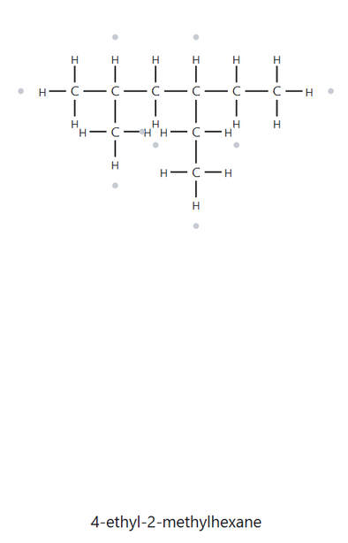
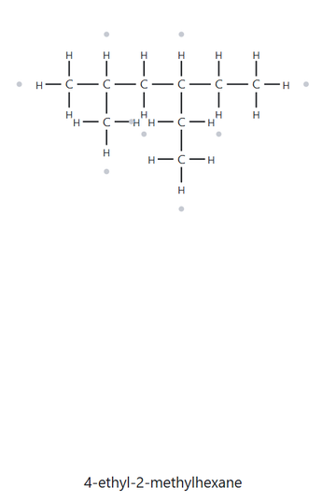
CARD A04 — STRUCTURE → NAME
Level: DEVELOPING Molecular Formula (counted): C9H20
1. NUMBERED PARENT
2. NAMING TRAIL
Parent: longest chain = 6 C → hexane. Several 6-C paths exist, but each carries one methyl and one ethyl group, so they lead to the same name.
Numbering: left → right gives 2,4; right → left gives 3,5. First point of difference: 2 < 3, so number from the left.
Substituents: ethyl on C4 and methyl on C2, listed alphabetically (e before m) → 4-ethyl-2-methyl.
6
1
2
3
4
5
3. MY NAME
4. THE ALKANE CHECK
4-ethyl-2-methylhexane
✓ MATCH
- VERIFICATION STRIP -
Longest Chain Ring
Lowest Locants
Alphabetical Order
Punctuation
Formula Counted

Slide 5
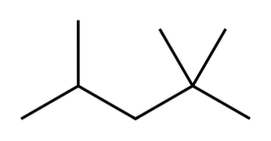
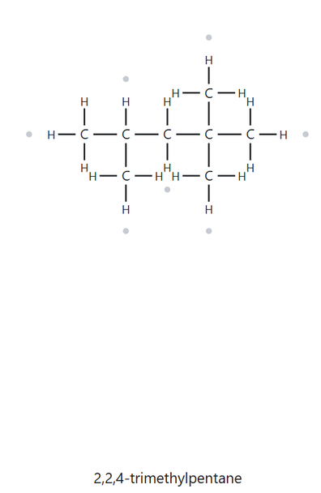
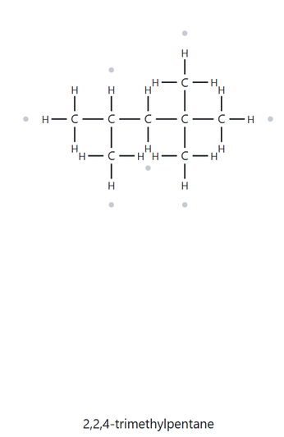
CARD A05 — STRUCTURE → NAME
Level: DEVELOPING Molecular Formula (counted): C8H18
1. NUMBERED PARENT
2. NAMING TRAIL
Parent: longest chain = 5 C → pentane. Several 5-C paths exist, but each carries three methyl groups, so they lead to the same name.
Numbering: left → right gives 2,4,4; right → left gives 2,2,4. First point of difference: 2 < 4, so number from the right.
Substituents: methyl on C2, C2 and C4 → 2,2,4-trimethyl. The locant is repeated for each methyl on the same carbon.
1
2
4
3
5
3. MY NAME
4. THE ALKANE CHECK
2,2,4-trimethylpentane
✓ MATCH
- VERIFICATION STRIP -
Longest Chain Ring
Lowest Locants
Alphabetical Order
Punctuation
Formula Counted

Slide 6
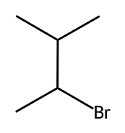
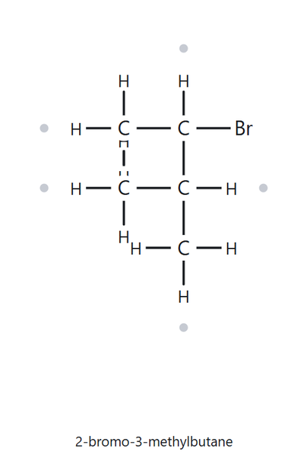
CARD A06 — STRUCTURE → NAME
Level: DEVELOPING Molecular Formula (counted): C5H11Br
1. NUMBERED PARENT
2. NAMING TRAIL
4
Parent: longest chain = 4 C → butane. Several 4-C paths exist, but each carries one bromo and one methyl group, so they lead to the same name.
Numbering: lower-right end → upper end gives 2,3; upper end → lower-right end gives 2,3. The locant sets are identical, so there is no first point of difference. The tie goes to alphabetical order: bromo comes before methyl, so the bromine gets the lower number, and I number from the lower-left end.
Substituents: bromo on C2 and methyl on C3, listed alphabetically (b before m) → 2-bromo-3-methyl.
3
2
1
3. MY NAME
4. THE ALKANE CHECK
2-bromo-3-methylbutane
✓ MATCH
- VERIFICATION STRIP -
Longest Chain Ring
Lowest Locants
Alphabetical Order
Punctuation
Formula Counted

Slide 7
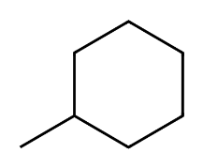
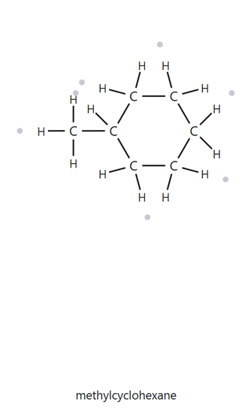
CARD A07 — STRUCTURE → NAME
Level: DEVELOPING Molecular Formula (counted): C7H14
1. NUMBERED PARENT
2. NAMING TRAIL
5
Parent: the ring has 6 C and the only chain attached has 1 C, so the ring is the parent → cyclohexane (ring, all single bonds).
Numbering: one substituent, so C1 is the carbon with the methyl. Both directions give {1}, so there’s no point of difference.
Substituents: methyl on C1 → methyl
6
4
1
2
3
3. MY NAME
4. THE ALKANE CHECK
methylcyclohexane
✓ MATCH
- VERIFICATION STRIP -
Longest Chain Ring
Lowest Locants
Alphabetical Order
Punctuation
Formula Counted

Slide 8
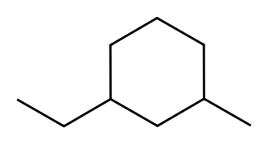
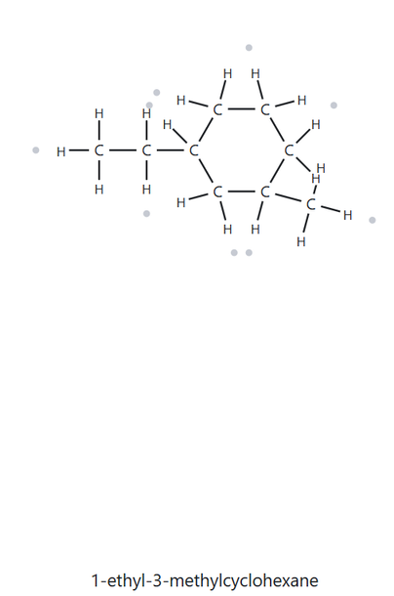
CARD A08 — STRUCTURE → NAME
Level: CHALLENGE Molecular Formula (counted): C9H18
1. NUMBERED PARENT
2. NAMING TRAIL
5
Parent: the ring has 6 C and the longest attached chain (the ethyl group) has 2 C, so the ring is the parent → cyclohexane (ring, all single bonds).
Numbering: both directions give 1,3. The tie goes to alphabetical order, so ethyl gets C1.
Substituents: ethyl on C1 and methyl on C3, listed alphabetically (e before m) → 1-ethyl-3-methyl
6
4
1
3
2
3. MY NAME
4. THE ALKANE CHECK
1-ethyl-3-methylcyclohexane
✓ MATCH
- VERIFICATION STRIP -
Longest Chain Ring
Lowest Locants
Alphabetical Order
Punctuation
Formula Counted

Slide 9
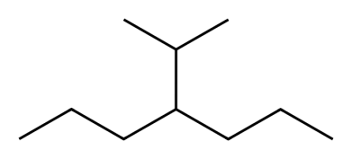
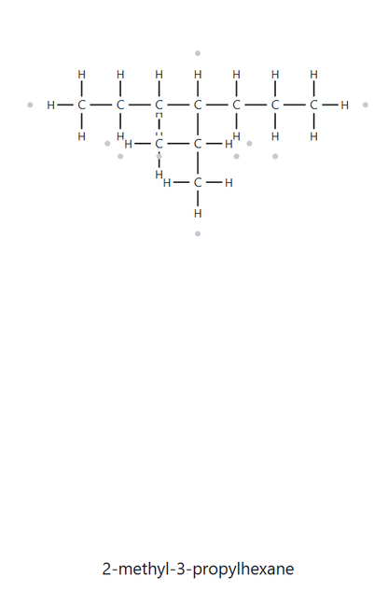
CARD A09 — STRUCTURE → NAME
Level: CHALLENGE Molecular Formula (counted): C10H22
1. NUMBERED PARENT
2. NAMING TRAIL
Parent: longest chain = 7 C → heptane. The 7-C path runs along the whole zigzag from the left end to the right end. Any path through the upward branch gives only 6 C, so that branch is a substituent.
Numbering: left → right gives 4; right → left gives 4. The locant sets are identical, so there’s no point of difference and either direction gives the same name.
Substituents: isopropyl on C4 → 4-isopropyl
2
6
3
4
5
1
7
3. MY NAME
4. THE ALKANE CHECK
4-isopropylheptane
X NOT A MATCH
- VERIFICATION STRIP -
Longest Chain Ring
Lowest Locants
Alphabetical Order
Punctuation
Formula Counted

Slide 10
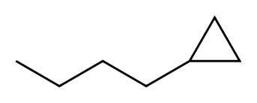
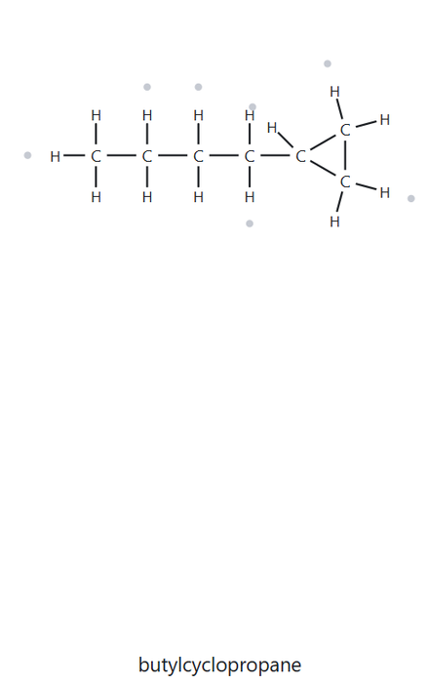
CARD A10 — STRUCTURE → NAME
Level: CHALLENGE Molecular Formula (counted): C7H14
1. NUMBERED PARENT
2. NAMING TRAIL
2
Parent: the ring has 3 C and the attached chain has 4 C. When the ring is the parent whenever a ring is present, so the parent is cyclopropane.
Numbering: one substituent, so C1 is the ring carbon that holds it. Both directions give {1}, so there’s no point of difference and no locant is needed.
Substituents: butyl (4 C, unbranched) on C1 → butyl
1
3
3. MY NAME
4. THE ALKANE CHECK
butylcyclopropane
✓ MATCH
- VERIFICATION STRIP -
Longest Chain Ring
Lowest Locants
Alphabetical Order
Punctuation
Formula Counted

Slide 11
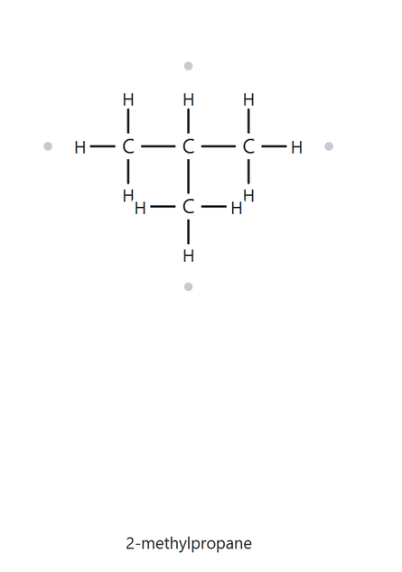
CARD B01 — NAME → STRUCTURE
Level: FOUNDATION Given Name: 2-methylpropane
1. NAME DECODED
2. BOND-LINE STRUCTURE (THE ALKANE)
Parent: propane → a 3-carbon chain
Substituents: methyl on C2
Expected formula: 3 + 1 = 4 C; open chain → C₄H₁₀
3. FORMULA CHECK
4. BACK-CHECK
Counted from the drawing: C₄H₁₀
Open Chain: CₙH₂ₙ₊₂ = C₄H₁₀. There are no halogens, so nothing is subtracted.
Returned by the Alkane:
2-methylpropane
✓ Same as the given name
- VERIFICATION STRIP -
Parent Length Matches
Substituent Positions Match
Formula Agrees
Back-Check Recorded

Slide 12
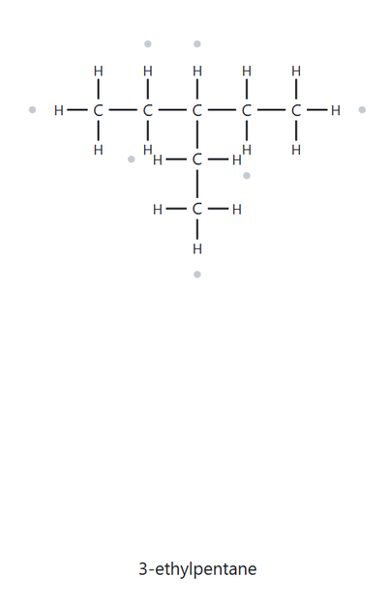
CARD B02 — NAME → STRUCTURE
Level: FOUNDATION Given Name: 3-ethylpentane
1. NAME DECODED
2. BOND-LINE STRUCTURE (THE ALKANE)
Parent: pentane → a 5-carbon chain
Substituents: ethyl on C3
Expected formula: 5 + 2 = 7 C; open chain → C₇H₁₆
3. FORMULA CHECK
4. BACK-CHECK
Counted from the drawing: C₇H₁₆
Open Chain: CₙH₂ₙ₊₂ = C₇H₁₆. There are no halogens, so nothing is subtracted.
Returned by the Alkane:
3-ethylpentane
✓ Same as the given name
- VERIFICATION STRIP -
Parent Length Matches
Substituent Positions Match
Formula Agrees
Back-Check Recorded

Slide 13
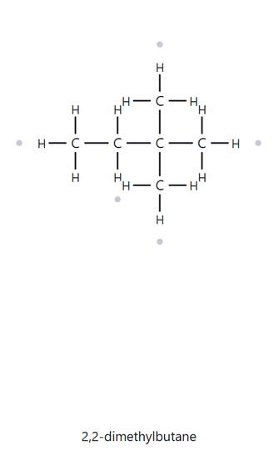
CARD B03 — NAME → STRUCTURE
Level: FOUNDATION Given Name: 2,2-dimethylbutane
1. NAME DECODED
2. BOND-LINE STRUCTURE (THE ALKANE)
Parent: butane → a 4-carbon chain.
Substituents: methyl on C2; methyl on C2
Expected formula: 4 + 2 = 6 C; open chain → C₆H₁₄
3. FORMULA CHECK
4. BACK-CHECK
Counted from the drawing: C₆H₁₄
Open Chain: CₙH₂ₙ₊₂ = C₆H₁₄. There are no halogens, so nothing is subtracted.
Returned by the Alkane:
2,2-dimethylbutane
✓ Same as the given name
- VERIFICATION STRIP -
Parent Length Matches
Substituent Positions Match
Formula Agrees
Back-Check Recorded

Slide 14
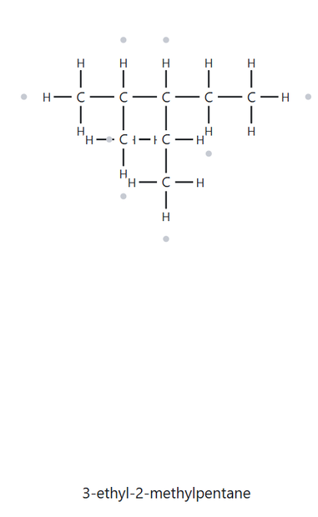
CARD B04 — NAME → STRUCTURE
Level: DEVELOPING Given Name: 3-ethyl-2-methylpentane
1. NAME DECODED
2. BOND-LINE STRUCTURE (THE ALKANE)
Parent: pentane → a 5-carbon chain
Substituents: methyl on C2; ethyl on C3
Expected formula: 5 + 1 + 2 = 8 C; open chain → C₈H₁₈
3. FORMULA CHECK
4. BACK-CHECK
Counted from the drawing: C₈H₁₈
Open Chain: CₙH₂ₙ₊₂ = C₈H₁₈. There are no halogens, so nothing is subtracted.
Returned by the Alkane:
3-ethyl-2-methylpentane
✓ Same as the given name
- VERIFICATION STRIP -
Parent Length Matches
Substituent Positions Match
Formula Agrees
Back-Check Recorded

Slide 15
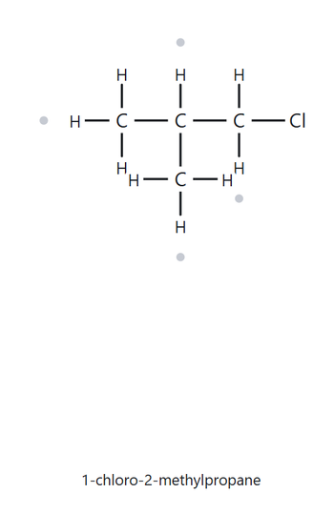
CARD B05 — NAME → STRUCTURE
Level: DEVELOPING Given Name: 1-chloro-2-methylpropane
1. NAME DECODED
2. BOND-LINE STRUCTURE (THE ALKANE)
Parent: propane → a 3-carbon open chain
Substituents: chloro on C1; methyl on C2
Expected formula: 3 + 1 = 4 C; open chain (alkane) → C₄H₁₀; Cl replaces one H → C₄H₉Cl
3. FORMULA CHECK
4. BACK-CHECK
Counted from the drawing: C₄H₉Cl
Open Chain: CₙH₂ₙ₊₂ = C₄H₁₀; minus one H for Cl = C₄H₉Cl
Returned by the Alkane:
1-chloro-2-methylpropane
✓ Same as the given name
- VERIFICATION STRIP -
Parent Length Matches
Substituent Positions Match
Formula Agrees
Back-Check Recorded

Slide 16
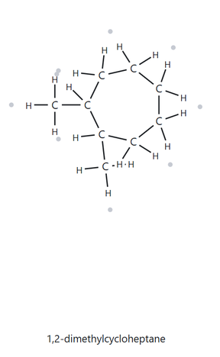
CARD B06 — NAME → STRUCTURE
Level: DEVELOPING Given Name: 1,2-dimethylcyclopentane
1. NAME DECODED
2. BOND-LINE STRUCTURE (THE ALKANE)
Parent: cyclopentane → a 5-carbon ring
Substituents: methyl on C1; methyl on C2
Expected formula: 5 + 1 + 1 = 7 C; one ring → CₙH₂ₙ = C₇H₁₄. There are no halogens, so nothing is subtracted. The expected formula is C₇H₁₄
3. FORMULA CHECK
4. BACK-CHECK
Counted from the drawing: C₇H₁₄
Open Chain: One ring: CₙH₂ₙ = C₇H₁₄. No halogens, so no H is replaced. The counted formula matches the expected formula.
Returned by the Alkane:
1,2-dimethylcyclopentane
✓ Same as the given name
- VERIFICATION STRIP -
Parent Length Matches
Substituent Positions Match
Formula Agrees
Back-Check Recorded

Slide 17
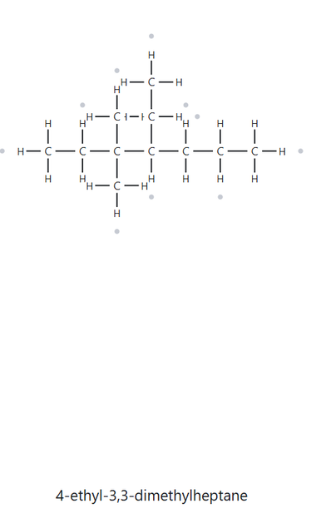
CARD B07 — NAME → STRUCTURE
Level: DEVELOPING Given Name: 4-ethyl-3,3-dimethylheptane
1. NAME DECODED
2. BOND-LINE STRUCTURE (THE ALKANE)
Parent: heptane, a 7-carbon open chain
Substituents: methyl on C1; methyl on C2
Expected formula: 5 ring carbons + 1 + 1 = 7 C. One ring means CₙH₂ₙ, so C₇H₁₄. There are no halogens, so no H is replaced
3. FORMULA CHECK
4. BACK-CHECK
Counted from the drawing: C11H24
Open Chain: CₙH₂ₙ₊₂ = C₁₁H₍₂×₁₁₊₂₎ = C₁₁H₂₄. The counted formula matches the general formula, so the drawing is consistent with the name.
Returned by the Alkane:
4-ethyl-3,3-dimethylheptane
✓ Same as the given name
- VERIFICATION STRIP -
Parent Length Matches
Substituent Positions Match
Formula Agrees
Back-Check Recorded

Slide 18
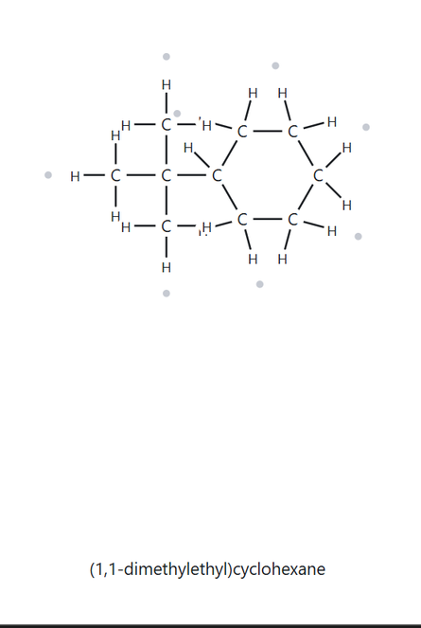
CARD B08 — NAME → STRUCTURE
Level: CHALLENGE Given Name: tert-butylcyclohexane
1. NAME DECODED
2. BOND-LINE STRUCTURE (THE ALKANE)
Parent: cyclohexane → a 6-carbon ring
Substituents: tert-butyl on C1. A single substituent on a ring, so the locant “1” is not written in the name. The tert-butyl group is -C(CH₃)₃, which has 4 carbons.
Expected formula: 6 + 4 = 10 C; one ring → C10H20; the substituent replaces one H on the ring, and the substituent is itself an alkyl group.
3. FORMULA CHECK
4. BACK-CHECK
Counted from the drawing: C10H20
Open Chain: CₙH₂ₙ₊₂ = C10H20. No halogens, so nothing is subtracted. The drawing matches the formula.
Returned by the Alkane:
(1,1-dimethylethyl)cyclohexane
X Not the same as the given name
- VERIFICATION STRIP -
Parent Length Matches
Substituent Positions Match
Formula Agrees
Back-Check Recorded

Slide 19
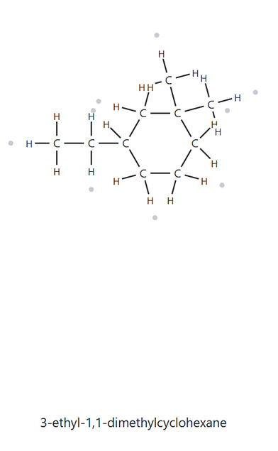
CARD B09 — NAME → STRUCTURE
Level: CHALLENGE Given Name: 3-ethyl-1,1-dimethylcyclohexane
1. NAME DECODED
2. BOND-LINE STRUCTURE (THE ALKANE)
Parent: cyclohexane → a 6-carbon ring.
Substituents: two methyl groups on C1 (both on the same carbon); ethyl on C3
Expected formula: 6 (ring) + 2 (two methyls) + 2 (ethyl) = 10 C; one ring → CₙH₂ₙ = C₁₀H₂₀. There are no halogens, so no H is removed.
3. FORMULA CHECK
4. BACK-CHECK
Counted from the drawing: C10H20
One ring: CₙH₂ₙ = C₁₀H₂₀ ✓ (the count matches the general formula, so the drawing is consistent with the name).
Returned by the Alkane:
3-ethyl-1,1-dimethylcyclohexane
✓ Same as the given name
- VERIFICATION STRIP -
Parent Length Matches
Substituent Positions Match
Formula Agrees
Back-Check Recorded

Slide 20
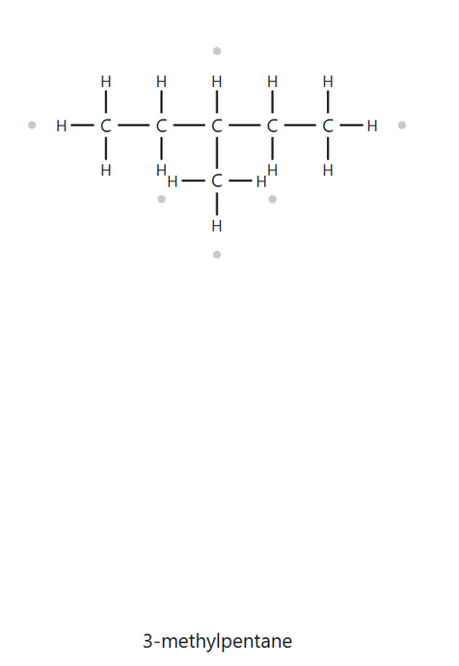
CARD B10 — NAME → STRUCTURE
Level: CHALLENGE Given Name: 2-ethylbutane
1. NAME DECODED
2. BOND-LINE STRUCTURE (THE ALKANE)
Parent: butane → a 4-carbon open chain
Substituents: ethyl on C2
Expected formula: 4 + 2 = 6 C; open chain → CₙH₂ₙ + 2 = C6H14.
3. FORMULA CHECK
4. BACK-CHECK
Counted from the drawing: C6H14
One ring: CₙH₂ₙ + 2 = C6H14. There are no halogens, so no H is replaced.
Returned by the Alkane:
3-methylpentane
X Not the same as the given name
- VERIFICATION STRIP -
Parent Length Matches
Substituent Positions Match
Formula Agrees
Back-Check Recorded

