Slide 1
CDet Update
June 16, 2025

Slide 2
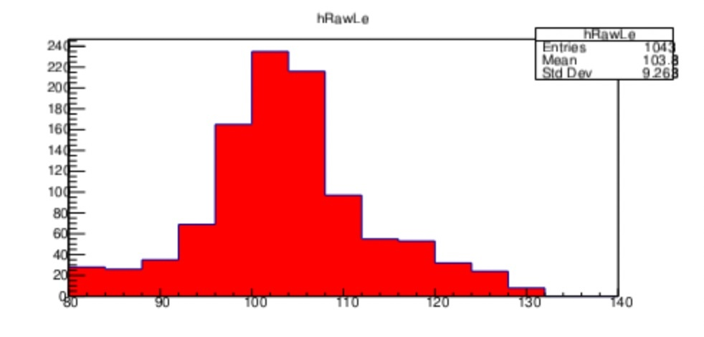
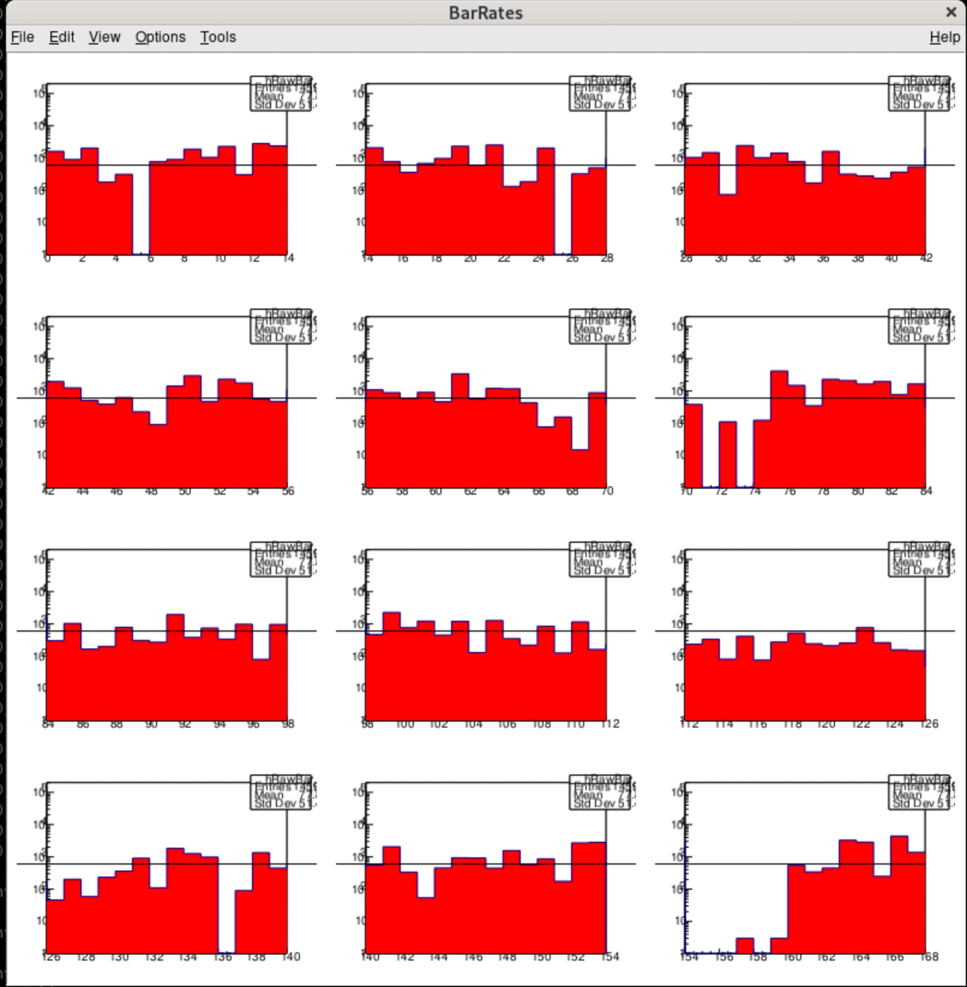
CDet Readout/Detector Performance
Latency = 3216 ns, Window = 52 ns
Clear peak in timing spectra – established at low current running
Using trigger reference signal in additional vfTDC module – reasonable vtTDC timing calibration achieved; resolution ~10’s of ps (still work in progress)
Updated vfTDC firmware to use block readout to solve deadtime/livetime issues
Reasonable HV/threshold values determined with HV scan at lower currents (still a few ”missing” bars at upper edge of second layer of CDet, as well as a few “hot” bars that have HV disabled)
LE Time (ns)
Hit Rates for All CDet Bars

Slide 3
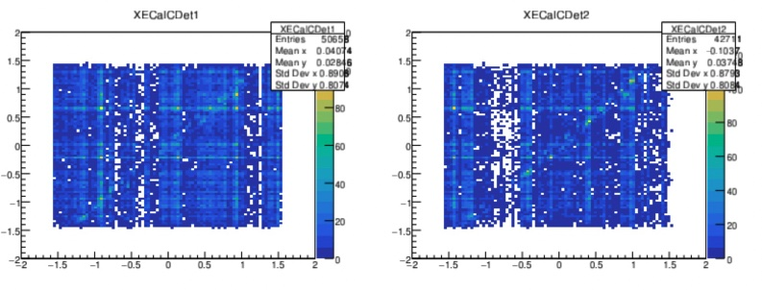
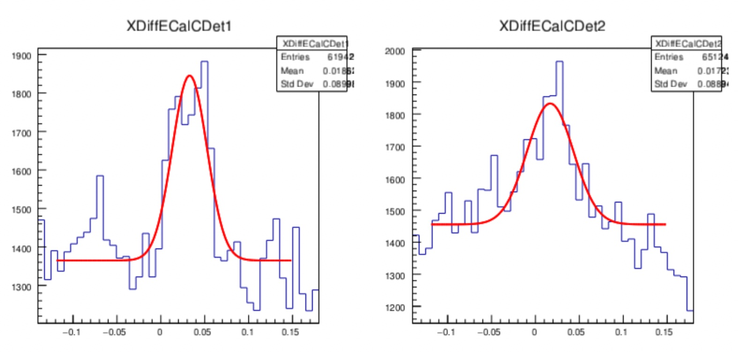
ECal Position Correlations
Observe clear correlation between CDet X-position of hit paddle and determined ECal X-position of best cluster
Signal-to-noise ratio ~0.15 per layer after all timing and multiplicity cuts applied
At 20uA on LH2, approximately 800 raw CDet TDC hits per event; filtering implemented in SBSCDet class to use LE timing and Time-Over-Threshold cuts -> reduction to ~30 TDC hits per event.
Working in progress -> identify CDet “clusters” based on hits in adjacent paddles.

