Slide 1
Jan 27th Update
Ben Spaude

Slide 2
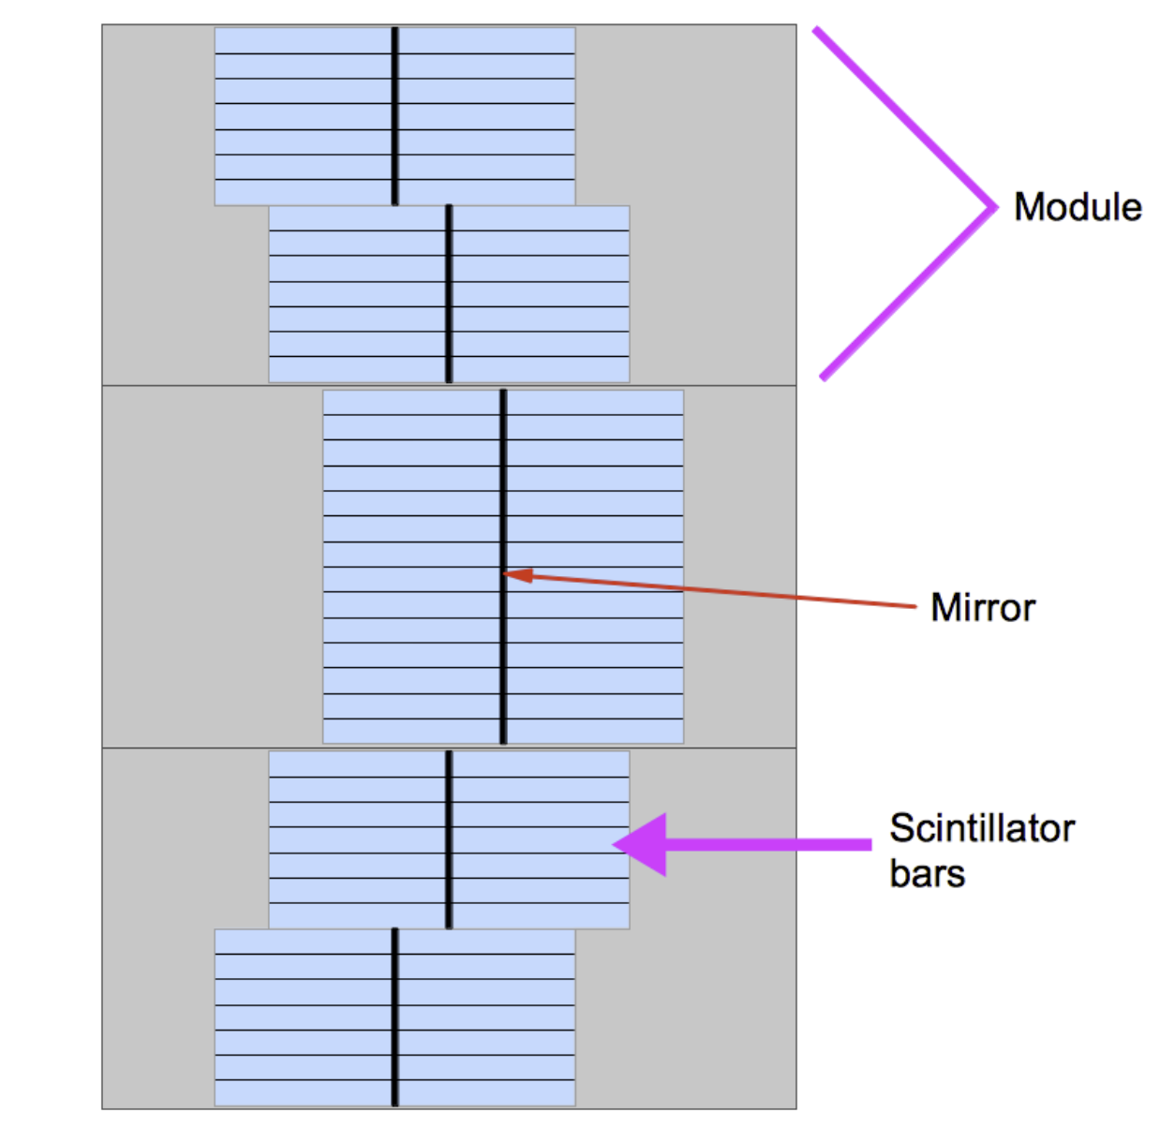
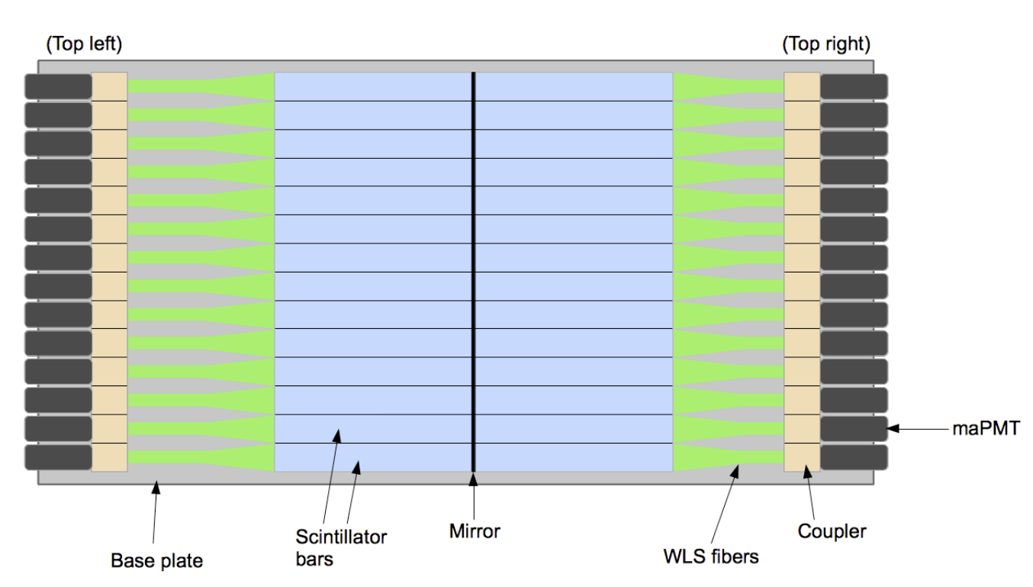
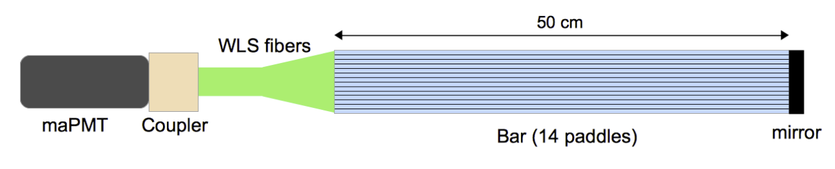
Coordinate Detector
Broken into layers, modules, bars and paddles
Paddles vs Pixels
maPMT 16 pixels but only 14 paddles (2 unused)
2352 (2688) total channels (pixels)

Slide 3
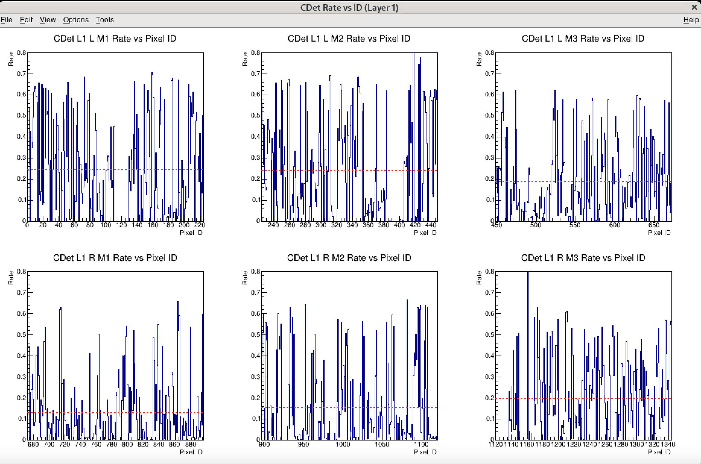
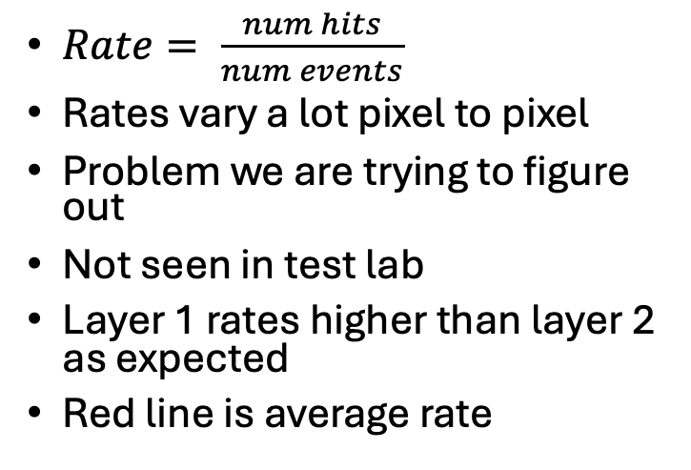
CDet Rates
Run 5811, ~627k events
Tot >1ns
$Rate= \frac{num hits}{num events}$
Rates vary a lot pixel to pixel
Problem we are trying to figure out
Not seen in test lab
Layer 1 rates higher than layer 2 as expected
Red line is average rate

Slide 4
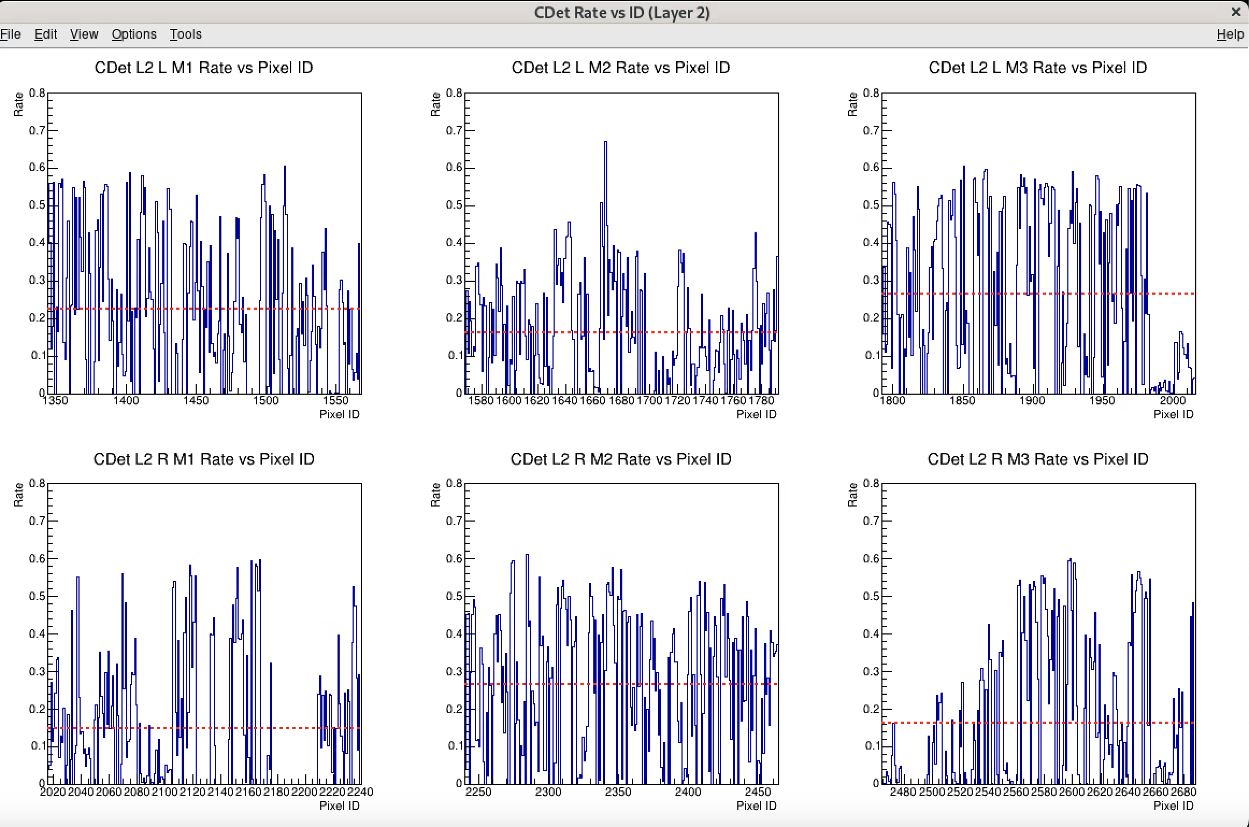
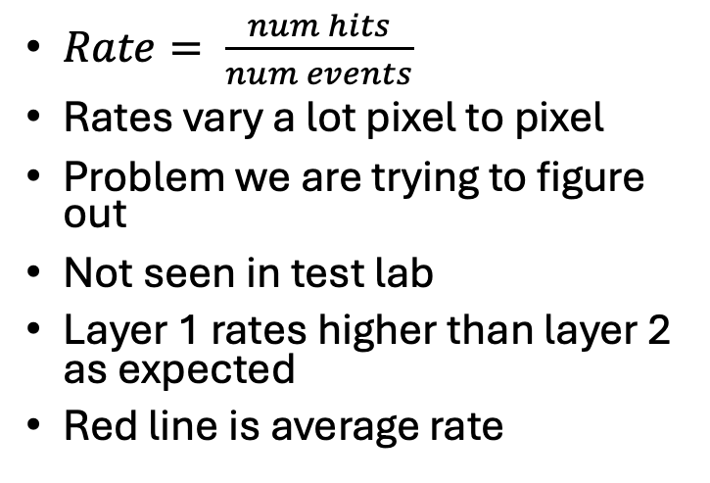
CDet Rates
Run 5811, ~627k events
Run 5811, ~627k events
Tot >1ns
$Rate= \frac{num hits}{num events}$
Rates vary a lot pixel to pixel
Problem we are trying to figure out
Not seen in test lab
Layer 1 rates higher than layer 2 as expected
Red line is average rate

Slide 5
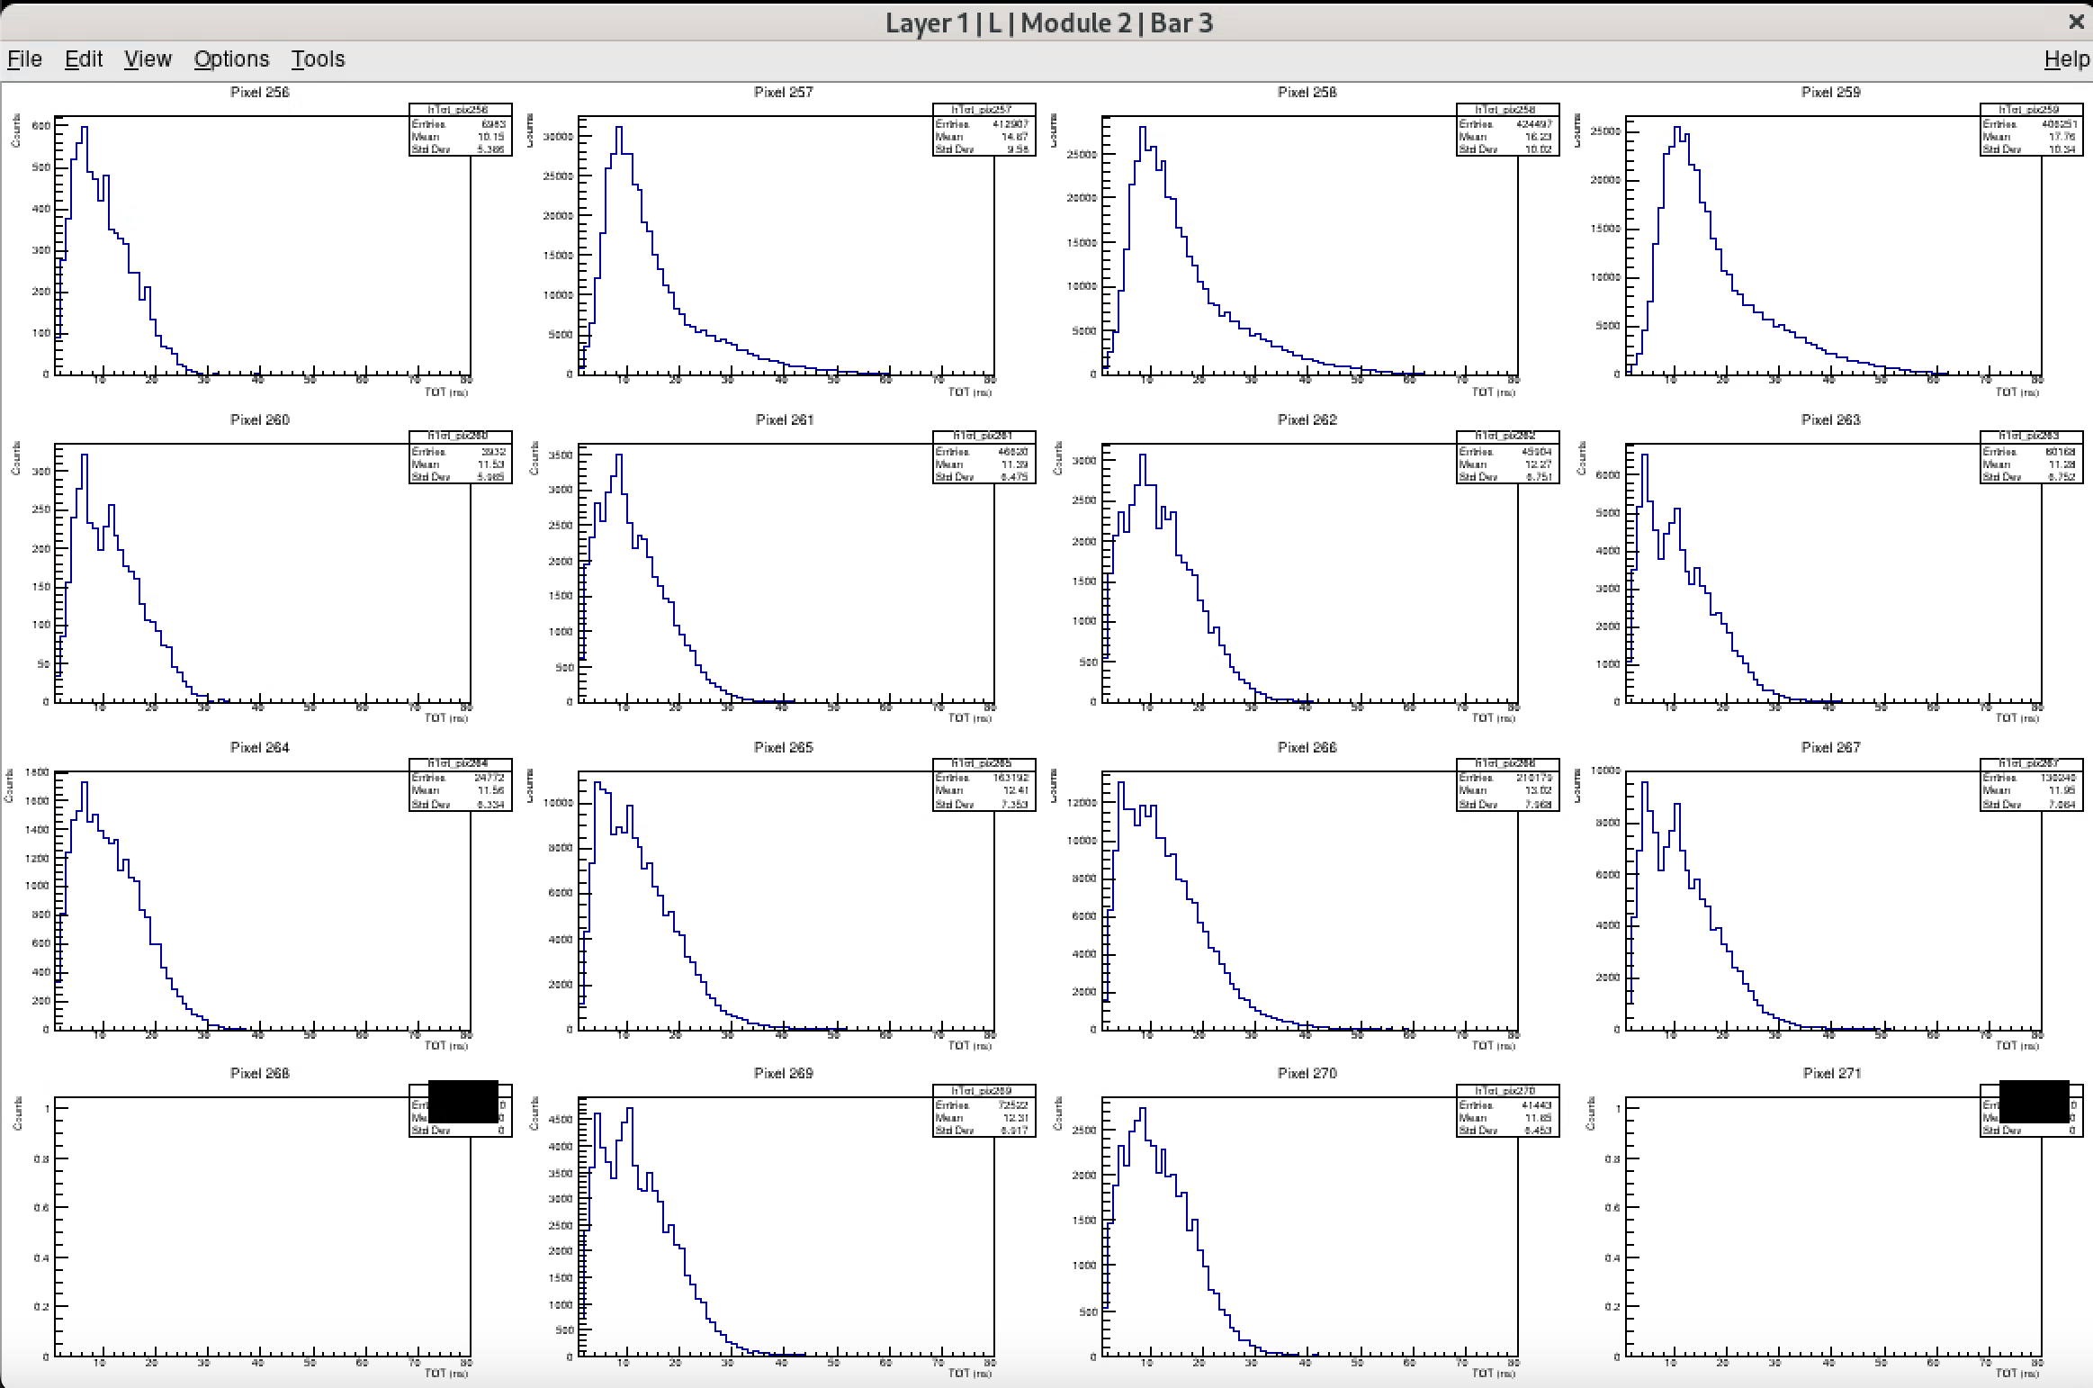
CDet Tot (Pixels 256-271)
7k
413k
424k
408k
Similar shapes for each set of 4
Shapes seem to indicate similar gain
Source of rate probably not from widely varying gain
Sensitive to noise threshold?
4k
47k
46k
80k
25k
163k
210k
130k
73k
41k
UNUSED
UNUSED

Slide 6
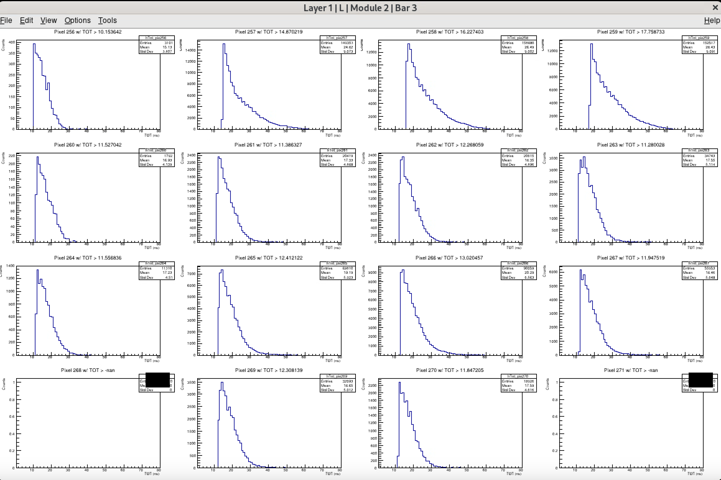
CDet Tot w/ average tot cut
3k
149k
159k
152k
2k
20k
20k
35k
11k
70k
90k
56k
32k
19k

Slide 7
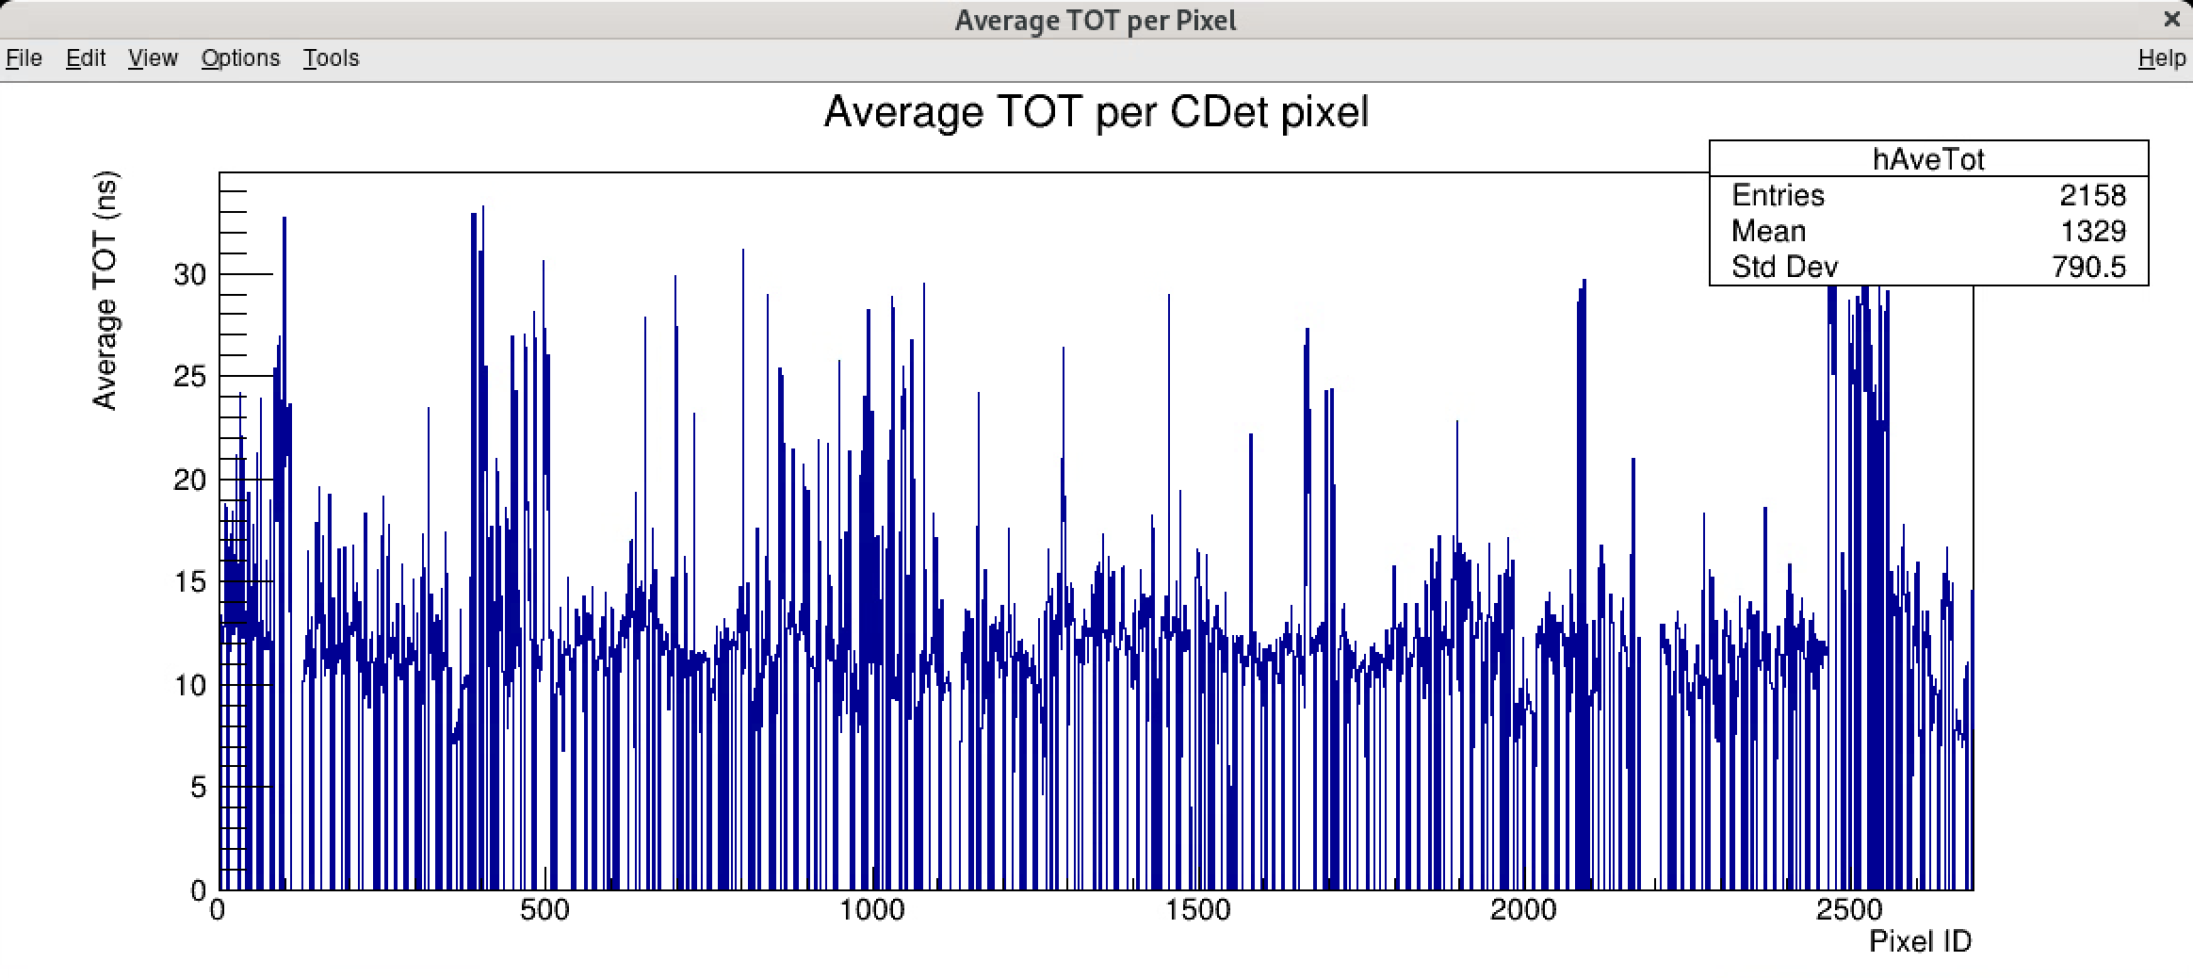
Average Tot
Average ~ 12-15ns

Slide 8
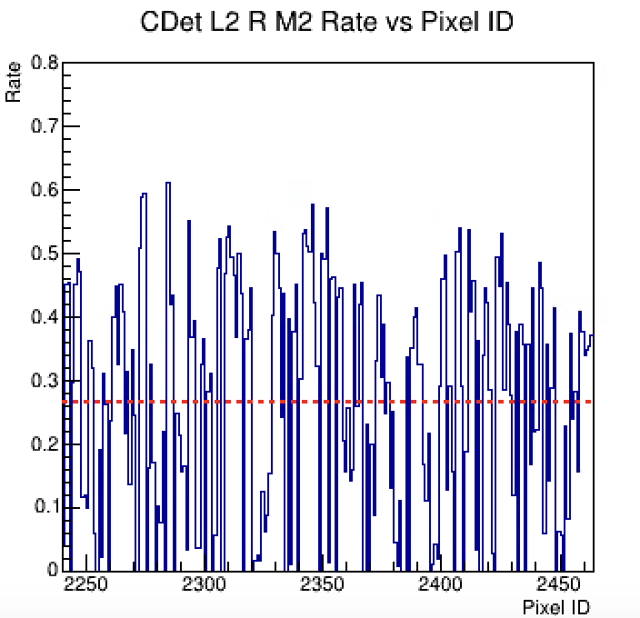
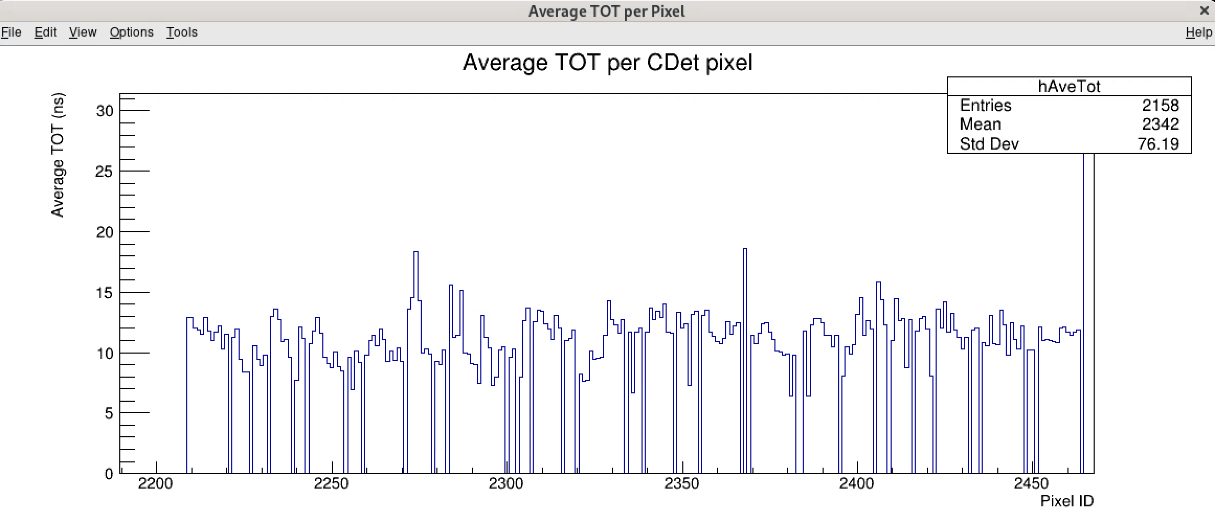
Average Tot

Slide 9
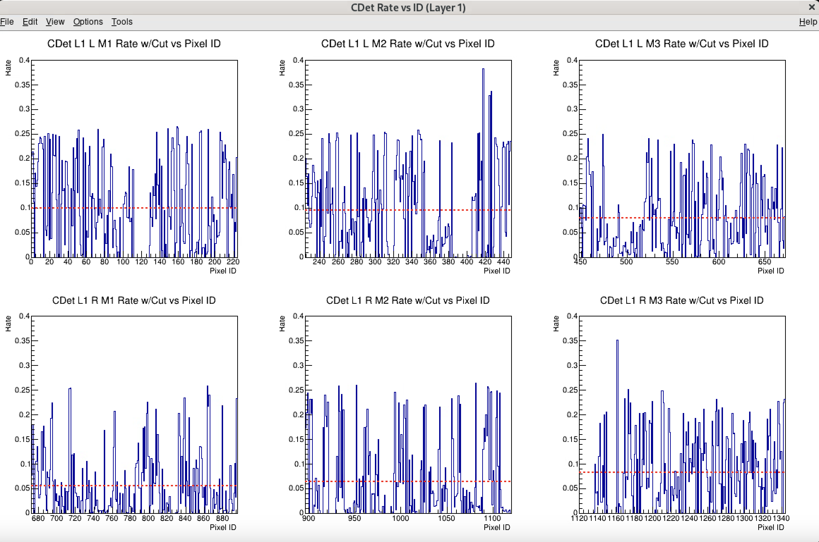
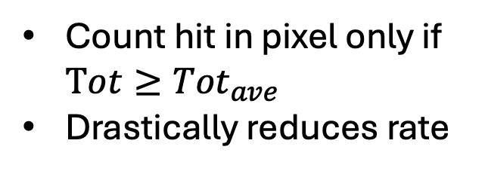
CDet Rates w/ average TOT cut
Count hit in pixel only if $Tot≥{Tot}_{ave}$
Drastically reduces rate

Slide 10
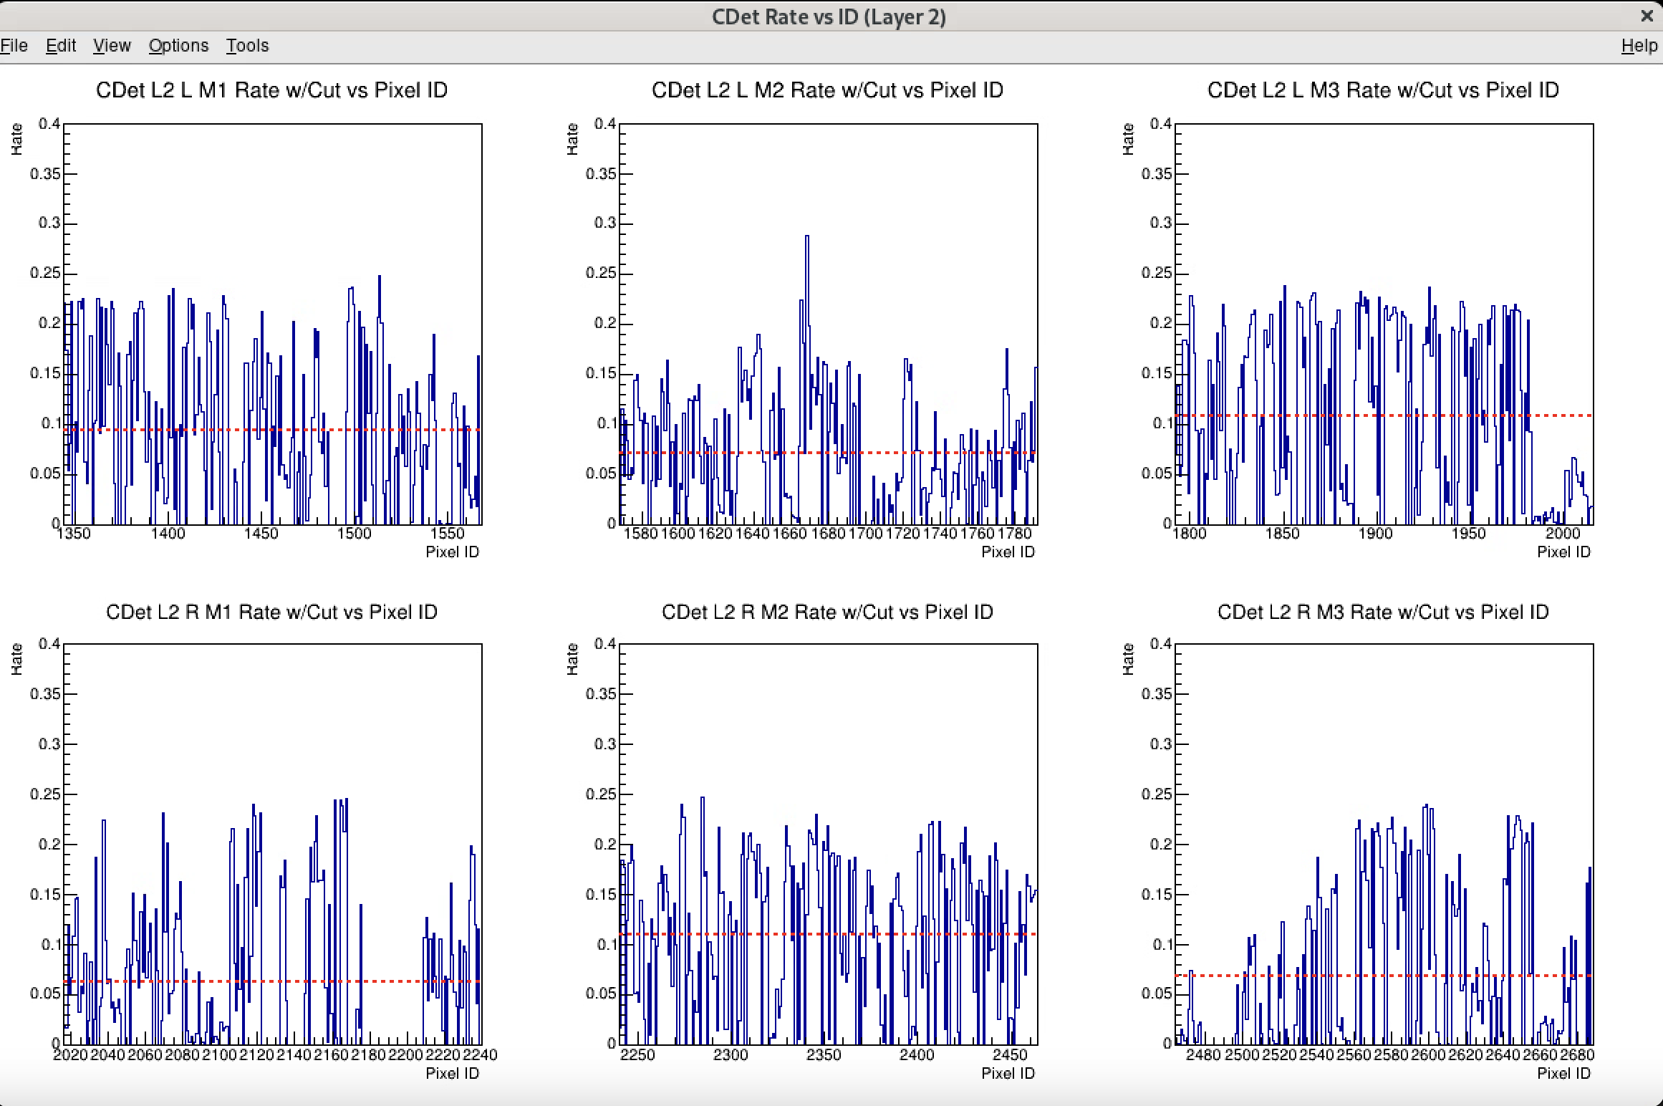
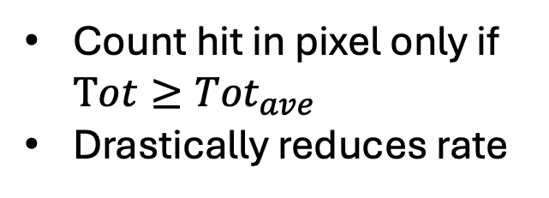
CDet Rates w/ average TOT cut
Count hit in pixel only if $Tot≥{Tot}_{ave}$
Drastically reduces rate

Slide 11
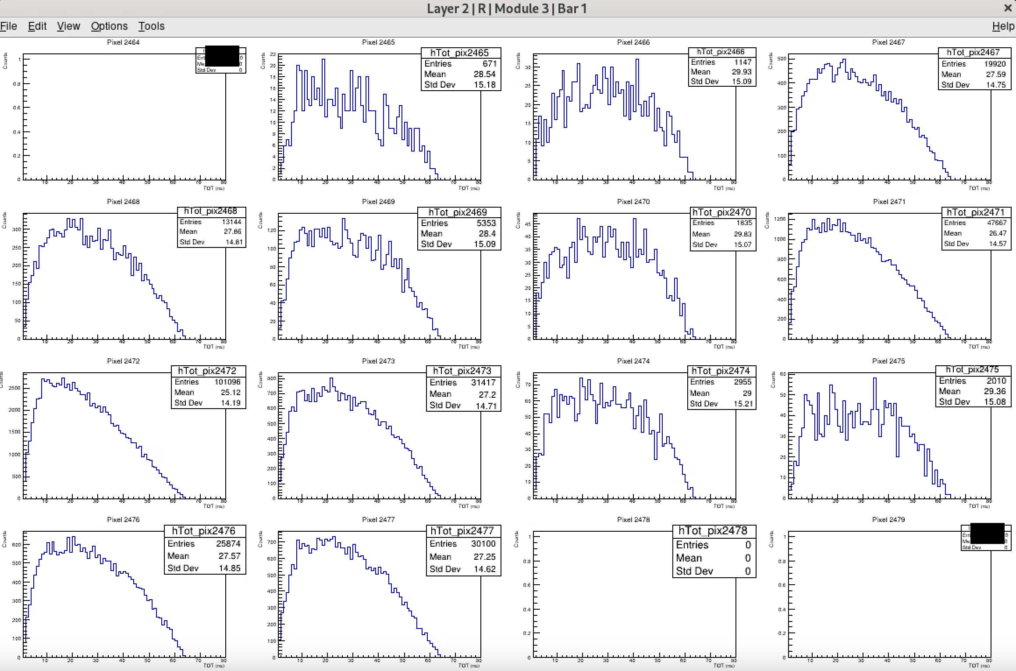
BACKUP

