Slide 1
Oct 24th Update
Ben Spaude

Slide 2
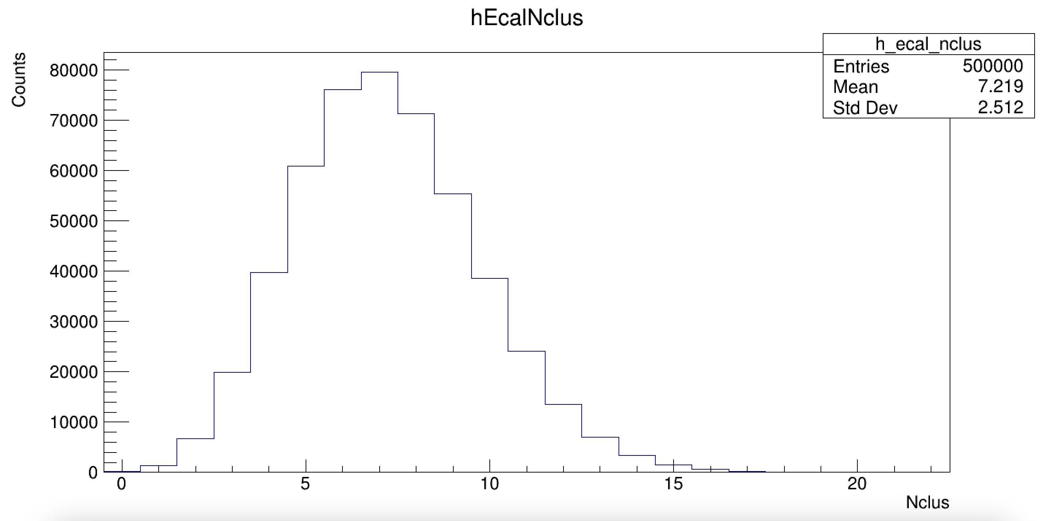
Number of Cluster
Kin 3 Cluster size ~ 10-15 blocks
One block 4.25x4.25x34cm³
One CDet paddle 0.5x50x4cm³
One ecal block covers ~8 paddles

Slide 3
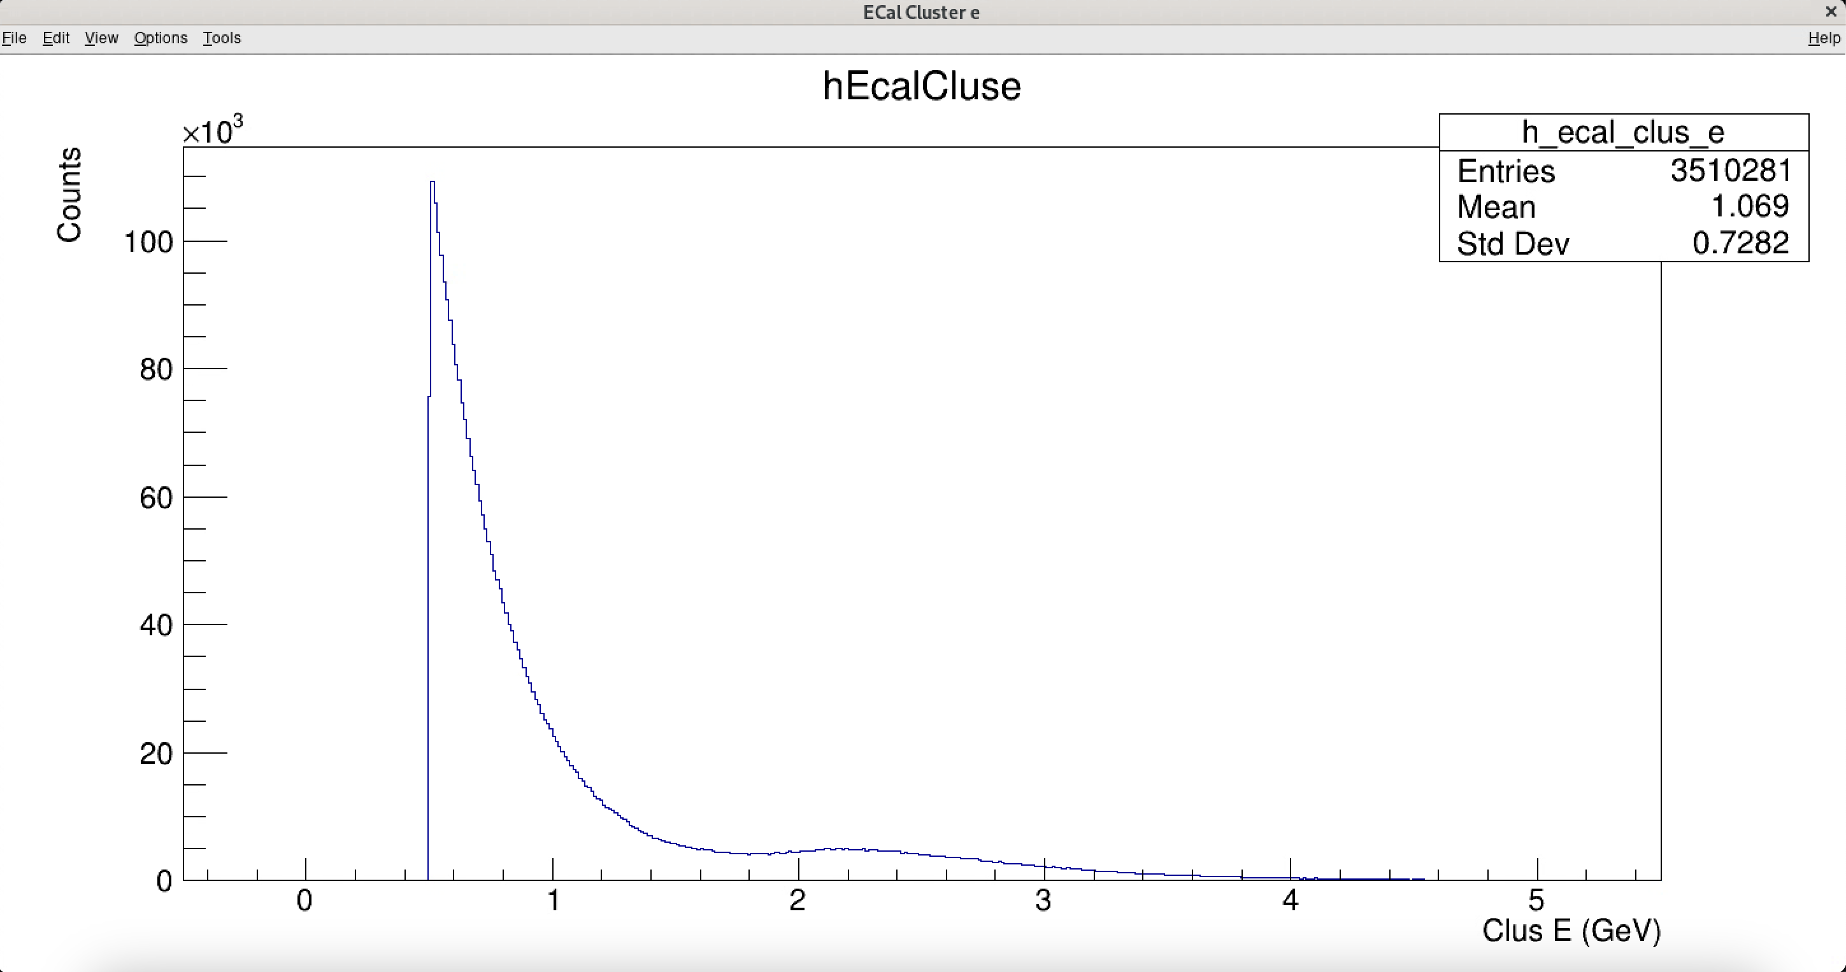
Ecal Cluster Energy
https://logbooks.jlab.org/files/2025/08/4439803/summaryPlots_5811_ECal.pdf

Slide 4
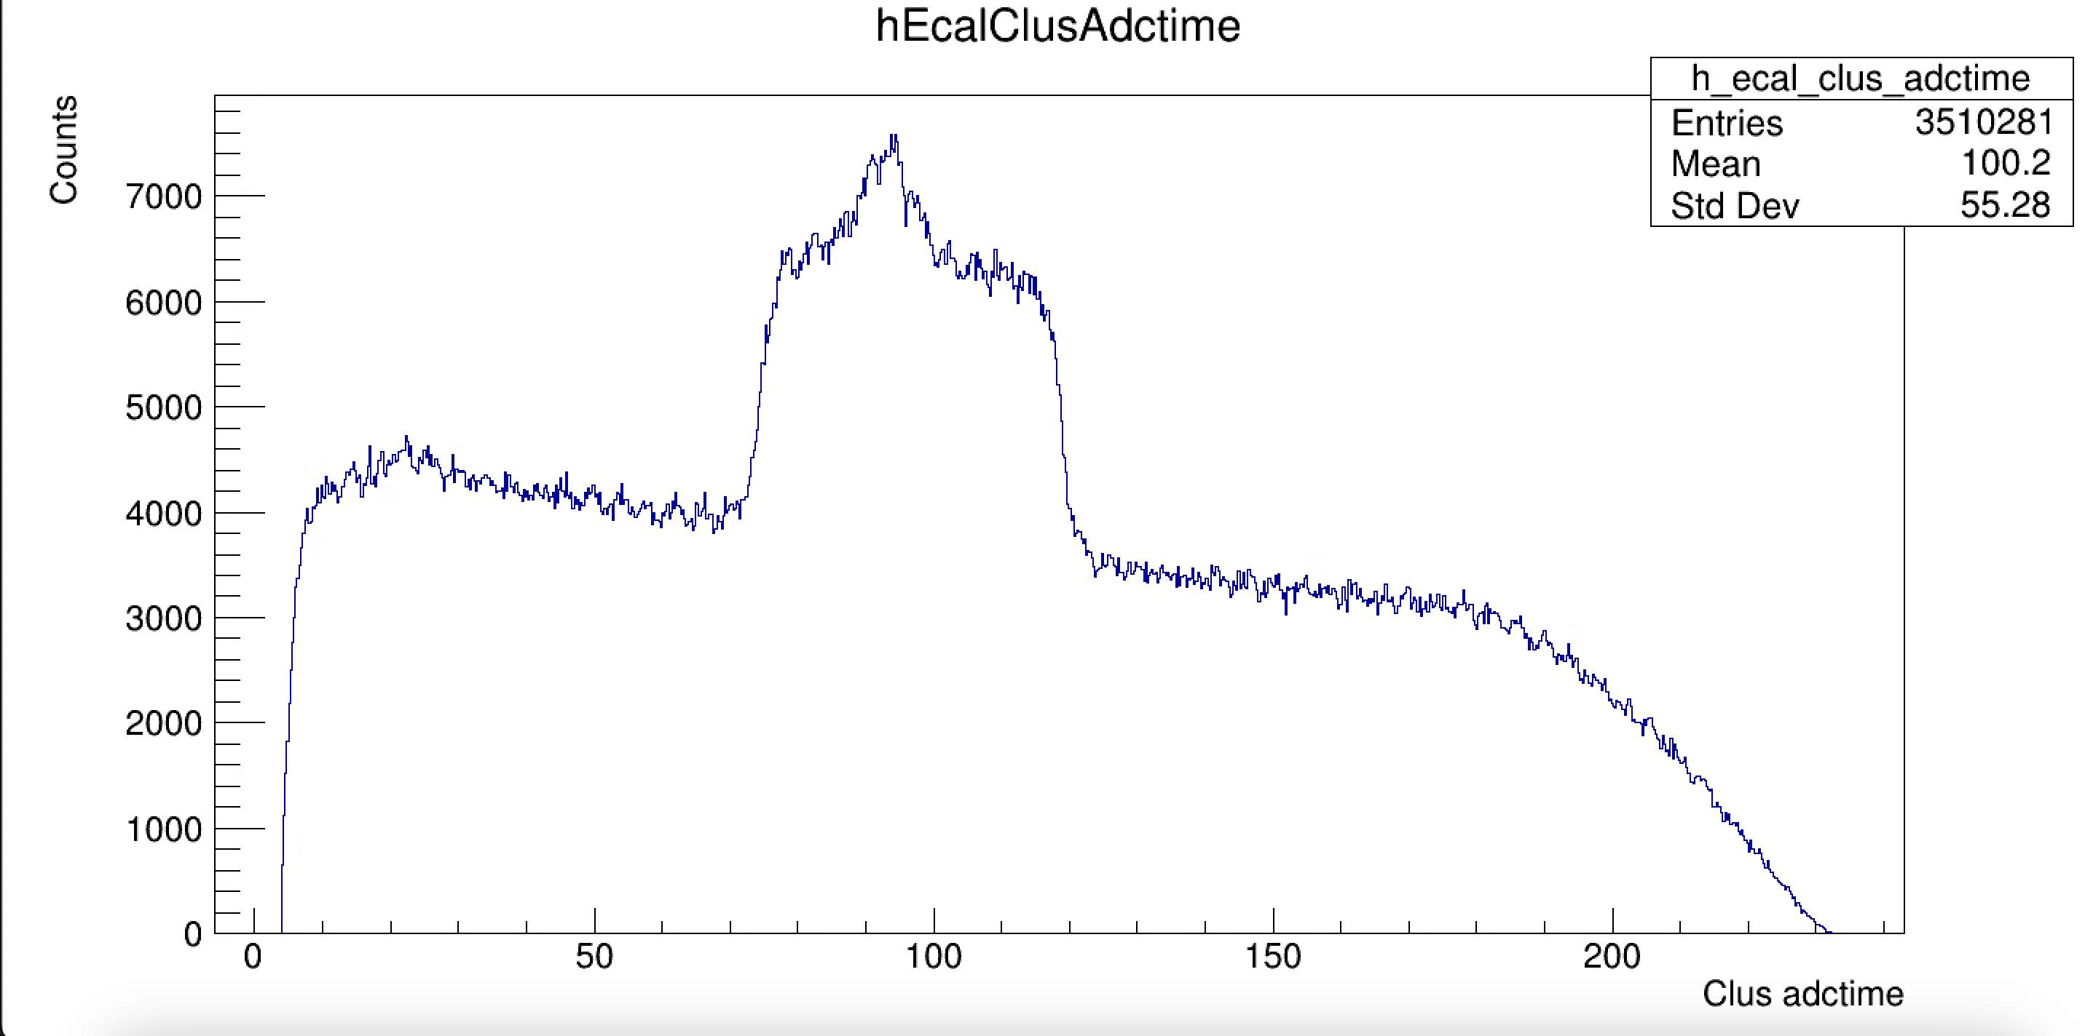
Cluster ADC Time
https://logbooks.jlab.org/files/2025/08/4446407/summaryPlots_5982_ECal.pdf

Slide 5
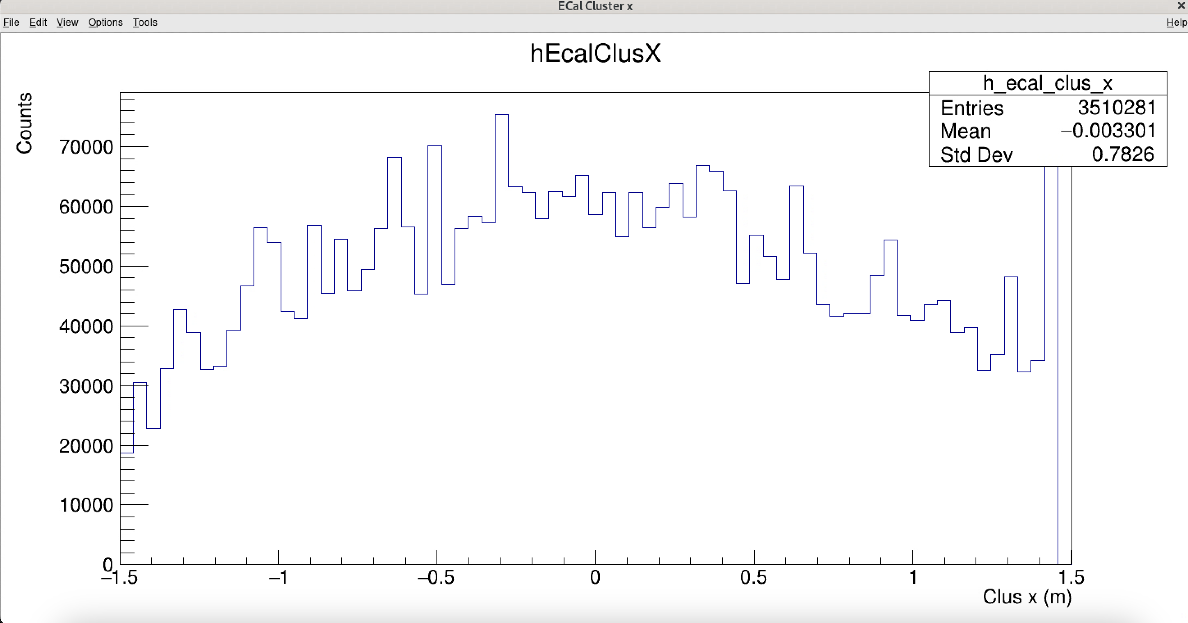
Cluster x

Slide 6
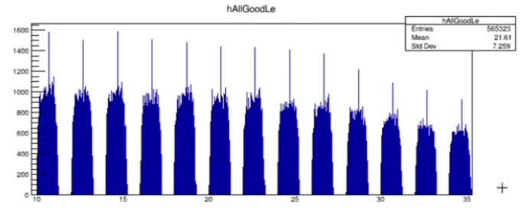
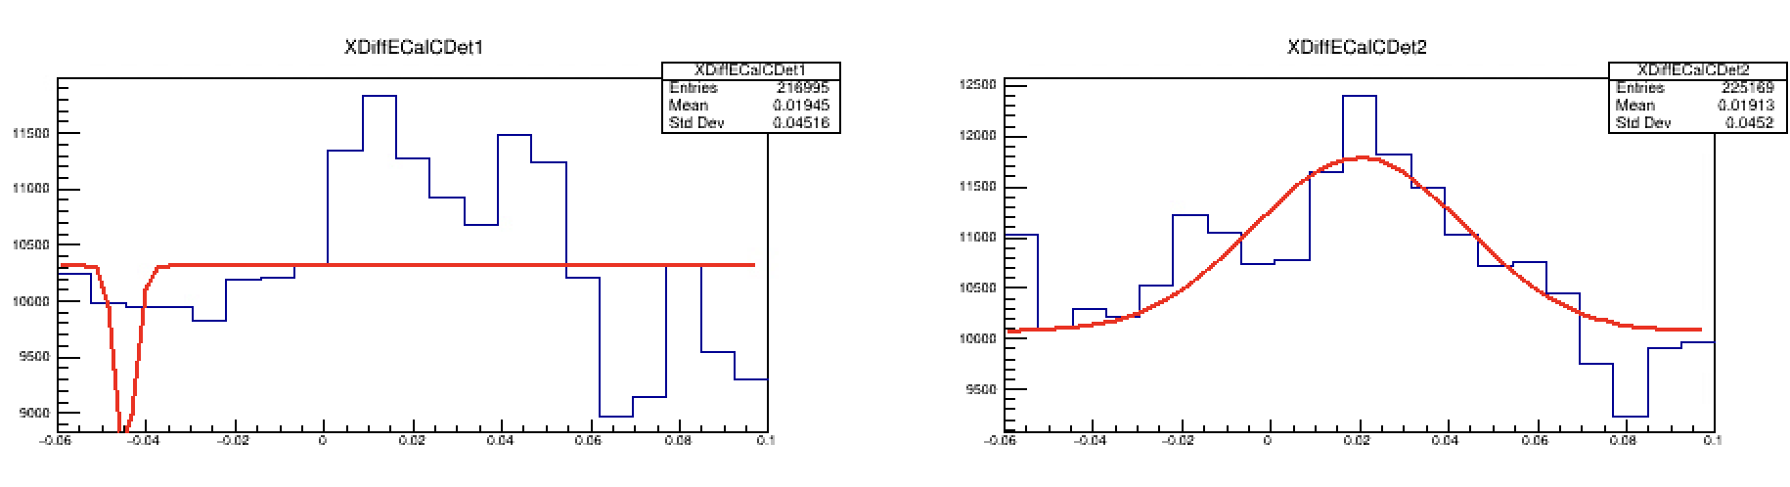
Switching Gears back to CDet
Look at xdiff plots, but for ~2ns chunks
Should allow us to see where the “real” events are

Slide 7
Oct 29th Quick Update
Ben Spaude

Slide 8
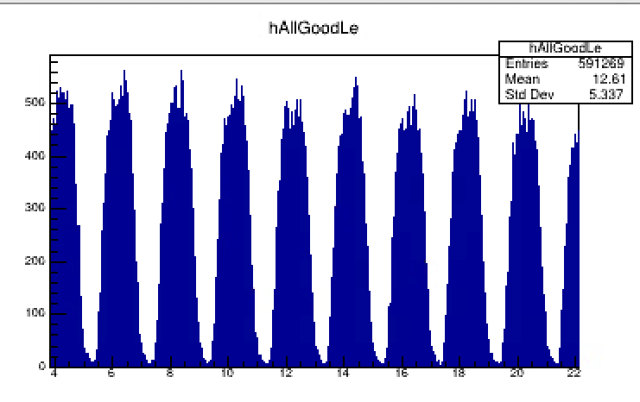
Tdc = coarse*4000+two_ns*2000 + fine*10

Slide 9
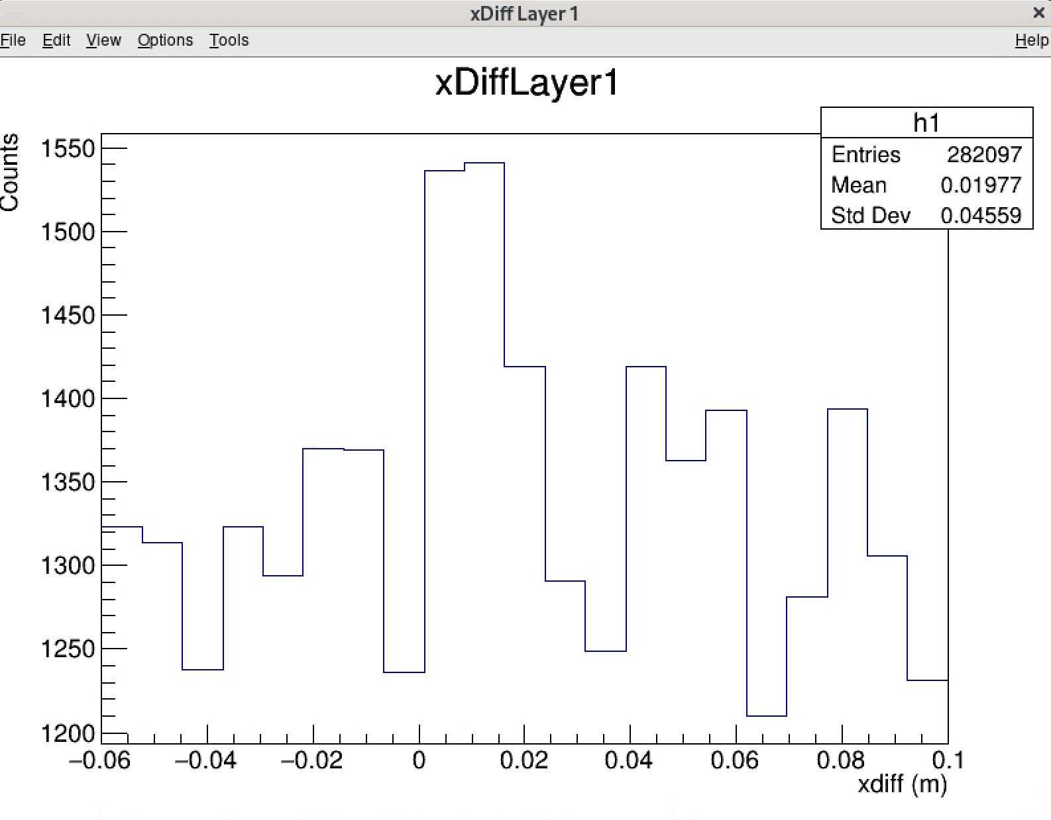
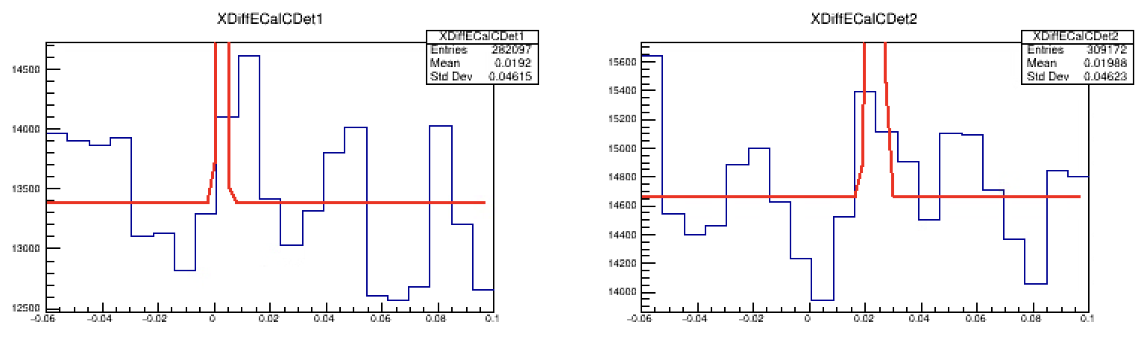

Slide 10
