Slide 1
Sept 17th Update
Ben Spaude

Slide 2
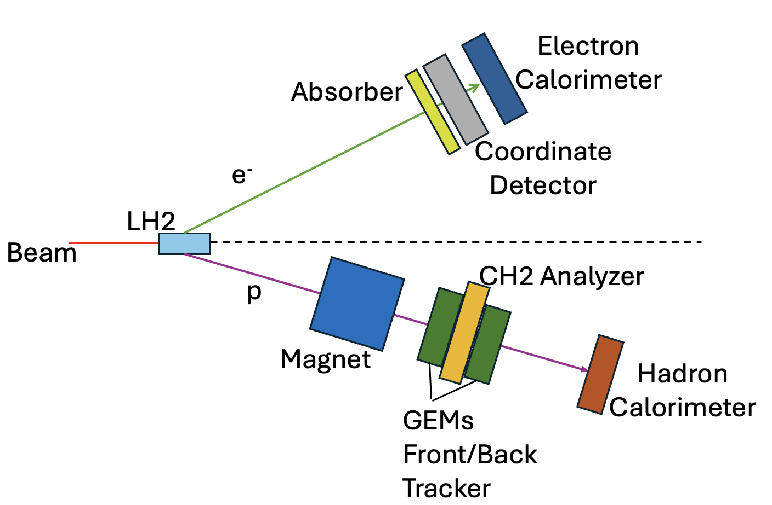
Experimental Setup & CDet Role
Elastic ep scattering
Form factor ratio of proton at 11.1 GeV²
Supplemental tracking detector for e’
Allows for measurement of out-of-plane angle of scattered electrons

Slide 3
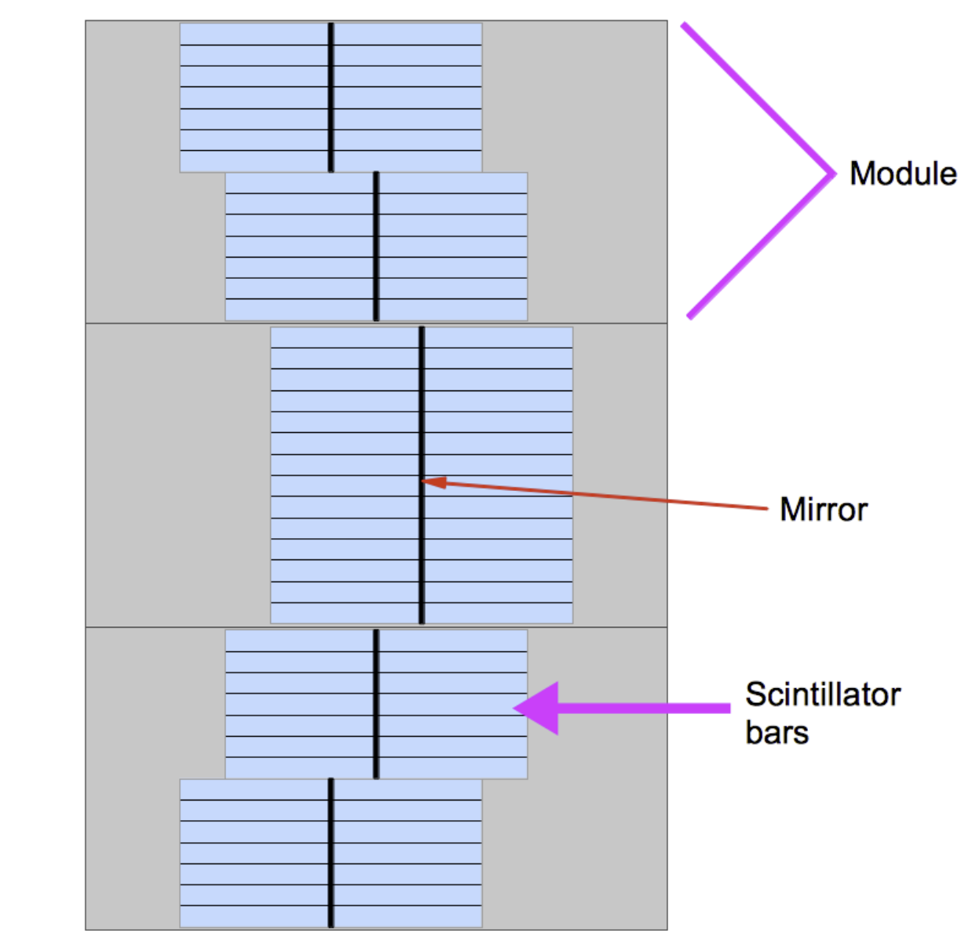
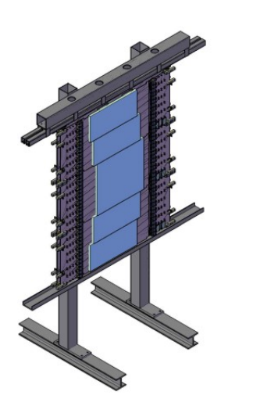
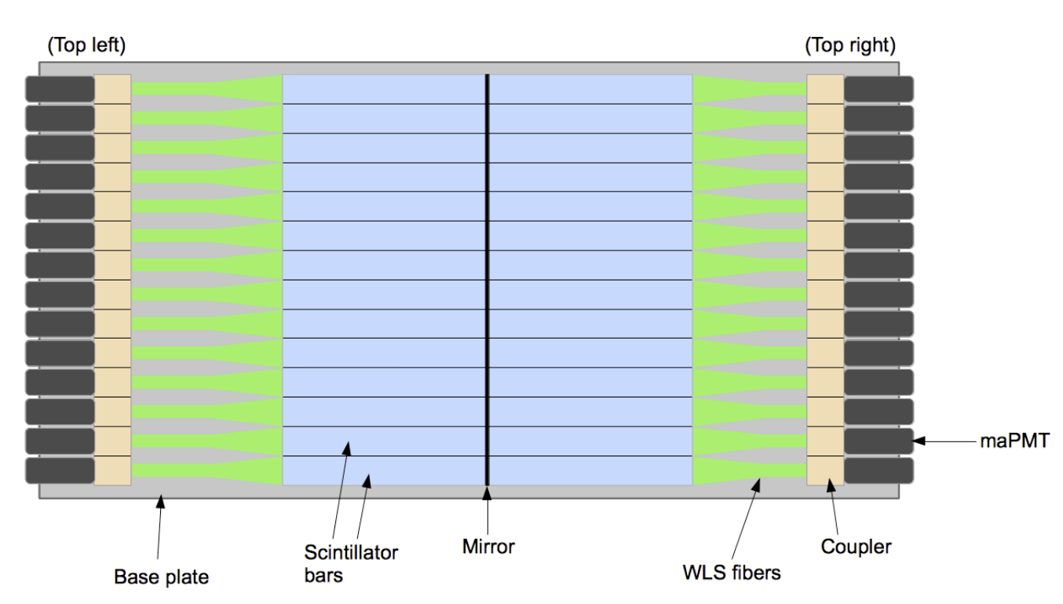
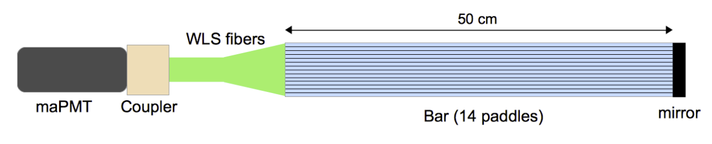
Coordinate Detector
Plastic Scintillating Detector (Vinyl toluene)
Broken into layers, modules, bars and paddles
maPMT & NINO Cards
Can utilize ADC or TDC signals
2352 total channels

Slide 4
DAQ
LVDS (detector)-> ECL (repeater) -> VETROC (vme)
vfTDC firmware
Two triggers
Coincidence trigger between ECal and HCal timing
Coincidence trigger between ECal and HCal timing and position
LH2 Target

Slide 5
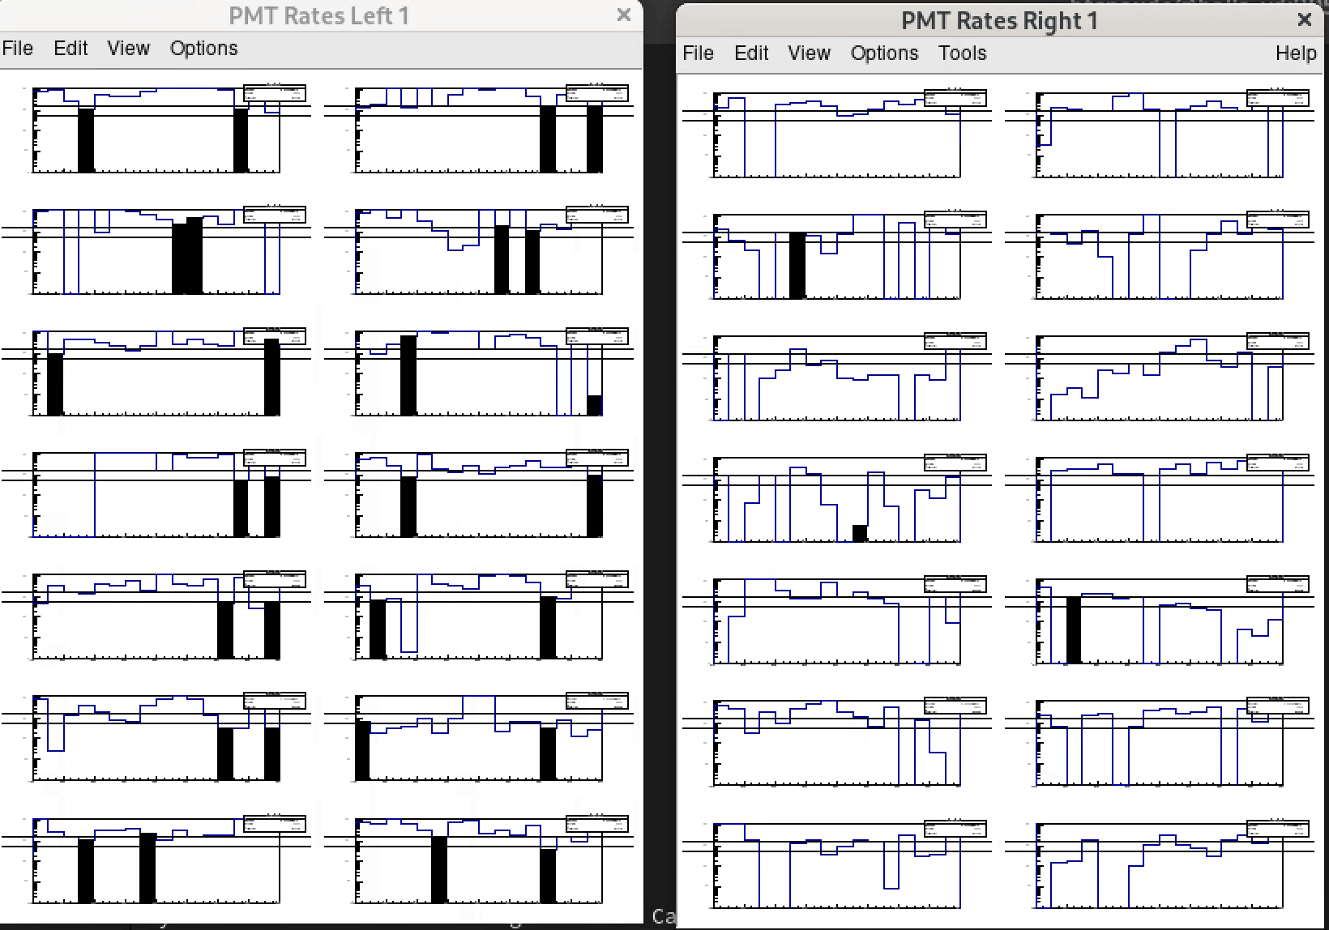
Gain Matching
Counts vs paddle (pixel)
1 side of module 1 for layer 1
Unused pixels in black
Limited ability to gain match by maPMT

Slide 6
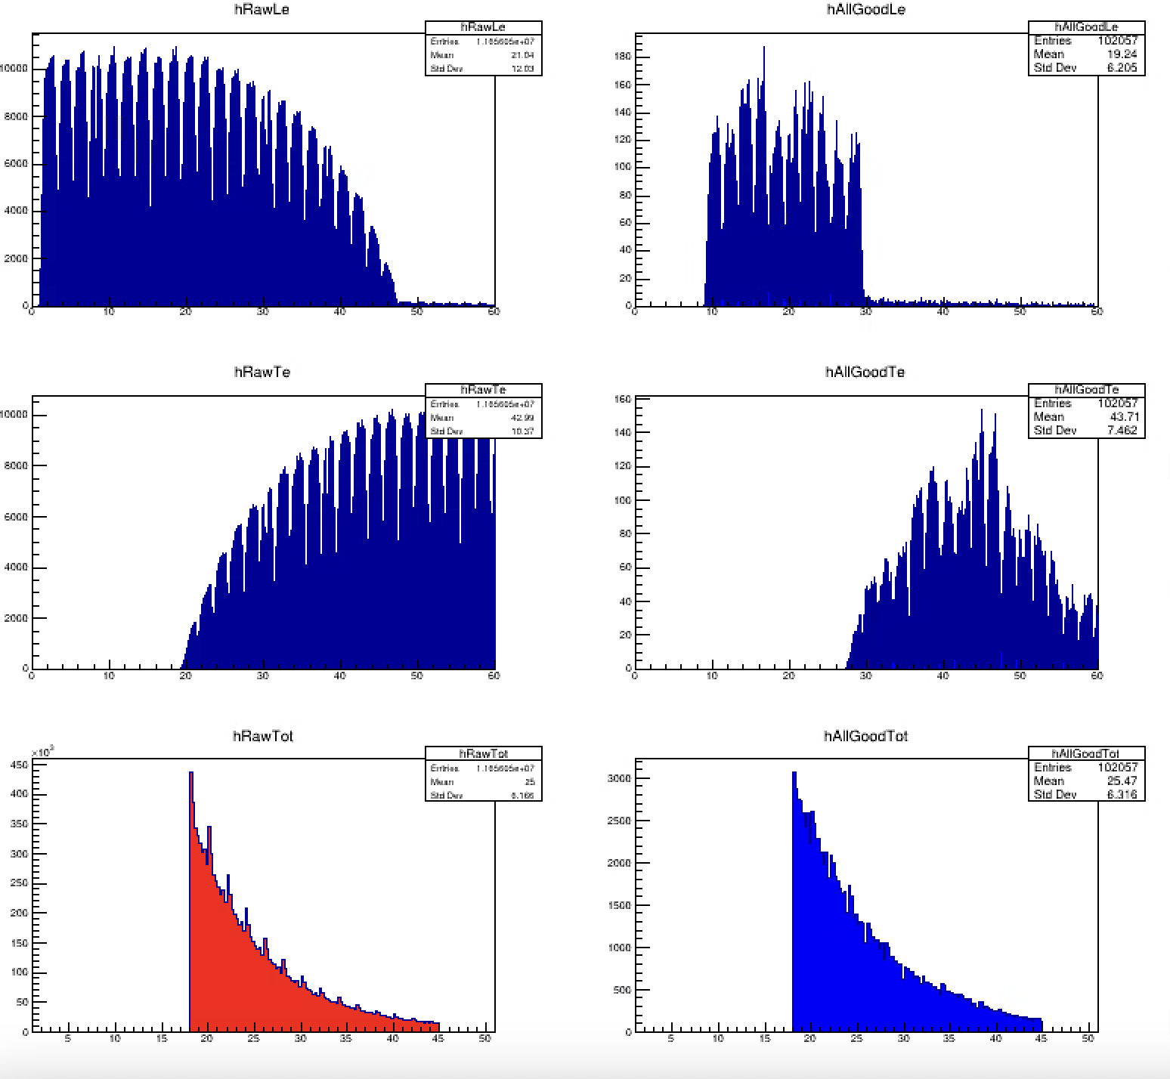
Timing Calibrations
Need to calibrate LE time in every paddle
Timewalk correction
Time Resolution
Need good statistics
0<LE<60ns
18<TOT<45ns

Slide 7
Performance and Calibrations
Efficiency calculations
Clustering algorithm
Region of interest
Position resolution*

