Slide 1
rates

Slide 2
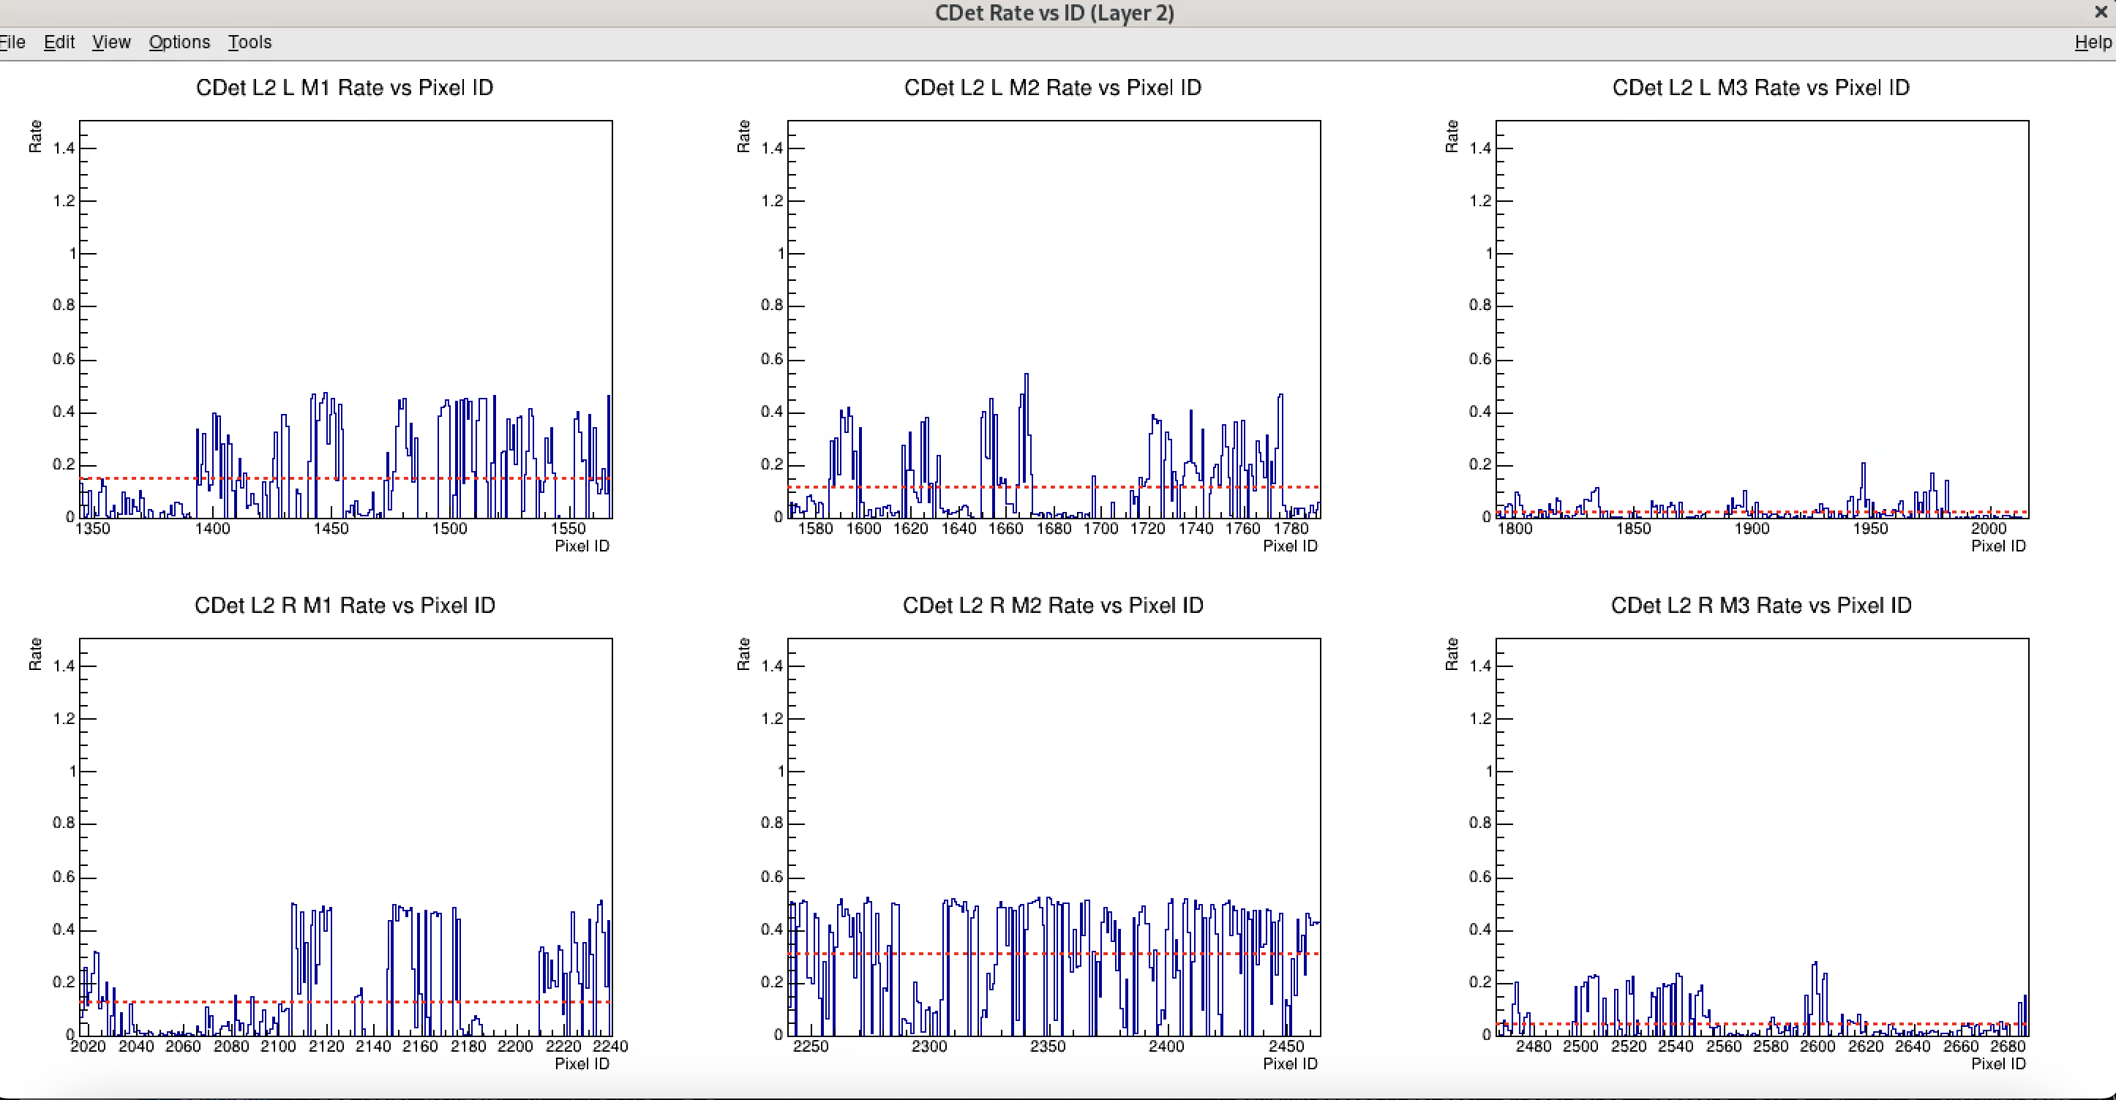
Run 3640 @ 5uA LH2

Slide 3
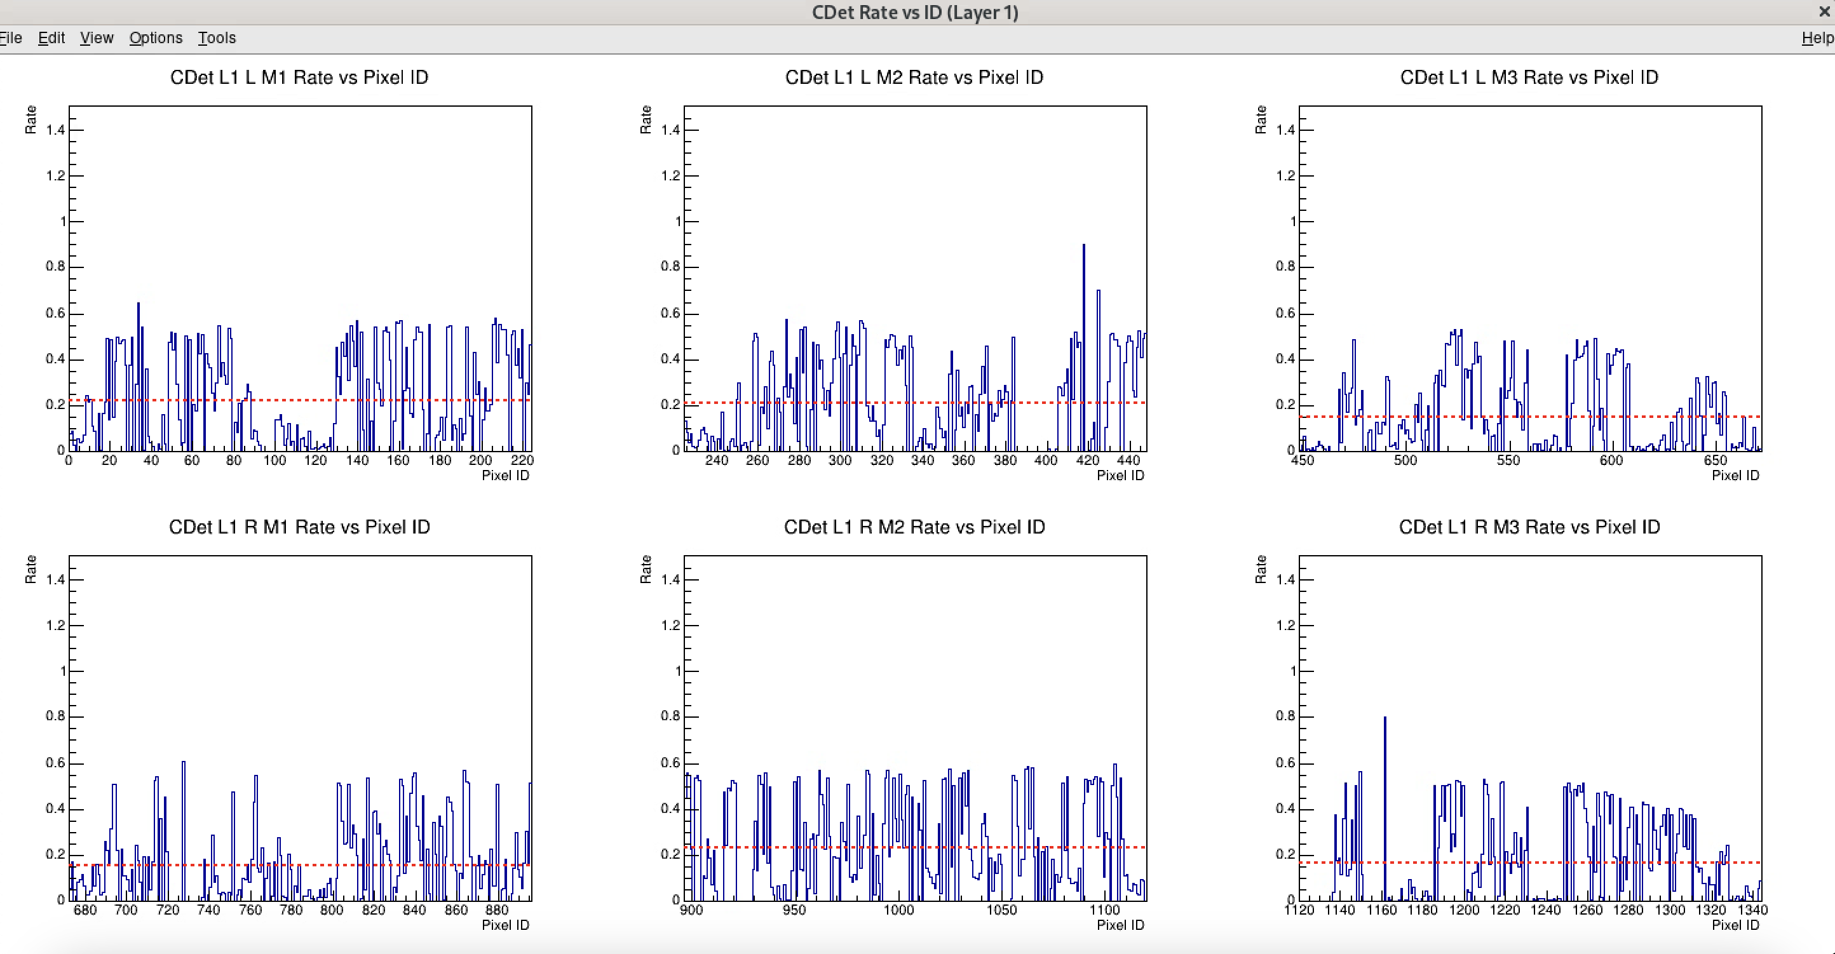

Slide 4
5811 @

