Slide 1
Cdet vs Ecal Timing Comparison
Ben Spaude

Slide 2
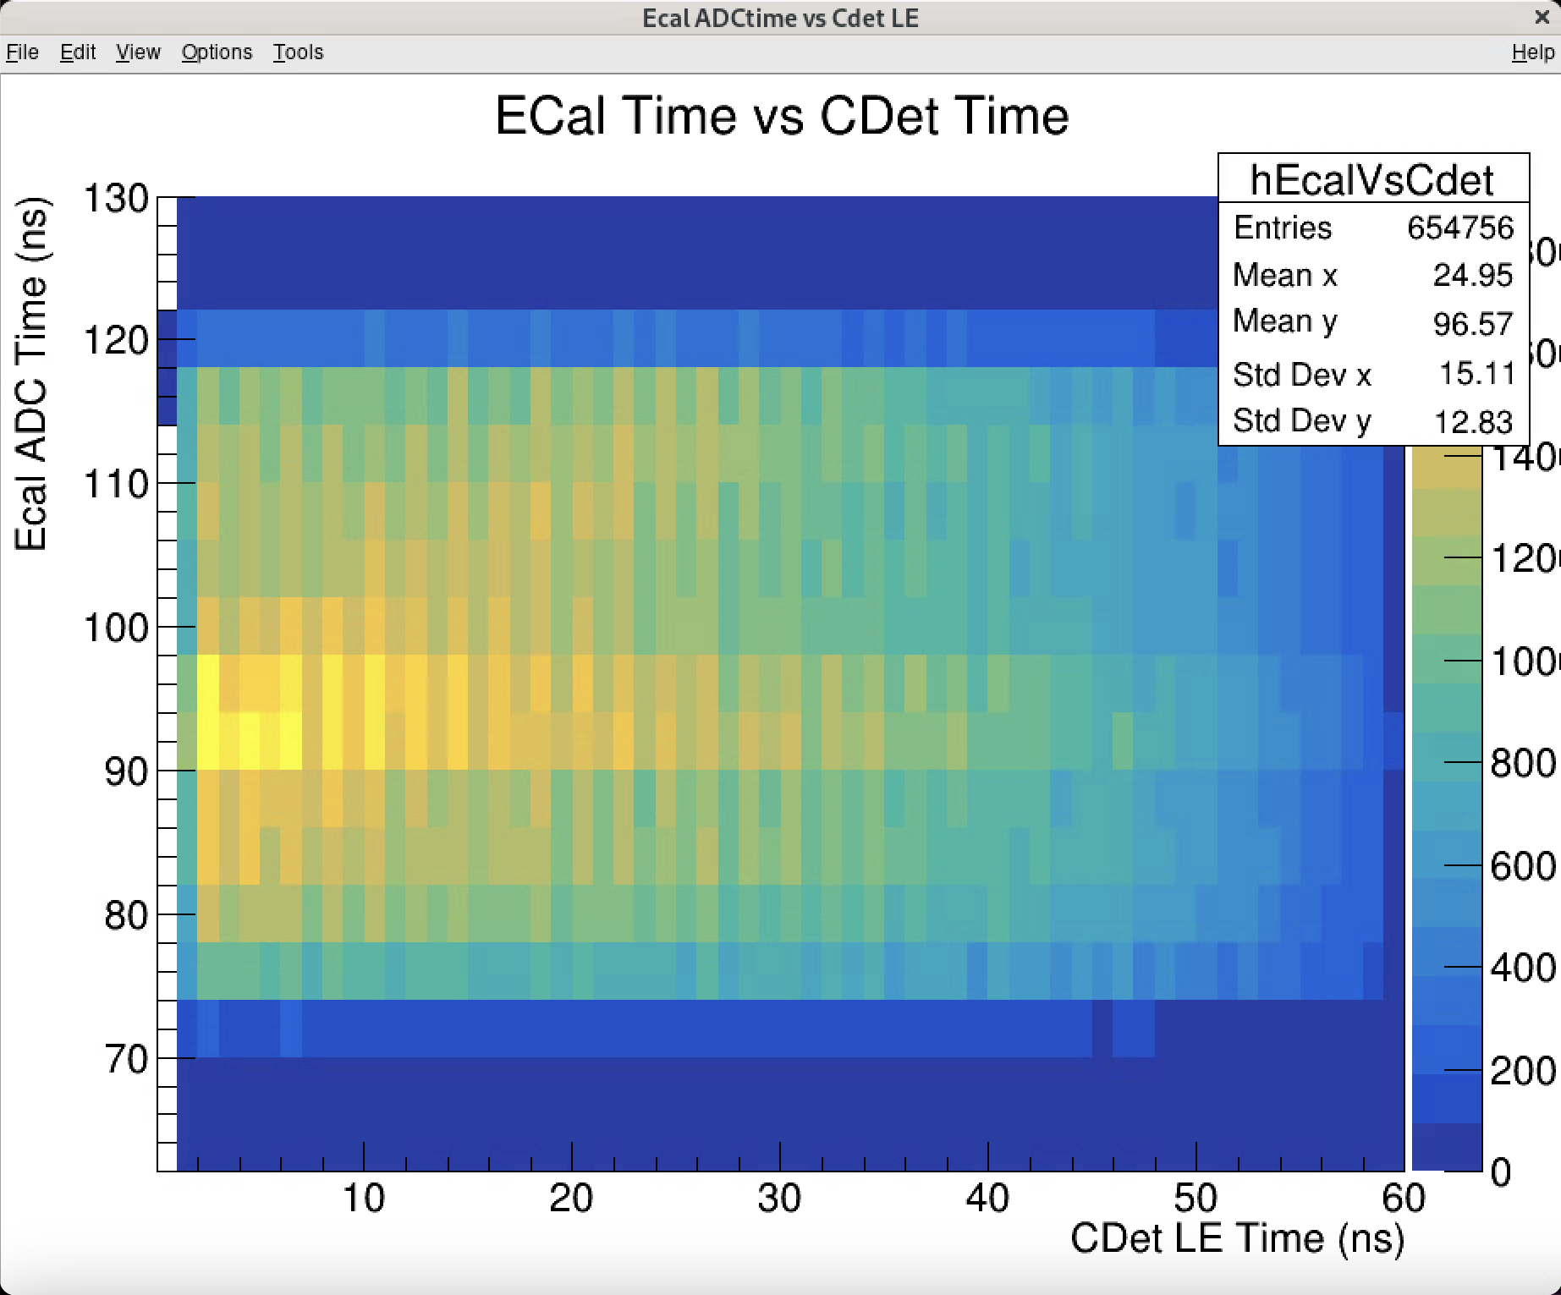
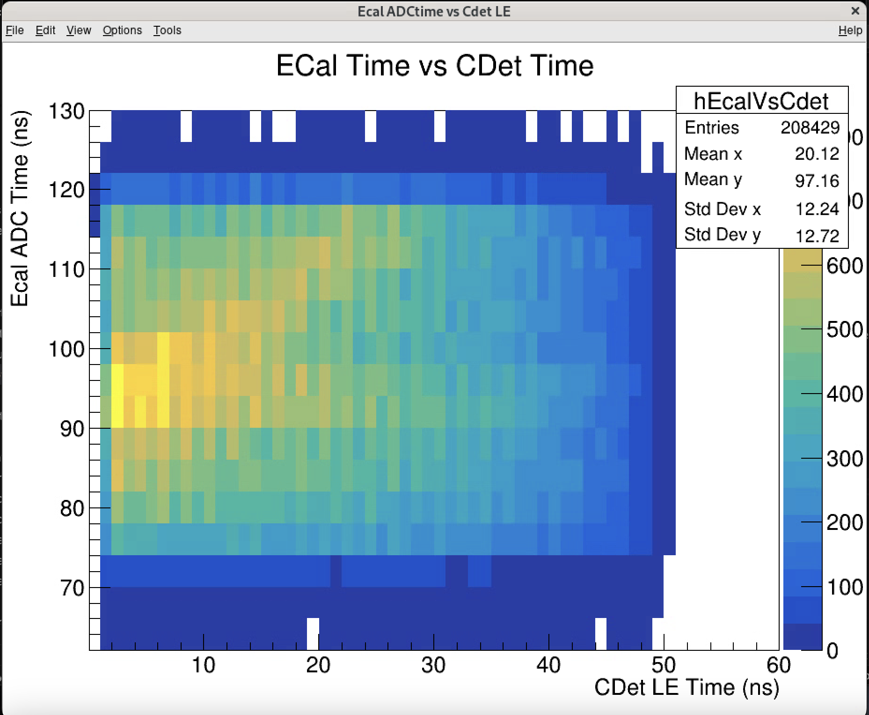
Ecal vs Cdet Timing Correlation
Tot Open Tot>15ns
Cdet 1ns bins, Ecal 4ns bins

Slide 3
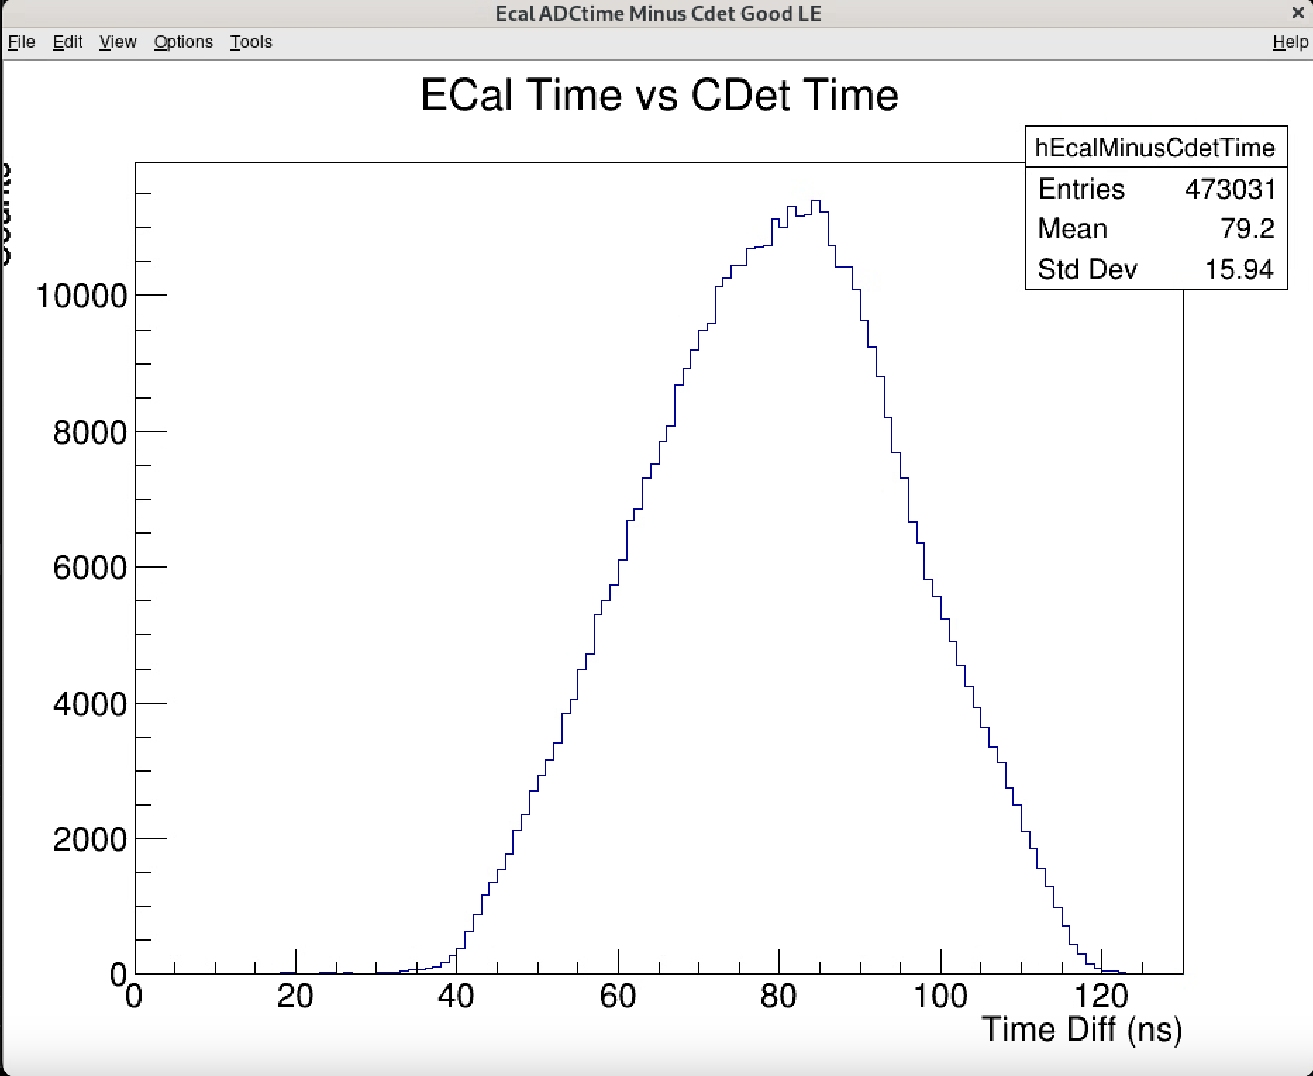
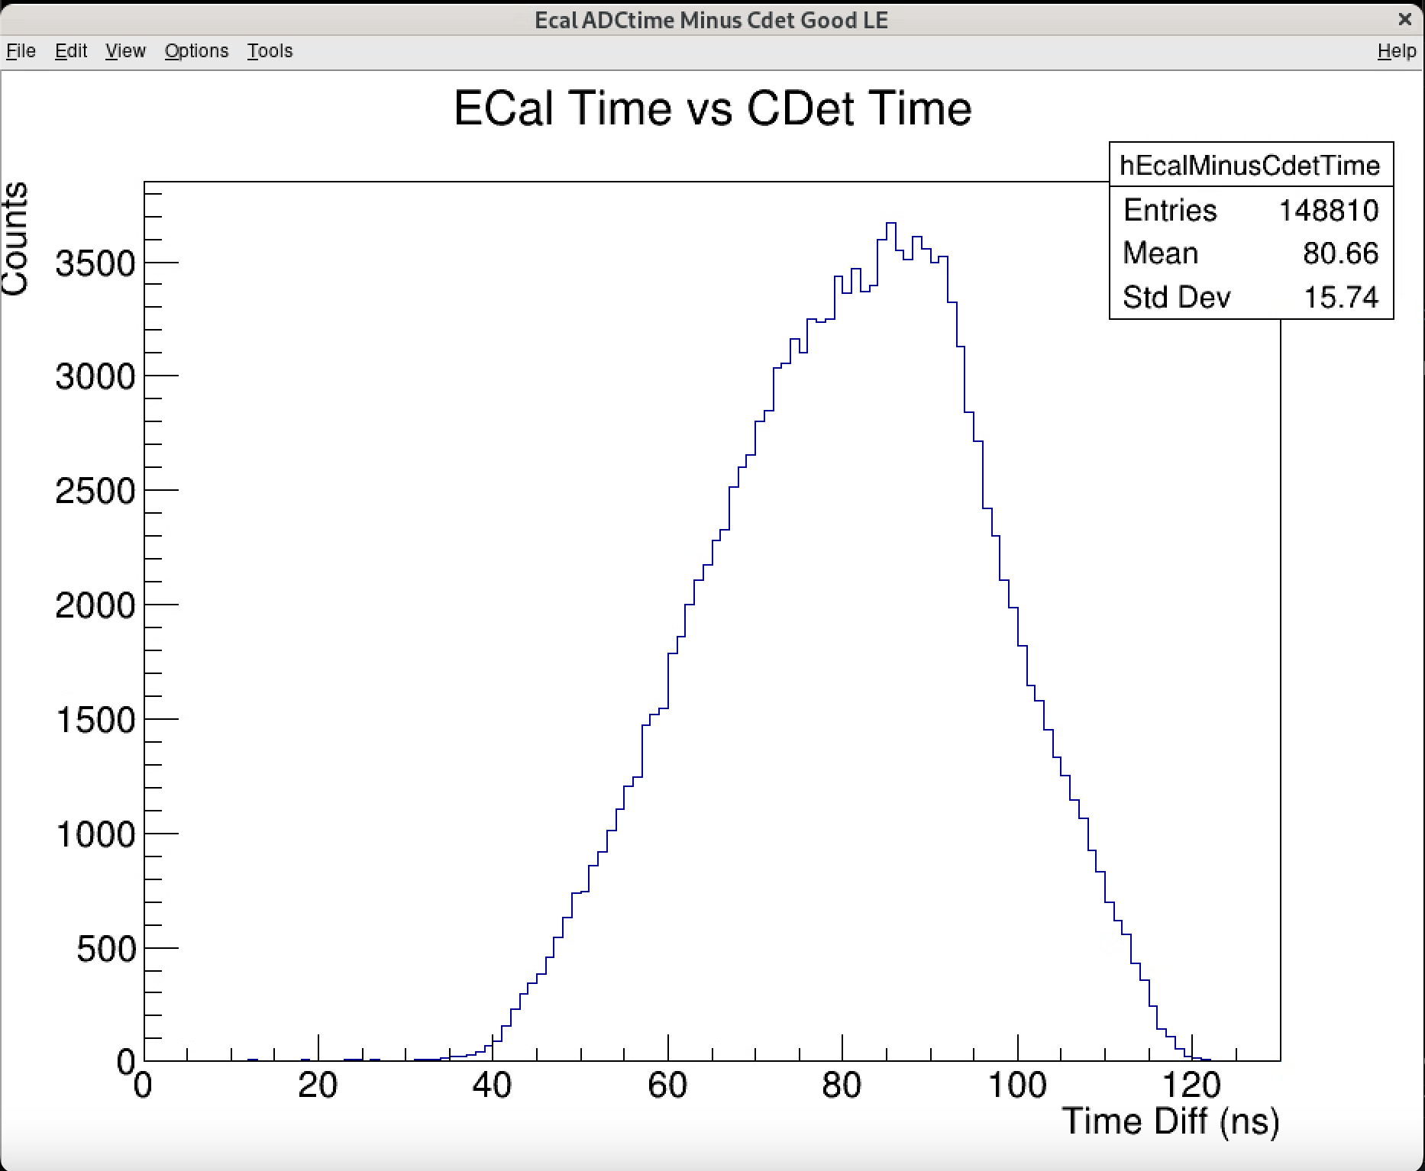
Ecal and Cdet Timing difference (LE 0 to 35ns)
Tot open
Tot >18ns

