Slide 1
Nov 11th Update
CNU Group + Ben Spaude

Slide 2
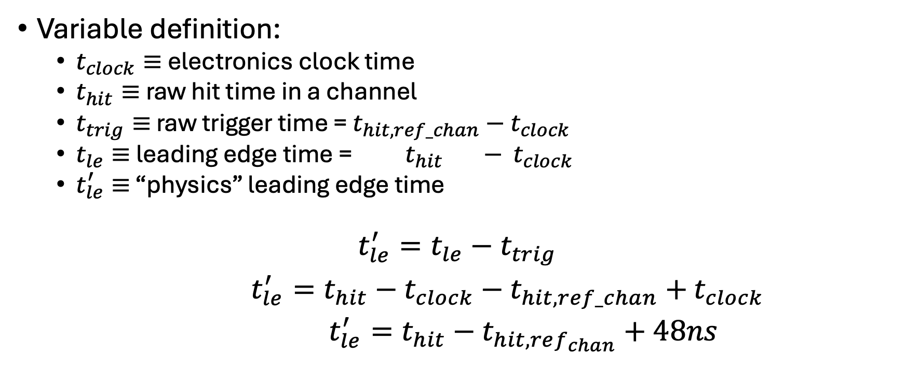
CDet Timing Calculation
Variable definition:
$t_{clock}≡$ electronics clock time
$t_{hit}≡$ raw hit time in a channel
$t_{trig}≡$ raw trigger time = $t_{hit,ref_chan}−$ $t_{clock}$
$t_{le}≡$ leading edge time = $t_{hit} −$ $t_{clock}$
$t_{le}^{′}≡$ “physics” leading edge time
$$t_{le}^{′}=t_{le}−t_{trig}$$
$t_{le}^{′}=t_{hit}−t_{clock}−$ $t_{hit,ref_chan}+$ $t_{clock}$
$t_{le}^{′}=t_{hit}−t_{hit,ref_{chan}}+48ns$

Slide 3
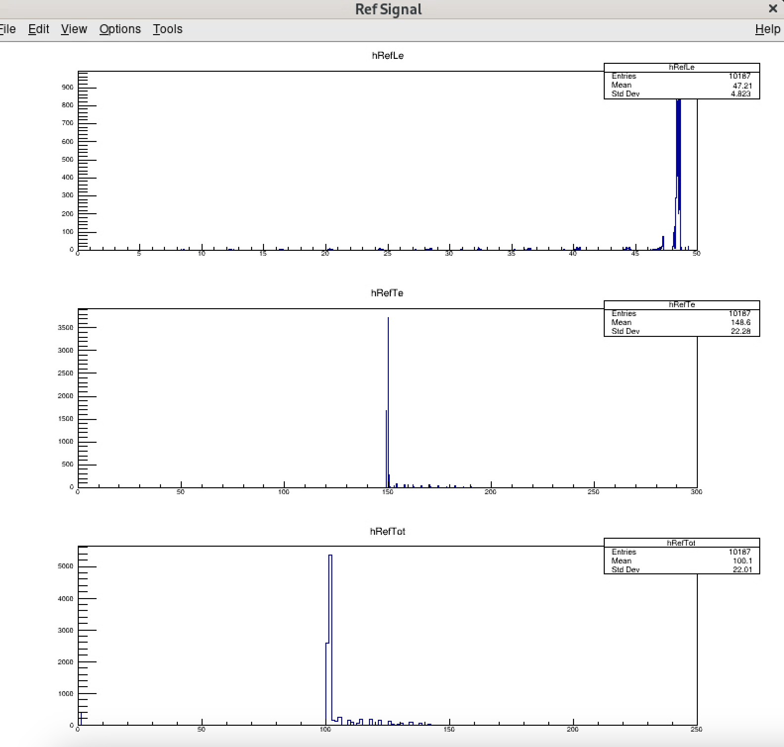
Reference Signal
Run 5811, 10k events, Counts vs ref time
187 “extra” hits in ref channel
Note the peak at 0 in ToT -> ”Double Hits”
Note smaller secondary peaks (more on this later)

Slide 4
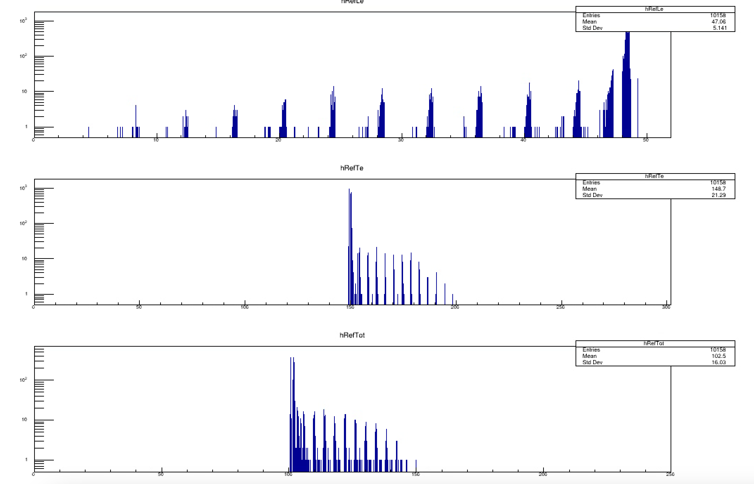
Reference Signal – Log Scaled
Run 5811, 10k events, Counts vs ref time
187 “extra” hits in ref channel
Note the peak at 0 in ToT -> ”Double Hits”
Note smaller secondary peaks (more on this later)

Slide 5
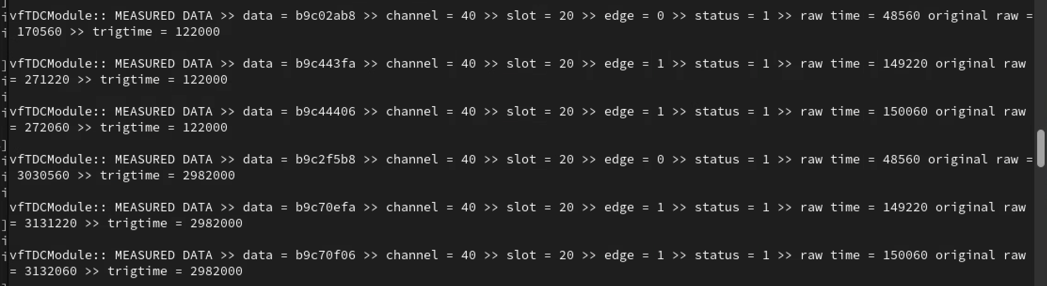
Ref Signal Double Hits
Edge = 0 -> LE Hit
Edge =1 -> TE Hit
SBSData.cxx doesn’t handle this as we would like
Had to modify to handle edge cases

Slide 6
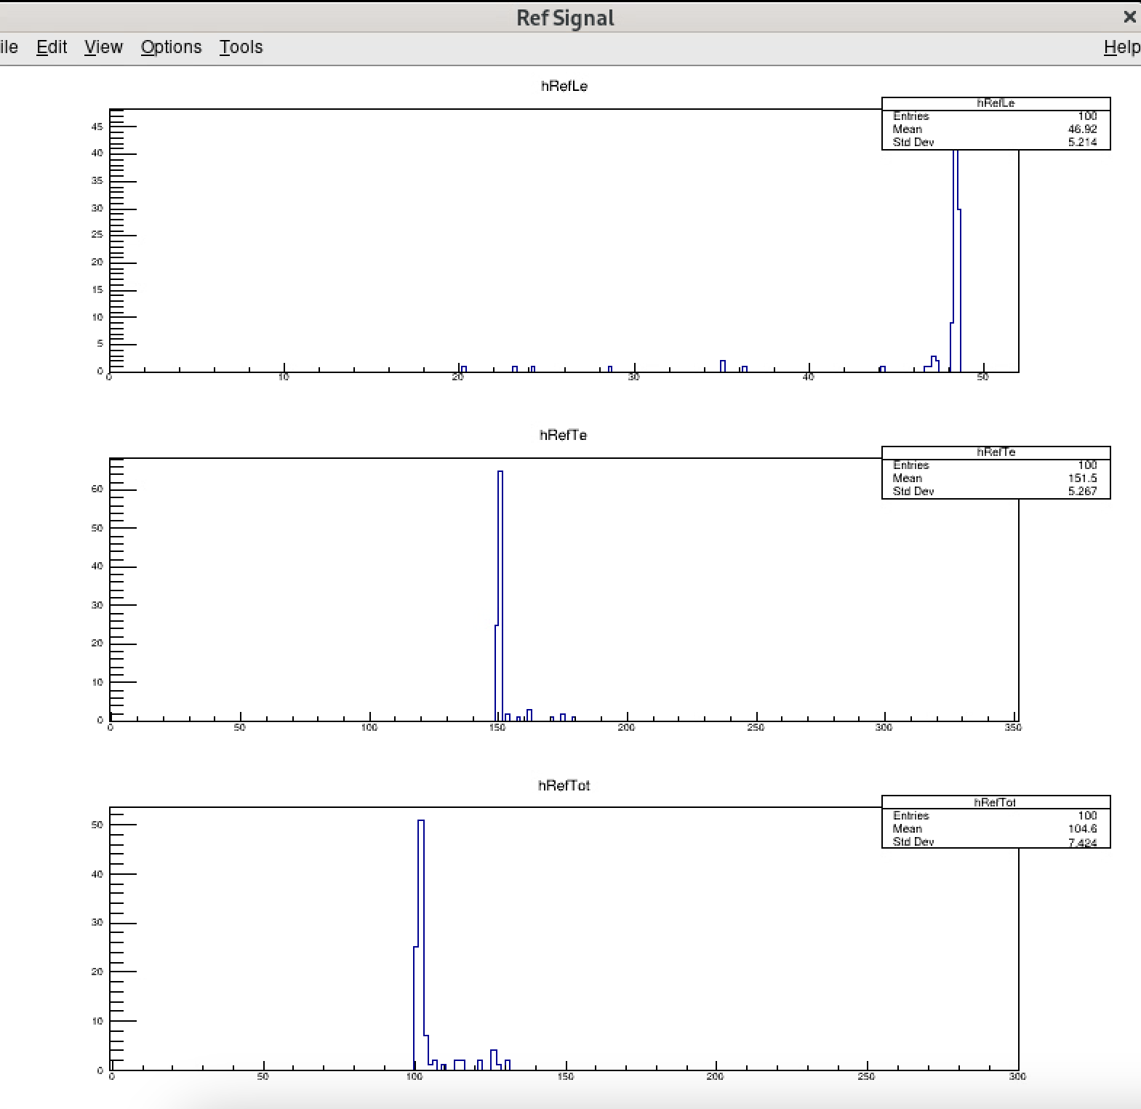
Ref Signal Fix
If double trailing edge, two te hits, second one has no associated Tot or Le
Double Te hits fine, since we enforce in analysis, LE>0
If double LE, Tot not set. Had to modify SBSData.cxx to handle this case.
Fixes “double” hits, but still secondary peaks

Slide 7
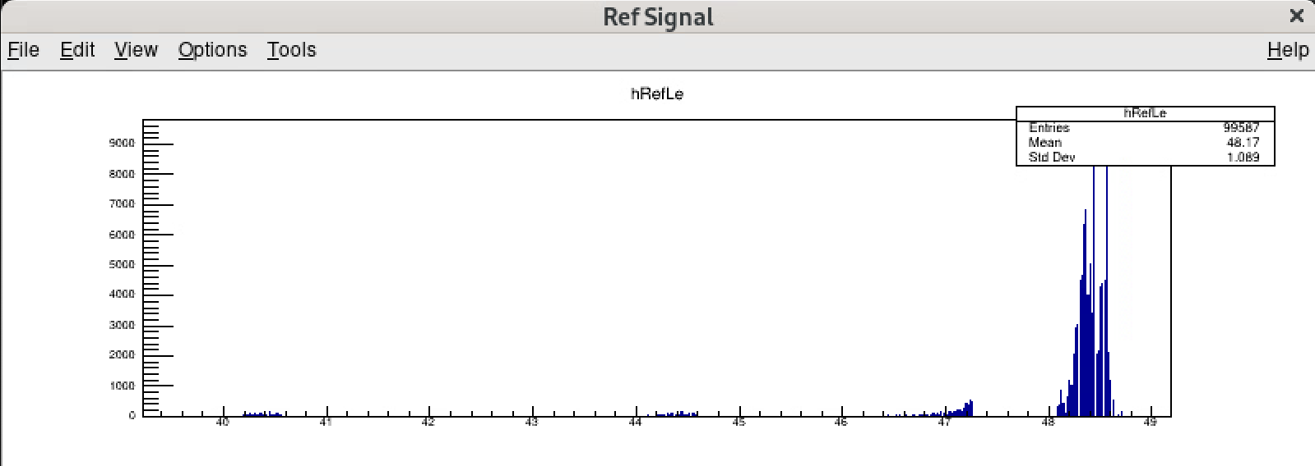
Secondary Peaks
~1ns second peak
4ns periodicity
For ref channel, starting/stopping tdc with same signal, expect self timing peak
Appears to be some problem with tdc (slot 20, but still investigating)

Slide 8
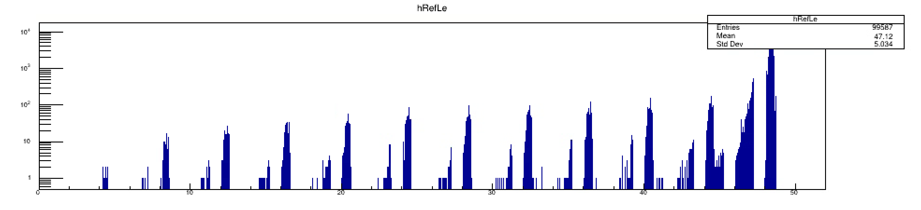
Secondary Peaks
~1ns second peak
4ns periodicity
Appears to be some problem with tdc (slot 20, but still investigating)
For ref channel, starting/stopping tdc with same signal, expect self timing peak

Slide 9
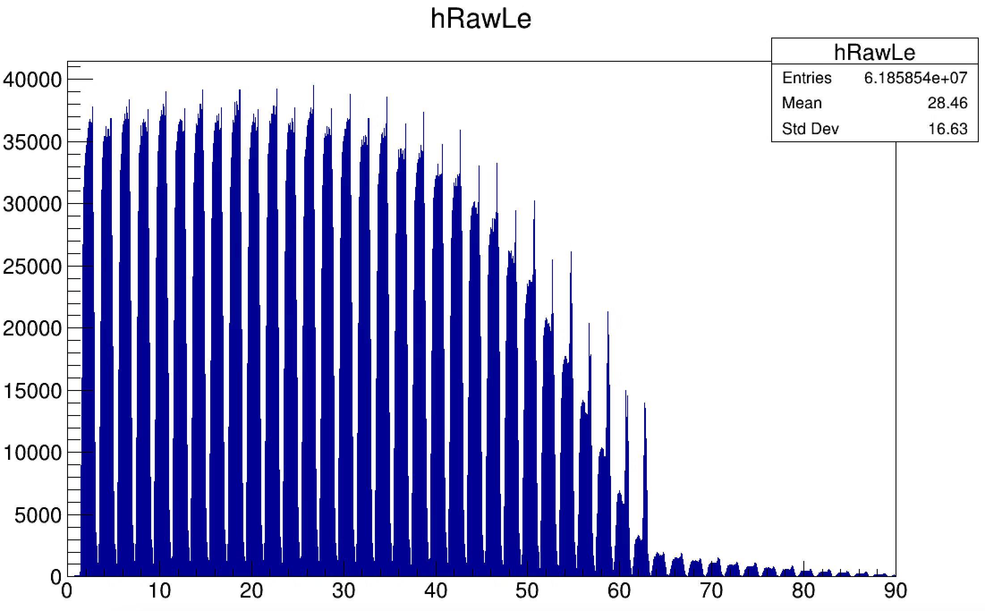
Secondary Ref Peaks Effect on LE
Peaks from 60-90ns
Not correct times

Slide 10
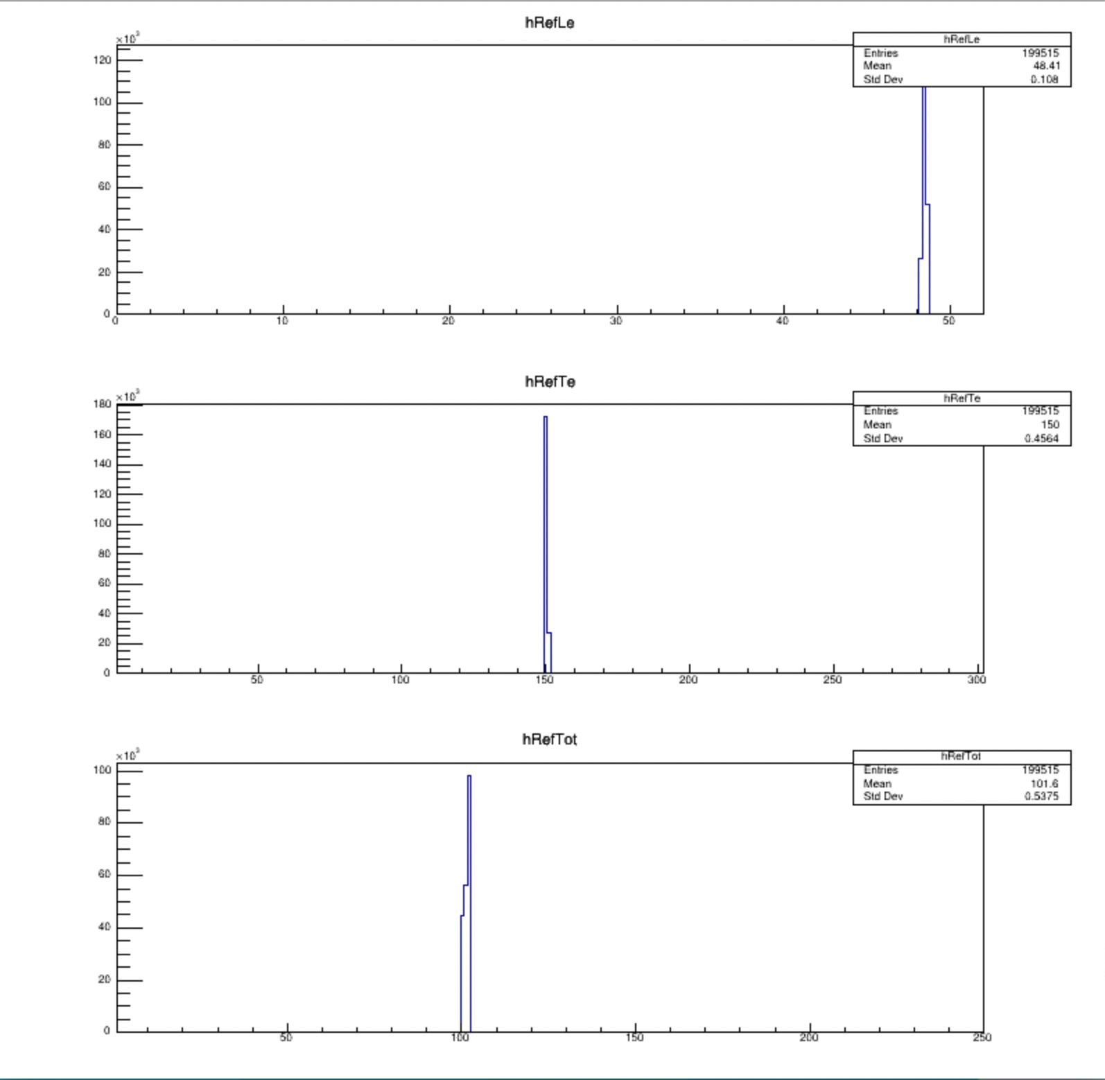
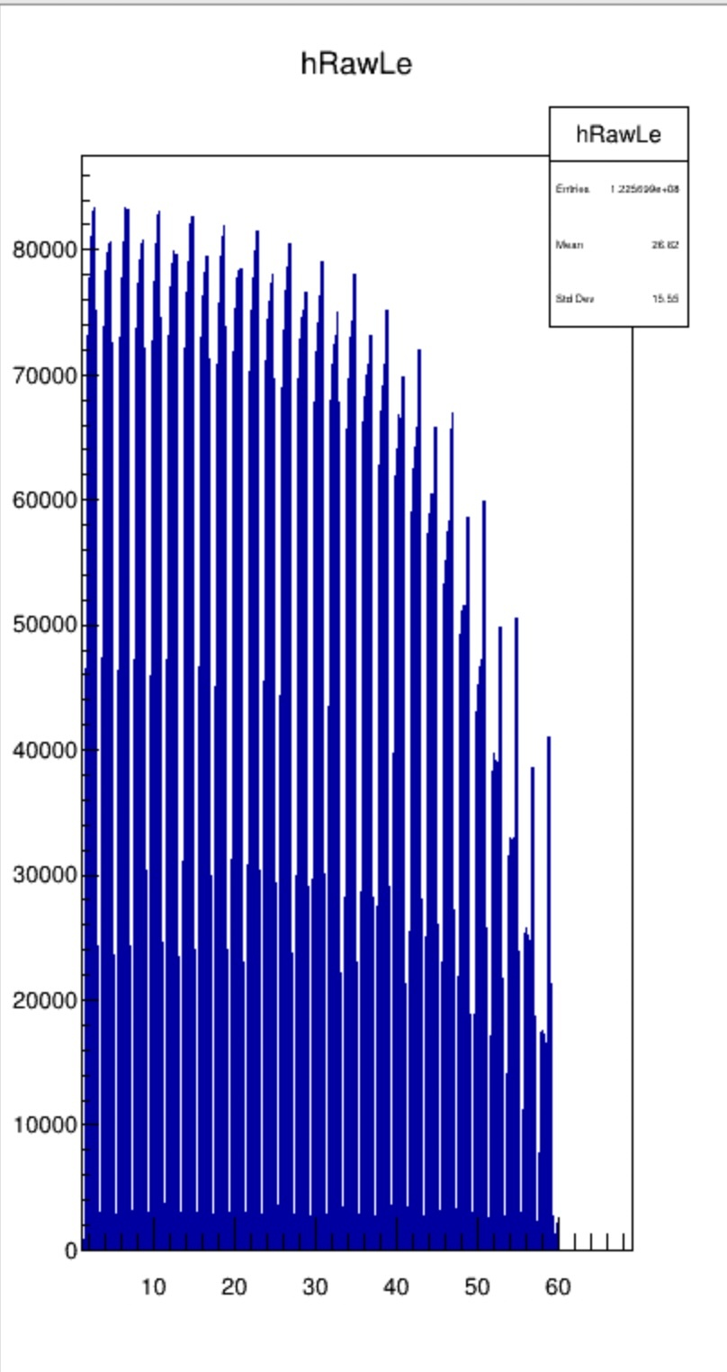
Adjust Ref Time
Notes:
Tdc calibration purposefully incorrect, part of investigation into tdc non-linearity

Slide 11
CDet Timing
Transit time along bar -> 2.5 ns
Time walk/pulse shape -> 1-2 ns (from g4sbs/CDetMC)
TDC non-linearity -> 0.5 ns (working on this)
Expect perhaps 5ns spread of “real” events (correlated in time with ECal)
Accidental/Real ratio: ~ 750/3 = 250
5ns/60ns window width = 1/12
Timing ”Peak” S/N ratio ~ 250/12 = 21 = 5% above accidental background

Slide 12
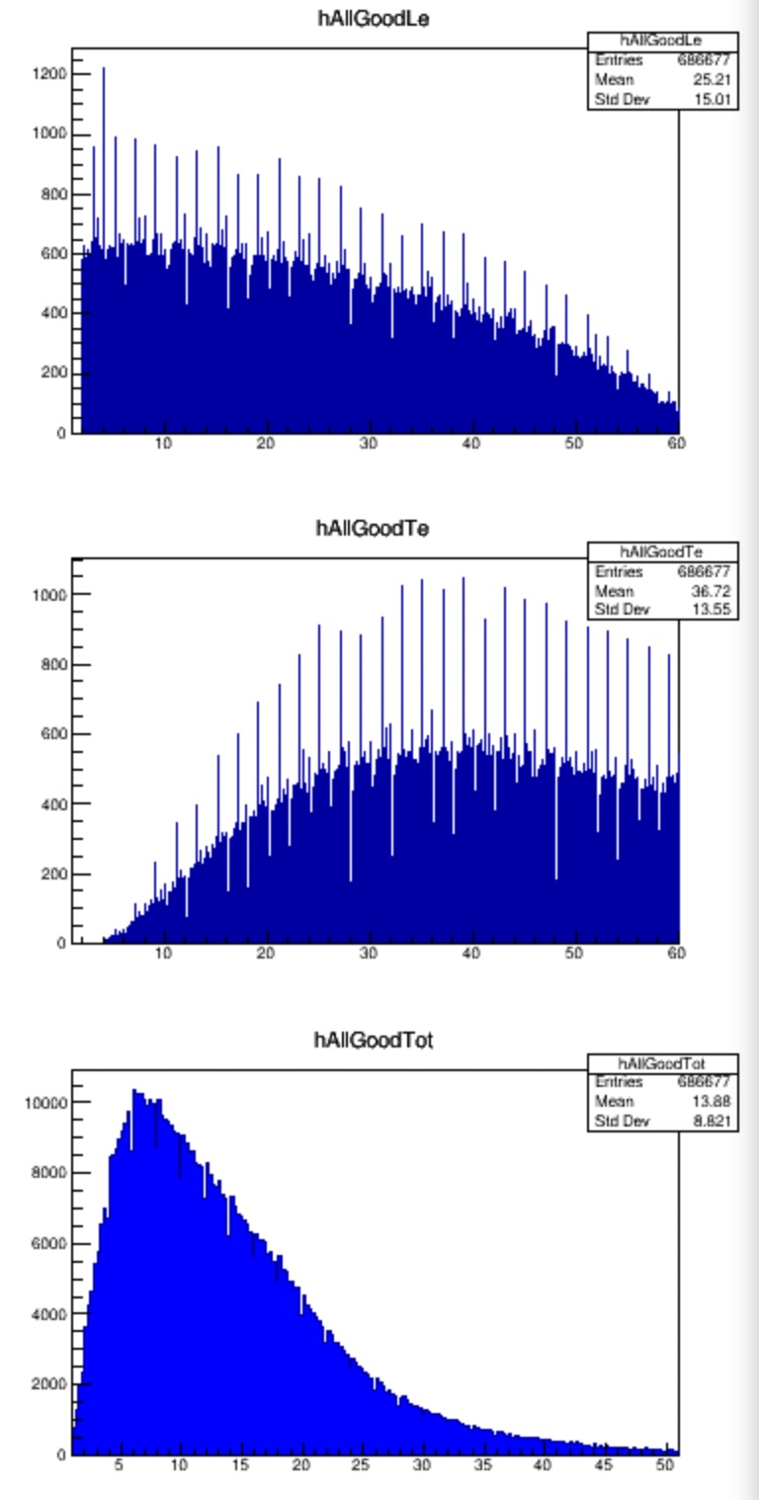
Work in Progress
TDC linearity studies … implementing a CDF approach
Event Display: identify the ~10-20 CDet hits in the region predicted by ECal (X,Y) position projected to CDet, to understand CDet “clustering” and to develop approaches to reduce accidentals
Implementing CNU GPU cluster for analysis (~300 cores with ~100% availability)

Slide 13
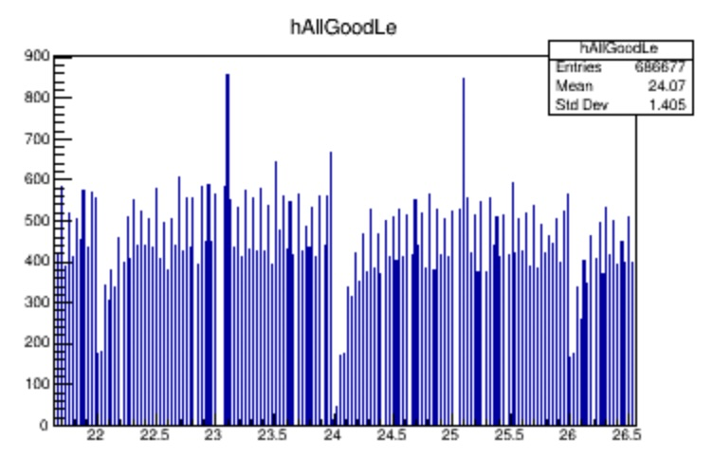
Work in Progress
TDC linearity studies … implementing a CDF approach
Event Display: identify the ~10-20 CDet hits in the region predicted by ECal (X,Y) position projected to CDet, to understand CDet “clustering” and to develop approaches to reduce accidentals
Implementing CNU GPU cluster for analysis (~300 cores with ~100% availability)

Slide 14
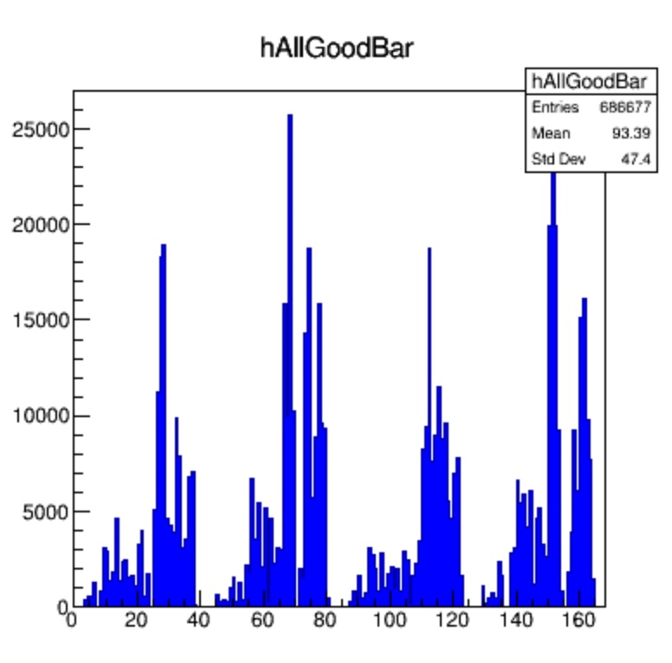
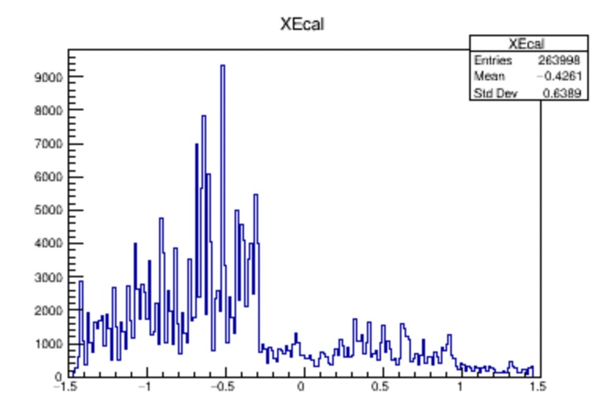
Work in Progress
TDC linearity studies … implementing a CDF approach
Event Display: identify the ~10-20 CDet hits in the region predicted by ECal (X,Y) position projected to CDet, to understand CDet “clustering” and to develop approaches to reduce accidentals
Implementing CNU GPU cluster for analysis (~300 cores with ~100% availability)

