Slide 1
Dec 16 Update – ECal/CDet Timing Comparison
Ben Spaude

Slide 2
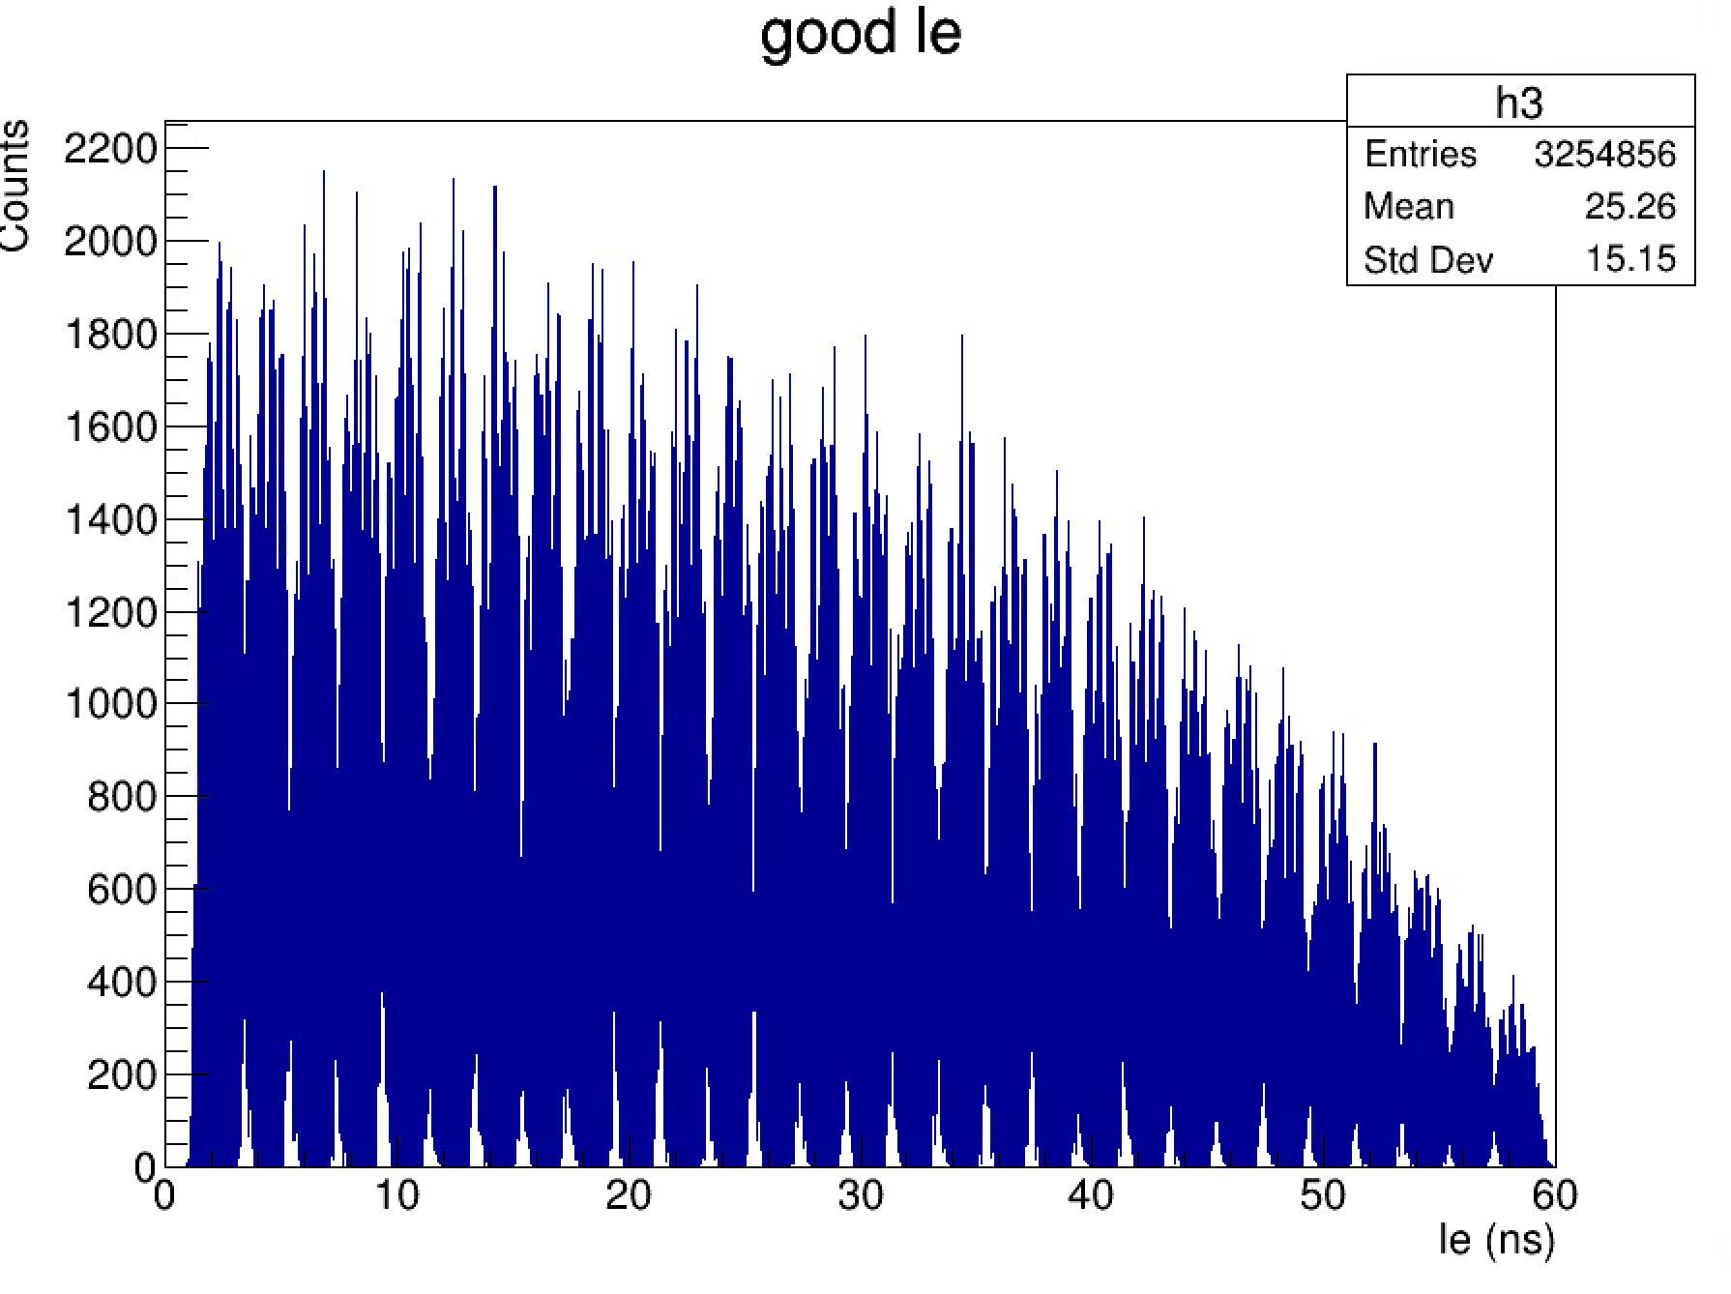
LE Timing in Coordinate Detector
Distribution of hits across entire timing window
Unclear where high energy electrons are

Slide 3

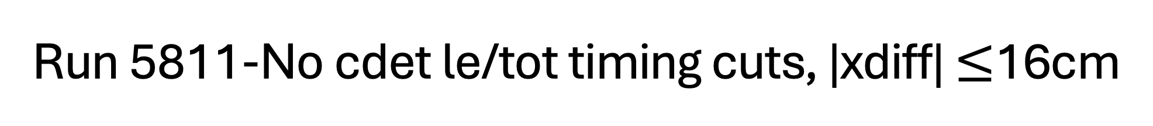



Run 5811-No cdet le/tot timing cuts, |xdiff| $≤$16cm
Cdet paddle height = 0.5cm
16cm xdiff -> $±$32 paddles from central hit (~2 bars)
$\tan{α=\frac{x_{CDet}}{z_{CDet}}=\frac{x_{ECal}}{z_{ECal}}} →{x′}_{CDet}=x_{ECal}\frac{z_{CDet}}{z_{ECal}}$
z
x
ECal
CDet
$$α$$
$$x_{ECal}$$
$$x_{CDet}$$

Slide 4
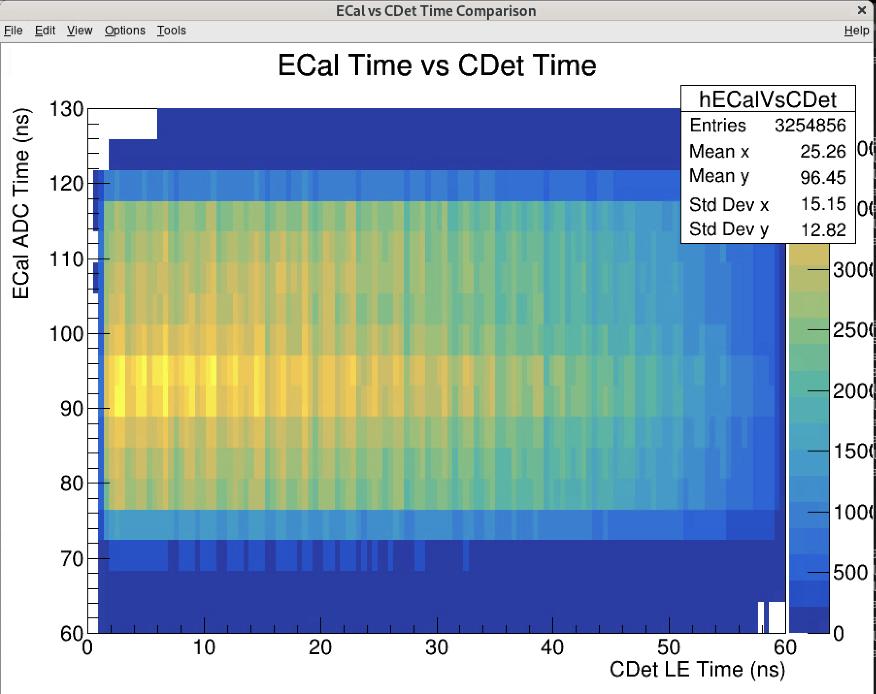
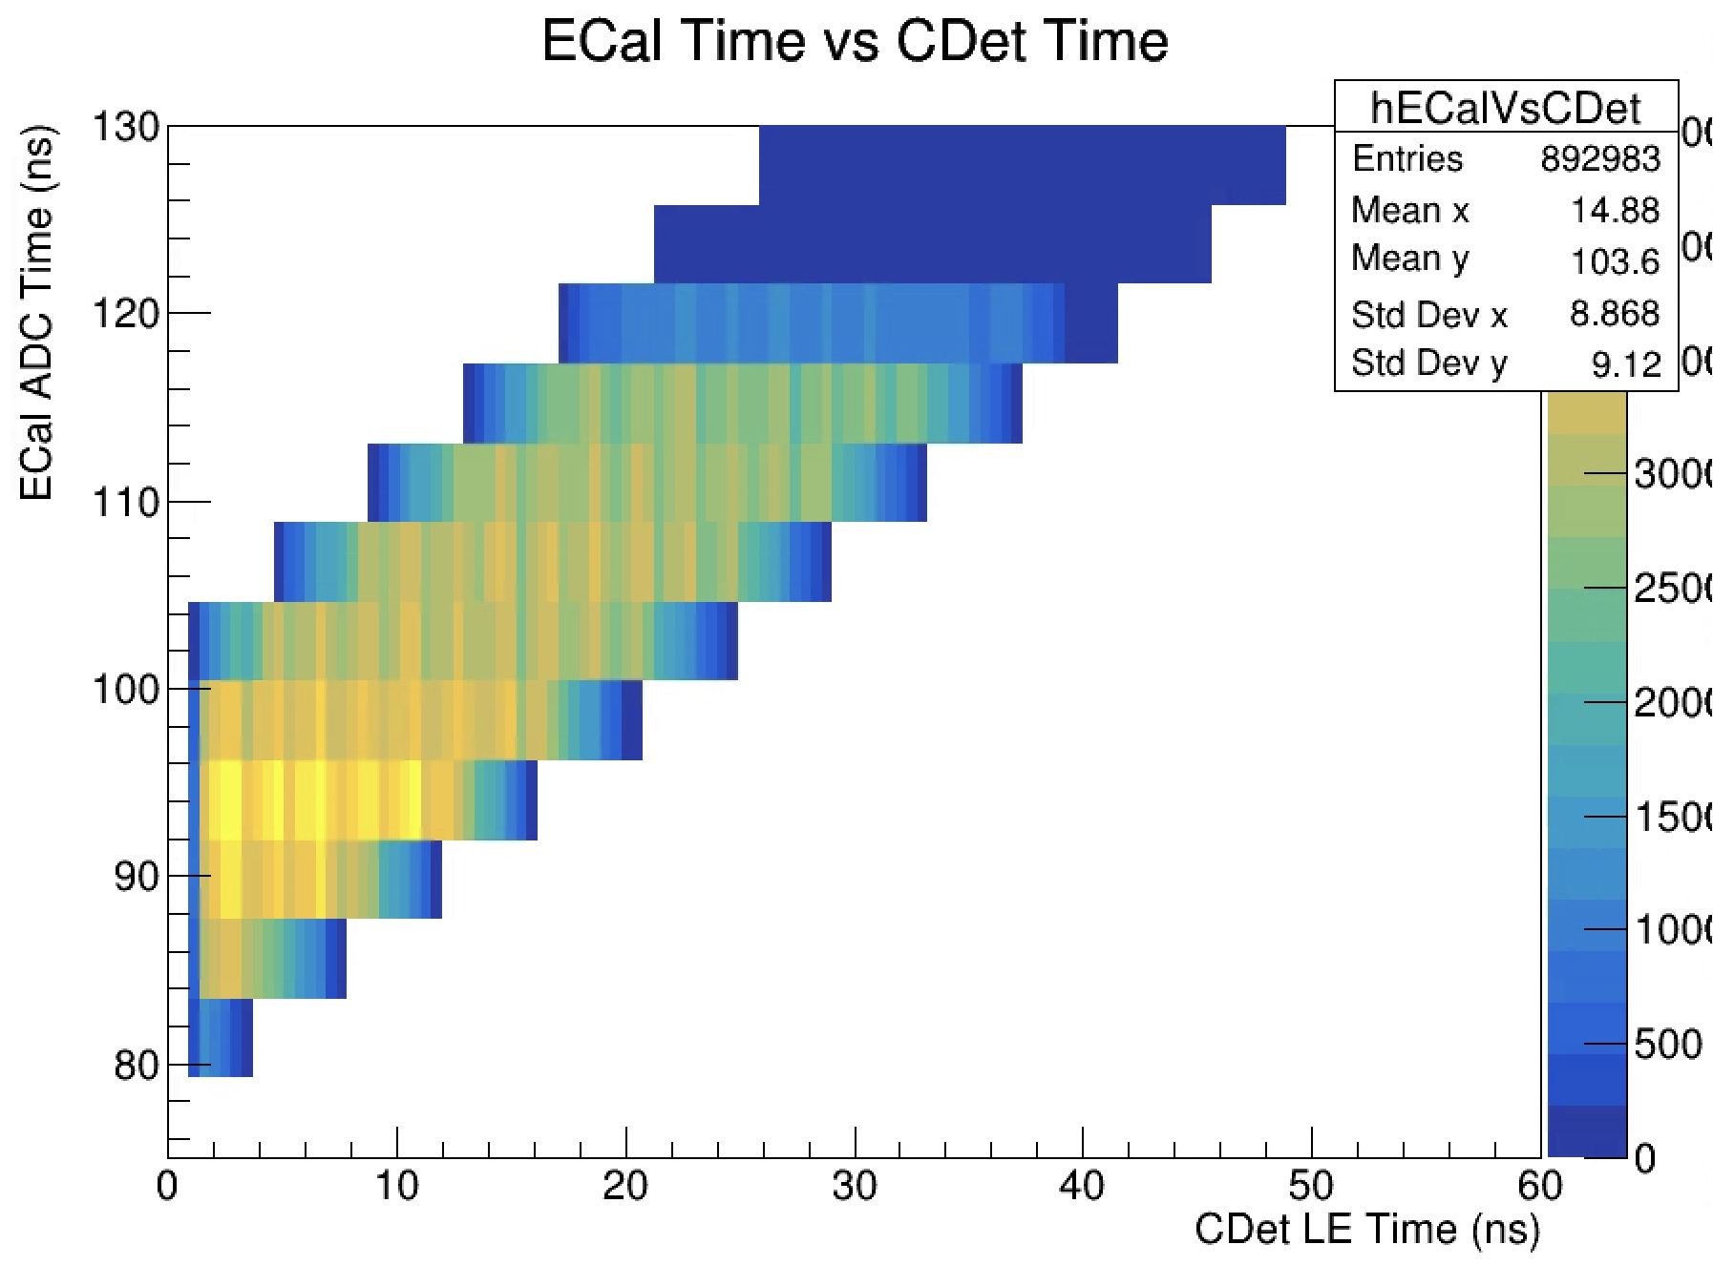
Ecal Good Adctime vs Cdet LE time
Time diff between 80-100ns
~31 CDet hits per event
~8 Cdet hits per event

Slide 5
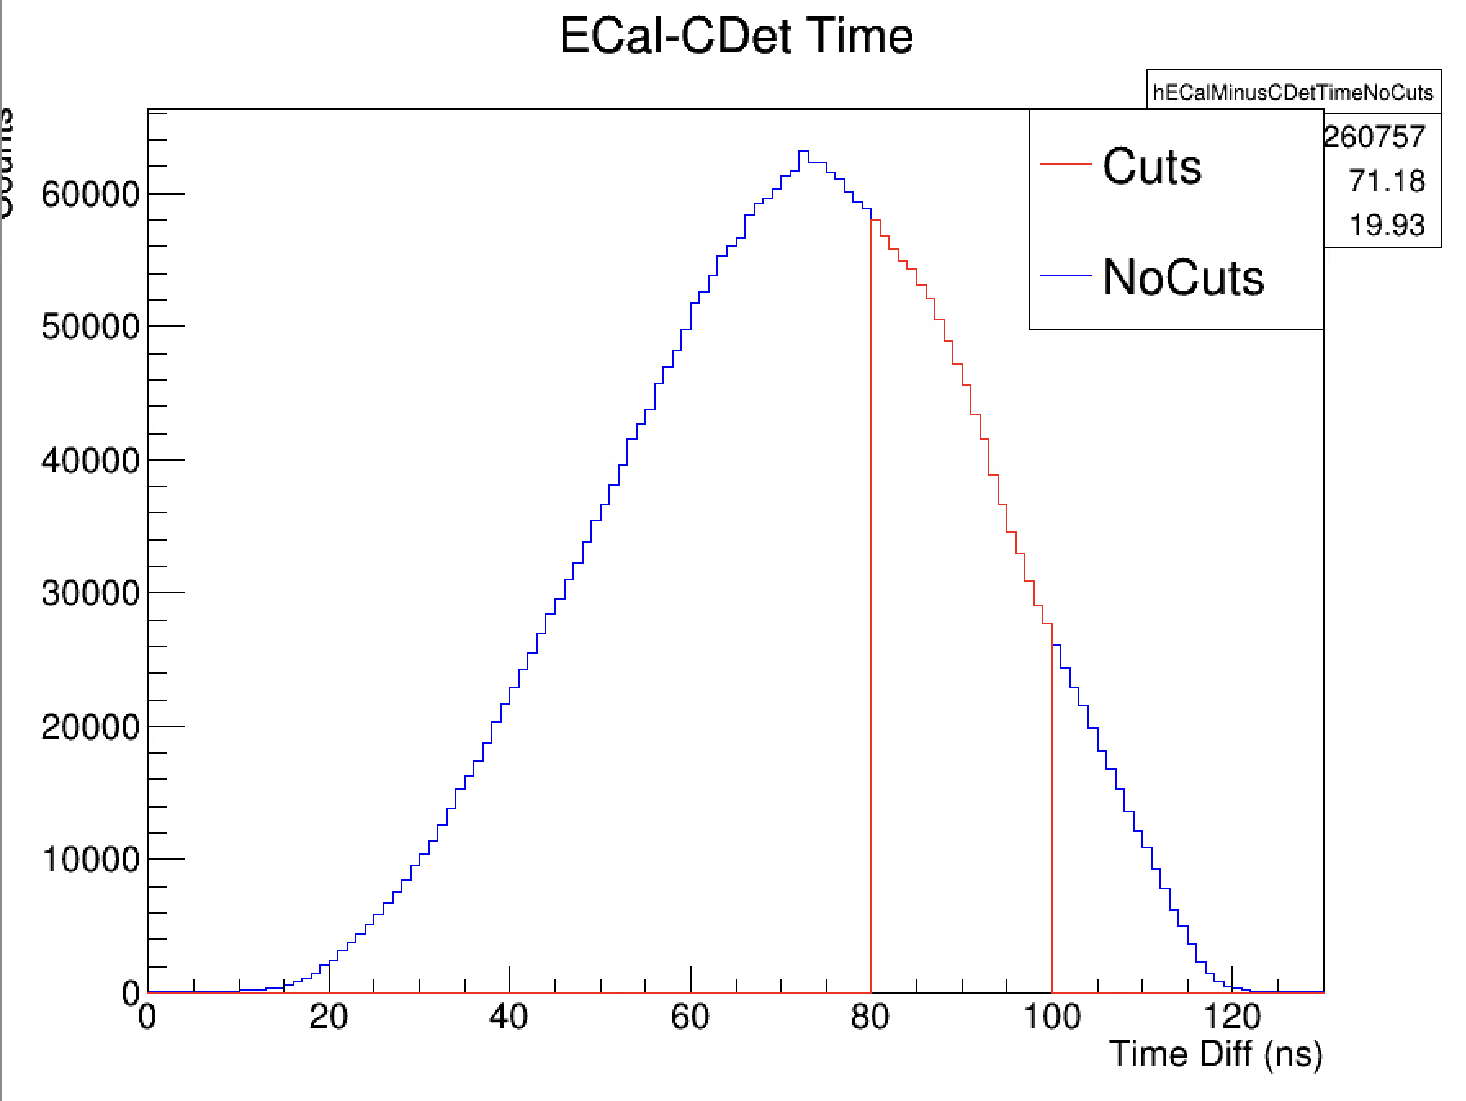
Time Diff vs Counts
Note slight bump around 85ns
WIP: Fitting with Gaussian and subtracting off from data
Should show bump in data more clearly
Create same histogram for uncorrelated hits (i.e outside xdiff cut)

Slide 6
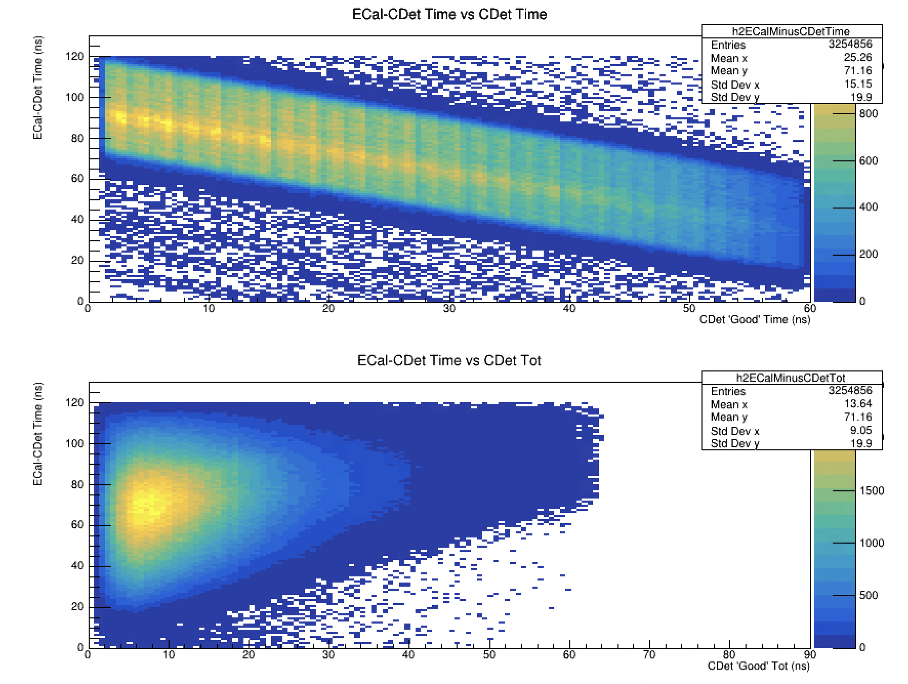
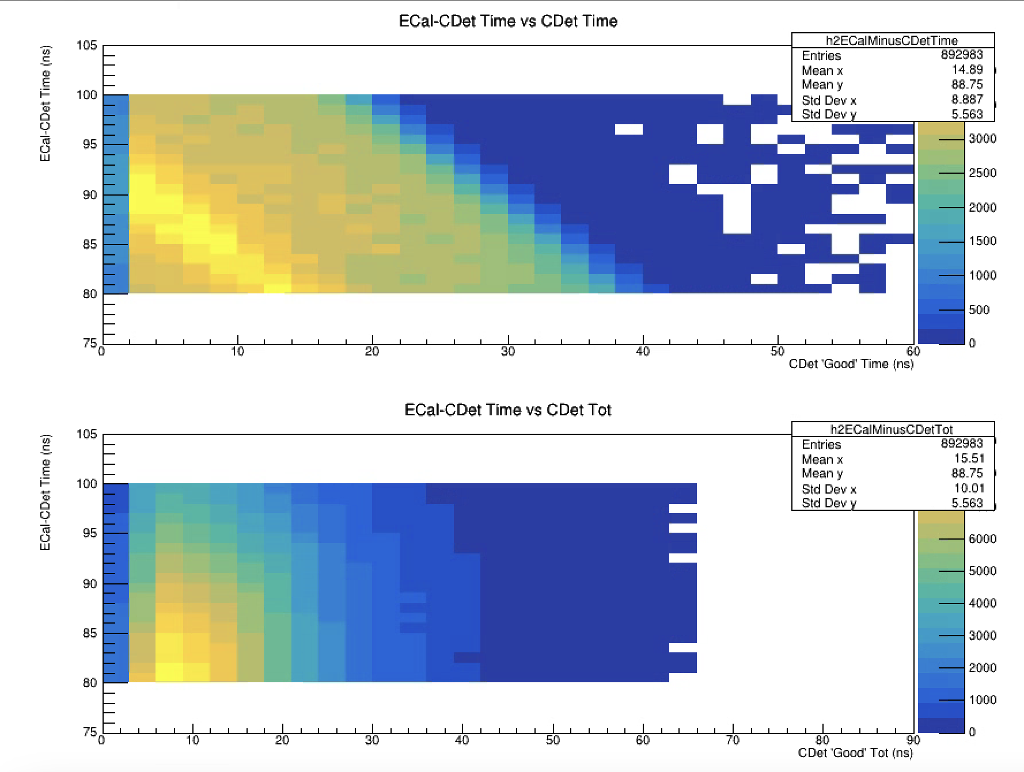
ECal-CDet Time vs CDet LE & TOT

Slide 7
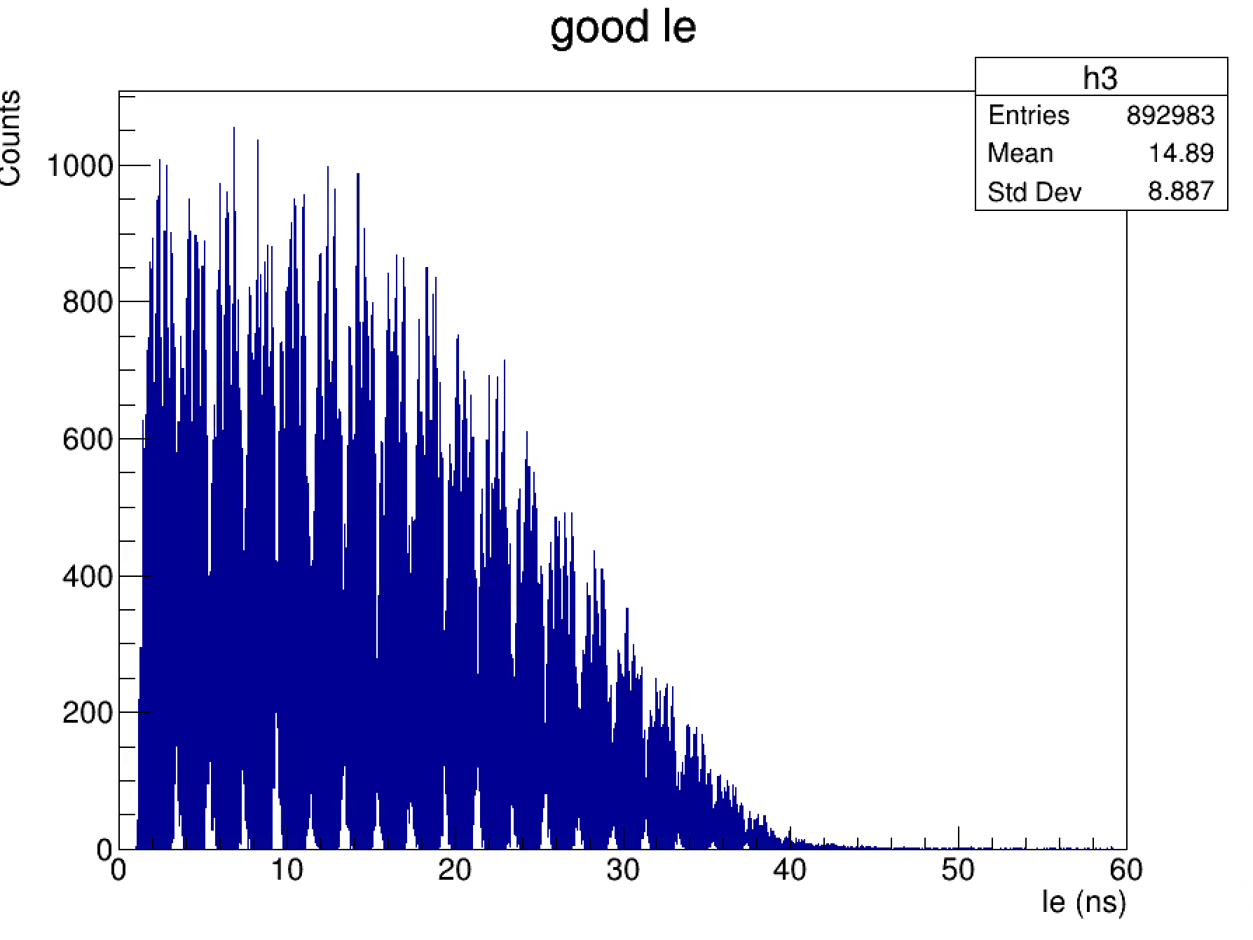
CDet LE Time
(no tdiff cut)

Slide 8
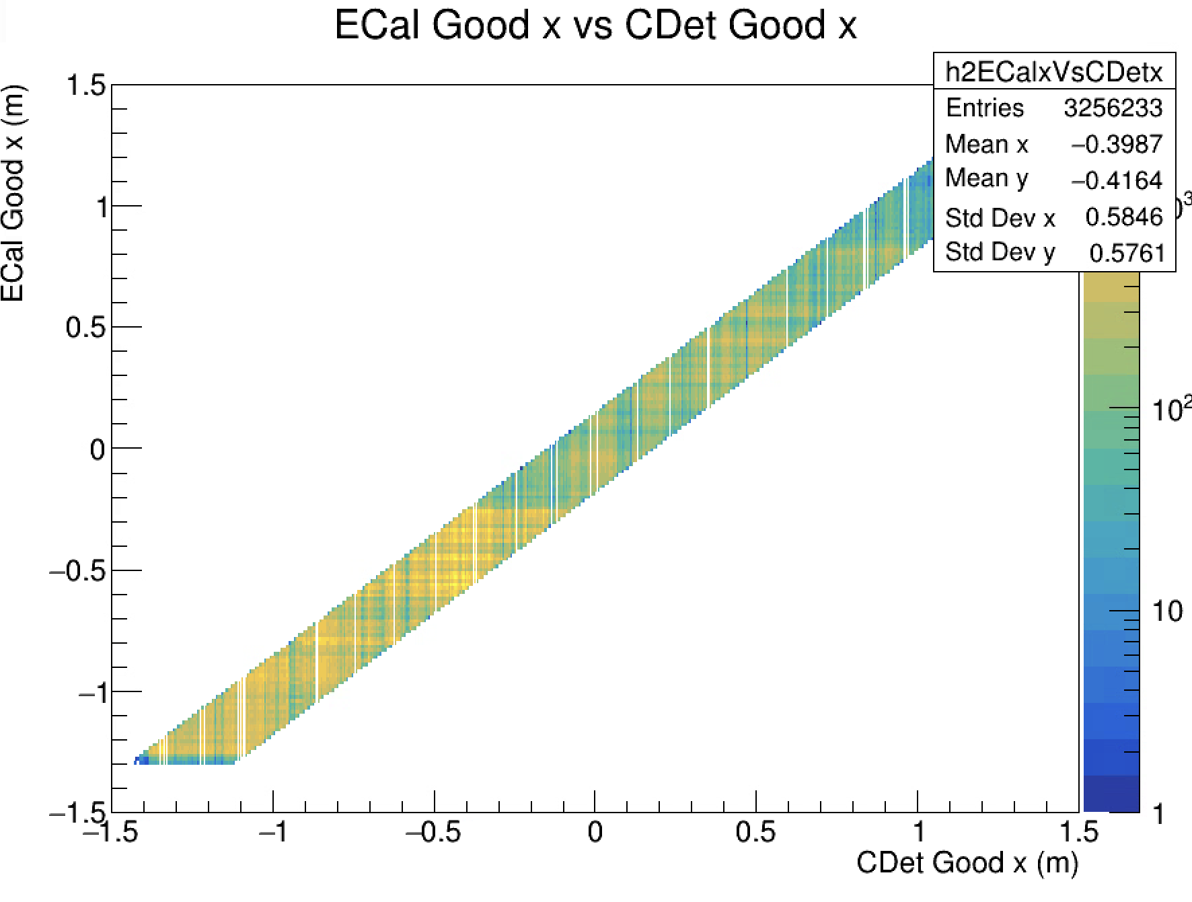
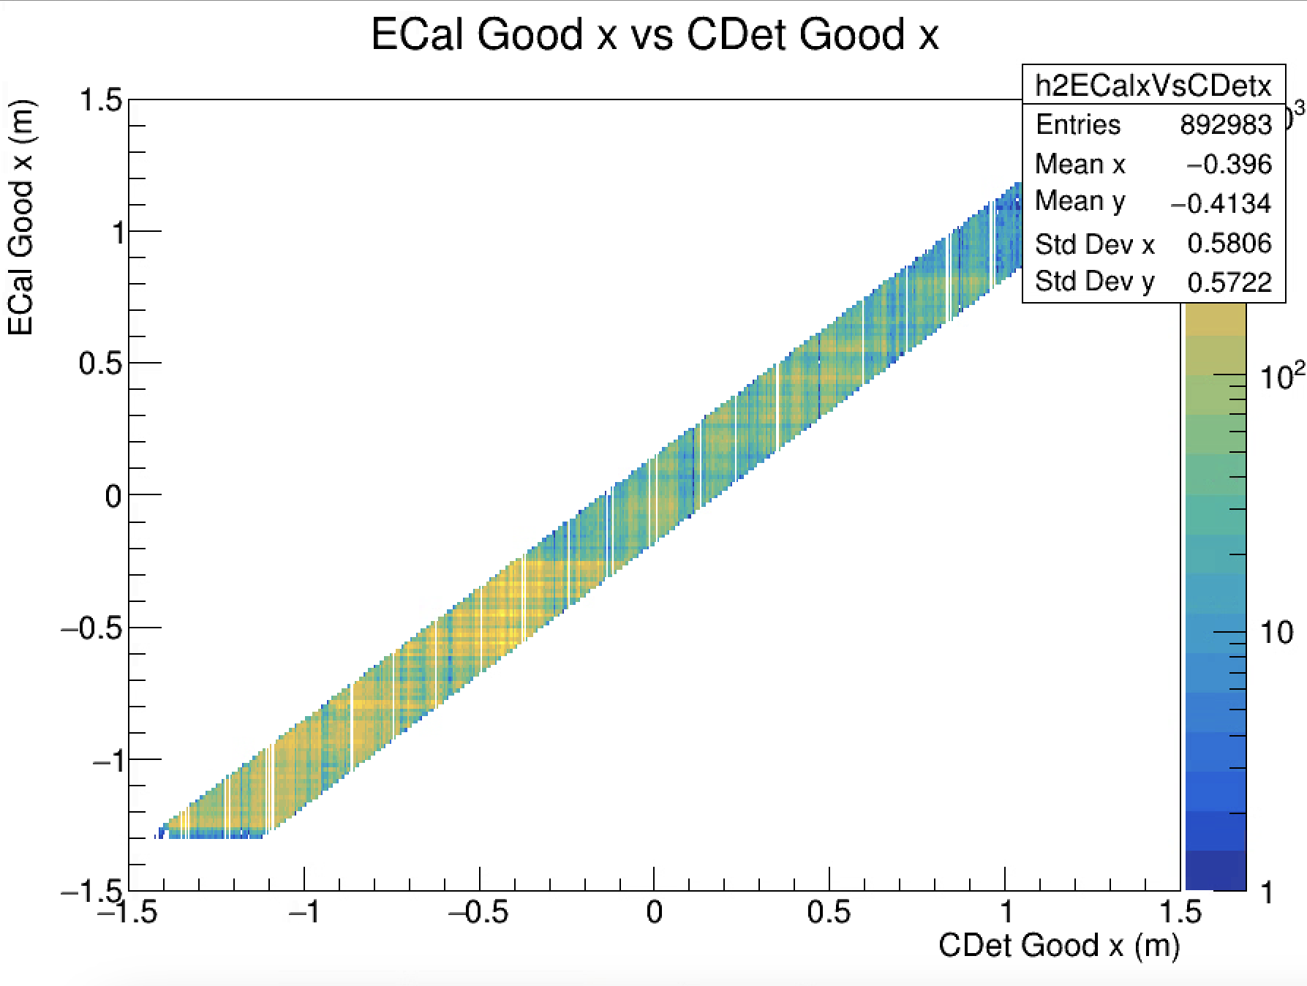
X position correlation

Slide 9
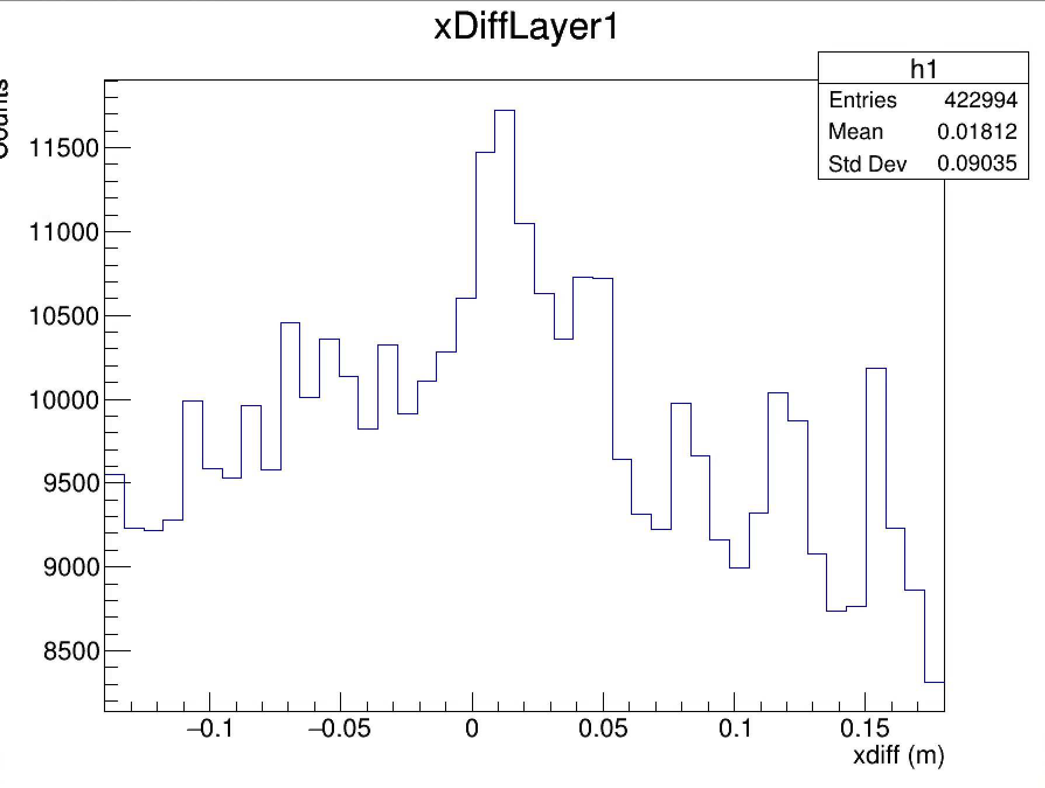
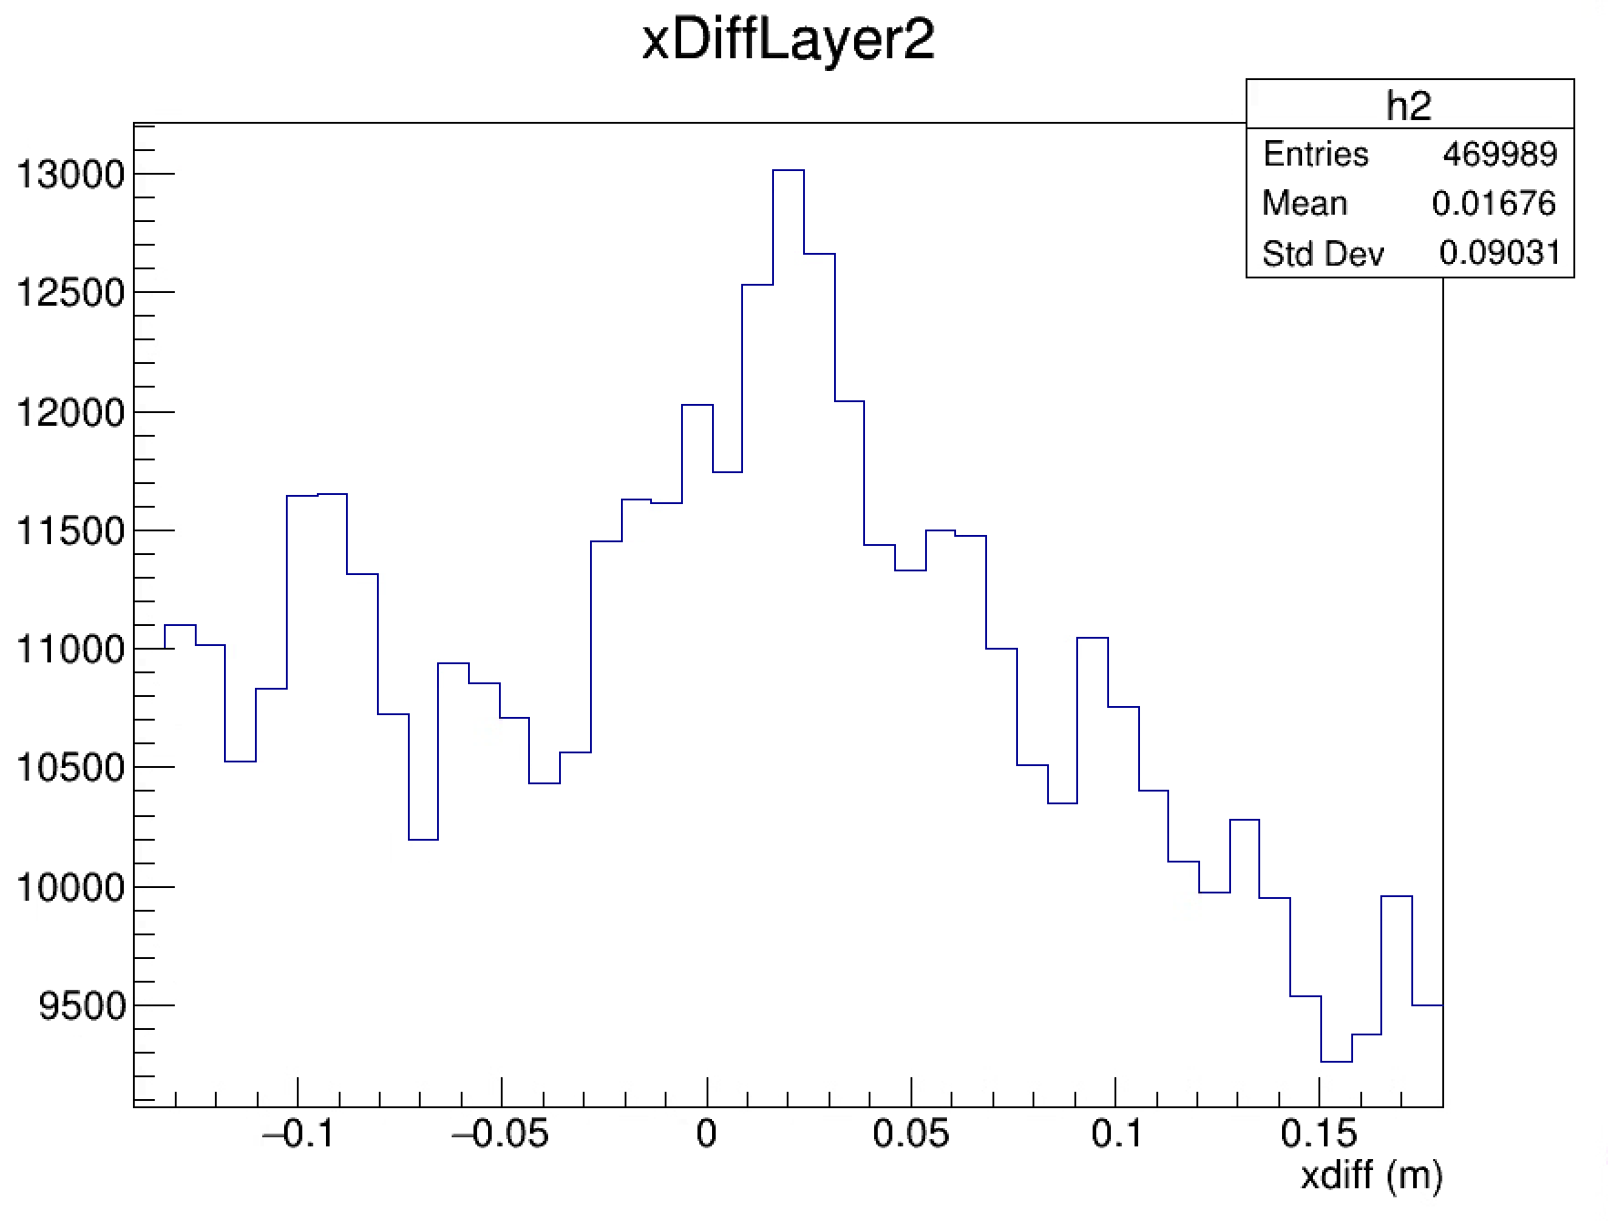
X Difference Plots

