Slide 1
Dec 5 Update – Ecal/Cdet Timing Comp
Ben Spaude

Slide 2
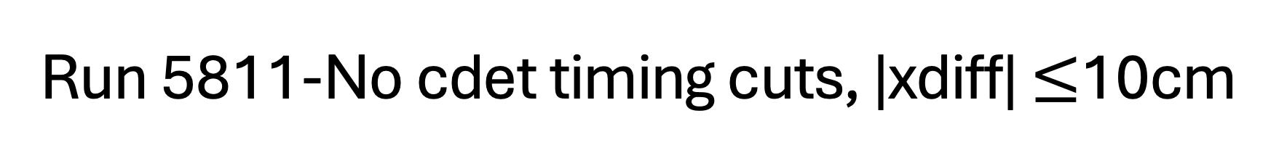
Run 5811-No cdet timing cuts, |xdiff| $≤$10cm

Slide 3
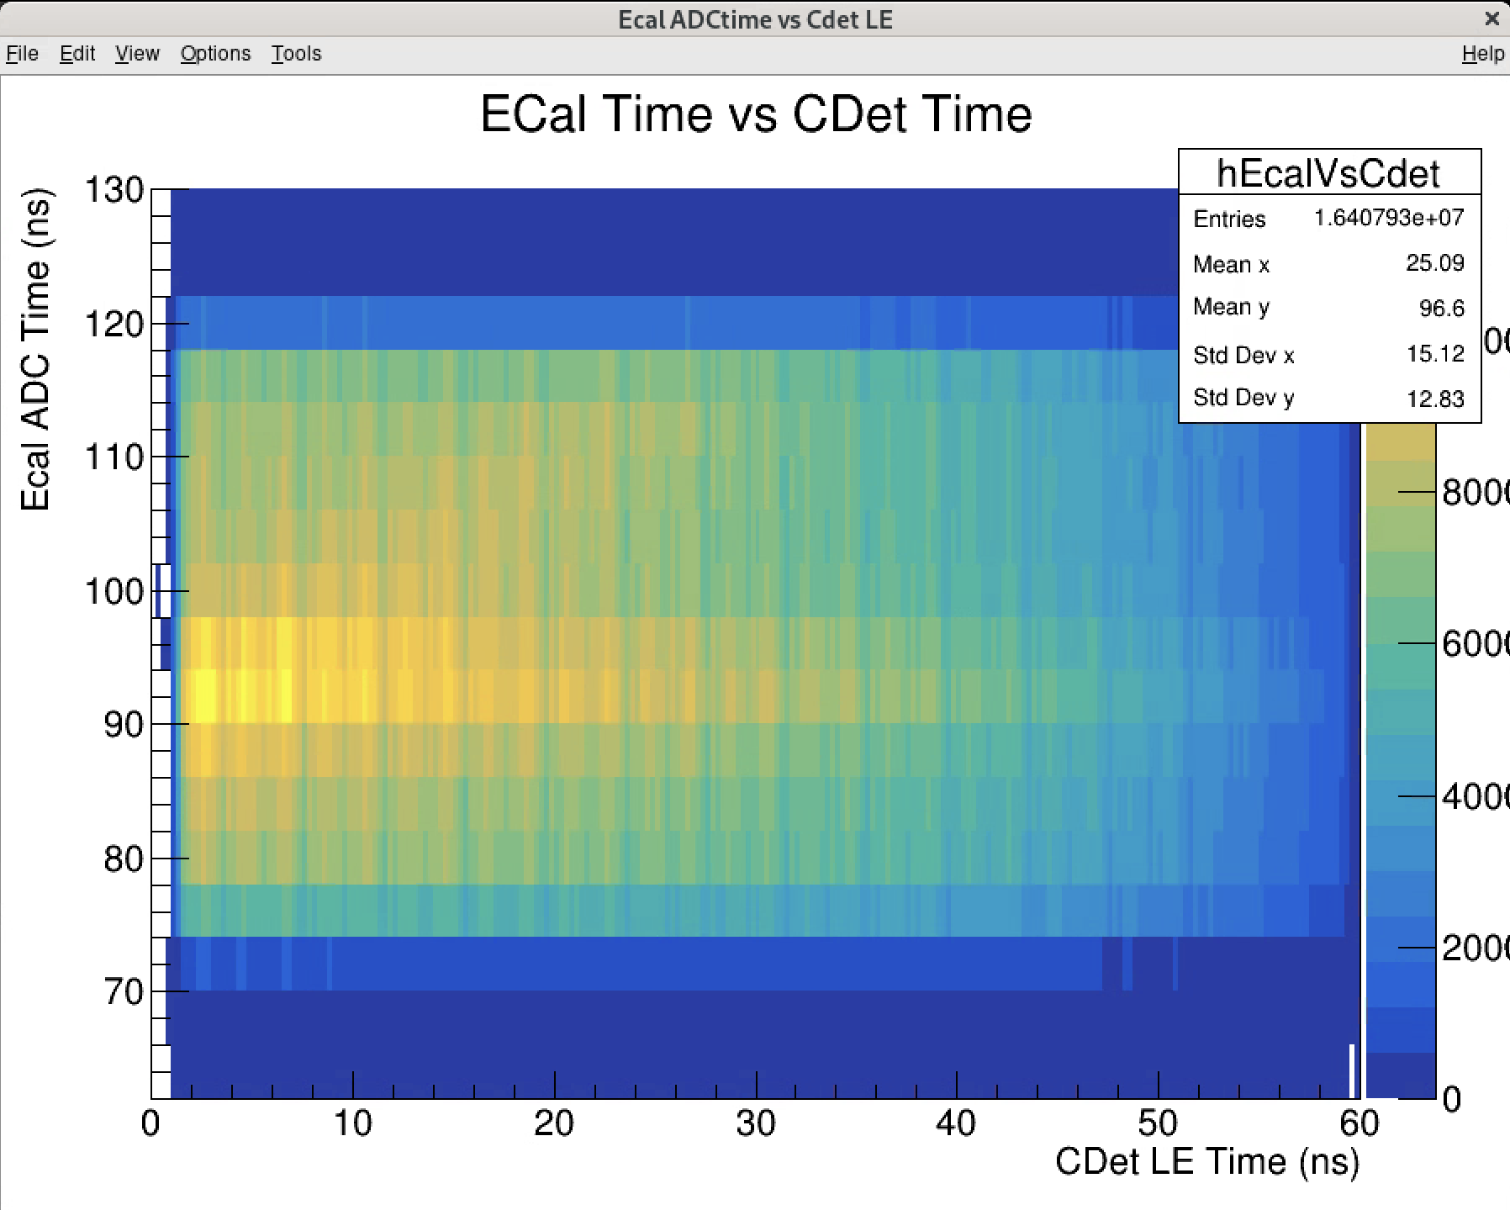
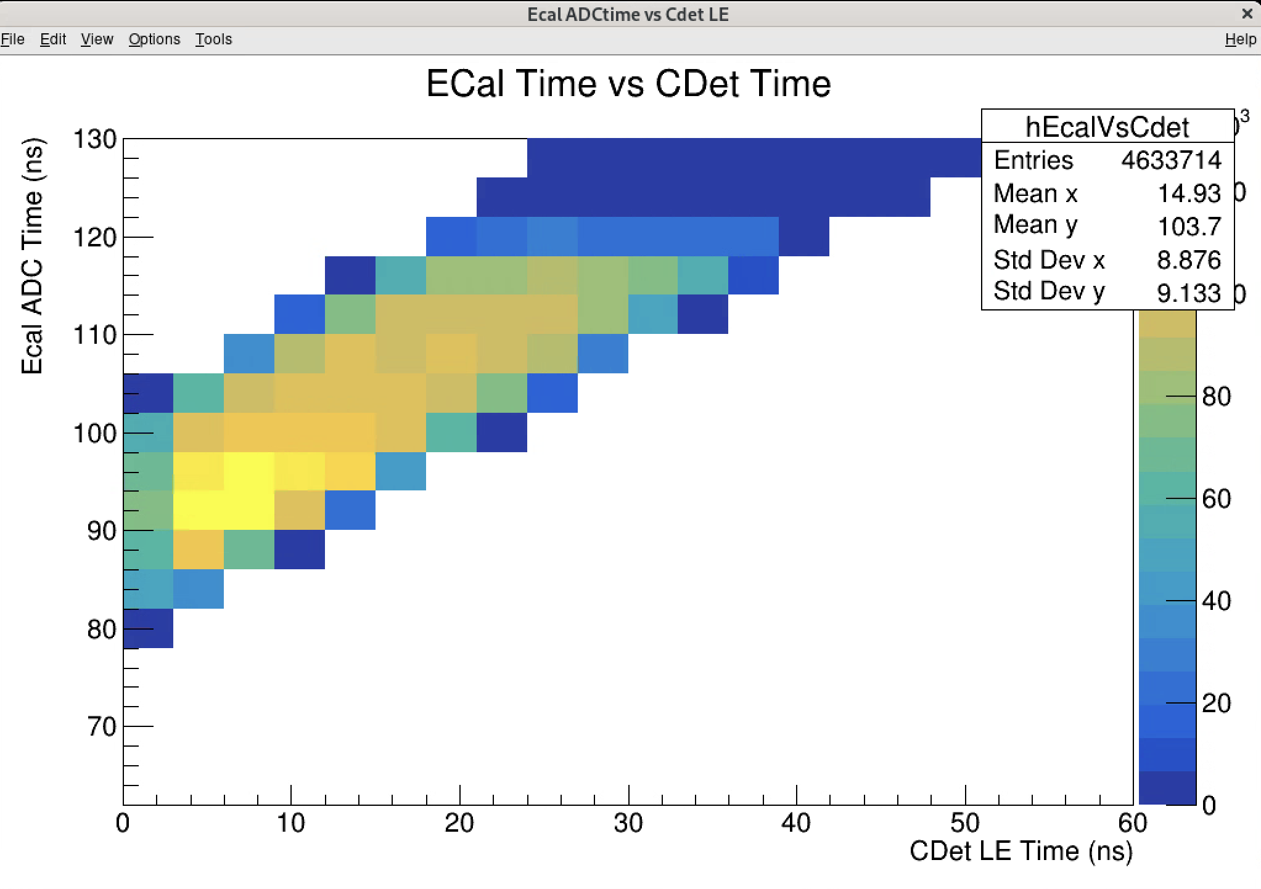
Ecal Good Adctime vs Cdet LE time
Time diff between 80-100ns

Slide 4
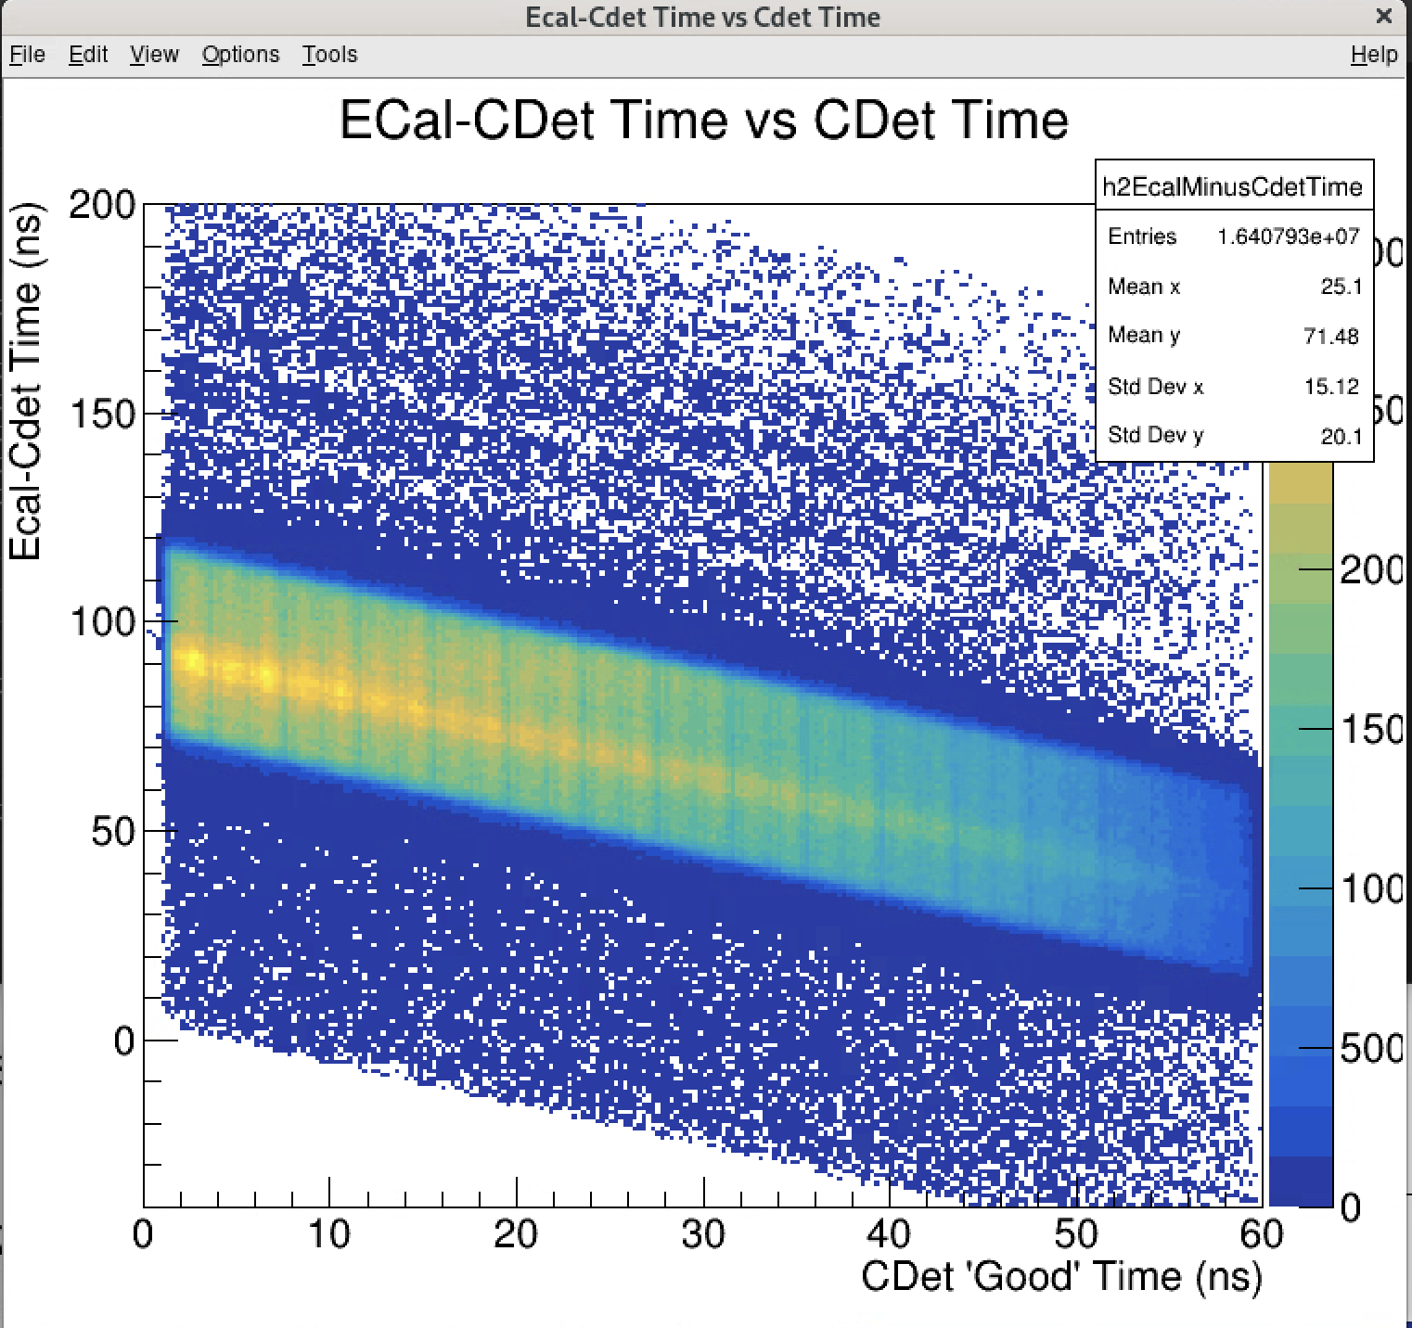
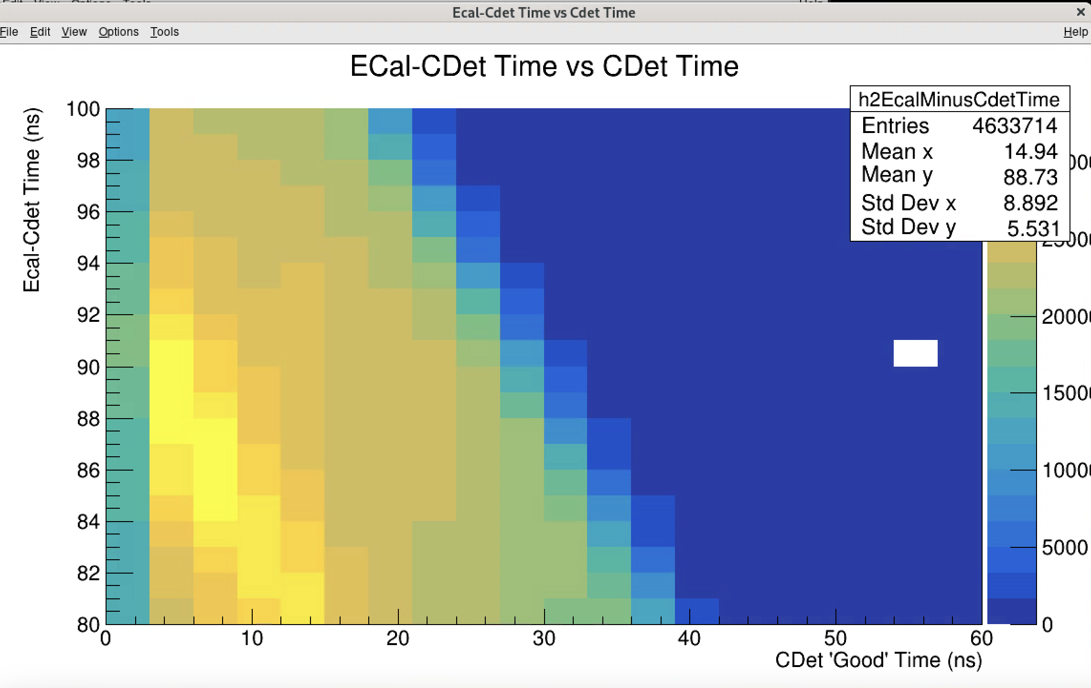
Ecal-Cdet Time vs Cdet LE time

Slide 5
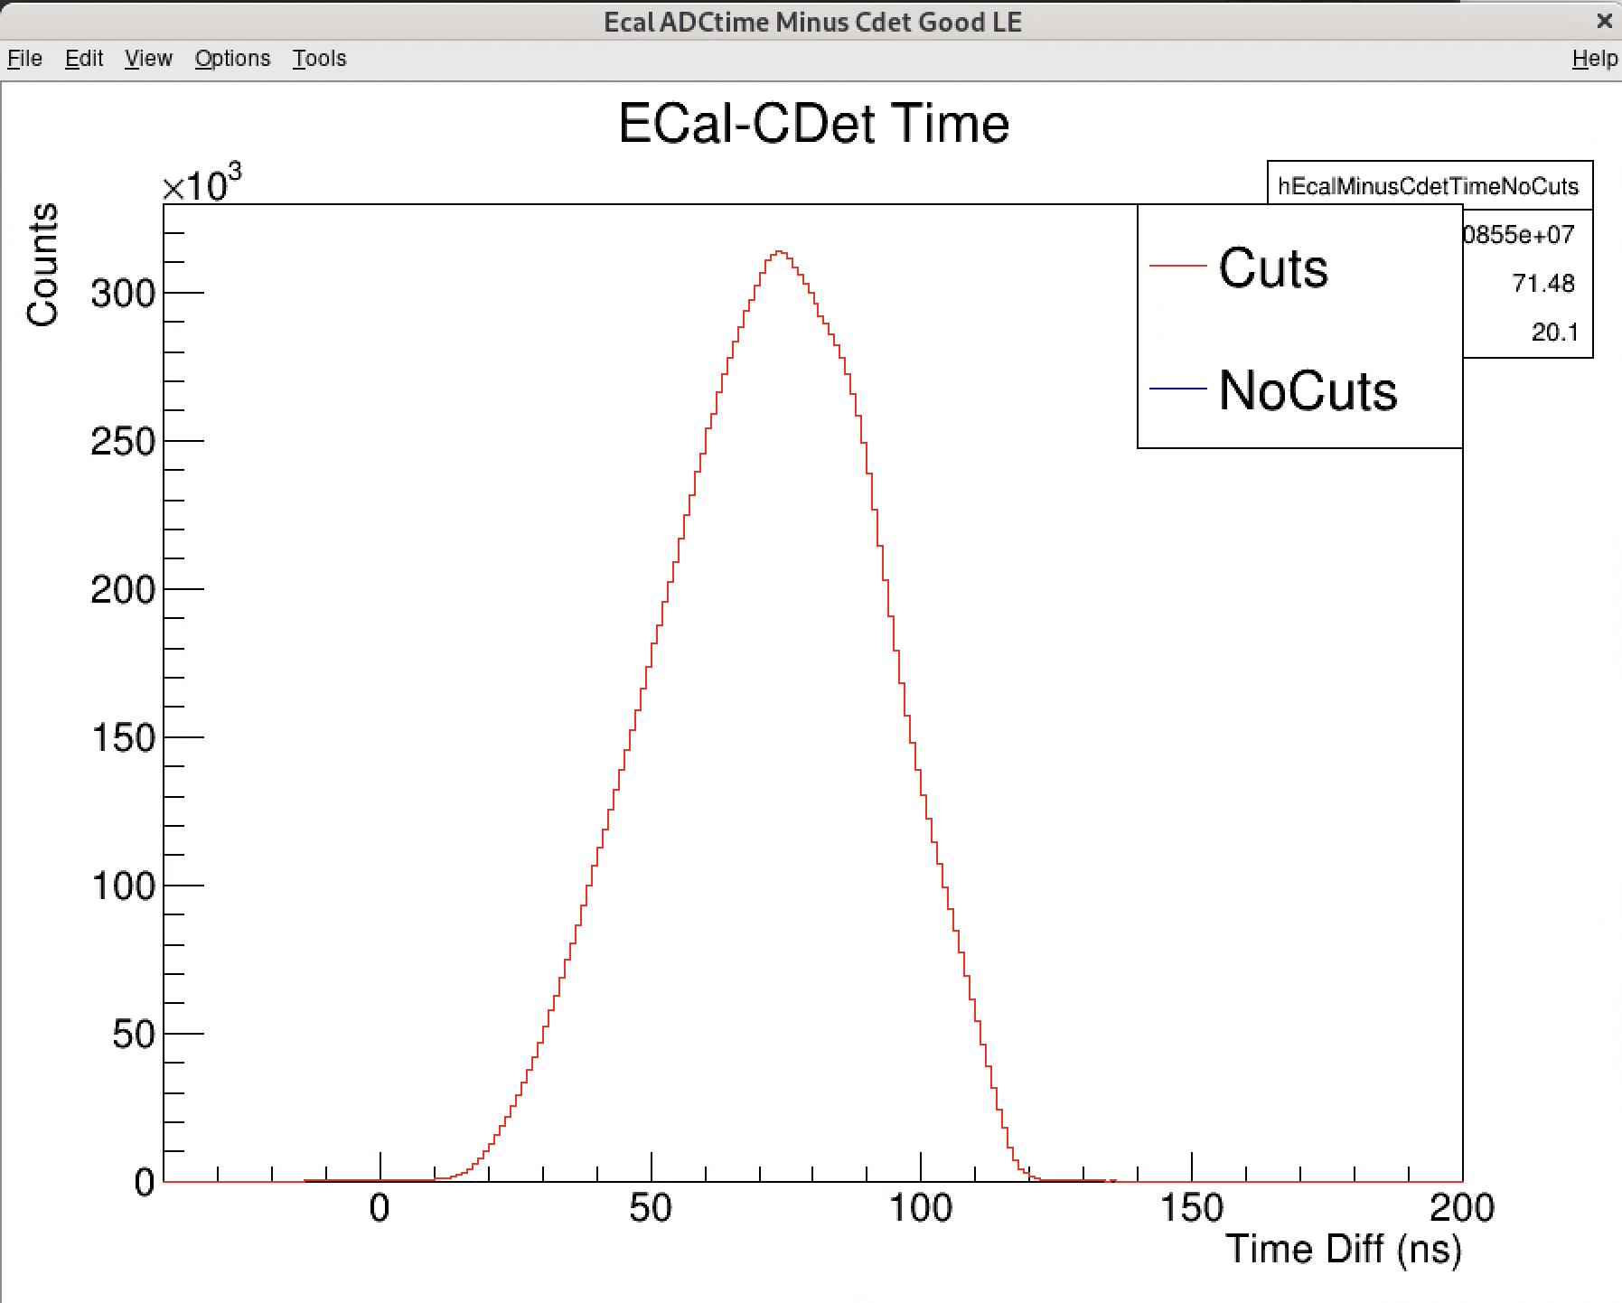
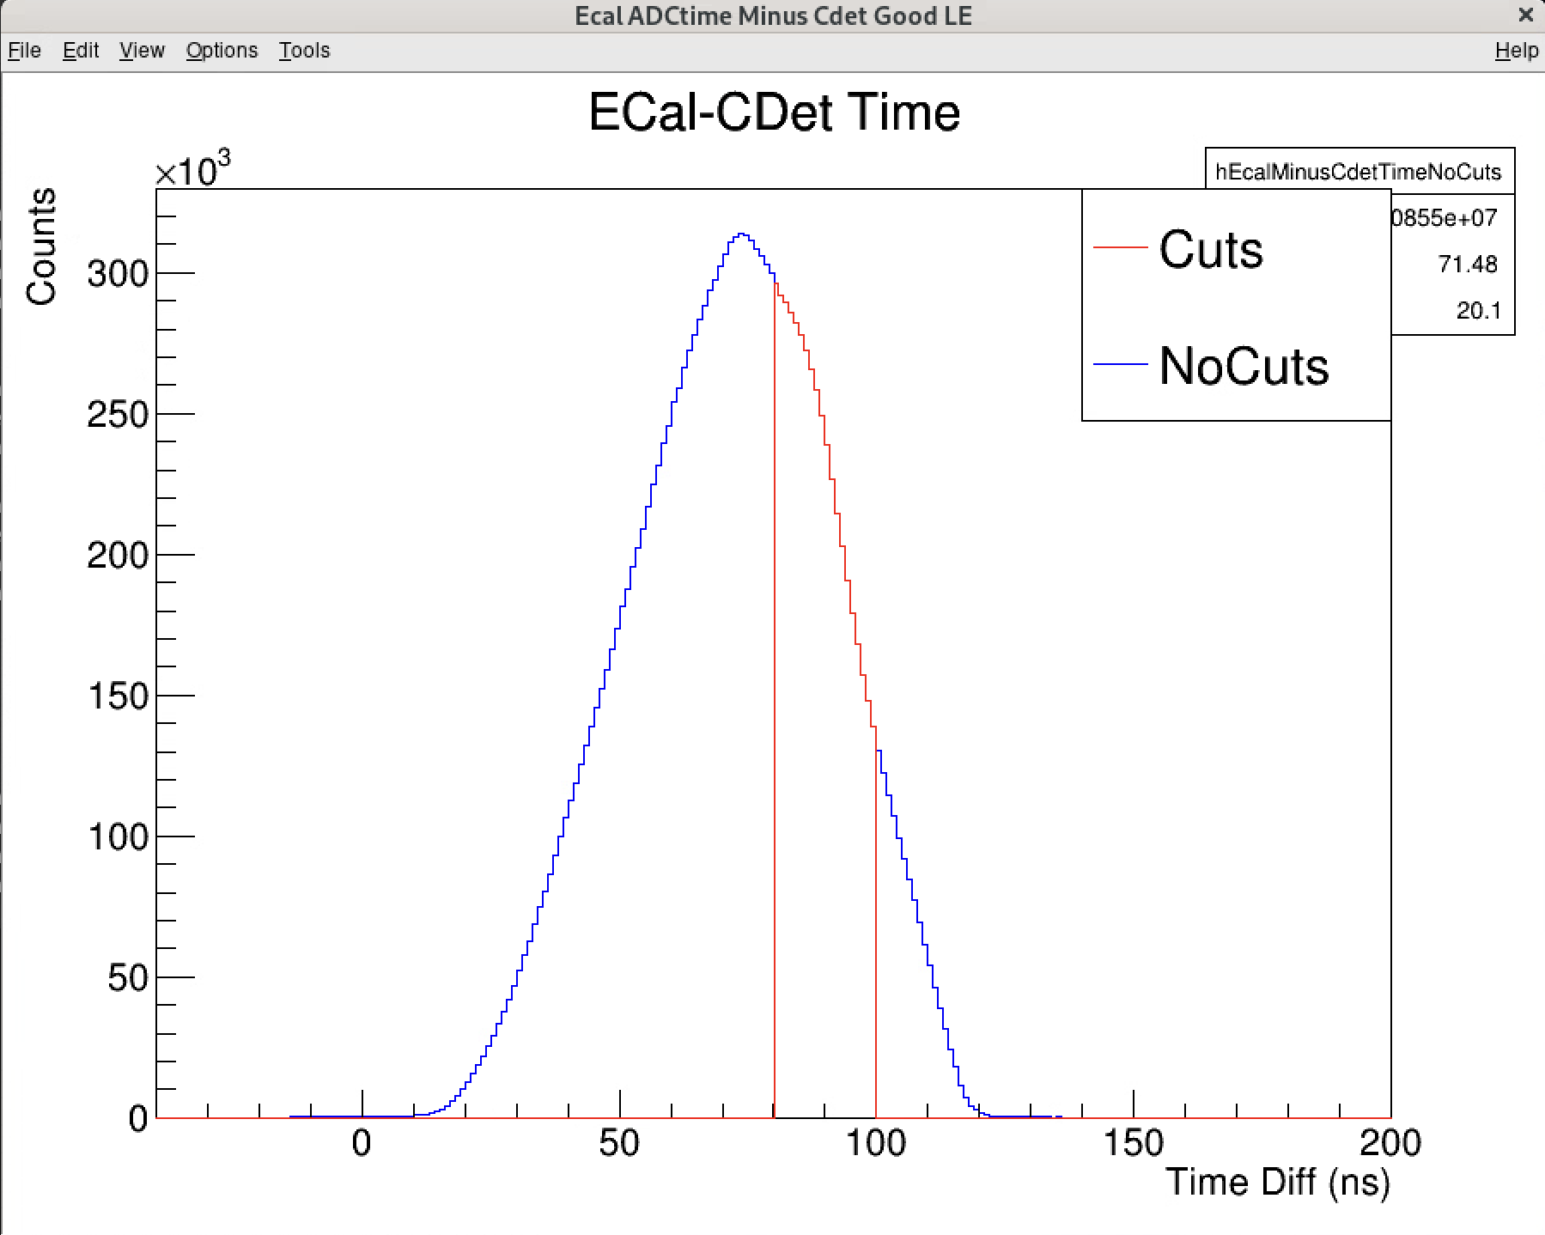
Time Diff vs Counts

Slide 6
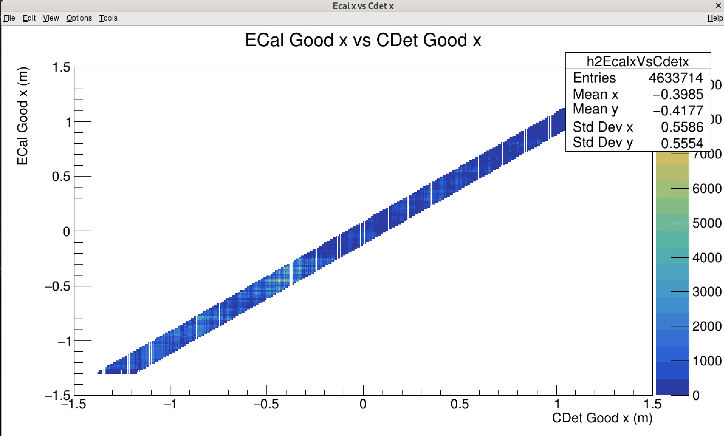
X position correlation

