Slide 1
October 7th Update
Ben Spaude

Slide 2
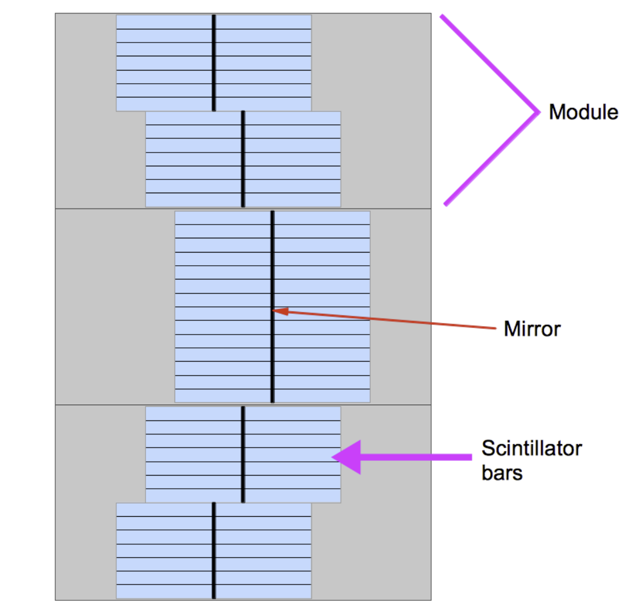
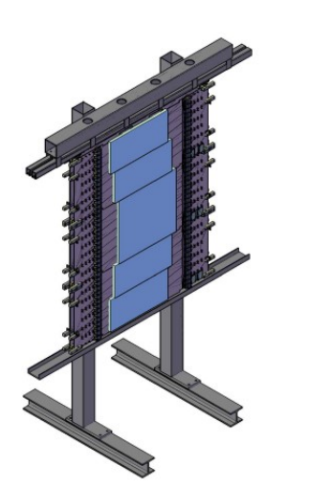
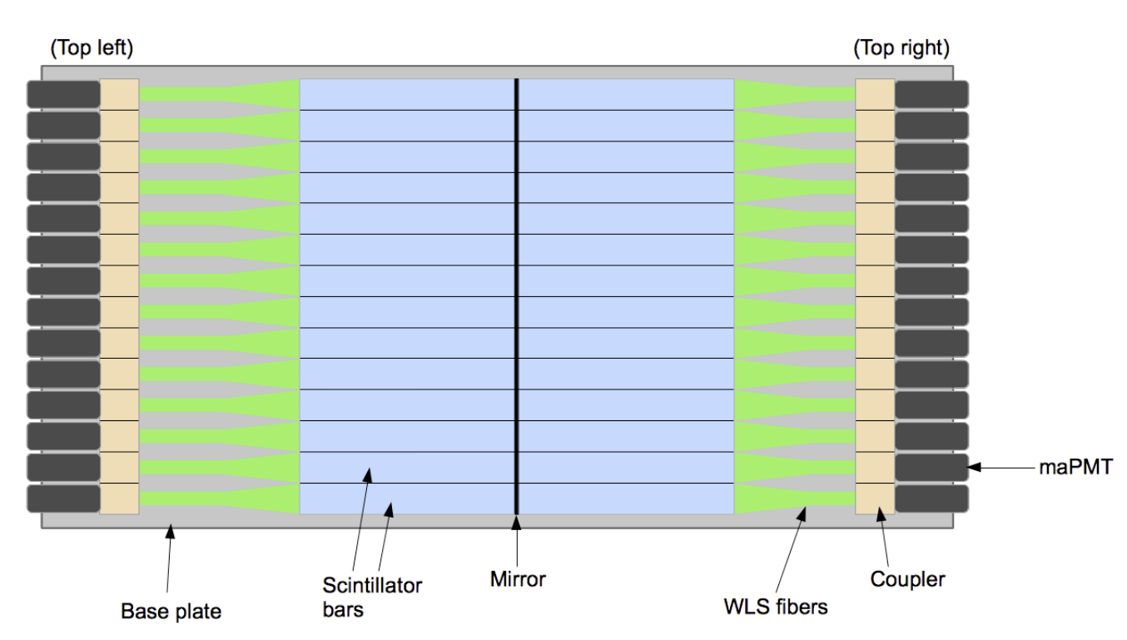
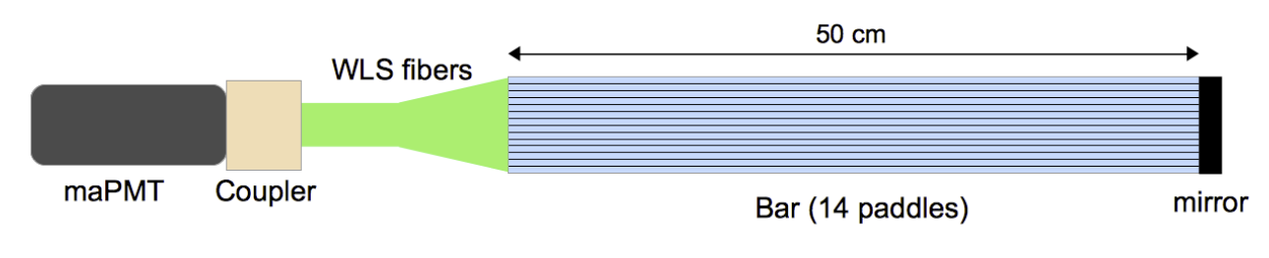
Coordinate Detector
Plastic Scintillating Detector (Vinyl toluene)
Broken into layers, modules, bars and paddles
maPMT & NINO Cards
Can utilize ADC or TDC signals
2352 total channels

Slide 3
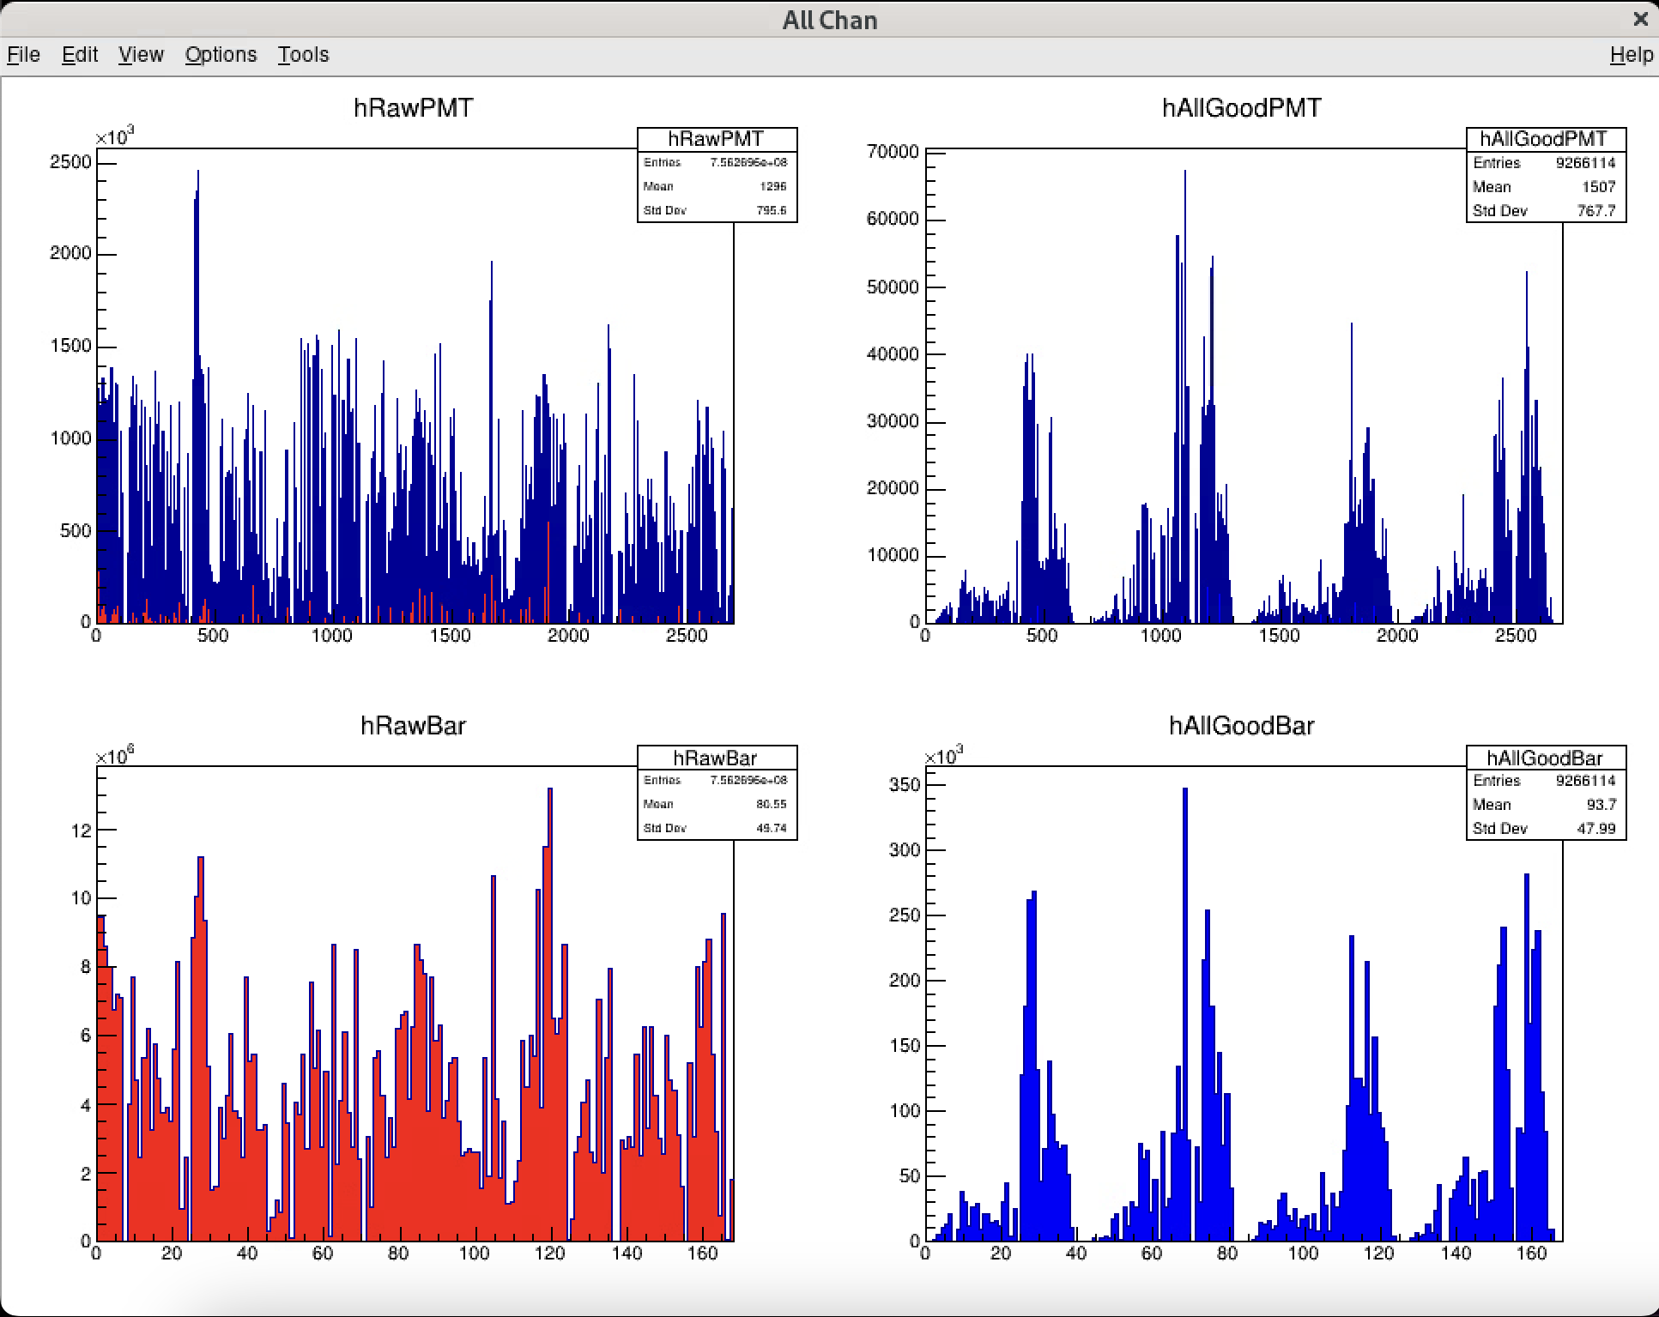
“Raw” – All data w/ timing cuts
“Good” – has position cuts

Slide 4
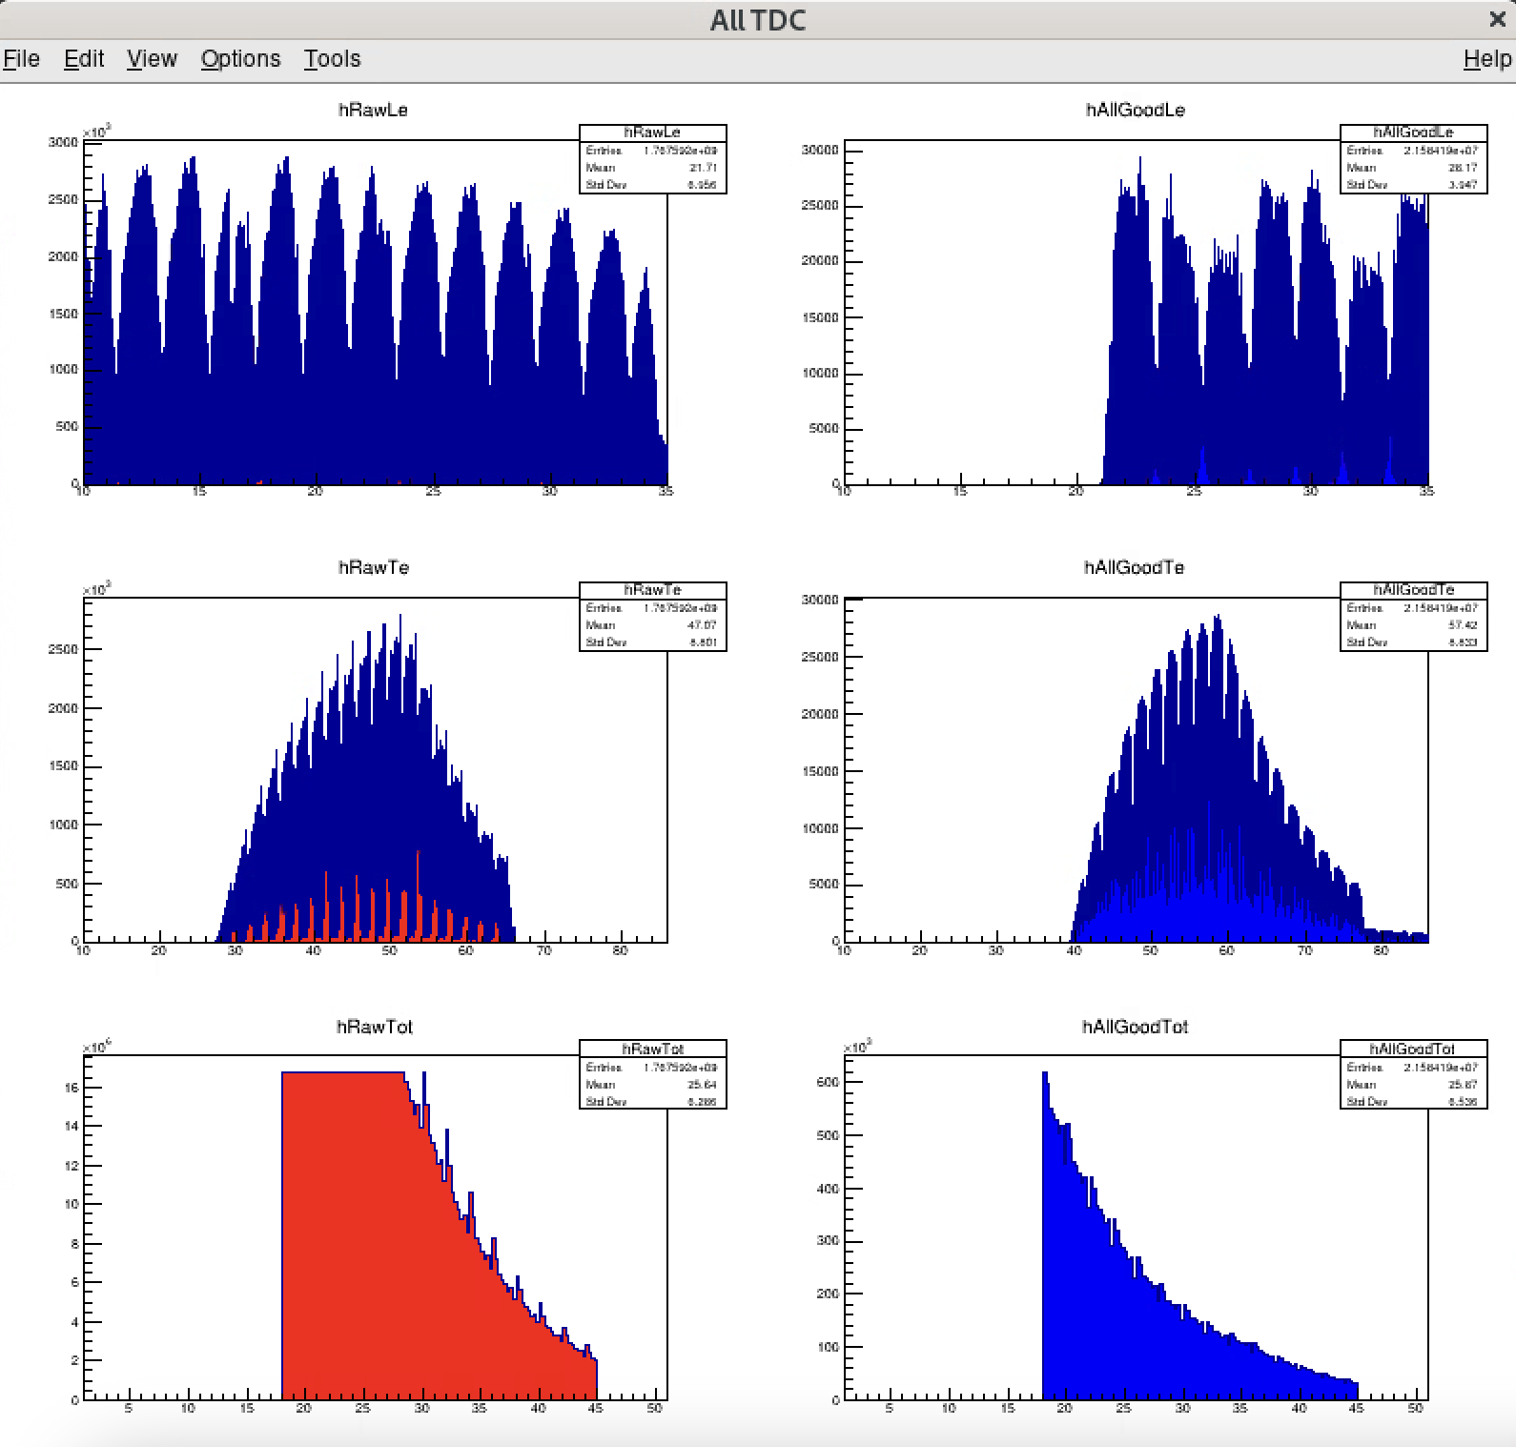
2ns “pulse” due to firmware, 2ns bit divided by fine-time calibration

Slide 5
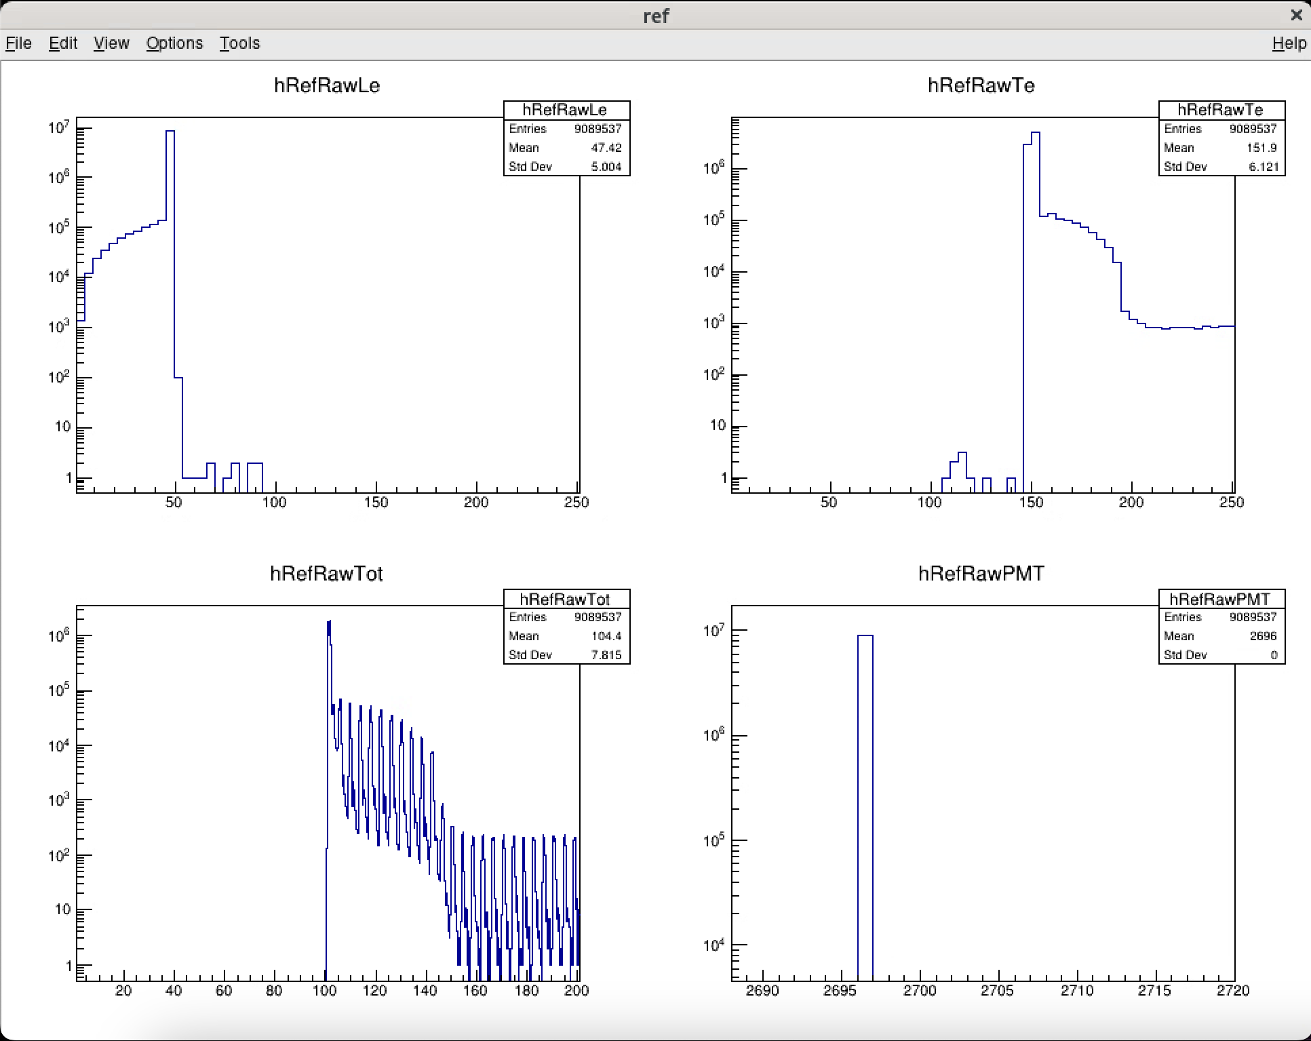
Ref Signal typically comes in at LE~50ns
Should always come in at approx. same time-jitter in trigger causes deviation in ref signal LE time

Slide 6
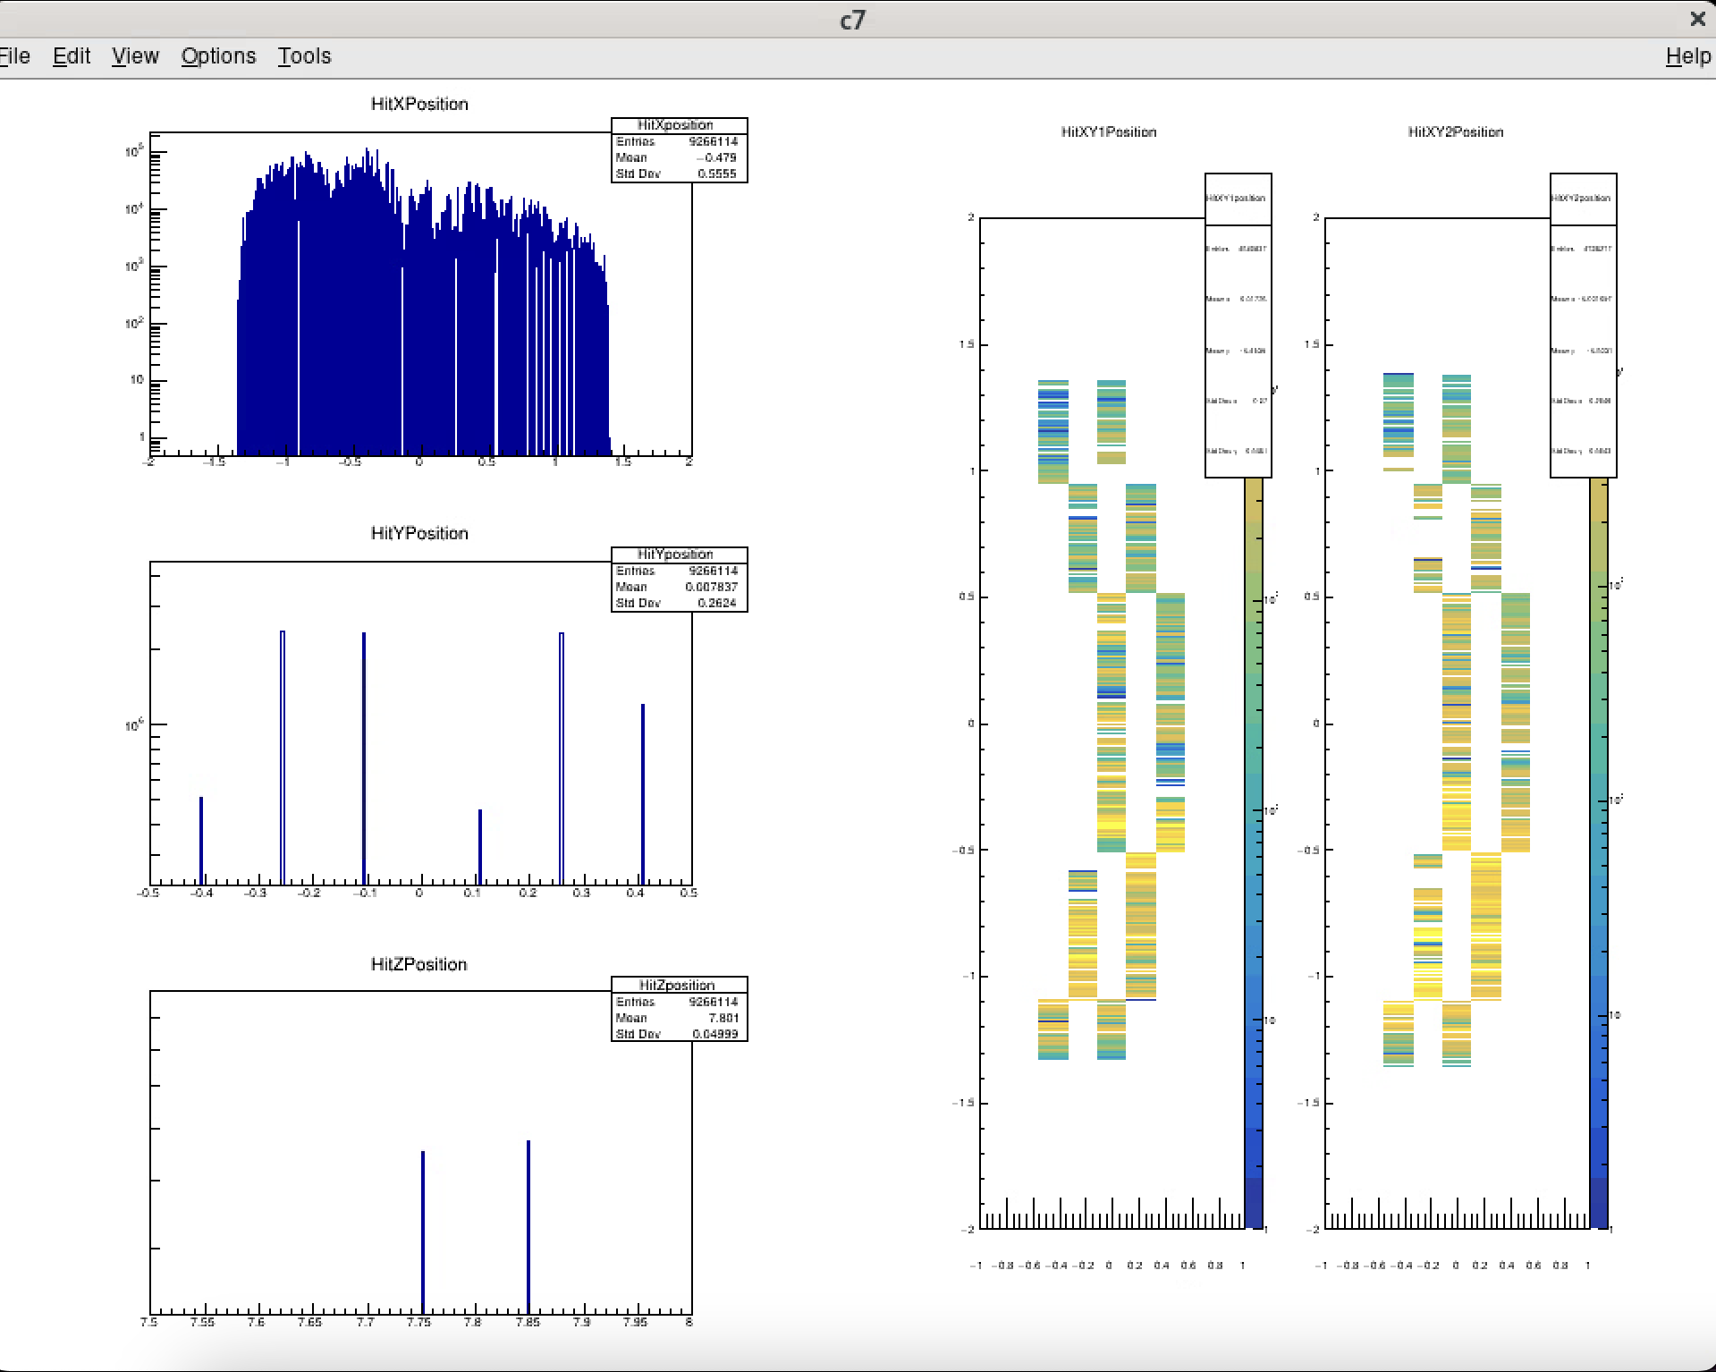
Missing a couple bars & paddles
Where missing in layer 1, present in layer 2

Slide 7
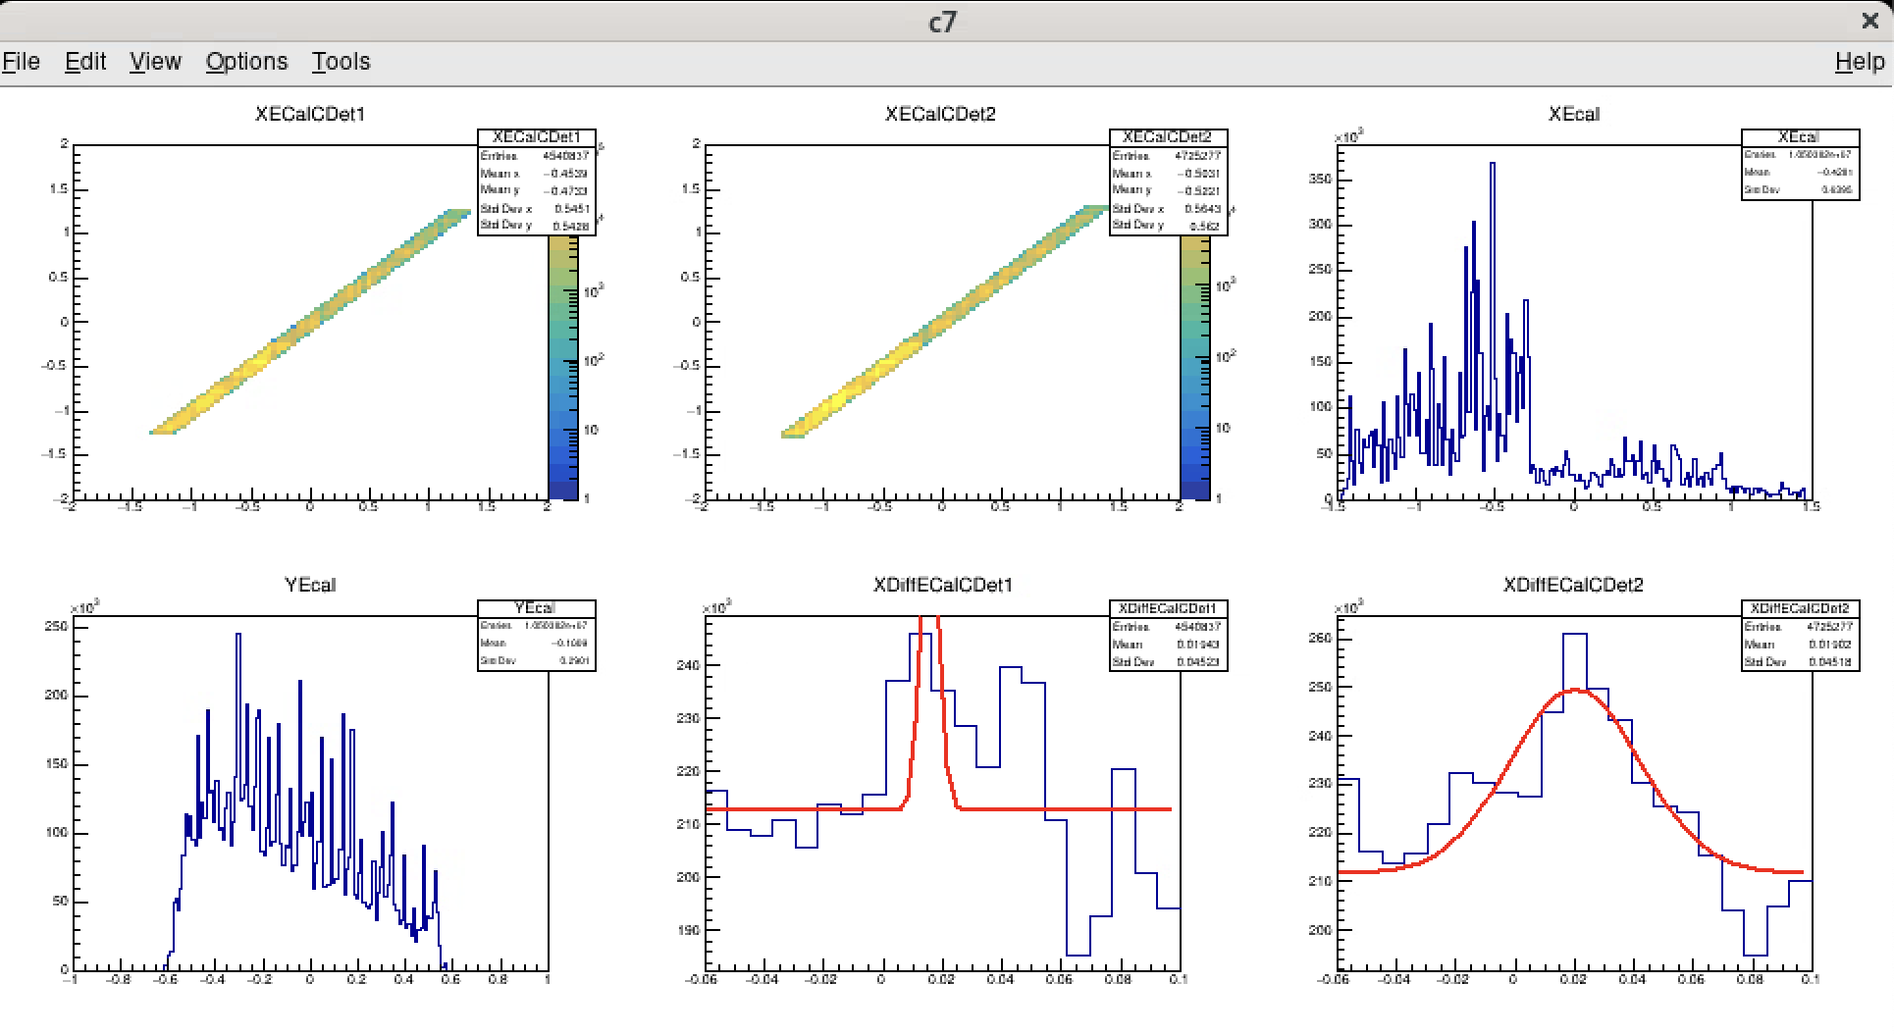

Slide 8
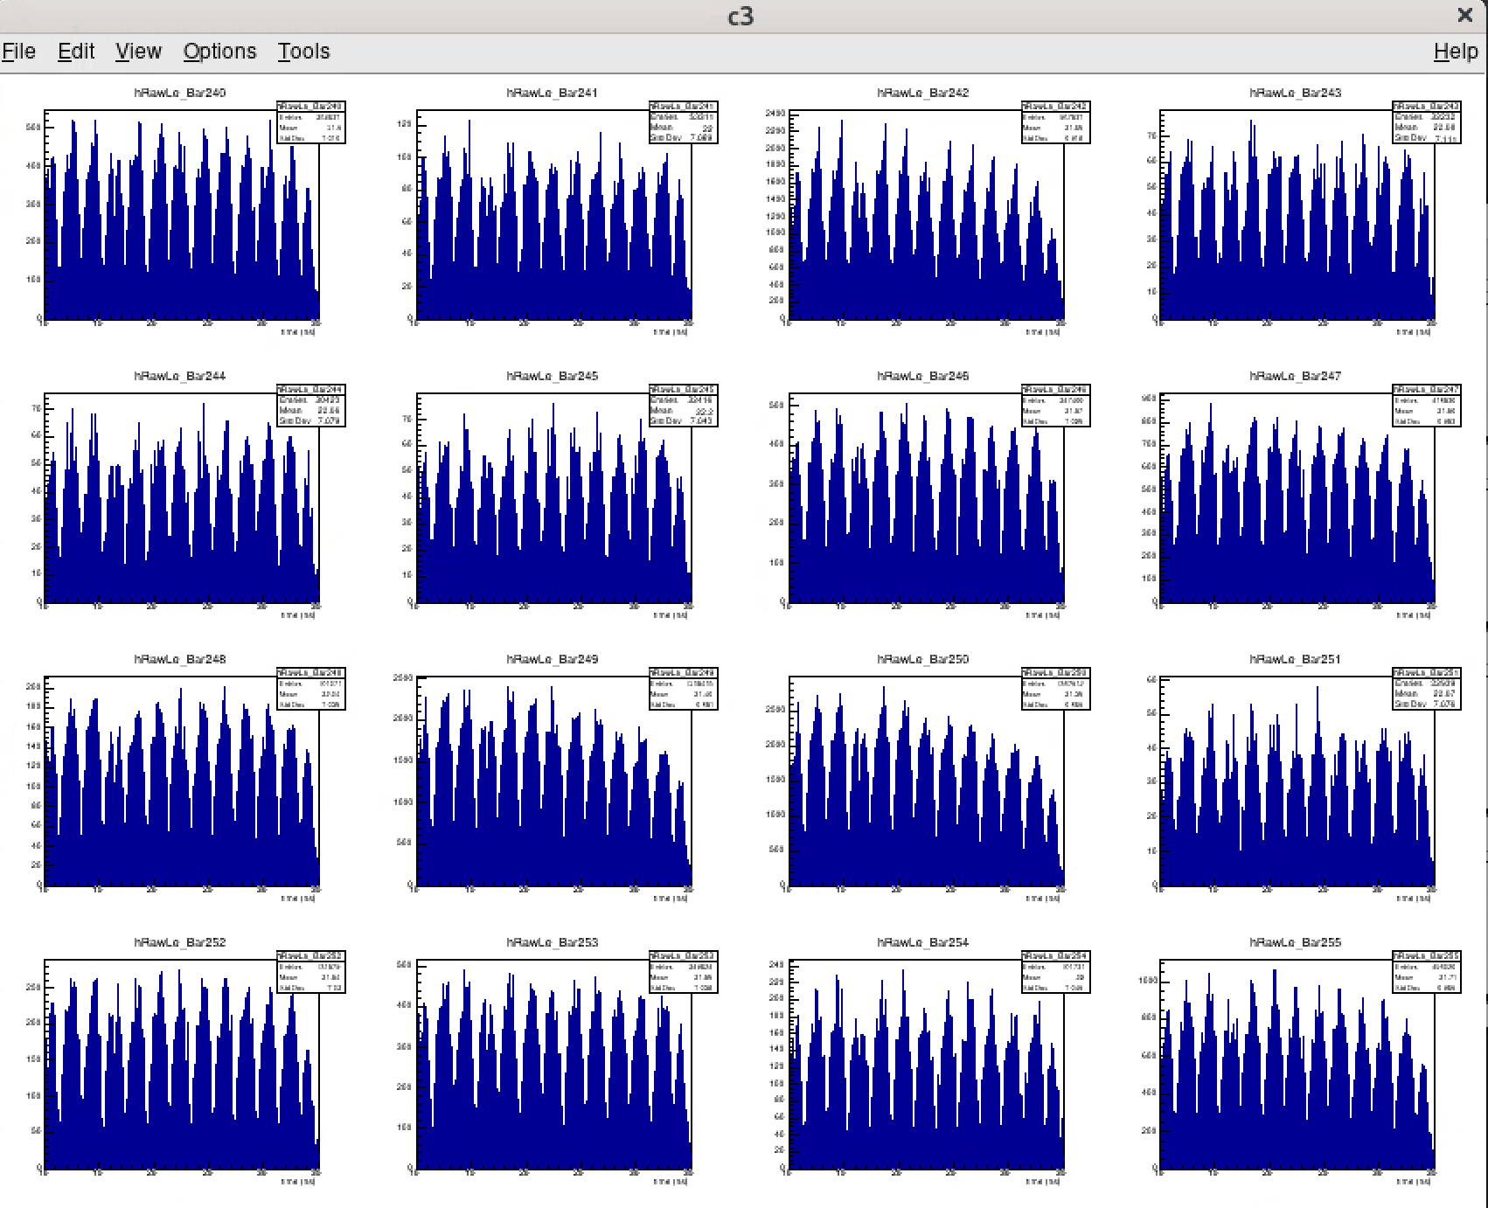

Slide 9
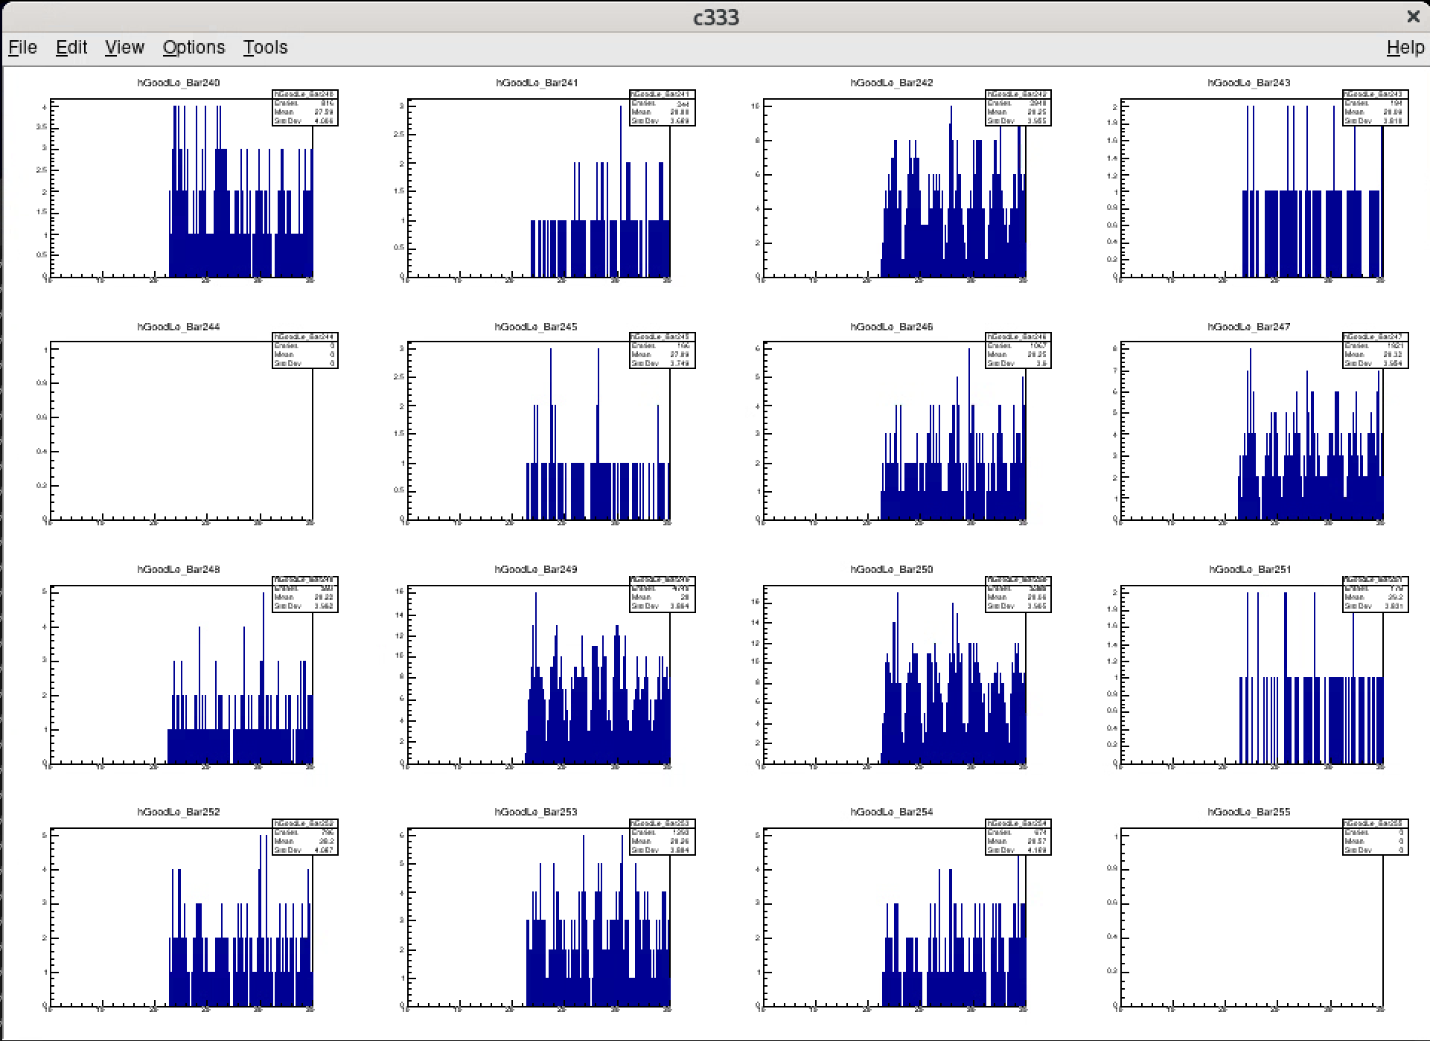
*Should say Paddle, not bar

Slide 10
BACKUP SLIDES

Slide 11
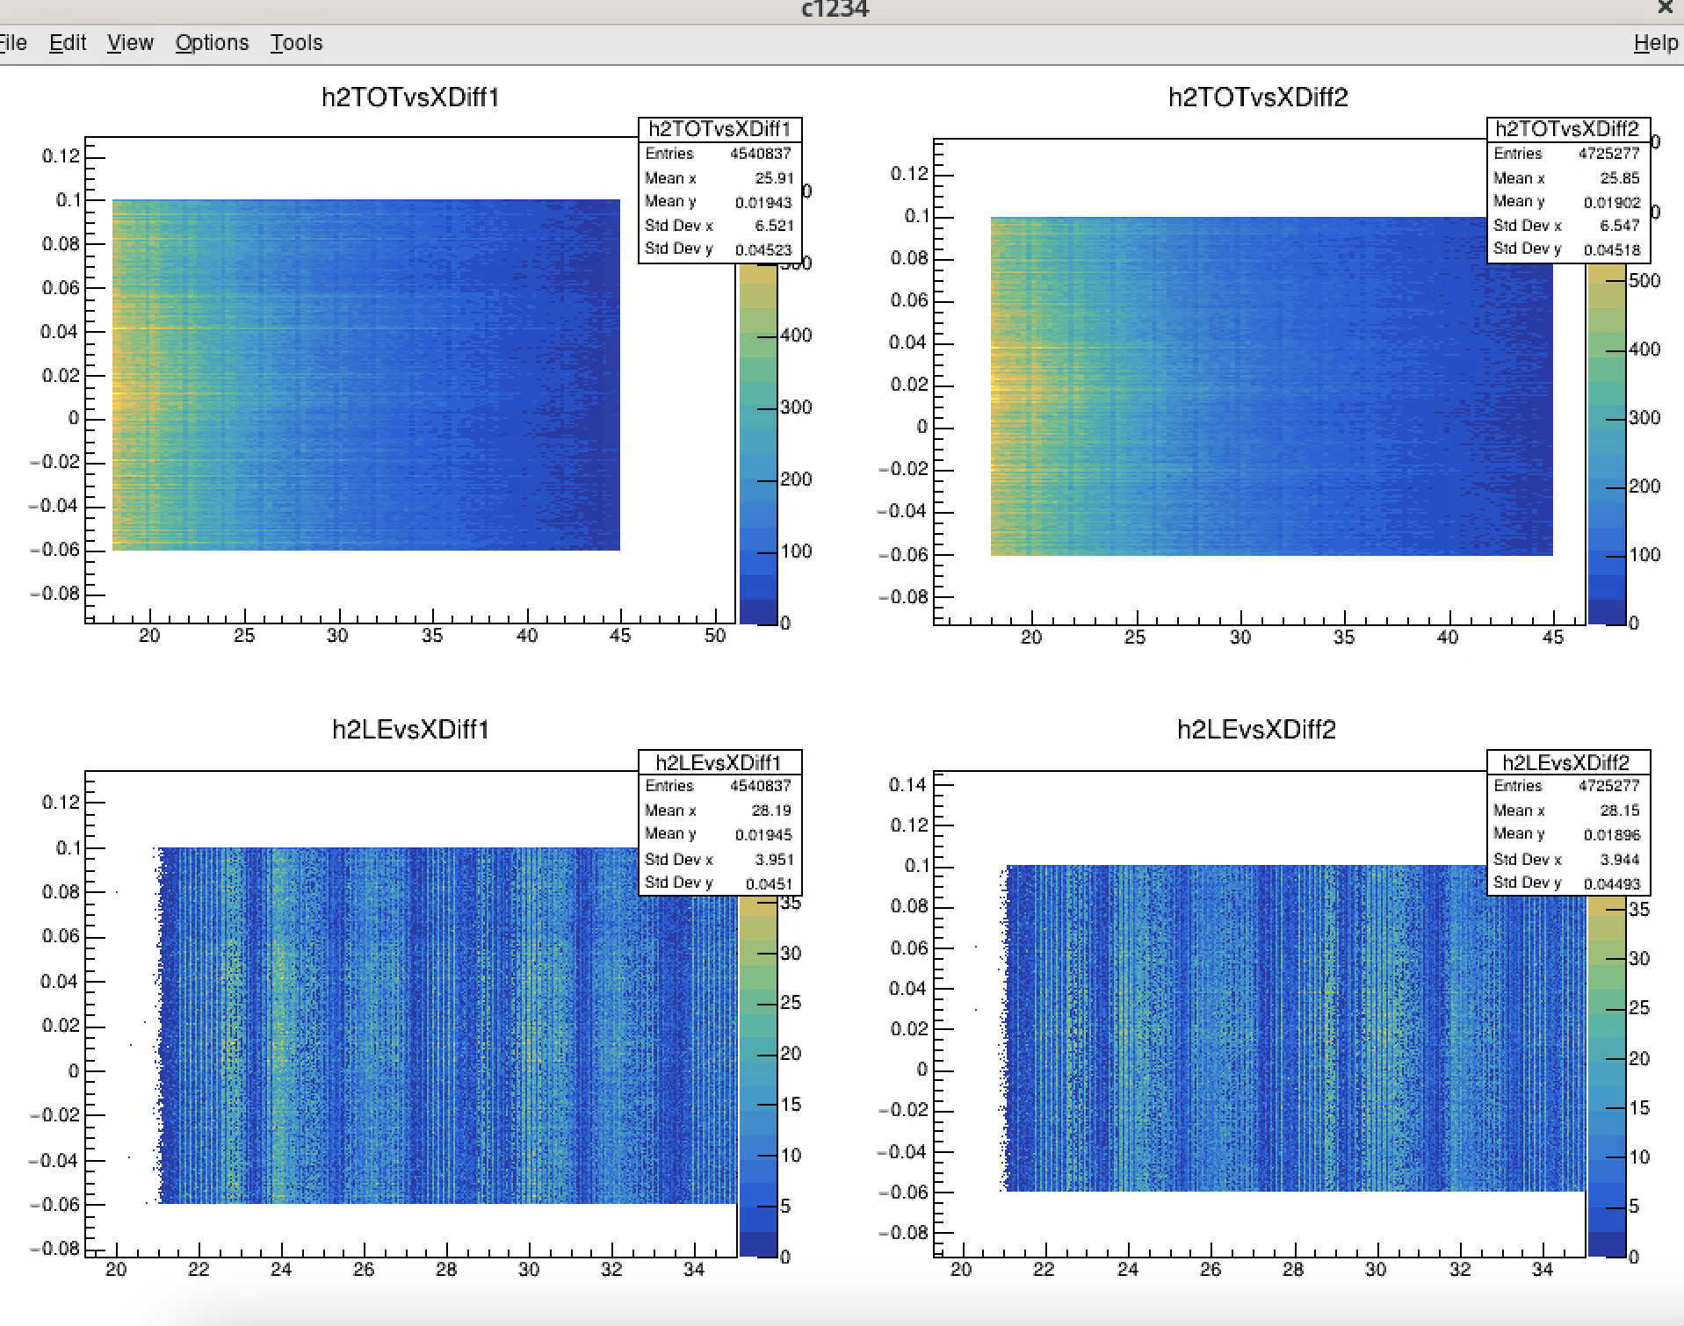

Slide 12
