Slide 1
CDet Pixel Investigation

Slide 2
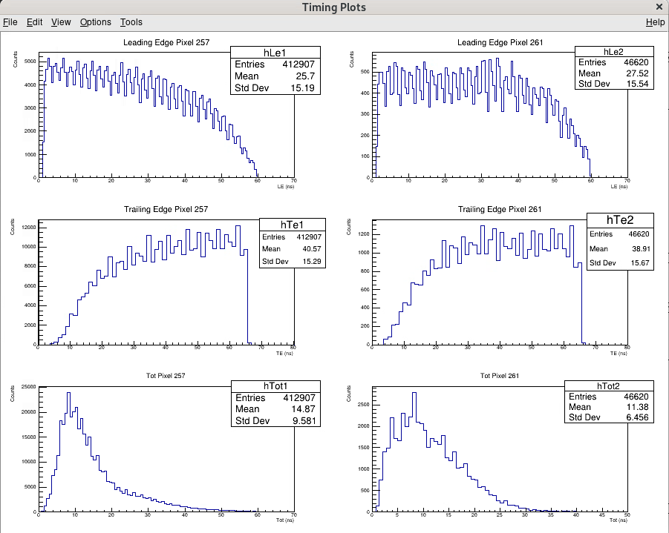
Notes:
Pixel 261 -> 0, 0, 1, 2, 5 -> Layer 1, left side, middle module, 3rd bar, 6th pixel

Slide 3
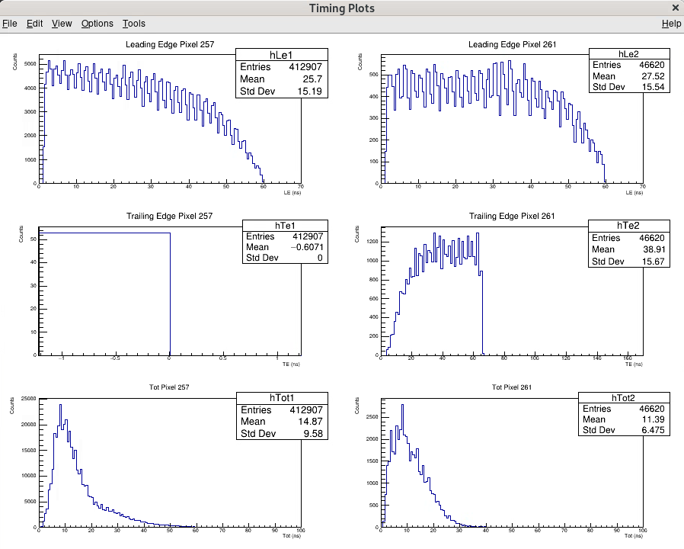

Slide 4
