Slide 1
Coordinate Detector Commissioning: Study of Crosstalk
Ralph Marinaro
Christopher Newport University
December 6, 2017

Slide 2
How do we perform commissioning?
Half module setup, 196 channels, 196 optical fibers, in 14 groups of stacked scintillating bars, 14 PMTs
Channels are oriented so that thin side of paddles face upwards
Allows for vertical tracks of cosmic rays to occur in individual channels without interacting with other channels
How do we collect data?
Use coincidence setup with two trigger scintillating paddles above and below detector
Triggers act as a gate in which ADC data is recorded to increase counting rate
How do we observe crosstalk?
Use multichannel oscilloscope connected to signal output for ADC and TDC
We can count events to verify analysis by using rough approximation of crosstalk percentages

Slide 3
What is the concern?
What is crosstalk?
Crosstalk is undesirable artificial correlation between signals in different channels of the detector. This parasitic correlation is caused by undesirable affects which lead to problems in the data.
We want to know which are the real signals and which are not and in which channel a real signal actually occurs.

Slide 4
Causes of Crosstalk
Displacement of fibers in relation to PMT, leads to optical leak of photons into incorrect pixels
Can be corrected by precision alignment which can be done since optical fiber is 2 mm and pixel area is 4x4 mm
Close proximity of fibers to each other, leads to leaking of photons between fibers
Can be corrected by improving system to include sleeves between fibers to avoid contact
Electrical crosstalk, caused by capacitive coupling in PMT between individual channels

Slide 5
Study of Probability of Crosstalk
Utilize ADC data to define unambiguously good event
Good event – high ADC signal in main channel, high TDC signal in main channel, low ADC signal in adjacent channels
Crosstalk event – high ADC signal in main channel, high TDC signal in main channel, low ADC signal in adjacent channels, high TDC signal in any other channel
Used number of crosstalk events over total events to get crosstalk percentages between channels

Slide 6
Results of Study on Probability of Crosstalk
Probability increases with HV and varies between PMTs and channels
Crosstalk for many channels are high (> 10%) so needed to investigate further on how to remove significant amounts of crosstalk
Next step involves utilizing TDC data to remove crosstalk events

Slide 7
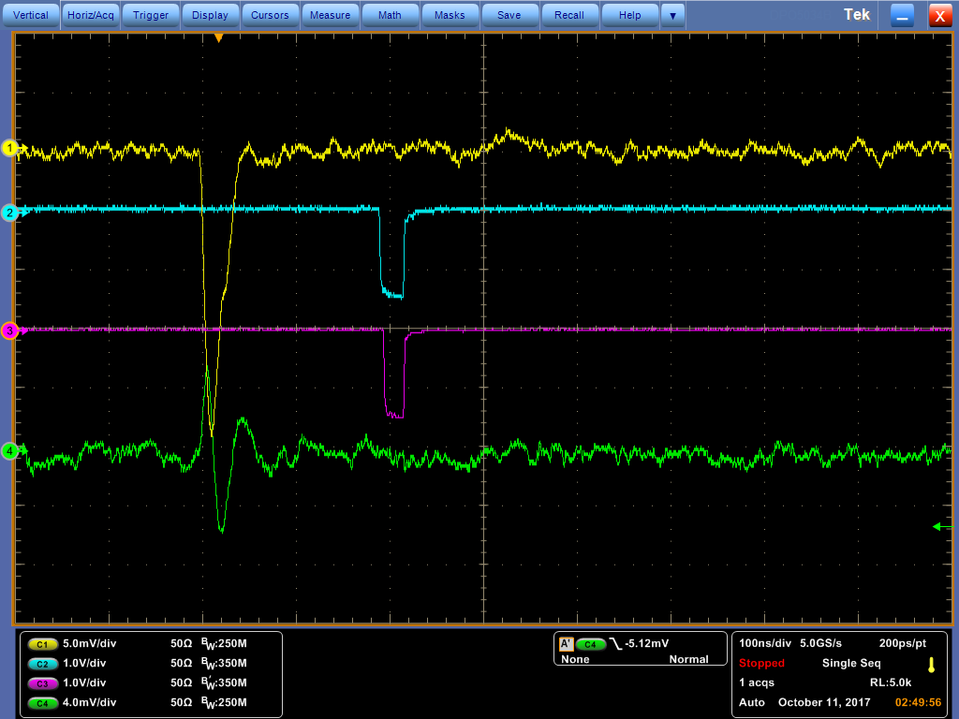
Oscilloscope Observations
What does a normal event look like?
Uni-polar negative ADC signal with corresponding TDC
What does a crosstalk event look like?
Bi-polar ADC signal with corresponding TDC
Means we can distinguish crosstalk event by small ADC signal

Slide 8
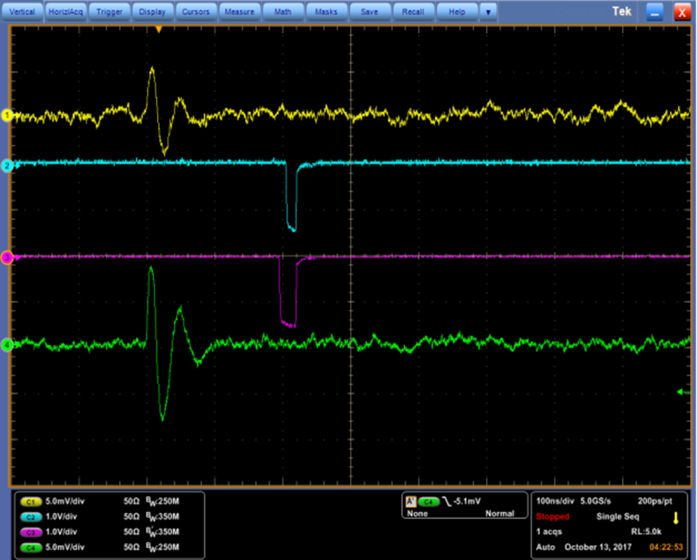
Oscilloscope Observations
We can also distinguish crosstalk event based on TDC signal width
Observed many crosstalk events have shorter TDC signal widths

Slide 9
Study of Crosstalk Reduction
Utilize TDC data to define unambiguously good event
Good event – high TDC signal in main channel, high ADC signal in main channel
Crosstalk event – high TDC signal in main channel, low ADC signal in main channel
Used number of crosstalk events over total events to get crosstalk percentage for main channel

Slide 10
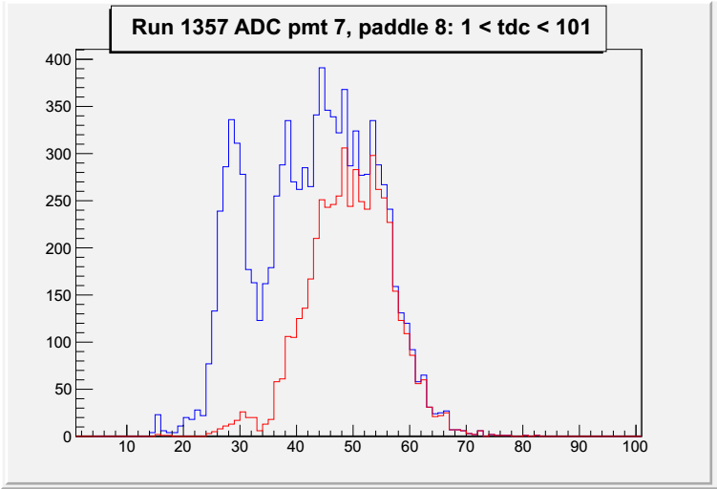
How do we determine TDC width cut?
Plot difference between TDC leading edge and TDC trailing edge
Blue – All TDC widths
Red – TDC widths w/ high ADC Signals (“good events”)
Found large spike at lower TDC widths representing a large portion of crosstalk events
Number of Events
TDC Widths
CUT

Slide 11
Example of Percent Crosstalk Reduction
PMT 1, HV = 725V
Results show large reduction of crosstalk across all channels
This is not a physical solution, only an analytical solution
Channel # | Before TDC Width Cut | After TDC Width cut
0 | 6.24% | 1.66%
1 | 6.81% | 1.87%
2 | 6.32% | 1.70%
3 | -
4 | -
5 | 2.97% | 0.43%
6 | 7.22% | 1.86%
7 | 10.50% | 2.63%
8 | 9.38% | 2.03%
9 | 3.80% | 0.70%
10 | 3.64% | 0.39%
11 | 8.67% | 2.15%
12 | 14.74% | 4.61%
13 | 3.18% | 0.68%
14 | 6.78% | 1.45%
15 | 10.01% | 2.78%

Slide 12
What are we currently doing?
Continuing with study on every channel in half module setup
Writing up documentation which summarizes the study
Plan on final completion of study in January 2018, ready for presentation of results at Winter Collaboration Meeting in February
Further understanding of crosstalk, its negative affect on data, how to identify crosstalk in data, and how to reduce crosstalk
What experience was gained?

