Slide 1
Feb 17th Update
Ben Spaude

Slide 2
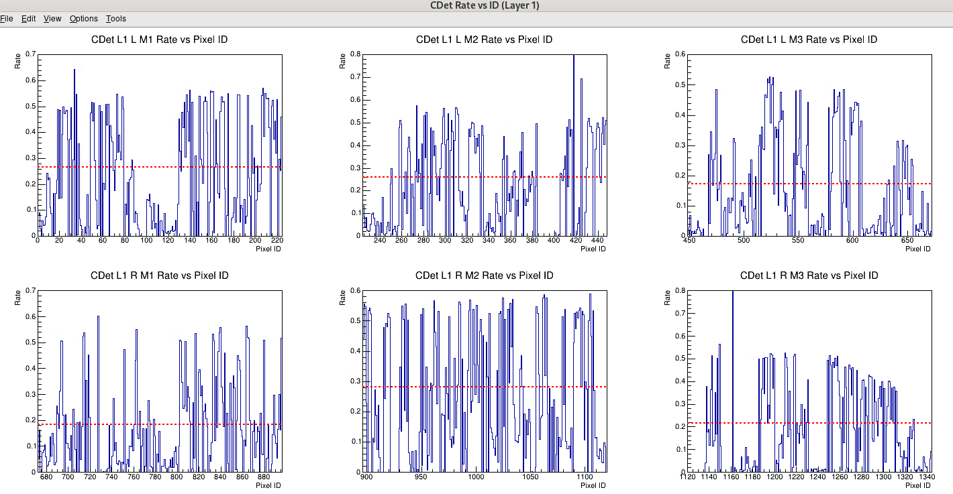
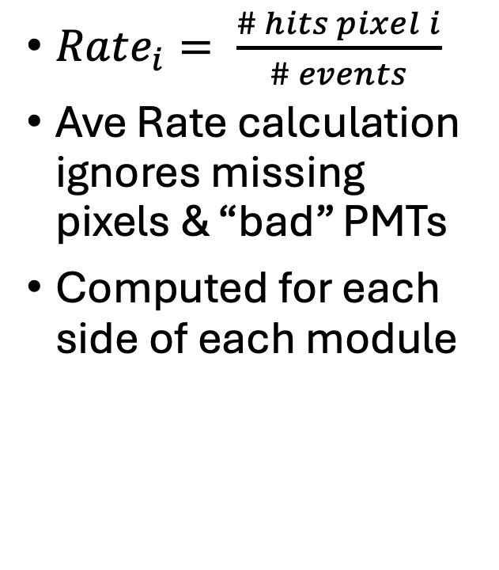
Raw Rates – Run 3640
Run 3640, 470k events, LH2 @ 5uA
$Rate_{i}= \frac{\# hits pixel i}{\# events}$
Ave Rate calculation ignores missing pixels & “bad” PMTs
Computed for each side of each module

Slide 3
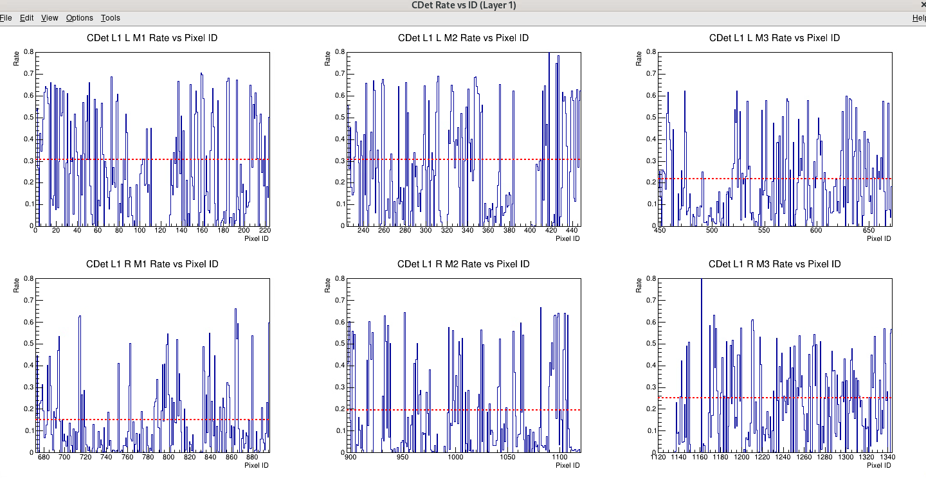
Raw Rates – Run 5811
Run 5811, 729k events, LH2 @ 16uA
$Rate_{i}= \frac{\# hits pixel i}{\# events}$
Ave Rate calculation ignores missing pixels & “bad” PMTs
Computed for each side of each module

Slide 4
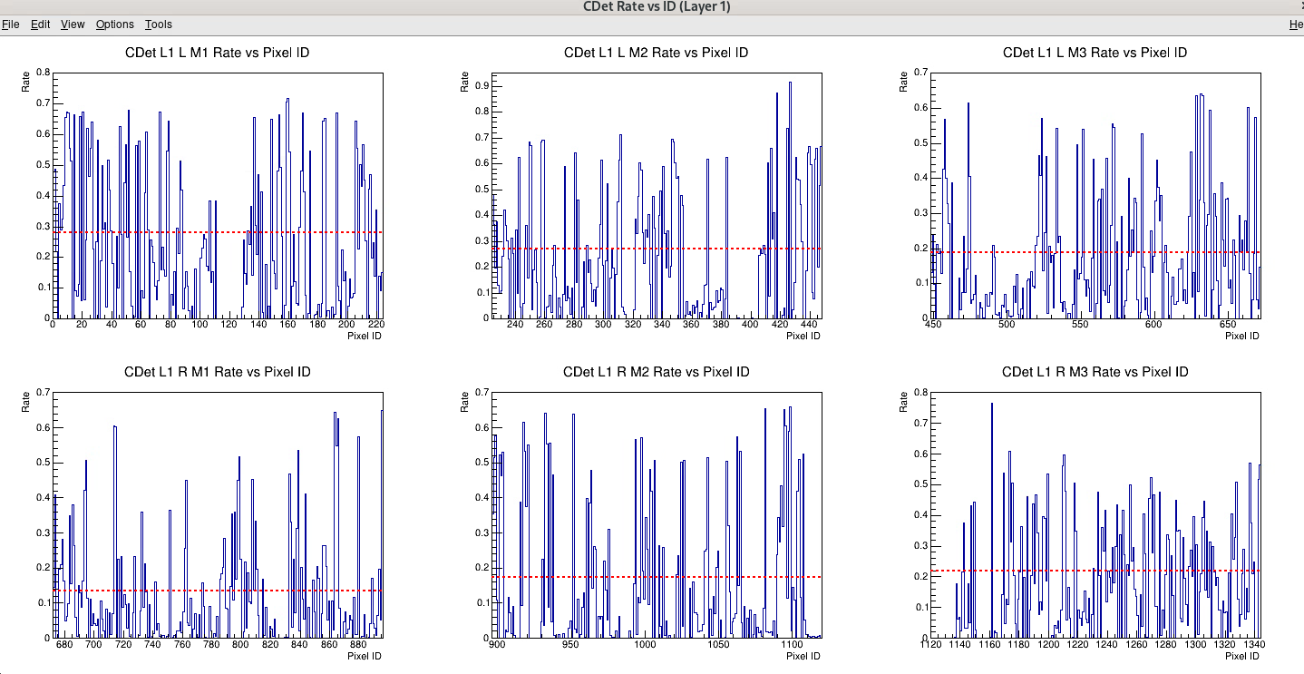
Raw Rates – Run 6077
Run 6077, 2.3M events, LH2 @ 22uA
$Rate_{i}= \frac{\# hits pixel i}{\# events}$
Ave Rate calculation ignores missing pixels & “bad” PMTs
Computed for each side of each module

Slide 5
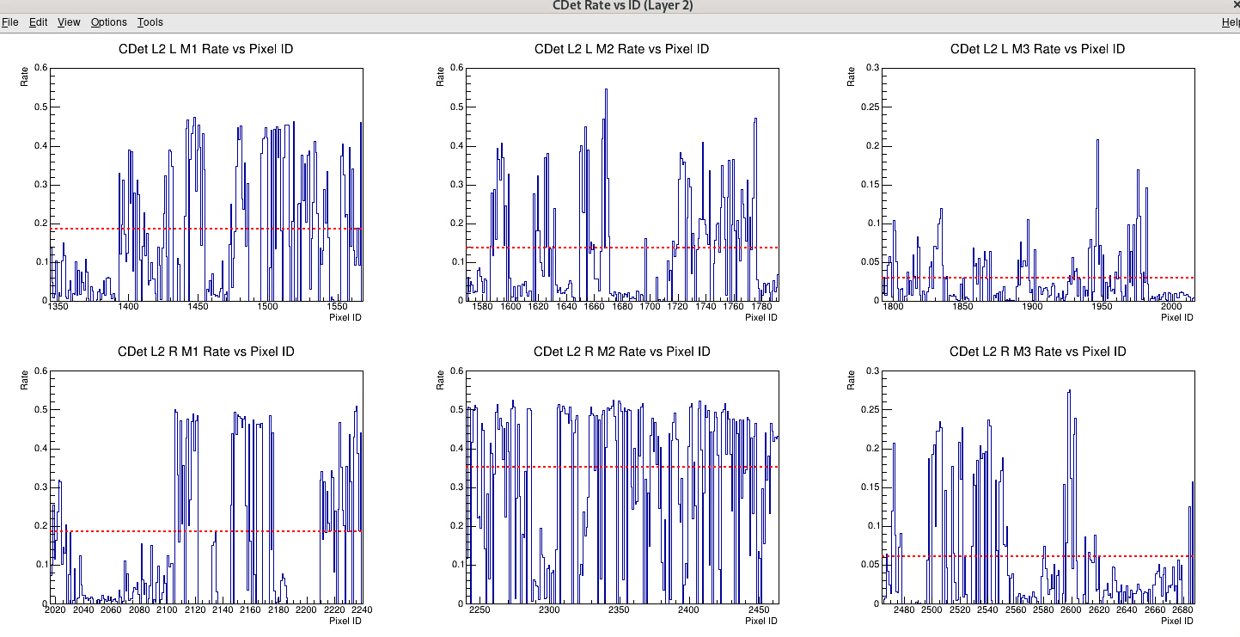
Raw Rates – Run 3640
Run 3640, 470k events, LH2 @ 5uA
$Rate_{i}= \frac{\# hits pixel i}{\# events}$
Ave Rate calculation ignores missing pixels & “bad” PMTs
Computed for each side of each module

Slide 6
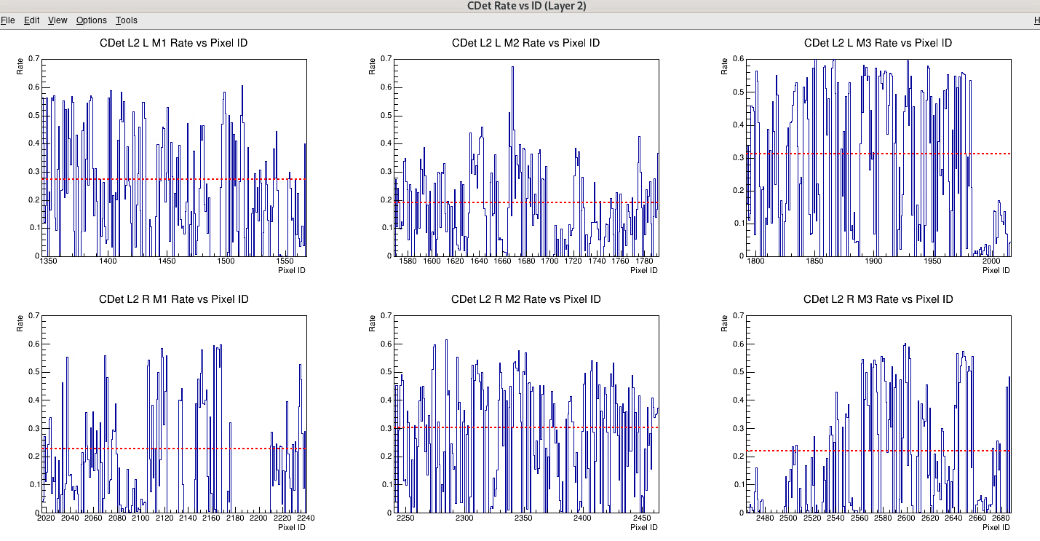
Raw Rates – Run 5811
Run 5811, 729k events, LH2 @ 5uA
$Rate_{i}= \frac{\# hits pixel i}{\# events}$
Ave Rate calculation ignores missing pixels & “bad” PMTs
Computed for each side of each module

Slide 7
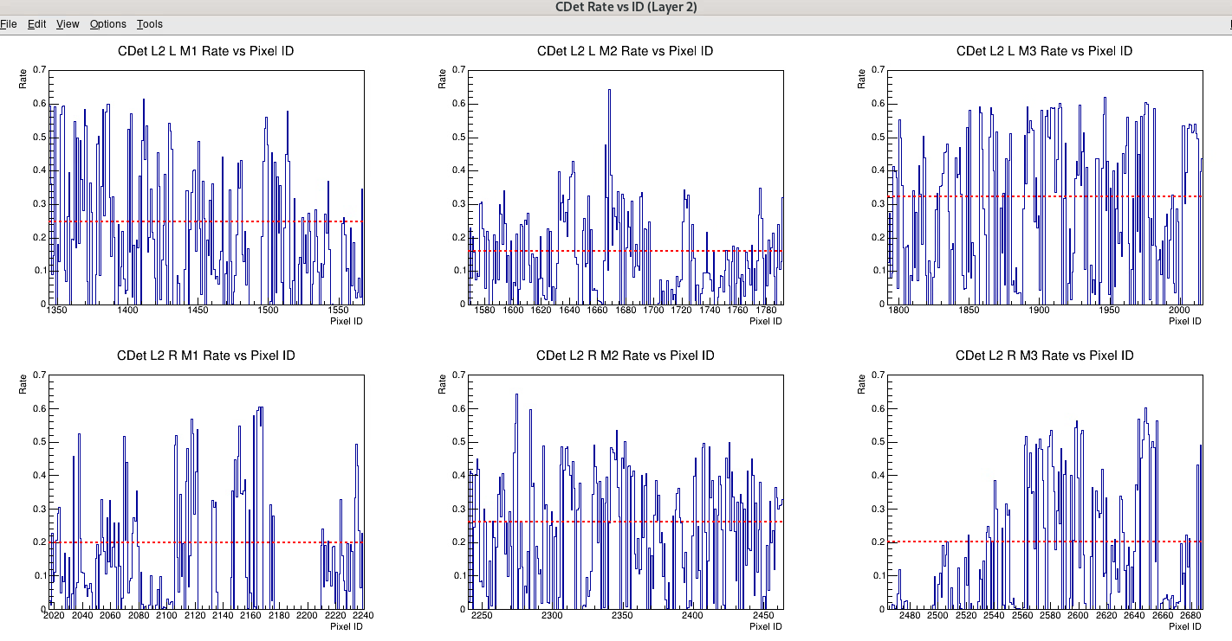
Raw Rates – Run 6077
Run 6077, 2.3M events, LH2 @ 22uA
$Rate_{i}= \frac{\# hits pixel i}{\# events}$
Ave Rate calculation ignores missing pixels & “bad” PMTs
Computed for each side of each module
Can do this with # total hits passing xdiff divided by total analyzed

Slide 8
Summary of Raw Rates
Reported with +/-0.005
Layer, Module, Side | Raw Rate - 5uA | Raw Rate - 16uA | Raw Rate - 22uA | Combined Ave Rate
L1,M1,Left | 0.270 | 0.310 | 0.280 | 0.287
L1,M2,Left | 0.260 | 0.310 | 0.275 | 0.282
L1,M3,Left | 0.275 | 0.220 | 0.190 | 0.228
L1,M1,Right | 0.180 | 0.155 | 0.140 | 0.158
L1,M2,Right | 0.280 | 0.200 | 0.175 | 0.218
L1,M3,Right | 0.220 | 0.255 | 0.220 | 0.232
L2,M1,Left | 0.190 | 0.280 | 0.250 | 0.240
L2,M2,Left | 0.140 | 0.195 | 0.160 | 0.165
L2,M3,Left | 0.030 | 0.315 | 0.320 | 0.222
L2,M1,Right | 0.190 | 0.230 | 0.200 | 0.207
L2,M2,Right | 0.350 | 0.300 | 0.260 | 0.303
L2,M3,Right | 0.060 | 0.220 | 0.200 | 0.160
Look for runs where we were missing a module
Make into graph
Put outlier on

Slide 9
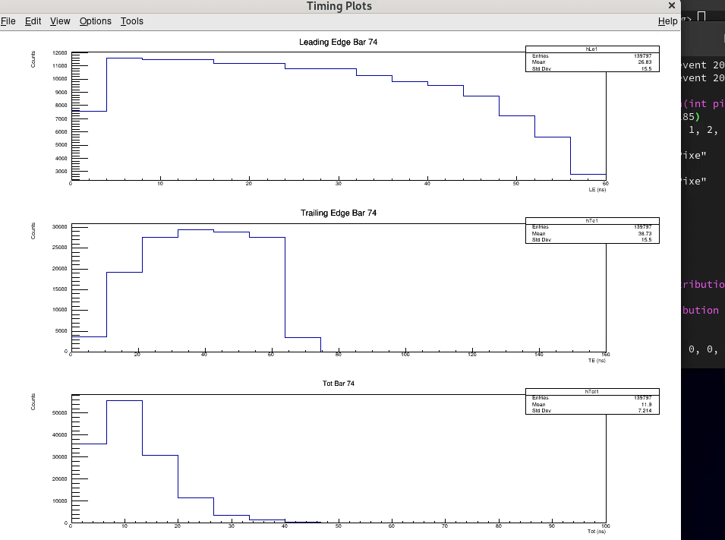
Timing Spectra in Bars
Cuts: Tot > 6ns , Cdet-Ecal xdiff within 10cm, raw rate < module average
Note: I forgot to implement the tot cut
139.8k hits
Rate < 1 (every pixel)
Looks like noise (as expected)

Slide 10
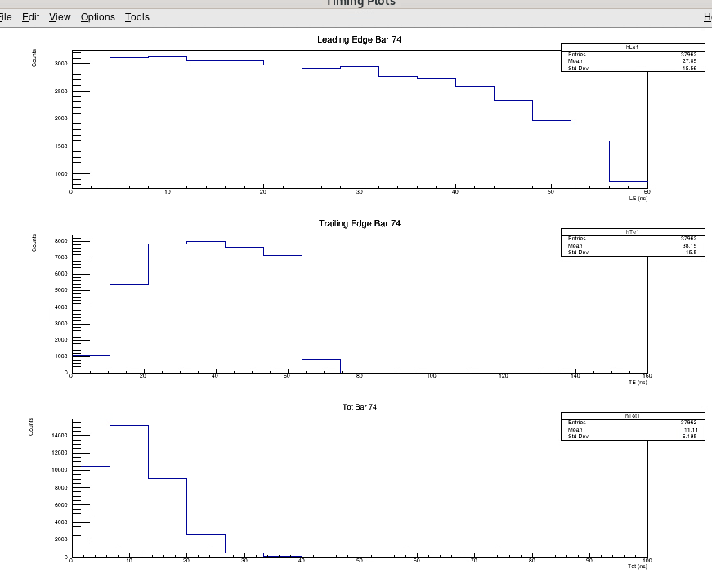
Timing Spectra in Bars
Cuts: Tot > 6ns , Cdet-Ecal xdiff within 10cm, raw rate < module average
Note: I forgot to implement the tot cut
38k hits
Rate < 0.3 (~ave for CDet)
Slight Bump at tot ~30ns?

Slide 11
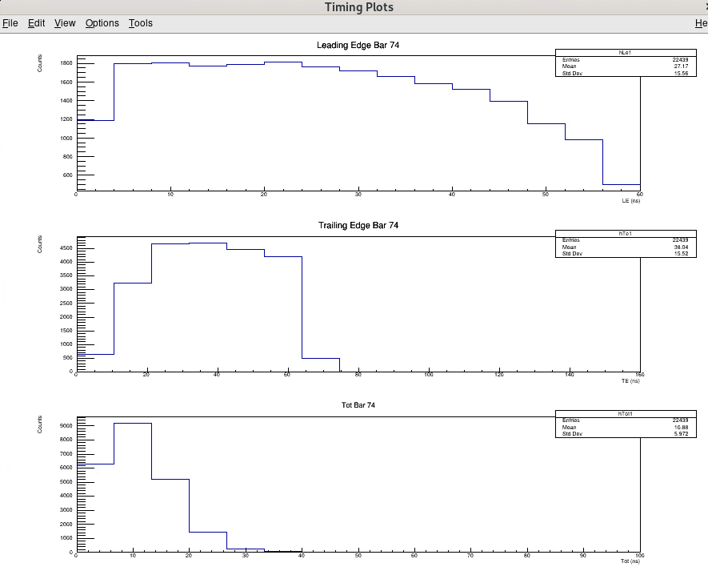
Timing Spectra in Bars
Cuts: Tot > 6ns , Cdet-Ecal xdiff within 10cm, raw rate < module average
Note: I forgot to implement the tot cut
22k hits
Rate < 0.175 module average)
Slight Bump at tot ~20-30ns?

Slide 12
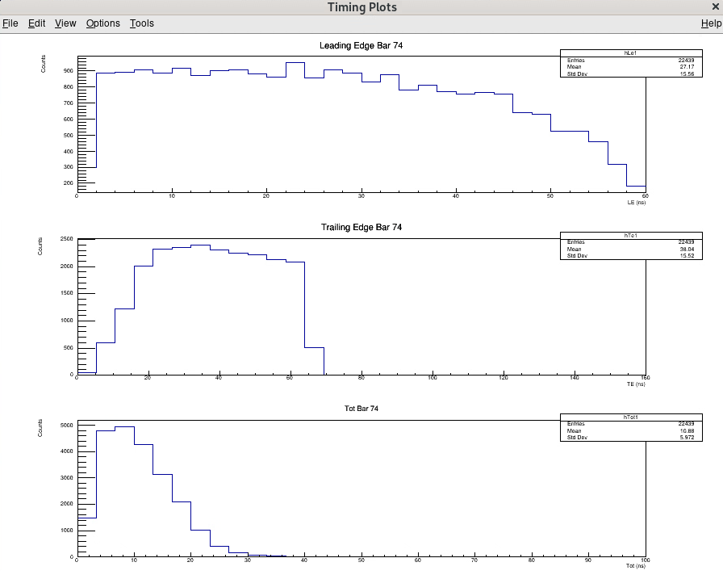
Timing Spectra in Bars (2ns bins)
Cuts: Tot > 6ns , Cdet-Ecal xdiff within 10cm, raw rate < module average
Note: I forgot to implement the tot cut
22k hits
Rate < 0.175 module average)
Slight Bump at tot ~20-30ns?

Slide 13
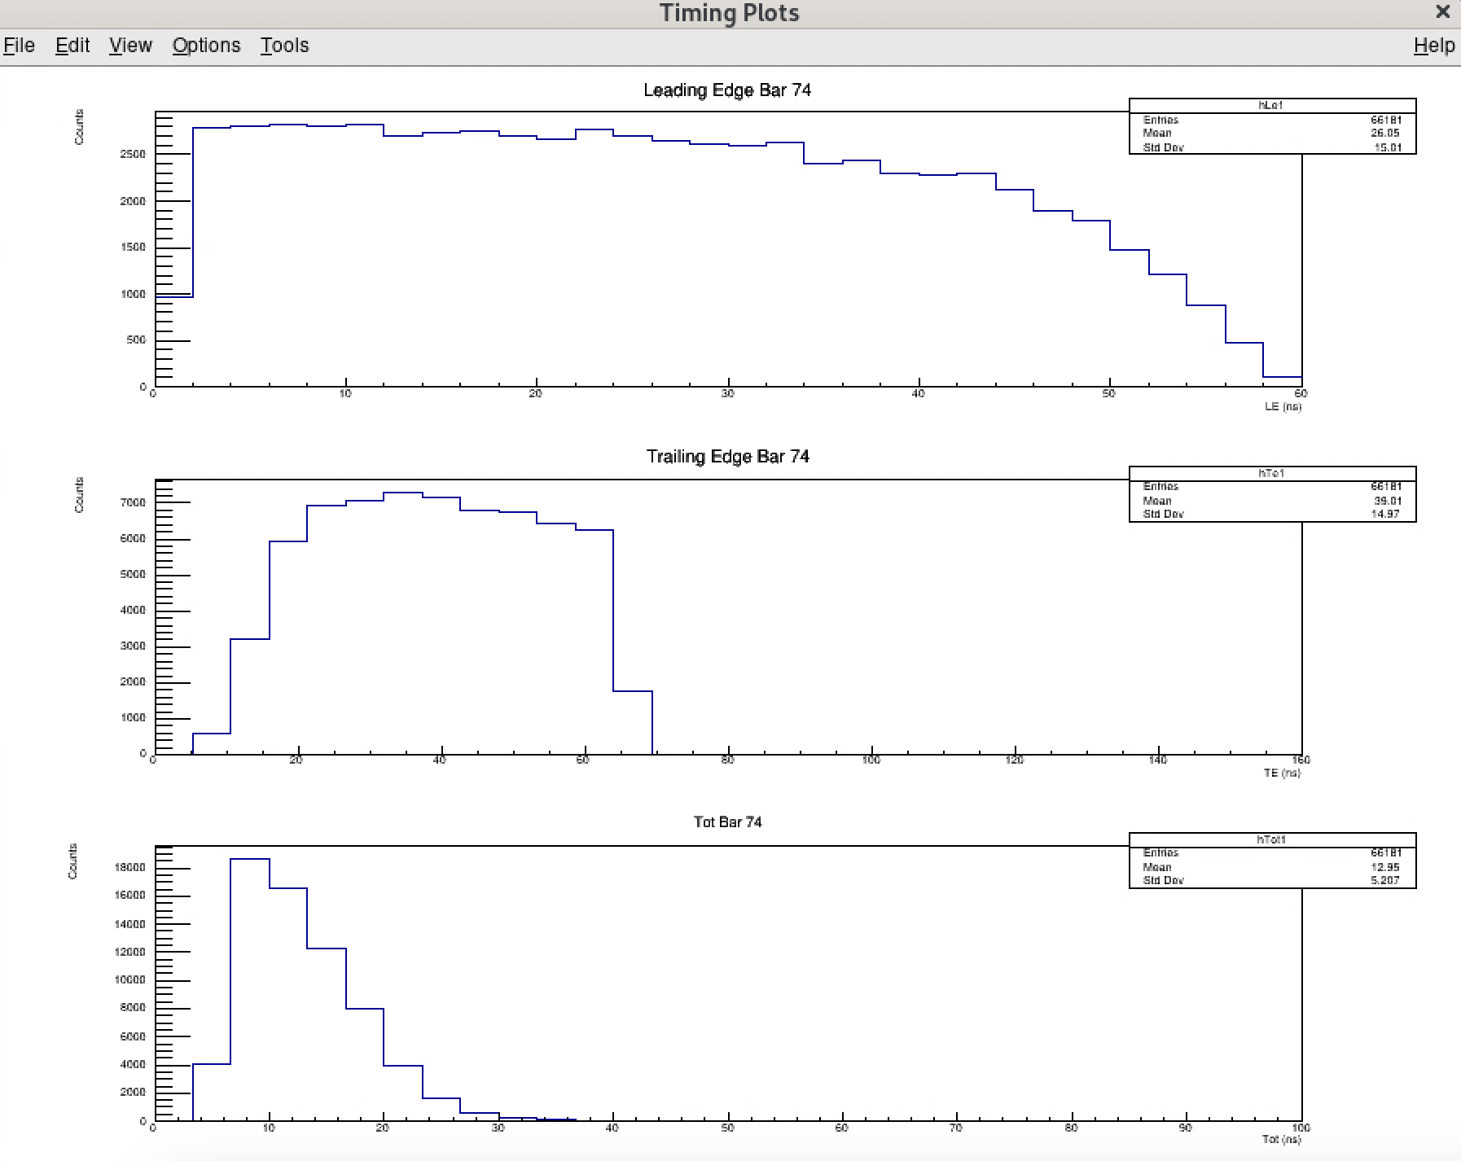
Timing Spectra in Bars
Cuts: Tot > 6ns , Cdet-Ecal xdiff within 10cm, raw rate < module average
66k hits from 8.8M events
Rate < 0.175 module average)
Slight Bump at tot ~20-30ns?

Slide 14
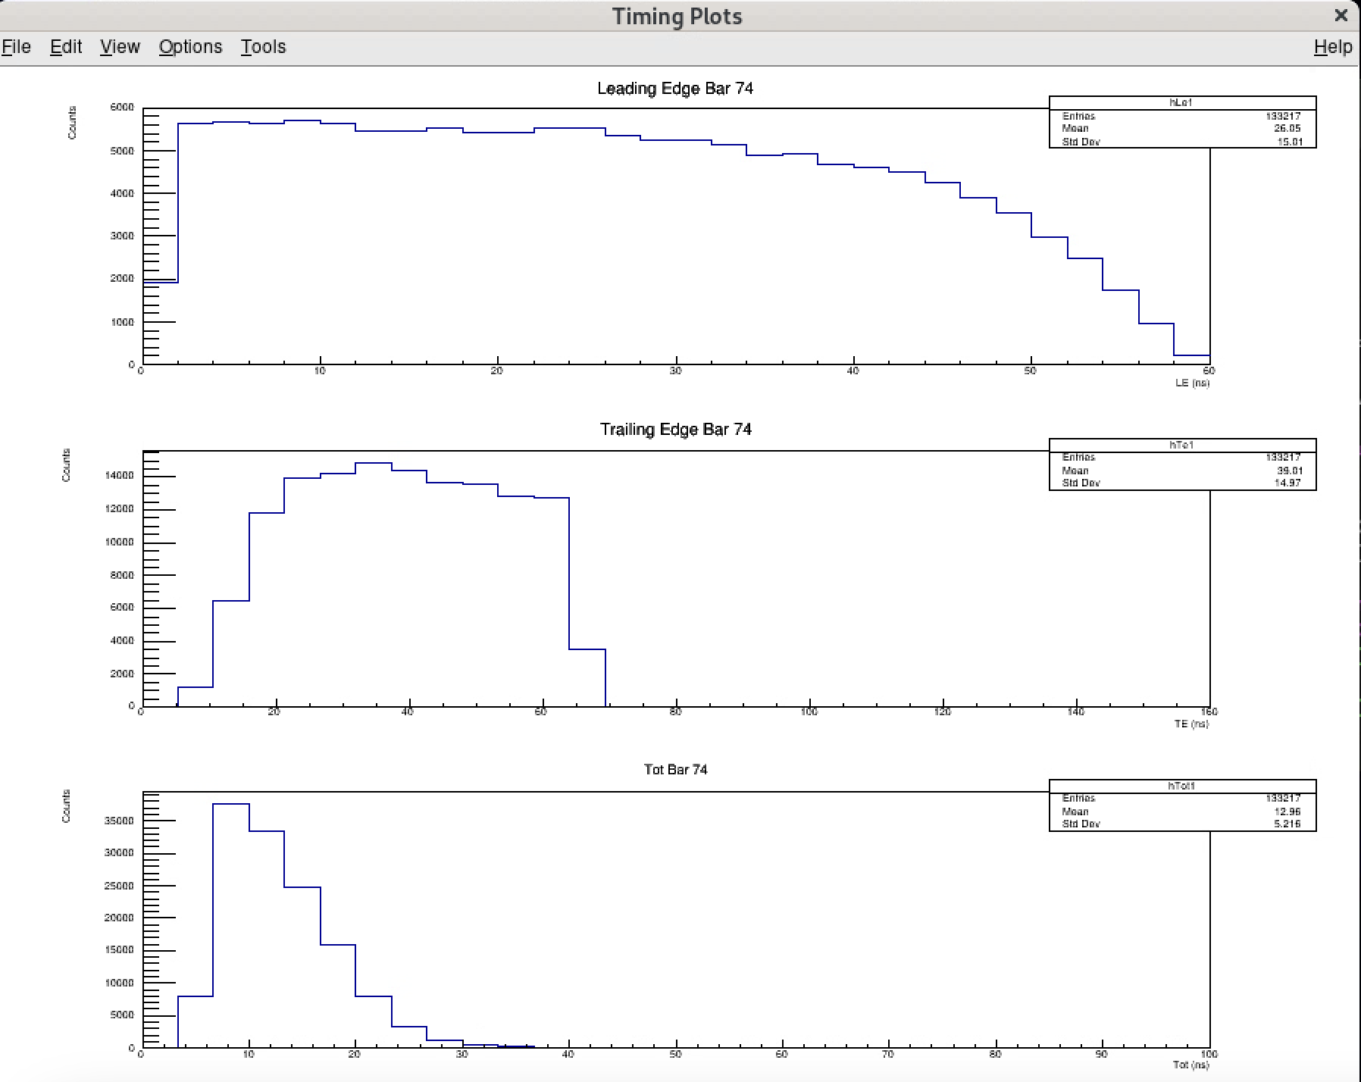
Timing Spectra in Bars (2ns bins)
Cuts: Tot > 6ns , Cdet-Ecal xdiff within 10cm, raw rate < module average
133k hits from 17.75M events
Rate < 0.175 module average)
Slight Bump at tot ~22-26ns?

Slide 15
What next?
Same timing spectra plots but for run 3640
TOT spectra of individual pixels in bar 74
Look back through notes, find when LV was changed or HV off
Carbon Cross Target runs
Cut on Ecal Energy?

Slide 16
Need to get algorithm for rates in ECal correlated events
Each event:
Each layer & side:
grab min & max pixels that passed xdiff cut
if pixel id within +/- 8 of max & min ,respectively:
Count as event for that set of pixels
Alternatively, grab pixel id in middle of min & max, and then count event for all pixels within +/- 8 of the middle → This is probably better
Should I account for missing pixels?
I should add so it gets num pixels above/below average rate

Slide 17
Interesting hit
1 hit in event 10
hit passed pos cut in event 10 for pixel 1149
le = 22.535 & tot = 11.292 with xdiff = 0.00132148

