Slide 1
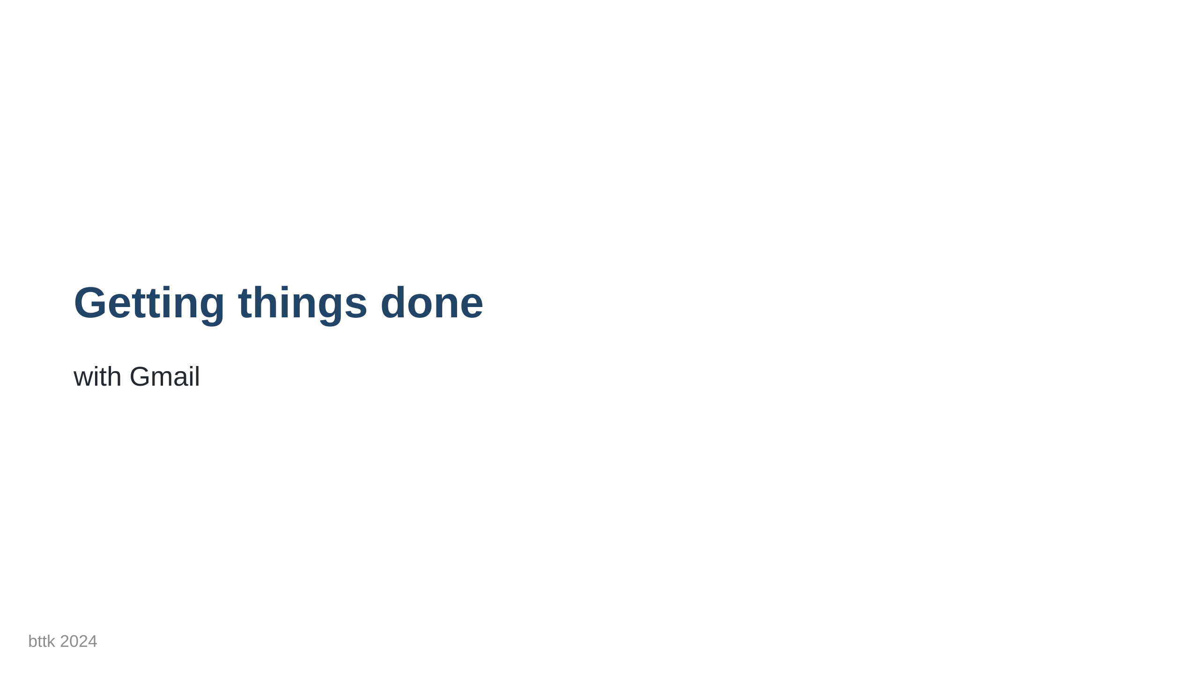

Slide 2
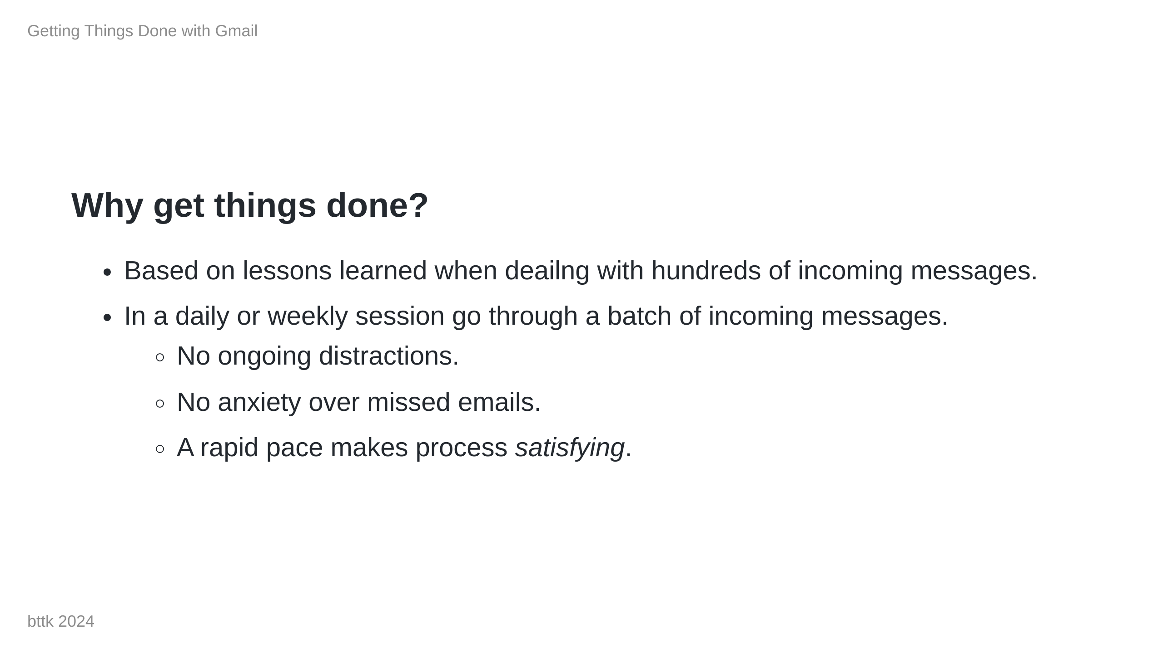
Notes:
I used to deal with big volumes of incoming emails. Easily hundreds of messages during a workday. Since my situation wasn't unique I have learned from my coworkers some tricks that are now applicable in my personal inbox (<100 messages/week). Why do I like it? - I execute the process when it works best for me. - The rapid pace makes each step feel satisfying. - It avoids the pitfals of notifications or missed emails.

Slide 3
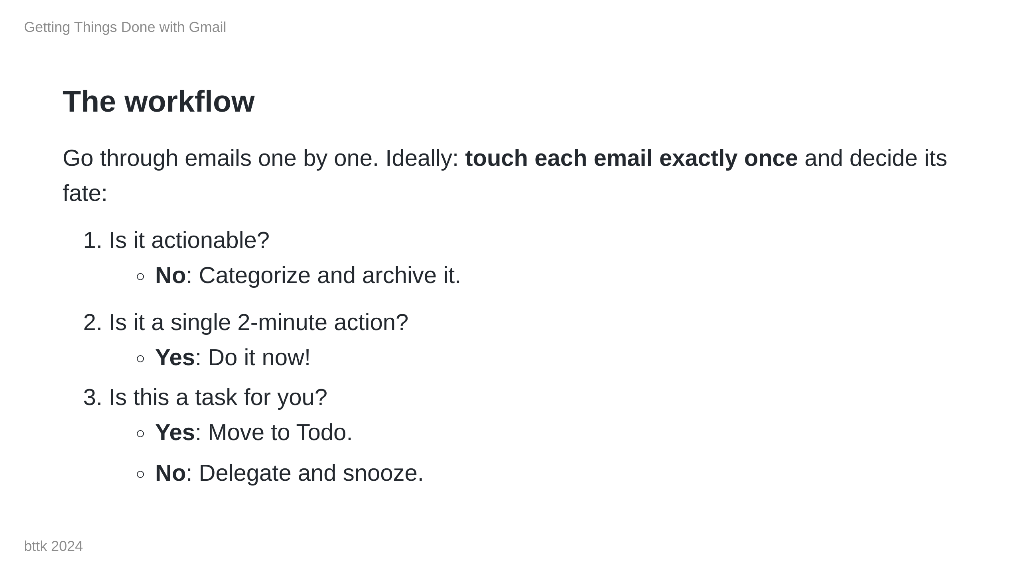
Notes:
I prefer starting with the newest "important" emails. I use gmail's stars ⭐ to mark my current context.

Slide 4
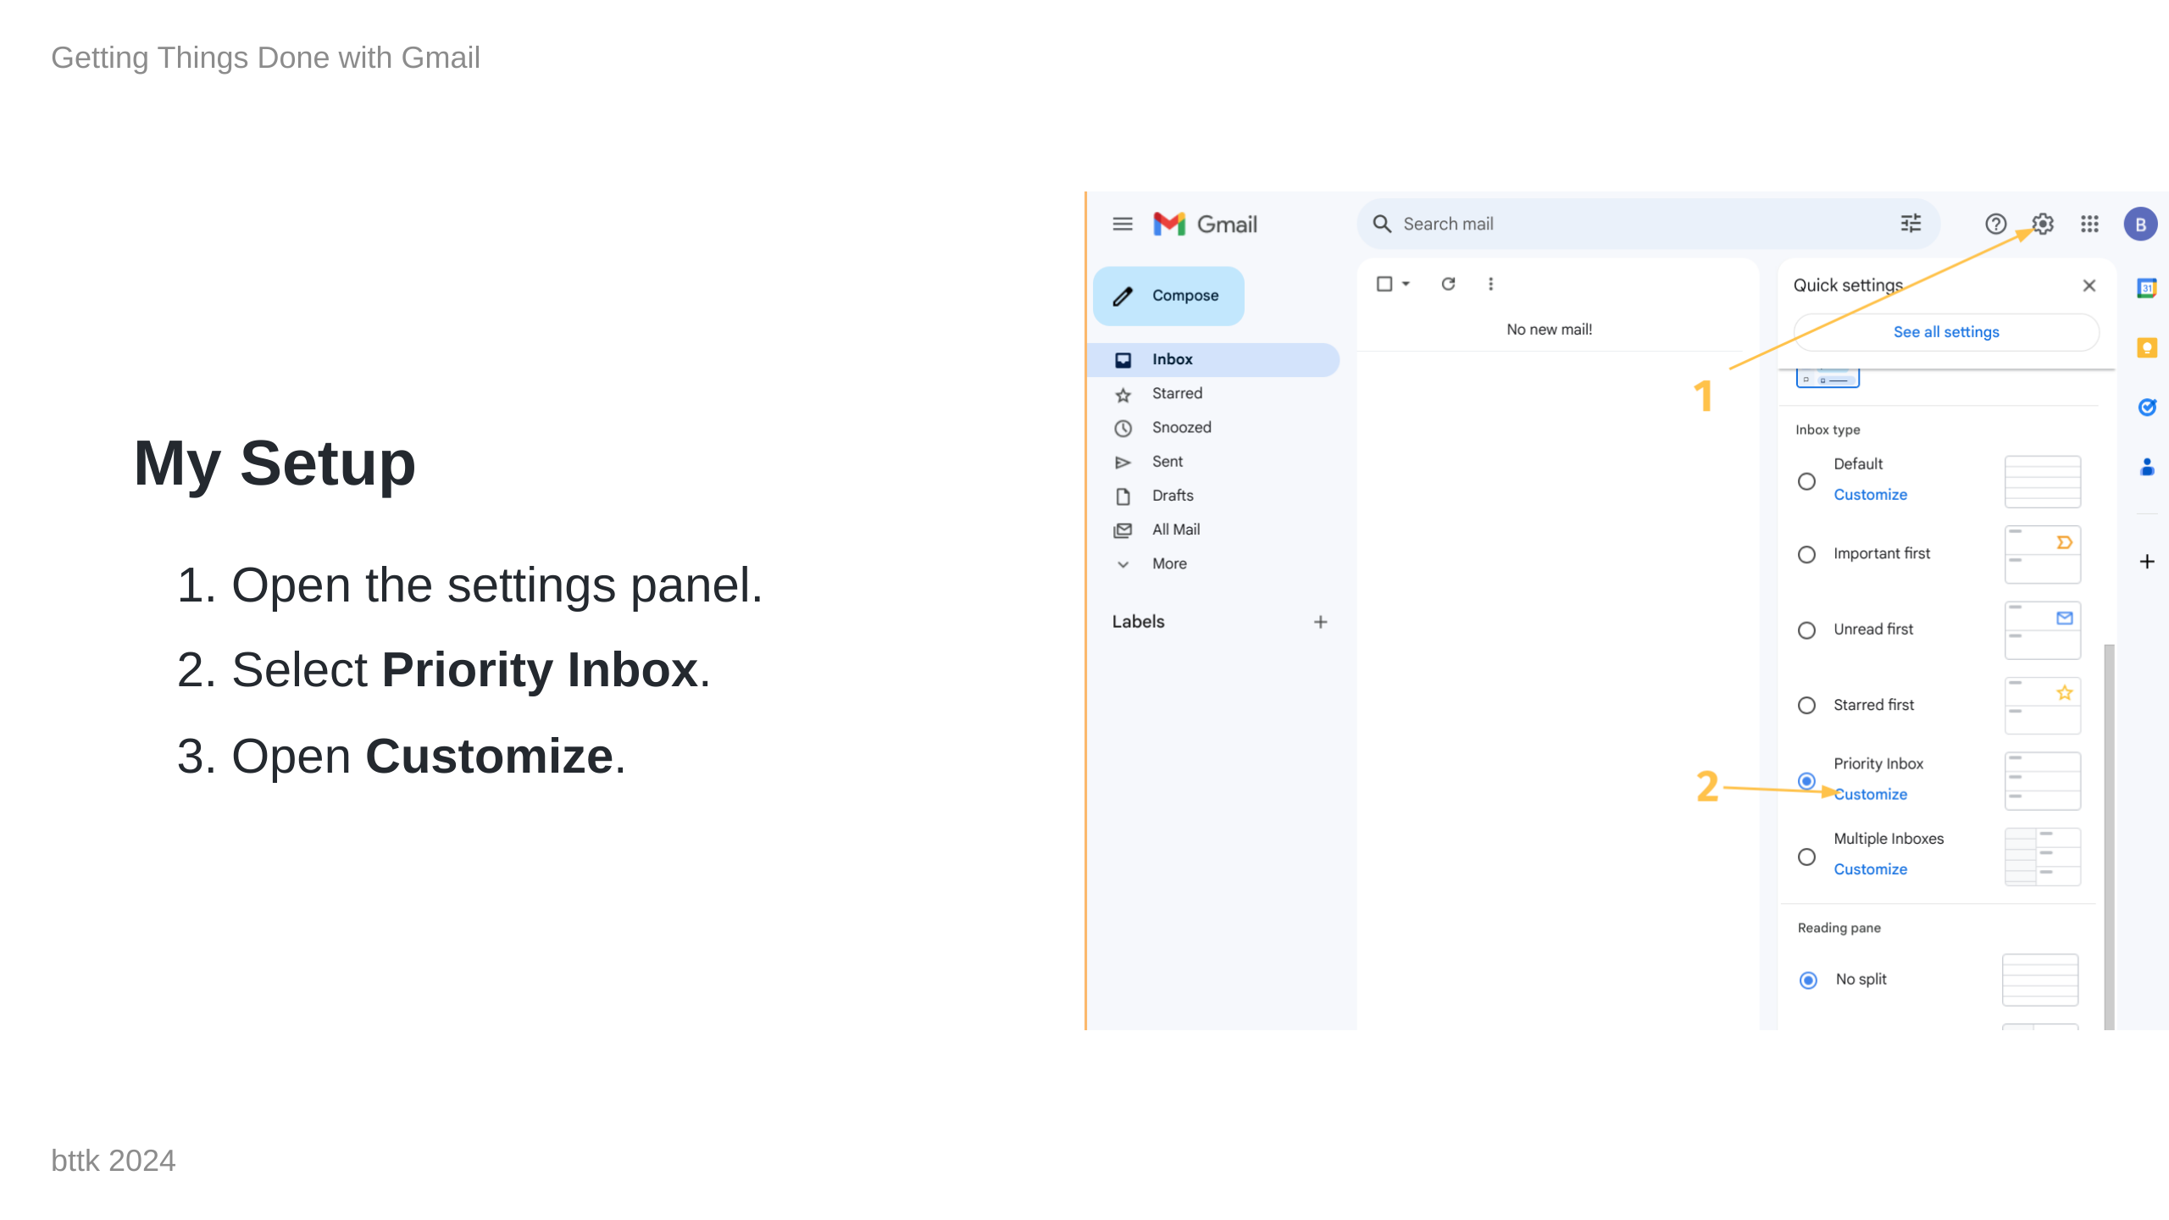

Slide 5
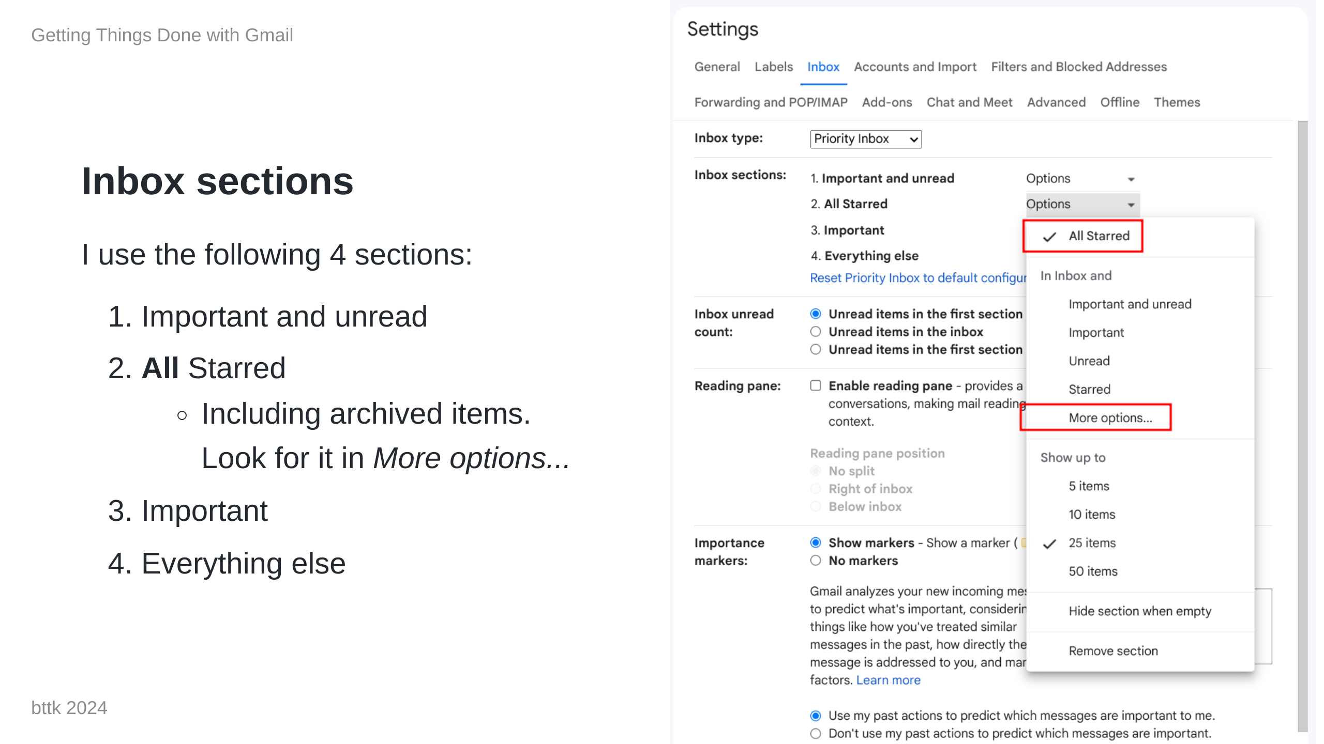

Slide 6
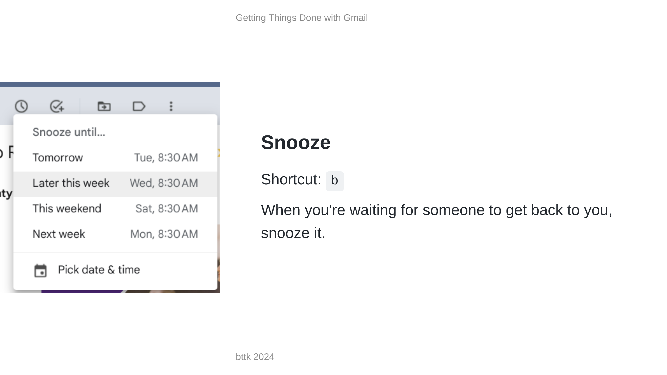
Notes:
Make sure it doesn't slip through the cracks.

Slide 7
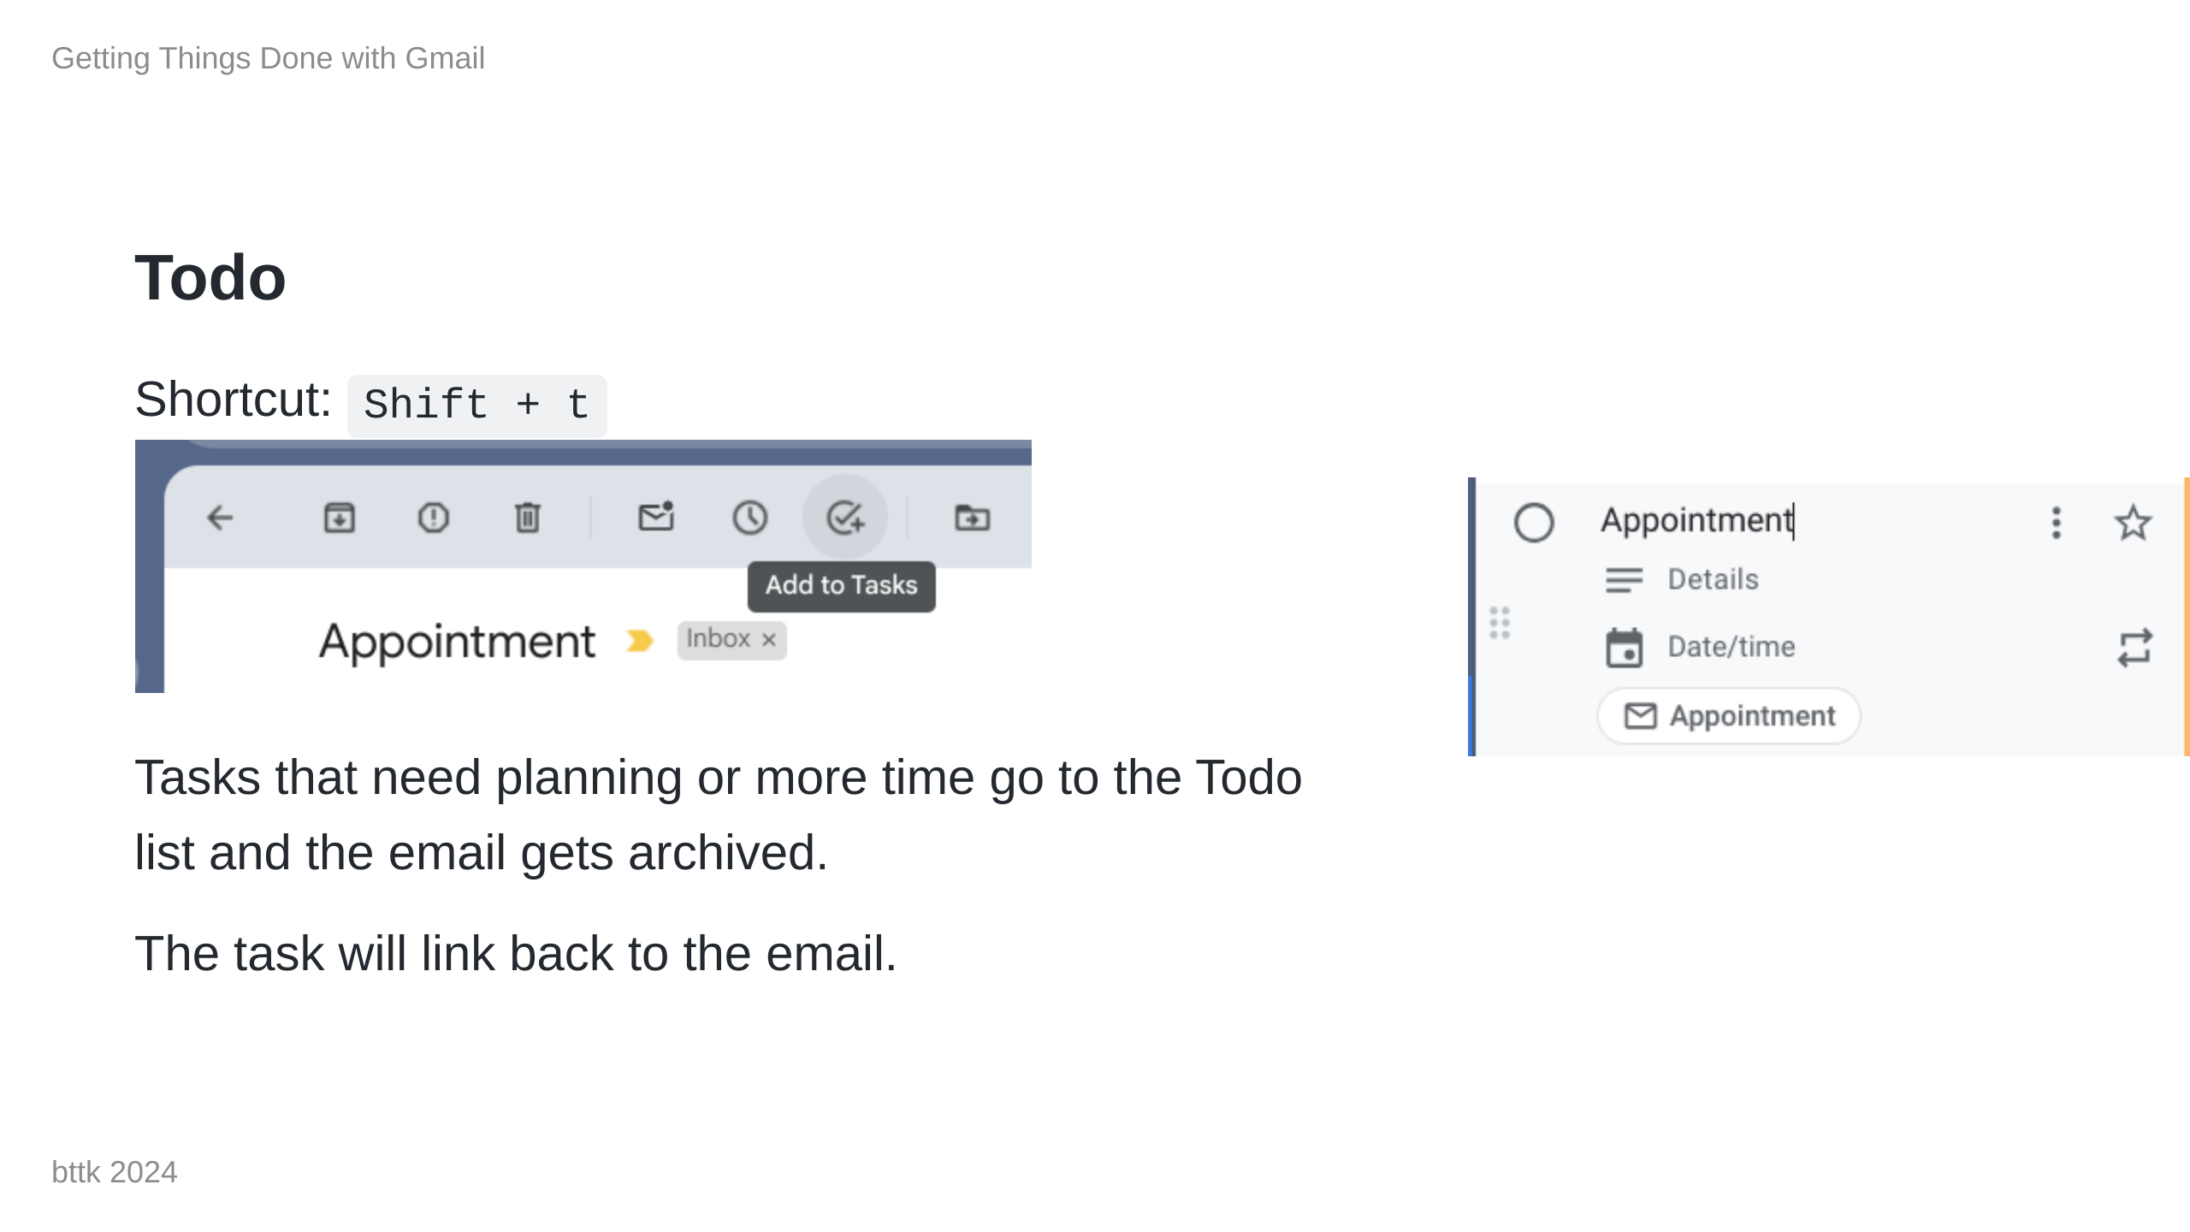
Notes:
You can also drag from the message list to the sidebar.

Slide 8
