Slide 1
Heart Disease
Brett Tully

Slide 2
About the Dataset
Heart Disease Death prediction
13 columns
299 rows
0 Null values
From Kaggle

Slide 3
Models used
Sequential ANN
Voting Classifier
Logistic Regression
Random Forest Classifier
Support Vector Classifier
Decision Tree Classifier
Bagging Classifier

Slide 4
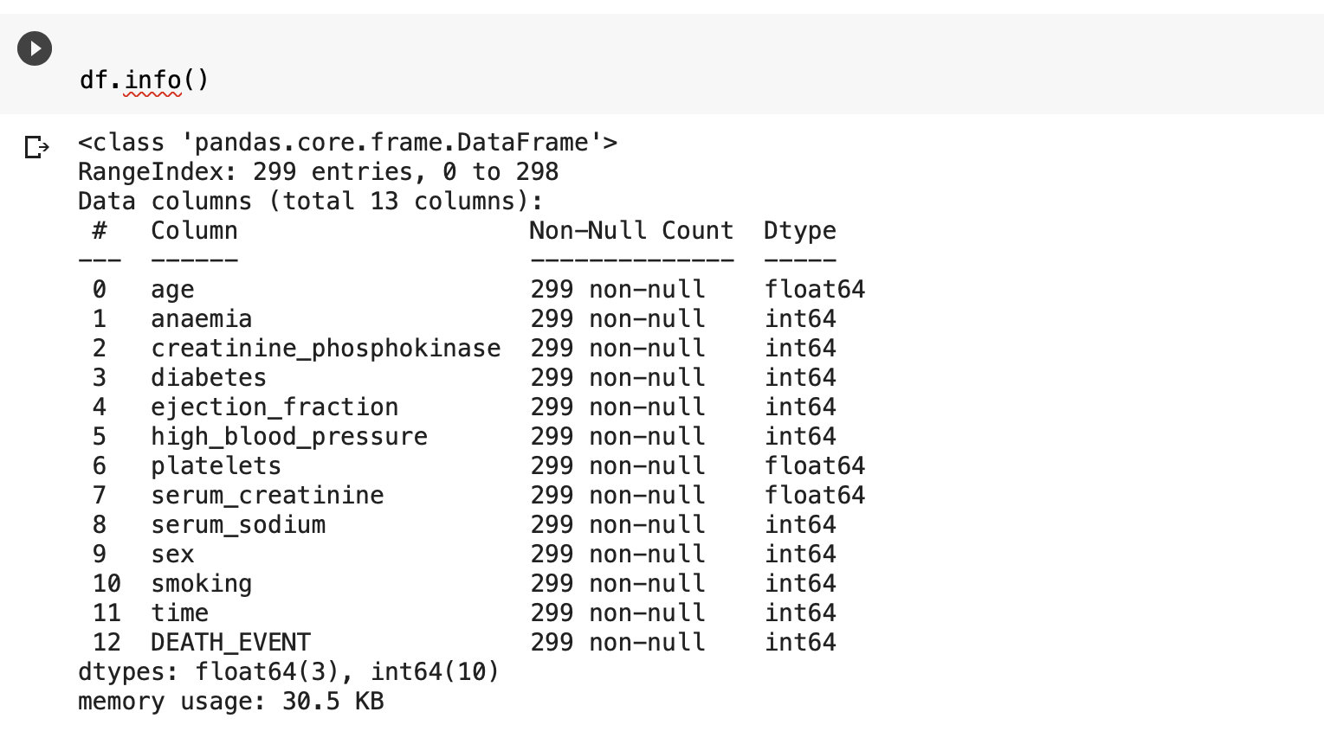

Slide 5
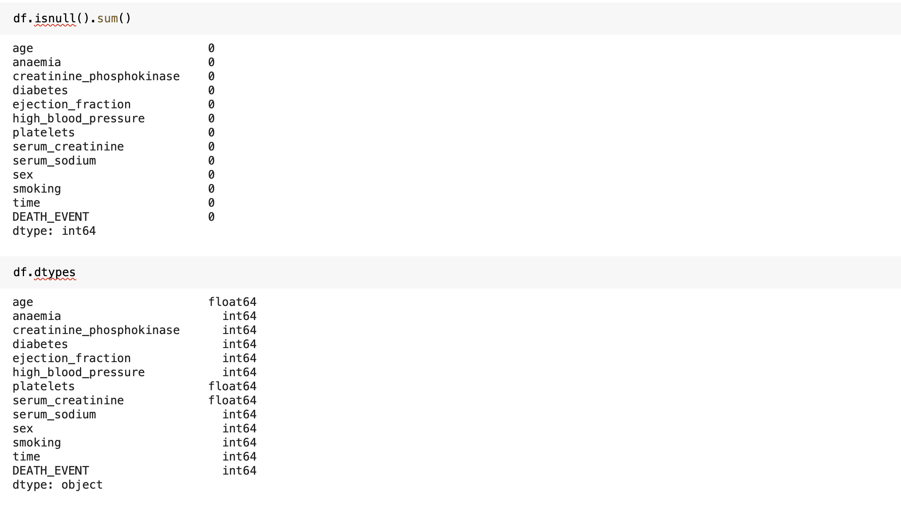

Slide 6
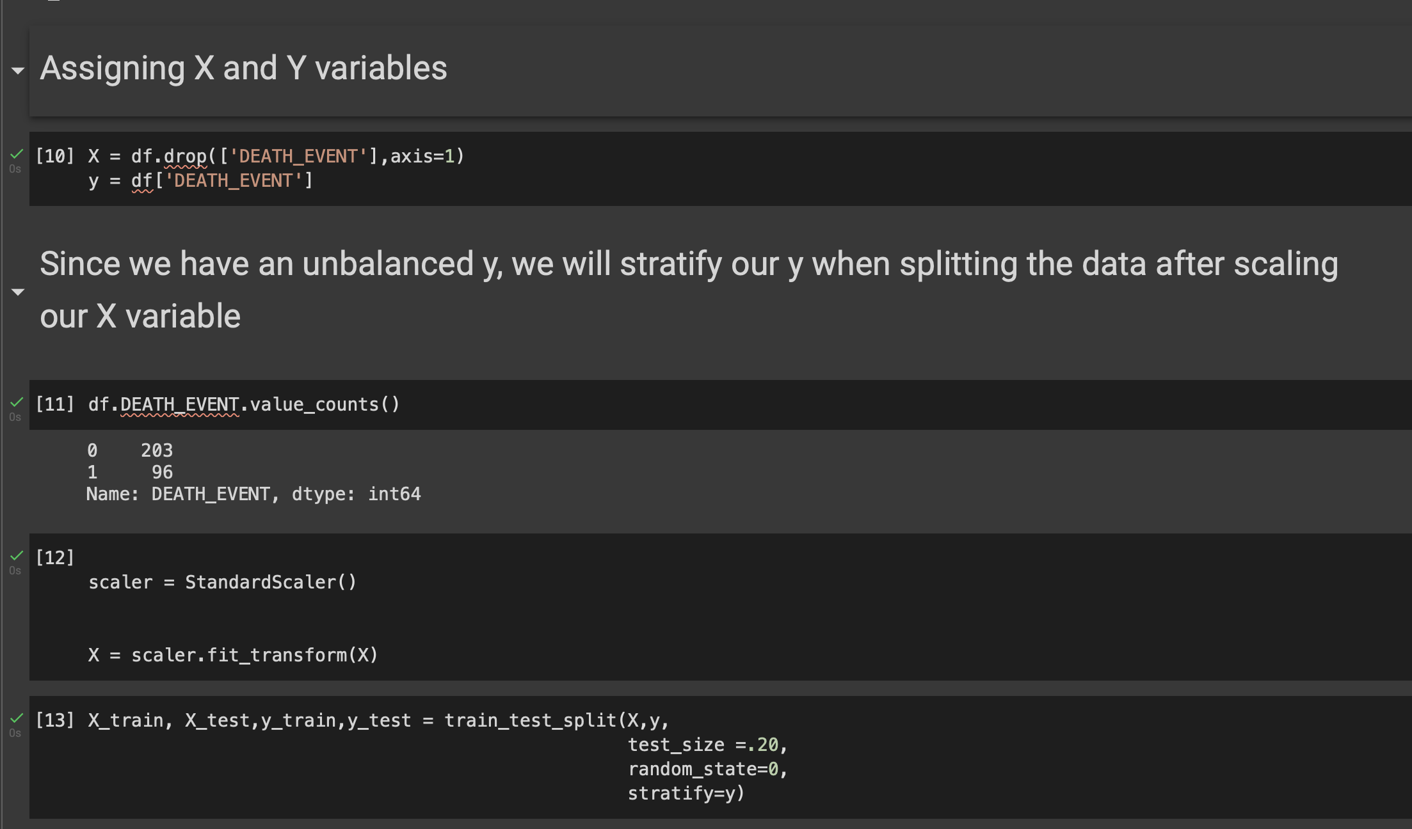

Slide 7
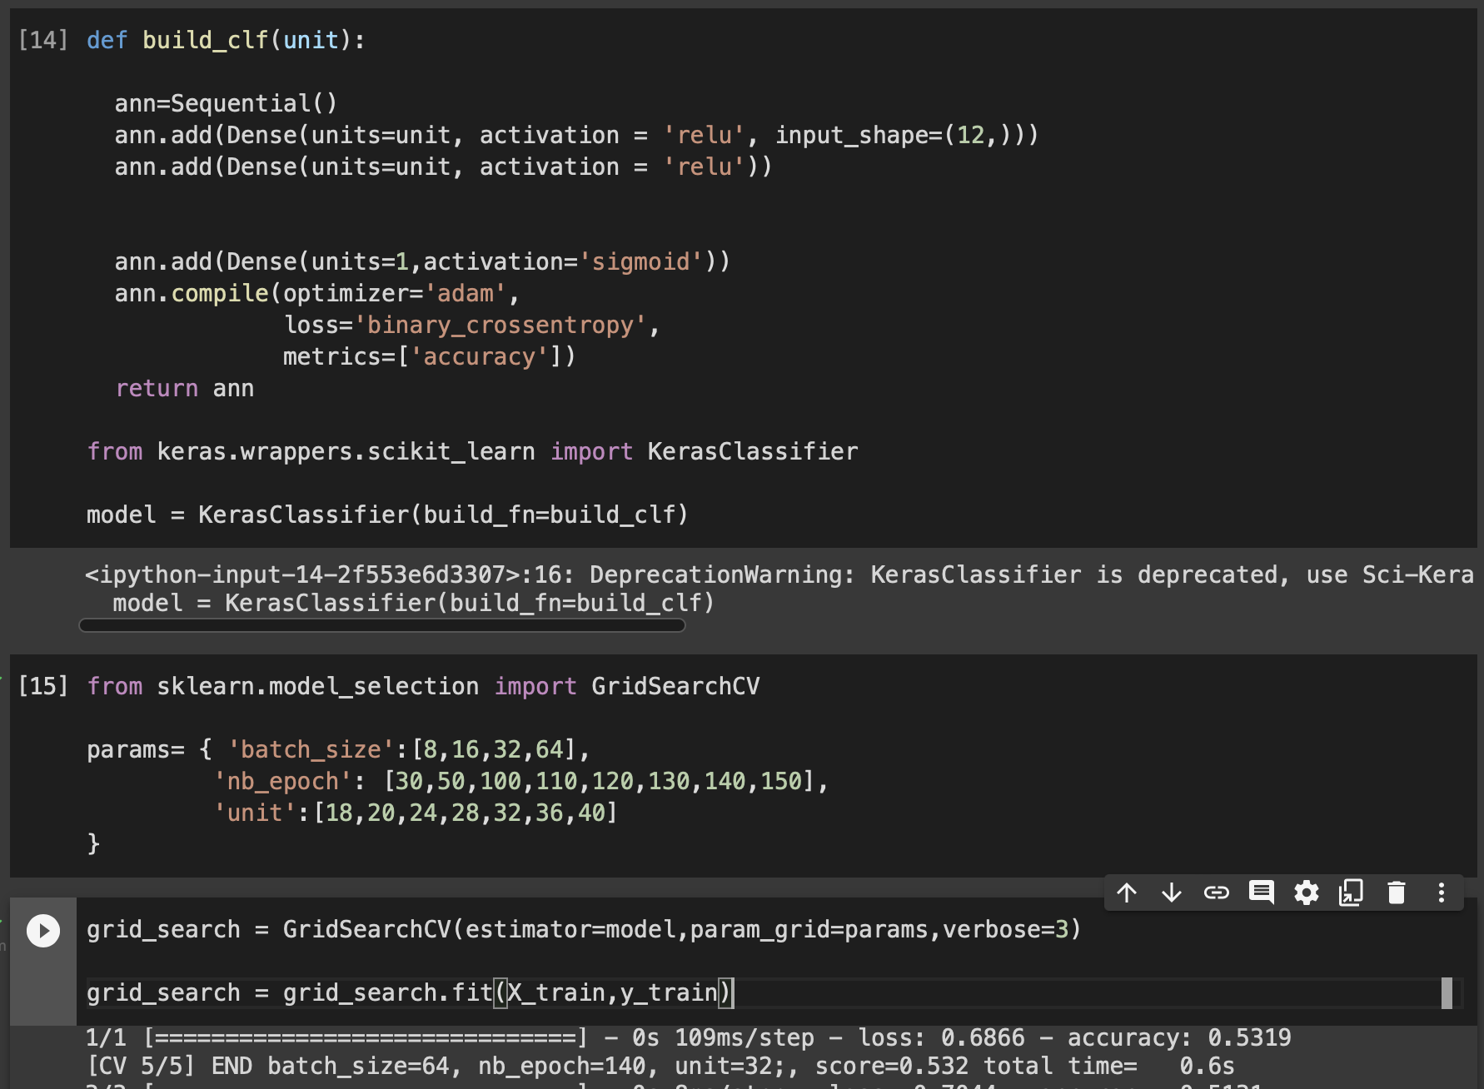

Slide 8
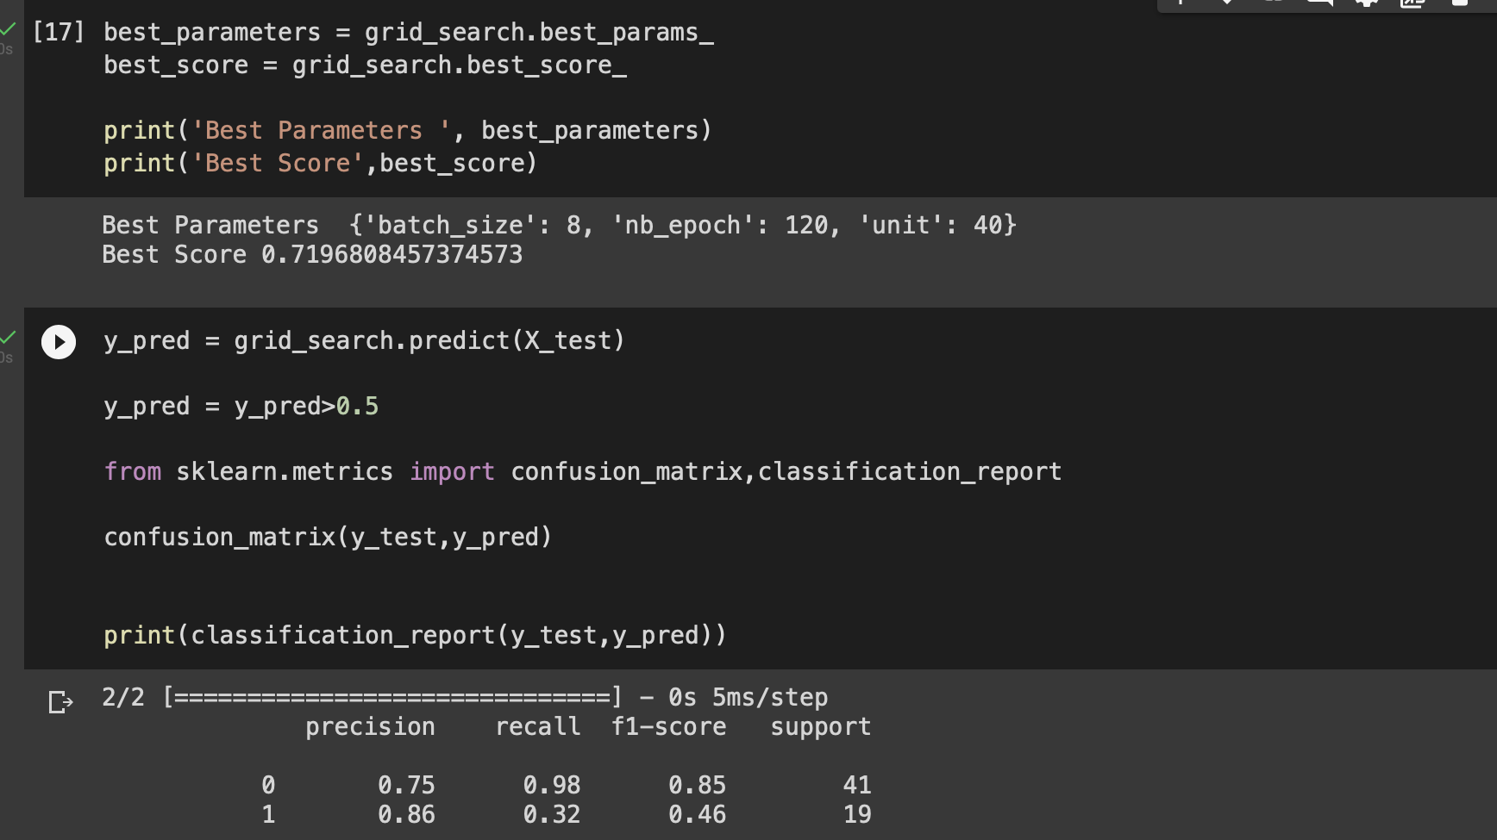

Slide 9
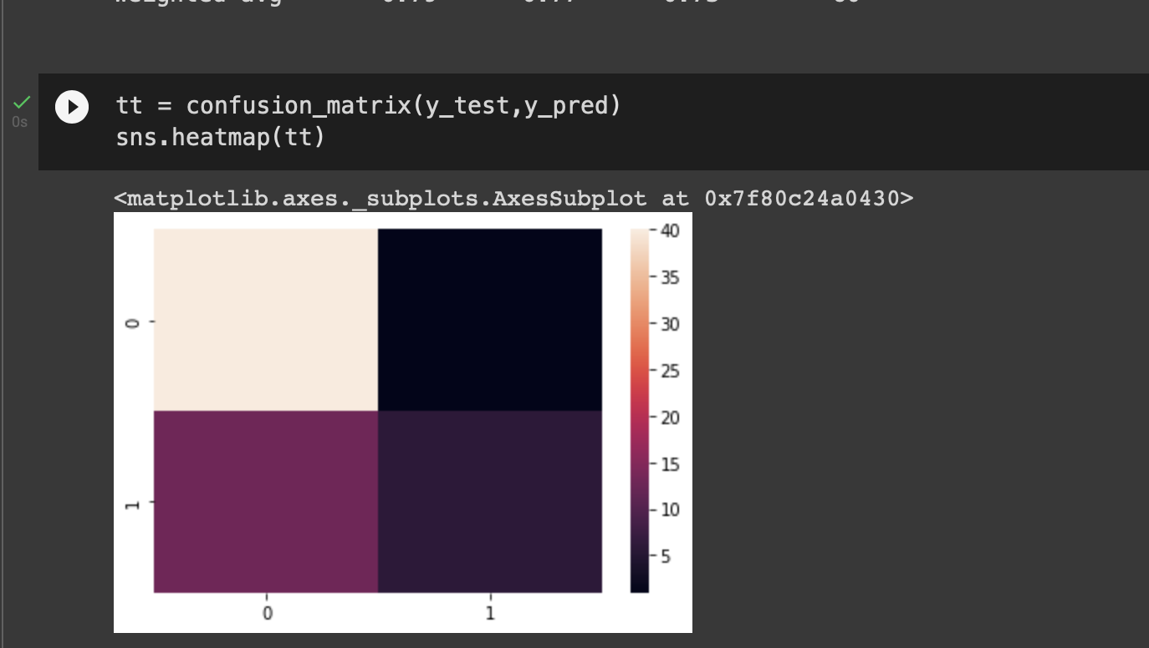

Slide 10
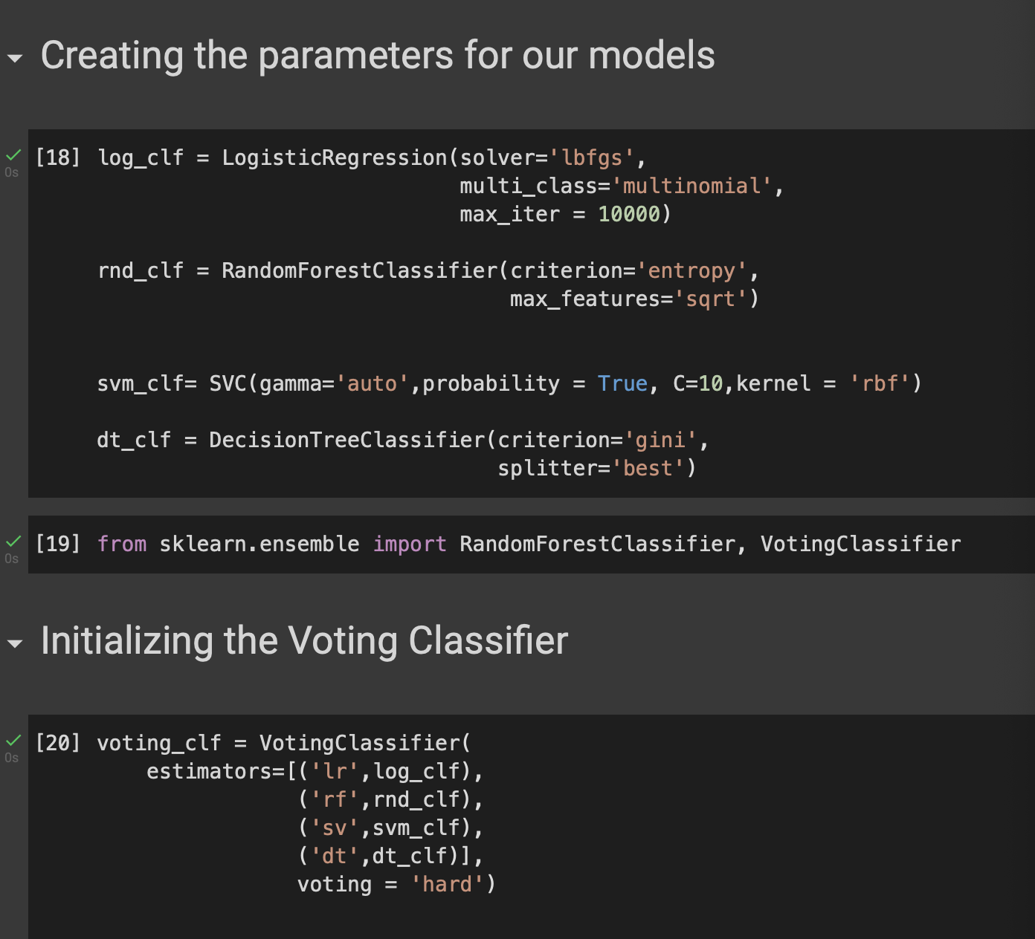

Slide 11
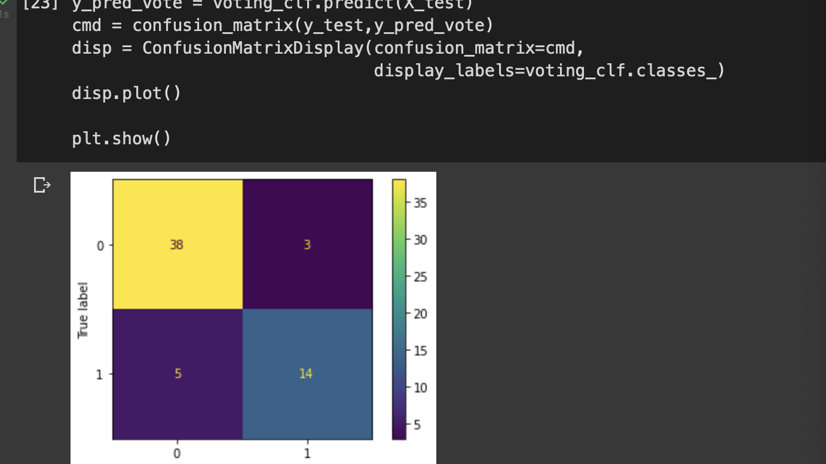

Slide 12
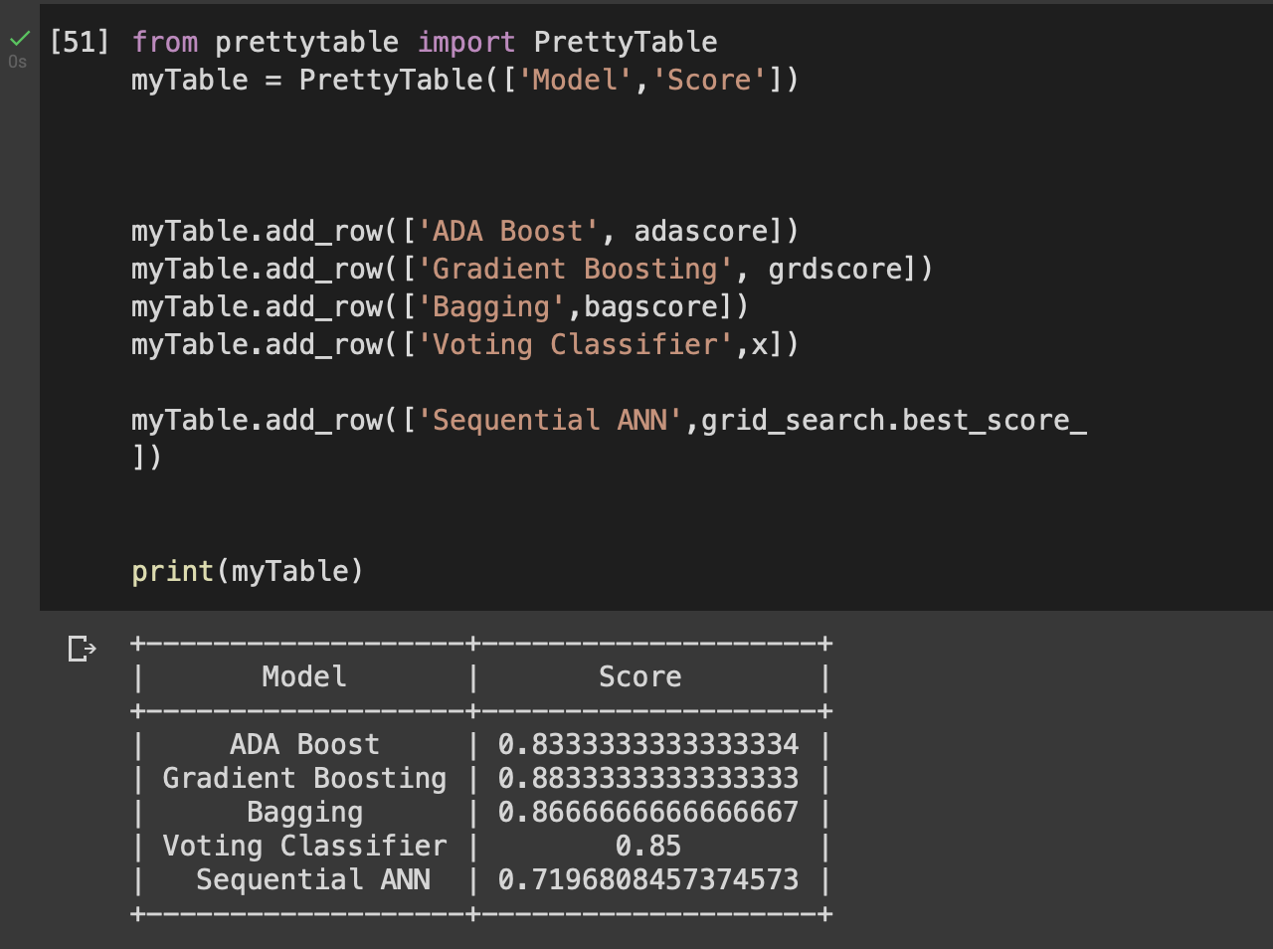

Slide 13
THANK YOU

